Slide 1
An Introduction to
Defibrillator Testing (60601-2-4)

Slide 2

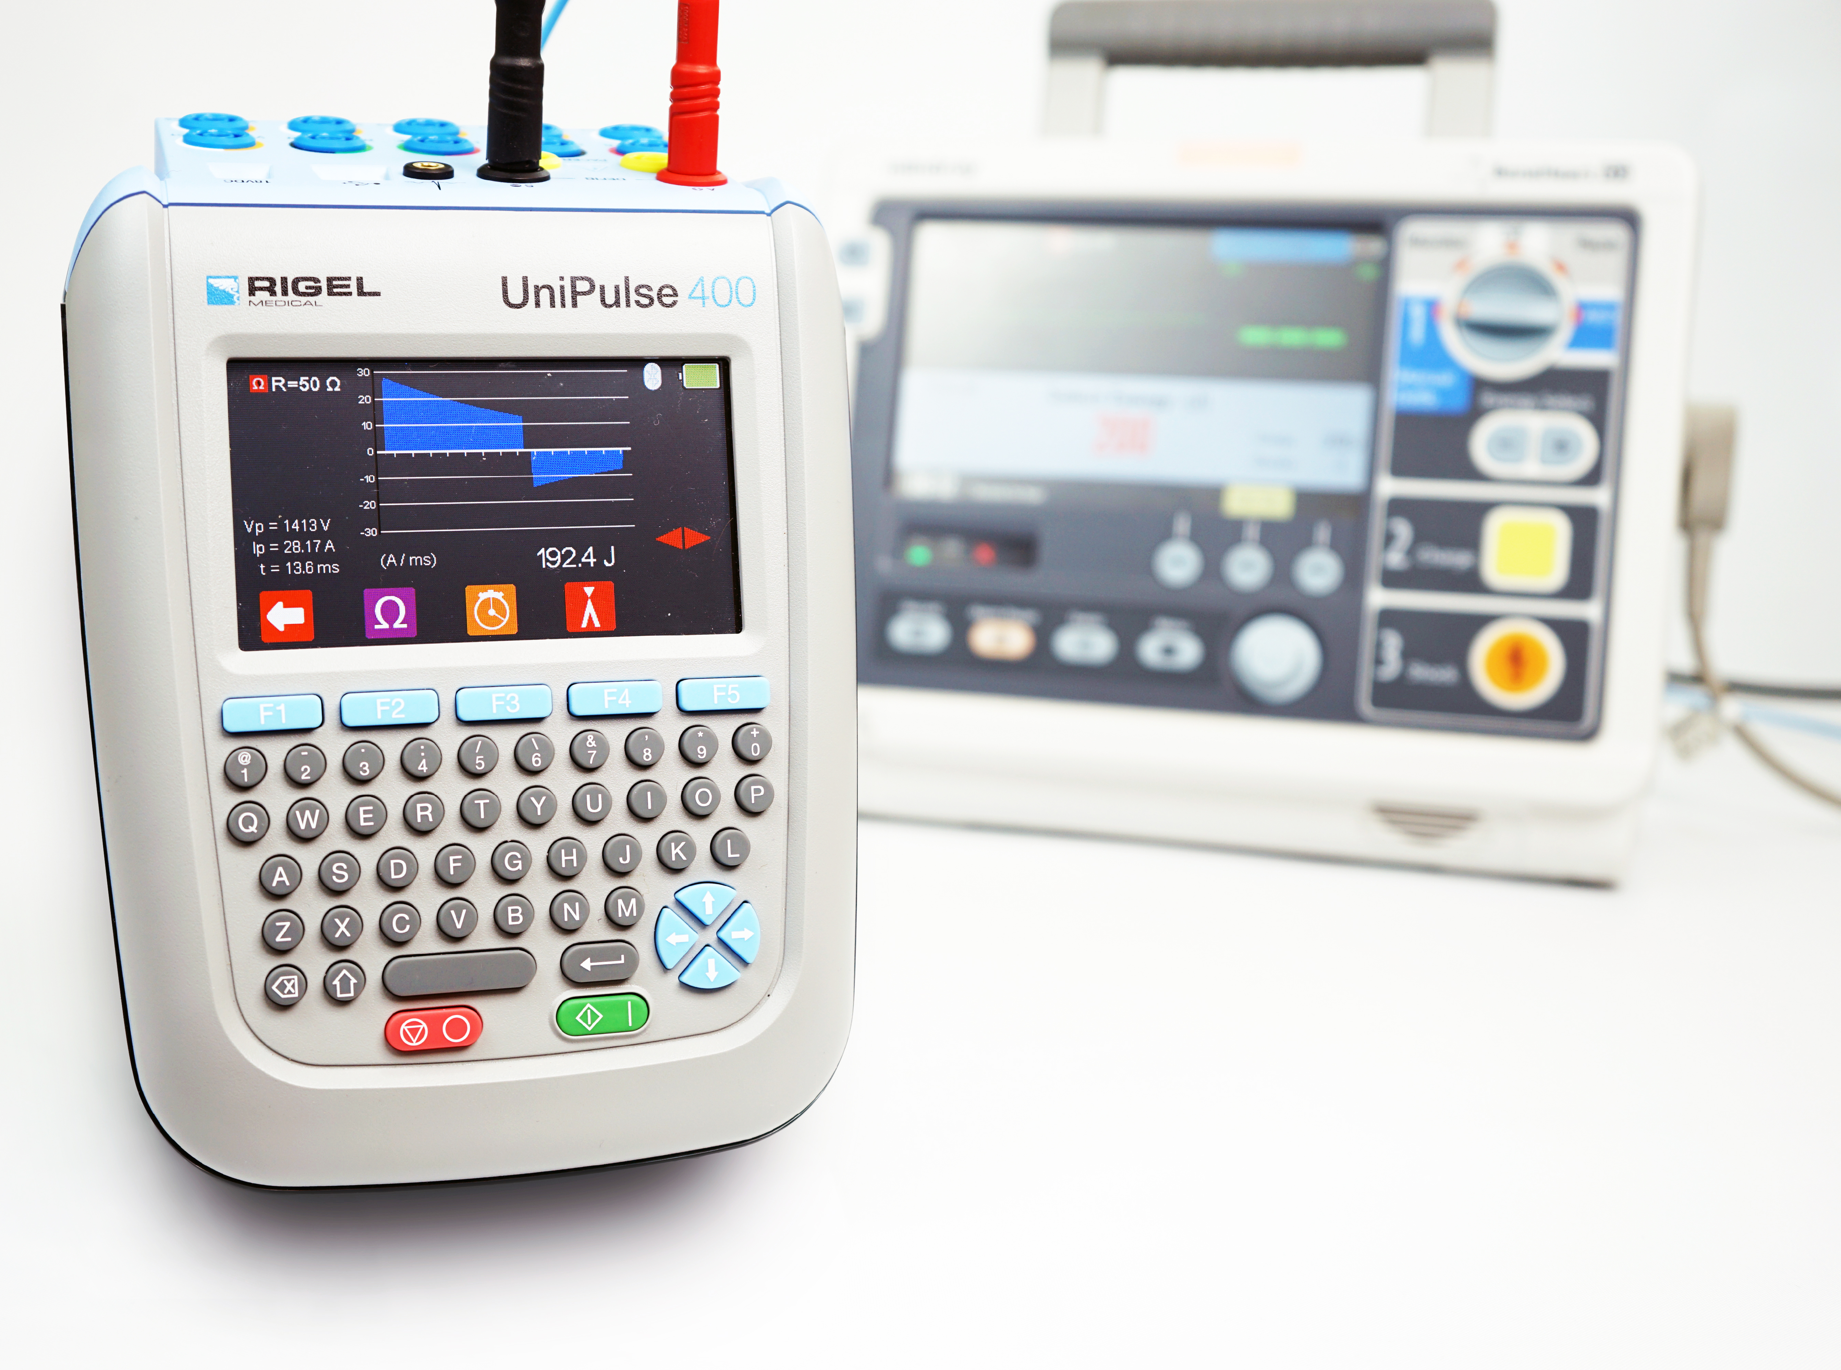
Agenda
1
Defibrillation - History and Theory
2
Definition & Use
3
Heart & Electrical Signals
4
Standard– IEC 60601-2-4
5
Defibrillator PM
6
Closing remarks

Slide 3
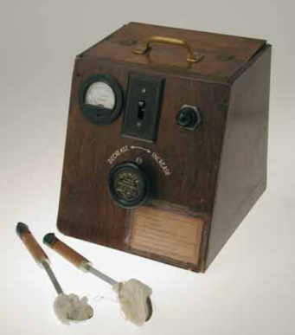
History of Defibrillation
Early 20th century Swiss researchers Jean-Louis Prévost and Frédéric Batelli brought about the paradox that electric current could lead to fibrillation of the cardiac chambers and more importantly defibrillation when experimenting on a dog’s heart.
In the 1920s engineering professor William B. Kouwenhoven began research on electric defibrillation at John Hopkins University, Baltimore. His pioneering work with surgeon Claude S. Beck, led to open-chest and clinical defibrillation.
In 1933 Kouwenhoven had restored a dog’s normal sinus rhythm (NSR) using an AC surge of electricity he called a counter shock.
Kouwenhoven's open-chest defibrillator

Slide 4
History of Defibrillation
Beck was an expert in improving heart circulation. He had noticed that during cardiac surgery, the heart would occasionally go into VF.
In 1947, Beck applied open-chest defibrillation to a human heart in VF during surgery, successfully reviving the patient using Kouwenhoven’s team’s AC biphasic electric defibrillator.
In Moscow, 1938-39 Naum L. Gurvich began work on a less
dangerous DC monophasic device to deliver transthoracic
defibrillation. Gurvich discharged between 2 kV – 6 kV from
a capacitor across the chest of animals to restore cardiac
function.
Kouwenhoven's open-chest defibrillator

Slide 5
History of Defibrillation
The 1950s-1960s led to improvements in defibrillator design.
  Paul Zoll – a Boston cardiologist who experimented with external closed-chest cardiac pacing and AC defibrillation.
  Dr. Bernard Lown – used DC for cardioversion, inventing the
  “cardioverter”.
  Bohumil Peleŝka – who optimized and improved Gurvich’s DC defibrillation.
From the 1960s to 1980s further advancements in technology paved the way for sophisticated defibrillators and pacemakers
The final development in defibrillation was AEDs in the 1990s, a single-button automatic defibrillator that could be used by anyone, bettering the survival rate odds for OHCA patients
Kouwenhoven's open-chest defibrillator

Slide 6
Agenda
1
Defibrillation - History and Theory
2
Heart & Electrical Signals
3
Definition & Use
4
Standard– IEC 60601-2-4
5
Defibrillator PM
6
Closing remarks

Slide 7
The Heart
The heart has four chambers, the right and left atria, and the right and left ventricles comprised of cardiac muscle; myocardium.
The electrical activity of the myocardium regulates the cardiac cycle.
  The cardiac cycle is the simultaneous contraction (systole) of both atria's, followed by the contraction of both ventricles.
  After ventricular systole the heart will relax (diastole) and the atria will fill with blood.
  The right atrium returns deoxygenated blood from the upper and lower body to the right ventricle via the right atrioventricular (AV) valve.
  As the right ventricle contracts, deoxygenated blood is pumped past the pulmonary semilunar valve, through the pulmonary artery to the lungs.
The lungs perform a gas exchange expelling the waste product - carbon dioxide from blood to air, and taking in the nutrient - oxygen from air to blood.
The left atrium receives oxygenated blood from the lungs via the pulmonary veins, the blood then passes the left AV valve to the left ventricle. When the left ventricle contracts, oxygenated blood is pumped past aortic semilunar valve, through the aorta to the upper and lower body

Slide 8
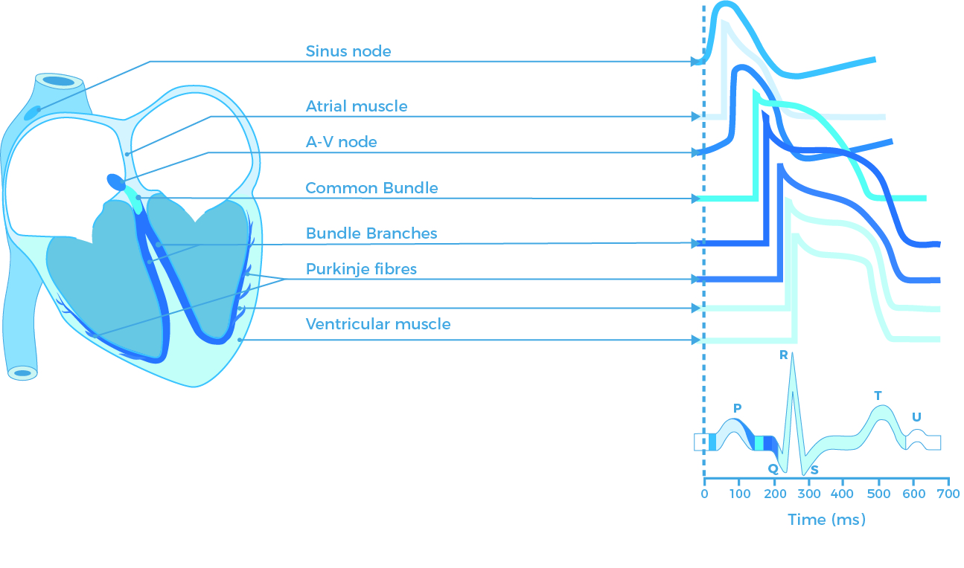
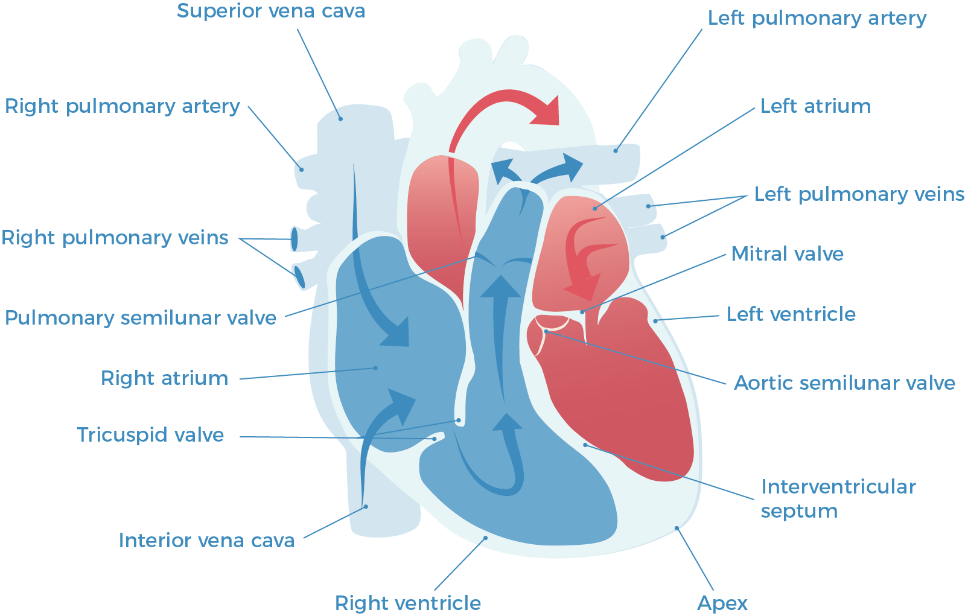
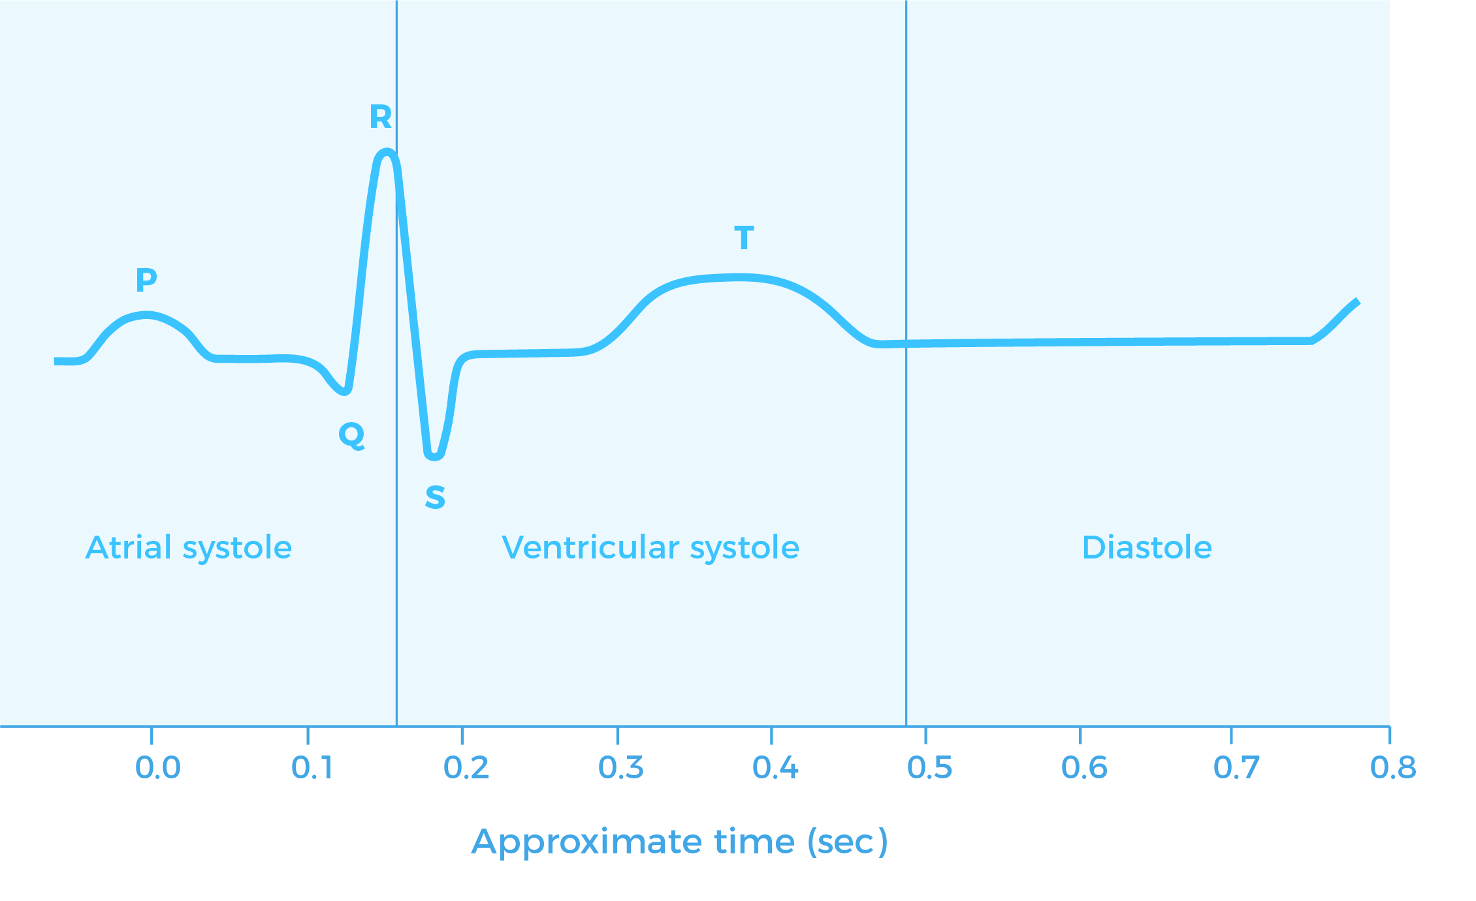
The Heart

Slide 9
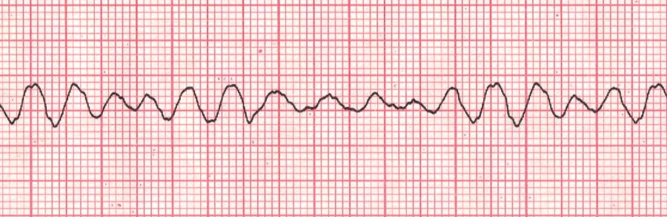
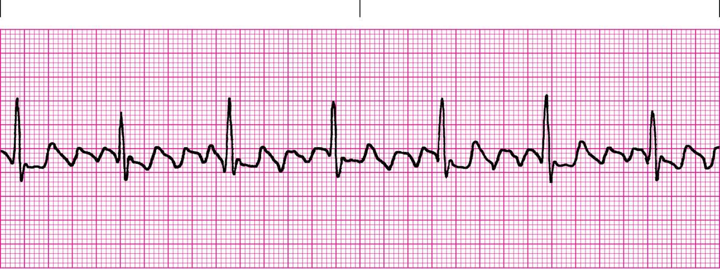
Shockable Arrhythmias
Ventricular Fibrillation (Fine) (VFF)
Ventricular Fibrillation (Course) (VFC)
Ventricular Tachycardia (VT)
  (Pulseless)
The above produce no pulsating blood flow and require no synchronized defib pulse
Atrial Flutter (AFLT)
Atrial Fibrillation (AFIB)
Ventricular Tachycardia (VT)
  (With pulse)
The above produce pulsating blood flow and require synchronized defib pulse
Notes:
Ventricular Fibrillation (fine) (VFF)
Ventricular Fibrillation (course) (VFC)
Ventricular tachycardia (VT)
(pulseless)
The above produce no pulsating blood flow and require no synchronized defib pulse
Atrial Flutter (AFLT)
Atrial Fibrillation (AFIB)
Ventricular tachycardia (VT)
(with pulse)
The above produce pulsating blood flow and require synchronized defib pulse

Slide 10
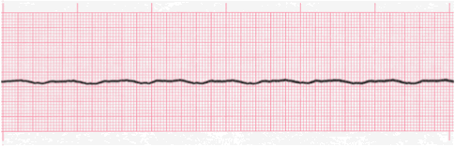

Non-Shockable Arrhythmias
Asystole – the P-wave can still be present (flat line)
Treatment possible through CPR and drugs to stimulate the heart into any electrical activity

Slide 11
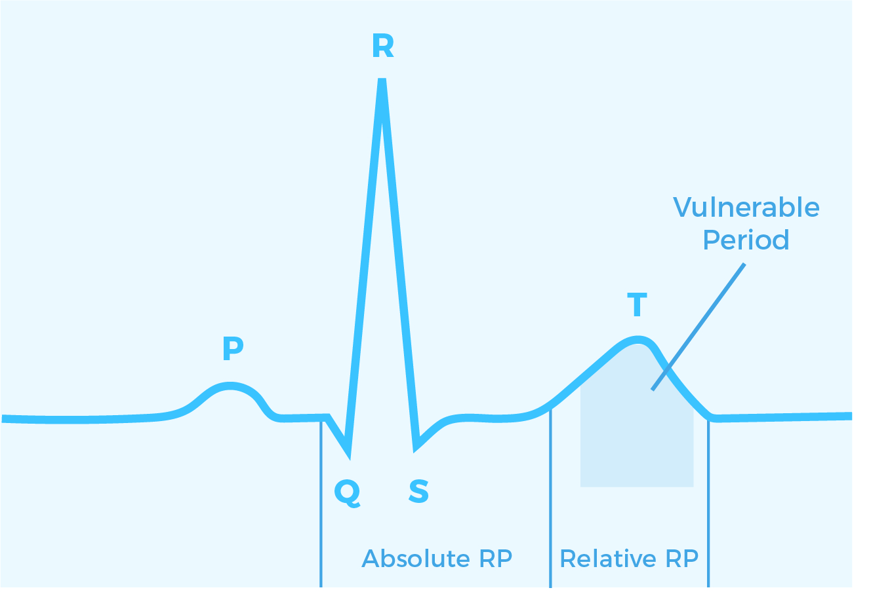
Cardiac Synchronization
When the heart goes through a depolarization and repolarization process, it produces recognizable electrical cardiogram (ECG) wave forms, example shown below
When a pulse is present, defibrillation shall not occur during the vulnerable period as this could lead to non-pulse fibrillation
An electrical pulse must be delivered as close to the R-wave, thus synchronized.
Delay typically between 10-30ms
The defibrillator analyzer measures the delay between R-wave and energy delivery in milliseconds (ms)

Slide 12
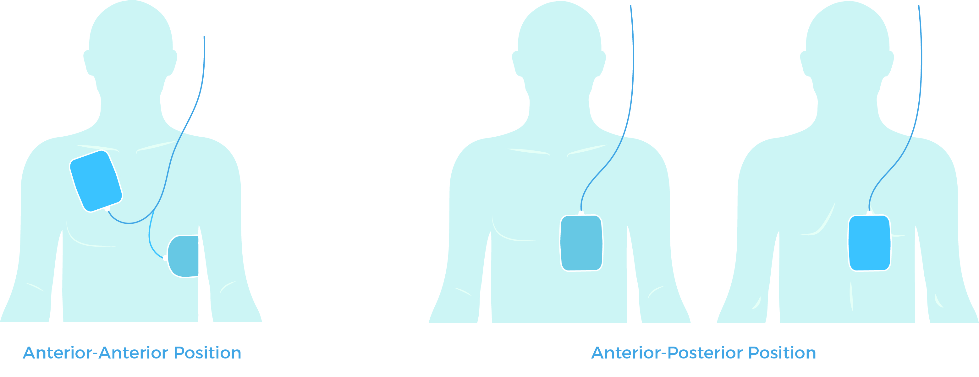
Transcutaneous Pacing
Applying a pulse of current up to 200mA non-invasively
Typically for bradycardic patients
Stimulate the myocardium
Demand and non-demand (fixed)
Anterior-Anterior, Anterior-Posterior placement

Slide 13
Agenda
1
Defibrillation - History and Theory
2
Heart & Electrical Signals
3
Definition & Use
4
Standard– IEC 60601-2-4
5
Defibrillator PM
6
Closing remarks

Slide 14
Definition
Defibrillation is a treatment for life-threatening cardiac dysrhythmias, specifically ventricular fibrillation (VF) and non-perfusing ventricular tachycardia (VT). A defibrillator delivers a dose of electric current (often called a counter shock) to the heart.

Slide 15
What is Fibrillation?
Uncontrolled (rapid) contractions of the heart muscles
Atrial and Ventricular fibrillations
  Atrial Fibrillation is not immediately life threatening
  Ventricular Fibrillation severely affects or even stops the blood flow leading to cardiac arrest
Rapid loss of consciousness, resulting in Asystole, followed by death if untreated immediately - window of opportunity up to 10 minutes!
Atrial fibrillation can be treated with heart rate lowering drugs or electrical stimulation (defib – cardioversion)
Ventricular fibrillation requires high energy source to “reset” the fibrillation (de-fibrillation)

Slide 16
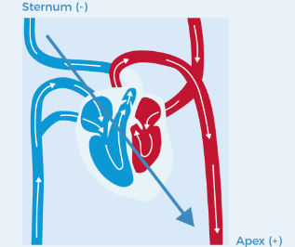
What is defibrillation?
Energy is across the heart, current flowing between the Atria to the Ventricles
The paddles on an external defibrillator are placed from the sternum to apex
Placement of the paddles can be anterior to anterior or anterior to posterior
Defibrillators clearly identify their paddles as Apex (+) and Sternum (-) to guide placement

Slide 17
  Defibrillation - Types of external defibrillators
Advanced life support (ALS) – External defibs
  All-in-one solution – pacing, vital signs monitoring, diagnostic ECG monitoring, and other optional features
  Comprehensive medical devices used by emergency medical service (EMS) personnel
Basic Life Support (BLS) – Automatic External Defibrillator (AED)
  Can be operated by unskilled personnel
  Basic functions
  Algorithms to accurately evaluate cardiac rhythms
  Will only shock VF or VT

Slide 18
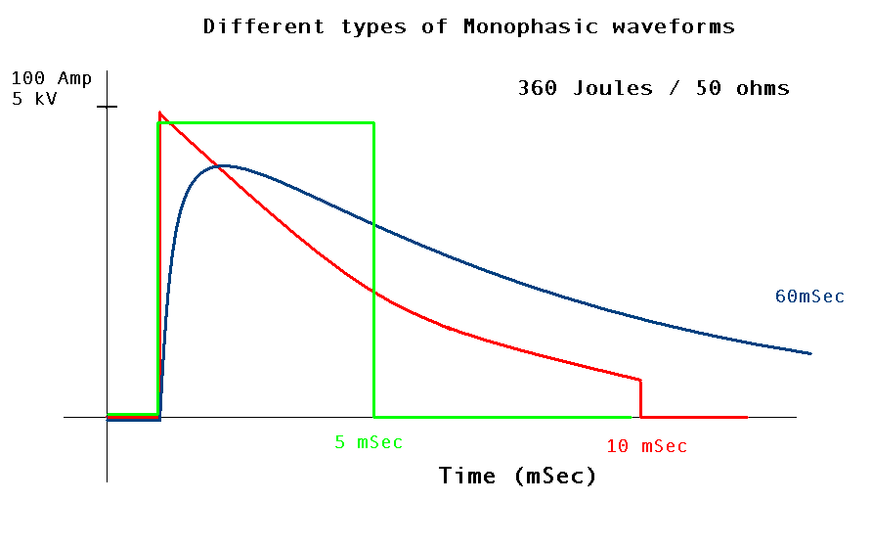
Monophasic
Earlier type defibrillators
Less effective
Require higher energy
Energy levels of 200 to 360J

Slide 19
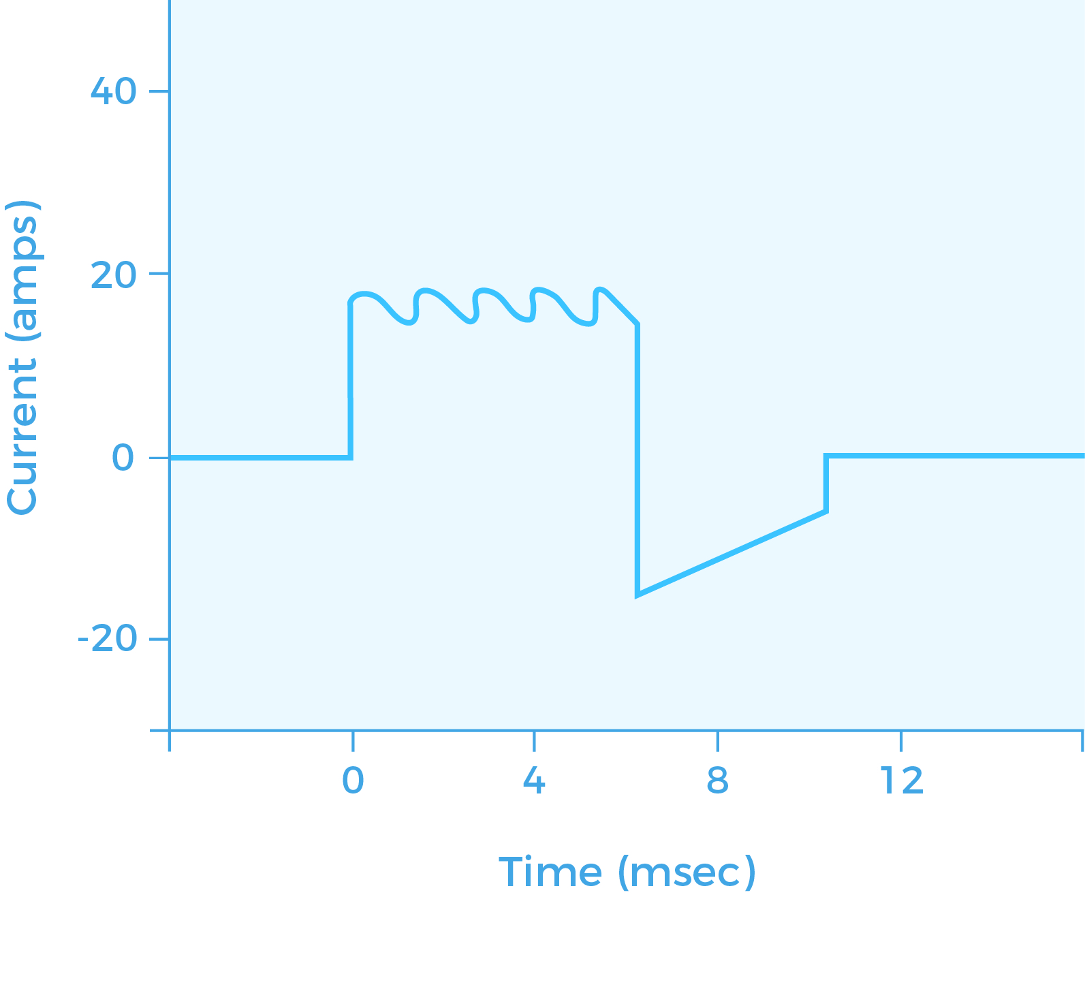
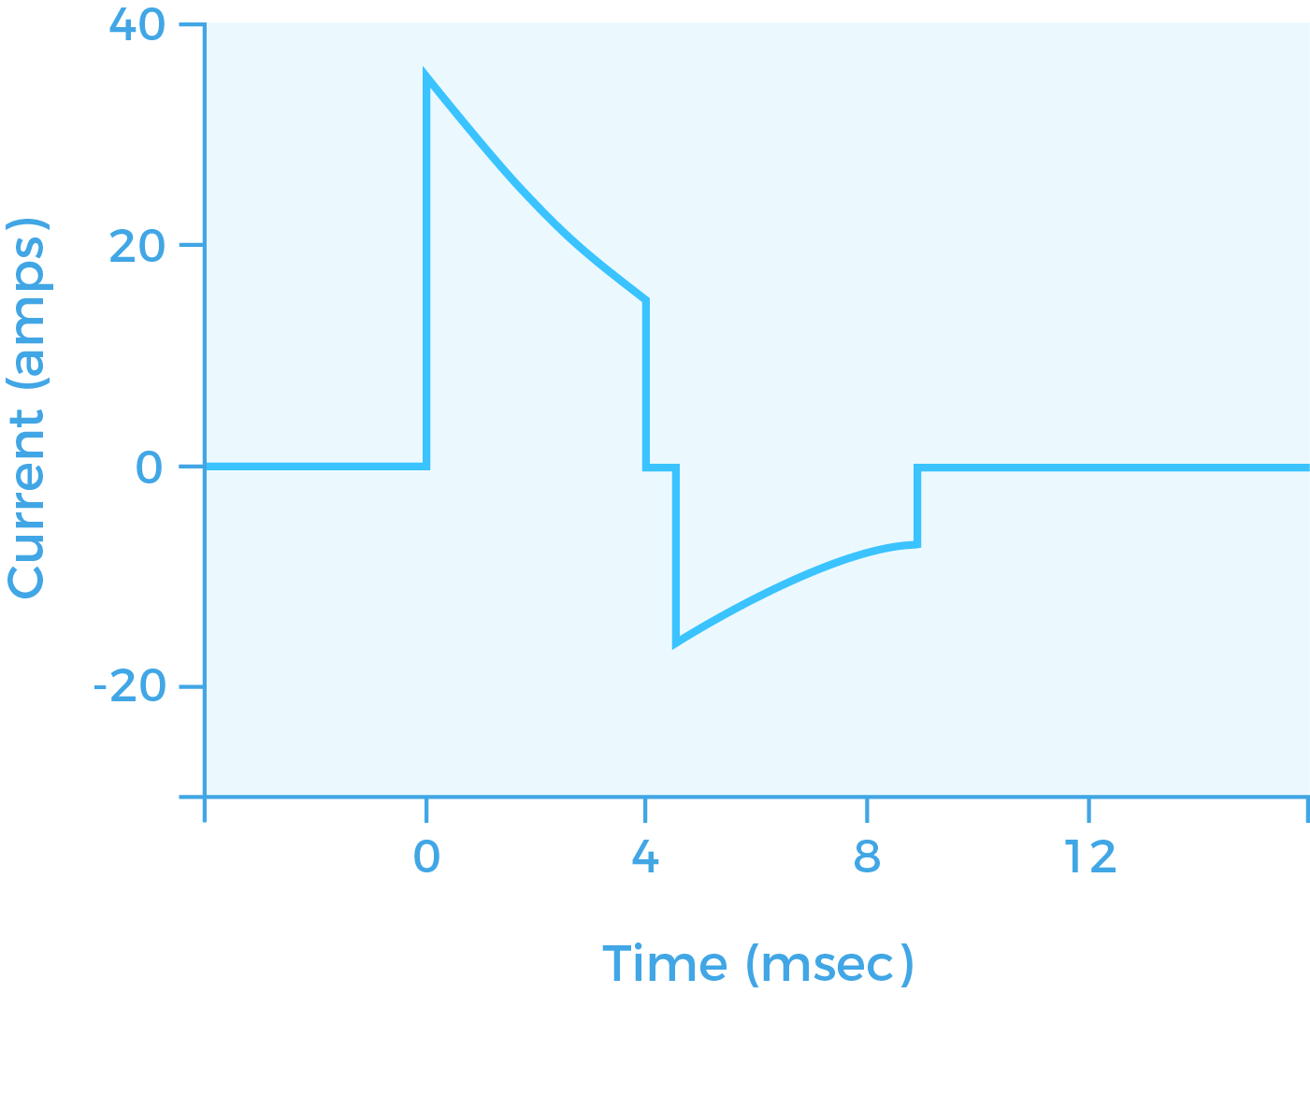
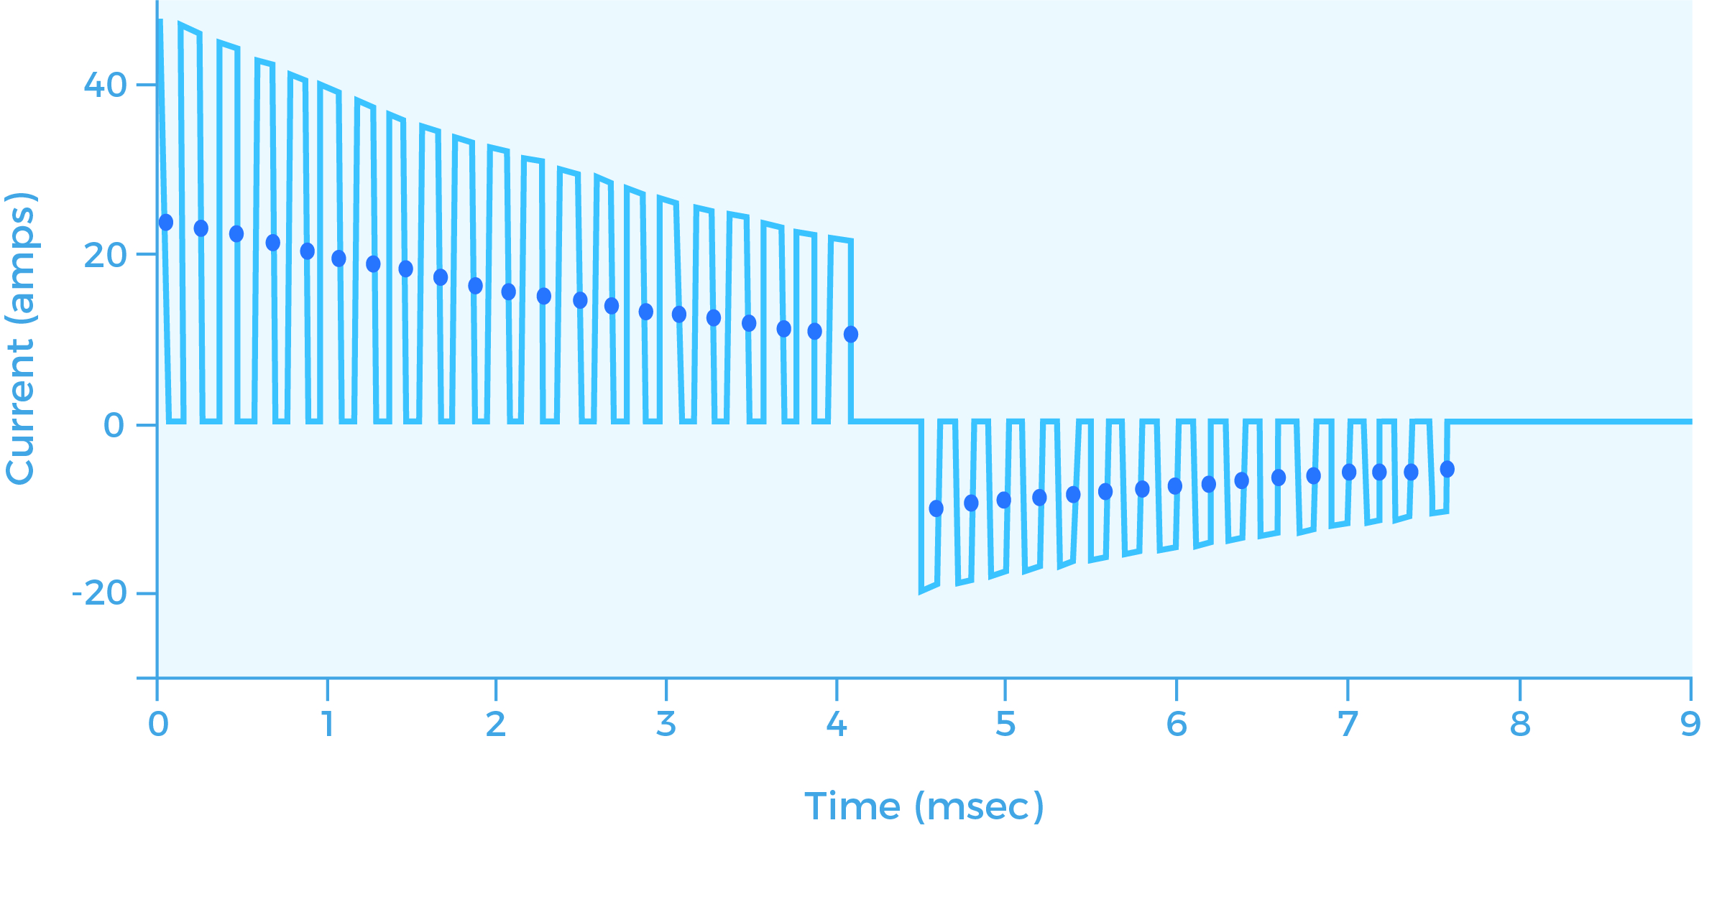
Biphasic
More modern type defibrillators
Energy levels up to 150-200J
Manufacturers have their own patented biphasic technologies
  Biphasic Truncated Exponential (BTE)
  Rectilinear Biphasic Waveform (RBW)
  Pulsed biphasic

Slide 20
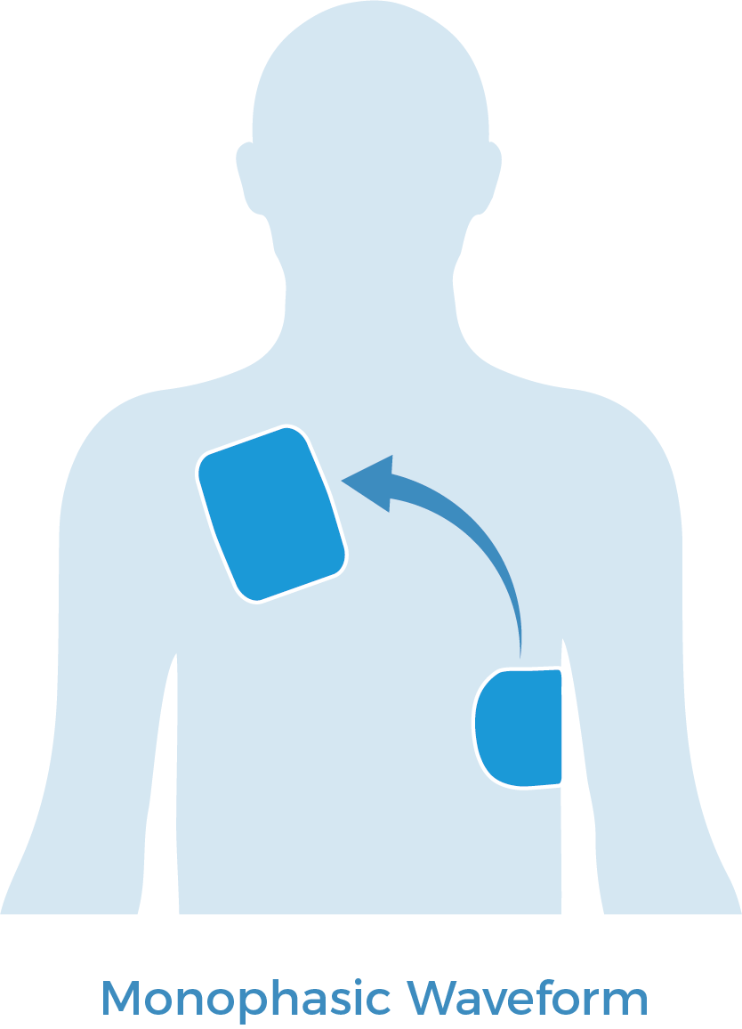
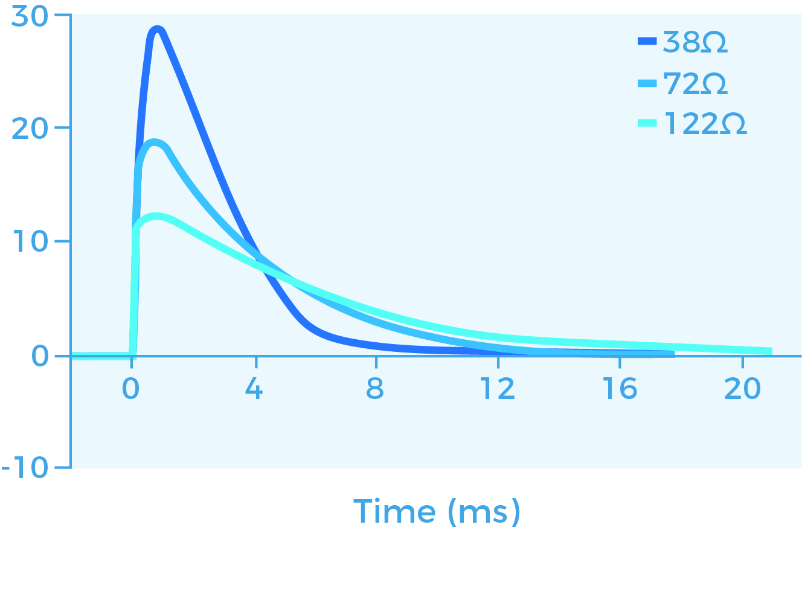
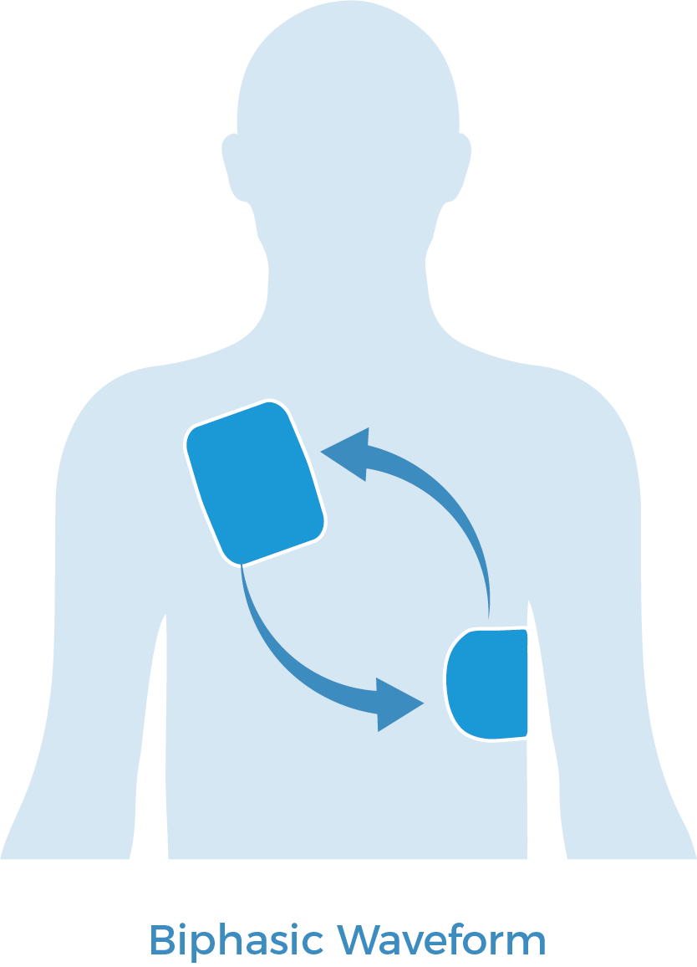
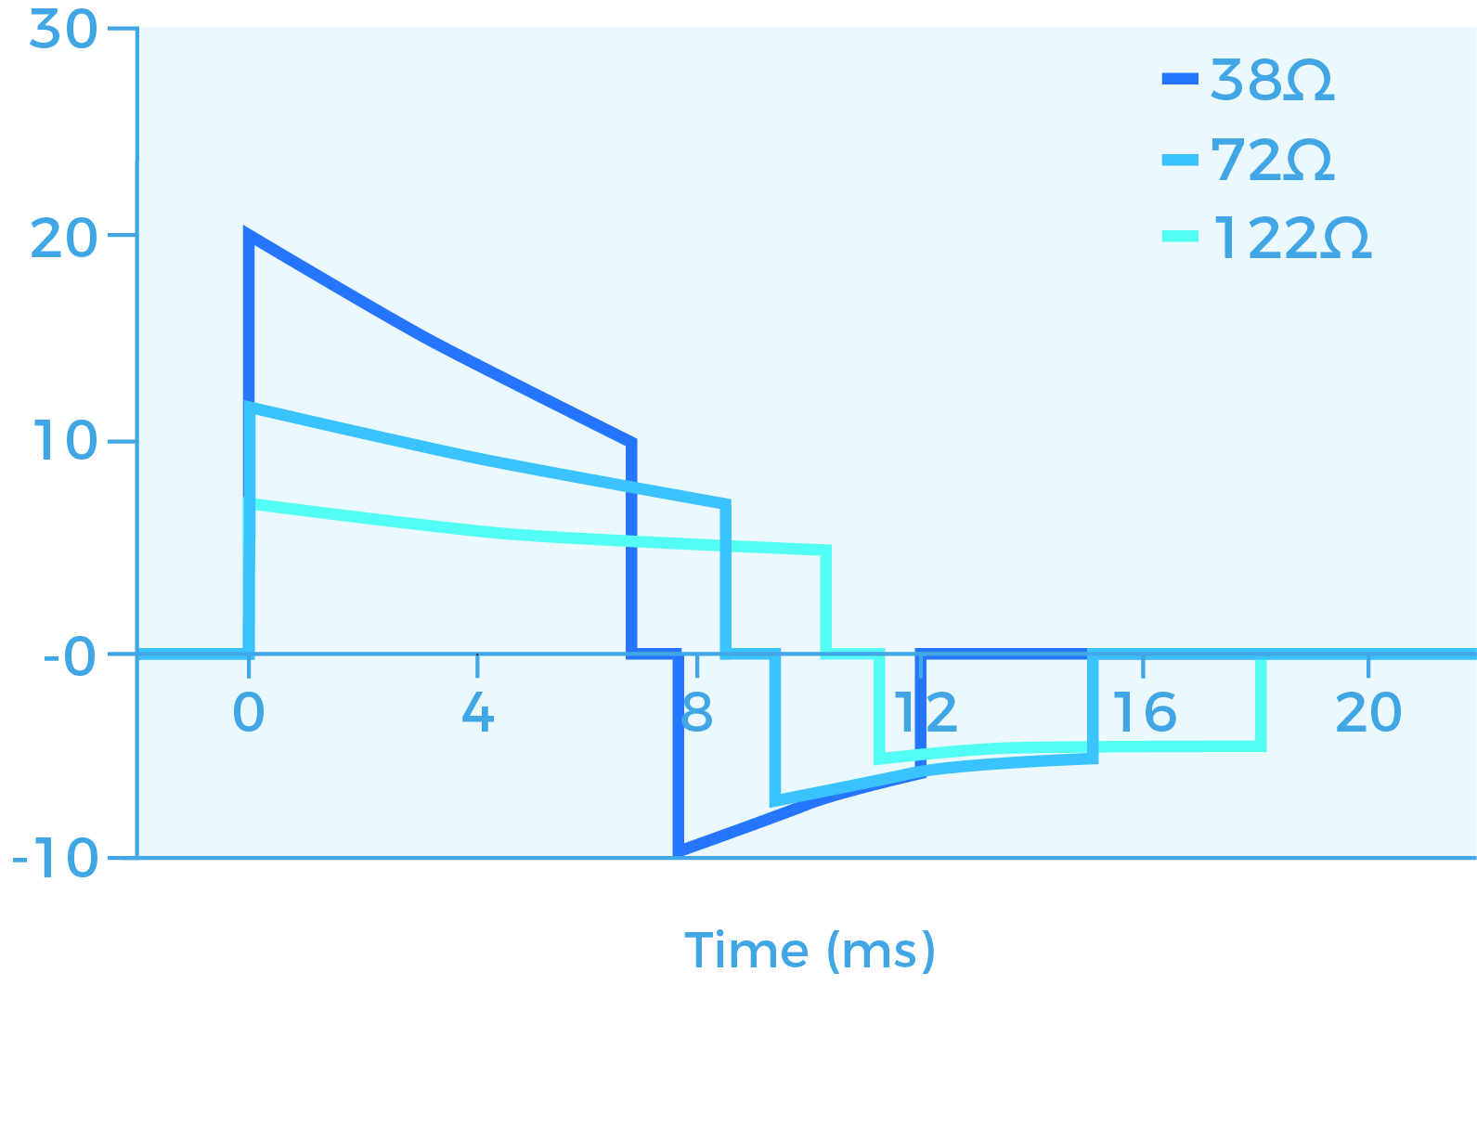
Monophasic vs Biphasic
Monophasic
Damped sine wave with a high peak current
Current flows in one direction across the heart
Current decreases as bodily impedance increases – the heart may not receive enough current to defibrillate if impedance is high
Biphasic
Current flow is bidirectional
Current waveforms adjust to maintain the delivered energy regardless of patient impedance - a patient will have equal chance of survival regardless of their impedance
Lower energy delivered by biphasic devices can be as effective as higher energy monophasic devices
Biphasic energy at 200 J or less can have equal or higher efficacy than monophasic energies of 200 to 360 J
Using lower biphasic energy may result in less damage to the myocardium

Slide 21
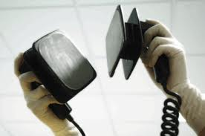
Defibrillation
Myth
Defibrillator starts the heart
Used when flat-line
True
A defibrillator briefly stops the heart
Then the heart re-starts by itself
Only possible when electrical activity is still present in the Myocardial muscles (i.e. no flat-line)

Slide 22
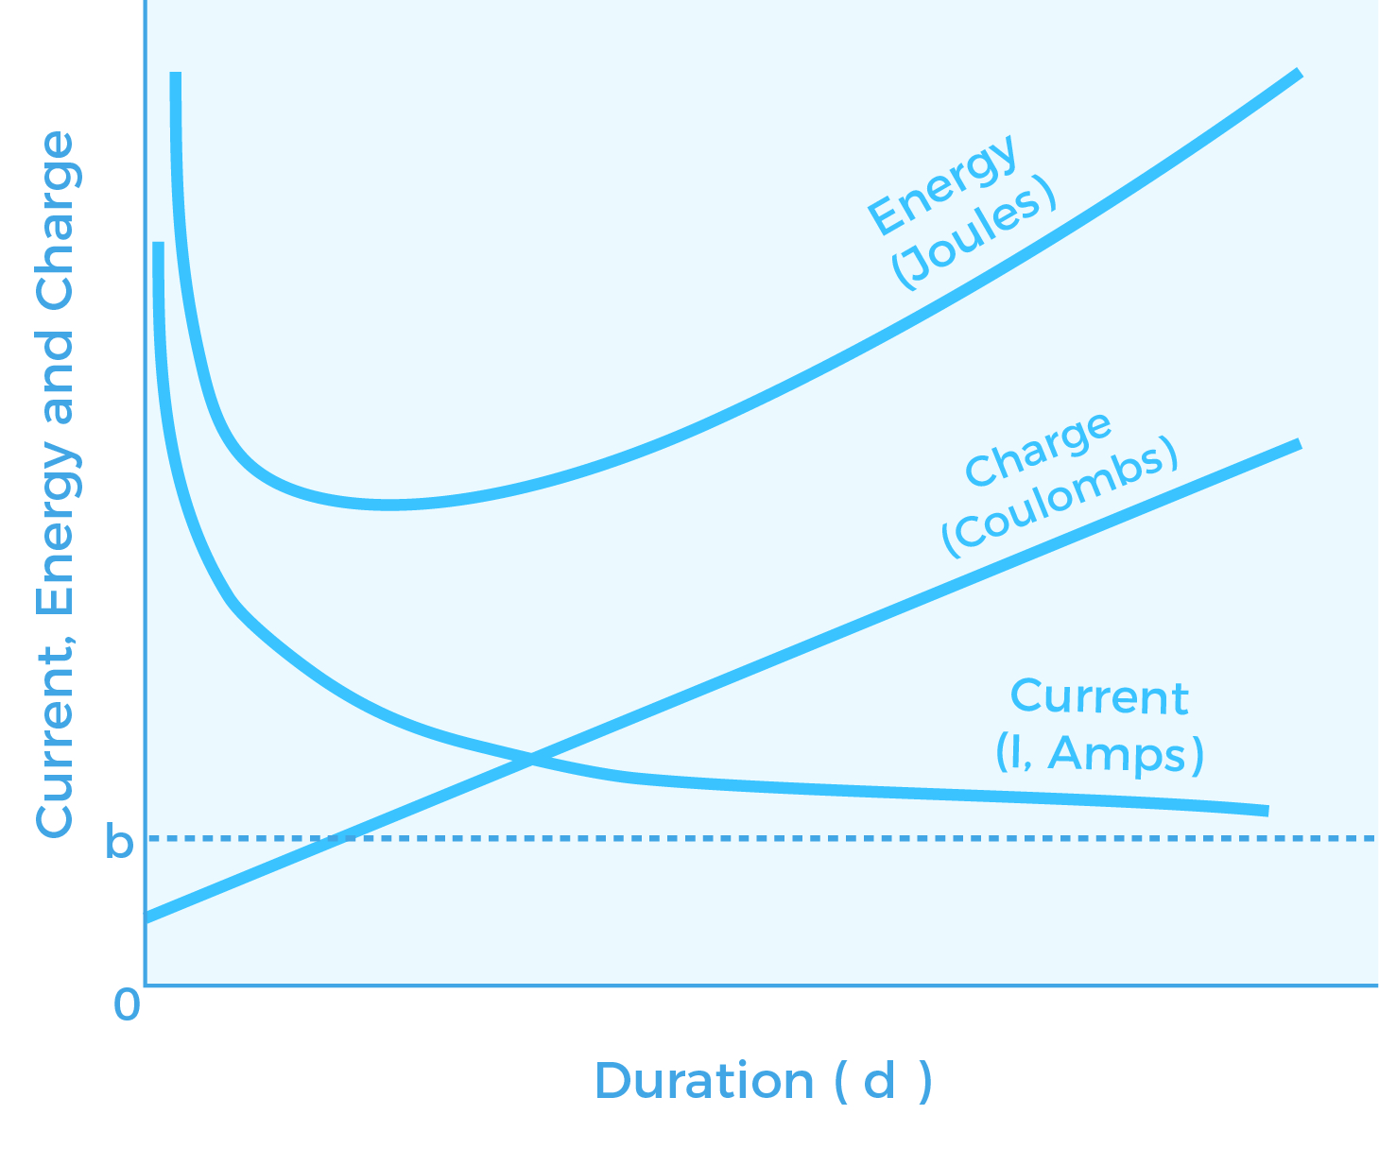
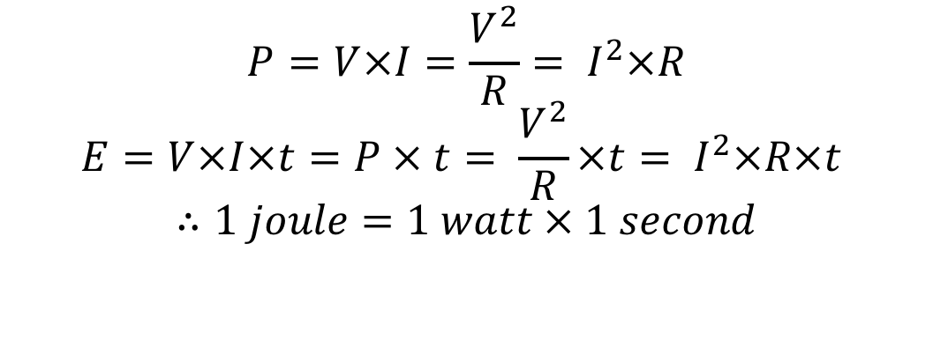
Joules of energy
The joule is the standard unit (SI) of energy used in scientific applications to measure and express the work done. The energy or work required to produce one watt of power (P) for one second (s) is a joule (J). The relationship between energy (E), voltage (V), current (I), resistance (R) power (P) and time (t) is as follows:
$$P=V×I=\frac{V^{2}}{R}= I^{2}×R$$
$$E=V×I×t=P × t= \frac{V^{2}}{R}×t= I^{2}×R×t$$
$$∴1 joule=1 watt × 1 second$$

Slide 23
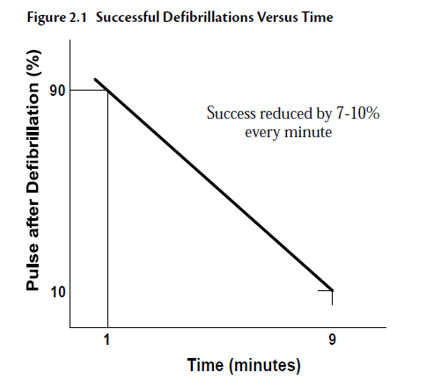
Time is of the essence
Source:
http://www.skillstat.com/PDF/mceElectric.pdf

Slide 24
Agenda
1
Defibrillation - History and Theory
2
Definition & Use
3
Heart & Electrical Signals
4
Standard– IEC 60601-2-4
5
Defibrillator PM
6
Closing remarks

Slide 25
IEC 60601-2-4:2011
The current in-use standard for external defibrillators is IEC 60601-2-4:2011 Particular requirements for safety of cardiac defibrillators. The purpose of the standard is to establish particular basic safety and essential requirements for cardiac defibrillators for manufacturers’ adherence.
The standard stipulates the accuracy of defibrillator energy output into various loads, maximum delay time from the synchronized peak QRS complex to the peak delivered energy - differentiation and identification of shockable and non-shockable arrhythmia, and the accuracy of the pacing pulse rate, current and duration.

Slide 26
Agenda
1
Defibrillation - History and Theory
2
Definition & Use
3
Heart & Electrical Signals
4
Standard– IEC 60601-2-4
5
Defibrillator PM
6
Closing remarks

Slide 27
Typical PM
Synchronization/cardioversion operation
  Recording sync delay
Energy output
  Energy Linearity
  Delivery after a specified time – typ. 1 minute @ max output
  Charge time @ max output – typ. < 10 s
  10th repetitive test @ max output
Pacer output
  Current linearity
  Pulse width
  PPM
Paddle impedance check
Printer
  Paper speed
Vital signs verification
  SPO₂, NIBP, CO₂
Visual test
Electrical safety Test
Battery performance
Alarms
ECG performance
  Amplitude gain
  BPM rate verification
  Frequency response
NOTE: When testing a defibrillator it is crucial to understand the operation of the device under test. The output energy from defibrillators is extremely hazardous; precautions must be followed to ensure the device is tested under safe conditions only. Always ensure that all tests are carried out by a competent suitably trained individual.

Slide 28
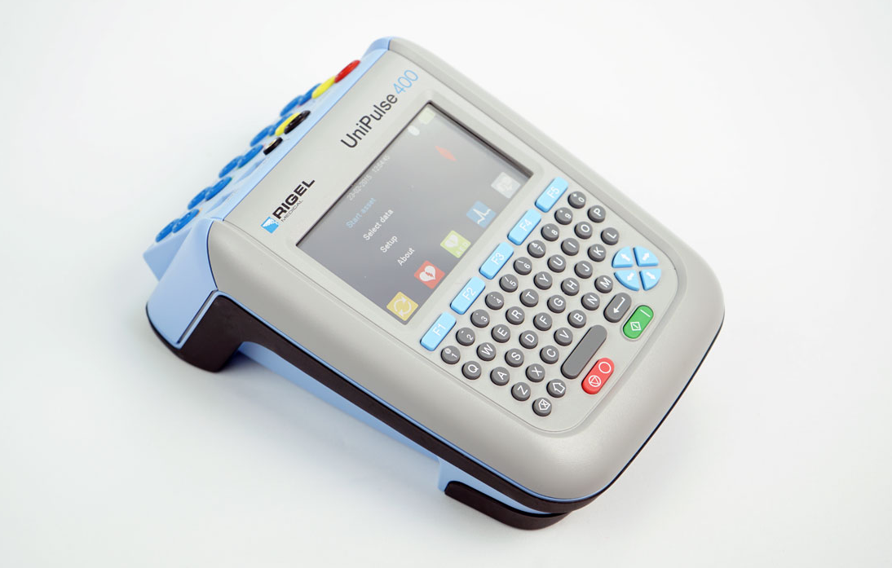
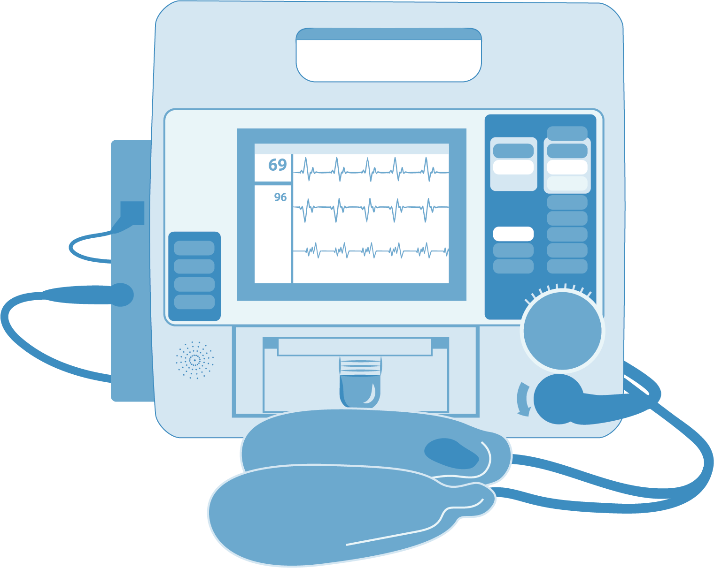
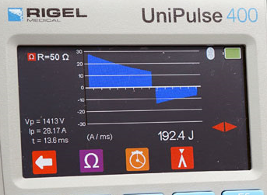
Video

Slide 29
Agenda
1
Defibrillation - History and Theory
2
Definition & Use
3
Heart & Electrical Signals
4
Standard– IEC 60601-2-4
5
Defibrillator PM
6
Closing remarks

Slide 30
Thank you for your time!
Q&A
Coming soon…
Guide to Defibrillator Testing
E-mail us at brittanys@seaward-groupusa.com for your e-copy

Slide 31
Rigel Medical, Seaward Group, 6304 Benjamin Rd, Suite 506, Tampa, FL 33634
T: 813-886-2775

