Slide 1
Applying a Formulary Approach to Healthcare Technology Management
Mara Pare’, Vice President, Client Solutions, PartsSource

Slide 2
Today’s Agenda
Formularies in Healthcare
How to Apply a Formulary in HTM (One approach)
Why to Apply a Formulary in HTM (Hint: outcomes)

Slide 3
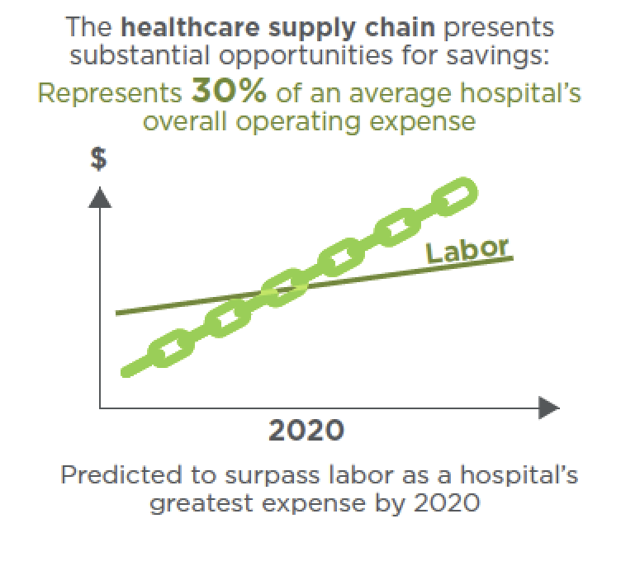
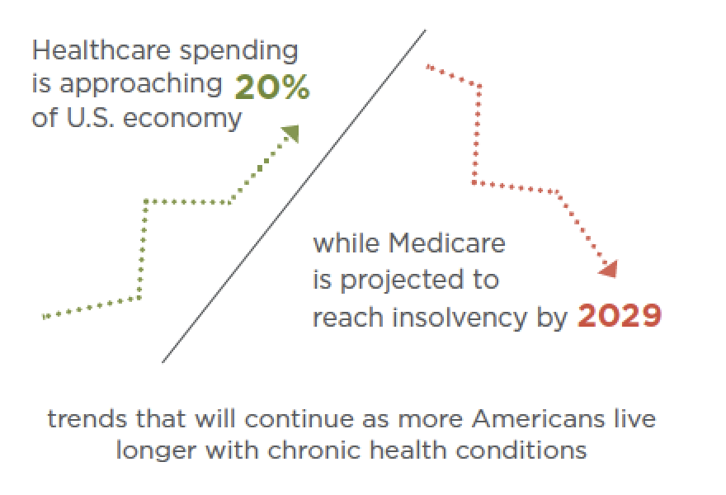
Why a Formulary Approach? Healthcare, an Industry in Crisis
Improving quality and controlling costs remain paramount
Pressure on hospitals and health systems to simultaneously improve quality and reduce costs will only intensify.
Source:
https://www.navigant.com/insights/healthcare/2017/thought-leadership-healthcare/supply-chain-analysis

Slide 4



Benefits of an Effective Formulary System: The Drug Formulary
Approved and efficacious medicines that all practitioners will have available for use
  Only the most effective and safest products
  Medicines have been evaluated systematically
  Medicines are chosen and approved to treat the diseases of the region or country
  Physicians develop greater experience with fewer medicines
Pharmaceutical therapy at lower cost
  Ineffective, high-cost medicines will be excluded from system
  Availability leads to fewer visits, improved outcomes, and lower cost
  Reduced inventory cost
Consistent supply of medicines
  Regulating the number of medicines will improve procurement and inventory management
  Economies of scale will increase availability of essential medicines
  Saving money leads to consistency in purchasing

Slide 5
Benefits of an Effective Formulary System—Summary
SUPPLY
  Easier procurement
  Lower amount of stocks
  Improved quality assurance
  Easier dispensing
PATIENT USE
  Focused education efforts
  Better compliance
  Improved availability
CONSOLIDATION
  More experience with fewer medicines
  Irrational alternatives not available
  Focused medicine information
  ADRs easier to manage
COST
  Lower prices, more competition

Slide 6
Switching Gears
A Look at the HTM and Clinical Engineering Landscape

Slide 7



Perspectives from within the CE Supply Chain
Clinical engineer director
“Where can I lower our total cost of service and empower my team to take on contract services?”
Finance director
Technician
“How do I reduce our operational cost and improve the efficiency and utilization of our assets?”
“How do I know I’m finding the best quality option for the most cost effective price?”
IT specialist
Supply chain
“Our health system needs to have integrations to save time so we can focus on big initiatives like cybersecurity”
“How can we enforce standardization and compliance and manage the long-tail spend?”

Slide 8
The Stats
Substantial variance exists among clinical engineering teams when purchasing replacement parts, resulting in multiple price points and varying levels of quality across the same part.
Health systems are spending 10%-30% more than best-in-class systems on medical device repair and replacement products.
In addition to these findings, further clinical engineering challenges exist
  Inability to standardize process, price and purchases for items not part of the MMIS
  The procurement organization is faced with having to reconcile hundreds of invoices from nearly a thousand suppliers

Slide 9
Supply Chain Variation
Supplier Type shows the percentage of orders that are direct from OEM vs. alternative suppliers. Alternative suppliers usually offer higher savings, but quality must be monitored systematically.
 | Invoices | Invoices | Spend $ | Spend $
Facility | OEM % | Alternative % | OEM % | Alternative %
Hospital 1 | 25% | 75% | 42% | 58%
Hospital 2 | 53% | 47% | 54% | 46%
Hospital 3 | 33% | 67% | 41% | 59%
Hospital 4 | 25% | 75% | 32% | 68%
Hospital 5 | 68% | 32% | 57% | 43%
Hospital 6 | 86% | 14% | 93% | 7%
Hospital 7 | 85% | 15% | 90% | 10%
Hospital 8 | 72% | 28% | 72% | 28%
Hospital 9 | 70% | 30% | 76% | 24%
Hospital 10 | 40% | 60% | 55% | 45%
Hospital 11 | 75% | 25% | 78% | 22%
Hospital 12 | 59% | 41% | 64% | 36%
Hospital 13 | 47% | 53% | 79% | 21%
Hospital 14 | 83% | 17% | 91% | 9%
Hospital 15 | 67% | 33% | 77% | 23%
Hospital 16 | 74% | 26% | 72% | 28%
Hospital 17 | 29% | 71% | 48% | 52%
Hospital 18 | 66% | 34% | 83% | 17%
Hospital 19 | 81% | 19% | 74% | 26%
Clinic 1 | 47% | 53% | 30% | 70%
Clinic 2 | 43% | 57% | 23% | 77%
Clinic 3 | 0% | 100% | 0% | 100%
Clinic 4 | 49% | 51% | 84% | 16%
Clinic 5 | 26% | 74% | 20% | 80%
Clinic 6 | 30% | 70% | 52% | 48%
Clinic 7 | 19% | 81% | 13% | 87%
Clinic 8 | 27% | 73% | 25% | 75%
Notes:
Supplier Type shows the percentage of orders that are direct from OEM vs. alternative suppliers. Alternative suppliers usually offer higher savings, but quality must be monitored systematically.

Slide 10
Supply Chain Variation
Orders for the same part with significant pricing variances highlights how a centralized supply chain approach can eliminate unneeded waste
Savings Opportunity highlights the potential savings if the total quantity of that part were purchased at the lowest price point
Parts with Significant Pricing Variance
Supplier Part Number | Item Description | Unit Price | Transactions | Quantity | Total Spend | Savings Opportunity
15003378000 | Bellows Assy Adult For Mod Ii | $ 175.35 | 4 | 4 | $ 701.41
15003378000 | Bellows Assy Adult For Mod Ii | $ 229.63 | 67 | 67 | $ 15,385.21
15003378000 | Bellows Assy Adult For Mod Ii | $ 394.00 | 1 | 1 | $ 394.00
15003378000 | Bellows Assy Adult For Mod Ii | $ 430.20 | 2 | 9 | $ 3,871.80
15003378000 | Bellows Assy Adult For Mod Ii | $ 449.14 | 31 | 31 | $ 13,923.34
15003378000 | Bellows Assy Adult For Mod Ii | $ 458.88 | 2 | 2 | $ 917.76
15003378000 | Bellows Assy Adult For Mod Ii | $ 478.00 | 4 | 4 | $ 1,912.00
15003378000 | Bellows Assy Adult For Mod Ii | $ 485.75 | 3 | 3 | $ 1,457.25 | $17,345
11141000149 | 12V 1.6Ah Ni-cd Battery | $ 182.08 | 1 | 10 | $ 1,820.80
11141000149 | 12V 1.6Ah Ni-cd Battery | $ 182.98 | 7 | 22 | $ 4,025.56
11141000149 | 12V 1.6Ah Ni-cd Battery | $ 249.00 | 7 | 10 | $ 2,490.00
11141000149 | 12V 1.6Ah Ni-cd Battery | $ 280.64 | 15 | 39 | $ 10,944.96
11141000149 | 12V 1.6Ah Ni-cd Battery | $ 280.65 | 3 | 7 | $ 1,964.55
11141000149 | 12V 1.6Ah Ni-cd Battery | $ 285.00 | 1 | 2 | $ 570.00
11141000149 | 12V 1.6Ah Ni-cd Battery | $ 344.00 | 13 | 40 | $ 13,760.00 | $11,905
TC10009596 | Pressure sensor for alaris pum | $ 53.54 | 1 | 12 | $ 642.42
TC10009596 | Pressure sensor for alaris pum | $ 70.00 | 15 | 16 | $ 1,120.00
TC10009596 | Pressure sensor for alaris pum | $ 75.00 | 136 | 210 | $ 15,750.00
TC10009596 | Pressure sensor for alaris pum | $ 85.00 | 1 | 1 | $ 85.00
TC10009596 | Pressure sensor for alaris pum | $ 89.14 | 3 | 30 | $ 2,674.20
TC10009596 | Pressure sensor for alaris pum | $ 107.07 | 38 | 107 | $ 11,456.49
TC10009596 | Pressure sensor for alaris pum | $ 107.70 | 1 | 2 | $ 215.40
TC10009596 | Pressure sensor for alaris pum | $ 107.89 | 1 | 1 | $ 107.89 | $11,762

Slide 11
What if…
We took a formulary approach to maintaining the health and wellness of clinical assets?

Slide 12
Would These Benefits Still Apply?
SUPPLY
  Easier procurement
  Lower amount of stocks
  Improved quality assurance
PATIENT USE
  Improved availability
CONSOLIDATION
  More experience with fewer parts and services
  Irrational alternatives not available
  POs and process easier to manage
COST
  Lower prices, more competition

Slide 13
Objectives
Based on the PartsSource approach of creating data-driven solutions for managing clinical resources, we know an enterprise-wide custom formulary:
  Provides more reliable results
  Offers reproducible results
  Ensures quality
  Provides consistency
  Generates cost savings

Slide 14
How
A Formulary Approach

Slide 15
Formulary Management Principles
Select medicines on the basis of need (diseases and conditions that have been identified locally)
Select “medicines of choice”
Maintain a limited number of medicines (avoid duplications)
Use INN (generic) names
Use combination (fixed-dose) products only in specific proven conditions
Use explicit selection criteria that include—
  Efficacy and effectiveness
  Safety
  Quality
  Cost

Slide 16
Maintaining a Formulary
Evaluate new medicine requests and deletions regularly
Conduct a systematic review of therapeutic groups and classes

Slide 17
Establishing a Formulary for HTM

Slide 18
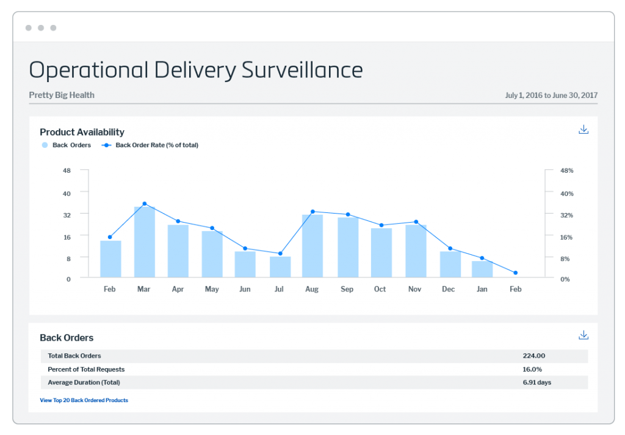
3 Questions to Ask
Are the quality return rates
within acceptable parameters?
Is it a cost effective option?
Does the supplier have a high deliverability rating?
Notes:
More than 6,000 OEM and aftermarket suppliers producing millions of different parts for the biomedical market participate in a single online marketplace,⁴ and many more firms than that supply hospitals. That is a lot of ground for supply chain managers and clinical engineering departments to cover in evaluating suppliers. But they can take a shortcut by asking their current suppliers and potential suppliers a few basic questions, including:
Is the supplier ISO 9001:2015 certified? The International Organization for Standardization (ISO) is an international standard-setting body composed of representatives from 161 national standards bodies.⁵ It sets standards for manufacturing across many industries, including the medical devices (biomedical) industry. The ISO 9001:2015 standard and the ISO 13485 standard set the criteria for a quality management system specifically focused on medical devices.⁶ To assure quality, a parts supplier should adhere to the ISO quality management principles. The standard is for OEM suppliers to do so, more often than secondary suppliers, however, more and more secondary market suppliers are becoming ISO-compliant. ISO certification must be renewed every year, so it’s important to check whether a company that claims to be ISO-certified or compliant maintains this status.
How does the supplier manage production quality? The quality management system structure in ISO and the U.S. Food and Drug Administration (FDA) {21 CFR 820} use in assessing the quality processes of biomedical companies includes document and record control, product realization (design, development, and manufacturing process), supplier management, corrective and preventive action, complaint handling, control of nonconforming parts, warehouse/distribution, training, and internal and external audits.⁷ If a supplier is not ISO-certified, hospitals can audit to check on whether the company has acceptable quality processes in place.
Are the supplier’s parts registered with the FDA? The FDA requires the registration of the supplier of all medical device parts (Class I, II, III), even batteries. So even if a supplier isn’t ISO certified, having FDA-registered parts gives some assurance of quality understanding. The FDA also reevaluates suppliers periodically and provides on its website updated lists of recalls and safety issues. In addition, the FDA issues regular reports on adverse events involving medical devices.
So, if a supplier isn’t ISO certified OR FDA registered and they are selling you parts, you should question the quality of the parts they are selling.
How do we do maintain our vigilance of our suppliers quality? Send a supplier self-assessment (SSA) and verify their responses and we conduct on-site audits of our suppliers to verify their compliance to our quality standards.
This is your data-ask for it!

Slide 19
Multiple Options
How can I drive my organization to make consistently good buying choices?
How can I get access to the quality, price and deliverability data I need to determine what the right choice is for my organization?
How can I enforce that choice as the system wide standard?
Ensure Compliance with Purchasing Policies and Implement Best Practices System-Wide

Slide 20
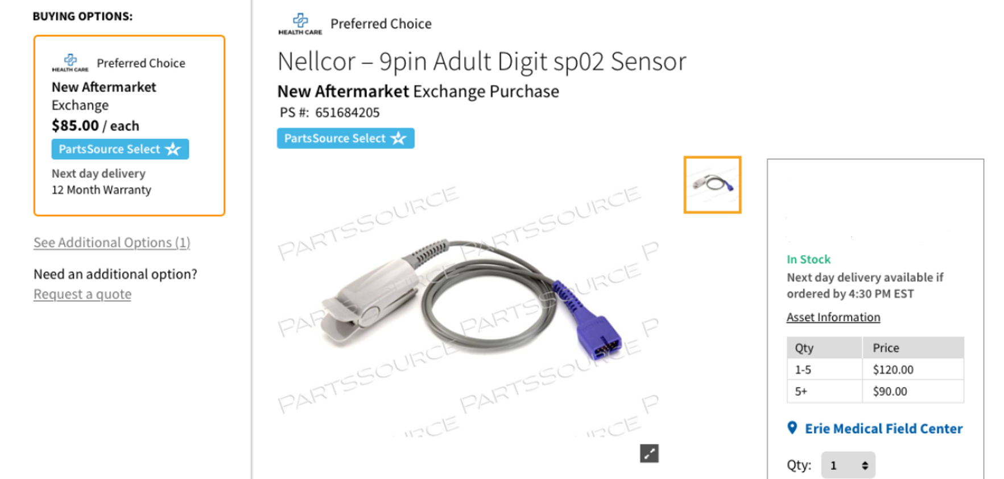
Multiple Options for Program Controls
Formulary Guidance
Client branded
Limited selection
Other options suppressed

Slide 21
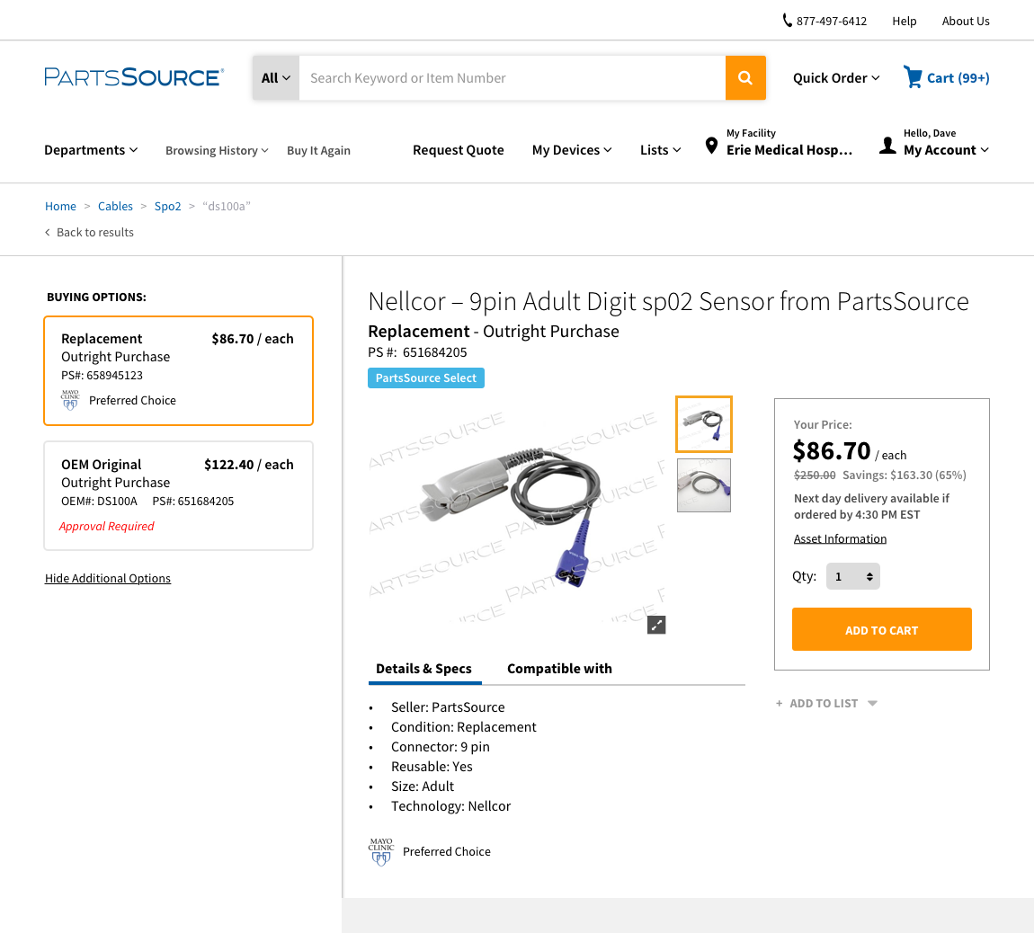
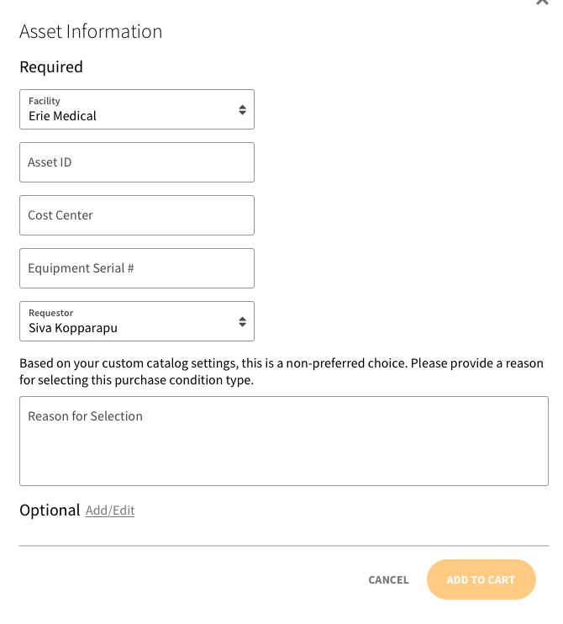
Mandatory and/or Preferred Options
How can I retain flexibility for my organization when utilizing a formulary approach?
Offers clear direction on vetted options to the end user
Formulary Guidance
Establish Policy
Reason Codes
Manager Approval

Slide 22
Formulary Management Tool
Customized data analytics peer benchmarks and enterprise catalog management
Evidence-based formulary design, cost reduction opportunities and purchase policy can be followed across a system, region or site level at click of a button
Access to industry benchmarking to create out of the box formulary options
Ensure Compliance with Purchasing Policies and Implement Best Practices System-Wide

Slide 23
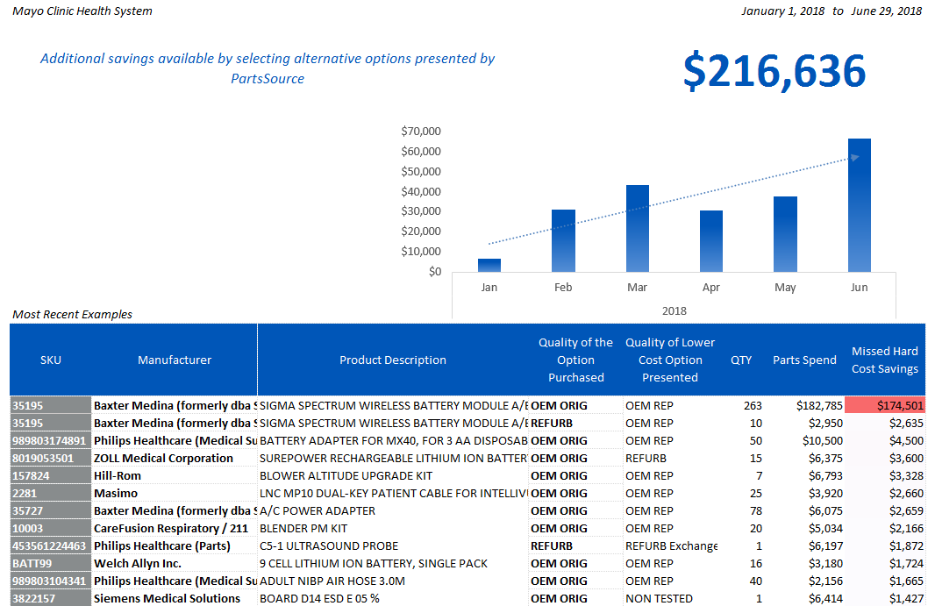
Reporting and Monitoring
Develop reporting to identify missed savings opportunities
Use data to identify and build formulary rules
Monitor and report out on impact to the organization including quality return rates and hard cost savings
Ensure Compliance with Purchasing Policies and Implement Best Practices System-Wide

Slide 24

PartsSource Customer Formulary: Real Results
Find opportunities to implement formulary rules and achieve cost savings, high quality and standardized outcomes.
Formulary
Mandating secondary market option while maintaining high quality results: limited buying option of battery to $32 version over $695 OEM Original option.
Real Results
Standardized this battery purchase across health system in multiple states: Six figure dollar savings on an annual basis.

Slide 25
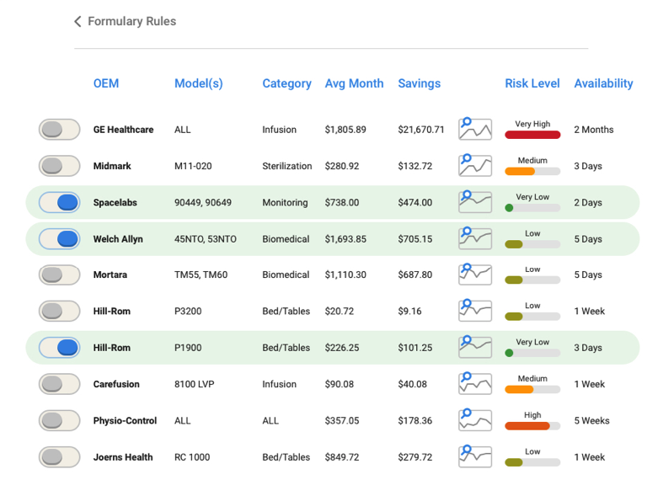
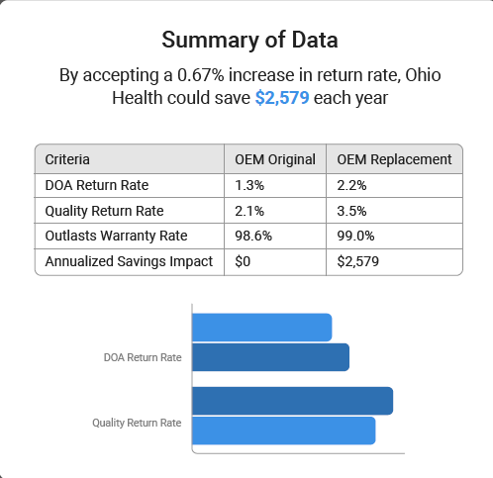
Takeaways
Formularies can be applied successfully to HTM
Approach can still offer options
Results include hard cost savings, standardization and quality controls

Slide 26
Mara Pare’ mpare@partssource.com
330-954-7674
Questions?

