Slide 1


MD Expo - Seattle
Kill Your Spreadsheets:
How Top HTM Teams Optimize Reporting

Slide 2

Meet The Speaker
Ben Person, VP Solution Consulting
Ben leads the product marketing and solution consulting teams at Nuvolo and helps Healthcare HTM teams upgrade or replace legacy CMMS solutions with a modern cloud based CMMS system

Slide 3
Today’s Agenda
1
2
3
4
Spreadsheet Challenges
How Real-time reporting advances HTM
Top HTM Reports Demo
How to Ensure Accurate Data Capture
3

Slide 4
Current State of HTM Reporting

Slide 5
The Problem with Spreadsheets
Time Consuming
Prone to Human Error
Difficult to Collaborate

Slide 6

Engage the C-Suite
Can you report in a clear and concise manner to a non-technical audience?
Visual dashboards, KPIs made possible by real-time reporting will help you accomplish this

Slide 7
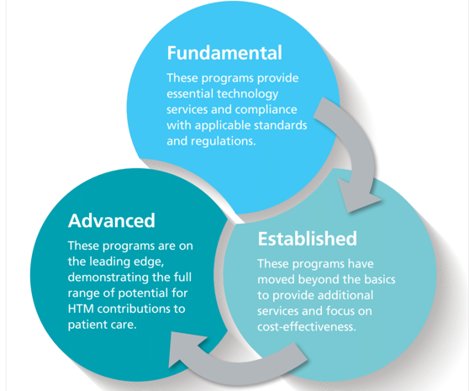
Achieve AAMI Advanced HTM Program Level
The HTM Program Manages ALL HTM-Related Costs
The HTM Program Monitors Productivity
The HTM Program’s CMMS has extensive analytical features
  Integration Capabilities (RTLS/RFID, ERP, etc.)
  Asset reliability measurements
  Self Service

Slide 8
How Real-time Reporting Helps
Imagine being able to create, view and collaborate, on reports in real time…
Let’s take a look at some of the reports top HTM teams use

Slide 9
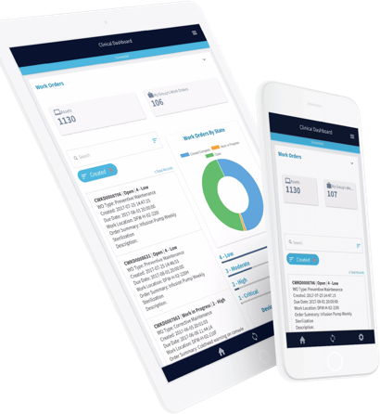
Equip Your Technicians with Mobile
Your reports are only as accurate as the data you collect.
Enable technicians to submit work orders during clinical rounds and at the point of service--online or offline

Slide 10
How Nuvolo Helps
Do you have an upcoming CMMS project?
If you’re interested in making data-driven business decisions, arming your technicians with mobile or want to upgrade your legacy CMMS…

Slide 11
Ask Us Anything!
...we invite you to pop over and meet Tom, Ryan, Bob, Megan and Kyle from the Nuvolo team at Booth #517, 519, 616, 618
Contact us at: info@nuvolo.com or 1-844-4-NUVOLO

