Slide 1

Electrical Safety Testing
Planned preventative maintenance

Slide 2
Overview
04
Overview
Scope of Presentation
Background
Standards & Classifications
Testing & Considerations
Summary & Closing Comments

Slide 3
Scope of Presentation
05
Scope of Presentation

Slide 4
Scope of Presentation
06
Discuss various test criteria, classifications, terminology, and standards.
Not a directive on what you should do in your facility

Slide 5
Medical Products - Life Cycle
Background
07
R&D
Production
Acceptance
PPM & repair
Decom’ing
Realm of the Biomed

Slide 6
Safety testing - Why?
Background
08
Objective to test and confirm the medical equipment is electrically safe to be used in a healthcare environment.
The most frequent and common testing a biomed does

Slide 7
Safety testing - Why?
Background
09
History
1970s a great deal of attention was paid to “micro shock hazard”
Studies showed that ventricular fibrillation could be introduced to the patient

Slide 8
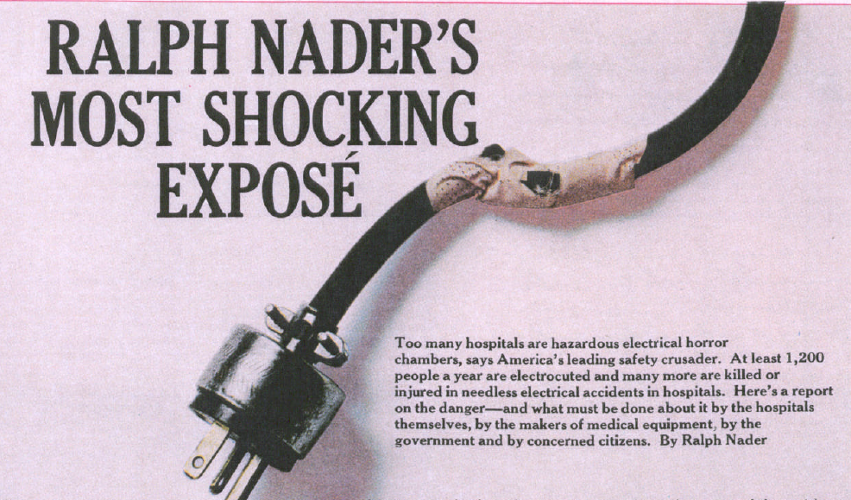
Safety testing - Why?
Background
10
1971 article by Ralph Nader in Lady’s Home Journal

Slide 9
Preventative Maintenance – PM
Background
11
Objective is to prevent or find potential faults
Visual Inspection
Testing means of protection
  Line cord
  Ground continuity
  Insulation
  Leakage currents
  Performance testing
Data capture and management

Slide 10
Electrical current
Background
12
Electrical Current;
  Requires a closed circuit
  Follows the path of least resistance (much like water)
  Electrical (functional) currents form an integral part during monitoring, treatment and diagnosis of patients
But can cause injury or even result in death as a result of muscle stimulation, tissue burns or trigger other events (e.g., ignition of pure oxygen)
Risk of (non-functional) electrical leakage is relatively small but always present.
Life saver in defibrillators (functional current)

Slide 11
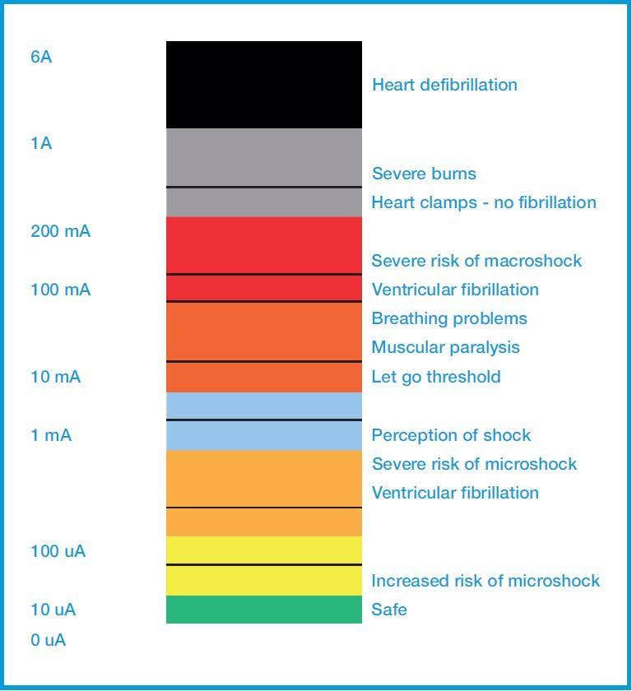
Electrical current on human body
Background
13
Impact of current on the human body, adapted from research by Howard M. Hochberg, 1971

Slide 12
14
Macroshock – an electrical current passing through the body when contact is made between skin and an electrical source (non-invasive)
Physiological Effect | Gender | DC | 60Hz AC | 10 kHz AC
Slight sensation | Men | 1 mA | 0.4 mA | 7 mA
 | Women | 0.6 mA | 0.3 mA | 5 mA
Threshold of perception | Men | 5.2 mA | 1.1 mA | 12 mA
 | Women | 3.5 mA | 0.7 mA | 8 mA
Pain, voluntary muscle control "Let-go" | Men | 62 mA | 9 mA | 55 mA
 | Women | 41 mA | 6 mA | 37 mA
Pain, involuntary muscle control | Men | 76 mA | 16 mA | 75 mA
 | Women | 51 mA | 10.5 mA | 50 mA
Severe pain. Difficulty breathing 99.5% muscle control lost | Men | 90 mA | 23 mA | 94 mA
 | Women | 60 mA | 15 mA | 63 mA
Ventricular fibrillation (3 seconds) | Men | 500 mA | 100 mA
 | Women | 500 mA | 100 mA
http://highvoltageconnection.com/articles/ElectricShockQuestions.htm

Slide 13
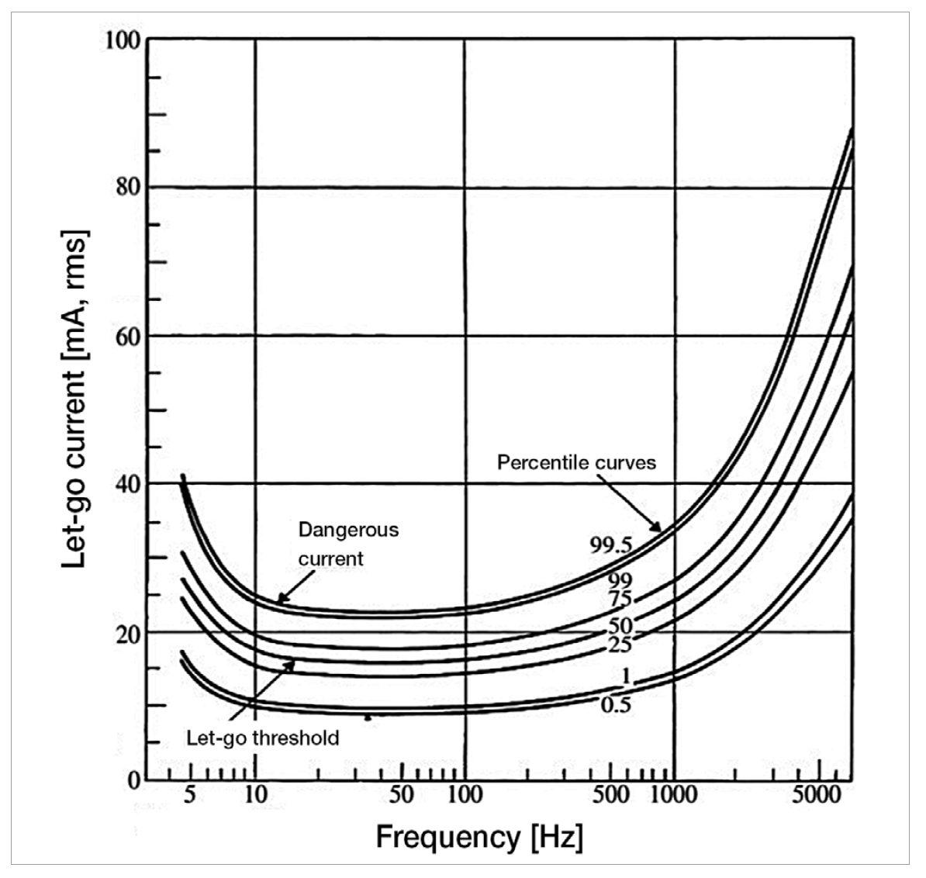
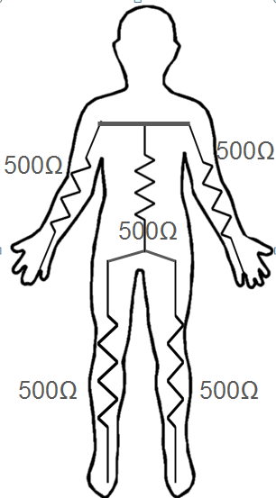
15
The average resistance of the human body can be ~ 1 - 2 kΩ
There is no physiological difference between “Let-go” currents at commercial frequencies of 50 to 60Hz
The frequency response between 5 to 1000 Hz is relatively flat
As the current frequency increases, the body becomes less stimulated
(C.F. Dalziel, “Electrical Shock”, Advances in Biomedical Engineering, edited by J. H. U. Brown and J. F. Dickson III, 1973, 3, 223-248)

Slide 14
16
Microshock – current following directly through the heart (invasive)
Shock risk from:
  Intracardiac connections – pacemakers or saline catheters
Current (μA) | Physiological Effect
20 - 100 | Ventricular Fibrillation, death
http://www.ccanesthesiareview.com/QF/Electrical_Shock.pdf

Slide 15
Leakage Current
Background
17
“Current that is not functional”
  IEC 60601-1:2006
Unavoidable and as a result of capacitive and resistive dielectrics
Flowing from high to low potential ( to ground or across the body arm – to arm)
Non-hazardous if controlled through IEC 60601 design criteria
Potentially hazardous if outside the stated standard limits
Easily overlooked and subject to incorrect testing

Slide 16
Standards & Classifications
18
Standards & Classifications

Slide 17
Standards
Standards & Classifications
19
Tests
IEC 61010 - Safety requirements for electrical equipment for measurement, control, and laboratory use NOT MEDICAL EQUIPMENT
  The definition of a Medical device is: “any instrument, apparatus, implement, machine, appliance, implant, reagent for in vitro use, software, material or other similar, intended by the manufacturer to be used, alone or in combination, for human beings, for one or more of the specific medical purposes to diagnose, prevent, treat and alleviate illness/injury, and support life, ” (http://www.who.int/medical_devices/full_deffinition/en/)
IEC60601 (ES60601)
IEC62353
NFPA 99
IEC 61010 (UL 61010)

Slide 18
Local adaptations of “field” standards
Standards & Classifications
20
PM
IEC62353
VDE 0751 / 62353(Germany / Austria)
MDA DB 2006 (UK)
IPEM Report 97 (UK)
NFPA 99 (USA)
AS/NZ 3551 (Australia)
Malaysia MS 62353

Slide 19
Classifications IEC 60601-1
Standards & Classifications
21
Class I
Class I
Equipment protection against electric shock is achieved through means of connecting exposed conductive parts to the protective earth in the fixed wiring of the installation or through the grounded power cord of portable equipment..

Slide 20
Classifications
Standards & Classifications
22
Class II
Class II
Also referred to as double insulated. Equipment protection against electric shock is achieved by additional protection to basic insulation through means of supplementary insulation, there being no provision for the connection of exposed metalwork of the equipment to a protective conductor and no reliance upon precautions to be taken in the fixed wiring of the installation.
Classifications are not to be confused with FDA equipment classifications.

Slide 21


ME Class (input protection) IEC 60601-1
Standards & Classifications
23
ME class 1 (Protection relying on fault currents to ground (earth)
ME class 2 (Double Insulated, protection relying on additional insulation)

Slide 22






ME Type (output protection)
Standards & Classifications
24
Type B (body)- Non-invasive. Earth Referenced
Type BF – Non Invasive. Patient Circuit Floating type.
Type CF – Cardiac. Patient Circuit Floating type.

Slide 23
Examples of Applied Parts – Patient Touch Points – Patient Leads
Standards & Classifications
25
ECG module (CF)
  Patient connections are the leads 3-10
Defib paddle module (BF)
  Patient connections are the paddles
SPO2 (BF)
Infusion Device (CF)
Hospital Bed (B)

Slide 24
IEC 60601-1
Standards & Classifications
26
Design and Type-Test standard (Mandatory)
Electrical and Mechanical Safety and Compliance of Medical Electronic Equipment
Ensure Safety of Patient / User and Environment
First published in 1976/77

Slide 25
Single fault conditions in 60601
Standards & Classifications
27
Open earth
Open neutral
Mains on applied parts
  Applied parts = patient connections
Mains on signal input / signal output

Slide 26
Applied Part testing in 60601
Standards & Classifications
28
Applied Part - Part of Medical Electrical Equipment that in normal use necessarily comes into physical contact with the patient
All tested to ground individually
All tested lead-to-lead individually
Under normal and single fault conditions

Slide 27
62353
Standards & Classifications
29
IEC standard for field testing
  Direct
  Alternative
  Differential
Not a 60601 replacement, but a test protocol for field located equipment. (Already qualified to 60601 and now tested to 62353)
It seeks to provide a uniform and unambiguous means of assessing the safety of medical equipment, while maintaining the relation to IEC 60601-1

Slide 28
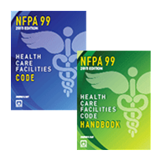

NFPA99
Standards & Classifications
30
NFPA99-2018 is the latest
Common in US hospitals
Dictated by law in many states

Slide 29

Classifications of Areas
Standards & Classifications
31
NFPA 99 requires a healthcare facility’s governing body to designate patient care rooms within the facility
NFPA 1.3.4.1
It will develop medical device risk-assessment maintenance criteria

Slide 30
Classifications of Areas
Standards & Classifications
32
NFPA 99 requires a healthcare facility’s governing body to designate patient care rooms within the facility
NFPA 1.3.4.1
It will develop medical device risk-assessment maintenance criteria

Slide 31
Category 1
Standards & Classifications
33
NFPA 99
A room in which the failure of equipment or a system is likely to cause major injury or death of patients or caregivers.
  ICU
  CCU
  Cath Labs
  OR
  ER

Slide 32
Category 2
Standards & Classifications
34
NFPA 99
A room in which failure of equipment or a system is likely to cause minor injury to patients or caregivers.
  Inpatient bedrooms
  Dialysis Rooms
  Procedural Rooms

Slide 33
Category 3
Standards & Classifications
35
NFPA 99
A room in which failure of equipment or a system is NOT likely to cause injury to patients or caregivers.
  Exam Rooms
  Dental Office

Slide 34
Category 4
Standards & Classifications
36
NFPA 99
A room in which failure of equipment or a system is not likely to have a physical impact on patients or caregivers.
  Labs
  Waiting Rooms
  Morgues

Slide 35
Classification
Standards & Classifications
37
NFPA 99
Class II - Double insulated appliances shall be permitted to have 2 conductor cords and shall be rated as Class II devices
Class II equipment is permitted to have two prong cords in the patient care vicinity

Slide 36
Fixed Equipment
Standards & Classifications
38
NFPA 99
It is equipment permanently wired to a certain location.
  In patient care vicinity should tested before installation.
  The leakage current should not exceed 10mA

Slide 37

Portable Medical Equipment
Standards & Classifications
39
Portable electrically powered equipment that can be moved from location to location if necessary.

Slide 38
Testing & Considerations
40
Testing &
considerations

Slide 39
Ground Resistance
Testing & Considerations
41
Portable Equipment
The power cord ground resistance is measured by connecting one lead of the plug grounding pin and the other to an exposed conductive surface
Grounding pin on the equipment is the preferred measuring point

Slide 40
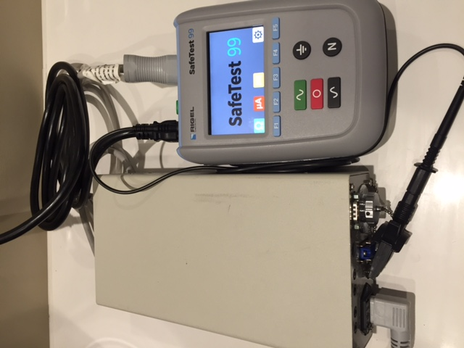
Ground Resistance
Testing & Considerations
42
Set up

Slide 41
NFPA99
Testing & Considerations
43
10.3.2* Resistance.
10.3.2.1 For appliances that are used in the patient care vicinity, the resistance between the appliance chassis, or any exposed conductive surface of the appliance, and the ground pin of the attachment plug shall be less than 0.50 ohm under the following conditions:
  (1) The cord shall be flexed at its connection to the attachment plug or connector.
  (2) The cord shall be flexed at its connection to the strain relief on the chassis.
10.3.2.2 The requirement of 10.3.2.1 shall not apply to accessible metal parts that achieve separation from main parts by double insulation or metallic screening or that are unlikely to become energized (e.g., escutcheons or nameplates, small screws).

Slide 42
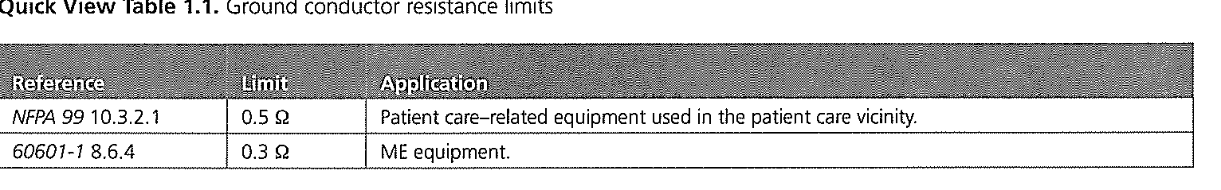
Quick view table
Testing & Considerations
44
Ground resistance
Zero readings are suspect.

Slide 43
Touch Current or Leakage Current
Testing & Considerations
45
Portable Equipment
New term for “leakage current” is “touch current”.
Reason? To remain consistent with International Standards (IEC).

Slide 44
Touch Current
Testing & Considerations
46
Portable Equipment
It is current flowing from the enclosure that is accessible to the operator or patient.
Must be tested with a Safety Analyzer from a conductive surface to the ground
Typically by connecting the meter to the ground of an electrical receptacle in good conditions

Slide 45
Touch Current
Testing & Considerations
47
Portable Equipment
Measurements are made under four conditions
  Ground closed and power off
  Ground closed and power on
  Ground open and power off
  Ground open and power on

Slide 46
NFPA99
Testing & Considerations
48
10.3.4 Leakage Current — Fixed Equipment.
10.3.4.1 Permanently wired appliances in the patient care vicinity shall be tested prior to installation while the equipment is temporarily insulated from ground.
10.3.4.2 The leakage current flowing through the ground conductor of the power supply connection to ground of permanently wired appliances installed in general or critical care areas shall not exceed 10.0 mA(ac or dc) with all grounds lifted.
10.3.5 Touch Current — Portable Equipment.
10.3.5.1* Touch Current Limits. The touch current for cord connected equipment shall not exceed 100 μA with the ground wire intact (if a ground wire is provided) with normal polarity and shall not exceed 500 μA with the ground wire disconnected.

Slide 47
NFPA99
Testing & Considerations
49
10.3.5.4 Touch Leakage Test Procedure. Measurements shall be made using the circuit, as illustrated in Figure 10.3.5.4, with the appliance ground broken in two modes of appliance operation as follows:
  (1) Power plug connected normally with the appliance on
  (2) Power plug connected normally with the appliance off (if equipped with an on/off switch)
10.3.5.4.2 Test shall be made with Switch A in Figure 10.3.5.4 closed.
10.3.6* Lead Leakage Current Tests and Limits — Portable
Equipment.
10.3.6.1 The leakage current between all patient leads connected together and ground shall be measured with the power plug connected normally and the device on.
10.3.6.2 An acceptable test configuration shall be as illustrated in Figure 10.3.5.4.
10.3.6.3 The leakage current shall not exceed 100 μA for ground wire closed and 500 μA ac for ground wire open.

Slide 48
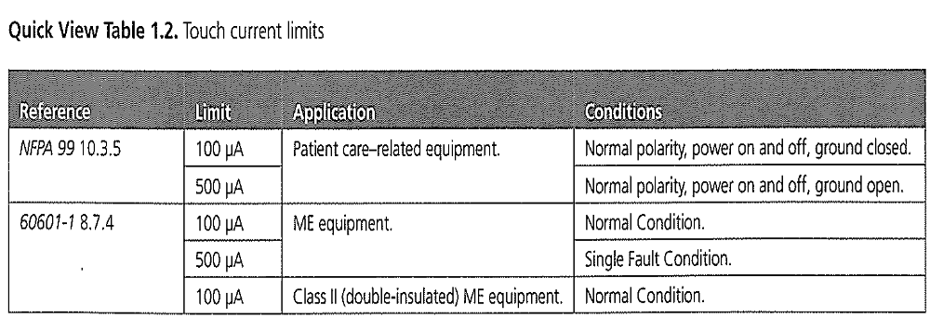
Quick view table
Testing & Considerations
50
Touch current
10.2.6* Touch Current — Portable Equipment. The touch current for cord connected
equipment shall not exceed 500 μA with normal polarity and the ground wire disconnected (if
a ground wire is provided).

Slide 49
Lead Leakage
Testing & Considerations
51
Portable Equipment
Lead leakage testing is conducted by connecting all patient leads together and measuring the current from that point to ground
  Ground closed and power on
  Ground open and power on

Slide 50
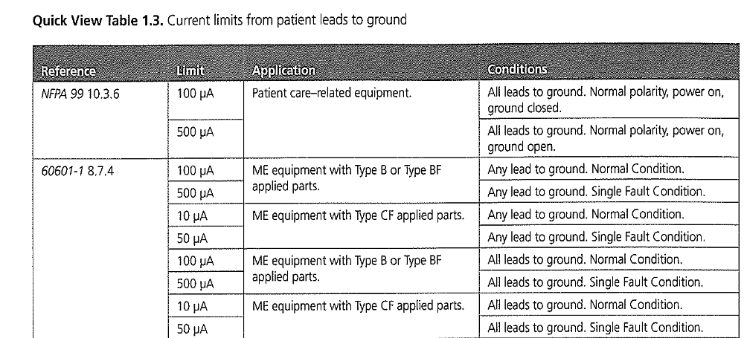
Quick view table
Testing & Considerations
52
Patient leads

Slide 51
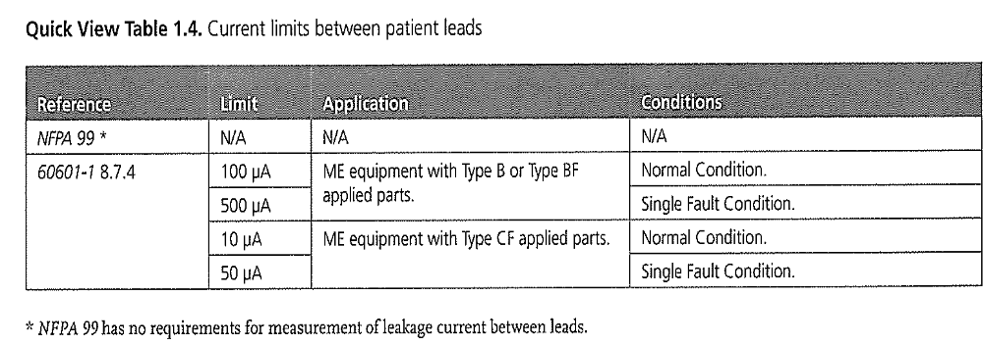
Quick view table
Testing & Considerations
53
Patient leads

Slide 52
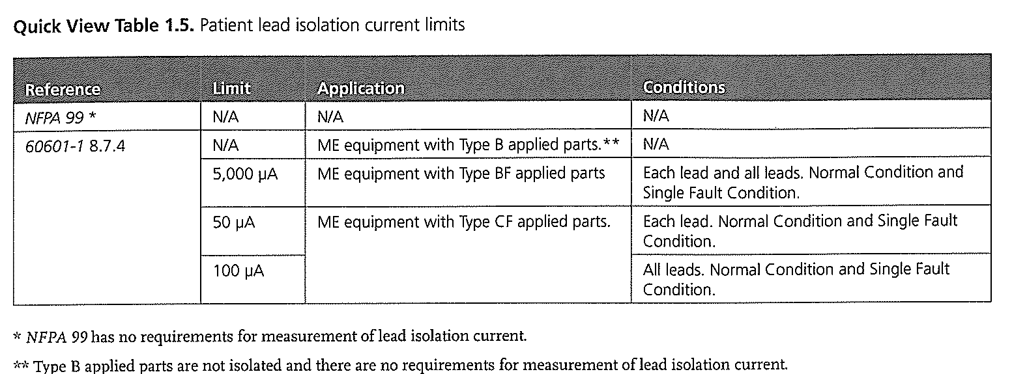
Quick view table
Testing & Considerations
54
Patient isolation

Slide 53
Class II
NFPA 99
Testing & Considerations
55
NFPA 99 no longer contains instructions for testing equipment with no exposed conductive surfaces
Ungrounded, plastic-encased devices intended for use in the patient vicinity
Should be visually inspected for damage and to verify that it is labeled as double insulated

Slide 54
Non-patient Care-related equipment
Testing & Considerations
56
NFPA 99
Non-patient Care-related equipment, facility or patient owned, shall be visually inspected by staff or “other personnel”
This is a new initiative, basically a common-sense approach. If it appears not to be safe or inoperable it shall be removed or reported

Slide 55
Visual Inspection
Testing & Considerations
57
Housing – Enclosure
  Including decontamination
Electrical Connections
  Secondary ground connections
Appropriate fuse rating
Safety markings and labelling
Integrity of mechanical parts
Latest operational hardware and software

Slide 56
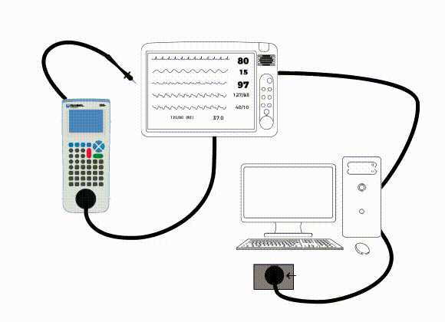
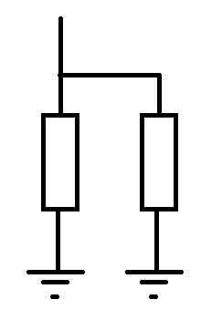

Secondary ground
58
I_{L}
100 μA
MD
1 Ω Alternative Earth Path via data lead to PC
2nd Earth
1 Ω
1 kΩ
99.9 μA
0.1 μA

Slide 57
Power cord
Testing & Considerations
59
Inspecting the power cord
Look for broken or bent pins
Look for discolored pins – may indicate loose connections
Look for physical damage to the strain relief

Slide 58
Power cord
Testing & Considerations
60
Color codes
US
Hot – Black
Neutral - White
Ground - Green
International
Hot – Brown
Neutral – Blue
Ground – Green or Green with yellow strip
IPS
Hot – Brown
Neutral – Orange
Ground - Green

Slide 59
Test Process
Testing & Considerations
61
Manufacturer’s recommendations
NFPA 2012 PAGE 383 – Para 10.5.2.1.2
  Removed the previously required 12 and 6 month testing intervals. Now, testing is required before being put into service for the first time and following any repair or modification that might compromise electrical safety.

Slide 60
DATA
Testing & Considerations
62
Paper based or Electronic?
Structured
Protocols
Comparing data
Trends
Scheduling
Traceability

Slide 61
Summary & Closing Comments
63
Summary & Closing Comments

Slide 62

Recommended Reading
NFPA 99 2015
Summary & Closing Comments
64
https://catalog.nfpa.org/NFPA-99-Health-Care-Facilities-Code-P1134.aspx?order_src=C900&gclid=EAIaIQobChMIuZSh5pb02gIV2JkbCh0bQw9OEAAYASAAEgLUYvD_BwE

Slide 63
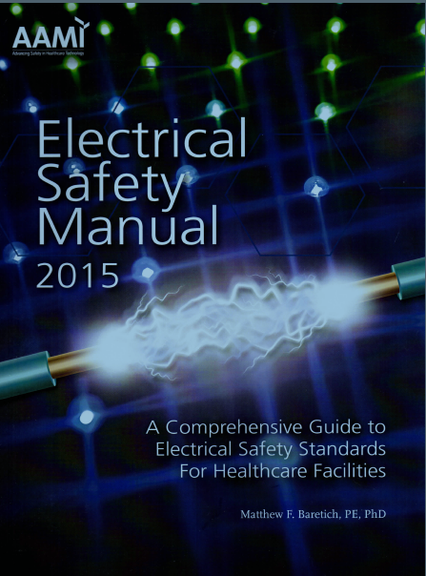
Recommended Reading
Summary & Closing Comments
65
http://www.aami.org/productspublications/ProductDetail.aspx?ItemNumber=2404
Sponsored by Rigel Medical

Slide 64
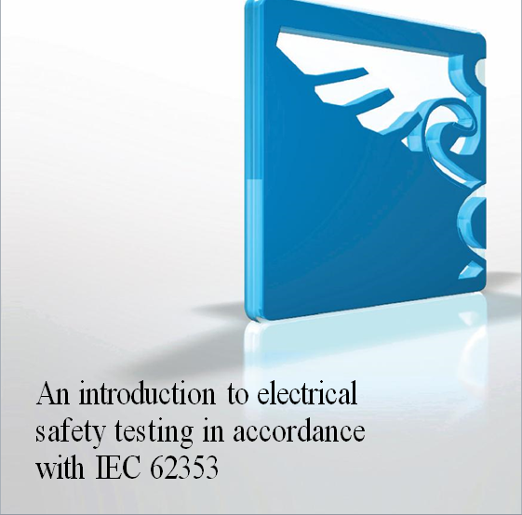
Recommended Reading
Guide to 62353
Summary & Closing Comments
66
Request your free guide. Ask for a hard copy or download.
  813-886-2775
  sales@seaward-groupusa.com

Slide 65
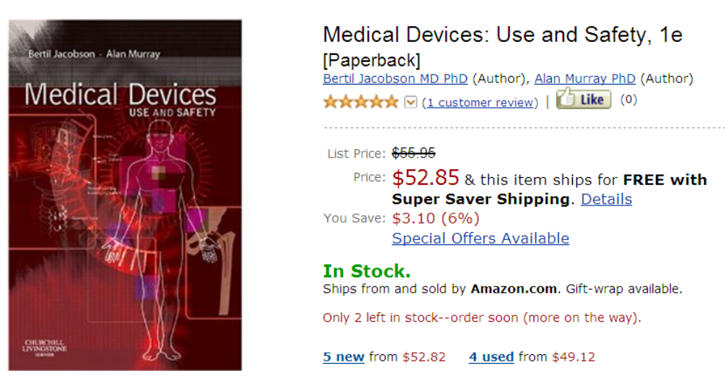
Recommended reading
Summary & Closing Comments
67

Slide 66
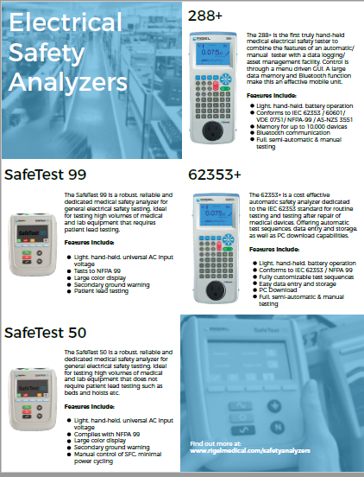

Summary & Closing Comments
68
Q&A
63
Brittany Schmidke
863-370-8774
brittanys@seaward-groupusa.com
Amber Spangenburg
813-335-3345
ambers@seaward-groupusa.com
Jack Barrett
860-729-9972
jackb@seaward-groupua.com

