Slide 1
Building a Health Technology Security management plan for a health system
Inhel Rekik, MS, CISM
Director of Health Technology Security

Slide 2
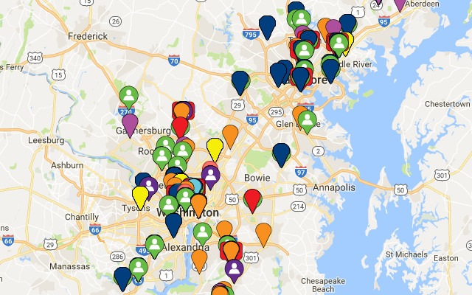
To be the trusted leader in caring for people and advancing health
1999 MedStar Health is established as the new name for the largest not-for-profit health care system in the mid-Atlantic region
30,000 associates and 6,000 affiliated physicians
10 hospitals
MedStar Health care for more than half-million patients each year across Maryland and the Washington, D.C., region in our hospitals, urgent care and ambulatory care facilities, and physician offices

Slide 3
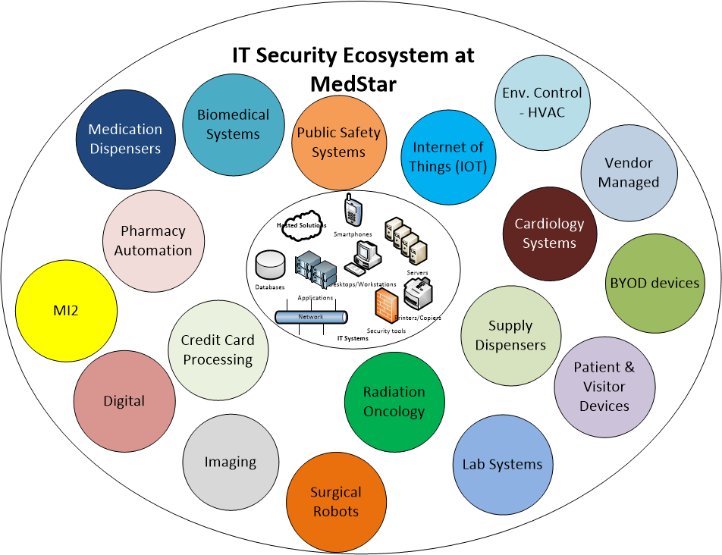
Health Technology Security landscape
Notes:
77k active devices Over 25 000 network connected medical devices with limited visibility into their network attributes and behavior
Managed by multiple departments, CE, lab, pharmacy, app teams, outsourced IT operations partner, outsources facilities partner, AND vendors
Roles and responsibilities are not clearly
Devices are not routinely updates with security updates
Several gaps in processes and procedures for managing security risk of medical devices

Slide 4
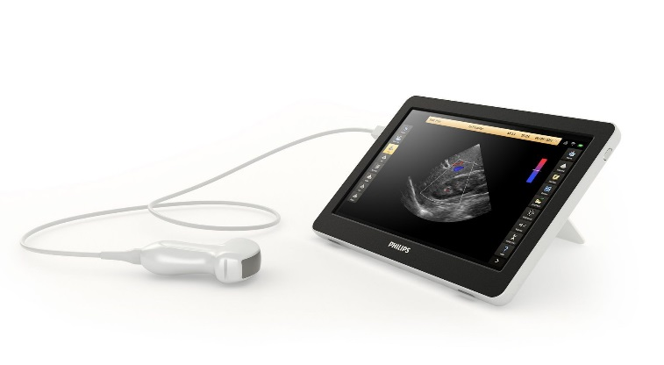
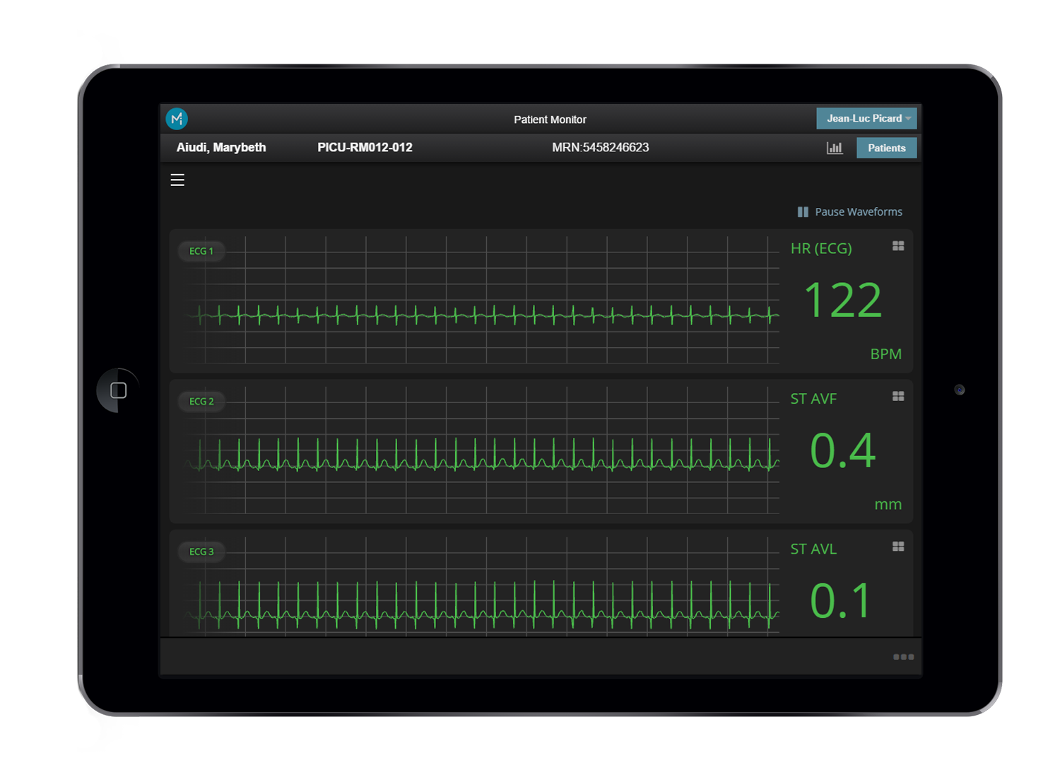
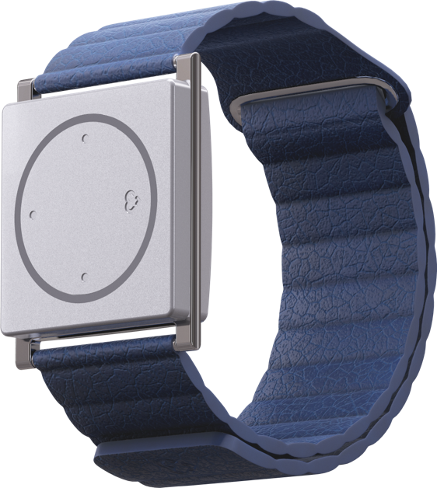
Emergent Technologies
Cloud computing
Mobile Technology
BYOD
PGHD
AI

Slide 5
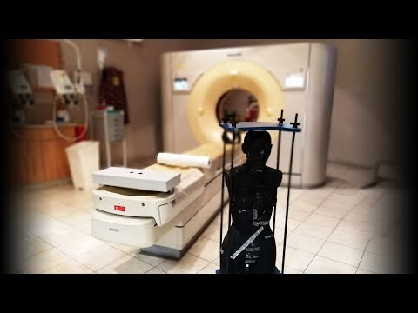
Emergent threats
URGENT/11
Dejablue and Bluekeep
https://www.youtube.com/watch?v=_mkRAArj-x0
Exploit DICOM Flaw to embed malware into DICOM images
Notes:
List of MDM advisories
Delay in releasing patches

Slide 6

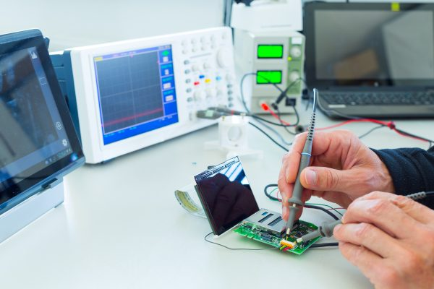
What CE thinks we do?
What we think CE does?
Notes:
Tell the story of CE basement in Saint Mary

Slide 7
Building a Health Technology Security management plan for a health system
Main security issues in medical devices
Vision of the Health Technology Security program
Roles and responsibilities as it pertains to health technology security
Building security into the lifecycle of health technology
Operationalizing your passive network monitoring tool
Future strategies

Slide 8
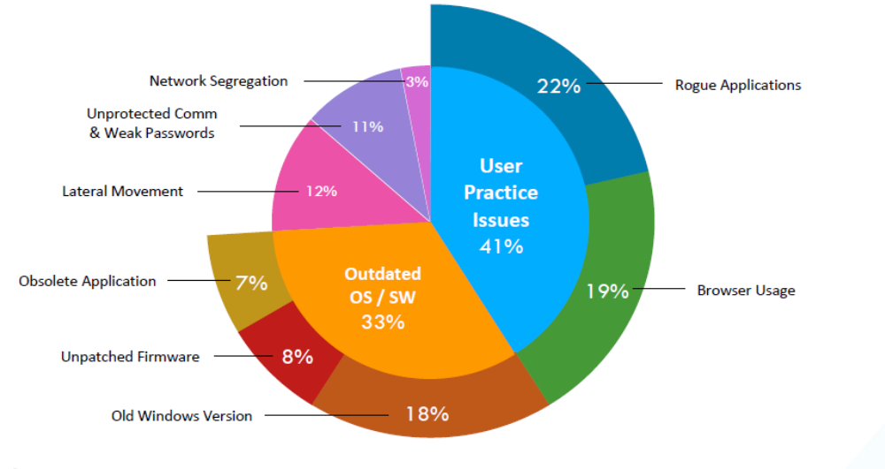
What are the main security issues?
Practical guide for medical device security by Xu Zou from Zingbox

Slide 9
Vulnerable medical devices
Widely publicized:
  infusion pumps – URGENT/11
  Implantable devices – defibrillators, pacemakers
  CT/MRI scanners
  Industrial Control Systems – HVAC, refrigeration
Prioritized differently (risk based):
  Internet accessible devices
  Outdated OS
  Misconfigured devices
Notes:
So what are some of the types of medical devices we know to be vulnerable?
Some of the widely publicized devices are:
But how easy are these devices to exploit? In many cases, the likelihood is very low.
So I would propose not prioritizing specific device types, but rather focus on devices that meet the following criteria:
What do I mean by misconfigured devices? Devices that have vulnerable services, protocols, or ports enabled.
____________________________________
infusion pumps – remotely change the amt of drug delivered, don’t encrypt, don’t authenticate
Implantables –Use Bluetooth, Allow default or weak passwords
CT/MRI scanners – remotely change configuration files to alter radiation settings
Environmental control systems – ventilation, temperature, humidity, medical refrigerators

Slide 10
Justifications for Health Technology Security Program
Need a team of security professionals within IS security:
  Has a working knowledge of medical devices
  Understand clinical workflow
  Has experience working closely with clinicians and a variety of stakeholders

Slide 11




Vision for Health Technology Security Program
Engage all your stakeholders
to stay ahead of the game
CULTURE
Educate, train, and spread awareness
OBTAIN EXECUTIVE LEADERSHIP SUPPORT AND RESOURCES
to drive security
TRANSFORM YOUR PROCESSES
through platforms that provide insight
Create ownership and accountability. Identify roles and responsibilities. Collaborate with Internal or external audit
Help care teams and patients understand the risks of connected clinical technologies.
Build a skilled workforce, deploy intelligent technology solutions, and $$$
Incorporate security into health technology lifecycle management

Slide 12
Key performance indicators
How can you measure the success of the Health Technology Security Program?
# service contracts equipped with security addendum
# security review done at the model level of health technology
# Critical & high findings mitigated (ICS-Cert, Zingbox alerts, scanning results)
# Security incident investigated
Notes:
Input from the audience about key performance indicators
How about these department how can we measure their success
Is your HTM engaged and to they have their key performance indication defined to asses their medical device security maturity level
# of unique medical device models connected to the network directly or indirectly
#devices connected to the network that have OS, Software and network information documented
#% of connected medical devices (systems) that are patched with schedule

Slide 13
Roles: Information Security / Health Technology Security
Partner with stakeholders to develop an organizational security plan
Develop and maintain security plan to align with business needs
Develop, implement and enforce organizational processes and policies
Identify security requirements
Develop and deliver security awareness and training based on roles
Works with IT teams to resolve security vulnerabilities and incidents
Provide input to legal on contractual security language for service and device contracts
Report on security posture to organizational leadership

Slide 14
Roles: Clinical Engineering / Health Technology Management / Biomed
Partners with stakeholders to develop an organizational security plan
Maintain an accurate inventory (Network attributes, OS, SW, PHI)
Participate in developing risk mitigation strategies to insure operational workflow is not impacted
Document patch management processes
Remediate vulnerabilities
Participate in incident response
Participate in security training and tabletop exercises
Work with vendors to enhance security posture

Slide 15







Build internal and external collaboration
Internal education and awareness
General education sessions
Pull in support functions when you are not in crisis mode – HTM, legal, supply chain, compliance, etc
Build relationships with peers, MDM, and other stakeholders.
FDA
US DHS & Other
Reg. Agencies
MDMs; other vendors
Federally Funded R&D Centers
Hospital IS & HTM; ISOs
Security Researchers
Collaboration is Key

Slide 16
Medical device incident response preparedness
Tabletop exercises with health technology stakeholders.
Mutual agreement aid with other health systems in the area.
Medical Device Cybersecurity. Regional Incident Preparedness and Response Playbook
Notes:
As part of MITRE
Device maintenance parameters (e.g., no longer supported by the manufacturer; internally maintained by (contract information of the department); or maintenance outsourced and provided by Y entity with these SLA parameters.
WE went through ransomeware scenarios

Slide 17
Build security into the lifecycle of health technology
Incorporate security into the procurement process
  Cybersecurity documentation (MDS2, AV, encryption, patch management,
  Who will maintain the OS?
  Add security addendum to contract to SLA or MSA
Inventory standard/ procedure/ policy
  Obtain and document network information (IP, MAC address, hostname), wireless/LAN; OS; SW; ePHI
  Device maintenance parameters (no longer supported, maintained through contract, or maintenance outsources by Y)
  Patch strategy documented
  Security requirement and compensating controls issued by IS Security

Slide 18
Build security into the lifecycle of health technology
Vulnerability management :
  ICS-CERT
  MDSISC
  DHS and FDA coordinated vulnerability disclosure
List of MDM security websites
Apply patches:
  Regular security updates
  Microsoft wormable vulnerabilities
  Submit exception request for compensating controls until a fix is available

Slide 19
Build security into the lifecycle of health technology
Mitigating your passive network monitoring alerts
Restrict internet access on your medical devices
Change default credentials
Out of support devices
  Replace
  Submit an exception request
  Make sure that they are properly isolated on your network

Slide 20
Build security into the lifecycle of health technology
Preventive maintenance procedure (periodic review of security control on the device)
  Default passwords
  AV updates, encryption
  Last patch update/do we need to update?
  Document the validated controls in the preventive maintenance action plan

Slide 21
Build security into the lifecycle of health technology
Medical device scanning
  Discovery scans to help identify assets
  Ongoing passive vulnerability scans
  Custom scans of new devices prior to deployment
  Custom scans of devices displaying “abnormal” behavior
Notes:
Discovery scans – build accurate inventory
Passive scanners – non-invasive; identify the active operating systems, applications and ports throughout a network, monitoring activity to determine the network's vulnerabilities
Active scanning – risk of knocking over device, downtime, impact to patient care; important to only perform on test devices’ helps identify known exploits
Passive = susceptible to exploit
Active = known/confirmed exploits
For IR – targeted scans

Slide 22
Operationalizing you passive network monitoring tools
Selection criteria’s
Deployment
Alert mitigation
How to leverage the tool
Lessons learned

Slide 23
Selection criteria
How established the company is and what are their customers?
Systems the solution can integrate with:
  NAC, Cisco Prime, CISCO WLAN
  SIEM, SOC
  Vulnerability scanners
Can the system do vulnerability scanning?
Notes:
The selling experience makes a big difference

Slide 24
Deployment
Customize the solution to your needs:
  Have the needed collaboration in place (IS Security, Enterprise Architecture, Lab, Pharmacy)
  Take a risk based/staged approach: medical devices and medical IoT then expand to other IoT
  Validate that you are capturing all the traffic you need
  Integration with CISCO prime and CISCO WLAN
  Integration with IS security incident response
  Establish a scope of work and workflow
Notes:
Who will be monitoring the alerts (Clinical Engineering, IS Security)
Workflow (SOM ticket, clinical engineering workorder?)

Slide 25
Alert and vulnerability mitigation
Critical alerts going to SOC
IS Security investigates Critical and High severity alerts
Perform vulnerability scanning to confirm vulnerabilities devices prior to mitigation
Notes:
Medium: inbound remote desktop connection
Insecure HTTP connection to the internet

Slide 26
VLANS for IoT devices
VLANs w/ mix of Medical & Non-Medical IoTs
100% of pie chart represents VLANs with any IoT devices by May Wang from Zingbox

Slide 27
Lessons learned
Plan for any integration you need upfront
Layer 2 versus Layer 3 deployment strategy identified as early as possible
Budget for TAP devices
Budget for help with operationalizing the tool

Slide 28
Future strategies
Integration of Zingbox with our SIEM
Replace the current CMMS system
Develop a security program for (IoT) and Industrial Control Systems (ICS)

