Slide 1


Your AEM Program: Patient Safety,
Standards Compliance, and Less PM!
Matt Baretich
Baretich Engineering, Inc.
Fort Collins, Colorado

Slide 2
What is an AEM program?
CMS: Alternate Equipment Management
TJC: Alternative Equipment Maintenance
CMS premise: Manufacturer knows best
CMS & TJC communication: Inconsistent

Slide 3


Slide 4
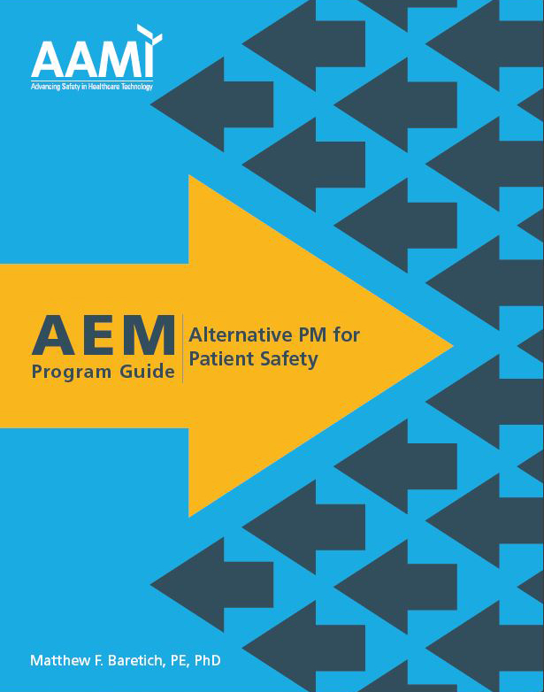

Slide 5
Why implement an AEM program?
Reduce PM cost,
consistent with the following criteria
Equipment safety equivalent to
manufacturer recommendations
Compliance with CMS and TJC requirements

Slide 6
Definitions

Slide 7
Definitions
PM = Planned Maintenance
PM Activity = What we do
PM Frequency = When we do it

Slide 8
Definitions
PM (Planned Maintenance) includes:
Device Restoration PM
Safety Verification PM

Slide 9
Definitions
Device Restoration PM
Intended to reduce the likelihood of failure
Genuine preventive maintenance

Slide 10
Safety Verification PM examples
Personal: blood pressure check, colonoscopy
Personal vehicle: check oil level, check tire pressure
Diesel motor-generator: test oil, monthly load test
Medical equipment ...

Slide 11
Definitions
PM Procedure = A set of PM
activities and PM frequencies
PM^{OEM} = PM that follows the procedure
recommended by the manufacturer
PM^{AEM} = PM that follows an AEM procedure

Slide 12
PM procedure for the Acme 123 (Step 1)
PM^{OEM} – Replace the beaucoup-bucks
widget every 24 months
PM^{AEM} – Take a look at the widget every
24 months and replace it only if it’s bad

Slide 13
PM procedure for the Acme 123 (Step 2)
PM^{OEM} – Verify the flow rate every 12 months
PM^{AEM} – Verify the flow rate every 18 months

Slide 14
PM procedure for the Acme 123 (Step 3)
PM^{OEM} – Give 3 cheers to the
manufacturer every 12 months
PM^{AEM} – Don’t bother

Slide 15
The Rules

Slide 16
Table 1. HAP EC.02.04.01 EP4
The hospital identifies the activities and associated frequencies, in writing, for maintaining, inspecting,
and testing all medical equipment on the inventory.
These activities and associated frequencies are in
accordance with manufacturers’ recommendations
or with strategies of an AEM program.

Slide 17
Table 1. HAP EC.02.04.01 EP4
Note 1: The strategies of an AEM program must not reduce the safety of equipment and must be based on accepted standards of practice, such as the ANSI/AAMI handbook ANSI/AAMI EQ56:2013, Recommended practice for a medical equipment management program.

Slide 18
Table 1. HAP EC.02.04.01 EP4
Note 2: Medical equipment with activities
and associated frequencies in accordance
with manufacturers’ recommendations
must have a 100% completion rate.

Slide 19
Table 1. HAP EC.02.04.01 EP4
Note 3: Scheduled maintenance activities for both
high-risk and non-high-risk medical equipment in an
alternative equipment maintenance (AEM) program
inventory must have a 100% completion rate. AEM
frequency is determined by the hospital’s AEM program.

Slide 20
Requirements for
On-Schedule PM Completion
On-Schedule PM Completion of Scheduled Maintenance
 | PM^{OEM} | PM^{AEM}
High-Risk | 100% | 100%
Non-High-Risk | 100% | 100%

Slide 21

Sidebar:
On-Schedule PM Completion

Slide 22
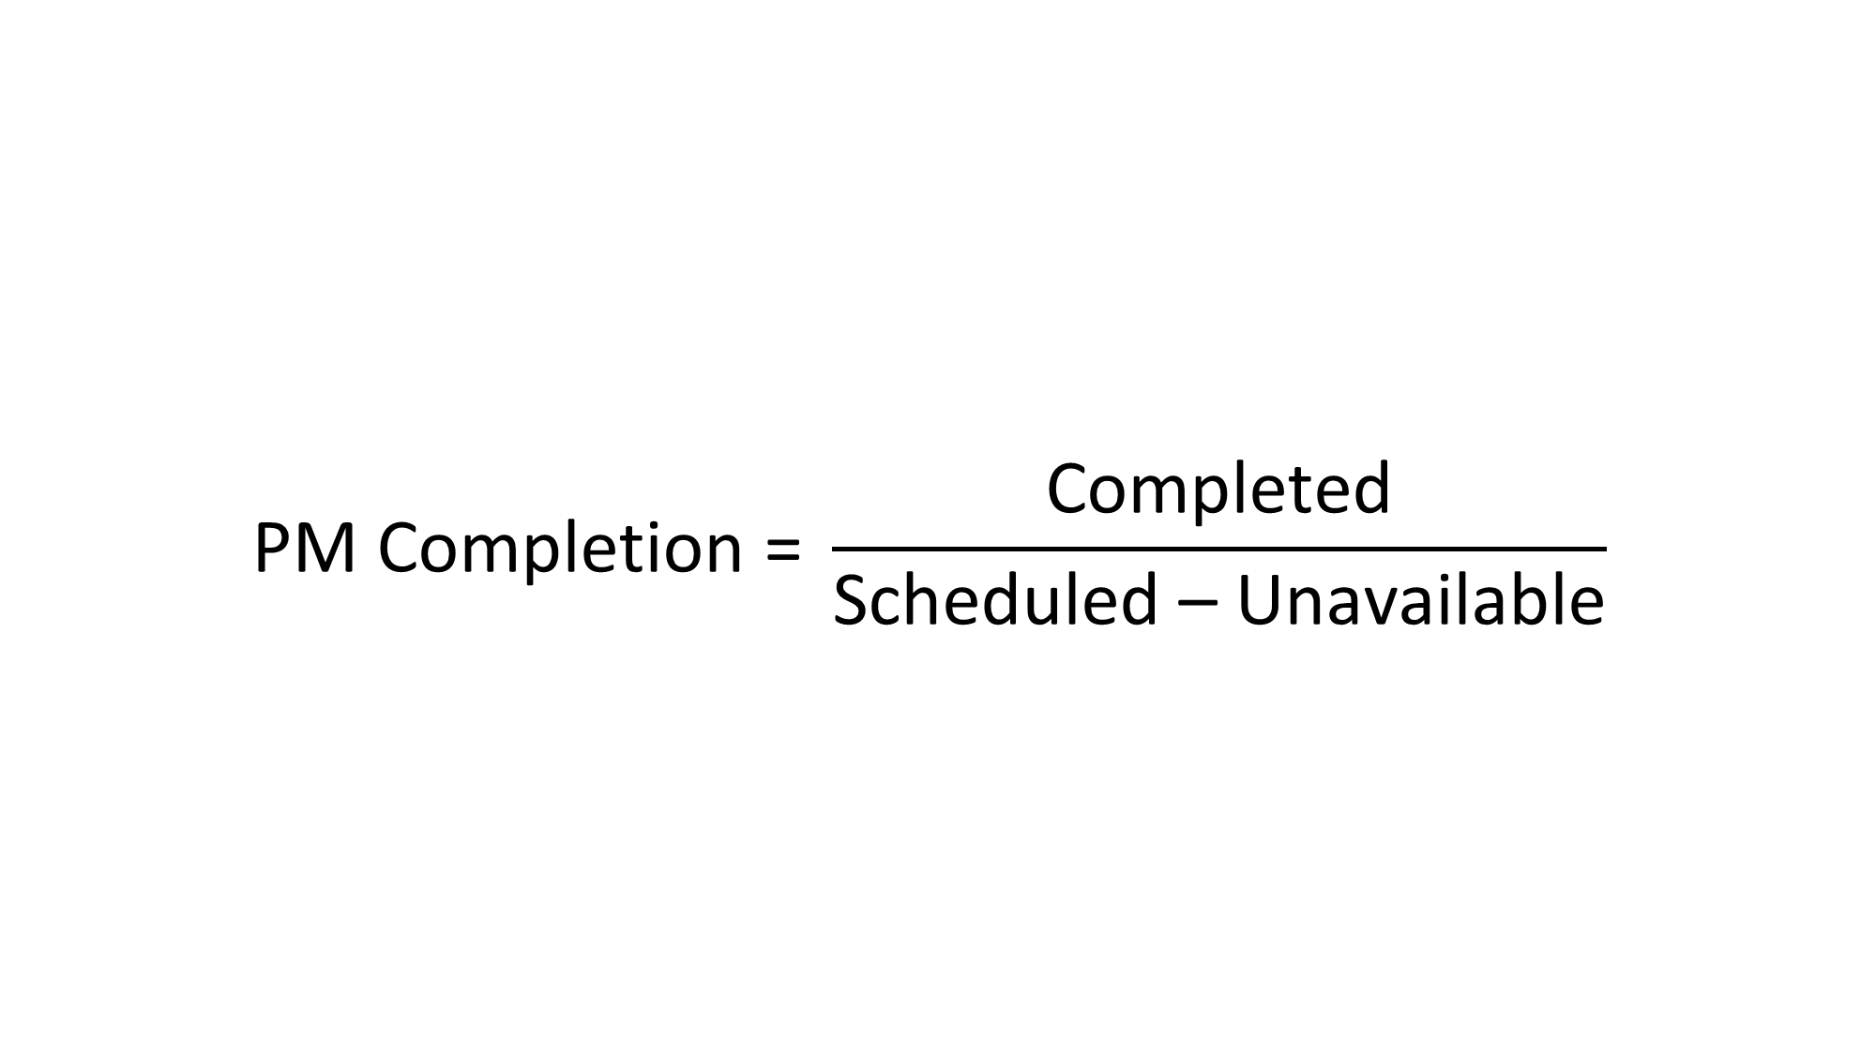
  $$\text{PM} \text{Completion} \text{=} \frac{\text{Completed}}{\text{Scheduled}\text{ – }\text{Unavailable}}$$

Slide 23
Getting to 100%
  Document legitimate unavailability: cannot locate, in use, etc.
  Only medical equipment: diagnosis, treatment, monitoring
  AEM program to take some off PM schedule
  Wide completion window*

Slide 24
PM completion window TJC standardization MAYBE
  Scheduled maintenance interval greater than 6 months: scheduled month ± 30 days.
  Scheduled maintenance interval of 3 to 6 months:
  scheduled month ± 20 days
  Scheduled maintenance interval of 1 or 2 months:
  scheduled month.

Slide 25
Taboo List

Slide 26
Table 2. HAP EC.02.04.01 EP5
The hospital’s activities and frequencies for inspecting,
testing, and maintaining the following items must be
in accordance with manufacturers’ recommendations:

Slide 27

Table 2. HAP EC.02.04.01 EP5
Equipment subject to federal or state law or
Medicare conditions of participation in which
inspecting, testing, and maintaining must be in
accordance with the manufacturers’
recommendations, or otherwise establishes
more stringent maintenance requirements

Slide 28
Table 2. HAP EC.02.04.01 EP5
Medical laser devices

Slide 29
Table 2. HAP EC.02.04.01 EP5
Imaging and radiologic equipment (whether
used for diagnostic or therapeutic purposes)

Slide 30
Table 2. HAP EC.02.04.01 EP5
New medical equipment with
insufficient maintenance history to
support the use of AEM strategies

Slide 31
How to decide what to include

Slide 32
Table 3. HAP EC.02.04.01 EP6
A qualified individual(s) uses written criteria to support the determination whether it is safe to permit medical equipment to be maintained in an alternate manner that includes the following:

Slide 33
Table 3. HAP EC.02.04.01 EP6
How the equipment is used, including
the seriousness and prevalence of harm
during normal use
Likely consequences of equipment failure
or malfunction, including seriousness of
and prevalence of harm

Slide 34
Sidebar: How to talk about risk

Slide 35
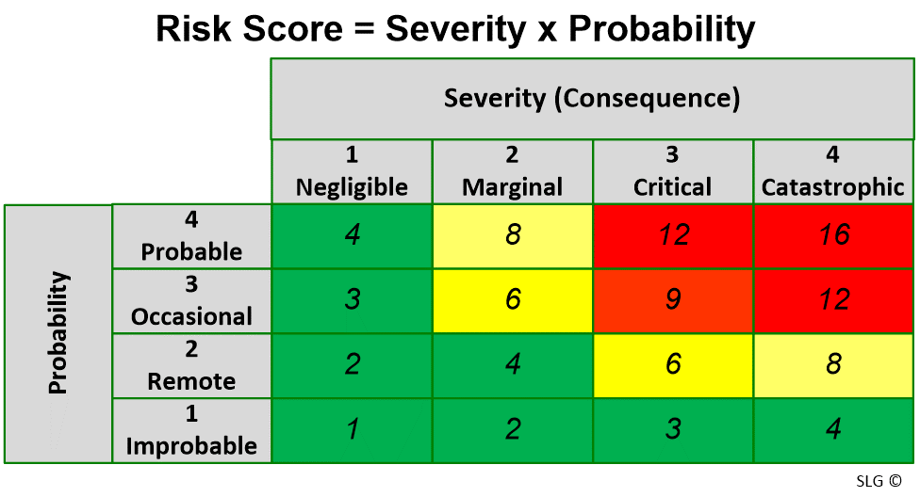
Risk = Severity x Probability

Slide 36
AEM-related risk assessments
Overall risk level of a device type:
Is this infusion pump a high-risk device?
Risk levels for failure modes (FMEA):
What is the risk of battery failure for this infusion pump?
Risk for PM^{AEM} procedures:
Is it safe to do flow-rate testing less often?

Slide 37
Process

Slide 38
Step 1: Select equipment for your AEM program
  Can you save PM time?
  Is it on your taboo list?
  What is the level of risk?

Slide 39
Step 2: Review the PM^{OEM}
  Are there PM activities that can be safely
  modified or eliminated?
  Are there PM frequencies that can be
  safely extended?
  Are there safe alternative PM strategies?

Slide 40
Step 3: Implement your PM^{AEM}
  Spell out the modified PM procedure
  Get the modified procedure approved
  Update your CMMS
  Communicate with front-line HTM personnel

Slide 41
Step 4: Monitor equipment safety
  Routinely monitor your equipment safety metric
  Periodically revisit your PM^{AEM} decisions
  Adjust the AEM program as needed

Slide 42
Sidebar:
How to measure “equipment
safety” for your PM program

Slide 43
Useful metrics
  Patient incidents
  Downtime:
  Hours per device per year
  Availability:
  Hours per device per year ÷ required service hours

Slide 44
Useful metrics
  Failure rate:
  Failures per device per year
  Mean time between failures (MTBF)

Slide 45

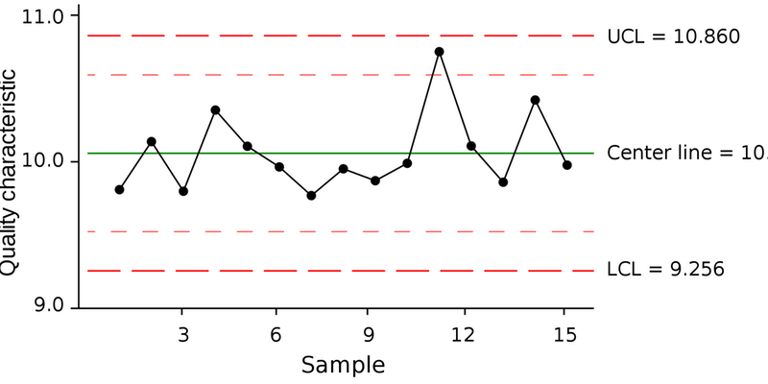
Nerd Tip: Statistical Process Control (SPC)

Slide 46
PM-related Failures
  Obvious failures: Recognizable by users; potentially preventable
  Example: Failure of infusion pump battery
  Example: Ventilator component wear-out
  Hidden failures: Not user-recognizable; patient care impact
  Example: Low defibrillator output
  Example: Occlusion pressure sensor failure

Slide 47
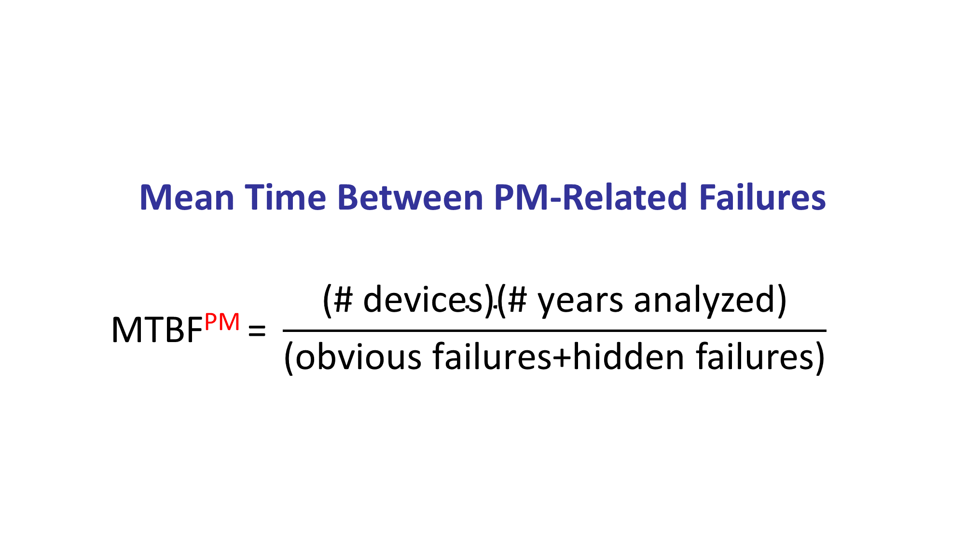
Mean Time Between PM-Related Failures
  $$\text{MTBF}\text{PM}\text{ = }{\frac{\text{(\# }\text{devices}\text{)(\# }\text{years} \text{analyzed}\text{)}}{\text{(}\text{obvious} \text{failures}\text{+}\text{hidden} \text{failures}\text{)}}}^{}$$

Slide 48
Quality assurance for the PM program
  Monitor MTBF^{PM} over time by device type
  Focus on high-risk device types
  Consider using SPC tools to identify problems
  Respond to identified problems
  Adjust AEM procedures as needed
  Periodically revisit AEM decision-making

Slide 49
Matthew F. Baretich, P.E., Ph.D.
Baretich Engineering, Inc.
P.O. Box 469
Fort Collins CO 80522-0469
970-493-8239
mfb@baretich.com
www.baretich.com

