Slide 1

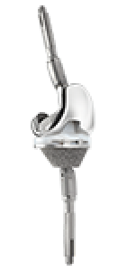
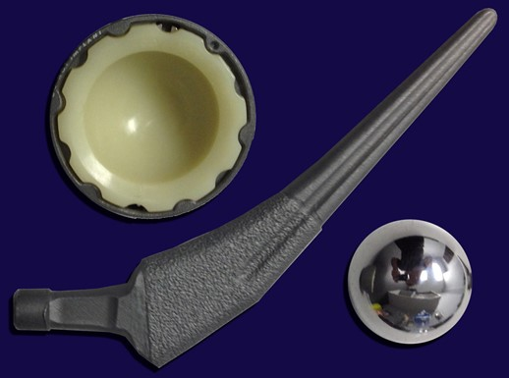
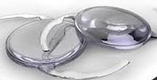

Proven Metrics for Optimizing Your Inventory and Supply Spend
April 2019

Slide 2




About VUEMED
VUEMED’s technologies address some of the most critical, costly, and challenging issues affecting the healthcare supply chain today
Cloud & SaaS & IoT
Hands-free RAIN RFID solution turns distribution, storage areas, cabinets, procedure rooms, and hallways into a fully RFID-controlled supply chain from manufacturer to the hospital patient, and reports live all inventory transactions with 99.5% accuracy – transaction-free.
Software/RFID printer solution that encodes and registers in the cloud RFID tags according to FDA UDI standards, using GS1 EPC Gen2 passive RFID global standards and recording all tag events using the VueTrack-RF infrastructure.
Hand-held RAIN RFID technology device powered by the VueTrack-Mobile App to manage consigned inventory, trunk stock, provide VMI services, etc. Ideal for physical inventory takes with a single scan. Provides detailed rep account data, analysis, and metrics.
Comprehensive yet flexible barcode scanning solution that manages products from their delivery to the point of care, while bridging the information gap at hospitals and delivering ROI > 5x1.

Slide 3

Core and Size of the Opportunity
The global medical device industry* is ~$500B/yr**, 40% in the U.S. alone.
U.S. hospital spending is about $1 trillion/yr***
Inventories are poorly managed and not tracked, costing $ billions in waste
Dollar share of products NOT tracked or accounted for by most hospitals*
Bloated inventory by >20%
Excess purchases by >15%
Waste levels >20%
Missed revenue from inaccurate billing >18%
* Includes stents, balloons, catheters, orthopedic devices, instruments, etc.
** Visiongain, Espicom Business Intelligence, Frost & Sullivan, SelectUSA.gov
*** CMS.gov
VUEMED, Inc. All rights reserved. 2019.
Notes:
3

Slide 4
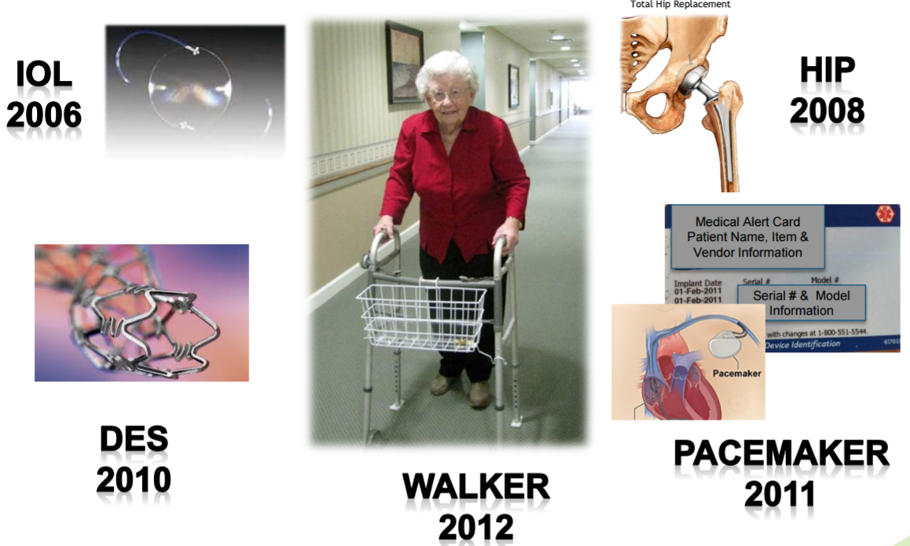
Patient Safety Impact
Patients’ Implantable Devices List
VUEMED, Inc. All rights reserved. 2019.

Slide 5
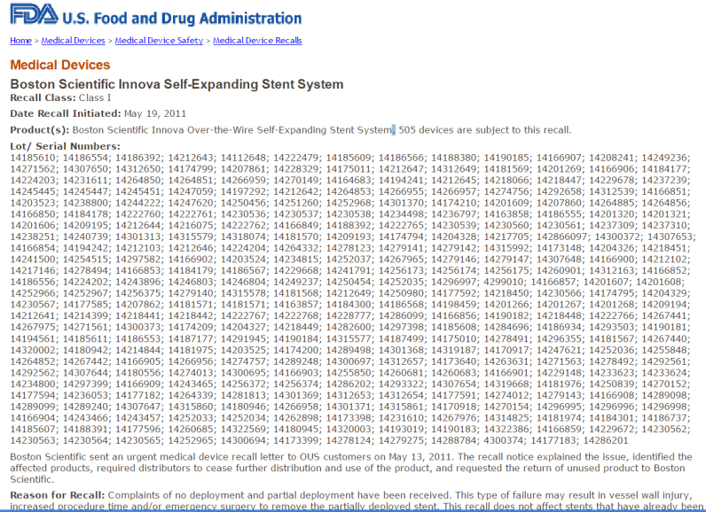
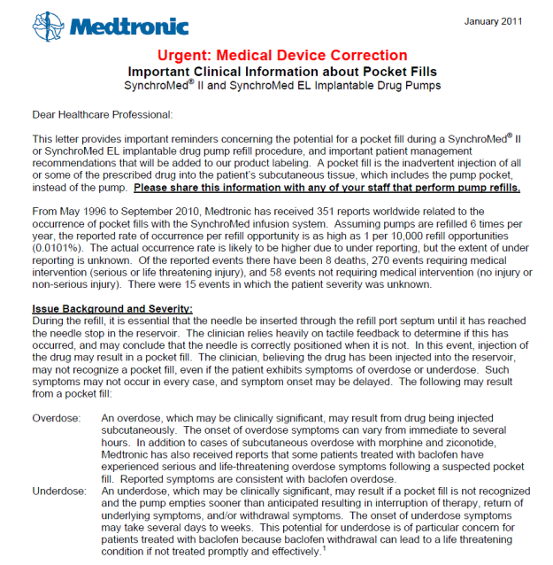
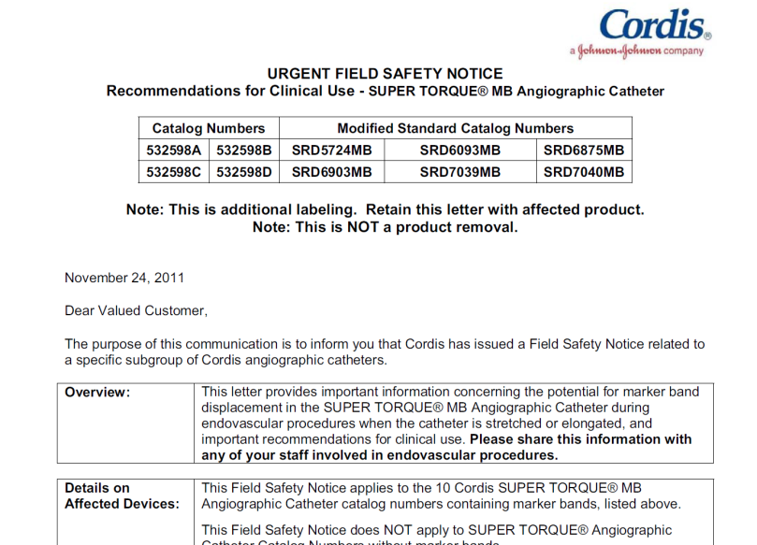
Medical Device Recalls
600 - 1,200 medical device recalls issued each year, affecting hundreds of millions of units
2-4% are Class I recalls – which pose a serious risk of injury or death* - meaning several million units need to be tracked down, removed from shelves and/or required clinical follow-up

Slide 6










The Vision
Transformation of the healthcare supply chain, from manufacturer
to patient, will provide better, safer and more affordable patient care
IoT
Data Analytics Data Access
Manufacturers
Warehouses
Distribution
Logistics
Hospital
Medical Devices
Storage Areas
Procedure Rooms
Patients
VUEMED, Inc. All rights reserved. 2019.

Slide 7
The Urgency
What is driving the current sense of urgency to adopt technology
to improve the healthcare supply chain?
Imperative cost reduction:
  Waste of time locating products and assets; waste through expirations
  Risk to the patient: stock-out, expired or recalled items, inaccurate medical records
  Efficiency: leaner, consolidated supplies; less time delivering better care
Market seeking to achieve 100% compliance, visibility, and trackability in supplies management, and scalability to assets/equipment and people
FDA’s Unique Device Identifier (UDI) by 2020
  Global impact: barcodes or RFID, EPC and GS1, HIBCC
Reimbursement environment changing:
  Shrinking reimbursement – do more for less
  Higher level procedural details becoming required by payors, including UDI data by CMS
VUEMED, Inc. All rights reserved. 2019.

Slide 8
Current Challenges at Hospitals – Data Gaps
This gap of technology, standards, and data reinforces existing silos inside hospitals and prevents the supply chain from being transformed into a value chain both inside and outside hospitals
Hospital
Silo Technology
Silo Technology
Technology , Standards & Data Gap
EMR
Purchasing
Contracting
Hospital
MMIS
Billing
Clinical
Documentation
Systems
Distribution
Poor or NO compliance
Poor or NO inventory visibility & trackability
Unavailable or inaccurate data
  Clinical
  Vendor
Procure-
ment
Value Analysis
Clinical
Analysis
Point of Delivery
Point of Care

Slide 9
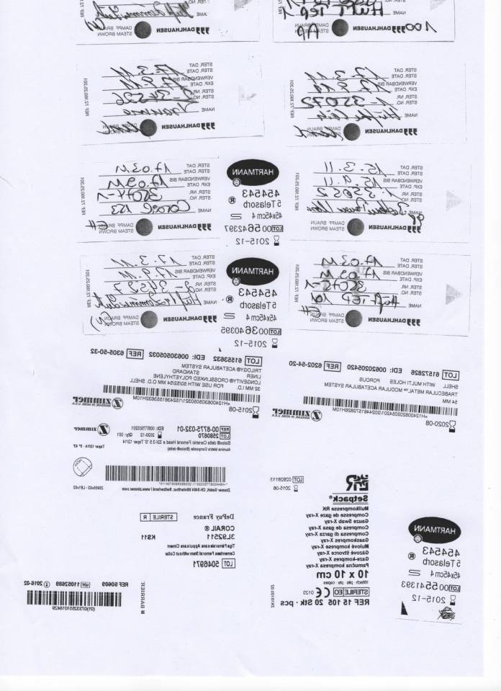
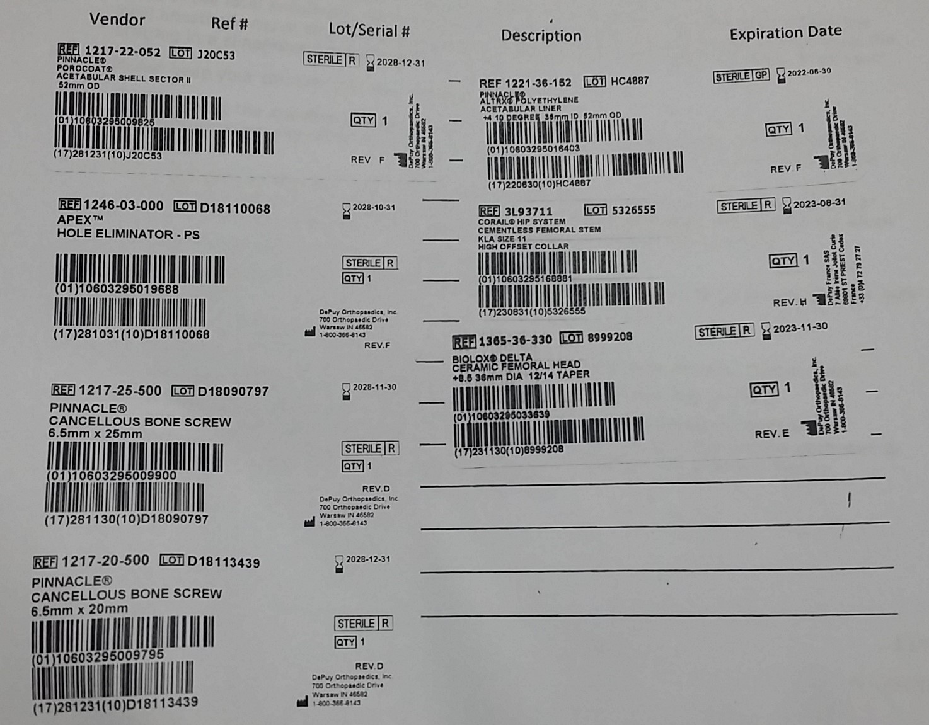
Current Challenges at Hospitals – Poor POC Data Capture
Supply documentation at the point of care is still highly manual, duplicative, and
error-ridden
Implant Record – 2013
Implant Record – 2019
Clinical Departments
Product
Order
Clinical IS
EMR
Billing

Slide 10
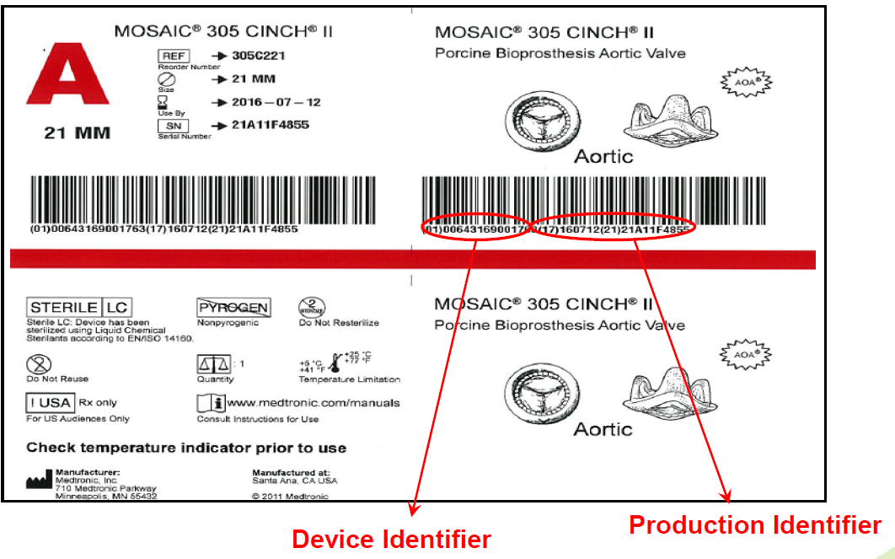
What is UDI?
UDI Mandate
FDA-mandated
Standard encoding system for all medical devices
Enables track & trace from point of origin to the patient
Designed to prevent errors and support recalls
Human AND machine-readable label can use barcodes and RFID
Fully implemented by 2020

Slide 11
UDI Mandate
Most hospitals are struggling with a number of issues that affect their performance and ability to implement and measure change
Traceability Throughout the Hospital
Extensive Risk and Waste Mitigation
User Compliance
Simplified Case Documentation
UDI and Global Standards Compliance
Data Accuracy
Track Assets & People as well as consumables
Guaranteed
ROI

Slide 12
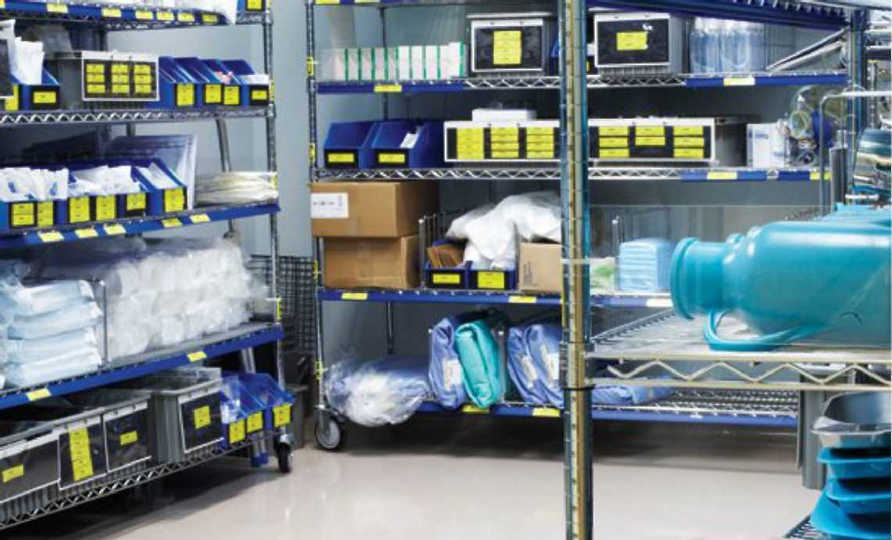
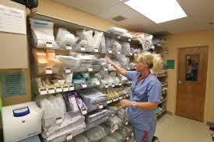
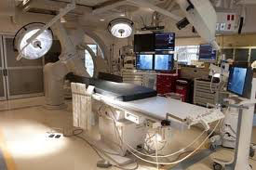

Comprehensive Data Capture & Feed
All data about products and their movements from delivery to point of care are recorded and fed into other hospital systems as well as the VUEMED Cloud for analyses and guidance
Point of Delivery
Point of Care
Delivery Area/Dock & Disposal
Supply Room
Procedure Room
Flow of Medical Products and Devices
Data Capture & Feed
Purchasing
EMR
Contracting
Hospital
MMIS
Clinical
Documentation
Systems
Billing
Distribution
Cloud Analytics
Procure-
ment
Value Analysis
Inventory availability
Par levels
Reorder
Product accurate ID
All pedigree info
Exact quantities
Clinical
Analysis

Slide 13

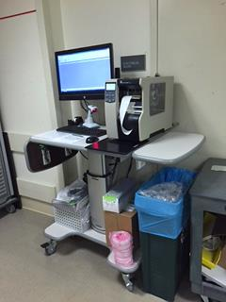
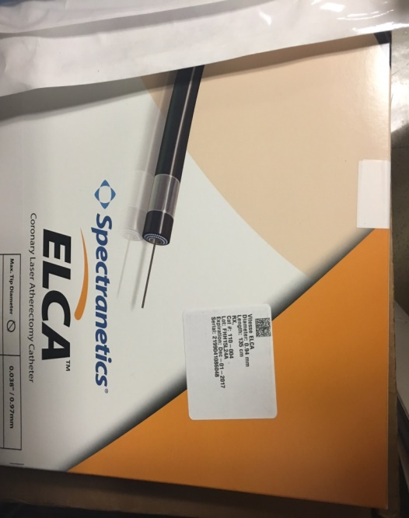
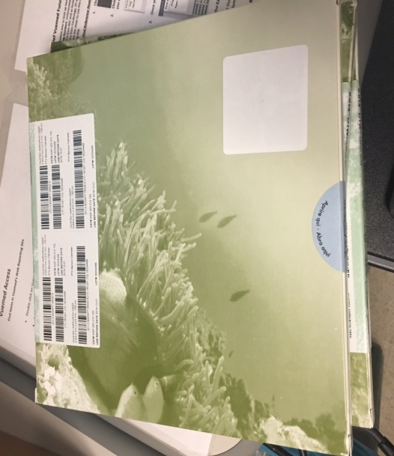
UDI Compliant RFID Tagging Solution
  FDA-mandated Unique Device Identifier (UDI) data is resident on the tag itself using GS1 EPC GEN2 UHF encoding standards
Tagging Station
Tag encoding
  Device Identifier
  Production Identifier Data as applicable:
    Lot Number
    Batch Number
    Serial Number
    Expiration Date
    Manufacture Date
    HCT/P ID
The UDI-encoded RFID tag may be printed with human readable text and a 2D barcode or blank
VUEMED, Inc. All rights reserved. 2019.

Slide 14
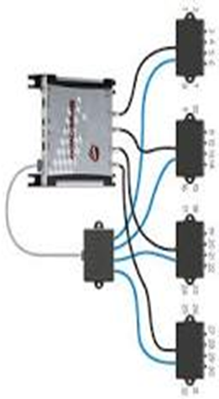

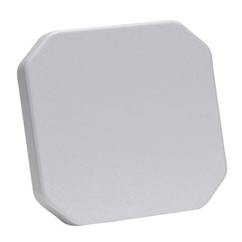
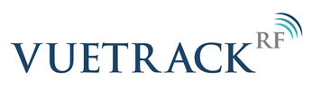
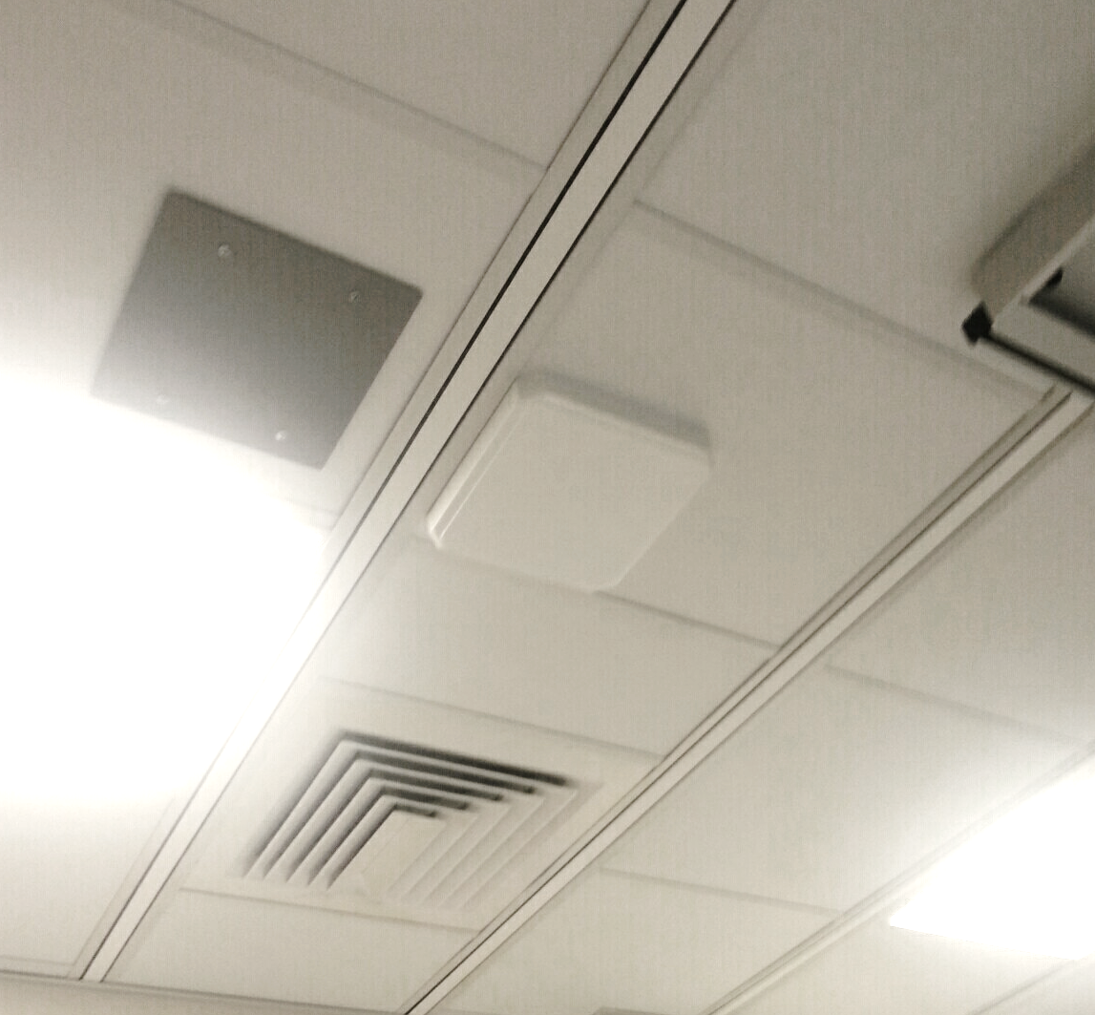
RAIN RFID Fixed Infrastructure-Based Solutions
Tracks inventory in supply and procedure rooms, as well as movement throughout, and entry & exit from the department
Cloud & SaaS
Department and Boundaries Tracking
Any department or floor
Procedure Room
Procedure Room
Procedure Room
Supply Room
Main Entrance
Main Entrance
Hallway Movement Tracking
Exit door
Reception
Procedure Room
Procedure Room
VUEMED, Inc. All rights reserved. 2019.

Slide 15
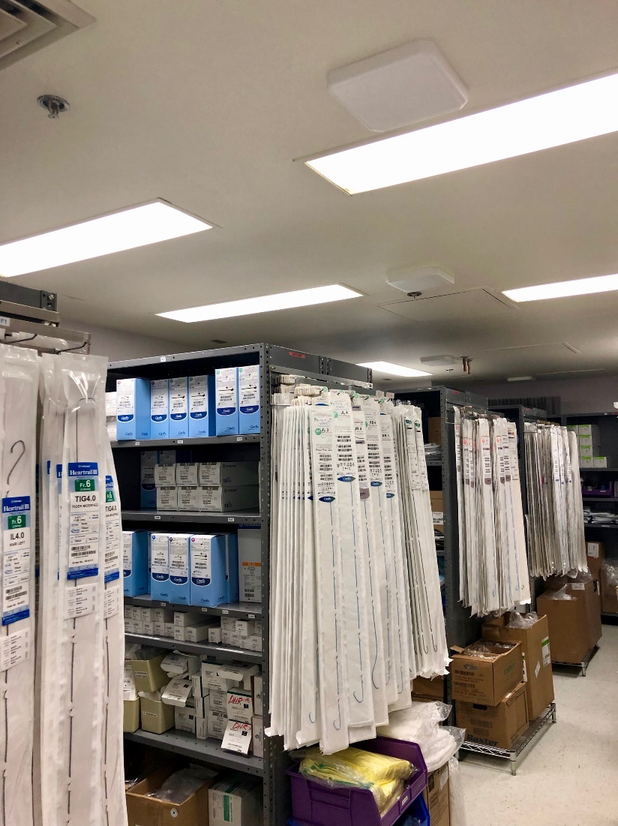
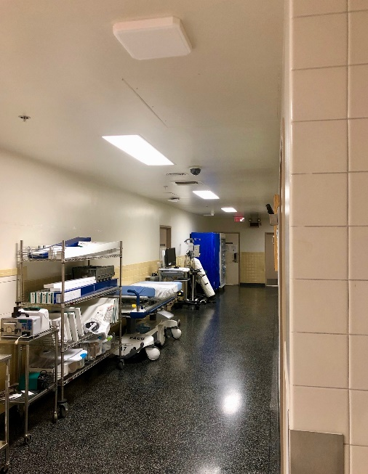
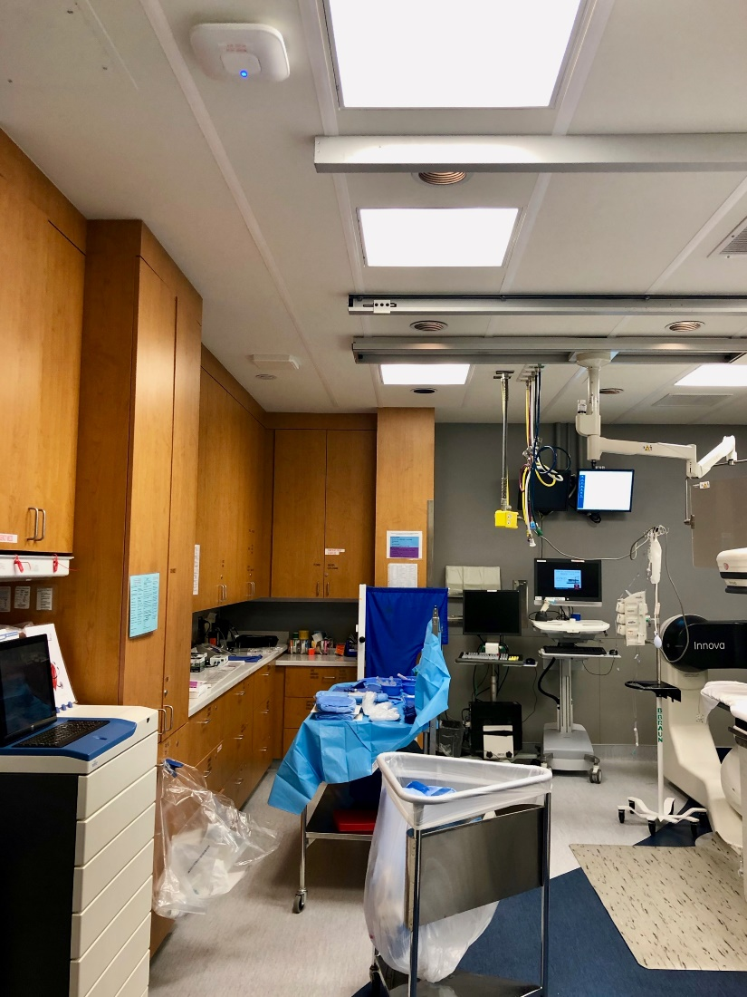
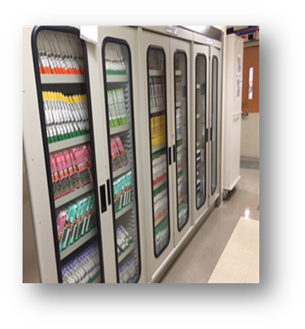
Fixed RAIN RFID Infrastructure Installation Footprint
Supply Rooms
Hallways / Cabinets
Procedure Rooms
Inside
VUEMED, Inc. All rights reserved. 2019.
Notes:
15

Slide 16
Typical ROI and Savings Achieved
High performing, versatile and cost effective RAIN RFID solutions help generate significant ROI for hospitals, and their suppliers
Typical Sources of Savings:
Typical Magnitude of Savings
Expiration control
Inventory size reduction
Reduction in product purchases
Clinical utilization management
8% to 12% of total inventory value
Ensure minimal waste: reflection of efficiently run inventory
5% to 15% of total inventory value
Support higher volume of patient cases with same or lower inventory levels
5% to 10% of total supply purchases
Ensure purchases are aligned with actual consumption needs
Up to 5% of total value of supplies used
Ensure consistent and standardized clinical operations & supply documentation protocols
VUEMED, Inc. All rights reserved. 2019.

Slide 17
Typical ROI and Savings Achieved
Easy access to accurate, comprehensive data is key to measure progress using well-defined metrics – typically this data is NOT available to SC
Typical Sources of Savings:
Metrics
Frequency
Expiration control
Expiring as % of total on-hand inventory: SKUs, Units, Value
Monthly
Inventory on-hand in relation to case volume: SKUs, Units, Value
Monthly
Inventory size reduction
Unused or infrequently used in the last 12 months as % of total on-hand inventory: SKUs, Units, Value
Quarterly
Purchased vs. consumed in relation to case volume: SKUs, Units, Value
Monthly
Reduction in product purchases
Impact of price discounts for top 20 most frequently utilized SKUs by value
Quarterly
Opened not used totals and average per case: SKUs, Units, Value
Clinical utilization management
Monthly
Cost per each type of case per physician

Slide 18
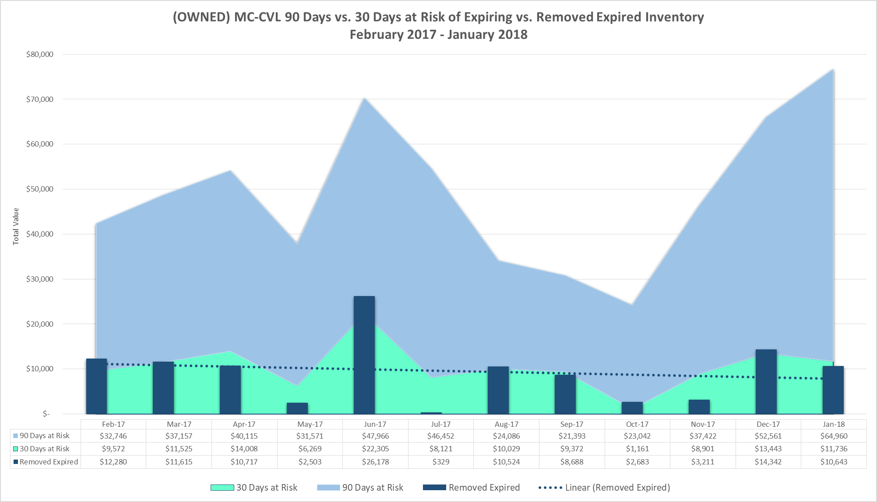
Inventory Optimization Program
Expiration Management
Avg 90 days at risk ($)
18

Slide 19
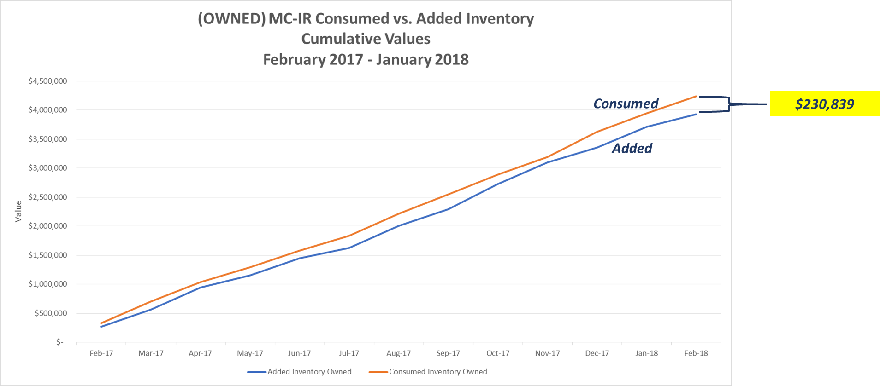
Inventory Optimization Program
Reduction in Purchases - Alignment with Consumption Needs
19

Slide 20
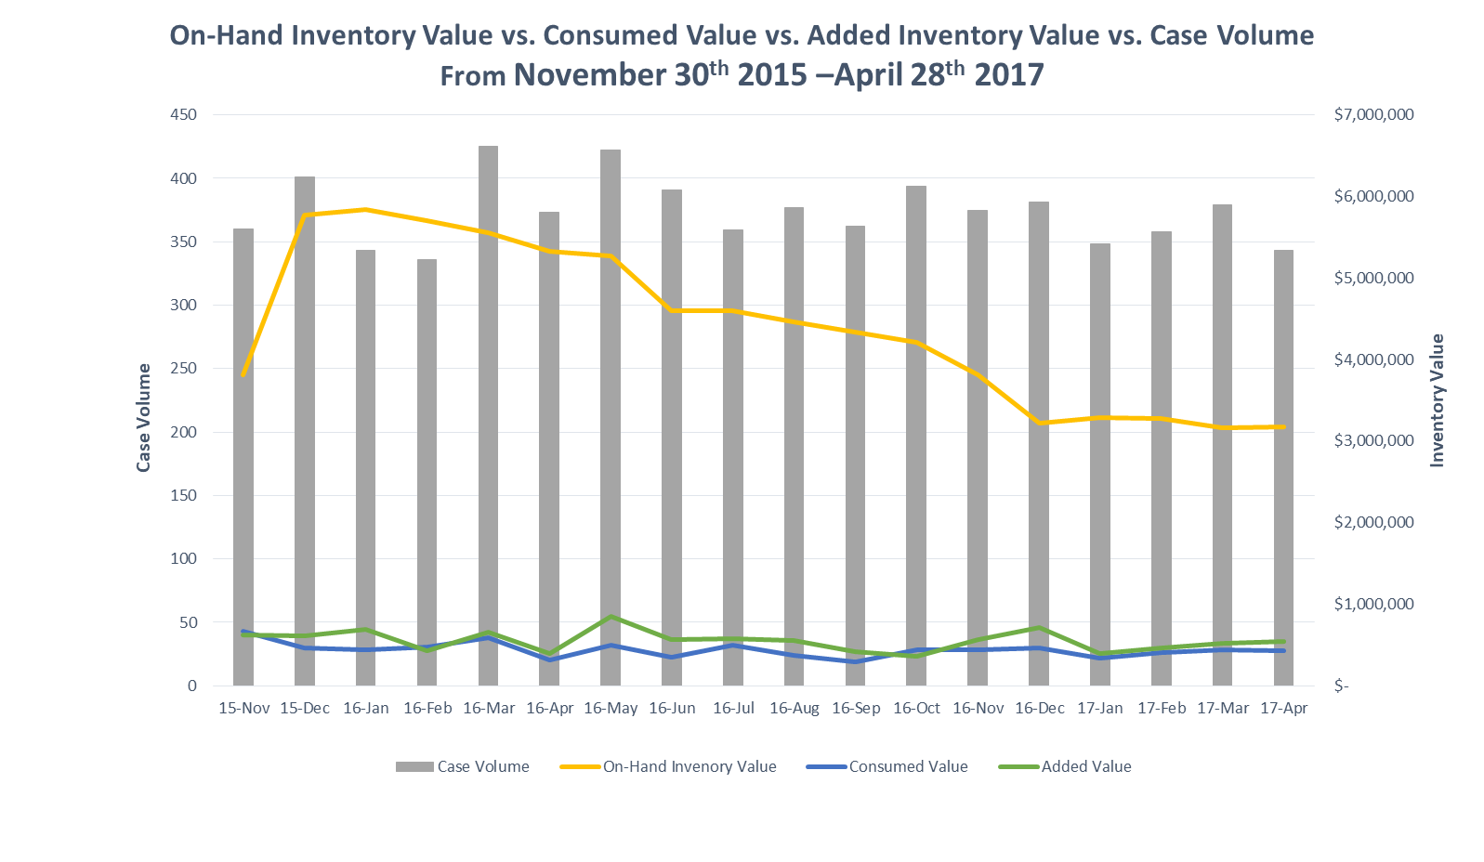
Inventory Optimization Program
Inventory Excess Reduction
Avg Monthly Case Volume (373)
20

Slide 21
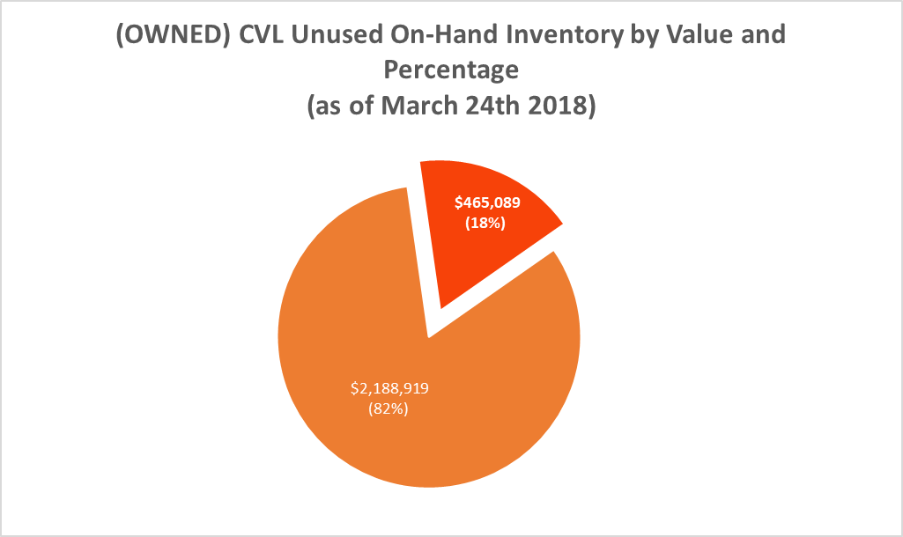
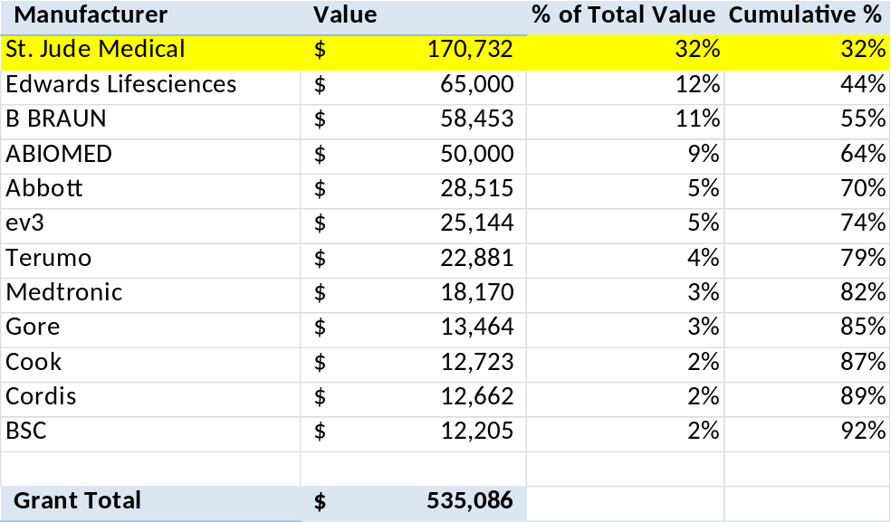
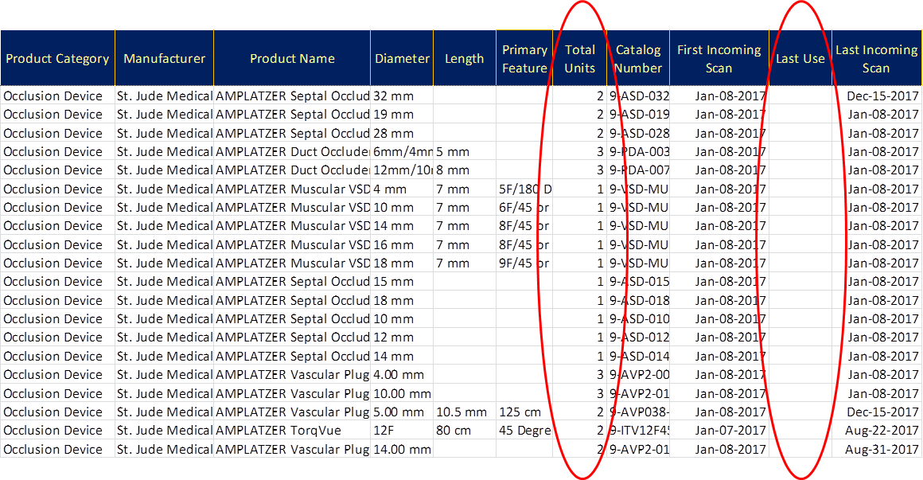
Inventory Optimization Program
Inventory Excess Reduction: Unused Items – Last 12 Months
21

Slide 22
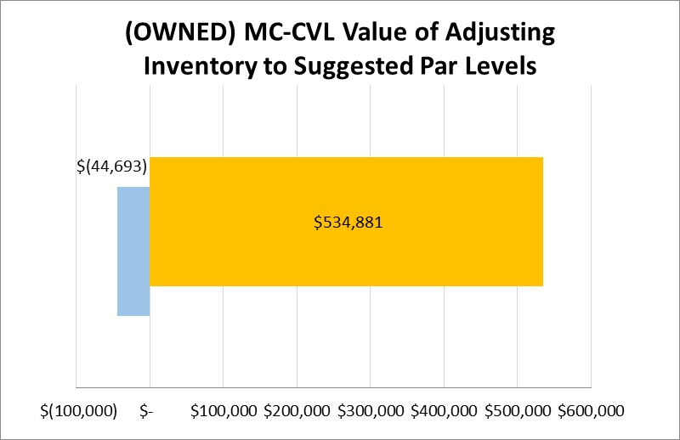
Inventory Optimization Program
Reduction in Purchases – Adjusting Pars to Suggested Levels
Value of Inventory Below Suggested Par
Value of Inventory Above Suggested Par
22

Slide 23
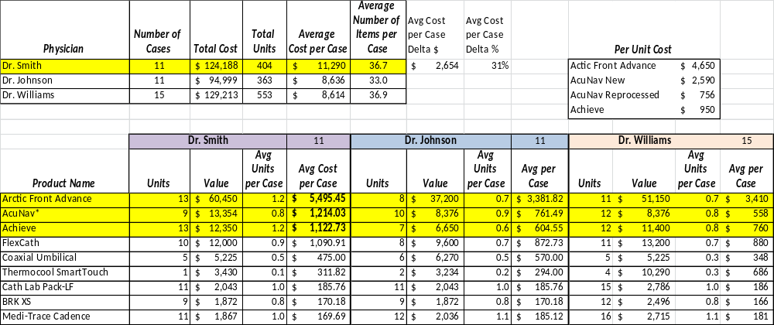
Inventory Optimization Program
Clinical Utilization - Cost per Case per Physician
23

Slide 24
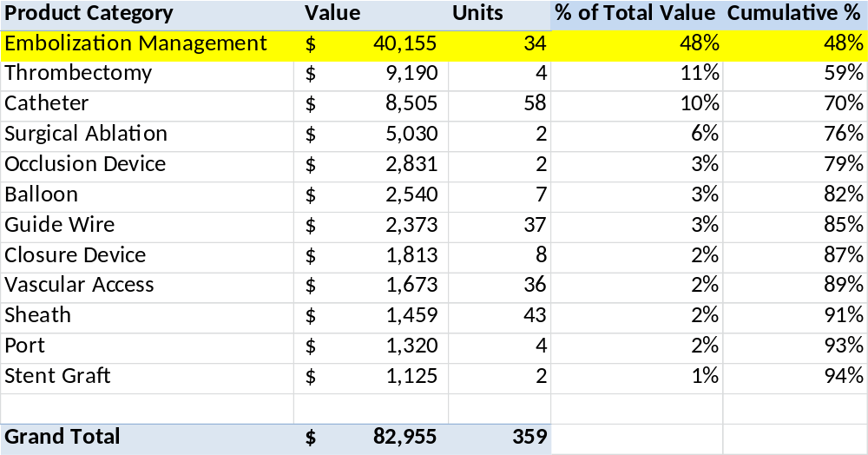
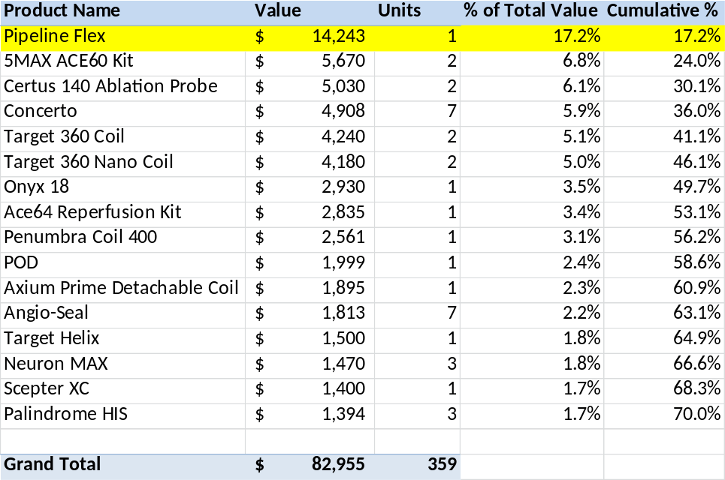
Inventory Optimization Program
Clinical Utilization – Opened Not Used Items
(by Product Category and by Product Name)
24

Slide 25

Q&A
Alex Barinaga
Director of Implementation Services
VUEMED
abarinaga@vuemed.com
www.vuemed.com
VUEMED, Inc. All rights reserved. 2019.

