Slide 1


Using Big Data and Machine Learning to Facilitate Benchmarking and Support/Defend Your AEM Program
April 12, 2019
AL GRESCH
Accruent VP of Client Success
MICHAEL GAREL
Accruent Director of Data Strategy
Notes:
Opening Questions:
How many currently employ an AEM Program?
Of those who do, how many have been through a recent accreditation survey?

Slide 2
Objectives
Review history of AEM
Review requirements of an AEM program
Discuss benefits of an AEM program
Review how to implement an AEM program
Review the criticality of having good data
Review data trends and how to proactively use data to make good maintenance decisions
Accruent Confidential and Proprietary ©2019

Slide 3
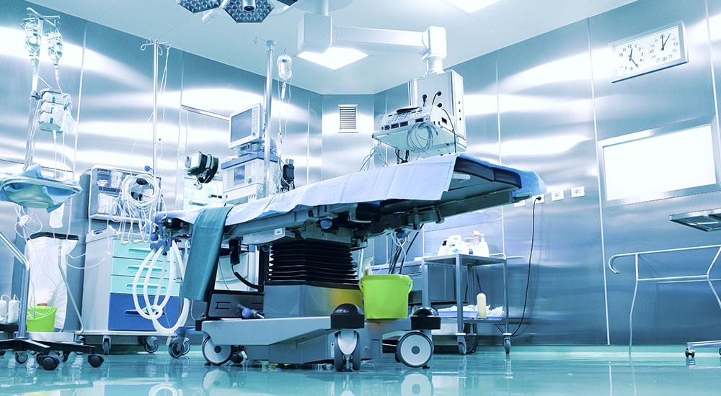
AEM History
December 2, 2011
CMS releases Hospital Equipment Maintenance Requirements interpretive guidelines, stating that hospitals should follow manufacturer’s Planned Maintenance requirements
December 20, 2013
CMS releases revisions to Hospital Equipment Maintenance Requirements interpretive guidelines, which included a section on Alternate Equipment Management (AEM)*
March 2014
CMS and TJC* revised standards to dictate a certain group of devices that must follow manufacturer recommendations. Including:
Equipment subject to federal or state law
Imaging and radiologic equipment
Medical device lasers
New medical equipment (wherein there is not sufficient history to determine whether alternative maintenance options are appropriate)
Equipment not in an AEM program
October 2015
AAMI announces support for Maintenance Practices Task Force (MPTF)

Slide 4
Objectives
Review history of AEM
Review requirements of an AEM program
Discuss benefits of an AEM program
Review how to implement an AEM program
Review the criticality of having good data
Review data trends and how to proactively use data to make good maintenance decisions
Accruent Confidential and Proprietary ©2019

Slide 5

July 2018 TJC Standards:
EC02.04.01 The hospital manages medical equipment risks
EP 4:
The hospital identifies the activities and associated frequencies, in writing, for maintaining, inspecting, and testing all medical equipment on the inventory. These activities and associated frequencies are in accordance with manufacturers’ recommendations or with strategies of an alternative equipment maintenance (AEM) program.

Slide 6
July 2018 TJC Standards:
EC02.04.01 The hospital manages medical equipment risks
EP 4 (continued):
Note 1: The strategies of an AEM program must not reduce the safety of equipment and must be based on accepted standards of practice, such as the American National Standards Institute/Association for the Advancement of Medical Instrumentation handbook ANSI/AAMI EQ56: 2013, Recommended Practice for a Medical Equipment Management Program.
Note 2: Medical equipment with activities and associated frequencies in accordance with manufacturers’ recommendations must have a 100% completion rate.

Slide 7
July 2018 TJC Standards:
EC02.04.01 The hospital manages medical equipment risks
EP 4 (continued):
Note 3: Scheduled maintenance activities for both high-risk and non-high-risk medical equipment in an alternative equipment maintenance (AEM) program inventory must have a 100% completion rate. AEM frequency is determined by the hospital's AEM program.
Notes:
Feb 19th Webinar

Slide 8
July 2018 TJC Standards:
EC02.04.01 The hospital manages medical equipment risks
EP 5:
For hospitals that use Joint Commission accreditation for deemed status purposes: The hospital’s activities and frequencies for inspecting, testing, and maintaining the following items must be in accordance with manufacturers’ recommendations:
Equipment subject to federal or state law or Medicare Conditions of Participation in which inspecting, testing, and maintaining must be in accordance with the manufacturers’ recommendations, or otherwise establishes more stringent maintenance requirements
Medical laser devices

Slide 9
July 2018 TJC Standards:
EC02.04.01 The hospital manages medical equipment risks
EP 5 (continued):
Imaging and radiologic equipment (whether used for diagnostic or therapeutic purposes)
New medical equipment with insufficient maintenance history to support the use of alternative maintenance strategies
Note: Maintenance history includes any of the following documented evidence:
- Records provided by the hospital’s contractors
- Information made public by nationally recognized sources
- Records of the hospital’s experience over time
Notes:
Note in the last major bullet, the statement that information from outside your own organization is acceptable.

Slide 10
July 2018 TJC Standards:
EC02.04.01 The hospital manages medical equipment risks
EP 6:
For hospitals that use Joint Commission accreditation for deemed status purposes: A qualified individual(s) uses written criteria to support the determination whether it is safe to permit medical equipment to be maintained in an alternate manner that includes the following:
How the equipment is used, including the seriousness and prevalence of harm during normal use
Likely consequences of equipment failure or malfunction, including seriousness of and prevalence of harm

Slide 11
July 2018 TJC Standards:
EC02.04.01 The hospital manages medical equipment risks
EP 6 (continued):
Availability of alternative or backup equipment in the event the equipment fails or malfunctions
Incident history of identical or similar equipment
Maintenance requirements of the equipment
(For more information on defining staff qualifications, refer to Standard HR.01.02.01)

Slide 12
July 2018 TJC Standards:
EC02.04.01 The hospital manages medical equipment risks
EP 7:
For hospitals that use Joint Commission accreditation for deemed status purposes: The hospital identifies medical equipment on its inventory that is included in an alternative equipment maintenance program.

Slide 13
Objectives
Review history of AEM
Review requirements of an AEM program
Discuss benefits of an AEM program
Review how to implement an AEM program
Review the criticality of having good data
Review data trends and how to proactively use data to make good maintenance decisions
Accruent Confidential and Proprietary ©2019

Slide 14



Benefits of an AEM Program
Increased Safety
Decreased Manhours
Decreased Costs
Accruent Confidential and Proprietary ©2019
Notes:
Quality costs less!!!
How many have gotten additional staffing to handle all the activities around cybersecurity?

Slide 15
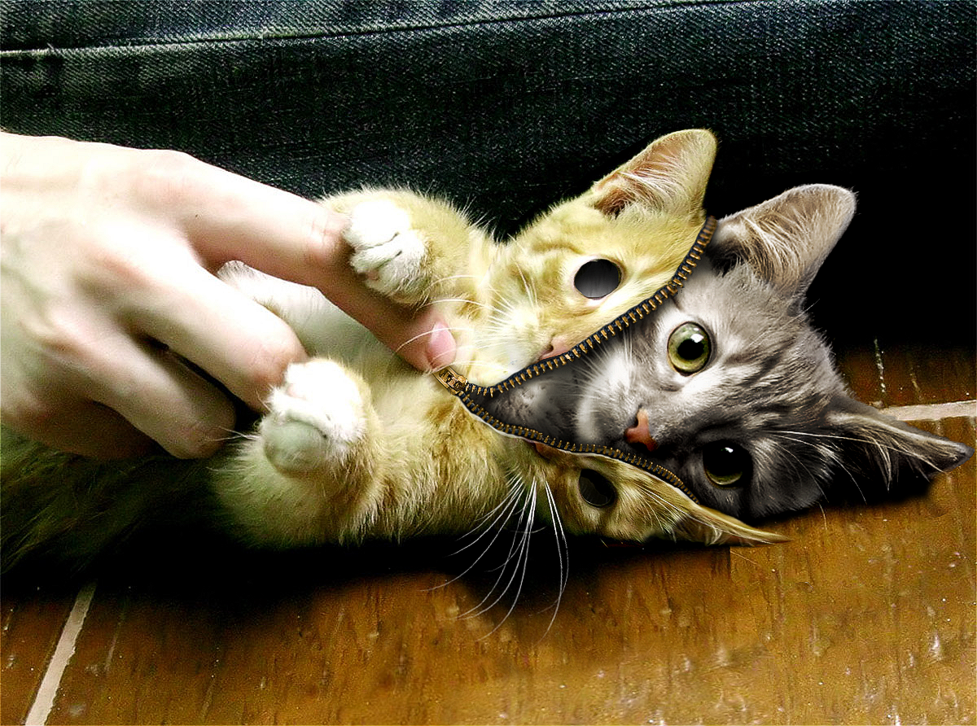
There’s More Than One Way

Slide 16
Various Methods of Determining Appropriate Maintenance
Reliability Centered Maintenance (RCM)
  Maintenance Practices Task Force (MPTF)
  www.HTMCommunitydB.org
Evidence Based Maintenance (EBM)
Binseng Wang, ScD, CCE, fAIMBE, fACCE, Director, Quality and Regulatory Affairs with Greenwood Marketing, LLC (formerly WRP32 Management, Inc.).
  Same principles as Evidence Based Medicine
  Data driven design based on standardized Failure Cause Codes (FCCs)
Others
  Survival Analysis
  Failure Rate Analysis
Notes:
Data Integrity!

Slide 17
RCM Factors/Considerations
PM Procedure Type
  Device Restoration
  Safety Verification
Level of Severity (LOS) Categories
LOS 3: Serious, life-threatening injury
LOS 2: Less serious, non-life threatening injury
LOS 1: No injury, but possible disruption of care
LOS 0: Negligible impact
PM Related Reliability
  Mean Time Between Failure (MTBF)

Slide 18
EBM Failure Cause Codes
FCC | Description | CM/PM/Both
NPF | No Problem Found (or the reported problem could not be duplicated). | Both
UPF | Unpreventable Failure, typically caused bynormal wear and tear but is unpredictable. | CM
ACC | Accessory Failure, excluding batteries, typically caused by normal wear and tear. | Both
BATT | Battery Failure, i.e., battery or batteries failed before the scheduledreplacement time. Does not include scheduled replacement of batteries. | Both
NET | Failure in or caused by network, while the equipment itself is working without problems. Applicable only to networked equipment. | Both
USE | Failures induced by use, e.g., abuse, abnormal wear and tear, accident, or environmental issues. | CM
EF | Evident Failure, i.e., a problem that can be detected without running any special tests or using a sppecialized tester, but was not reported by the user | SM
SIF | Service-Induced Failure, i.e., caused by CM or SM that was not properly completed or by a part that was replaced and failed prematurely. | CM
HF | Hidden Failure, i.e., a problem that could not be detected by the user under normal circumstances unless running a special test or using specialized tester. | SM
PF | Potential Failure, i.e., failure is either about to occur or is in the process of occurring but has not yet caused equipment to stop working or cause problems for patients or users. | SM
PPF | Preventable and Predictable Failure. Typically caused by wear and tear that can be predicted or detected. | CM
Notes:
Data Integrity!!

Slide 19
Objectives
Review history of AEM
Review requirements of an AEM program
Discuss benefits of an AEM program
Review how to implement an AEM program
Review the criticality of having good data
Review data trends and how to proactively use data to make good maintenance decisions
Accruent Confidential and Proprietary ©2019

Slide 20
Steps to Implement an AEM Program
1
Assess Risk considering Failure Modes
­Device Reliability
­Process Related Failures
­Maintenance Related Failures
Notes:
Data Integrity!!!

Slide 21
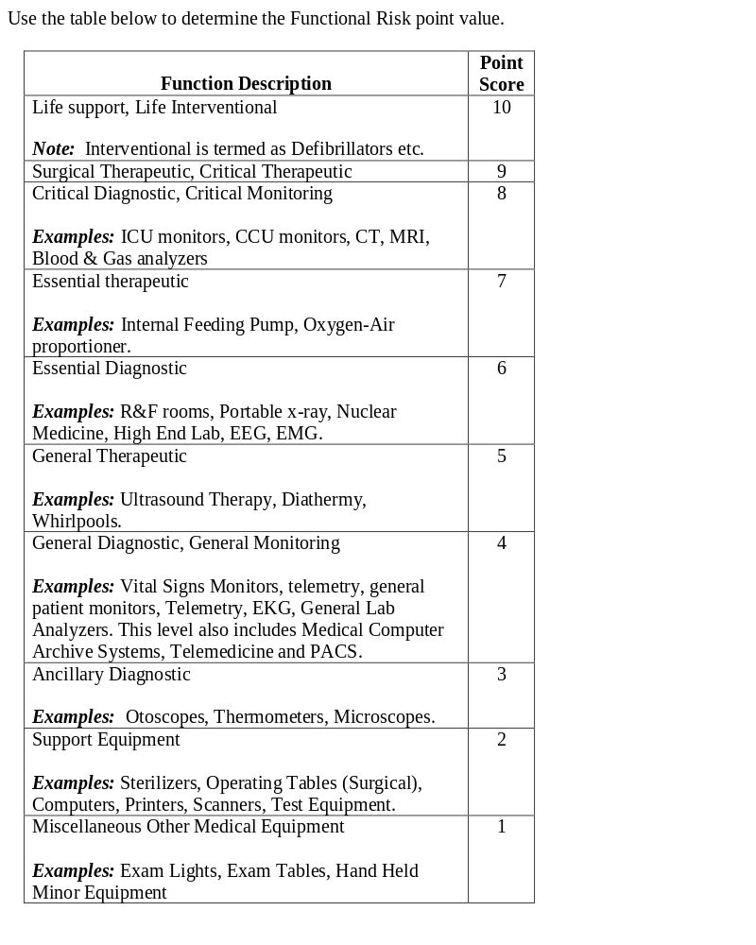
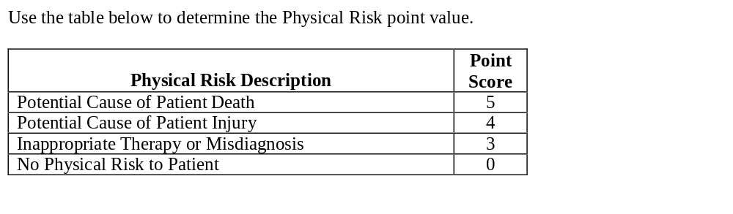
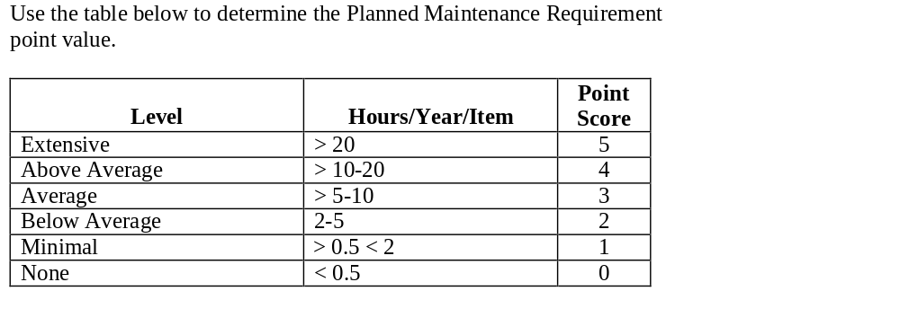
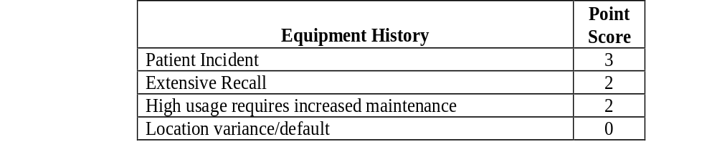
Fennigkoh-Smith Model
1
Notes:
Problem is it didn’t take into account probability

Slide 22
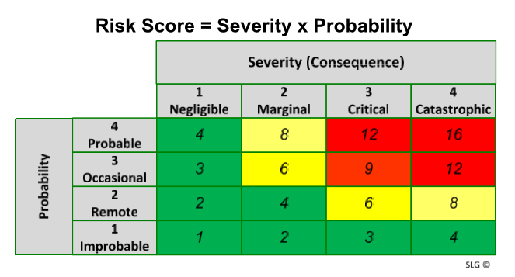
1
Risk Scoring Matrix
AEM Eligibility Criteria
Any eligible device identified as LOW risk based on incident / service histories …
can be placed in an Alternate Equipment Maintenance (AEM) Program as long as
risks to patients or staff do not increase.
Notes:
Problem is it didn’t take into account probability

Slide 23
Steps to Implement an AEM Program
1
Assess Risk considering Failure Modes
Equipment subject to federal or state law
Imaging and radiologic equipment
Medical device lasers
2
Assess for inclusion in AEM Program
CMS carve outs
Risk Criteria
Professional Experience & Supporting Data
Notes:
Professional Experience & Supporting Data includes things like incident history, maintenance requirements, etc.

Slide 24
Steps to Implement an AEM Program
1
Assess Risk considering Failure Modes
Equipment subject to federal or state law
Imaging and radiologic equipment
Medical device lasers
2
Assess for inclusion in AEM Program
CMS carve outs
Risk Criteria
Professional Experience & Supporting Data
3
Assess appropriate frequency and depth of PM based on standardized methodology

Slide 25
3
Failure Rate Methodology
Any initial device category evaluation will have its PM procedures and frequencies evaluated by first establishing a baseline failure rate. The failure rate (FR) will be established as follows: FR=(CM/(INV*TFY))/12
CM = # of Corrective Maintenance work orders
INV = Inventory of equipment in a particular device category
TFY = Time Frame in Years (Number of years historical data was collected.)

Slide 26
1
3
Healthcare Technology Management has established a starting baseline of 8.33%.
corrective maintenance work request
per device per year
Step | Action
1 | If monthly failure rate is above 8.33% then: Evaluate for an increase in PM frequency and/or PM depth. Authorized only if it has the potential to reduce the failure rate.
2 | If monthly failure rate is below 8.33% then: Evaluate for a decrease in PM frequency and/or PM depth or removal from the PM program. PM frequencies may only be decreased at a maximum of one year increments unless approved by HTM leadership. The maximum PM frequency for any device is 2 years. Any device category that is rated greater than 2 years will be removed from the PM program and labeled as run to failure.
3 | Once a PM frequency has been determined it will be Documented in the Planned Maintenance Assessment Table, Entered into the CMMS.

Slide 27
Steps to Implement an AEM Program
1
Assess Risk considering Failure Modes
Equipment subject to federal or state law
Imaging and radiologic equipment
Medical device lasers
2
Assess for inclusion in AEM Program
CMS carve outs
Risk Criteria
Professional Experience & Supporting Data
3
Assess appropriate frequency and depth of PM based on standardized methodology
4
Ensure a complete set of PM Procedures

Slide 28
Steps to Implement an AEM Program
4
Ensure a complete set of PM Procedures
CMS Carve outs
  Mfr. Recommended procedure
No PM required
    No PM procedure required
PM Required
  Use Mfr. Recommended procedure as baseline
    Any steps unnecessary?
    Any additional steps needed?

Slide 29
Steps to Implement an AEM Program
1
Assess Risk considering Failure Modes
Equipment subject to federal or state law
Imaging and radiologic equipment
Medical device lasers
2
Assess for inclusion in AEM Program
CMS carve outs
Risk Criteria
Professional Experience & Supporting Data
3
Assess appropriate frequency and depth of PM based on standardized methodology
4
Ensure a complete set of PM Procedures
5
Continuously Monitor impact and outcomes of program changes to ensure no reduction in patient safety/increase in failure rates.

Slide 30
Objectives
Review history of AEM
Review requirements of an AEM program
Discuss benefits of an AEM program
Review how to implement an AEM program
Review the criticality of having good data
Review data trends and how to proactively use data to make good maintenance decisions
Accruent Confidential and Proprietary ©2019
Notes:
You can’t accomplish ANY OF THIS if you don’t have good data that you can trust and rely on!

Slide 31
5
Planned Maintenance Assessment Table
Device Category | Baseline Inventory (12/31/09) | 36 month Baseline Work Order Count | 36 month history Corrective Hours (1/1/07 - 12/31/09) | Total Corrective Hours in a year (12/31/09) | Baseline Failure Rate | Prior Year's Failure Rate | Current Failure Rate | Failure Rate Change - Last Year vs Current | Last Review Date | Regulatory Mandated Frequency Y/N | Current # PMs Per Year | Adjusted # PMs Per Year (.67 = 18 months) | Current Total Annual PM Hours | Adjusted Annual PM Hours | Annual PM Hours Change
Air Cleaner, Particulate, Germicidal, UV | 2 | 0 | 0 | 0 | 0.00% | 0.00% | 0.00% | 0.00% | Jul-10 | N | 0 | 0 | 0.0 | 0.0 | 0.00
Air Cleaner, Particulate, High-Efficiency Filter | 4 | 0 | 0 | 0 | 0.00% | 0.00% | 0.00% | 0.00% | Jul-10 | N | 0 | 0 | 0.2 | 0.0 | 0.00
Alarm, Occupancy, Bed | 639 | 1,515 | 897 | 353 | 6.59% | 0.00% | 0.00% | 0.00% | Jul-10 | N | 0 | 0 | 0.5 | 0.0 | 0.00
Amalgamator | 5 | 0 | 0 | 0 | 0.00% | 0.00% | 0.00% | 0.00% | Jul-10 | N | 0 | 0 | 0.0 | 0.0 | 0.00
Analyzer, Phys, Middle Ear, Impedance Tympanometry | 115 | 81 | 133 | 69 | 1.96% | 0.00% | 0.00% | 0.00% | Jul-10 | N | 1 | 1 | 228.1 | 228.1 | 0.00
Analyzer, Phys, Neuro Musc Funct, Body Motion | 20 | 56 | 180 | 110 | 7.78% | 0.00% | 0.00% | 0.00% | Jul-10 | N | 0 | 1 | 7.6 | 10.0 | 2.45
Analyzer, Phys, Neuromuscular Funct,Posturographic | 3 | 12 | 11 | 8 | 11.11% | 0.00% | 0.00% | 0.00% | Jul-10 | N | 0 | 1 | 0.0 | 1.5 | 1.50
Analyzer, Phys, Peristaltic Motility, Esophageal | 9 | 11 | 18 | 12 | 3.40% | 0.00% | 0.00% | 0.00% | Jul-10 | N | 0 | 0 | 0.0 | 0.0 | 0.00

Slide 32
Results
1st pass of implementing Failure Rate Analysis to adjust PM intervals
  - Reduced PM time by 3000 hrs.
1st pass of increasing PM intervals/procedure steps to reduce Failure Rates
  - Increased PM time 135 hrs.
  - Reduced CM time by 1563 hrs.

Slide 33
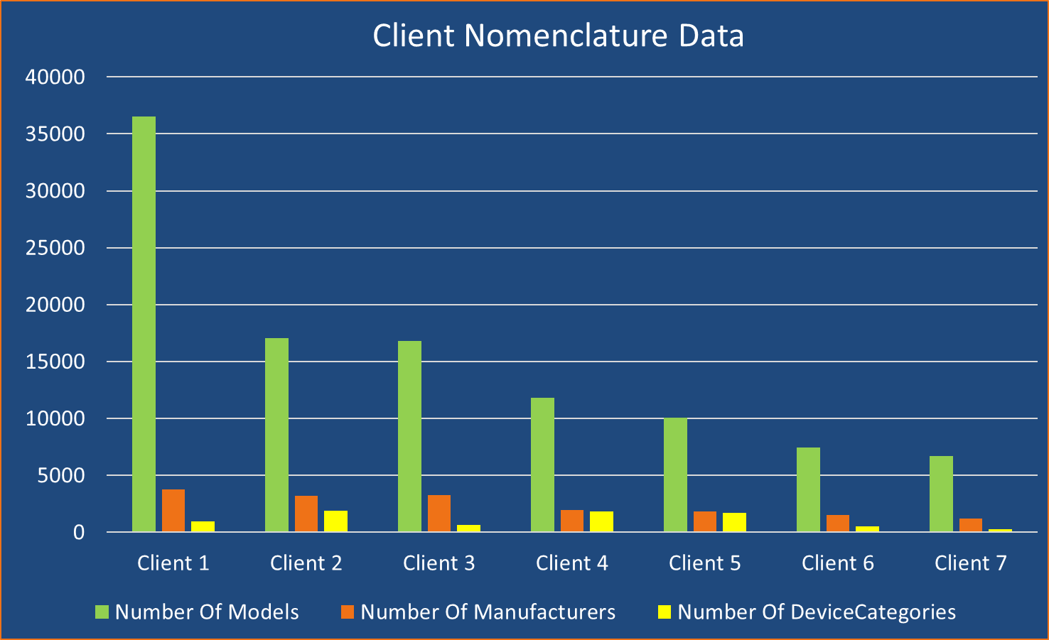
Is Your Data Clean Enough to Make Business Decisions?
DMM by the Numbers

Slide 34
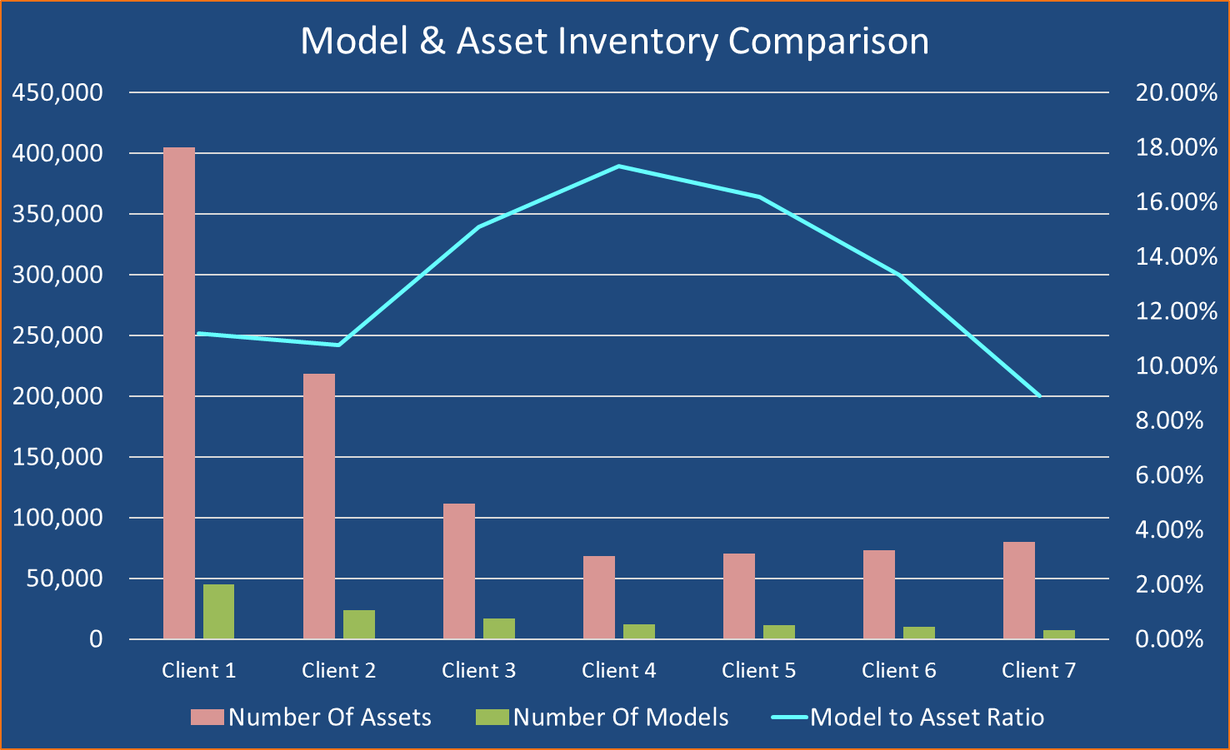
Is Your Data Clean Enough to Make Business Decisions?
DMM by the Numbers

Slide 35
July 2018 TJC Standards:
EC02.04.01 The hospital manages medical equipment risks
EP 5 (continued):
Imaging and radiologic equipment (whether used for diagnostic or therapeutic purposes)
New medical equipment with insufficient maintenance history to support the use of alternative maintenance strategies
Note: Maintenance history includes any of the following documented evidence:
- Records provided by the hospital’s contractors
- Information made public by nationally recognized sources
- Records of the hospital’s experience over time

Slide 36
Objectives
Review history of AEM
Review requirements of an AEM program
Discuss benefits of an AEM program
Review how to implement an AEM program
Review the criticality of having good data
Review data trends and how to proactively use data to make good maintenance decisions
Accruent Confidential and Proprietary ©2019

Slide 37
Big Data
Notes:
Opening Questions:
How many currently employ an AEM Program?
Of those who do, how many have been through a recent accreditation survey?
How many attended yesterday’s AEM Forum?

Slide 38
Accruent Data Asset Size (Healthcare)
233 Million
13 Million
WORK ORDERS
ASSETS
754,000
55%
TECHNICIANS
ACCREDITED HOSPITALS

Slide 39
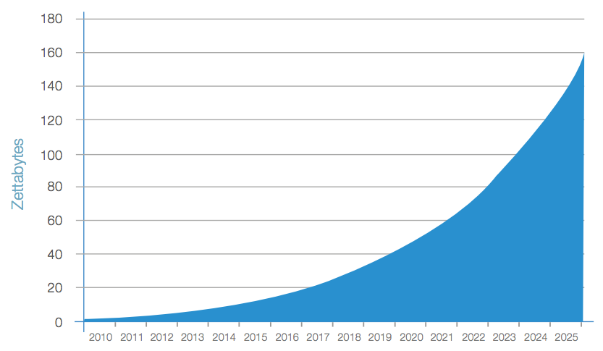
Key Trends:
Data evolution from business to life-critical
Embedded systems and IoT
Mobile and real-time data
Artificial Intelligence
Security
1 zettabyte – 1 billion terabytes = 1 trillion gigabytes
Source: IDC’s Data Age 2025 Study

Slide 40
$3.1 trillion
IBM’s estimate of the annual cost of poor data quality in the US alone

Slide 41
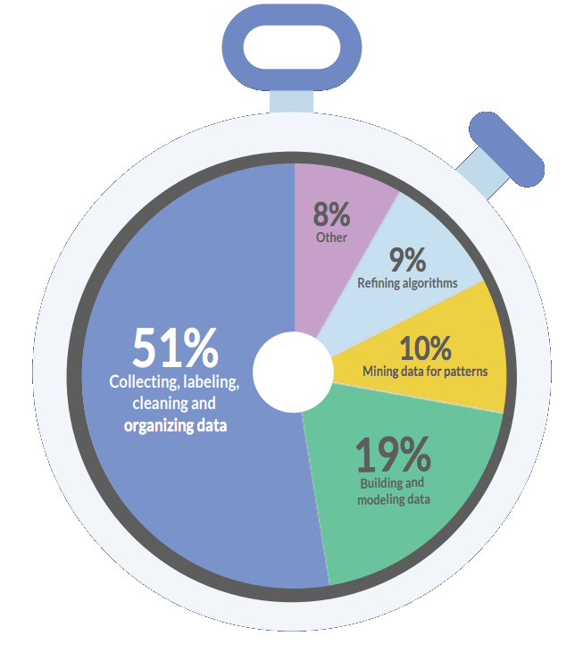
Data Integrity Challenges
Over 50% of a Data Scientist’s time is spent cleaning data
Source: Cloudflower 2017 Data Scientist Report

Slide 42
Data Integrity Challenges
I-STAT CORPORATION/ABBOTT DIAGNOSTIC
ABBOTT LABS, NUTRITION DIVISION
Abbott Laboratories Hosp. Prod. Div
ABBOTT LABS, HOSP PRODUCTS DIV (HOSPIRA INC)
ABBOTT LABORATORIES ELECTRONIC DRUG DEL*
ABBOTT POINT OF CARE INC
LAROSS/ABBOTT LABORITORIES
Abbott Laboratories Diagnostics Div
ABBOTT LABORAT.
ABBOTT AMBULATORY INFUSION SYSTEMS SUB ABBOTT LABORATORIES
ABBOTT DIABETES CARE DIV ABBOTT LABORATORIES INC
ROSS LAB (ABBOTT LAB)
ABBOTT LABORATORIES(2)TECHNICAL SUP
ABBOTT LABS, POINT OF CARE DIVISION
ABBOTT/HEALTHCARE TECHNOLOGIES
ABBOTT MEDISENSE
ABBOTT LABORATORIES-DIAGNOSTIC DIV
ABBOTT LABS
ABBOTT CRITICAL CARE SYSTEMS DIV ABBOTT LABORATORIES
ABBOTT (IV)
ROSS PRODUCTS/ABBOTT LABS
ABBOTT LABORTORIES
ABBOTT LABORATORIES INC
ABBOTT LABORATORIES DIAGNOSTIC DIV
184 different spellings of Abbott Laboratories

Slide 43
Data Integrity Challenges
Time Machine!
WorkOrderId | WOType | AssetId | DateCreated | DateCompleted | Manufacturer | ModelNumber | PurchaseDate | AssetAge
131903079 | PM | 3451005 | 1/1/2018 | 1/9/2018 | IRADIMED | 3850 | 9/9/9999 | -7981
131936235 | PM | 3450699 | 2/1/2018 | 2/28/2018 | BAXTER | 35700 | 9/9/9999 | -7981
97753278 | CM | 3347425 | 5/11/2015 | 5/11/2015 | CAREFUSION | ALARIS PUMP 8100 | 10/25/6200 | -4185
97167285 | PM | 3347425 | 3/1/2016 | 3/10/2016 | CAREFUSION | ALARIS PUMP 8100 | 10/25/6200 | -4184
96781551 | PM | 3347425 | 3/1/2017 | 3/23/2017 | CAREFUSION | ALARIS PUMP 8100 | 10/25/6200 | -4183
96979627 | PM | 3455321 | 4/1/2016 | 4/18/2016 | CAREFUSION | 8120 | 4/1/5015 | -2999
97533437 | PM | 3455321 | 4/1/2017 | 4/27/2017 | CAREFUSION | 8120 | 4/1/5015 | -2998
100659512 | PM | 1586865 | 2/1/2015 | 2/2/2015 | HOSPIRA | PLUM A+ | 3/24/2914 | -899
100579434 | PM | 1586865 | 2/1/2016 | 2/23/2016 | HOSPIRA | PLUM A+ | 3/24/2914 | -898
100658445 | PM | 1586865 | 2/1/2017 | 2/28/2017 | HOSPIRA | PLUM A+ | 3/24/2914 | -897
122659161 | PM | 1586865 | 2/1/2018 | 2/15/2018 | HOSPIRA | PLUM A+ | 3/24/2914 | -896

Slide 44
Data Quality Waterfall
1.2m assets missing vendor info
6.6m assets analyzed
76.9m
WOs
26.6m
WOs
400k assets unable to tie to an ECRI vendor
2.65m assets mapped to ECRI vendor with low confidence
7.5m
WO’s
26.9m
WOs
1.7m assets lack WO data in the last 8 years
650k assets with enough data to make purchasing, repair / replace, EOL, and service contract decisions
8.2m
WOs
7.7m
WOs
Notes:
Note: this is TMS Online (inclusive of those we do not have reuse rights for)

Slide 45
Data Cleaning and Data Acquisition (i.e. AI) Process
Data rarely follows a common taxonomy, and needs to be cleaned to be able to aggregate and process.
Methods Utilized To Date:
Fuzzy Matching (Semantic Similarity) to Authoritative Source (ex. FDA)
Amazon Mechanical Turk
Created an App to Facilitate/Share Data Cleaning Efforts
LIKE queries in SQL
Web Scraping
Neural Network / AI

Slide 46

Semantic Similarity to FDA
Asset: 123456
Inconsistent Data
MFG: CAREFUSION
MODEL: ALARIS 8015
FDA
A match score is provided
Very CPU intensive process
+ Fuzzy match to FDA
+ Human Intelligence
Asset: 123456
MFG: CAREFUSION
MODEL: ALARIS 8015
FDA_MFG: CAREFUSION 303 INC FDA_MODEL: 8015
FDA_BRAND: ALARIS
MATCH_SCORE: 100
HUMAN_MATCH:100
FDA_CODE: FRN
FDA_CODE: Pump, infusion
GMDN: General-purpose infusion…
KNUM: K051641
RECALLS: #
ADV EFFECTS: #
= Clean/Enriched Data

Slide 47
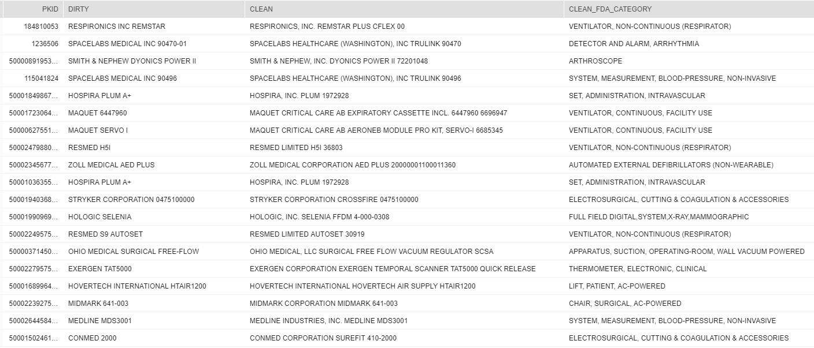
RESULTS OF FUZZY MATCH TO FDA

Slide 48
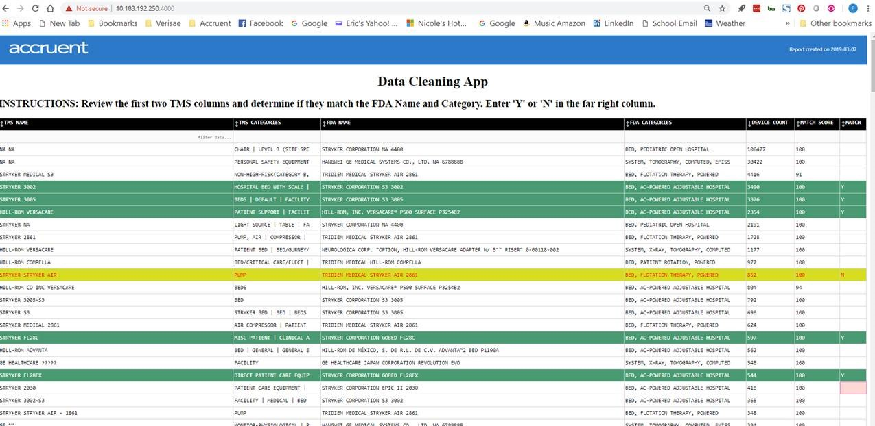
Custom Data Cleaning App – Alternative to Mechanical Turk

Slide 49
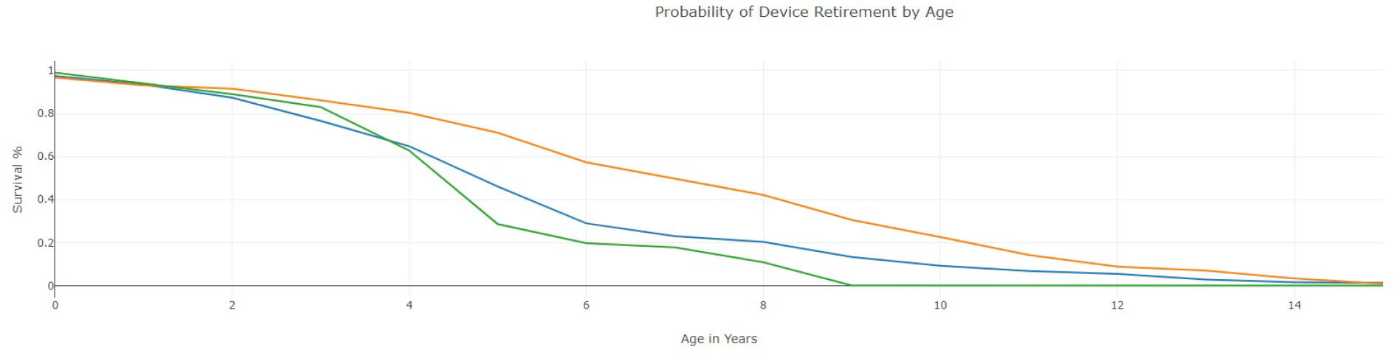
Survival Analysis

Slide 50
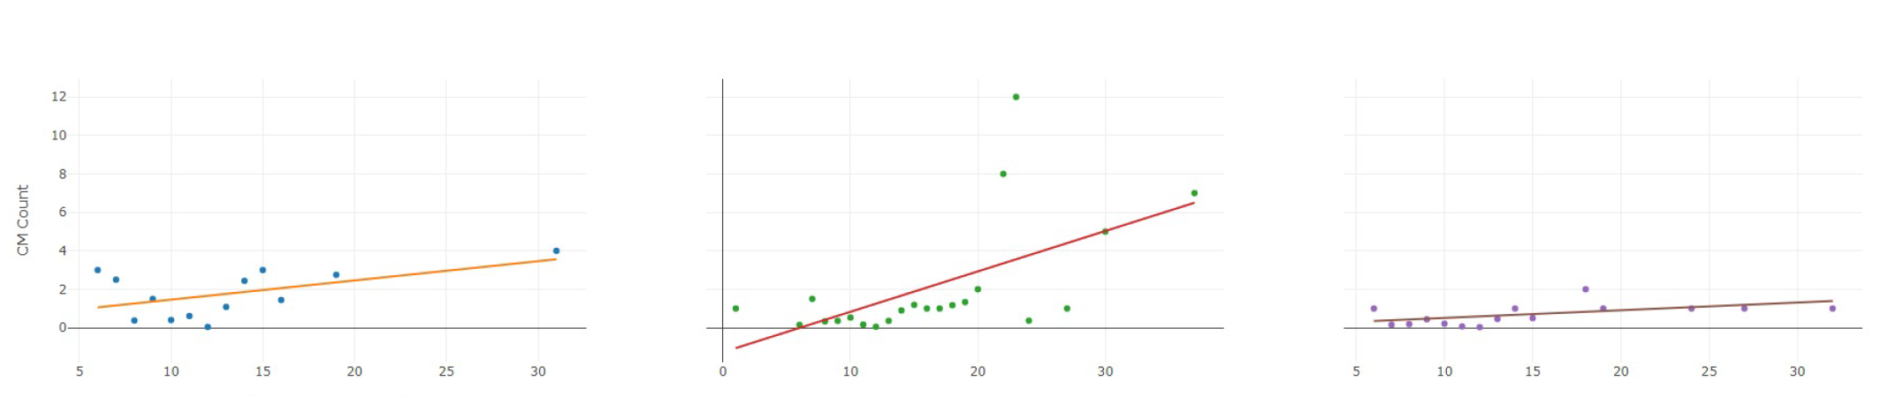
PM Frequency Effect on CM Work Orders

Slide 51


Slide 52




agresch@accruent.com
linkedin.com/company/accruent
twitter.com/accruentllc
facebook.com/accruent
accruent.com/blog

