Slide 1

The Future of Healthcare and HTM
David W. Braeutigam
President
Braeutigam Enterprises LLC
Healthcare Technology Management Consulting
PO Box 202125
Arlington, Texas
http://www/BraeutigamEnterprises.com
http://www/BraeutigamPublishing.com
dave@BraeutigamEnterpises.com

Slide 2
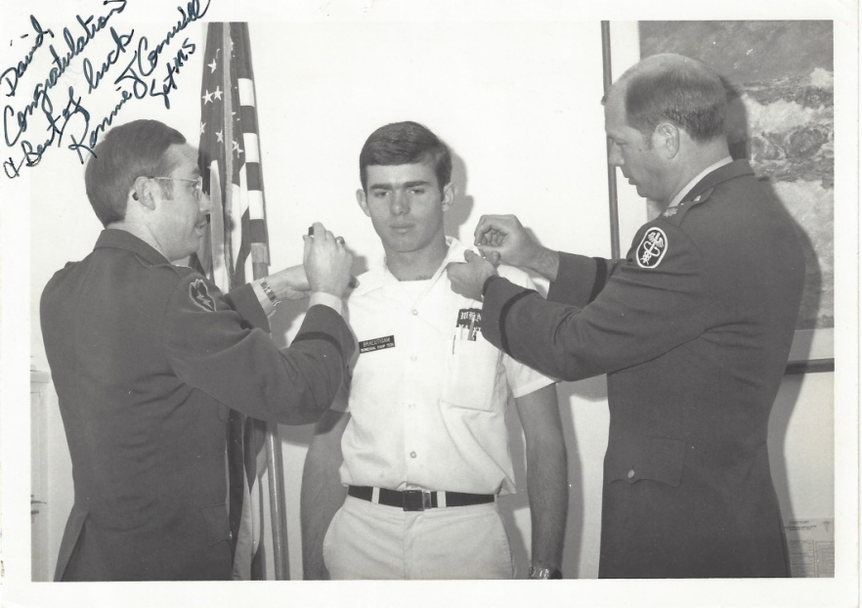
About David Braeutigam
35+ years in Healthcare Technology Management
Trained at Fitzsimons in the U.S. Army
BMET at Walter Reed Army Medical Center, Ft. Bragg, El Paso, TX and in Dallas, TX
Former System Director for 22+ hospitals and 400+ clinics in Texas
Currently consulting in HTM

Slide 3
Agenda
Today – what are the big things in HTM and Healthcare today?
Tomorrow – what can we expect of HTM and Healthcare in the future?

Slide 4
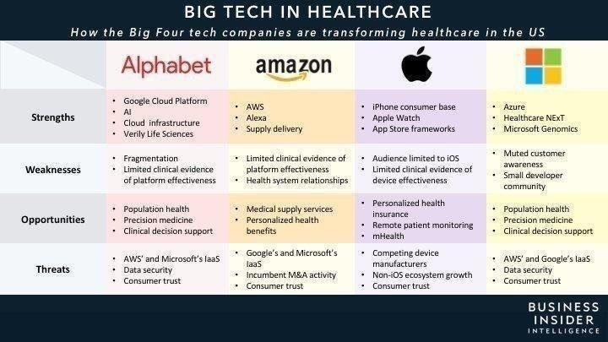
New Major Vendors in Health IT
https://hitinfrastructure.com

Slide 5
Google in Health IT
Google and Apple have both secured additional patents for healthcare IT infrastructure technology.
Google’s patents include several focused on its artificial intelligence (AI) technology DeepMind and its healthcare disease and research entity Verily.

Slide 6
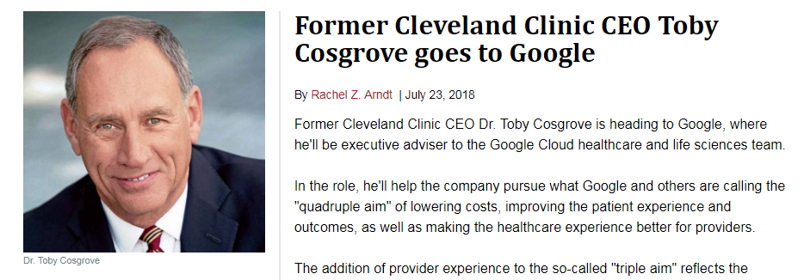
Google adds Cleveland Clinic CEO

Slide 7
Apple in Health IT
Apple has filed over 50 patents that will allow the iPhone to be used as a medical device to track patient health.

Slide 8
Microsoft in Health IT
Microsoft’s patents include expanding on its AI technology to help monitor chronic disease.
Cloud storage Azure.

Slide 9
Amazon in Health IT
Amazon’s health IT project known as 1492 is focused on interoperability among disparate EHR systems to make it easier for healthcare organizations to migrate to new EHR systems, as well as helping entities share data with other healthcare systems. The project aims to make EHR data more available to clinicians as well as patients.
Largest cloud storage in industry.

Slide 10
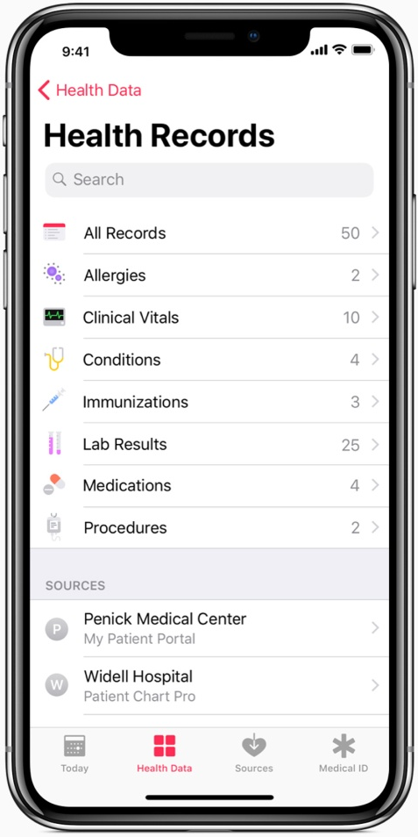
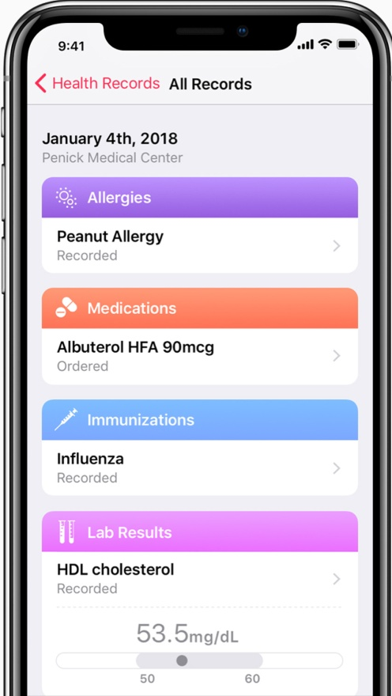
Apple Announces Health Records on iPhone
Announced in early 2018
Partners with Johns Hopkins, Cedars-Sinai, Penn Medicine, Geisinger Health System, UC San Diego Health, UNC Health Care and other participating hospitals and clinics
https://www.apple.com/newsroom/2018/01/apple-announces-effortless-solution-bringing-health-records-to-iPhone/

Slide 11
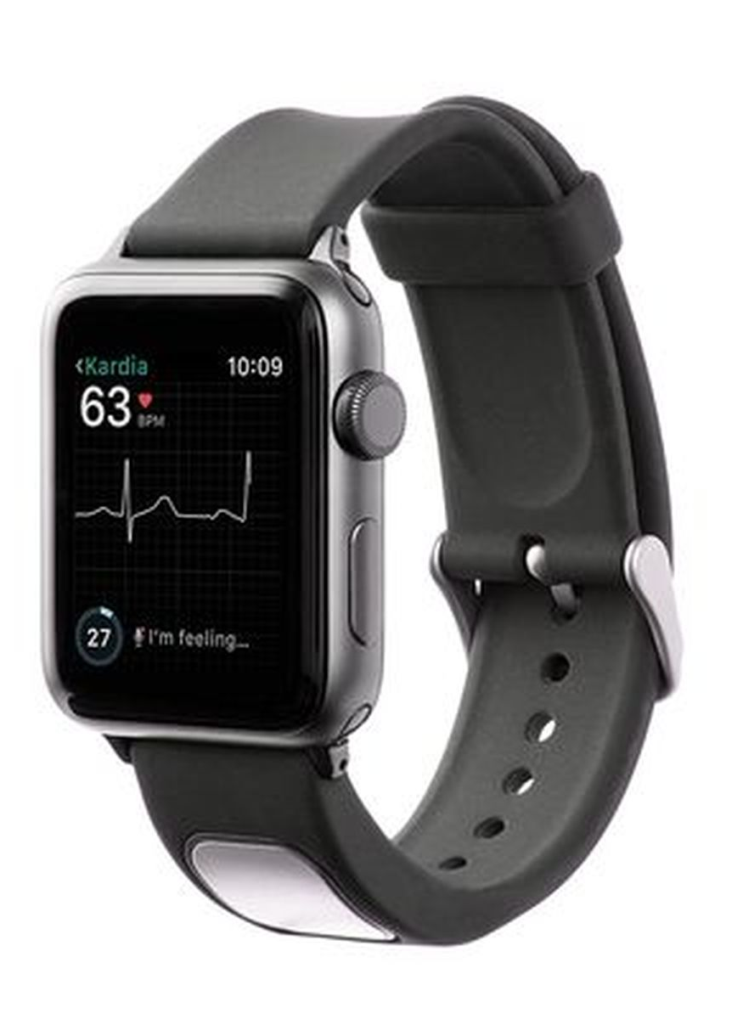
FDA clears first EKG reader for Apple Watch
FDA cleared the first medical device accessory for the Apple Watch in November 2017
AliveCor’s KardiaBand electrogardiogram reader
Uses AI to analyze data from the watch’s heart rate and activity sensors
$199
https://www.theverge.com/2017/11/30/16718978/fda-medical-device-accessory-apple-watch-alivecor

Slide 12
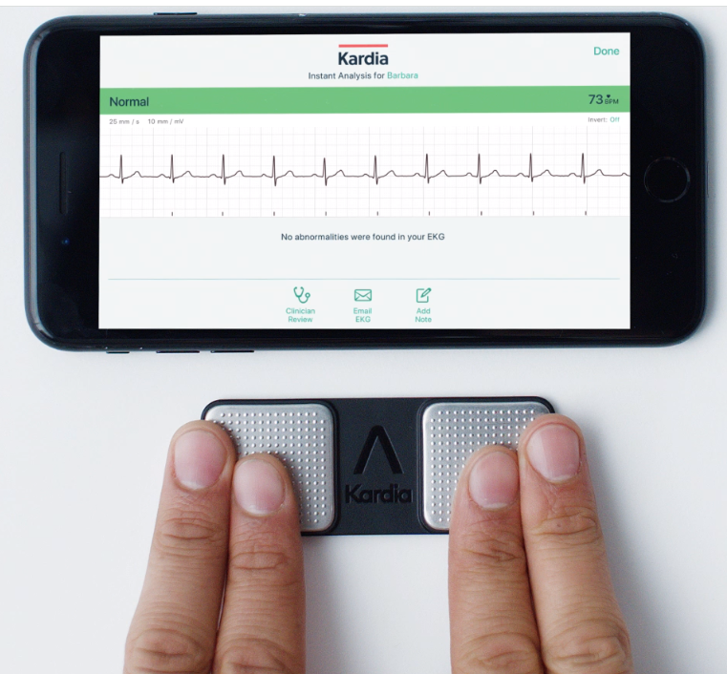
AliveCor also has a less expensive model - KardiaMobile
$99

Slide 13
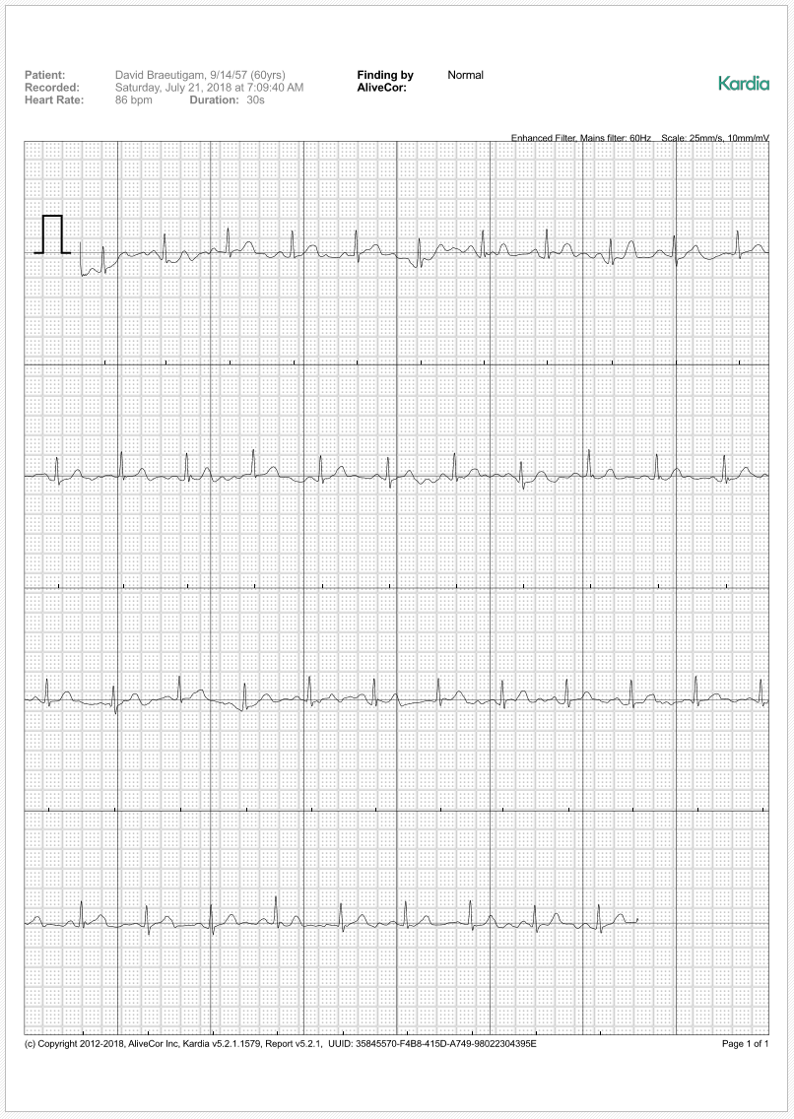
Here is the report you get back from AliveCor on your ECG
You can store it with AliveCor for $10 a month
Or you can just send it to you email in an encrypted PDF format
What lead is being recorded it I am using each finger to record?

Slide 14
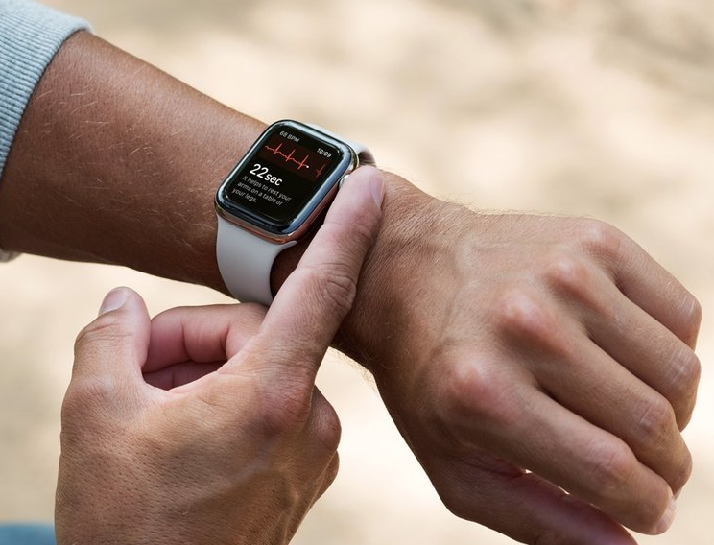
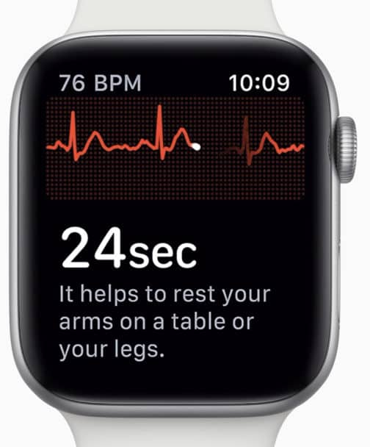
Apple Watch Series 4
Apple just received FDA approval for taking an ECG on an Apple Watch

Slide 15
CVS-Aetna Merger
CVS acquires Aetna for $69 billion
Largest pharmacy and third-largest health insurer
http://thehill.com/policy/healthcare/378145-shareholders-overwhelmingly-approve-cvs-aetna-merger

Slide 16
Cigna to buy Express Scripts
Cigna buys Express Scripts for $67 billion
Express Scripts is the largest independent drug middleman in the U.S.
http://thehill.com/policy/healthcare/377354-cigna-to-buy-express-scripts-in-67-billion-deal

Slide 17
Large Hospital Systems create nonprofit drug company*
Hospital executives expressed frustration over scarcity of essential drugs
“This is a shot across the bow of the bad guys”, said Dr. Marc Harrison, chief executive of Intermountain Healthcare
The hospitals state they are tired of the increasing shortages and price escalation
*NY Times January 18, 2018

Slide 18
Amazon, Berkshire Hathaway and JP Morgan Chase
January 2018 Amazon, Berkshire Hathaway and JP Morgan Chase announced they are working together to create a new health-care venture for their own staff aimed at “improving employee satisfaction and reducing costs”
Will work first on technology as a way to provide simplified, affordable access to medical services
https://www.nytimes.com/2018/01/30/technology/amazon-berkshire-hathaway-jpmorgan-health-care.html
https://www.nytimes.com/2018/01/30/business/amazon-health-care-plan-reaction.html?action=click&contentCollection=Technology&module=RelatedCoverage&region=Marginalia&pgtype=article

Slide 19
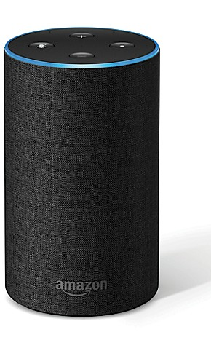
A.I. for the Simple Things
“Amazon could assume drug distribution. They could start to use voice platforms, like Alexa, to help discuss symptoms and get feedback, to coordinate hospital post-op care through voice-activated A.I., to do these and other rote things.”
— Dr. Eric Topol, director, Scripps Translational Science Institute in San Diego
https://www.nytimes.com/2018/01/30/business/amazon-health-care-plan-reaction.html?action=click&contentCollection=Technology&module=RelatedCoverage&region=Marginalia&pgtype=article

Slide 20
Employers in the Patient-Doctor Relationship
“Maybe they will develop some kind of algorithm that can be loaded onto any company software to help employers identify the low-hanging fruit, the patients that are using the most care or the highest-cost drugs. These guys have the data resources to really mine what’s going on, to get in the middle of that patient-doctor relationship. But employees are going to have to sign off on letting their employers really dig into that data.”
— Erin Fox, senior director of drug information, University of Utah Health Hospitals and Clinics
https://www.nytimes.com/2018/01/30/business/amazon-health-care-plan-reaction.html?action=click&contentCollection=Technology&module=RelatedCoverage&region=Marginalia&pgtype=article

Slide 21
Digital Health, Available Anywhere
“Most health care is local, even though people occasionally seek care away from home. So the opportunity is in leveraging telecommunications technology, in taking advantage of internet-based services that can be delivered to you everywhere, which is a movement already growing rapidly throughout health care.”
— David Lansky, chief executive, Pacific Business Group on Health
https://www.nytimes.com/2018/01/30/business/amazon-health-care-plan-reaction.html?action=click&contentCollection=Technology&module=RelatedCoverage&region=Marginalia&pgtype=article

Slide 22
Cutting Out the Middlemen
“With the technology that’s available today, it seems like a logical next step for self-insured companies to administer the health benefit themselves. You could develop a relationship where you’re significantly reducing costs, while still making the providers whole and cutting out so much of the red tape and bureaucracy that currently stymies and frustrates them. The providers’ masters are largely those intermediaries — the health plans, the pharmacy benefit managers. This is a way for companies like Amazon to be the new masters.”
— B. Douglas Hoey, chief executive, National Community Pharmacists Association
https://www.nytimes.com/2018/01/30/business/amazon-health-care-plan-reaction.html?action=click&contentCollection=Technology&module=RelatedCoverage&region=Marginalia&pgtype=article

Slide 23
Doctor as Independent Advocate
“You can imagine them using a different sort of model, where everyone gets a concierge to help them with their health care, to have a primary care doctor be an independent advocate that helps patients navigate the system, not as an agent of the hospital where they have to feed the beast. And then if you need lab tests, an M.R.I., an elective service in the hospital, you would have a health savings account and a marketplace with transparent pricing. And then, if something really bad happens — you get leukemia, you get hit by a bus — the high-deductible insurance kicks in. That’s the way the market is moving anyway, so I bet this is where these companies are likely going.”
— Dr. Rushika Fernandopulle, chief executive, Iora Health, Boston
https://www.nytimes.com/2018/01/30/business/amazon-health-care-plan-reaction.html?action=click&contentCollection=Technology&module=RelatedCoverage&region=Marginalia&pgtype=article

Slide 24
“Alexa I Have a Sore Throat and a Runny Nose”
“This might answer your question …”
“Here is what I found on WikiPedia …”
  Pain medication such as nonsteroidal anti-inflammatory drugs …
  Mayo Clinics advises gargling with salty warm water and resting the voice
  Without treatment the symptoms typically lasts two to seven days

Slide 25
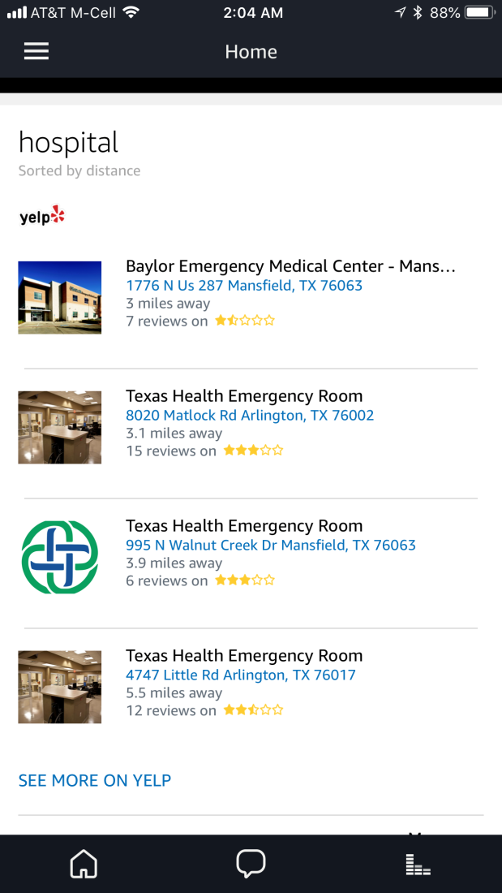
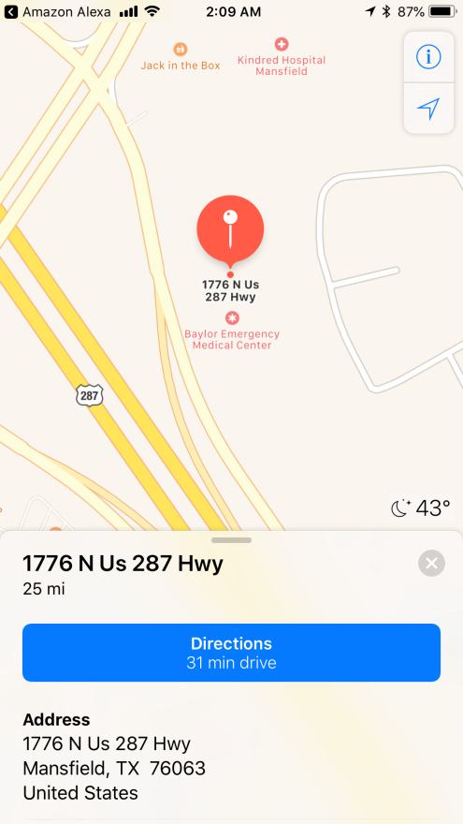
“Alexa What’s the Closest Hospital”
“Based on your zip code settings here are a few examples …”

Slide 26
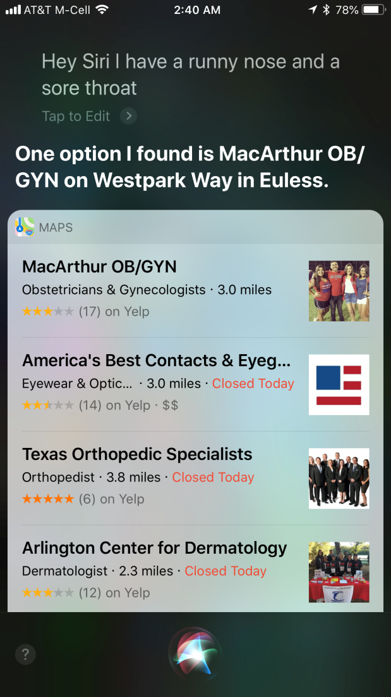
“Hey Siri I have a Runny Nose and a Sore Throat”
Siri wasn’t as good as Alexa in answering this question …
I don’t think an OB/GYN clinic, an eye doctor, an Orthopedic Specialists or a Dermatology Center will help me out!

Slide 27
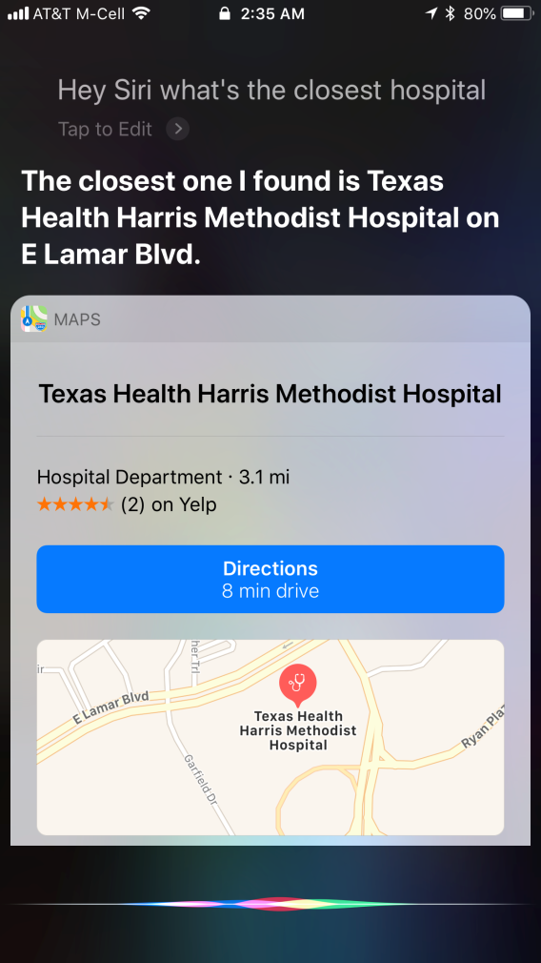
“Hey Siri What’s the Closest Hospital”
Siri was much better at answering this question – even better than Alexa because of the location data (not perfect – this is their corporate headquarters!)
This might be fixed in Alexa by adding your address in the App

Slide 28

Speak to Your CMMS
At least one current CMMS allows you to speak to your phone to document a work order
How’s that for a time saver!

Slide 29

Using an Amazon Echo Show to Consult with your doctor
Imagine being able to talk with a doctor over a device at your home?
Lenovo and Google are designing similar devices for the home

Slide 30
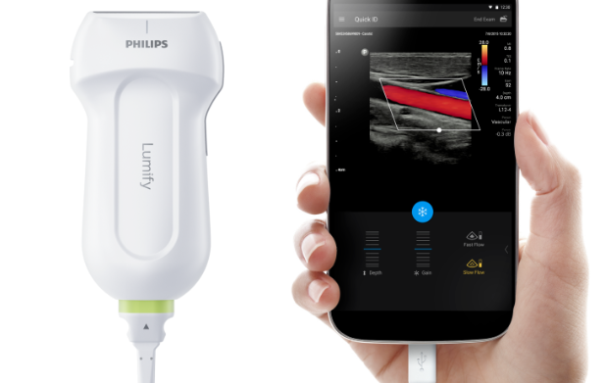
Medical Devices on Your Phone
Ultrasound
EKG
Pulse Oximetry
NIBP
https://www.linkedin.com/pulse/why-digital-app-based-ultrasound-soon-bring-next-medical-sharma/

Slide 31

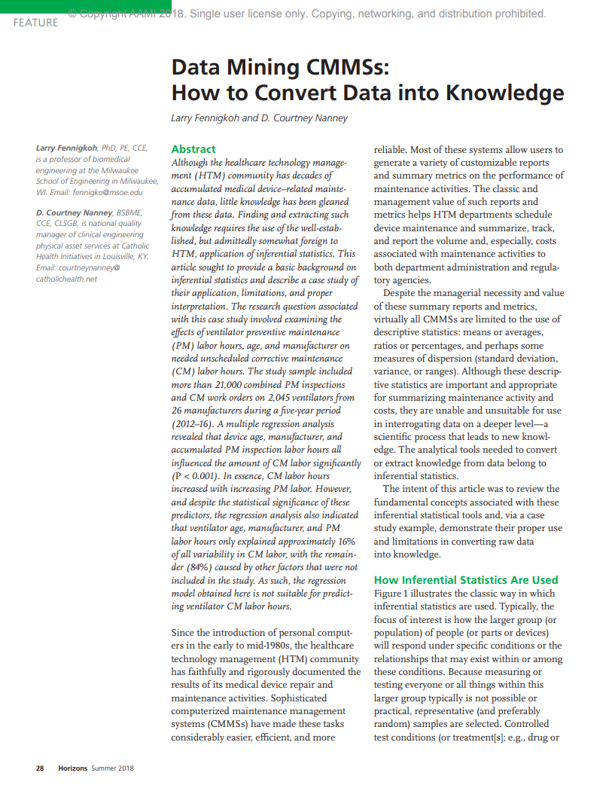
Medical Data and Knowledge
Mine your data in your CMMS to make better informed decisions
Good information is the key to better decisions. Make sure your data is clean and accurate.
AAMI Horizons Summer 2018

Slide 32
Holographic Imaging
Holographic Imaging Market to witness remarkable growth by 2024
Detect serious issues with sensitive organs such as the brain, the abnormalities of which are particularly difficult to interpret
This technology finds applications in ophthalmology, urology, pathology, and orthopedics
http://www.newequipment.com/industry-trends/holographic-imaging-set-take-world-storm

Slide 33
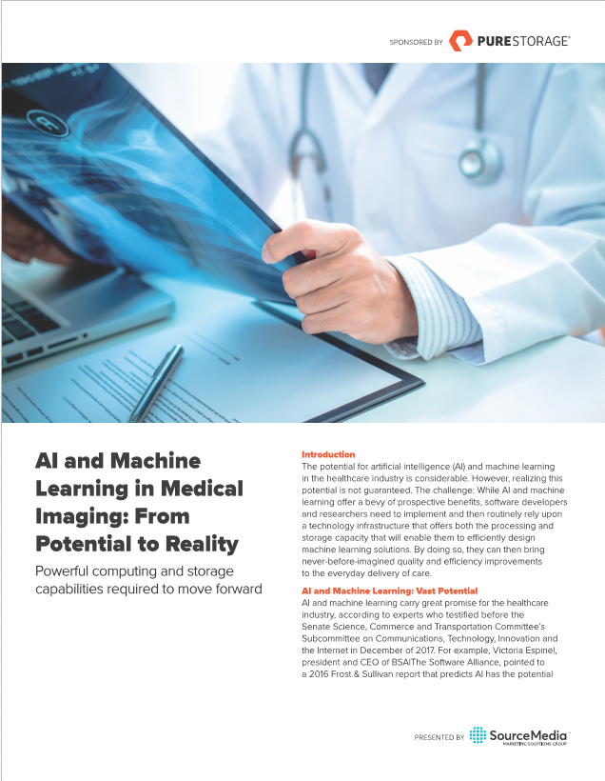
AI and Machine Learning in Medical Imaging
AI could improve health outcomes by 30-40%
Mayo is using it for genetic markers in MRI
Stanford has developed an AI algorithm that can diagnose up to 14 types of medical conditions
Memorial Sloan Kettering using for prostate cancer

Slide 34

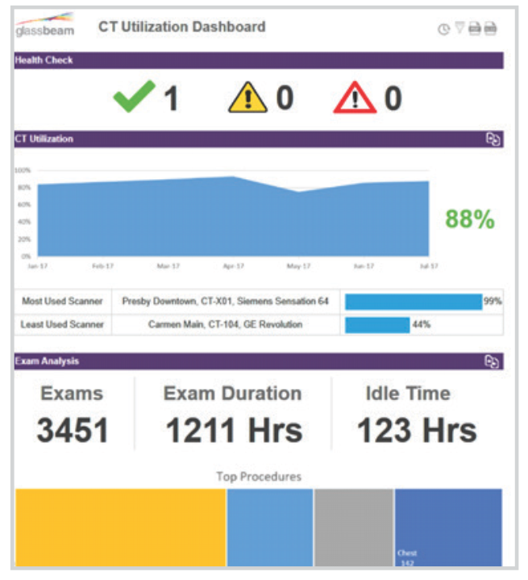
AI and Machine Learning in Medical Imaging
Derive actionable insights from your machine log data
  Know when a tube needs to be replaced
  Increases uptime since you KNOW when to replace components
  Know the usage of devices

Slide 35
AI for the Operating Room
Using AI and computer vision during surgery*
Uses AI to ‘road map’ surgeries as it happens
Reduces risk
Makes surgery safer
*OR Today October 2018 Digital Surgery Deploys Surgical AI System for the Operating Room

Slide 36

Virtual Medicine

Slide 37
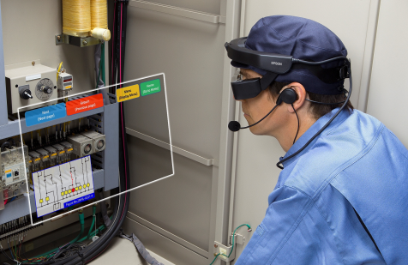
Virtual Training
Milwaukee, Wis – June 1, 2018 With 25 percent of the Healthcare Technology Management (HTM) population expected to retire over the next 10 years, hospitals and healthcare systems face an increasing challenge to train the next generation of professionals safely, affordably and efficiently. At AAMI 2018, GE Healthcare is introducing interactive, customizable training options enabled by Virtual Reality (VR) technology for HTM professionals who service CT and MR equipment.
https://www.genewsroom.com/press-releases/ge-healthcare-introduces-virtual-reality-training-healthcare-technology-management

Slide 38
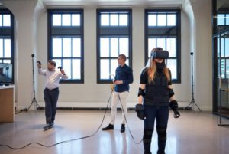
Virtual Reality in Medical Equipment Planning
Initial design of hospitals was on paper
Later mockups were done to give a better idea of flow and room
Newer VR technology will give physicians, clinicians and planners a better idea of space and equipment location
https://mcdmag.com/2017/09/enhancing-healthcare-planning-through-virtual-reality/

Slide 39
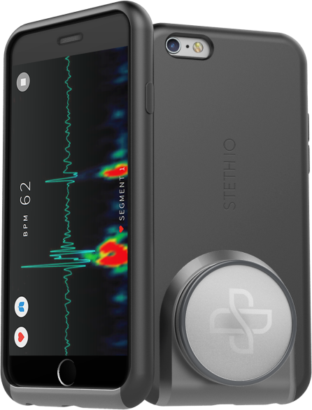
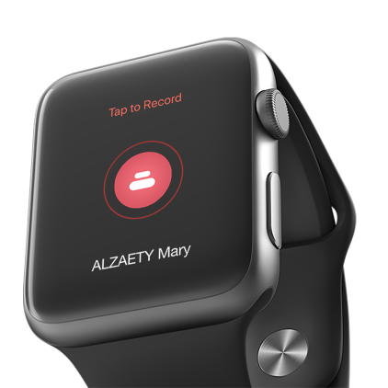
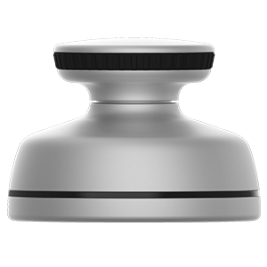
Smart Stethoscopes
Smart Stethoscopes are being designed by several companies that interface with a smart phone or smart watch
https://stethio.com/
https://www.stethee.com/

Slide 40

Robots
Surgical robots
UV cleaning robots
Supply chain robots
https://1technation.com/the-robots-are-coming-who-will-maintain-them/

Slide 41
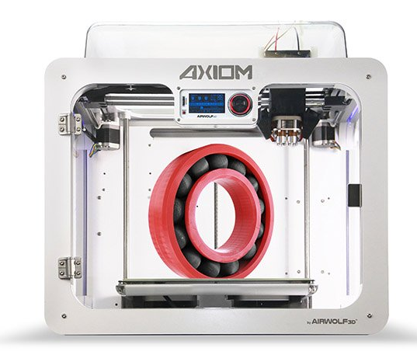
3D Printing
Imagine being able to print parts for your equipment?
The U.S. Military training for BMETs is already working on this at their school in San Antonio, Texas.

Slide 42


Slide 43






Cyber Security and HTM
It continues to be a HUGE issue
HTM and IT need to work TOGETHER to solve
HTM needs staff that understands Cyber Security and how to work with their vendors and IT counterparts
This past AAMI Conference there were more Cyber Security companies displaying their products

Slide 44
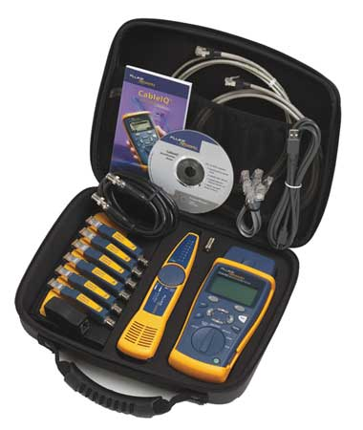
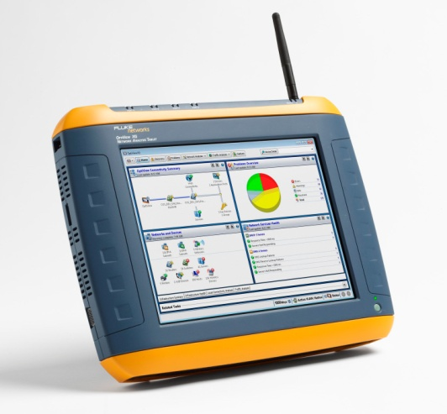


So We Now Have New Tools!

Slide 45
Identify Network Medical Devices
Identify IP address, MAC address, OS version, patch version, virus protection vendor and version, etc.
Identify the type of PHYSICAL security on devices – i.e. cable lock, locked door, etc.
Work with vendors to obtain MDS2 and determine the OS version, patches, etc. that you should be running at for maximum protection

Slide 46
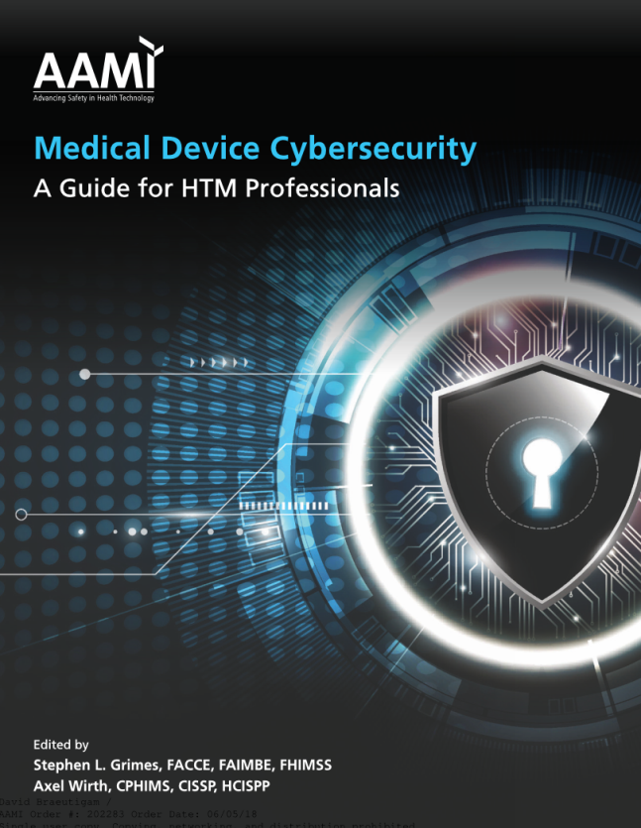
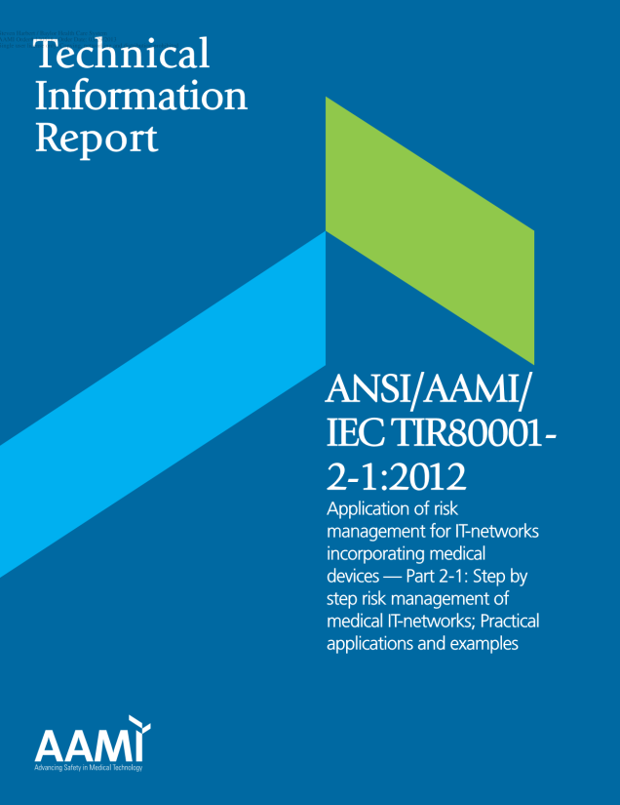
Resources Available
AAMI Medical Device Cybersecurity
IEC 800001
Search BI&T for Cybersecurity papers
Subscribe to information on Cybersecurity
  HealthITAnalytics.com
  HITInfrastructure.com

Slide 47
Future of Medical Devices
Gartner in their healthcare report estimates that “by 2020, the number of medical devices requiring security hardening by a healthcare provider will increase by 45%.”¹
Verizon states that healthcare ranks number two in breaches, which is no surprise.²
¹ Gartner, Top Three Security and Privacy Impacts of Connected Medical Devices on Healthcare Providers, Saniye Burcu Alaybeyi, Marc-Antoine Meunier, Gregg Pessin, 27 September 2017
² “2017 Data Breach Investigations Report,” Verizon

Slide 48
Change is Constant
As a security and risk professional in healthcare, there’s one thing you can always count on – change is constant. Innovative ways of delivering quality care are dramatically transforming the digital landscape in this sector. One of the biggest game changers is the push for new Internet of Things (IoT) devices and other connected technologies designed to enhance patient care and save lives. While these innovations have enormous benefits for patients and caregivers, they come with new security and compliance challenges.
https://www.forescout.com/company/blog/need-strategy-compliance-asset-management-healthcare-facility-start-visibility/

Slide 49
Connected Medical Devices
Do you know how many connected devices you have at your hospital?
Probably 90-95% of your imaging devices are connected
The balance of IV pumps, patient monitoring, EKG carts, Lab equipment, etc. is probably about 25%
Roughly 25-30% of medical equipment is connected NOW!!
Expect that to grow in the future.

Slide 50
So What Does All This Mean for HTM?
Our field is evolving – but it always has
More IT knowledge and IT work will be required
More information about data and what to do with it will be required
WE need to be prepared for these new changes
The CORE of what we do does not change though – providing patient safety!

Slide 51
Questions and Discussion

