Slide 1


Aspiring Leaders: Are you a new leader or aspiring to take on a leadership role?

Slide 2
Presenters
Richard Engdahl, CBET
Certified Biomed, Stanford Health Care
Darwin Fontanares, MBA, BSBMET, CBET
Manager, Stanford Health Care
Donald Armstrong, CBET, CHTM
Sr. Manager, Stanford Health Care

Slide 3
What we are going to discuss
What steps to take to get yourself in line for a leadership role
Being a leader from wherever you are
What it is like to be a brand new leader. Lessons Learned…
What it looks like for a life long Biomed to take a Leadership role
How to manage your life once you are in a leadership role
How to go from Colleague to Leader
Managing staff
Managing Expectations

Slide 4
Richard Engdahl - Who am I?
BS in Biomedical Engineering from Cal Poly: San Luis Obispo
2 years in DaVita, 1 year in SFGH, 2 years in Stanford Healthcare
Graduated 2013, CBET Certified in 2015, BMET III by 2016.

Slide 5
Steps for an aspiring leader
Communicate
  Communicate effectively with your leaders about what you want
Participation
  Participate in your work culture to allow yourself to shine
Contribution
  Ensure your contribution is meaningful and accurate
Education
  Learn about how leadership works

Slide 6
Communication
How well spoken you are
  Verbal and electronic methods
    Perceived professionalism
Communicate with leaders
  Updates on statuses, upcoming projects
Communicate with your leader
  Tell your leader what you want out of your career
  How can your leader help you become what they are?

Slide 7
Participation
Show you are willing to go the extra mile
  Huddles, department events, additional responsibilities
Network in a way so people will remember your name
  Make an effort to meet people in leadership roles
Attended relevant extracurricular conferences

Slide 8
Contribution
Volunteer to offer a solution
  Be the answer people are looking for
Accuracy of fulfillment, building credibility
  Technical repair competencies
  Project completion results

Slide 9
Education
Shadow your leaders
  Ask how? Why? What if?
  Understand their way of thinking and solving problems
Continuous learning
  Taking management classes (HTM)

Slide 10

“Innovation distinguishes between a leader and a follower…”
- Steve Jobs

Slide 11
Darwin Fontanares, MBA, BSBMET, CBET
2012 - BS in Biomedical Engineering Technology (DeVry University)
President of Biomedical Engineering Club at Alma Mater
2012 - Hired as a Biomed Tech by Stanford Health Care
2014 - Master in Business Administration w/ Concentration on Project Management (Keller Graduate School of Business)
2016 – Promoted to Clinical Systems Engineer
2017 – Earned CBET Certification
2017 – Promoted to Senior Clinical Systems Engineer
2018 – Promoted to Manager of Biomedical Engineering at Stanford ValleyCare (Pleasanton, CA)

Slide 12

How was I promoted to a Leadership Role?
COMMUNICATION
- Self-presentation, both verbal & non-verbal, creates long-lasting impressions
- Use “effective communication” → build good-will, inform, and persuade
- 50% of effective communication is “active listening”
- Before presenting a new problem, propose a solution to supplement it
- Be respectful & humble to everyone, regardless of title and rank (2-way street)

Slide 13

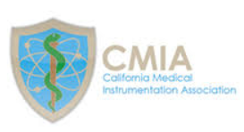
How was I promoted to a Leadership Role?
PARTICIPATION
- Take pride in being a Biomed → show pride in being a Biomed
- From managerial perspective, those who care to learn are easily distinguished
- Shadowing: Supply Distribution, Main OR, ASC, Cath Lab, Clinical System Engineers
- Show genuine care to serve entire department, not just your personal motives
- Never portray entitlement → training and/or promotion is an earned privilege through humility
- Join industry affiliations such as AAMI and CMIA

Slide 14

How was I promoted to a Leadership Role?
CONTRIBUTION
- Never withhold knowledge & skill → SHARE IT!
- True “department heroes” empower others, not undermine them
- Sharing knowledge & skills elevates the entire department
- “People will forget what you said, but they will always remember how you made them feel”
- Created182-page Comprehensive CBET Study Guide for department

Slide 15

How was I promoted to a Leadership Role?
EDUCATION
- Our industry is constantly changing → never be content with what you’ve learned
- To supplement technical skill, pursued an M.B.A. to understand business aspect
- Even with 2 degrees, respect the CBET Certification as the industry standard
- Currently enrolled in a Certified Cisco Networking Associate Program
- Currently studying for the CHTM Certification
- Developed a CBET Study Workshop outside of work to empower others in their career
- Continually invest in yourself → People will continually invest in you

Slide 16

Challenges As a New Leader
New Biomed Department Initiatives & Projects at Stanford ValleyCare:
- Build a new Biomedical Engineering Department from scratch
- Hire 4 new Biomed Techs
- Purchase new tools and preventive maintenance test equipment
- Perform full-audit of 6,000+ medical devices & systems
(retagging all equipment w/ standard identifier labels & PM Stickers)
- Process audit-data into Computerized Maintenance Management System
- Renew 13 expired subcontracts & re-process through SHC Contract Administration
- Collaborate w/ CMMS System Analysts to add new hospital department Cost Centers
- Perform Validation-testing for all Medical Device Software Applications on new Win10
- Develop an IT Cyber-Security plan for all devices that connect to a Network
- Develop FY2019 Biomedical Engineering Expense Report

Slide 17
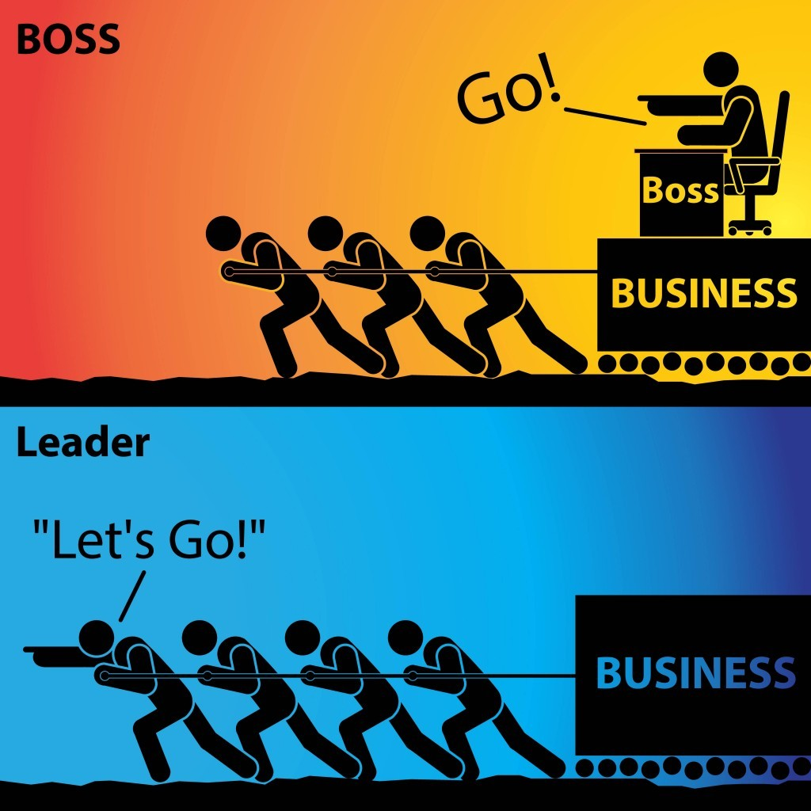
Lessons Learned: From Good to Dynamic Leadership
MANAGERIAL COMPETENCE
EXCELLENT COMMUNICATION
SINCERE ENTHUSIASM
LOYALTY
DECISIVENESS
EMPOWERMENT
CHARISMA
INTEGRITY

Slide 18
“Management is doing things right.
Leadership is doing the right things…”
- Peter Drucker

Slide 19
Don Armstrong, How did I get here?
Been a Biomed for 35 Years (started in 1983)
25 years with Stanford, 6 with GE (in Houston and NYC) and 1 year at UCSF and3 for Smaller Medical Companies
Worked mainly in the OR’s as a Biomed.
Became CBET Certified in 2006
Always Accepted stretch roles
Volunteer as much as I could for AAMI (TMC, Editorial Board, Nominating Committee and Standards)
Became President of HTMA Texas (Local Houston Biomed Association)
Became CHTM Certified in 2016
Became Sr. Manager at Stanford Health Care in 2017

Slide 20
Now that I am here
Take advantage of all leadership courses offered at my Organization
Learning to take time to Learn process’s and getting the know the Team. Learn where the restrooms are. This should take 6 months.
Speak with other leaders in the Biomed Field
Have to reset Work Life balance
Learning to manage E-Mails and Meeting (impossible task)
Finding ways to Lead that are consistent to who I am as a person
Creating Trust, Teams and Networks

Slide 21
What important things to consider
Can you Manage People you know?
Do you want to be an exempt employee?
Are considering leadership just for the raise or promotion?
What got you to where you are know wont get you to be a great Leader
Do you have a trusted leader you can speak to about becoming a leader
Leadership is not a position, it is an Attitude and Mindset.
Are you leading know from where you are?

Slide 22
Hints and Suggestions (Lessons Learned, the Hard Way)
Be your authentic self. If you are in a position to lead it must be because of who you are. It is possible to stay true to who you are and still lead.
This is not a sprint. Give yourself time to grow into the role.
Surround yourself with smart and trustworthy people. I believe if you are the smartest person on your team, you need a new team.
Find Balance, what ever that is to you. Leading teams is a 24/7 job so just know you cant be there every minute so find ways to disconnect.

Slide 23
Question and Comments
Please contact us if you have any questions or comments
If you would like to come visit us Stanford Health Care we would love to give you a tour.
Donald Armstrong, CBET, CHT darmstrong@stanfordhealthcare.org
Richard Engdahl, CBET rengdahl@stanfordhealthcare.org
Darwin Fontanares, MBA, BSBMET, CBET dfontanares@stanfordhealthcare.org

