Slide 1

2018 ACCE Body of Knowledge (BOK) Survey Results
Katherine Navarro, CCE
Bhaskar Iduri, MS, CCE, CHTM
Sarah Brockway, MS
Rehman Syed, MS, CBET, CCE
Notes:
KN
Welcome everyone to the MD Expo session on the 2018 ACCE Body of Knowledge Survey Results
Introduce self and others

Slide 2
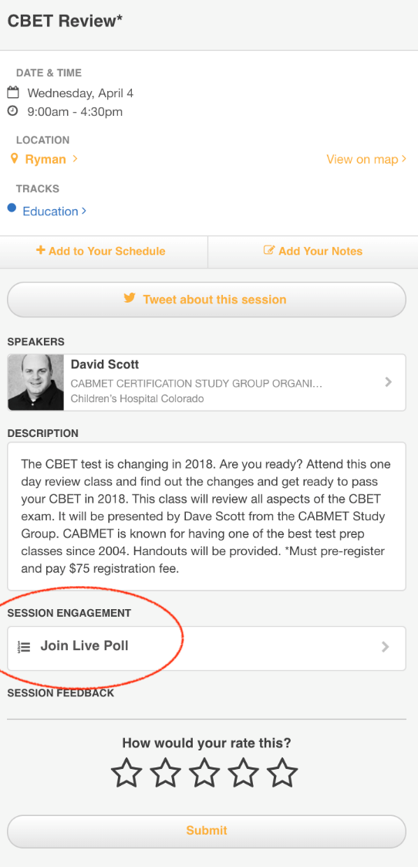
2018 ACCE Body of Knowledge (BOK) Survey Results
We will be using LIVE POLLING throughout the presentation
Download the MD Expo 2019 app
Find the “2018 ACCE Body of Knowledge (BOK) Survey Results” Session
“JOIN LIVE POLL”
Notes:
KN
Change screen shot of our session in MD Expo app when published
During our presentation we will be asking the audience some of the survey questions to see how your results compare to the results from the official survey.
To do this we will be using the Live Polling feature on the MD Expo 2019 app, so if you have not already, please take a moment to download the MD Expo 2019 app now!
Once you are in the app, find our session “ 2018 ACCE Body of Knowledge (BOK) Survey Results”
Then click “Join Live Poll”
We’ll give you a minute to do this.

Slide 3
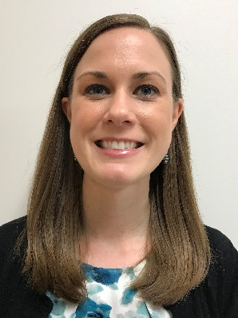
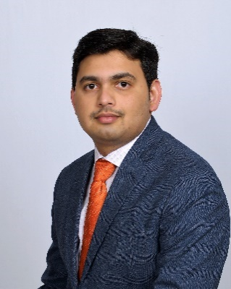
About the speakers
Katherine Navarro, CCE
  Biomedical Engineer with the South Texas Veterans Health Care System in San Antonio, TX
  10 years experience in Clinical Engineering
  ACCE BOK Committee Chair 2017 – 2019
Bhaskar Iduri, MS, CCE, CHTM
  Director of Clinical Engineering & QA with RENOVO SOLUTIONS LLC in Irvine, CA
  8 years experience in Clinical Engineering
  ACCE, BOK Committee member
  AAMI, Technology Management Council Member
  ISO 9001:2015 trained internal auditor
Notes:
KN, BI
Katherine Navarro - Staff Biomedical Engineer for the South Texas Veterans Health Care System, San Antonio, TX – primarily project management for new equipment implementations
Started career in VA in 2009 through the Technical Career Field (TCF) Trainee Program for Biomedical Engineers
In July I’ll have 10 years of experience in the HTM/CE field
In 2015 I became a certified Clinical Engineer
Currently the Chair of the Body of Knowledge Committee for the ACCE

Slide 4

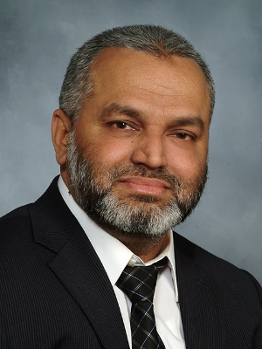
About the speakers
Sarah Brockway, MS
  Clinical Engineer at Kaiser Permanente, Northern California Regional Office in Berkeley, CA since 2017
  Began Clinical Engineering through University of Connecticut Clinical Engineering Internship program in 2015
  ACCE BOK Committee member 2015-present
Rehman Syed, (Syed) BE, MS, CBET, CCE
  Director, Clinical Engineering, Health and Hospital Corp, NYC
  Employed by Crothall HTS Compass Group
  Two decades of Clinical Engineering Experience
  Member of ACCE, “BOK Committee” and “ACCE FDA Task Force”
  AAMI’s “National Coalition for Alarms Management Safety” committee
  AEHIT Education Committee, ACHE NJ Diversity Committee
Notes:
SB and RS

Slide 5
Session Outline
ACCE Organization
Body of Knowledge (BOK) Committee
2018 BOK Survey
  Description
  Survey topic results and analysis
  Key take-aways
Suggestions for 2021 BOK Survey
Notes:
RS

Slide 6

Live Poll – Go to the MD Expo App!
Are you a member of ACCE?
  Yes
  No
Did you take the BOK survey in 2018?
  Yes
  No
Notes:
RS

Slide 7
American College of Clinical Engineering (ACCE)
Description of ACCE organization
  Founded in 1990, ACCE is committed to enhancing the profession of clinical engineering worldwide.
ACCE Mission:
  To establish a standard of competence and to promote excellence in clinical engineering practice
  To promote safe and effective application of science and technology in patient care
  To define the body of knowledge on which the profession is based
  To represent the professional interests of clinical engineers
Notes:
RS

Slide 8
Body of Knowledge (BOK) Committee
Description of BOK Committee
  Consists of a Chair and 4 members
  Reports to the ACCE Board
Tasked with the following:
  Administration and analysis of the BOK survey
  Revision of the ACCE CCE Study Guide
  Other tasks as requested
Volunteers always needed!
Notes:
RS
Other tasks as requested – definition of Clinical Engineer, pamphlets, banner
Ask audience who wants to volunteer for ACCE – then mention volunteers are always needed. If you want to volunteer, please stop by the ACCE booth in the foyer or contact us.

Slide 9
Body of Knowledge (BOK) Survey
Purpose
  To develop the scope of practice for Clinical Engineers
  Survey results are used to design the Clinical Engineering Certification (CCE) exam to closely match the knowledge needed for clinical engineering roles
Previous surveys performed approximately every 3-5 years:
  2005, 2010, 2015, 2018
Notes:
RS

Slide 10
Body of Knowledge (BOK) Survey
Improvements from the 2015 survey
  Assess respondent eligibility to take the CCE Exam
  Revise definitions to better describe profession options
  Add regulatory compliance as an option for profession, position, and employer
  Add CHTM, S+, EIT, Lean Six Sigma, FACHE, FACCE certifications
  Match Categories of Work and Responsibilities sections to topics in the ACCE CCE Exam Handbook
  Expand Knowledge topics to capture additional work duties
Notes:
RS
Improvements from the 2015 survey from lessons learned of previous surveys
We looked at the CCE exam handbook to get the most recent list of topics and matched the categories of work and responsibilities listed in the survey to the handbook
Knowledge topics added – pharmacy, research, infection control, regulatory, facilities management, project management
EIT – Engineer in Training
S+ - CompTia Security Plus

Slide 11
Body of Knowledge (BOK) Survey
Number of responses
  534 responses
  13% increase in responses from 2015
Survey duration and distribution
  Open longer - approximately 6 months
  Open during HIMSS and AAMI 2018 conferences
  Primarily sent through email to HTM professionals
  Advertised on the ACCE website, social media sites and professional organizations
  Included three raffle prizes for participation
Notes:
RS
We received 534 responses to the survey, though not all respondents answered all questions
Requests to participate primarily sent through emails to peers in the field
(1 free membership/renewal to ACCE and 2 $30 Amazon gift cards).
Professional organizations: the survey was also shared by many other organizations as ABEClin (Brazilian Association for Clinical Engineers), CMBES (The Canadian Medical and Biological Engineering Society), ASPIC (Asociacion Peruana de Ingenieros Clinicos ), and many States Associations as NCBA, CEAI.
Social Media – LinkedIn, Twitter, Facebook

Slide 12
Body of Knowledge (BOK) Survey
Major Survey Topics – Visual Representation
Notes:
BI

Slide 13
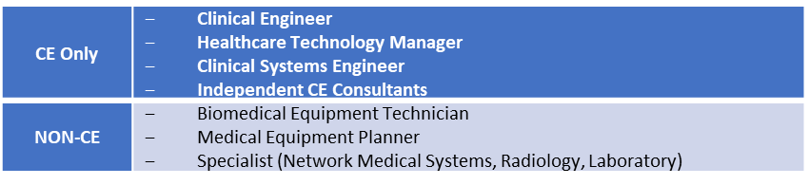
Body of Knowledge (BOK) Survey
Analysis of survey data:
  Categorized the respondents into two sets:
    CE Only and Non-CE
  CE Only – 373 of the 534 responses
    Respondents self-identified as Clinical Engineers, Healthcare Technology Managers, or Clinical Systems Engineers
Notes:
BI

Slide 14
Demographics - Country
  534 respondents
  Majority from USA
  Brazil most represented outside of USA
  Comparison to 2015 – Brazil responses dropped from 98 (28%) in 2015 to 52 (9.7%) in 2018
Notes:
SB

Slide 15
Live Poll – Go to the MD Expo App!
What is your current employer?
  Hospital/Clinic/Health System
  Independent Service Organization
  Medical Equipment Vendor
  Student
  Other
What is your current profession?
  Clinical Engineer
  Clinical Systems Engineer
  Healthcare Technology Manager
  Biomedical Equipment Technician
  Specialist (Lab, Radiology, Networking)
  Medical Equipment Planner
What is the primary nature of your present position?
  Healthcare Technology Management
  Service Delivery (i.e. equipment repair and maintenance)
  Consulting
  Project Management
  Equipment Planning
  Other
Notes:
SB

Slide 16
Demographics – Current Employer
  534 respondents
  Majority work in a hospital/clinic/health system
  Comparison to 2015 – ISO responses increased from 36 (8%) in 2015 to 80 (15%) in 2018
Notes:
SB
Other includes the following options – other, academia, medical equipment manufacturer, consulting firm, student, regulatory/accreditation agency, non-medical industry, international aid organization

Slide 17
Demographics - Profession
512 respondents
Majority are Clinical Engineers, followed by Healthcare Technology Managers and Biomedical Equipment Technicians
Notes:
SB
CLINICAL ENGINEER (an engineering professional who focuses on healthcare technology planning, evaluation, management, analysis, education, support and regulatory compliance)
CLINICAL SYSTEMS ENGINEER (an engineering professional that focuses on ensuring the effective deployment, integration and support of multi-component and interconnected medical systems)
HEALTHCARE TECHNOLOGY MANAGER (a management personnel responsible for planning and directing activities of others, monitoring their work, and taking corrective actions when necessary in the support of healthcare technology)
BIOMEDICAL EQUIPMENT TECHNICIAN (a technical professional who focuses on inspection, testing and repair of medical devices and systems)
SPECIALIST (a field modality expert who demonstrates a working knowledge of clinical equipment such as radiology, laboratory, biomed, networking)
Specific Specialty:
Radiology
Laboratory
Network Medical Systems
MEDICAL EQUIPMENT PLANNER (a technical professional who focuses on implementation of healthcare technology during planning, design, and construction of healthcare facilities)

Slide 18
Demographics – Primary Nature of Present Position
491 respondents
A majority identify themselves in Healthcare Technology Management
Comparison to 2015: Healthcare Technology Management positions increased from 37.8% in 2015 to 67% in 2018
Notes:
SB
Out of all respondents, 328 (66.8%) selected Healthcare Technology Management as their primary nature of their present position. Similarly, out of CE Only respondents, 272 (75.8%) also selected Healthcare Technology Management as their primary position. For the All Respondents and CE Only groups, all other positions were 10% or less. The Non-CE group had 56 (42.4%) select Healthcare Technology Management as their primary position, which is the majority, but there were also 39 (29.5%) that selected Service Delivery and 22 (16.7%) that selected Professional Support.

Slide 19
Demographics – Highest Degree Attained
480 respondents
Most had either a 4-Year or 6-Year Degree
In the Non-CE group, the majority had a 2-Year Degree
Notes:
SB
In the All Respondents group, the majority of the respondents have either a 4-year degree (30.8%) or a 6-year degree (39.2%), and less than a fifth (18.3%) of the respondents have only a 2-year degree. In the CE Only group, almost half (49.7%) of the respondents have a 6-year degree and a third of the respondents (32.8%) have a 4-year degree. In the Non-CE group, about half (48.4%) have only a 2-year degree and a fourth of the respondents have a 4-year degree.
This disparity confirms that the CE Group is comprised of mainly engineers and the Non-CE group is comprised mainly of technicians

Slide 20
Demographics – Degree in Engineering
480 respondents
Majority have a Degree in Engineering
Notes:
SB

Slide 21
Live Poll – Go to the MD Expo App!
How many years of experience do you have in the HTM field?
  0-5 years
  5-10 years
  10-15 years
  15-20 years
  20-25 years
  25-30 years
  >30 years
Are you eligible to take the CCE exam?
  Yes
  No
  Unsure, do not know eligibility requirements
Notes:
KN
Okay everyone – go to the live polling in the MD Expo 2019 app and answer the following questions:
How many years of experience do you have in the HTM field?
0-5 years
5-10 years
10-15 years
15-20 years
20-25 years
25-30 years
>30 years
Are you eligible to take the CCE exam?
Yes
No
Unsure, do not know eligibility requirements

Slide 22
Demographics – Years of Experience
508 respondents
21.3% had 0-5 years of experience
19.7% had greater than 30 years of experience
Notes:
KN
Here are the survey results for the years of experience question that you all just answered – (compare to live results)
Go over the year ranges and percentages
We had 508 respondents to this question
The highest percentage, 21.3% had 0-5 years of experience, followed closely behind those who had greater than 30 years of experience (19.7%)
Comparison to 2010: A majority had from 0 to 5 years of experience, whereas in 2010, the majority had more than 20 years of experience. This shows that the field is gaining new people.

Slide 23
Demographics – CCE Eligibility
CCE Eligibility
  Licensure in the United States as a Professional Engineer (PE)
    3 or more years of clinical engineering practice
  BS or higher degree in engineering (EAC/ABET accredited program)
    4 or more years of engineering practice, including 3 or more years of clinical engineering practice
  BSET degree in engineering technology (TAC/ABET accredited program)
    8 or more years of engineering practice, including 3 or more years of clinical engineering practice
  Licensure in Canada as a Professional Engineer (PE)
    3 or more years of clinical engineering practice
Link to CCE Handbook: https://accenet.org/CECertification/Documents/CCE_Handbook.pdf
Notes:
KN
The second polling question you answered asked if you were eligible to take the CCE exam – for everyone who answered that you did not know, here are the eligibility requirements:
Licensure in the United States as a Professional Engineer (PE)
3 or more years of clinical engineering practice
BS or higher degree in engineering (EAC/ABET accredited program)
4 or more years of engineering practice, including 3 or more years of clinical engineering practice
BSET degree in engineering technology (TAC/ABET accredited program)
8 or more years of engineering practice, including 3 or more years of clinical engineering practice
Licensure in Canada as a Professional Engineer (PE)
3 or more years of clinical engineering practice
The Certification in Clinical Engineering is offered by ACCE (American College of Clinical Engineering)
The examination process for this certification is administered by the HTCC (Healthcare Technology Certification Commission) affiliated with ACCE
This certification provides formal recognition of individual competence in Clinical Engineering
Clinical engineering certification is a three-step process: (1) application review by the US and Canadian Board of Examiners for Clinical Engineering Certification consisting of eligibility qualifications and three references, (2) written exam of 150 multiple-choice questions, and (3) oral exam where you have to respond to questions on three clinical engineering scenarios
Clinical Engineering Certification Program:
Purpose: The purpose of certification is to promote healthcare delivery improvement through the certification assessment of competency of professionals who support and advance patient care by applying engineering and management skills to healthcare technology.
1 – The certification process includes establishing and measuring: the level of knowledge, the ability to communicate that knowledge, the ability to use that knowledge to solve problems in healthcare technology, that are required for certification as a clinical engineer
2 – Providing a standard for certification, thereby assisting the employer, public and members of the health professions in the assessment of the clinical engineers
3 – Recognizing formally those individuals who met the eligibility requirements of the Board and pass the Certification examination
4 – Requiring continued personal and professional growth in the practice of clinical engineering to maintain certification
2019 Certification Examination:
Application Deadlines:
- Testing in the US & Canada: July 19, 2019
- Testing outside the US-Canada: June 22, 2019
The computerized written examination will be available from November 2, 2019 thru November 16, 2019
For detailed information and to apply, go to:
https://accenet.org/CECertification/Pages/Default.aspx

Slide 24
Demographics – CCE Eligibility
496 respondents
Majority are eligible for the CCE exam
Notes:
KN
Asking respondents to identify their eligibility for CCE examination is new to the 2018 survey.
In the survey, we provided the eligibility requirements, so the respondents would know if they were or were not eligible.
We wanted to collect this information to find out the amount of potential CCE exam takers.
Here are the survey results for CCE Eligibility – state percentages
We had 496 respondents to this question, and as you can see the majority of the respondents are eligible for the CCE exam.

Slide 25
Demographics – Not CCE Eligible and in CE Positions
196 respondents are not eligible for the CCE exam
52% of these respondents are in CE positions
More individuals starting their careers as Clinical Engineers
Notes:
KN
We also thought it would be telling to look further at the responses that said they were not CCE eligible and filter them by CE positions and non-CE positions
These were the results we got – Of the 196 respondents that were not eligible to take the CCE exam, 52% are in CE positions currently (clinical engineer, healthcare technology manager, clinical systems manager), and 48% are in non-CE positions (medical equipment planner, biomedical equipment technician, specialist)
These results could indicate that there are more individuals starting their careers as Clinical Engineers and may become eligible in the near future, since a major portion of the CCE exam eligibility is years of experience. This is also highlighted in the years of experience question with the majority having 0-5 years of experience
Confirms importance of this survey and interest in CCE exam (Assumed interest based on eligibility)

Slide 26
Demographics - Certifications
306 respondents
Most held either a CCE or CBET certification
Notes:
KN
The last section of the demographics we wanted to discuss is the certifications. The graph shows the percentage of respondents that have each type of certification.
The percentages will not add up to 100%, since people can have multiple certifications
CCE (includes HTCC certified and ICC certified (older form of certification through AAMI)) – 29.1%, CBET – 25.2%, CompTia A+, N+, S+ (any of them) – 22.6%, PE – 17%, LEAN Six Sigma – 15.7%, CHTM – 9.2%, PMP (PMI certified Project Management Professional) – 4.6%, FACCE (Fellow of the American College of Clinical Engineering) – 3.6%, FACHE (Fellow of the American College of Healthcare Executives)– 1.6%
There were 306 respondents to this survey question, and from the results most respondents held either a CCE or CBET certification.
Many respondents also have the following certifications: IT/Networking (23%) (To include CompTIA A+, N+, S+), PE (17%), and LEAN Six Sigma (16%).

Slide 27
Knowledge and Responsibilities
Scale and Weighting:
    Used to quantify the importance rankings for both sections
KNOWLEDGE
IMPORTANCE | WEIGHT
Minor Importance | 1
Moderate Importance | 2
High Importance | 3
RESPONSIBILITIES
IMPORTANCE | WEIGHT
No Importance | 0
Minor Importance | 1
Moderate Importance | 2
High Importance | 3
Notes:
BI

Slide 28
Knowledge – Top 10 Areas
KNOWLEDGE
ALL RESPONDENTS | RANK
Physiological Monitoring | 2.6
Surgical Equipment | 2.6
General Medical / Nursing Equipment | 2.6
Anesthesia | 2.5
Regulatory | 2.5
Presentation Skills | 2.4
Medical Imaging | 2.4
Computers, Networking, IT / Security | 2.4
Respiratory Therapy | 2.4
Project Management | 2.4
KNOWLEDGE
CE ONLY | RANK
Physiological Monitoring | 2.6
Project Management | 2.6
Surgical Equipment | 2.6
Presentation Skills | 2.6
General Medical / Nursing Equipment | 2.6
Regulatory | 2.6
Anesthesia | 2.6
Medical Imaging | 2.5
Respiratory Therapy | 2.5
Computers, Networking, IT / Security | 2.5
Project Management – knowledge area added this year
Notes:
BI
The top 10 Knowledge categories were the same (albeit with slightly different rankings) between All Respondents and the CE Only Group.
Project Management was one of the Knowledge categories that was added this year to the survey.
was in the top 10 for the All Respondents group and was the second highest in the CE Only group.

Slide 29
Knowledge – Top 10 Areas
KNOWLEDGE
ALL RESPONDENTS | RANK
Physiological Monitoring | 2.6
Surgical Equipment | 2.6
General Medical / Nursing Equipment | 2.6
Anesthesia | 2.5
Regulatory | 2.5
Presentation Skills | 2.4
Medical Imaging | 2.4
Computers, Networking, IT / Security | 2.4
Respiratory Therapy | 2.4
Project Management | 2.4
KNOWLEDGE
CE ONLY | RANK
Physiological Monitoring | 2.6
Project Management | 2.6
Surgical Equipment | 2.6
Presentation Skills | 2.6
General Medical / Nursing Equipment | 2.6
Regulatory | 2.6
Anesthesia | 2.6
Medical Imaging | 2.5
Respiratory Therapy | 2.5
Computers, Networking, IT / Security | 2.5
Project Management – knowledge area added this year
Notes:
BI
The top 10 Knowledge categories were the same (albeit with slightly different rankings) between All Respondents and the CE Only Group.
Project Management was one of the Knowledge categories that was added this year to the survey.
was in the top 10 for the All Respondents group and was the second highest in the CE Only group.

Slide 30
Responsibilities - Summary
CATEGORY OF WORK | RESPONSIBILITY | RANK
Technology Management | Technology Assessment | 2.5
 | Product Selection / Vendor Selection | 2.2
 | Inventory Management | 2.2
 | Life Cycle Analysis | 2.2
 | Device Integration Planning | 2.2
Service Delivery Management | Equipment Repair and Maintenance | 2.3
 | Service Contract Management | 2.2
 | Equipment Performance Testing | 2.2
Product development | Regulatory Compliance Activities | 2.0
 | Documentation Development / Management | 1.8
Information Technology (IT) Management | Integration of Medical Device Data | 2.0
 | Information Technology (IT) Management | 2.0
Education | Technician Education | 2.4
 | Engineering Education | 2.2
Facilities Management | Facility Emergency Preparedness Activities | 1.4
 | Building Plan Review | 1.3
 | Emergency Electrical Power | 1.3
Risk Management/ Safety | Patient Safety | 2.8
 | Product Safety / Hazard Alerts / Recalls | 2.3
General Management | Staff Skills / Competency Assessment | 2.2
 | Policy/Procedure Management/Development | 2.1
 | Budget Development/Execution | 2.1
 | Staffing | 2.1
Patient Safety received the highest score
Notes:
BI
Patient Safety was the Responsibility that received the highest score of all Categories of Work, which confirms that patient safety is paramount in the HTM field.
The following tables summarize the top two responsibilities (or more, if a tie existed) in each of the Categories of Work. The tables are divided into two groups: All Respondents and CE Only. The difference in responsibilities between these two groups is most evident in the Technology Management and Service Delivery Management Categories of Work. In Technology Management, for All Respondents, the top responsibilities are Technology Assessment, Product Selection / Vendor Selection, Inventory Management, Life Cycle Analysis, and Device Integration Planning. For the CE Only group, Technology Assessment still ranked highest, but the responsibilities that ranked second were slightly different: Product Selection / Vendor Selection, Life Cycle Analysis, Project Management, and Healthcare Technology Strategic Planning. In Service Delivery Management, for all respondents, the top responsibilities are Equipment Repair and Maintenance, Service Contract Management and Equipment Performance Testing, in that order. For the CE Only group, however, Service Contract Management jumps to the top position, and Maintenance Software (CMMS) Administration and Technician/Service Supervision (two responsibilities not in the top list for all respondents) tie with Equipment Repair and Maintenance. Also, important to note, the responsibility that received the highest score out of all Categories of Work and in both groups, was Patient Safety, which confirms that in the Healthcare Technology field, patient safety is paramount.

Slide 31
Live Poll – Go to the MD Expo App!
Please choose the top three categories of work in which you spend the majority of your time in your current position. (multiple selection)
  Technology Management
  Service Delivery (i.e. equipment repair and maintenance)
  Product Development
  Information Technology (IT) / Telecommunications
  Education of Others
  Facilities Management
  Risk Management / Safety
  General Management
  Other
Notes:
BI

Slide 32
Categories of Work
512 Respondents
Technology Management and Service Delivery Management were the top two Categories of Work among all groups
Comparison to 2015 – For CE Only group, time spent in IT Management increased from 6.8% to 9.4% in 2018
Notes:
BI
Technology Management and Service Delivery Management were the top two Categories of Work among all groups, but the order differed depending on the group. The CE Only Group, which is comprised mainly of engineers and managers, showed Technology Management as the most important; whereas the Non-CE Group, which is comprised of mainly technicians, showed Service Delivery Management as the most important.
Comparison to 2015 - percent of time spent in IT Management for the CE Only group, increased from 6.8% to 9.4% in 2018. This shows that IT is playing a more integral role in the HTM field.

Slide 33
Categories of Work - Professions
IT Management was the second highest Category of Work for the Clinical Systems Engineer
Notes:
BI
IT Management was the second highest Category of Work for the Clinical Systems Engineer, showing the importance of IT integration in their daily tasks.
We also looked at the percentage of time spent in each category of work for each different profession group. When compared to all other groups, the Biomedical Equipment Technician group spends a greater amount of time in Service Delivery Management (39.5%) rather than Technology Management (17%), whereas all the other professions spent the most time in Technology Management (21.7% - 32.2%). In looking at the Information Technology (IT)/Telecommunications category of work for the all respondents, CE and Non-CE Groups, the percentage of time spent was similar (8% - 9.4%). However, when we filtered the responses by position, we noticed a significant variation in the amount of time spent in the IT category for Biomedical Equipment Technician, Clinical Engineer and Clinical Systems Engineer. The Biomedical Equipment Technician spends only 6.4% of their time on IT, whereas the Clinical Engineer spends a little higher at 9.0% and the Clinical Systems Engineer is the highest at 16.9% (2nd ranked category of work for that position).

Slide 34
BOK Survey – Where the Field is Headed
Key Take-Aways:
  Increase in participation rate of the field
  Increase in new Clinical Engineers (CEs)
  Increase in Healthcare Technology Management positions
  Project management is a key knowledge area for CEs
  Time dedicated to IT Management is increasing
  Recommended certifications – CCE, CBET, CompTIA (A+, N+, S+)
  Patient Safety is the most important responsibility
Notes:
KN
We realize that this survey collected a lot of information and that it may be overwhelming to understand what it means to you, so we wanted to leave you with some key take-aways on where we believe the field is headed based on our survey data analysis. These also underscore the need for and importance of this survey for the Clinical Engineering field.
Increase in participation rate of the field
More people, more interest, more aware of benefits of survey, allows us to get more precise results to share with HTCC for the creation of the CCE exam
Increase in new clinical engineers
(0-5 years of experience)
Field is gaining new people, long-term growth of the field
Focus on training new (less experienced) staff, succession planning – retirements causing need for new staff
Increase in Healthcare Technology Management positions
37.8% in 2015 to 67% in 2018, more employers may be recognizing the need for this position in their organizations. Could also be from the re-branding of Biomedical/Clinical engineering by AAMI a few years ago.
Project management is a key knowledge area for Clinical Engineers
Identified this year with the addition to the survey, clearly it was a needed addition
2nd highest for CE, top 10 overall
Project management training
Time dedicated to IT Management is increasing – I think we all are probably seeing this increase in our own organizations, but these survey results confirm it
Look at hiring Biomed/IT techs
Get IT/networking training
Recommended certifications – CCE, CBET, CompTIA (A+, N+, S+) – based on the survey results percentages these are the most popular
Most had CCE or CBET
CompTIA training recommended due to increase in IT Management time
Patient Safety is the most important responsibility – this has remained the same from the 2015 survey, and I think everyone can agree that that patient safety is paramount in what we do a clinical engineers.

Slide 35
BOK Survey – 2021
Suggestions for Improvements
  Ask respondents about ACCE membership and length of membership
  For the respondents that are not CCE, ask them if they plan on taking the exam in the future
  Ask respondents if their employer provides an incentive for obtaining certifications
  Ask for additional details on IT Management and Project Management
What did you think of the 2018 BOK survey?
What improvements would you like to see for the next survey?
Notes:
KN
After the survey closed and we were analyzing the results, we had a few moments where we wished we had asked something additional on the survey, so we made the following list of suggestions for improvements for the 2021 BOK survey cycle:
Ask respondents about ACCE membership and length of membership – this could help provide statistics to ACCE for actionable responses to get more members or keep them longer
For the respondents that are not CCE, ask them if they plan on taking the exam in the future – help us judge the actual interest in the CCE exam instead of assumed interest based on eligibility
Ask respondents if their employer provides an incentive for obtaining certifications – could see if those that provide incentives have more certifications – could be a best practice to industry
Ask for additional details on IT Management and Project Management – what are you managing – network security for medical devices, medical equipment implementations, etc.
What did you think of the 2018 BOK survey?
What improvements would you like to see for the next survey?

Slide 36

Questions?
Notes:
KN
That concludes our presentation. We hope you enjoyed learning about the results from our BOK survey and the direction the clinical engineering field is headed based on our analysis.
Thank you again to everyone who took the survey – your input helps the CCE board of examiners and the entire clinical engineering field!
Do you have any questions for our group?

Slide 37
ACCE BOK Committee
Email address: bokchair@acccenet.org
secretariat@accenet.org
Website:
https://accenet.org
Notes:
KN
Thank you again for your attention today! If you have any further questions or would like to volunteer with the BOK committee or ACCE, please contact us at the following addresses.
And check out the ACCE website for lots of great information!
Have a great day and enjoy the rest of MD Expo!

