Slide 1


Slide 2

Introduction
Benjamin Stock
Ben.Stock@ssmhealth.com
@StockHIT

Slide 3

Are You Doing Enough to Protect Patient Data?

Slide 4
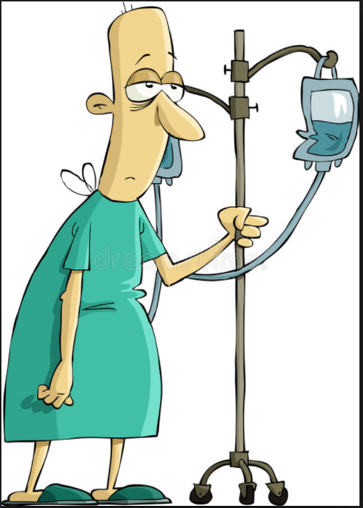
Are You Doing Enough to Protect Your Patient and Their Data?
+

Slide 5

Is Cybersecurity A Patient Safety Risk?
Should security vulnerabilities be handled like safety recalls?
How do we rate security vulnerabilities?
Are hackers out to hurt people or make money?

Slide 6
What Are You As An HTM Organization Doing?
Does your organization have a person dedicated to medical device security?
Are you pushing vendors for better security when purchasing equipment?
Are you part of the process when new medical devices are purchased?
When security vulnerabilities are discovered are you pressuring manufacturers for solutions?
Are you or your IT department scanning your network for vulnerable devices?
Have you implemented any network access control (NAC) policies?

Slide 7
What is ePHI
Electronic protected health information (ePHI) refers to any PHI that is covered by the Health Insurance Portability and Accountability Act of 1996 that is stored, created, transmitted, received or viewed in an electronic format.
For clinical devices the most common forms of ePHI are:
Names
Dates (other than year)
Medical Record Numbers (MRN)
Full face photographs
Any other unique identifying number

Slide 8
Basics of protecting ePHI
Limit physical access to devices that contain ePHI
Create easy to use access management policies and tools
Physically secure portable medical devices whenever possible
Secure ports that can be used for removable storage media (USB, Etc.)
Encrypt any drive or folder containing ePHI when allowed
Store ePHI on a network storage solution
Have policies related to the disposal of ePHI including guidelines on preferred method and process for documenting
Perform HIPAA compliance self-assessment
Limit exposure

Slide 9

Story Time
Notes:
Email stating a laptop had been stolen from a medical office
Urgent invite to a meeting to discuss laptop theft
Realization that the laptop was not just a laptop but part of an EMG system
Investigation in to contents of laptop
Had no physical security
Kept in a room that patients had access to
Contained patient data in excess of 10 years old
Required no log in information
Was not encrypted
Reporting the event
No way to identify all the patients on the device
Device did not receive a technical assessment because it was not on the network
Device was acquired with the purchase of the practice and had patient data from previous practice on it

Slide 10
Limiting Physical Access
Secure portable devices
Pay close attention to devices that look like or are laptops
Be cognizant of where you put devices that continually display patient data
Enable passwords and screen savers
Securely store portable devices

Slide 11
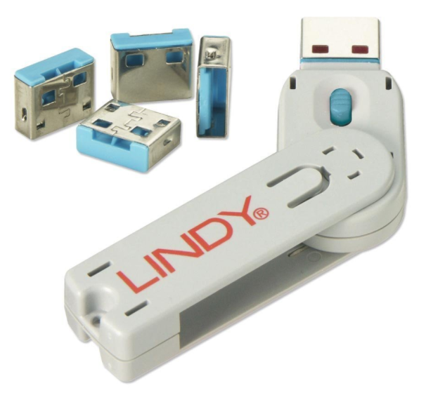
Access Management
Active Directory/directory services
Have policies and procedures to manage access
Remove access immediately when no longer necessary
Securing removable media access
Physically secure all non-used USB and network ports
Regulate vendor access
Require encryption on all removable media

Slide 12
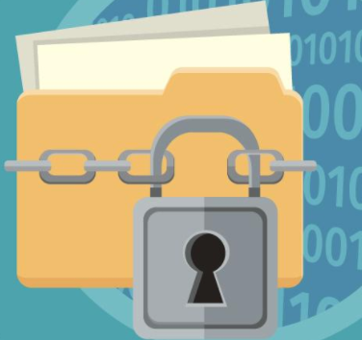
Encryption Encryption Encryption
At a minimum folders containing patient data
Work with IT on a remote managed encryption standard
If encryption is not possible try to store any ePHI on a network share
Pressure vendors to either include encryption or validate a third party encryption before purchase is finalized

Slide 13
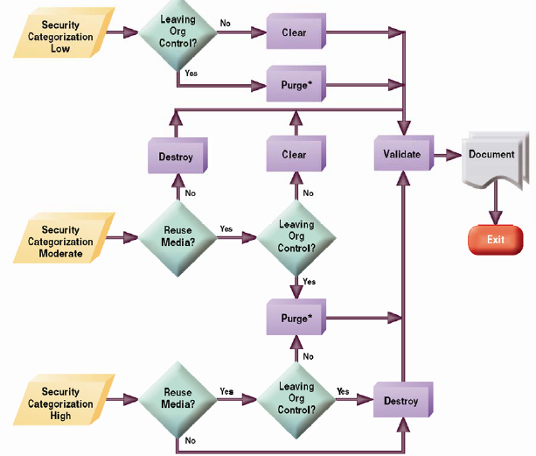
ePHI Disposal
Procedures should be made to determine when and how ePHI should be cleaned or destroyed
Some organizations have chosen to destroy all media containing ePHI even if it reduces trade in value
Organizations should have a BAA in place with any manufacturer or vendor that could come in contact with ePHI
Document how ePHI was removed from any device that has the ability to store ePHI
Notes:
* For some media, clearing media would not suffice for purging. However, for ATA disk drives manufactured after 2001 (over 15 GB) the terms clearing and purging have converged. Studies have shown that most of today’s media can be effectively cleared and purged by one overwrite using current available sanitization technologies.
NIST Special Publication 800-88
Guidelines for Media Sanitization 2006

Slide 14

HIPAA compliance self-assessment
High level analysis of an deficiencies in HIPAA compliance
Assessment must include clinical devices
Work closely with IT or department with overall responsibility for securing ePHI
Outline any deficiencies found and create a remediation strategy
Document and monitor your remediation strategy

Slide 15

What happens when you fail?

Slide 16
Do You Need to Report?
The acquisition, access, use, or disclosure of PHI in a manner not permitted under the [HIPAA Privacy Rule] which compromises the security or privacy of the PHI. See 45 C.F.R. 164.402.6
The HIPAA breach notification provisions apply to “unsecured PHI” (see 45 C.F.R. 164.402), that is not secured through the use of a technology or methodology specified by the Secretary in guidance
Notes:
If the electronic PHI (ePHI) is encrypted by the entity in a manner consistent with the Guidance to Render Unsecured Protected Health Information Unusable, Unreadable, or Indecipherable to Unauthorized Individuals7 such that it is no longer “unsecured PHI,” then the entity is not required to conduct a risk assessment to determine if there is a low probability of compromise, and breach notification is not required.

Slide 17

Let’s Play “Do you need to report”
A Physician's laptop is reported missing that is known to contain patient data
  The laptop has BitLocker with a 128-bit key installed and activated
  When the laptop was last seen it was powered off and closed

Slide 18
Is this a reportable event?
Data on the laptop was encrypted so it would not be considered “Unsecured PHI”
This event would most likely not need to be reported
But, a full risk assessment should be done and a mitigation plan put in place

Slide 19
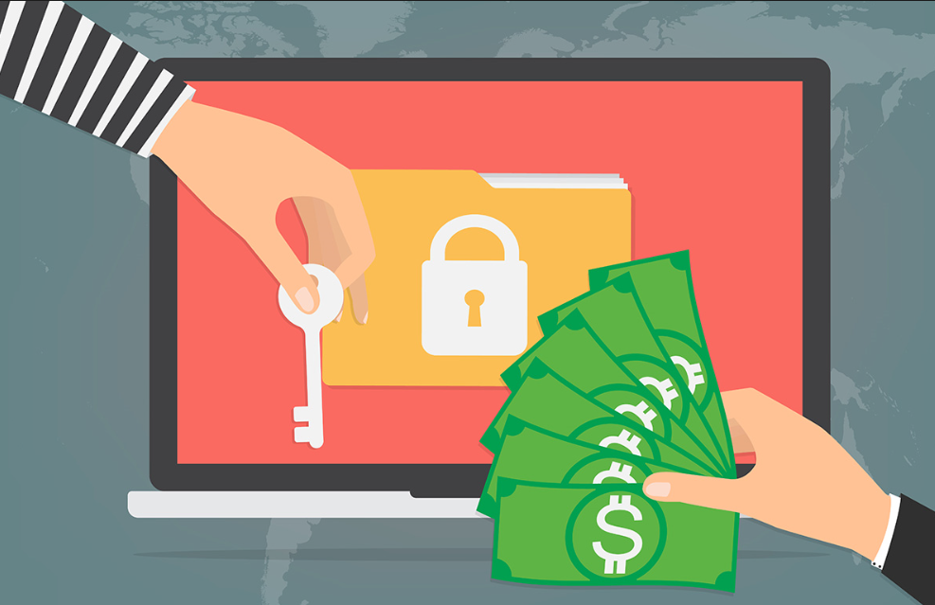
Ransomware
The CT in your Emergency department is infected with ransomware rendering it useless
All application files and PHI on the device have been encrypted by the infection
A Backup of the application is located and the system is restored
Patient data is not restored
The IT department is able to determine that no data from the device left the internal network
Notes:
HHS Published
FACT SHEET: Ransomware and HIPAA ~late 2016

Slide 20
Is this a reportable event?
Was the PHI involved identifiable?
Was the PHI acquired or viewed?
Has the risk to the PHI been mitigated?
Has the affected PHI been recovered?
Does the loss of the PHI affect patient care?

Slide 21
Ransomware part 2
A database server containing PHI is infected with ransomware
  The database was encrypted with 256-bit encryption
  Data from the infected device did leave the internal network and was identified going to Malaysia
  The infected database was immediately isolated from the network
  The database server was rebuilt and all PHI restored to the exact state before the infection

Slide 22
Is this a reportable event?
Was the PHI acquired or viewed?
Was the PHI identifiable?
Has the risk to the PHI been mitigated?
Has the affected PHI been recovered?
Does the loss of the PHI affect patient care?

Slide 23

You have identified a reportable event
What do you do now?

Slide 24
Get help
Determine the scope of the event
Identify why it happened
Formulate a mitigation strategy
Report the event appropriately based on risk assessment
Be responsive with any requests after reporting
Follow your mitigation strategy
Document the progress
Get done early

Slide 25
What can we do going forward?
Push manufacturers to develop products with an initial focus on security
Evaluate product security before purchases are made
Work with manufacturers that develop security in to their products
Stop putting Band-Aids on everything
Reward the manufactures that are developing secure products
Notes:
Encryption, Directory services

Slide 26

Questions

