Slide 1
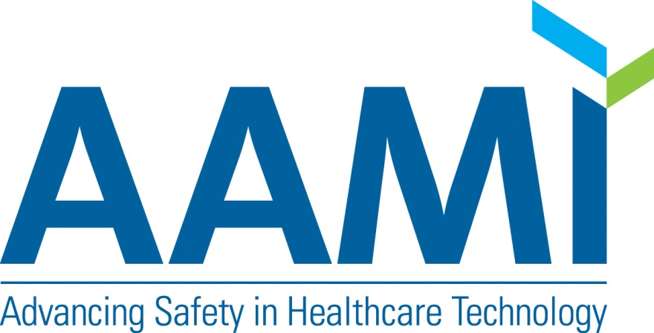


Slide 2
ARE YOU UP TO STANDARDS?
MD Expo
Nashville, TN
April 6, 2018
2

Slide 3
Joseph Dysko
Sr. Director - Clinical Engineering and Capital Services
Dignity Health
Clinical Engineering Program Leadership
Capital Contract Portfolio Development
30+ years clinical engineering and capital management at the regional, IDN, and national GPO levels
AAMI Technology Management Council (TMC)
AAMI TMC Standards Task Force chair
AAMI Awards Committee chair
BS Biomedical Eng. – Northwestern University
3

Slide 4

4

Slide 5


Slide 6
Objectives for Today
How can standards affect you?
How are standards developed?
What is AAMI’s role in standards?
What HTM standards is AAMI considering?
How can you participate in AAMI and in standards development?
6

Slide 7
How Does This Affect You?
Standards matter to HTM because;
they can work to improve patient care,
they may have a financial impact,
they can affect how you do your job,
they help elevate the profession,
they help level the playing field,
and they let you know what is expected.
They are guidance written in many cases for us and by us
7

Slide 8
Key Principles of a Standard
Standards respond to a need in the market
Standards are based on global expert opinion
Standards are developed through a multi-stakeholder process
Standards are based on consensus
Source: www.iso.org/developing-standards.html
8

Slide 9
Four Agreements
There is a variation in practice.
There is a benefit to reducing the variation.
There is a cause of the variation that can be identified.
There is a defined process that will control the cause of the variation.
9

Slide 10

AAMI’s Unique Role
Support the healthcare community in development, management and use of safe and effective healthcare technology.
Convening diverse groups to solve problems.
Notes:
This is achieved through standards development, summits, patient safety workgroups, white papers, safety-oriented research and more.

Slide 11
AAMI Standards Program
AAMI is the leading source of consensus standards and guidelines to expedite and enhance the development, management, and use of healthcare technology.
Standards philosophy:
“One product, one standard, one test worldwide”
11

Slide 12
AAMI Standards Program
Accredited by American National Standards Institute (ANSI) to write American National Standards
Administers technical committees of the International Organization for Standardization (ISO) and International Electrotechnical Commission (IEC)
Administers U.S. Technical Advisory Groups (TAGs) to ISO and IEC Committees – responsible for U.S. participation in committees and U.S. votes on documents
Develops U.S. Standards, recommended practices and technical documents
Convenes a global community of medical technology standards professionals
12

Slide 13
AAMI Technical Committee
An AAMI technical committee makes recommendations concerning the need for new standards and other technical publications within its area of competency and expertise.
13

Slide 14
Technical Advisory Groups
U.S. Technical Advisory Groups (TAG) develop national consensus on International Standards and Technical Information Reports (TIR) out for comment or vote.
14

Slide 15
AAMI Standards Program
More than 140 AAMI technical committees and working groups, consisting of thousands of volunteers, develop and maintain medical device standards, recommended practices, and guidance documents on a wide range of crucial devices and topics including:
Device Standards (apply to a particular device) | Horizontal Standards (apply across devices)
Infusion pumps | Alarms
Multi-parameter patient monitors | Human factors
ECG | Sterilization
Anesthetic and respiratory equipment | Interoperability
Dialysis equipment | Healthcare Technology Management
Active implants | Software
Cardiac valves | Quality systems/risk management
15

Slide 16
AAMI and HTM Standards
The AAMI 2018-2020 Strategic Plan outlines three broad goals that focus on community, infrastructure, and knowledge.
AAMI will have a broader community of engaged stakeholders.
AAMI operations will be enhanced and improved.
AAMI will be the essential resource for high-quality knowledge and learning in health technology.
16

Slide 17
Director – HTM Standards
New full-time role created by AAMI
Liaison to the Medical Equipment Management Committee (EQ Committee)
Focus on HTM-related standards creation
Development of shorter-term guidance documents, which could serve as basis for future standards.
17

Slide 18
TMC Standards Task Force
The TMC Standards Task Force is not a standards creating body.
Identifies HTM topics where a standard may be beneficial,
Works with the HTM community to review and develop New Work Item proposals,
Supports the Standards Program in soliciting volunteers and resources
18

Slide 19
EQ56: Recommended Practice for a Medical Equipment Management Program
Minimum criteria for a management program designed to minimize risks associated medical equipment in a healthcare delivery organization.
Undergoing periodic review/revision
19

Slide 20
EQ89: Medical Equipment Maintenance Strategies and Procedures
Guidance to help HTM departments standardize and document their maintenance procedures, as well as guidance in selecting the most appropriate maintenance strategy for a given device type.
Published
20

Slide 21
Vocabulary Used in Medical Equipment Management Programs (EQ93)
Provide the FDA with definitions for seven terms (e.g. refurbishing, reconditioning) where they requested assistance
Approved as a provisional standard on 3/26
21

Slide 22
Healthcare Technology Acquisition (EQ94)
A consistent process for technology acquisition and a uniform set of topics that should be covered in the requisition process
Approved by the Standards Board, drafting underway
22

Slide 23
Alternative Equipment Maintenance
(AEM)
Includes two main modules; a quality-assurance module to ensure proper decisions are made and sound engineering principles are employed, and a corrective action module to address deficiencies.
Approved by the TMC Task Force, pending approval by Standards Board
23

Slide 24
Supportability of Medical Devices and Systems
Addresses access to the resources needed to carry out technical support within hospitals.
Under consideration by TMC Task Force
24

Slide 25
Technical Information Report (TIR)
Occasionally, AAMI will provide additional guidance to specific standards in the form of a Technical Information Report (TIR). These TIRs reflect common industry practices that evolve from an accumulated process knowledge base
25

Slide 26
NEMA/MITA 2-201X
Launched by Medical Imaging and Technology Alliance in Feb 2017
“…describe and define the process of servicing medical imaging equipment … in a safe and effective condition…”
First ballot in Dec 2017 did not reach the required approval threshold.
26
Notes:
This standard will describe and define the process of servicing medical imaging equipment in hospital and non-hospital settings to a safe and effective condition, including actions such as repair, rework, update of software/hardware, and replacement of worn parts with qualified parts

Slide 27
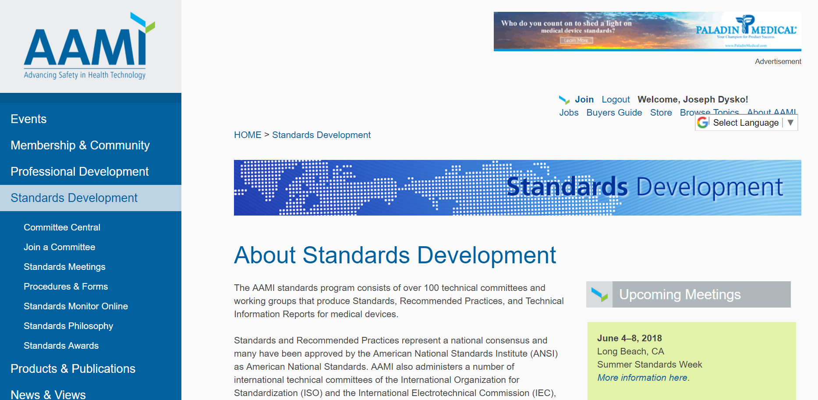
Where to get more info?

Slide 28
Who can participate in AAMI standards development?
National activities (including mirror committees for international projects) – Any stakeholder directly and materially affected by the standard.
International activities – National member bodies and their officially appointed representatives. International meetings are closed to the public; only appointed experts may attend.
28

Slide 29
How can you be involved?
Volunteer for Standards Committees (Not just HTM standards – 150+)
Submit a New Work Item Proposal
Submit comments during Public Review
Attend an open meeting of an AAMI Committee or US Technical Advisory Group
Instructions for how to find a view Public Review drafts and calendars can also be found on the AAMI website
29

Slide 30
Other ways to participate
Subscribe to “Standards Monitor Online”
Submit feedback through your local BMET or CE association
Submit an article or opinion for publication.
Volunteer for the TMC Task Force
30

Slide 31
Questions?
31

Slide 32


32
Notes:
Questions?

