Slide 1
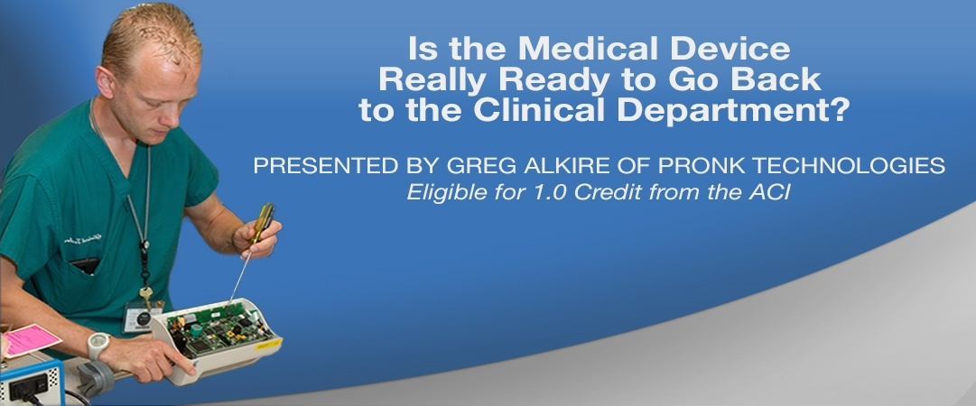
WWW.PRONKTECH.COM
Notes:
Edited by JC in June 2016 to change Uncertainty references to Accuracy to make it easier to understand.
Nov 17 – fixed extra zero in resolution for analyzer pressure meter specs on slide 16

Slide 2

Overview
During this discussion we will help to uncover tools for:
Decoding specification terminology.
Untangling medical device accuracy specifications from requirements for test equipment.
Review of how to determine what accuracy is required when testing specific medical devices.
How to choose test equipment that meets the manufacturer requirements.
Understanding other potential errors that can also impact medical device readiness.

Slide 3
Specification Overload
Medical Device
Test Equipment
Test Equipment Calibration
Published Accuracy Specifications
Accuracy % Full scale vs. % of Reading???
NIST Traceable Calibration Certificate
Test Equipment Requirements
Published Accuracy Specifications
Test Points and Tolerances used for Calibration Testing
“PM” Accuracy Requirements
Test Equipment ±1 LSD???
Is Calibration Standard 4 X More Accurate than test Equipment?
Calibration Accuracy Requirements
4:1 Ratio between Medical Device and Test Equipment?
PM Test Points and Tolerances
Published Accuracy Specifications
Notes:
As a manufacturer of Test Equipment we deal with Test Equipment and Calibration every day. After looking closer at Medical Device Specs on top of all this it became obvious that it is very challenging for Biomeds to sort it all out. Almost 3 different languages -
The biggest problem- different companies are speaking different languages in terms of specifications.

Slide 4

Decoding the Terminology
    Uncertainty
    Tolerance
    ± (X) LSD
    Resolution
    4:1 Ratio
    Accuracy % of Reading
    Accuracy % of FS (Full Scale, aka Span)
    Accuracy % of Range
    Accuracy % (No reference to “of Reading” or “FS”)
    Scale (XYZ) or Equivalent

Slide 5
Decoding the Terminology:
Uncertainty vs. Accuracy
Uncertainty (of measurement):
Calculated maximum error
Accuracy
The term “Accuracy” is often used where uncertainty is actually specified –
i.e. Accuracy: 1% of FS ± 1LSD
Does this mean it’s only 1% accurate, and 99% inaccurate? No.
Since our industry commonly refers to uncertainty in this way (as accuracy %) we will continue to state it that way during this presentation for consistency sake.
Notes:
Although forgive me if I slip and state “Uncertainty”- I’ve been trained for years by our Calibration / Metrology partner to state it correctly.

Slide 6
Decoding the Terminology: continued
Tolerance
  Specified allowable error or min/max allowable error
Resolution The smallest unit of measure that can be displayed or measured.
± (X)LSD Additional uncertainties beyond published % accuracy.
        (LSD is least significant digit of the displayed resolution)
Example: Digital Pressure Meter, Accuracy = 0.5% of Reading ± 1LSD
    In this case Accuracy = 0.5% + 1 LSD
        Resolution = 0.01
        10 PSI test point: 10 x 0.5% = 0.05 + .01 (1LSD) = 0.06 Total Accuracy
Notes:
Once you calculate % uncertainty, you would add the additional uncertainty of the (X) LSD. By taking the resolution of the device and multiplying it by the Least Significant Digit (X) the number in the specification you will have calculated this additional uncertainty.

Slide 7
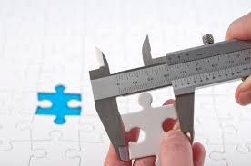
  4 : 1 Ratio – Used To Establish A Chain Of Comparisons. Standard Must Be At Least 4 Times More Accurate Than Instrument Being Calibrated.
  Each laboratory is at least 4 x more accurate in its measurements than the previous laboratory
  Much more crucial if calibrating a device vs. PM/Performance Testing
Decoding the Terminology:
4:1 Ratio
The comparison between the accuracy of the UUT and the estimated calibration Uncertainty of the test equipment is known as the test uncertainty ratio.
NIST
0.0156%
Primary Lab
0.0625%
Secondary Lab
0.25%
With 4:1 Ratio through calibration, Traceability can be achieved back to NIST Standards.
Biomedical Dept.
1.00%
Medical Device
4.00%
Notes:
Even if you don’t have a 4:1 ratio between your test equipment and the medical device, you should identify what your ratio is and how much that potential error could influence the readiness of the device going back to clinical departments.

Slide 8
Decoding the Terminology:
Accuracy % of Reading
When accuracy is stated as % of Reading, the percentage is applied to all measurements (all test points) across the range/scale.
      Example: Accuracy stated = 0.5% of Reading, Range -12.5 to +75
      With “% of reading” range does not impact Accuracy
      If the test point is 10
      0.5% X 10 = 0.05 Accuracy
When specifications are stated as Accuracy % (does not specify FS or Reading) – Don’t assume % of reading, request clarification from manufacturer.
Notes:
Range does not impact uncertainty when % of reading stated

Slide 9
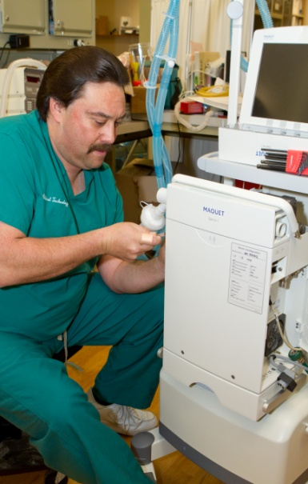
Decoding the Terminology:
Accuracy % FS (Full Scale)
The accuracy percentage is based on the maximum range
of the device. To determine its’ Uncertainty (Accuracy) take the
Full Scale and multiple it by the Accuracy % specified.
      Example 1: Accuracy stated = 1% of FS, Range 0-45
      FS/Full Scale, Scale = 45
      So: 1% X 45 = 0.45 Accuracy
      BUT if the test point is 10:
      0.45 ÷ 10 = 4.5% Accuracy
      Example 2: Accuracy stated = 1% of Full Scale, Range -10 to+75
      Full Scale, Total Scale = 85
      So: 1% X 85 = 0.85 Accuracy
      BUT if the test point is 10:
      0.85 ÷ 10 = 8.5% Accuracy
    Neither provide the expected 1% at 10 PSI
Notes:
% FS VERY different from % of Reading

Slide 10
Decoding the Terminology:
Accuracy % Range
This is similar to Full Scale but the range is typically less than full scale. Either a specific range is specified relating to that accuracy %, or a ± range is specified (i.e. ± 200) and in that case 200 is the range.
      Example 1: Accuracy stated = 2% of Range, Range ± 200
      Range = 200
      So: 2% X 200 = 4 (Accuracy)
      BUT if the test point is 10:
      4 ÷ 10 = 40% Accuracy

Slide 11
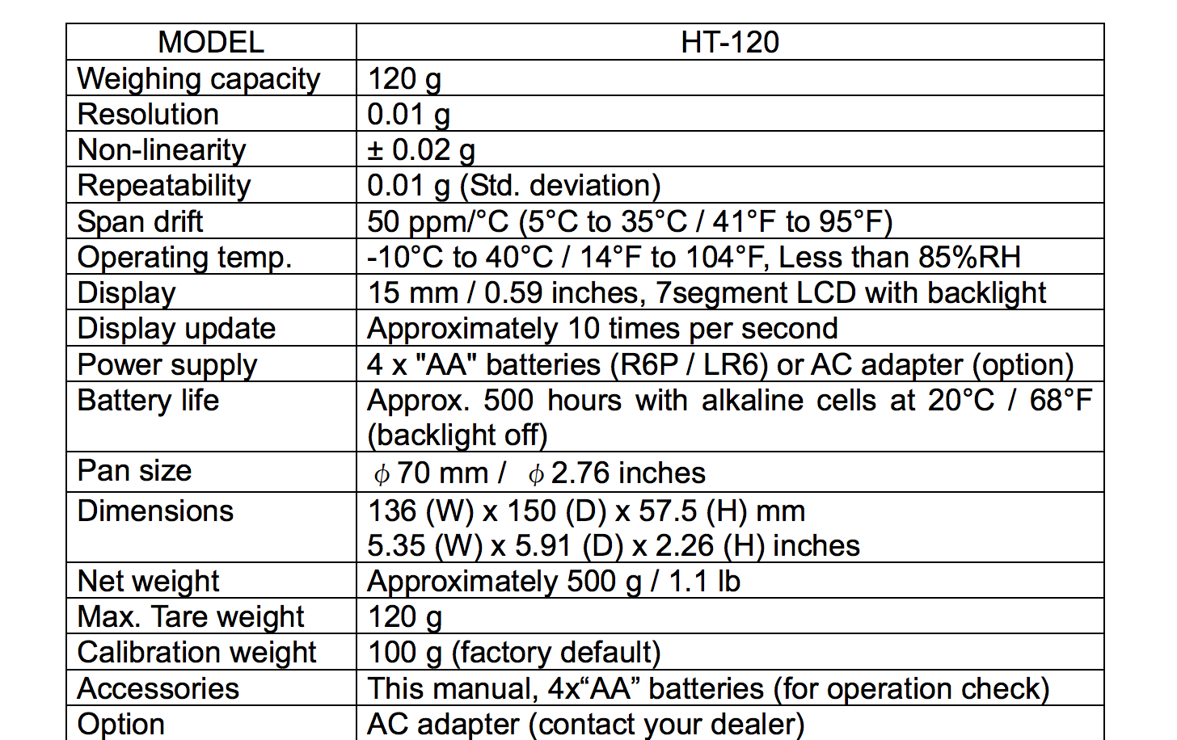
Additional Terms- Scales
    Typical Scale or balance terminology
      Show sample spec sheet- HT-120
Notes:
Scales are a whole other animal all together- not specified with stated accuracy as a percent, notice they don’t even mention “accuracy”. Uncertainty calculation for this scale: 0.03 g (Non-Linearity + Repeatability) in this case. DOES NOT include Drift Draft Drops or evaporation impact on uncertainty when doing fluids.

Slide 12

Sorting it all out…
Step 1
Medical Device User Specifications
Step 2
Medical Device Service Specifications,
Test Points and Tolerances
Step 3
Establish Minimum Accuracy needed from Test Equipment
Step 4
Identify Test Equipment Accuracy at Service Test Points.
Step 5
Determine if Test Equipment meets minimum accuracy needed.

Slide 13
Medical Device Accuracy Specifications vs. Accuracy Requirements for Test Equipment
Step 1
Step 2
Step 3
MEDICAL DEVICE Specifications
Make/Model | (User Manual) Accuracy Spec | Test
CFN/Alaris 8100 | ± 5% | Rate / Volume
(Service Manual) Test Equipment Specified | (Service Manual) Test Point | (Service Manual) Test Point Tolerance
A&D HT-120 or equivalent | 12ml | 3.4% or ± 0.408ml
Resolution: 0.01
Non-Linearity: ± 0.02
Repeatability: 0.01
Bottom Line: Accuracy needed from Test Equipment (4:1)
0.408 ÷ 4 = 0.102ml
(3.4% ÷ 4 = 0.85%)

Slide 14
Translating the Test Equipment specifications as they relate to the Medical Device.
Step 4
Test Equipment
Test Equipment | Accuracy Specification (at Test Point) | % Reading or FS | Resolution (PSI) | Test Point (ml) | ± LSD | Accuracy At Test Point (ml)
IV Pump Analyzer A Rate/Volume | 0.85% | Reading | 0.001 | 12 | 0 | 0.102
IV Pump Analyzer B Rate/Volume | 2% | Reading | 0.01 | 12 | 1 | 0.250
Accuracy at Test Point: Multiply Accuracy % × Test Point + LSD = Accuracy
Notes:
Analyzer A did not have a +/- 1LSD at this test point.

Slide 15
Compare: Requirements of the medical device to the accuracy of the test equipment
Step 5
MEDICAL DEVICE |  |  | TEST EQUIPMENT
Make/Model | Test | (Service Manual) Test Point Tolerance | Analyzer A: Accuracy At Test Point | Analyzer B: Accuracy at Test Point
CFN/Alaris 8100 | Rate / Volume | ± 0.408ml | ± 0.102ml | ± 0.250ml
Bottom Line: Medical Device vs. Test Equipment Ratios
Analyzer A : 0.408 ÷ 0.102 = 4:1
Analyzer B : 0.408 ÷ 0.250 = 2:1

Slide 16
Example 1: Comparing IV Pump Analyzers
Pressure Accuracy
% of reading vs. % of Full Scale
Test Equipment Comparison
Test Equipment | Resolution (PSI) | Range | Accuracy Specification | Of Reading or Full Scale | ± LSD | Accuracy in PSI: Full Scale
IV Pump Analyzer A- Pressure | 0.01 | 75 | 0.50% | Reading | 1 | 0.39
IV Pump Analyzer B- Pressure | 0.01 | 45 | 1% | FS | 1 | 0.46
Accuracy in PSI: at 10PSI | Accuracy as %: at 10PSI
0.06 | 0.60%
0.46 | 4.60%
Accuracy in PSI: at 5PSI | Accuracy as %: at 5PSI
0.04 | 0.80%
0.46 | 9.20%
Accuracy at Full Scale: Multiply Accuracy % × Range + LSD = Accuracy FS Accuracy at Test Point: IF FS: Divide Accuracy units by test point units + LSD = Accuracy % at Test Point IF READING: Multiply % x test point + LSD = Accuracy at Test Point
Notes:
Remember- uncertainty when accuracy stated as % of Reading means simply % specified X any test point across range.

Slide 17
What if Test Equipment doesn’t meet 4:1 Ratio?
Scenario 1: IV pump is out of Tolerance for Volume
Tester A has a 4:1 Ratio compared to the IV Pump test tolerance
Tester B has a 2:1 Ratio compared to the IV Pump test tolerance
Rate / Volume Test: Target 12.000ml | % Error | Result: ml | Device Test Point Tolerance: 3.4%
 |  |  | Minimum | Maximum | Pass/Fail
IV Pump: out of tolerance- High by: | 5% | 12.60 | 11.59 | 12.41 | Fail
Tester A measuring low by: | -0.85% | 12.49 | 11.59 | 12.41 | Fail
Tester B measuring low by: | -2% | 12.35 | 11.59 | 12.41 | Pass
⬅ We Just passed a Failing Device.
Scenario 2: IV pump is out of Tolerance for Occlusion
Tester A has a 50:1 Ratio compared to the IV Pump test tolerance
Tester B has a 5:1 Ratio compared to the IV Pump test tolerance
Occlusion Testing: Target Pressure 10PSI | % Error | Result: PSI | Device Test Point Tolerance: 25%
 |  |  | Minimum | Maximum | Pass/Fail
IV Pump: out of tolerance- High by: | 35% | 13.50 | 7.5 | 12.5 | Fail
Tester A measuring low by: | -0.5% | 13.43 | 7.5 | 12.5 | Fail
Tester B measuring low by : | -4.60% | 12.88 | 7.5 | 12.5 | Fail
⬅ We Just failed a Failing Device.
Scenario 3: IV pump: Calibrating Occlusion Pressure
Tester A has a 4:1 Ratio compared to the IV pump Cal Tolerance
Tester B has a 4.6% Accuracy at IV Pump Calibration Tolerance of 2%
Occlusion Calibration: Target Pressure 10PSI | % Error | Result: PSI | Device Test Point Tolerance: 2%
 |  |  | Minimum | Maximum | Pass/Fail
Target Pressure: 10.00 PSI | NA | 10.00 | 9.8 | 10.2 | NA
Tester A measuring low by: | -0.50% | 9.95 | 9.8 | 10.2 | Pass
Tester B measuring low by: | -4.60% | 9.54 | 9.8 | 10.2 | Fail
⬅ We Just mis-calibrated a Device.

Slide 18
Example 2: Ventilator vs. Vent Testers
% of Reading vs. % of Range
Vent Tester A Specifications:
3% of Reading or 2% of Range
Range = 200 (0-200)
Vent Tester B Specs:
2% of Reading
Range (0-300)
MEDICAL DEVICE: Philips / Respironics V200 Esprit
Test Points LPM | (User Manual) Accuracy Specification | Test | (Service Manual) Tolerance ± LPM | Accuracy Needed From Test Equipment (4:1)
50 | 10% | Flow Test | 5 | 1.25
100 | 10% | Flow Test | 10 | 2.50
120 | 10% | Flow Test | 12 | 3.00
165 | 10% | Flow Test | 16.5 | 4.13
Tester Comparison
Vent Tester A Accuracy as 3% Of Reading
1.5
3
3.6
4.95
Vent Tester A Accuracy as 2% of Range
4
4
4
4
Vent Tester B Accuracy as 2% of Reading
1.00
2.00
2.40
3.30

Slide 19
What if the test equipment doesn’t meet manufacturer requirements?
Does it meet 4:1 Ratio?
Are performing an actual calibration of the device, or only doing a check or PM /performance test?
Assess potential risk.
Likelihood of risk.
Tighten Tolerances for pass / fail on medical device based on Accuracy percentages-

Slide 20
Users could tighten tolerances based on uncertainties
If you don’t have 4:1 and are concerned about passing a device that may be out of tolerance, you could subtract the Accuracy % of the tester from the Accuracy % of the device being tested:
    Medical Device Accuracy: 5%
    Tester Accuracy: 2%
    Tolerance for passing Medical Device: 3%
This would prevent medical devices from passing when they should be failing, but of course you will see some failing that should be passing.
Notes:
Hadn’t considered this approach until interviewing some Clin Tech Directors from health systems- it is a viable approach but has down sides-

Slide 21
Understanding potential test setup errors that can also impact medical device readiness.
Setup errors can have a significant impact on the results, enough to cause a medical devices to be outside of specifications if calibrating.
Test equipment may also have caveats in their specifications and/or setup that can also impact the accuracy of your test results.
Notes:
This applies to both volume and pressure testing.

Slide 22
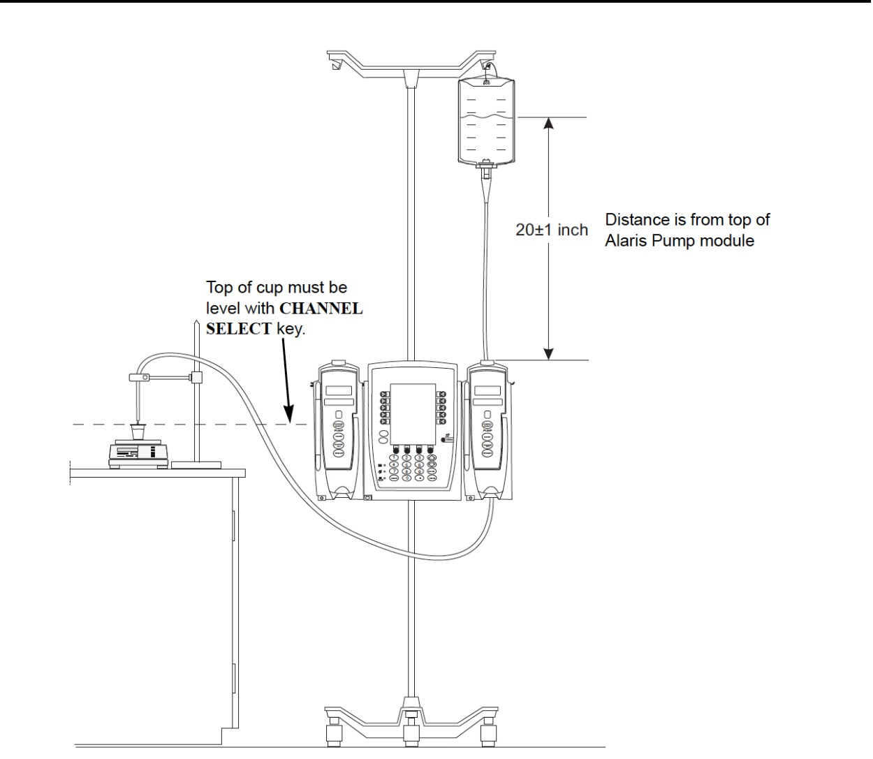
IV Pump Testing potential setup and testing errors
⬅ If Fluid Height is at 10”, 1-3% reduction in Pump output
If Tester 12” above Pump Mechanism, 0.5% reduction in Pump output ➔
IMPORTANT: For IV Analyzers collection containers may also need to be at same height as analyzer and pump mechanism.
Notes:
The height requirements apply to both volume and occlusion testing.

Slide 23
Why test with Fluid height at 20”, if Nursing doesn’t pay attention to height?
One reason- the manufacturer is counting on controlled conditions during testing and especially calibration to reduce error when the device is being used in a less controlled environment.
Not much different from testing alarms on any medical device- even if nursing can turn them down or off, we still test to make sure they are working.

Slide 24
Pressure Meter potential setup and testing errors
Pressure meter must be zeroed properly with it vented to atmosphere only.
Some Pressure Meters have a “zero offset error” that must be factored into the accuracy of the pressure meter
  For Example: Accuracy = 1% of Range, ± 5mmHg zero offset error
  The zero offset error must be factored into overall Accuracy calculation if specified.

Slide 25
Watch out for:
    NIST Traceable Calibration of your test equipment.
      Understand whether your calibration lab has a certified Quality System and they utilize 4:1 Uncertainty ratio or better when calibrating your test equipment.
      Ensure your calibration lab is informing you on the calibration certificate whether your test device was found to be outside its published tolerances.
    % Full Scale, % Range vs. Of Reading accuracy %
    Rate or flow dependent accuracy (% accuracy only applies to rates X-Y)
    Minimum sample size required for meeting accuracy specified.
    Operating temperatures specified for test equipment.

Slide 26
Visit our new website for more information about our products
WWW.PRONKTECH.COM
Or call us: (800) 609-9802
          (818) 768-5600

