Slide 1

Embedding Security into the Clinical Technology Enterprise Strategy
Priyanka Upendra – BANNER HEALTH
SHAWN ANDERSON – INTERMOUNTAIN HEALTHCARE

Slide 2
PURPOSE
To discuss medical device security program approaches that are viable, scalable, and sustainable at healthcare organizations, regardless of its size.
AND
To socialize the value of embedding security practices in the overall clinical technology strategy.
OUTCOME
Provide an easy-to-follow and implementable recipe, which will include key elements of education, procurement, risk management, and network security that will help move past the initial trouble and get to implementation.
PROCESS
Overview of the programs at Banner Health and Intermountain Healthcare
Discuss how we got started and where we are at, including key drivers
Discuss various operating elements of a MDS program
Evaluating your MDS program and measuring success
Identifying a role/ vision for a long-term MDS program
Notes:
With an increased adoption of connected clinical technologies, a hostile environment has emerged posing threats to the security of these technologies and the health systems that use them. This has created a growing need to embed robust security practices into an enterprise wide strategy to protect against patient safety risks, unauthorized access, and cyberattacks. While we have a number of standards, published articles, and documents to refer from, experts from Banner Health and Intermountain Healthcare recognized the need for an easy-to-follow and implementable recipe for healthcare technology management professionals. This interactive session will include key elements of education, procurement, risk management, and network security that will help move past the initial trouble and get to implementation.

Slide 3
Agenda
Introductions
Where do you start to build a medical device security program?
Key drivers of a medical device security program
Operationalizing these key elements
Assessing security posture of your program and inventory
Building an enterprise level framework
Government and Information Security Engineering References
AAMI Cybersecurity Practice Guide
Templates for P&P
References
Notes:
Where do you start to build a medical device security program?
Key elements:
Cost justification
Education – security 101, educating employees, moving from break fix culture..
Governance structure
Procurement – must-haves during acquisition and disposal
Risk management,
Network segmentation
Operationalizing these key elements
Governance structure
How do you assess the security posture of your medical device inventory?
How do you understand what you have? Asset attributes useful for a security assessment (NIST 800-30 | section 2.4.3) (Chapter 3 – AAMI guide)
Understand your organization’s risk profile – risk categorization
Building an enterprise level framework
Remediation
Templates for P&P

Slide 4
About our Organizations

Slide 5
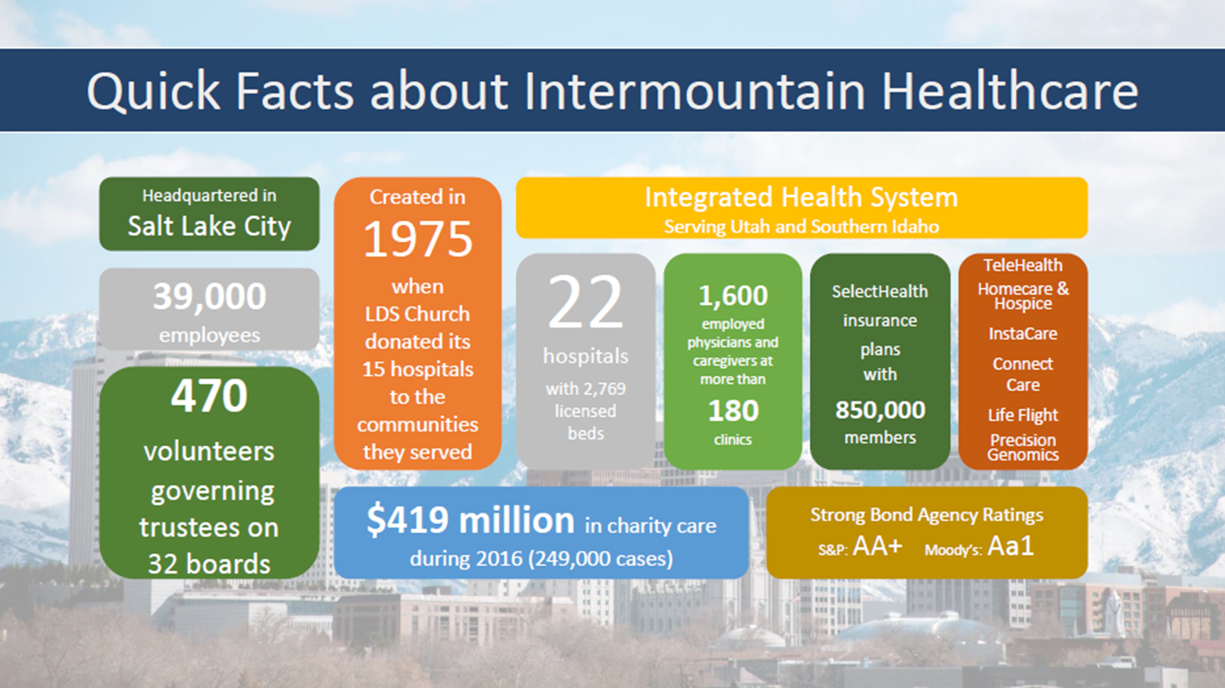

Slide 6

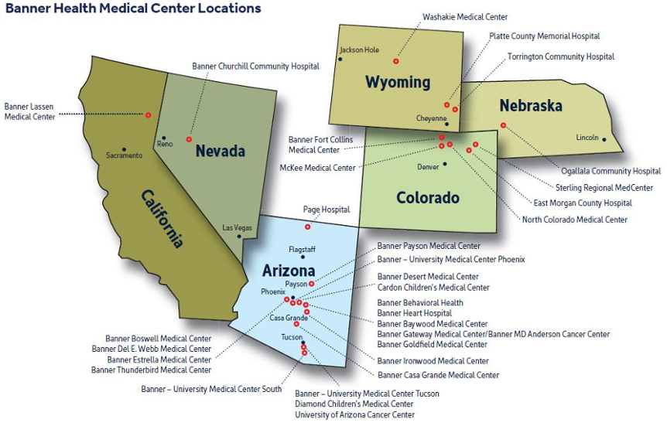
“Making health care easier, so life can be better.”
Technology Management (TM) Organizational Structure
~251 staff members
  [139] biomedical equipment technicians
  [40] imaging service engineers
  [27] management
  [7] medical physics
  [13] integrated clinical technologies
  [10] project management
  [15] business support
[>33] shops providing service in 29 hospitals, >480 clinics in 6 states
Over 243,000 medical devices and systems inventoried and valued at approximately $1.3B

Slide 7
“Wall of Shame”
Data

Slide 8
July 2018 - 199 breaches affecting 3.9 million individuals has been added to the HHS HIPAA Breach Reporting Tool website, commonly called the “wall of shame.” ⁵
March 2014 to May 2014 , the United States Office of Personnel Management (OPM) was breached with over 21 million people affected. Besides data they also retrieved about 6 million fingerprints. Breach was discovered 2015. DoD cost was $132 million to protect credit of people affected that were part of DoD. Vulnerable legacy systems. Cyberespionage, Cyberwarfare. ¹
About 47% of US had personal healthcare data compromised in 2015.¹
June 2016, credit card payments in food and beverage outlets at Banner locations were accessed by unauthorized persons resulting in copying of 21,000 credit card numbers. Attackers also gained access to Banner servers containing personal and patient information of ~3.7 million individuals, including patients and providers. ⁴
May 2017, WannaCry ransomware malware attack infected over 75,000 computers in 99 countries demanding ransom payments. Vulnerable MS OS computers. Cybercrime, Cybernuisance. ³
September 2017,Equifax reported breach of 143 million consumers. A virus-like software exploited a vulnerable Apache server. Patch was available in March. Vulnerability discovered months after exploit. Cybercrime, Cybernuisance.²
Notes:
Institute of Critical Infrastructure Technology. (2016). Hacking Healthcare IT in 2016: Lessons the Healthcare Industry can learn from the OPM breach.
Newman, L. (2017). Equifax officially has no excuse. Wired. https://www.wired.com/story/equifax-breach-no-excuse/
CISCO. (2018). Cisco 2018 Annual Cybersecurity Report | The attack landscape.
Banner breach. August 2016. http://www.modernhealthcare.com/article/20160803/NEWS/160809954
Health data breach tally: lots of hacks, fewer victims. https://www.healthcareinfosecurity.com/health-data-breach-tally-lots-hacks-fewer-victims-a-11246

Slide 9
OCR Investigations
Lahey Clinic Hospital: Laptop connected to CT scanner stolen from unlocked treatment room – $850,000; 599 records
Feinstein Institute 2016 HIPAA Settlement: Lost laptop, no encryption – $3.9 million!​
Concentra HIPAA Settlement: Stolen laptop, no encryption – $1.7 million​
Fines are increased if OCR determines policies and procedures are inadequate and access is not limited
Public data shows it costs an average of $881,305 in HIPAA fines for each single stolen laptop​

Slide 10
Connected Medical Devices and IoT in Healthcare – worth 158.1B in 2022*
    Improve diagnosis and treatment
    Facilitate medication delivery
    Remote monitoring of health
    Enable digital health
Delivers greater convenience and functionality to patients and their physicians
Remote Patient Monitoring System
Tracks vital parameters at a bedside location (home or hospital), transmits that data to the electronic medical record, where the physician can access it for diagnosis and treatment.
Open APS* – closed loop insulin delivery
The open artificial pancreas system uses data feed from the continuous glucose monitor and a Raspberry Pi computer, completes a loop, and continuously alters the amount of insulin the pump delivers.
Connected Inhalers*
Inhaler connects to a digital platform via a sensor, passively recording and transmitting usage data. This delivery mechanism allows doctors to keep accurate track of whether patients are sticking to their treatment plan.
Ingestible Sensors
Pills dissolve in the stomach and produce a small signal which is picked up by a sensor worn on the body, which again relays the data to a smartphone app.
Notes:
* Deloitte UK Health Centre 2018 Report
Technology in healthcare space has come a long way. With the introduction of IoT within the space, the prospects of significantly improving situational awareness around the patient and hospital operations are closer than ever.
Understanding and managing cybersecurity risks for this mission-critical environment is challenging as a HDO has a mix of state-of-the-art applications and legacy devices that use unsupported OS’s and networking protocols. In addition, making these systems available for updates is a challenge as they often provide round-the-clock care to patients and they cannot be taken out of service.
Cybersecurity breach, device security and back-end systems security, unwarranted exposition of critical clinical data poses enormous consequences to human life.
Different type of systems managed by multiple entities with not much clarity in roles and responsibilities and several gaps in policies and procedures

Slide 11
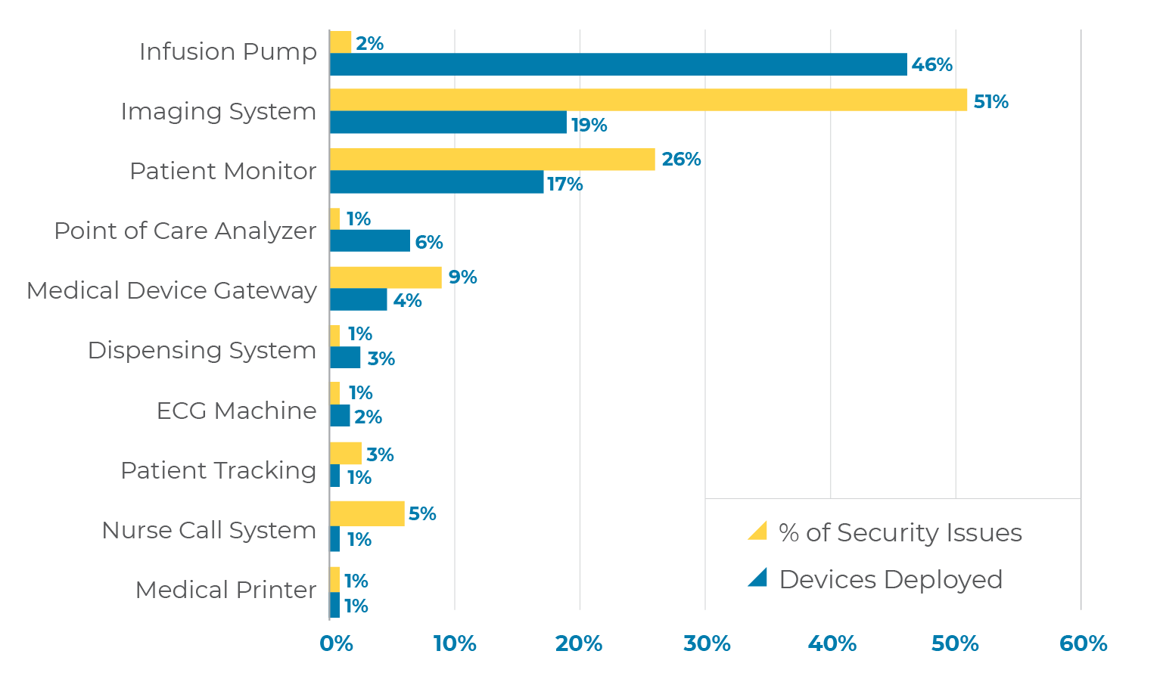
Medical Devices and Clinical Systems with Most Security Issues
Top 3 device types account for 86% of the security issues
Practical guide for medical device security by Xu Zou from Zingbox
Notes:
Weak default credentials (talk about audit in radiology when caregiver shared the username and password twice)
Known vulnerable software platforms – Win XP, 95, etc..
Hard coded passwords to facilitate service
Wireless communication vulnerabilities with no firmware or software fixes
Lack of use restrictions – browser usage and downloading stuff, rogue applications
Restrictions from MDM and FDA on updates and upgrades
Lack of data encryption, unpatched firmware and OS, lack of network segregation

Slide 12
As an HTM, what is my role?

Slide 13
Understanding Your Organization
As it pertains to medical device life cycle management:
Understand the role of Information Technology and Information Security
Understand the role of Compliance, Privacy and Legal
Understand the role of Supply Chain
Understand the role of Risk Management and Patient Safety Committees
THEN:
Collaborate with each stakeholder to identify roles and responsibilities
Discuss relevant regulations, standards, and best practices
Educate and train these stakeholders, extend the training to their teams
Ensure there is governance over medical device security

Slide 14
Refining your technology evaluation & maintenance process
Ensure equipment is functional and meets organizational requirements – patient safety, business continuity, regulatory, and information security
Collaborate with leadership to develop, implement, and adhere to those requirements
Engage the cross-functional teams throughout the life cycle to:
  Ensure inventory is complete, accurate, and up to date
  Risk assessments are completed and risk is categorized
  Risk management strategies are developed and discussed with vendors and users
  Maintenance strategies include checking security controls periodically
  Patching strategies are developed, agreed upon, documented, and implemented
  Disposition strategies are developed, agreed upon, documented, and implemented
  Due diligence reporting and responding to security events and incidents occur in a timely manner
Notes:
Check configurations: Validate patch status, validate password enabled, validate encryption enabled, validate data is being wiped, etc.
Connected equipment: Understanding what the connected system is supposed to do, the data it contains, vendor access, etc.
Reporting: Do you know who to call?

Slide 15
Documenting relevant information in the CMMS
Clinical contact
IT/ HTM contact – system manager
Device location
Nearest telephone number
Asset identifier (equipment control number/ asset tag)
Serial number
Manufacturer/ model name/ model number
Wireless connectivity type
Remote connectivity tools
MAC addresses
Host name
IP addresses
System dependencies
Application
Support model
OS type
OS version
Application software version
Last patch update date
ePHI processing
Anti-virus and encryption capability

Slide 16
Key business drivers for your MDS program
Resiliency of facilities
Resiliency of clinical care areas
Ability of clinicians to continuously see patients without delay in care and treatment
Notes:
Not screw up medical device security because it will affect the business – to continue and operate in business

Slide 17
Cost justification for your leadership
Addressing weak medical devices is a manual effort, requiring staff knowledgeable in medical devices and information security
Research data (1h-2 weeks)
  Determining roles and responsibilities, accurate inventory of devices to evaluate, and gather MDS2/ other cybersecurity related documentation from the vendor
Risk assessments (1h)
  Time taken to complete risk assessments and agree upon with business owner and vendor
Patch management (~2.5h once you have the update available)
  Capturing, verifying, and performing critical updates
Incident response
  Planning and executing IR and BCDR plans

Slide 18
Example- Quantifying Mitigation Effort for ~7500 devices
Estimated tech effort to remediate a vulnerability
Cost to patch ~7500 devices once
Effort | Tech Hours
Low | 2000
Medium | 10000
High | 1800
TOTAL | 13800
Effort | Expense
Low | $150,000
Medium | $810,000
High | $125,000
GRAND TOTAL | $1,085,000
If every network connected device and device storing data locally were to require remediation,
Estimated cost, per touch, per asset: ~$34-39
Keith Whitby, Mayo Clinic

Slide 19
How do you start?

Slide 20
Know Your Audience and Speak their Language
“It’s one thing for a CT scanner to be down, it’s another thing if that CT scanner is impacted in a way that delivers an abnormally high dose of radiation.”
Patient safety risks
  Damages in device reliability or performance
  Malicious device or data manipulation
  Misdiagnosis or compromise to delivery of treatment
Care delivery risks
  Downtime
  Delayed patient testing
  Increased work backlogs
  Patient diversion
Privacy and security risks
  Loss of patient or proprietary business data
  Lack of adherence to security standards and processes
Business (financial) risks (~$2.4M/ breach)
  Revenue loss due to degraded reputation
  Loss of Meaningful Use funds
  Lawsuits
  Stock value
Indirect risks
  Loss of patient trust
Notes:
* Beware These Nine Medical Device Vulnerabilities. By Derek Brost. 24x7 magazine.

Slide 21
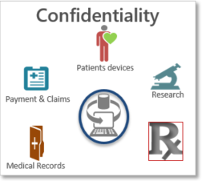
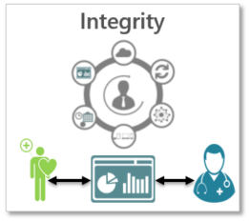
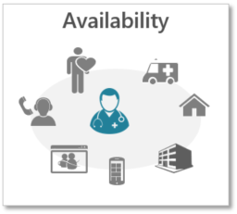
Understanding the Cybersecurity Triad in Terms of Patient Safety
  Scenario 1
  Scenario 2
  Scenario 3
Unauthorized access may allow an intruder to obtain AND/ OR alter AND/ OR delete important healthcare information
Corrupt patient information from an integrated infusion management system can result in wrong volume of drugs delivered to the patient
Incident impacting the hospital network may force medical devices to operate in ‘stand-alone’ mode interrupting clinical workflow and patient access
Streamline access to providers and medical records, create a better patient experience, and improve treatment.
Notes:
Information going into the eMR from medical devices need to be accurate so the diagnosis or treatment plan is appropriate
Malware infecting the medical device may alter patient data
Data will not be sent to the eMR forcing caregivers to move back to manual charting

Slide 22
Identify, Categorize, and Keep it Simple and Sustainable
Identify the scope of your MDS Program
  Asset inventory
    Is this a complete and accurate list?
    Do you have the attributes necessary to assess into risk categories?
What are the constraints and assumptions?
Identify how you will assess the clinical technologies?
  A single device? A group of devices? An organizational unit? The whole organization?
Do you have a specific timeline?
Are you scoping in network architecture?
  Are you assuming that the network architecture has been managed per standards?
Identify sources of information – CMMS, CMDB, SMEs, vendors/ manufacturers?

Slide 23
Identify, Categorize, and Keep it Simple and Sustainable
(continued..)
Identify the threats and threat events that are applicable to the scope of your program
  Man-made
    Active attacker
    Insider threats (accidental or malicious)
  Environmental
    Loss of power
    Loss of telecom
  Structural
    Operating system crash
    Bad network cable
Determine your organization’s appetite for risk
  Denial of service
  Modification of data (drug libraries, vitals, safety thresholds, etc.)

Slide 24
The risk management process needs to be cross-functional and vetted by all stakeholders
Think of medical device security like leakage and grounding standards. Leakage is the security hole that needs identification and remediation. Grounding is to sustain a process that will protect safety and reliability of clinical technologies and ensure accurate clinical workflow and dataflow.
4 Important Recommendations:
Include every place where ePHI resides – MRI systems to pulse oximeters (if device has patient data, it is subject to HIPAA)
Evaluate the type of systems – do legacy systems connect to the network? Are there other secure ways to transmit data?
Evaluate the need to store data locally? Do we really want patient files on a laptop based medical device that are so easy to steal?
Conduct routine security awareness training – this is a HIPAA requirement. Define acceptable use policies and procedures and train all healthcare workers
Notes:
Even if you do nothing else, please observe the first pillar – complete a risk assessment that captures all places where ePHI is stored in your organization.
This fulfills a vital HIPAA requirement, but is also a foundation to identify your true risk level and what risk mitigation steps to take next.
This will help you pin point high impact next steps so you don’t waste your resources -> greater patient safety, data security, and HIPAA compliance

Slide 25
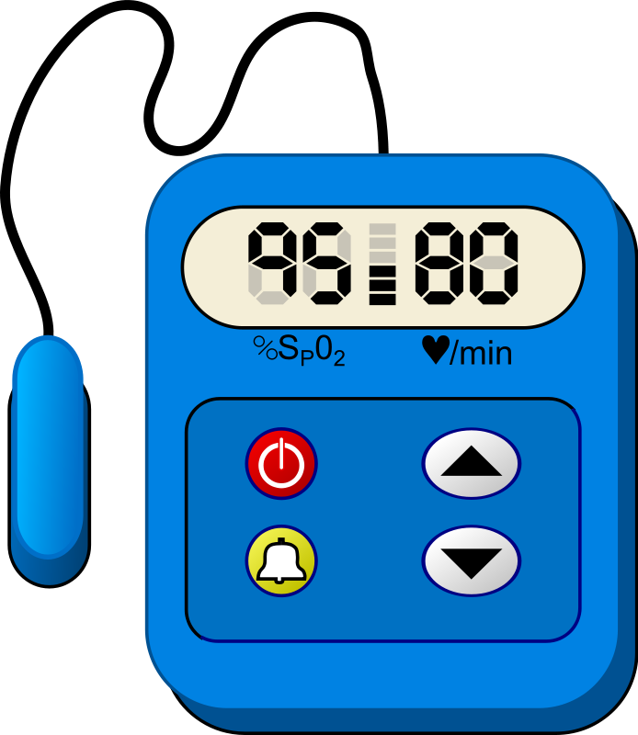

Collaborate with your IT/ IS/ Clinical/ Supply Chain counterparts
Anyone know about this thing?

Slide 26
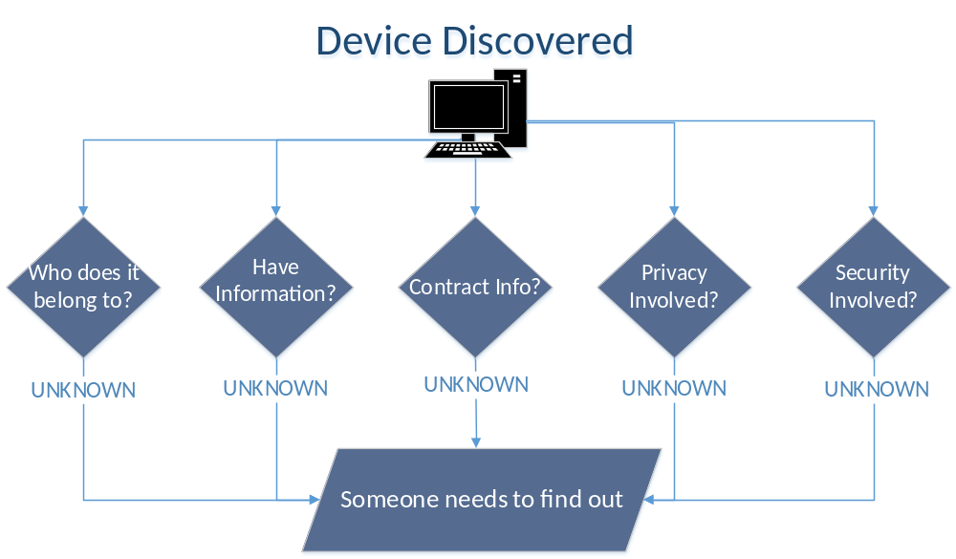
Collaborate with your IT/ IS/ Clinical/ Supply Chain on Risk Assessments and Management

Slide 27
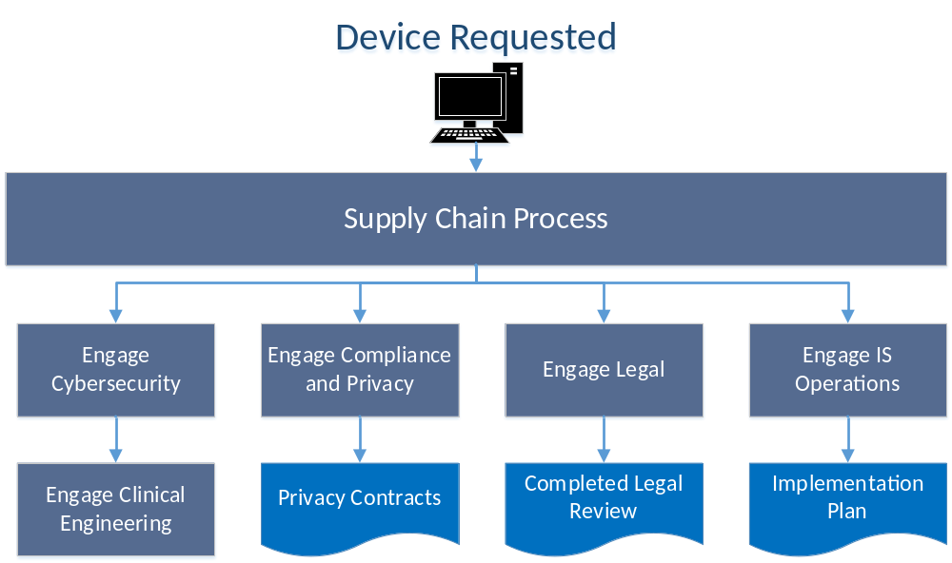
Collaborate with your IT/ IS/ Clinical/ Supply Chain on Technology Evaluation

Slide 28
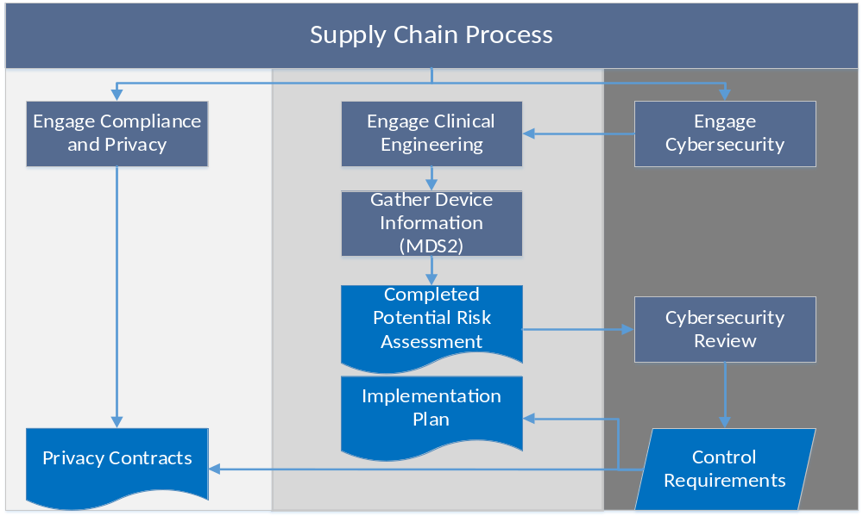
Collaborate with your IT/ IS/ Clinical/ Supply Chain on Evaluating Contractual Language

Slide 29
What do you with this information?
Answer: Operationalize It!

Slide 30
Defining processes for your connected medical devices and those storing data locally
Define environment
  Define data and systems
  Document the environment and its security controls
Do you have the infrastructure to protect the technology?
  Firewalls/ DMZ
  Server and application hardening
Do you have the right policies and procedures?
  Remote access, system use, system and application hardening
  Vulnerability resolution, malware/ breach resolution, BCDR, IR
Are you following any best practices?
Are the users aware of security concepts applicable to the technology?
  Train engineers, system administrators, IT/ IS, users
Is there a continuous improvement process?
  Review vulnerability trends? Review exception requests?
Notes:
Best practices:
Patch management
Centralized logging
Vulnerability scanning
Data loss prevention program

Slide 31
Ensure you have key educational elements in your organization’s learning modules?
Communication w.r.t medical devices and other clinical technologies
Standard purchasing & disposal process
Standard incoming inspection and deployment process
Standard scheduled and unscheduled maintenance procedures
Standard response when a breach occurs
  Breach response plan
Standard communication process when an incident occurs
  Incident response plan
Standard business continuity and disaster recovery process
  BCDR plan

Slide 32
Example: Medical Device CyberSecurity Procedure Outline
  Lifecycle Management
  Access Control
    Authentication, passwords, network access, encryption, etc.
  Software and Maintenance Considerations
    Software updates, firmware updates, operating system updates
  Physical Security
  Cybersecurity monitoring, logging, auditing
  Cybersecurity tools, such as AV, Intrusion Prevention, etc.
  Contracting and Privacy Requirements
  Risk Assessment and Remediation Procedures
  Vulnerability Management
  Remote Access and Support
  Disaster Recovery
  Account for Exceptions

Slide 33
Risk profiling for a medical device
Security configuration
Operating environment
Reducing residual risk

Slide 34
Evolution of the Documentation – Patching Workflow
Current patching capitalizes on the CMMS
Relies on known system, ISAC alerts, and system coordinator for generating work orders specific to patching efforts
Standard procedure for the Integrated Clinical Technologies (ICT) team and technicians
  ICT assesses and coordinates with vendor and Information Security
  ICT and technicians coordinate to apply patches
Reportable and specific to each asset in the inventory
  Problem and response code is prepopulated in the work orders
  Service template has instructions to apply the patches
  Remediation options are set in the resolution code

Slide 35
Proactive Patching
This would encompass regular updates to operating system, firmware, antivirus, whitelisting tools, etc.
There are cost/ benefit considerations relating to the need and frequency of these types of updates
  Cost per touch
  Risk score/ rating of the equipment
  Organizational priorities
Collaboration with clinical practice, HTM, Information Security and consensus policy/ process should be established per manufacturer/model
If possible, HTM will update/ patch in line with the device Preventative Maintenance (PM) schedule
Off-cycle updates can be handled with additional PM’s and SCM’s

Slide 36
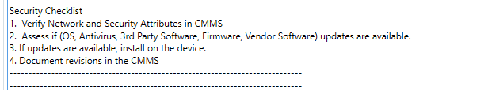
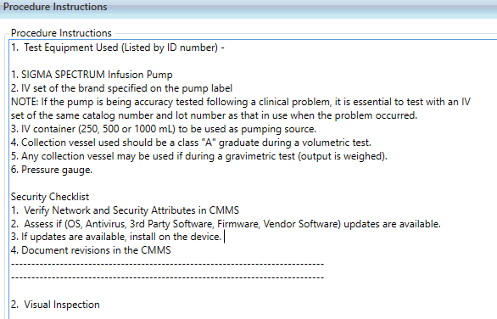
Proactive Patching
HTM can add security related procedures to the PM procedure checklist within the CMMS
This would assure that cybersecurity related tasks are completed as part of the normal maintenance process on each device.
More modern CMMS systems have robust checklist features.
Keith Whitby, Mayo Clinic

Slide 37
Proactive Reviewing of Service Contracts
Use and disclosure of sensitive data
  Login authorization and authentication
  Audit trails
  Physical/ electronic/ external access to devices and systems
Enact and adherence to internal security policies and procedures
  Anti-malware/ code or software that collect information or assert control over medical devices and associated information systems
  Client and device encryption, wireless encryption, electronic encryption
  Vulnerability management and patch management strategy
Audit, inspection and assessment
Business continuity and disaster recovery
Reporting requirements during an event or incident

Slide 38
Documenting Disposition
Secure wipe techniques described in NIST 800-88 or DoD 5220.22M
Contact the MDM if HDO cannot destroy confidential data and obtain a certificate of data destruction
Secure wipe and disposal of medical device must be fully auditable.
Logs must be kept that contain, at a minimum, the following items:
  Medical device asset identifier
  Date of secure wipe
  Name of technician performing the disposition or wipe activity
  Reason for data wipe or device disposal
  Method of data removal
  Outcome of data removal and/or device disposition processes
An appropriate disposition log retention period should be defined

Slide 39
Planning disaster recovery and incident response
Before everything, have a plan for business continuity
Work with key stakeholders to vet the incident response process
Work with clinical caregivers to understand how to use the devices offline or to go to manual process
  Include education and training on a routine basis, if necessary
Identify DR resources – do you have contracts to bring in additional help?
What plans are in place for vendor support for recovery if multiple devices need to be reimaged?
Practice – tabletop exercises?

Slide 40
Reporting metrics to your leadership
Generate a suite of medical device security program metrics and/ or key performance indicators (KPIs) to quantify overall program maturity and progress against established goals. At the very basic level, these KPIs include:
# of unique medical device models connected to the network directly or indirectly
# of unique medical device models storing data locally
% of medical devices (systems) meeting BH enterprise Info. Sec. requirements
# of cybersecurity risk assessments
Cybersecurity risk category population for medical device models
  % of risk register items rated critical or high
# of medical devices (systems) patched in 30-60-90 days
# of critical or high findings with vendors and medical devices (systems)
# of secure configuration builds in 30-60-90 days
Raw event count collected by security monitoring tool

Slide 41
Future Strategies

Slide 42
@ Banner Health
Established a medical device security governance committee
Refining policies, procedures, and baseline standards for connected medical devices
Automation
  Tools to passively monitor network connected medical and IoT devices
    Assist with risk management/ scoring—Probability versus impact
    Interface with vulnerability databases
    Interface with vendor’s maintenance service portals
    Interface with CMMS and GRC
Active notification of update/ patch availability, regardless of service agreement status
  Remote, passive methods of updating devices
Improved and more centralized vendor engagement
  Regular updates and patch management
  Collaboration on known security vulnerabilities

Slide 43
@ Intermountain Healthcare
Medical Device monitoring
  Passive network and behavioral analysis
  Integration with Security Event and Incident Management tools
  Increased network micro-segmentation
Assessments of clinical care areas (e.g. Cath Lab)
Increasing scope of CyberSecurity to include home care and implantable devices
Executive level dashboards and reporting on vulnerability response
Technical vulnerability assessments of network-connected devices pre-production

Slide 44
References

Slide 45
US Cyber Gov & ISE References
Presidential Policy Directive/PPD-21 Critical Infrastructure Security and Resilience issued February 12, 2013.
Executive Order (EO) 13636 Improving Critical Infrastructure Security, Federal Register issued February 19, 2013.
Guidance for Industry, FDA Reviewers and Compliance on Off-The-Shelf Software Use in Medical Devices, U.S. Department of Health and Human Services, Food and Drug Administration, Center for Devices and Radiological Health, Office of Compliance, Office of Device Evaluation issued September 9, 1999.
Guidance for Industry Cybersecurity for Networked Medical Devices Containing Off-the-Shelf (OTS) Software issued January 14, 2005.
Content of Premarket Submissions for Management of Cybersecurity in Medical Devices, Guidance for Industry and Food and Drug Administration Staff issued October 2, 2014.
Infusion Pumps Total Product Life Cycle Guidance for Industry and FDA Staff issued December 2, 2014.
Post market Management of Cybersecurity in Medical Devices, Draft Guidance for Industry and Food and Drug Administration Staff issued on January 22, 2016.
Updated recommendations on submitting a new 510(k) for device modifications August 5, 2016.
Deciding When to Submit a 510 K for a software change to an existing device issued August 8, 2016.
Post Market Management of Cybersecurity in Medical Devices Guidance for Industry and Food and Drug Administration Staff Document issued on January 22, 2017.
Credits: Bill Hagestad, Cybersecurity Expert

Slide 46
US Cyber Gov & ISE References
AAMI TIR57/Ed. 1, Principles for Medical Device Information Security Risk Management dated June 9, 2016.
IEC 80001-1:2010 Application of Risk Management for IT-Networks Incorporating Medical Devices -- Part 1: Roles, Responsibilities and Activities.
AAMI’s Health IT Risk Management: A Practical Tool to Help Hospitals and Medical Devices Stay Secure in a Complex World.
ISO/IEC 27005:2011 provides guidelines for Information Security Risk Management.
ISO/IEC 15408-3 1999-12-01 Information Technology — Security Techniques — Evaluation Criteria for IT Security — Part 3: Security Assurance Requirements.
ISO/IEC 14971 Risk Management for Medical Device Manufacturers.
ISO/IEC 29147 Vulnerability Disclosure Process.
ISO/IEC 30111 Vulnerability Handling Processes.
RFC 2196 Site Security Handbook September 1994.
IEC TS 62443-1-1:2009 Industrial Communication Networks - Network and System Security - Part 1-1: Terminology, Concepts and Models.
IEC TS 62443-2-1:2009 NIST Cybersecurity Framework Core: Informative Reference Standards.
IEC TR 62443-2-3:2015 Security for Industrial Automation and Control Systems - Part 2-3: Patch Management in the IACS Environment.
Credits: Bill Hagestad, Cybersecurity Expert

Slide 47
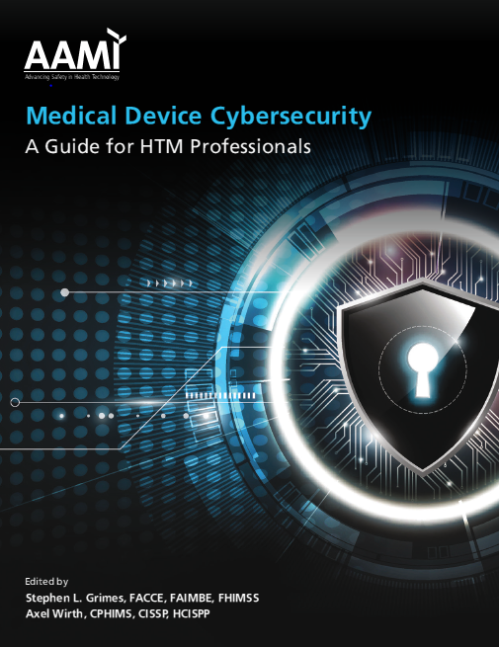
AAMI’s Medical Device Cybersecurity – A Practice Guide for HTM Professionals
- Appendix
P&P Templates

Slide 48


Slide 49

Open Position:
Medical Equipment Data Security Manager
Job # 220558 https://intermountainhealthcare.org/careers/explore-careers/
Questions?
Contact the recruiter Debbie Rakhsha
801-442-2121
Debbie.Rakhsha@imail.org

Slide 50
Job Description
The Clinical Engineering (CE) Medical Equipment Data Security Manager is responsible for providing management and direction for the development, implementation, and maintenance of policies, procedures, guidelines, processes, technologies, and measurement of the Clinical Engineering program strategy for medical equipment data security. This includes the operational analysis along with the support, prevention, detection and response to medical equipment threats, vulnerabilities, and incidents. Job duties include the management and oversight of medical equipment networking, remote access control, and integration of devices into automated processes for documentation of patient treatment and equipment performance. Additional responsibilities will include a working relationship with Corporate Compliance to ensure CE adherence to regulatory requirements.

