Slide 1

What does Compliance mean for the HTM Department?
Priyanka Upendra – BANNER HEALTH

Slide 2
Nothing in this presentation is intended to be legal advice.
Any examples or scenarios are for discussion purposes only.

Slide 3
Session Overview
Healthcare faces more regulations each year and a more aggressive enforcement environment. Keeping up with numerous regulations, standards, reporting to internal and external boards, and managing risks in the environment of care and with advanced connected clinical technologies is a challenge for HTM departments. In this interactive session, attendees will learn about different program evaluation methodologies, risk framework and risk categorization, and effective reporting that showcase value.

Slide 4

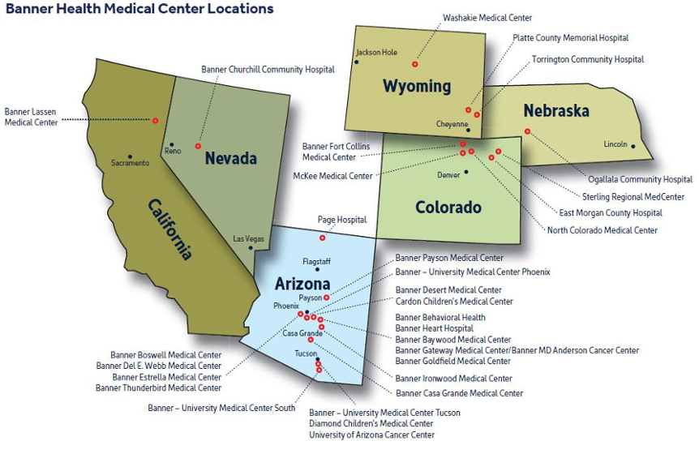
“Making health care easier, so life can be better.”
Technology Management (TM) Organizational Structure
~251 staff members
  [139] biomedical equipment technicians
  [40] imaging service engineers
  [27] management
  [7] medical physics
  [13] integrated clinical technologies
  [10] project management
  [15] business support
[>33] shops providing service in 29 hospitals, >480 clinics in 6 states
Over 243,000 medical devices and systems inventoried and valued at approximately $1.3B

Slide 5
Current State
Healthcare faces more regulations each year and a more aggressive enforcement environment
HTM services enforce their own requirements with the vendors they partner with
Issues can flare up in minutes, magnifying the impact of problems, that in the past did not seem such a big deal

Slide 6
System Availability and Patient Care Access are Highly Visible to Executive Leadership
The HTM Compliance Program offers 3 main benefits in this understanding:
It provides a well documented, current, and accurate program that could be referred to at any time when federal, state, or other accreditation agency knocks on your door
It keeps HTM services and its employees in compliance and avoids trouble
It allows services to operate smoothly and reasonably when responding to changes in the industry and regulatory environment

Slide 7
An HTM Compliance Program:
Designed to:
Prevent and detect wrong-doing
Understand and manage the risk in medical device management
Manage the risk of non-compliance and appropriately react to problems when they occur
Assure external stakeholders (aka regulators)
Assure internal stakeholders (executive leadership/ board of directors) that the organization is doing what it can to manage risk
Allow employees to know what they need to do in their jobs to avoid compliance problems
Allow everyone to sleep better at night

Slide 8
Core Elements for an Effective HTM Compliance Program
Compliance Director/ Officer
Well-written policies, procedures, and processes
Training, education, and communication
Periodic assessments
Auditing & monitoring plan
Disciplinary/ corrective actions for non-compliance
Respond appropriately to compliance issues

Slide 9
When you decide to develop an HTM Compliance Program
Decisions will need to be made as a compliance program is started and as it operates:
Who will be accountable?
If there is a non-compliance, what happens?
What resources are dedicated to compliance?
How will the organization/ department choose between compliance alternatives?
How will information about compliance be escalated?
How will the organization/ department know what regulations they need to comply with and what to do if regulation changes?
How will the organization/ department decide how to change the program if services change?

Slide 10
HTM Compliance Professional:
Direct reporting to HTM Department and dotted line to Compliance/ Risk Management
Overall responsibility of day to day operations of the compliance program
Must have prompt access to compliance reporting
Must routinely report to compliance board and executive leadership
Must have access to effective executive management and leadership oversight
Be a subject matter expert in HTM, go-getter, and motivated individual
Exercise effective and ongoing oversight
Must promote the program
Speak the same language as compliance, privacy, and legal

Slide 11
HTM Compliance Program Initiatives
Policy, procedure, and process documentation management
Purchasing and contract management
Medical device recalls and alerts management
Medical device related events and incident management
Medical device cybersecurity management
Standardization and evaluation of technology
HTM internal audit
Education and awareness of medical device risks

Slide 12
CONTINUOUS IMPROVEMENT CYCLE
“PLAN-DO-CHECK-ACT”
A recurring theme in building a compliance program

Slide 13
Conduct the compliance risk analysis:
What is your HTM department’s structure, objectives, and operations?
Risk identification: what are the possible medical device risks in your organization?
Risk assessment:
  Likelihood of risk
  Impact of risk
Risk evaluation: assessing the risk
  Organization's appetite for risk
  Most important risks to address
Risk treatment
Monitoring, review, and corrective action
Communication throughout the organization

Slide 14
Risk Identification
Process flow analysis
  Regulatory analysis
  Responsible parties
Event inventories
  Department history
  Executive leadership expectations
  Best practices in the industry
Interviews, questionnaires, and surveys
Facilitated workshops
Leading events and escalation triggers

Slide 15
Periodic risk assessments
Efficiency: risk assessments allow you to maximize the utility of scarce resources by directing them to the most significant compliance issues faced by your organization
“Buy-in” and Ownership: when individuals who have day to day administrative responsibilities participate in identifying compliance risks and developing mitigation plans they are more likely to actively participate in the compliance process
Coordination: most compliance risks have potential significance across multiple functions, so risk management encourages coordination and consensus building, particularly in organizations with distributed/ decentralized management

Slide 16
Periodic risk assessments
Keep the risk management process simple
    Build into existing business processes
    Complex processes feel like red tape
Start small and build over time
    Don’t overload senior management with too many projects
    Additional projects and processes can be added over time
“Don’t let the perfect be the enemy of the good”

Slide 17
Design a RA Project for Engagement
Eliminate Mystery – Map out the RA project plan and educate stakeholders on the expected resources. Be clear throughout the process.
Time is Money – Have clear goals for every meeting with stakeholders, do not invite stakeholders to meetings where they do not have a role.
Make People Look Good – Engage stakeholders personally in discussions with upper management whenever possible so they get credit for being sophisticated about compliance and solving problems.
Develop Ownership – Look for stakeholder decision‐making on eliminating obstacles or solving problems involves their teams during the project. The more decisions stakeholders make, the more they have ownership in the process.

Slide 18
Creating a Risk Registry
Selection of Laws/ Regulations Based on Current Operations
+
Selection of Laws/ Regulations Based on Strategic Plan
+
Selection of Laws/ Regulations Based on Benchmarking
+
Selection of Laws/ Regulations Based on Enforcement Trends
+
Any Other Sources That Your Services Find Important
=
Compliance Risk Registry

Slide 19
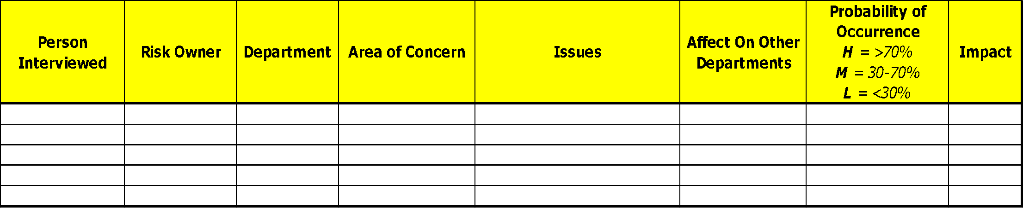
Sample Risk Registry
Risk assessment survey
What are the issues/ areas of concern that keep you up at night?
What is the probability of occurrence?
Risk owner impression of impact level
Create a risk registry

Slide 20
Risk Evaluation
Having assessed the risks:
    What is your organization’s “appetite” for risk?
    What are the most important risks to address?
For the high probability and high impact risk, do a detailed analysis on the impact or consequences of the risks
    Patient safety
    Legal/ compliance
    Reputation
    Environmental health and safety
    Operational
    Social/ behavioral
    Physical environment
    Financial
Rate the impact of each risk using a defined scale

Slide 21
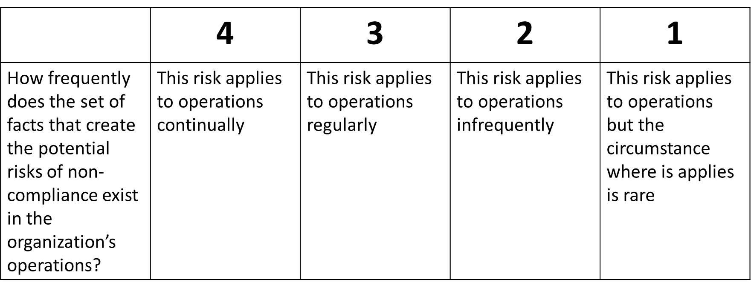
Likelihood matrix

Slide 22
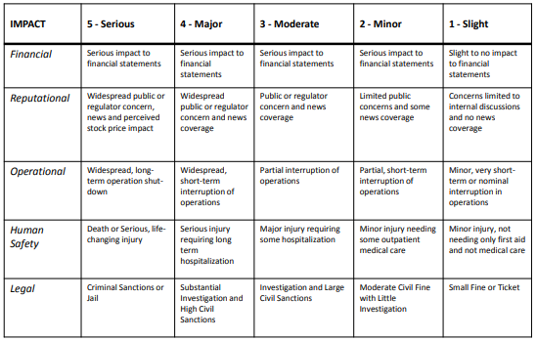
Impact matrix

Slide 23
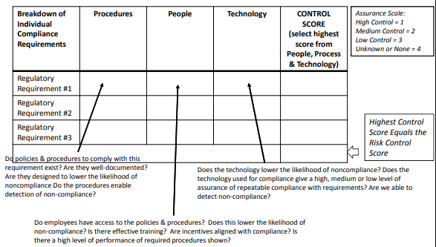
Evaluate Existing Risk Controls for Each Law/ Regulation

Slide 24
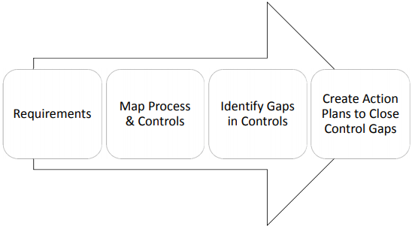
Creating Action Plans to Manage/ Mitigate Risks

Slide 25
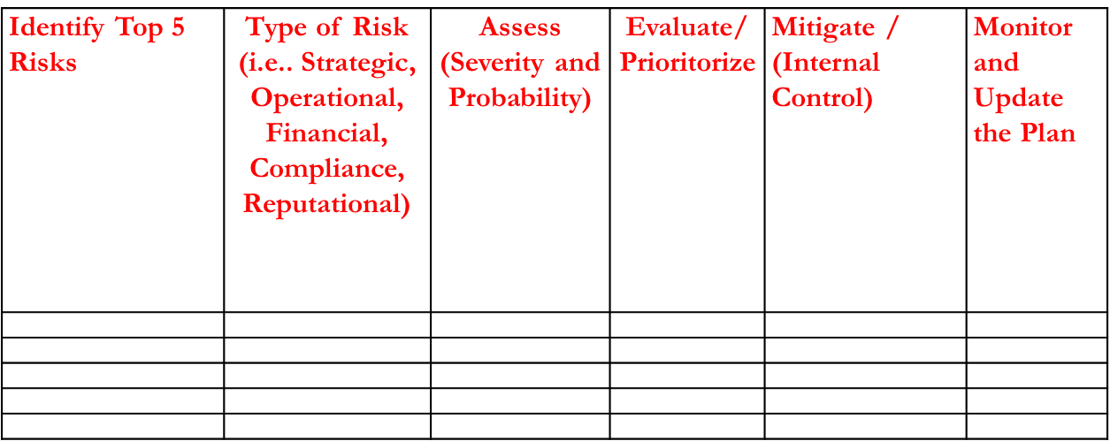
Distill Registry to Top 5 Risks

Slide 26
Reports that Engage and Showcase Action Plan Progress
Frequency: keeping in mind your organization’s budget cycle.
At – A – Glance: Design reports communicating the main points with diagrams and tables (whenever possible).
Specificity: Use every communication as an opportunity to educate specifics on the risks and impact to the company.
Consistency: Use the same format of the report for every quarter to avoid training executives multiple times on multiple formats. Ensure that risks that appear in working documents appear in the final report.

Slide 27
Risk Response
Avoidance
Reduction/ mitigation (internal controls)
Sharing (e.g., insurance)
Acceptance
    Crisis management plans
    Business continuity plans
    Other operational plans
    Development of new policies/ procedures

Slide 28
Internal Controls
Organizational/ process controls (i.e., separation of duties)
Documentation – written policies, procedures, and processes
Training
Audit reports
Security and integrity

Slide 29
Compliance Communication
More Elements:
Written policies, procedures, and processes
Training and education
Lines of communication
    Hotline and Whistleblowers
Standards enforced through well-publicized guidelines
    Leadership statement
    Reporting obligations
    Whistleblower, non-retaliation

Slide 30
Monitoring & Reviewing
Reasonable steps to:
    Ensure that the organization’s compliance program is followed
    Periodically evaluate the effectiveness of the compliance program
Routine monitoring of actual performance vs. expected performance
Review and periodic investigation of the current state
Types of Monitoring
  Line management reviews of risks and their treatments
  Internal auditing
  External auditing

Slide 31
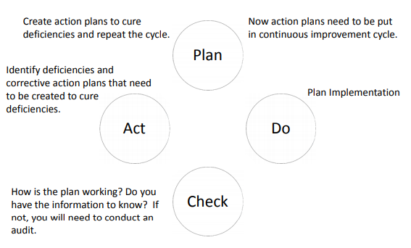
Continuous Improvement Cycle

Slide 32
Before Building an Effective Compliance Program
You must have buy in from the top
Establish Compliance as a component of the department’s strategic plan
Identify common behaviors that cut across multiple compliance areas and make those central
Establish risk ownership and management of risk
Develop a model that focuses on:
    Regulatory standards
    Guidelines and best practices
    Emerging regulations and guidelines

Slide 33
Develop a Department Compliance Calendar
Create universal template
    Must include the governing authority/ risk owner
    Description of action steps, responsibility, and completion date
Divisions of regulatory compliance
Organization wide inventory of dates for compliance
    Must include the standard, requirement, risk owner, deadline, and status update

Slide 34
Summary
“Do what you can, with what you have, where you are.”‐ Theodore Roosevelt
Start with Governance
Risk Assessment
Manage & Mitigate Risks with Action
Reporting
Continuous Improvement
Design for Engagement

Slide 35

Priyanka Upendra
Compliance Program Director
Technology Management,
Banner Health
Priyanka.Upendra@bannerhealth.com
(602) 747- 2393

