Slide 1
Redefining the Clinical Engineering Supply Chain
Presented by Mara Pare’, Senior Director, Client Solutions, PartsSource

Slide 2
Today’s Agenda
Current State of Healthcare
Making Supply Chain a Focus
Ideas to optimize
  People
  Process
  Technology

Slide 3
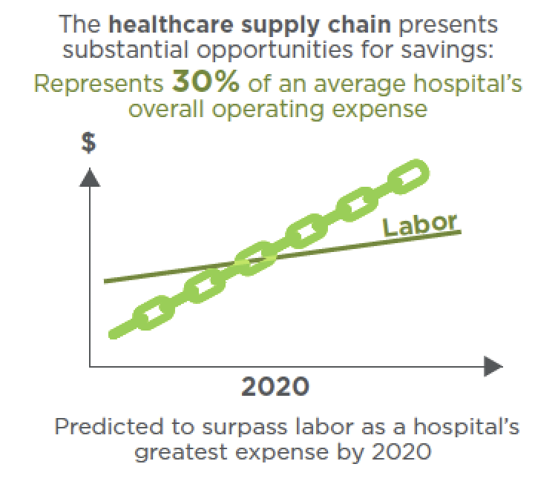
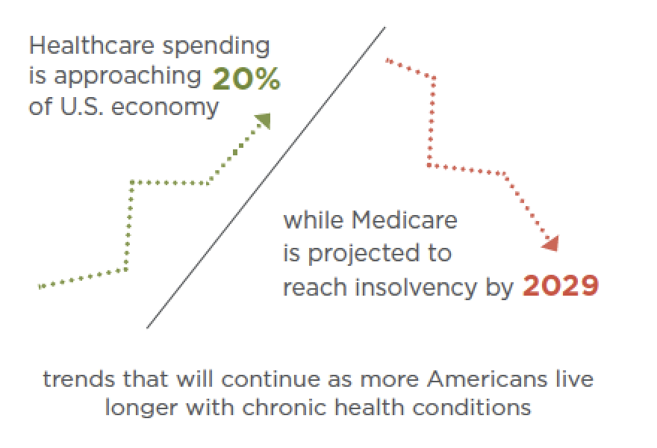
Current State of Healthcare: An Industry in Crisis
Improving quality and controlling costs remain paramount
Pressure on hospitals and health systems to simultaneously improve quality and reduce costs will only intensify.
Source:
https://www.navigant.com/insights/healthcare/2017/thought-leadership-healthcare/supply-chain-analysis

Slide 4
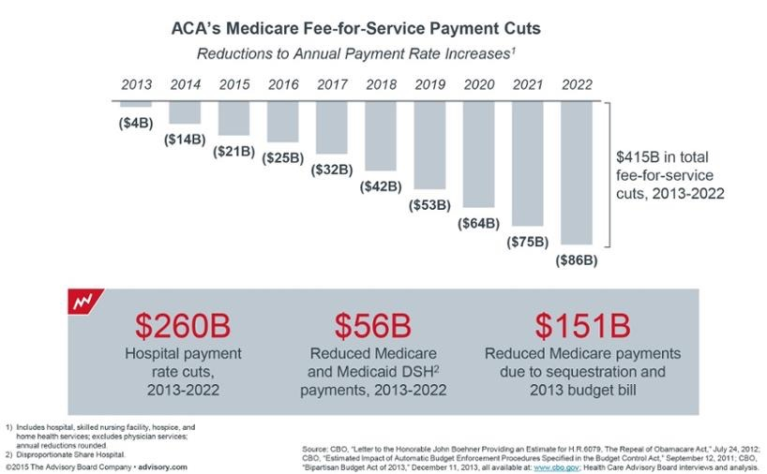
Current State of Healthcare: An Industry in Crisis

Slide 5

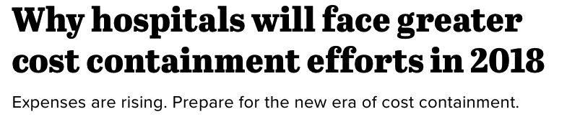
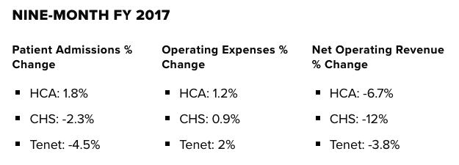
Current State of Healthcare: An Industry in Crisis
New challenges in today’s healthcare environment are driving fundamental change in the supply chain business model and operational processes.
Source:
https://www.healthcaredive.com/news/hospital-budgets-2018/512137/
https://www.supplychaindive.com/news/hospital-supply-chain-cost-pressure-change/512721/

Slide 6
But first…a little inspiration to help us innovate
Slides courtesy of Jeff Hoffman

Slide 7
We need to open our minds
We need to look at the same things differently

Slide 8
Current State of Healthcare: An Industry in Crisis
An opportunity for clinical engineering
New challenges in today’s healthcare environment are driving fundamental change in the supply chain business model and operational processes.
Source:
https://www.healthcaredive.com/news/hospital-budgets-2018/512137/
https://www.supplychaindive.com/news/hospital-supply-chain-cost-pressure-change/512721/

Slide 9
Gather periodically to toss around ideas, even crazy ones
Every once in a while, start your department over

Slide 10
What would you do if you could start over?
Ask why not?

Slide 11




Why Not Focus on Supply Chain?
A nationwide study looked at 2,300 hospitals and their supply spend and found the providers could reduce their annual supply budgets by a total $23 billion. This is a savings of about 18 percent.
Source:
http://www.healthcarefinancenews.com/news/hospitals-could-save-about-10-million-year-supply-chain-study-finds
https://www.fiercehealthcare.com/finance/hospitals-could-save-billions-by-optimizing-their-supply-chains

Slide 12



Perspectives from within the CE Supply Chain
Clinical engineer director
“Where can I lower our total cost of service and empower my team to take on contract services?”
Finance director
Technician
“How do I reduce our operational cost and improve the efficiency and utilization of our assets?”
“How can I find extra time to implement AEMs and PM programs.”
IT specialist
Supply chain
“Our heath system needs to improve med device privacy, security, and cybersecurity.”
“How can we enforce standardization and compliance and manage the long-tail spend?”

Slide 13
How to Redefine the CE Supply Chain Strategy
Why not use our assets of people, process and technology to improve?
Question the status quo
People
Process
Technology

Slide 14
People
Where do we spend lots of time for little value? Why not change it?
Strong relationship with Supply Chain and other internal key stakeholders
Create strategy for taking more service in-house
Partner with organizations that leverage strong buying power and large supply chain
Partner with organizations that leverage strong buying power and large supply chain

Slide 15


People
Focus on opportunities to increase productivity and free-up time to take on install projects, device cybersecurity, interoperability implementations and more.
Soft Cost Savings
Parts procure to pay time reduction from 89 minutes per order to 4 minutes
per order, equating to saving 31 hours per day
Real Results
Refocused time and energy on cybersecurity and bringing COSR down system wide

Slide 16
Process
Don’t know your high-spend vendors and supplier quality rates? Why not change that?
Review Service Contracts and Parts Procurement
Vendor Consolidation - Scope of Services
ISO Certified Vendors
Supplier Vetting Process
Industry Benchmarking

Slide 17

Process
Find opportunities to consolidate suppliers and achieve better pricing.
Supplier Consolidation & Quality Metrics
Consolidated over 450 suppliers while achieving a 98.1 Quality Acceptance Rate and 27% hard cost savings. Parts procure to pay time reduction from 89 minutes per order to 24 minutes per order
Real Results
Able to actively monitor quality metrics against industry benchmarks and reduce procure to pay time by 31%. Technicians became involved in system-wide projects and strategic modality initiatives.

Slide 18
Technology
Do we optimize our supply chain to result in faster equipment uptime and better quality patient care? Why not?
Integrations:
CMMS
ERP
EDI
Automated processes: Better tools
Data
Integrity:
In CMMS
Reporting and Analytics: Monitor spend patterns
Start tracking and reporting cost savings: Showcase value of CE

Slide 19

Technology
Technology can provide meaningful cost savings and access to data to optimize operations.
Workflow Integration
Standardized fragmented procurement process across CE organization, resulting in 35% cost reduction in spend.
Real Results
Now able to effectively communicate and back each other up across system, cemented relationships across various departments and sites.

Slide 20
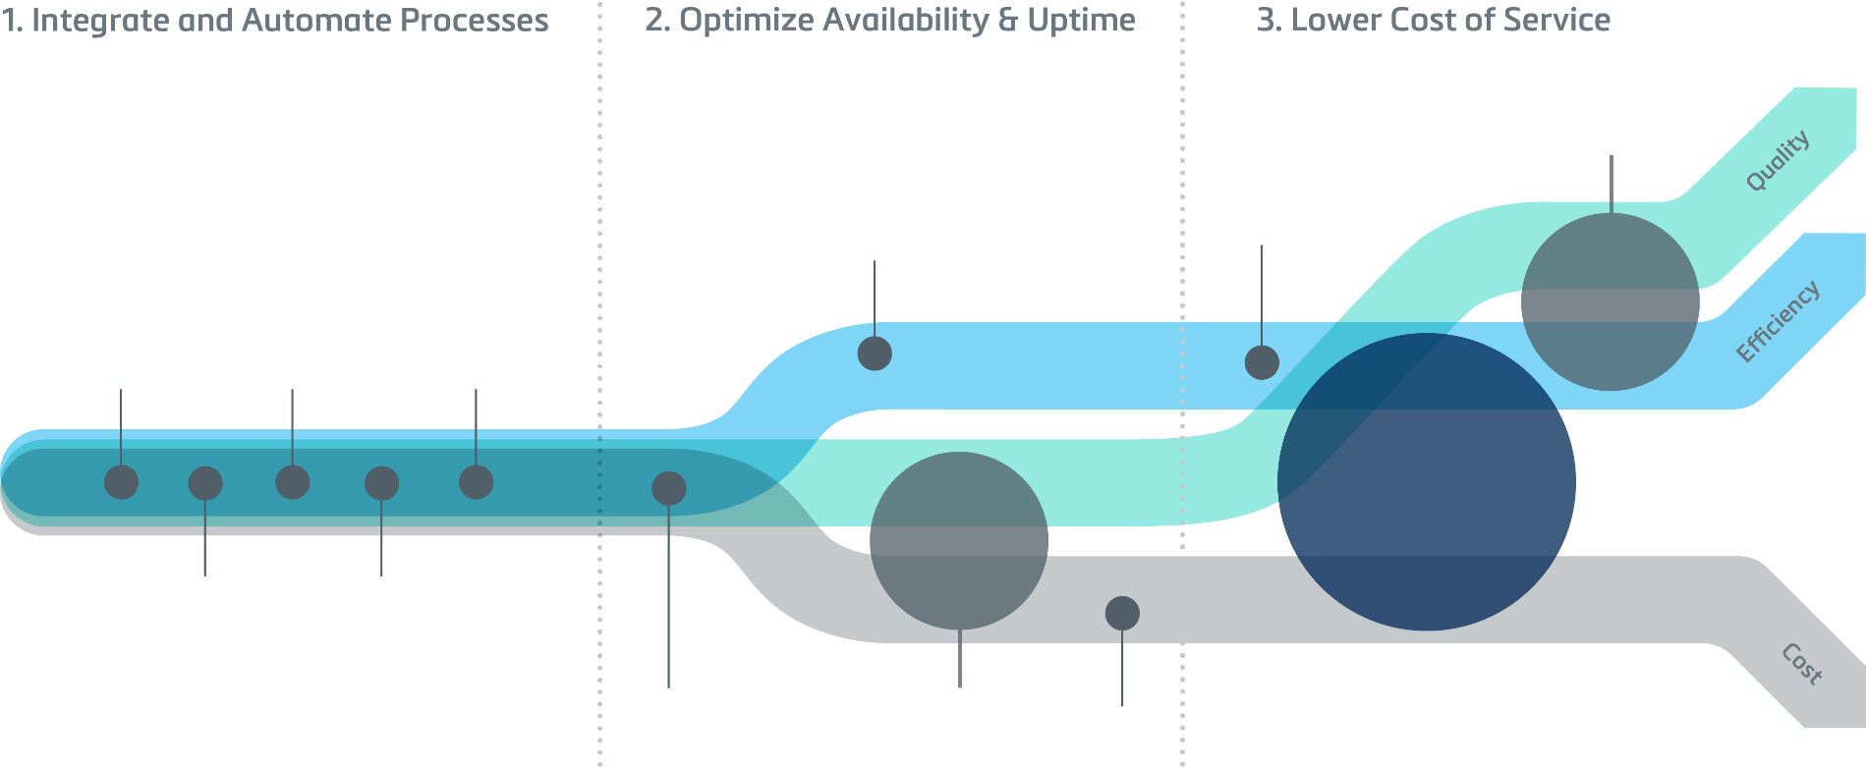
Framework to Success
Plan
Analyze
Improve
Improve Procurement Logistics
Optimize / Train
Resources
Consolidate
Suppliers
Integrate
CMMS/ERP
Analyze
Parts Spend
Manage
Contracts
Reduce
Cost of Service
Maximize
Secondary
Options
Reduce
Sourcing Time
Benchmark
Performance
Depot Repair
Strategy
Evaluate Contract
Strategy

Slide 21
Takeaways
Impact what’s happening in healthcare and the value CE brings to the organization by using your people, process & technology to make improvements
Eliminating service contracts and consolidating suppliers are 2 opportunities to achieve the greatest positive impact in the CE supply chain
Ask why not?

Slide 22
Mara Pare’ mpare@partssource.com
330-954-7674
Questions?

