Slide 1


Maintaining Security While Building Your Medical Device Security Program
at an Integrated Delivery Network
Priyanka Upendra, BSBmE, MSE, CHTM
CE Compliance Manager, Intermountain Healthcare
Inhel Rekik, MSE
Director of Health Technology Security, MedStar Health

Slide 2
Priyanka Upendra & Inhel Rekik
Have no real or apparent conflicts of interest to report.

Slide 3
Session Overview
HTM professionals from Intermountain Healthcare and MedStar Health will discuss how to maintain security while building a medical device security program.
The session will discuss various aspects of a medical device’s life cycle as it pertains to cybersecurity management. These aspects are essential to building a medical device security program based on the five principles from the NIST cybersecurity framework.
This includes medical device procurement, data security agreements and contract language, risk assessment and security review process, patch management, replacement planning, and data destruction during medical device disposition.
This session will also discuss essentials to sustaining a medical device security program at an IDN.
This session will conclude by discussing regulatory aspects such as HIPAA compliance and FDA reporting as it pertains to medical device security.

Slide 4
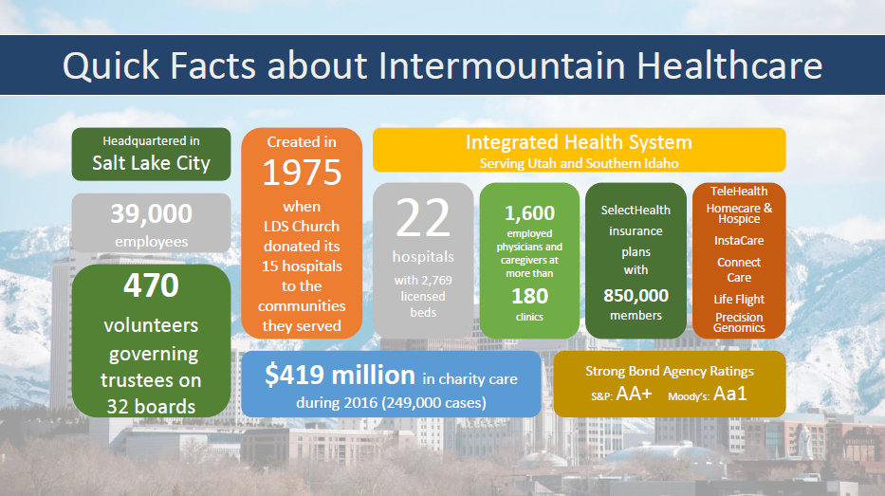

Slide 5

Background
Bachelor’s of Engineering in Medical Electronics – Bioinstrumentation; Signal and Image Processing from B.M.S College of Engineering, Visveswaraya Technological University, Bangalore, India
Masters of Engineering in Biomedical Devices from San Jose State University, California
Currently working on a Doctorate in Health Administration
Certified Healthcare Technology Manager by AAMI Credentials Institute
Certified Change Management Specialist and Six Sigma Lean Professional from Management and Strategy Institute
Research and Technical Adviser for BME departments at San Jose State University and B.M.S College of Engineering
Joined Intermountain Healthcare in July 2016. Prior experience in Stanford Health Care, Stanford Children’s Health, Santa Clara Valley Medical Center, Stanford University Medical Center, and Stanford University
Worked in GE Healthcare and Philips Healthcare on hybrid imaging modalities R&D prior to HTM industry
Have worked in the medical device industry for over 10 years and HTM industry for over 7 years
2017 Winner of the AAMI Young Professional Award and 2015 BI&T Best Article Award
Board Member at ACCE and Active member of the Healthcare Technology Certification Commission
Active Member at AAMI’s Awards Committee, Nominating Committee, EQ Committee, BI&T Editorial Board, and Technology Management Council
Active Member of HIMSS, NH-ISAC, MDSISC, and NH-ISAC cybersecurity education committee

Slide 6

Clinical Engineering Organizational Structure
Central Support Services and Management
  System Director <--- CE Compliance Manager (Shared Clinical Services Compliance)
  Central Support CE Director
  Dispatch Center & Inventory Coordinator
  Business Analysts & Service Contract Specialist
  Homecare CE & Surgical Services CE
CE Hospital Operations
  Three CE Directors
  Local CE Departments and Technicians
  Local Parts and Supply Stock
Imaging Equipment Services Program
  Program Manager
  Regional Service Engineers
  Centralized Budget and Parts Stock
Central Depot Repair Services
  Depot Clinical Engineers– Mobile Medical Equipment
  Field Service Operations
  Centralized Parts Stock

Slide 7
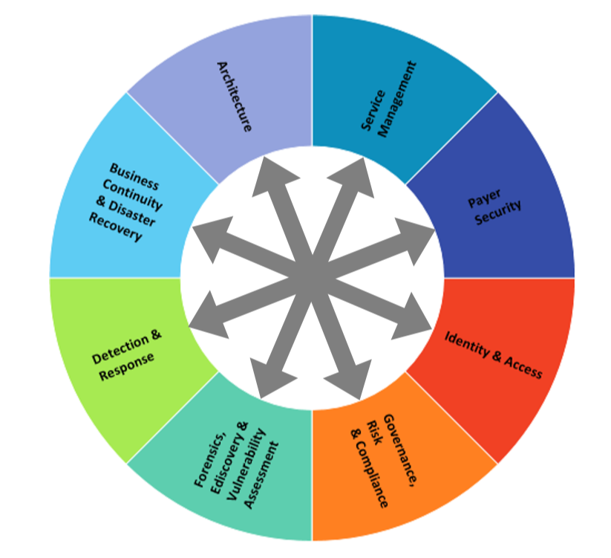


CyberSecurity
Architecture
BC/DR
Detection/Response (SOC)
Forensics, eDiscovery
GRC
IAM
Payer
Service Management
Vulnerability Assessment

Slide 8

To be the trusted leader in caring for people and advancing health
1999 MedStar Health is established as the new name for the largest not-for-profit health care system in the mid-Atlantic region
30,000 associates and 6,000 affiliated physicians
10 hospitals
MedStar Health care for more than half-million patients each year across Maryland and the Washington, D.C., region in our hospitals, urgent care and ambulatory care facilities, and physician offices
MedStar Family Choice – health plan

Slide 9

Background
Inhel is the Director of Health Technology Security at MedStar Health where she overseas the security program for medical devices as well as devices non traditionally supported by IT.
Prior to this role , Inhel held over 10 years of HTM experience with her most recent role being the clinical engineering manager at MedStar Georgetown University Hospital.
Inhel pursued her education in Canada where she received her Bachelor’s degree on Computer engineering from Laval University and Master’s degree in Biomedical engineering from Polytechnic School of Montreal.
Inhel is an active member of AAMI Healthcare Technology leadership committee, AAMI Next Generation Task Force and the author of Tech Tips column in TechNation magazine.

Slide 10
Clinical Engineering and Information Services Relationship
Clinical Engineering is decentralized, directors are located at each site.
Reports through COO at hospitals, to local hospital president
Most purchasing is governed centrally through Performance Improvement
Hospitals maintain some purchasing autonomy for biomedical equipment
Vendor relationships maintained by each site
No direct reporting relationship to Information Services
Information Services is centrally managed by the CIO who reports to the CAO for MedStar Health
CISO reports to the CIO
IS manages patching for applications, servers, desktops
IS manages the network infrastructure
No direct reporting relationship with Clinical Engineering

Slide 11
Director of Health Technology Security - Responsibilities at MedStar
Responsible to develop and establish the medical device and IoT security program across the MedStar enterprise
Responsible to operationalize risk management strategies for vulnerable clinical technologies
Security function areas include:
  Governance
  Risk Assessment and Risk Analysis
  Security Operations
  Investigation and Enforcement
  Security Education

Slide 12
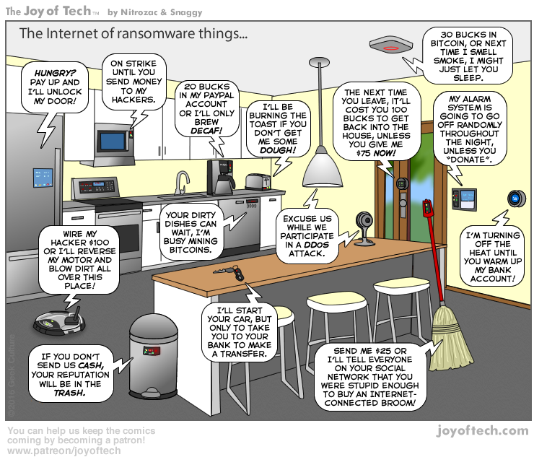

Slide 13
Why Are We Talking About Medical Device Cybersecurity?
Device-specific vulnerabilities
  Weak default credentials (User and User)
  Known vulnerable software platforms (e.g., Windows XP)
  Wireless communication vulnerabilities (man-in-the-middle attacks, change device behavior)
OCR Investigations
  Lahey Clinic Hospital: Laptop connected to CT scanner stolen from unlocked treatment room – $850,000; 599 records
  Feinstein Institute 2016 HIPAA Settlement: Lost laptop, no encryption – $3.9 million!
  Concentra HIPAA Settlement: Stolen laptop, no encryption – $1.7 million
  Fines are increased if OCR determines policies and procedures are inadequate and access is not limited
  Public data shows it costs an average of $881,305 in HIPAA fines for each single stolen laptop
Notes:
Lahey: https://www.hhs.gov/sites/default/files/lahey.pdf
Feinstein: http://www.healthcaredive.com/news/feinstein-institute-for-medical-research-to-pay-39-million-in-hipaa-settl/415998/
Concentra: https://www.hhs.gov/sites/default/files/ocr/privacy/hipaa/enforcement/examples/concentra_agreement.pdf
Launch pad: The virus/malware doesn’t even know it’s running on a medical device and may not be intended to affect the functioning of the device. The malware only knows that it’s vulnerable and can be used to propagate itself, infect other machines, perform reconnaissance, botnet (dos/DDOS). IoT related vulnerabilities and DYN attack.

Slide 14
Safe and Reliable Patient Care is our top Priority
Integrity
  Information going into the eMR from medical devices need to be accurate so the diagnosis or treatment plan is appropriate
  Malware infecting the medical device may alter patient data
Availability
  An incident impacting the hospital network may force medical devices to operate in ‘stand-alone’ mode interrupting clinical workflow
  Data will not be sent to the eMR forcing caregivers to move back to manual charting
Confidentiality
  Unauthorized access may allow the intruder to obtain AND/ OR alter AND/ OR delete important medical information
Notes:
Integrity:
An example of this is integrated infusion management where the dose delivered to the patient depends on the patient data the infusion pump received from the electronic medical record (EMR). Corrupted patient information received by the infusion system, such as incorrect patient weight, can result at the wrong volume of drugs delivered to the patient.

Slide 15
Big Picture – 30,000ft Overview of HTM’s Role
Ensure Safety and Cybersecurity standards throughout the device life cycle
Maintain consistency with IS policies, procedures, and processes as it pertains to medical device security
Review clinical technologies and ensure:
  Network information is collected and documented in the CMMS
  Risk assessment is completed
  Risk management strategies are developed and documented
  Data security addendums are included in service contracts
  Patch management strategies are agreed upon and documented
    Secure configurations are deployed and maintained
  Data sanitization techniques are used during disposition or transfer of devices
  Due diligence reporting security events and incidents
Notes:
Check configurations: Validate patch status, validate password enabled, validate encryption enabled, validate data is being wiped, etc.
Connected equipment: Understanding what the connected system is supposed to do, the data it contains, vendor access, etc.
Reporting: Do you know who to call?

Slide 16
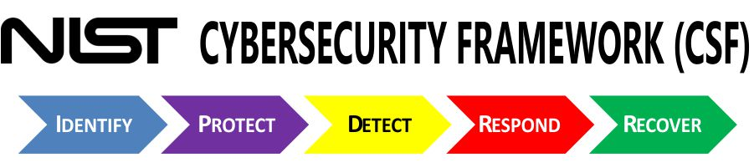
Identify
  Manual and automated identification via network scanning, device discovery tools, etc.
  Understanding and identifying data flows, architectural diagrams, and support requirements
Protect
  Determine controls available and not available on the medical devices
  Create implementation plans for securely deploying devices
  Determine and applying compensating controls and appropriate network segmentation methods as necessary
Detect
  Establish behavior baselines and monitor for abnormal behavior
Respond
  Establish response plans when controls fail and develop communication plans for control failures, breaches, theft, loss, etc.
Recover
  BCDR plans for redeploying medical device following an incident and to restore data
Notes:
Key objectives of a medical device security program
Identify - Manual identification pre and post purchase
Recover - Reimaging medical devices, placing service calls, and ensuring access and availability of medical devices

Slide 17
Policy, Procedure, and Process Governance
Supply Chain Process – procuring new clinical technologies or reviewing existing technologies
  Obtaining the MDS2 document
  Obtaining service and operator manuals, other cybersecurity documentation (AV, encryption, patch management, data destruction technique..)
Medical equipment inventory policy
  Obtain and document network information; ePHI/ PII/ PCI; local data storage capability
Medical equipment incoming inspection procedure
  Checking secure configurations
  Deviations documented as an exception request

Slide 18
Policy, Procedure, and Process Governance – continued..
Medical equipment scheduled maintenance procedure
  Periodic review of security controls for the device or systems
    Default passwords
    AV updates
    Encryption of sensitive data
    Last patch update/ Do we need to update?
    Document the validated controls in the PM action plan
Medical equipment disposition procedure
  Effective disposition of medical device ensures the confidentiality of any data that may have been gathered by the device during its life cycle
  Use of secure wipe techniques described in NIST 800-88 or DoD 5220.22M
  Equipment control number, date of secure wipe, technician performing the secure wipe, reason for wipe, method and outcome of secure wipe

Slide 19
Collecting and Documenting Network Information
Primary user
Location
Network jack number
Asset serial number
Nearest telephone number
Hostname
MAC address
IP addresses – static or dynamic
Operating system type
Software revision level
Date of last patch update

Slide 20
Risk Assessment
Is an on-going process of discovering, correcting and preventing security problems.
Integral part of a risk management process designed to provide appropriate levels of security for various systems
Information systems, connected medical devices, devices with local data storage, device-device dependency, device-IT component dependency…
MDRAP tool – federally funded, available free of cost for participating healthcare delivery organizations
Risk assessment report aids development of risk management strategies

Slide 21
Provisions in the Service Contract – DSA, other…
Use and disclosure of sensitive data
  Login authorization and authentication
  Audit trails
  Physical/ electronic/ external access to devices and systems
Enact and adherence to internal security policies and procedures
  Anti-malware/ code or software that collect information or assert control over medical devices and associated information systems
  Client and device encryption, wireless encryption, electronic encryption
  Vulnerability management and patch management strategy
Audit, inspection and assessment
Business continuity and disaster recovery
Reporting requirements during an event or incident

Slide 22
Patch Management Strategy
In accordance to FDA post-market cybersecurity guidance, HDOs should ensure medical device software, operating systems, and other components receive cybersecurity routine updates and patches in a timely manner
MDMs are expected to supply the HDO with cybersecurity routine updates and patches for the duration of the life of the medical device
HTM department must develop patch management plans as part of the device maintenance plan
HTM, with guidance from the HDO Cybersecurity and MDM, should develop upgrade or transition plans for medical device running software that is no longer supported or has been deprecated by the software creator
In the event that the medical device will not or cannot be patched or updated to remediate a known security vulnerability, the MDM is expected to detail, in writing, the reasons why the patch or update would invalidate the FDA certification or cause patient safety concerns

Slide 23
Data Sanitization
Secure wipe techniques described in NIST 800-88 or DoD 5220.22M
Device must also be securely wiped whenever physical control of the device is relinquished
If the data on the medical device cannot be destroyed according to the above standards, the vendor or manufacturer should be consulted regarding other effective methods
The HTM department is responsible for the creation, maintenance, and implementation of medical device disposition procedures and processes, as well as ensuring data is securely wiped from equipment
Secure wipe and disposal of medical device must be fully auditable. Logs must be kept that contain, at a minimum, the following items:
  Medical device asset identifier
  Date of secure wipe
  Name of technician performing the disposition or wipe activity
  Reason for data wipe or device disposal
  Method of data removal
  Outcome of data removal and/or device disposition processes
An appropriate disposition log retention period should be defined within the medical device disposition procedures.

Slide 24
Vulnerability Management
NH-ISAC alerts
  Indicators of compromise shared daily
  MDSISC and PSIC – vulnerability notices are shared routinely
ICS-CERT advisories
  Vulnerability notices validated by manufacturers are posted routinely
Partnerships with manufacturers
MedSec group on LinkedIn – information from independent security researchers

Slide 25
Building a Business Plan to Address The Gaps
Use of organizational effectiveness, continuous improvement, risk management, and supply chain to create a foundation
  Facilitate organizational change to reflect the intersection of IT/ IS, clinical and biomedical engineering, and clinical practice
  Identify gaps and establish a framework for analyzing and controlling health IT risks related to safety, effectiveness, and data and system security
  Build an estimate for resources needed to bridge the gap and transfer/ accept/ avoid/ mitigate risk
  Improve (and develop if needed) change control processes, including upgrades, updates, software patches, and bugs remediation
  Promote shared responsibility and partnerships among healthcare systems and suppliers
Educate and advocate for support of the program from senior leadership
Notes:
How do we identify gaps – through internal audit or annual evaluation of HTM program

Slide 26
Challenges
Organizational complexity where HTM and Cybersecurity only have visibility and management over 80% of networked assets
  Areas not covered are:
    Supplier (or vendor) managed services – demo, loaners, rentals
    Facilities and plant engineering
    Security services/ public safety
    Pharmacy and lab
    Shadow IT
Medical devices are increasingly accessible due to the nature of healthcare
Lack of standards or regulation governing medical device security for HDOs
Isolation and silos internally and externally
Notes:
These are generalized and not specific to Intermountain or MedStar Health

Slide 27
Keeping The Wheels on While You Are Building The Car
Include cybersecurity concepts in the Medical Equipment Management Plan and HTM policies, procedures, and standards
Steps taken to proactively address issues while you are building the program
  Continued collaboration with supply chain to review new medical devices
  Continued collaboration with disaster and emergency response and preparedness
  Information sharing with different groups within the Environment of Care and Patient Safety committees
  Continued collaboration with IT’s governance, risk management, and compliance
  Continued collaboration with IT’s threat sharing and vulnerability testing teams
Notes:
These are generalized and not specific to Intermountain or MedStar Health

Slide 28
Keeping The Wheels on While You Are Building The Car
Computer based training for all employees – clinical and non-clinical
Create a culture that is open to new ideas and improvement
Stay current with industry standards and best practices
Integration and collaboration with information sharing systems
Continuous monitoring and validation of inventory
Collection of software bill of materials for each medical equipment
Generating a security configuration baseline that accompanies a PM work plan
  Monitoring and validating of security controls during normal CM and PM cycles
Better incident response capabilities
Notes:
These are generalized and not specific to Intermountain or MedStar Health

Slide 29
Business Continuity And Disaster Recovery
Before everything, have a plan for business continuity
Work with organizational disaster and emergency response and preparedness to utilize existing incident response plans
Work with clinical caregivers to understand how to use the devices offline or to go to manual process
  Include education and training on a routine basis, if necessary
Identify DR resources – do you have contracts to bring in additional help?
What plans are in place for supplier support for recovery if multiple devices need to be reimaged?
Practice these processes – tabletop exercises?

Slide 30
Internal Collaboration
Collaboration added a few hundred extra eyes and ears to alert on security threats
Collaboration with organization’s supply chain to standardize:
  Procurement process and mandate Cybersecurity review for new medical devices
  Mandate Cybersecurity and Compliance review for existing medical devices during service contract renewal process
  Mandate a thorough asset disposal process that includes data destruction procedures approved by Cybersecurity
Collaboration with corporate Compliance and Privacy
Bring subject matter experts from HTM, IT, risk management, and supply chain together and on the same page when understanding how medical devices are used in clinical settings

Slide 31
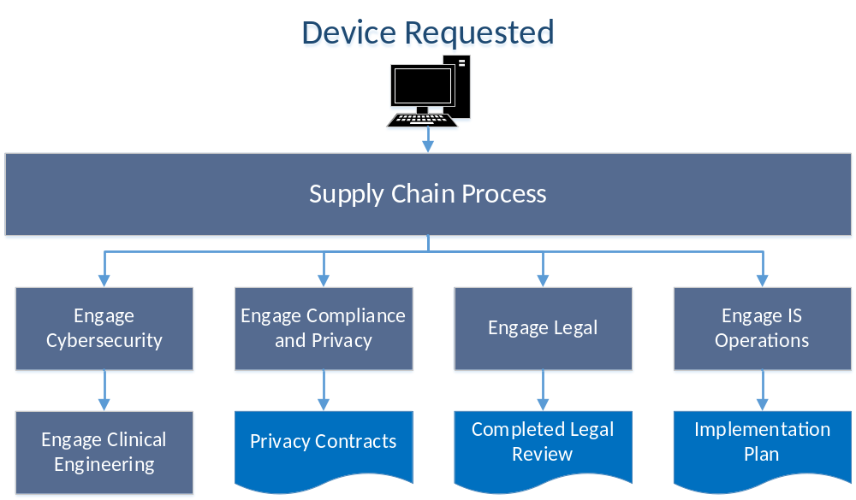
Notes:
This should be the ideal state when healthcare technologies are reviewed
SCO notifies Cybersecurity-> notify CE -> perform risk assessment
Discuss risk with BO-> develop recommendations->security config. Part of PM work plan
Specific to Intermountain

Slide 32
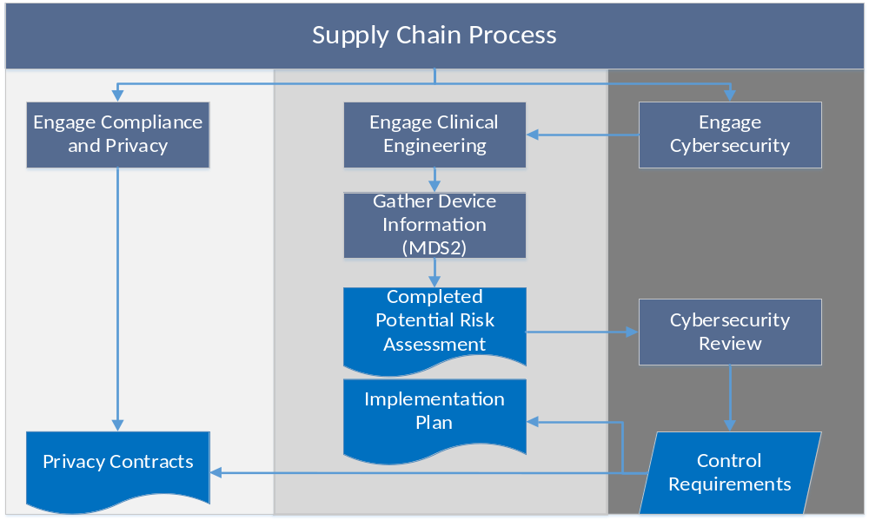

Slide 33
External Collaboration
Collaboration with FDA, NH-ISAC and MDISS
  Nation-wide activities such as TTX, workshops, MDRAP, MD-VIPER, WHISTL
Collaboration with AAMI and ACCE
  AAMI’s Device Security Task Force
  ACCE’s CE-IT Community
Establish receiving cybersecurity-related notices from medical device manufacturers
  If not already posted by ECRI, submit it to ECRI so they can share with rest of the community
Collaboration with ICS-CERT and review of advisories they post
Notes:
ICS-CERT alerts: Resulting in more investigations and coordination from clinical engineers. Do we have the medical device in our organization? Are they connected to the network? Are they patched? Can they be patched? Do we have a remediation plan from the manufacturer?

Slide 34
AAMI’s Medical Device Cybersecurity Practice Guide for HTMs

Slide 35
US Gov Cyber & Information Security Engineering References
Presidential Policy Directive/PPD-21 Critical Infrastructure Security and Resilience issued February 12, 2013.
Executive Order (EO) 13636 Improving Critical Infrastructure Security, Federal Register issued February 19, 2013.
Guidance for Industry, FDA Reviewers and Compliance on Off-The-Shelf Software Use in Medical Devices, U.S. Department of Health and Human Services, Food and Drug Administration, Center for Devices and Radiological Health, Office of Compliance, Office of Device Evaluation issued September 9, 1999.
Guidance for Industry Cybersecurity for Networked Medical Devices Containing Off-the-Shelf (OTS) Software issued January 14, 2005.
Content of Premarket Submissions for Management of Cybersecurity in Medical Devices, Guidance for Industry and Food and Drug Administration Staff issued October 2, 2014.
Infusion Pumps Total Product Life Cycle Guidance for Industry and FDA Staff issued December 2, 2014.
Postmarket Management of Cybersecurity in Medical Devices, Draft Guidance for Industry and Food and Drug Administration Staff issued on January 22, 2016.
Updated recommendations on submitting a new 510(k) for device modifications August 5, 2016.
Deciding When to Submit a 510 K for a software change to an existing device issued August 8, 2016.
Post Market Management of Cybersecurity in Medical Devices Guidance for Industry and Food and Drug Administration Staff Document issued on December 28, 2016.
Credits: Bill Hagestad, Principal Cybersecurity Engineer, BD

Slide 36
US Gov Cyber & Information Security Engineering References
AAMI TIR57/Ed. 1, Principles for Medical Device Information Security Risk Management dated June 9, 2016.
IEC 80001-1:2010 Application of Risk Management for IT-Networks Incorporating Medical Devices -- Part 1: Roles, Responsibilities and Activities.
AAMI’s Health IT Risk Management: A Practical Tool to Help Hospitals and Medical Devices Stay Secure in a Complex World
ISO/IEC 27005:2011 provides guidelines for Information Security Risk Management.
ISO/IEC 15408-3 1999-12-01 Information Technology — Security Techniques — Evaluation Criteria for IT Security — Part 3: Security Assurance Requirements.
ISO/IEC 14971 Risk Management for Medical Device Manufacturers.
ISO/IEC 29147 Vulnerability Disclosure Process.
ISO/IEC 30111 Vulnerability Handling Processes.
RFC 2196 Site Security Handbook September 1994.
IEC TS 62443-1-1:2009 Industrial Communication Networks - Network and System Security - Part 1-1: Terminology, Concepts and Models.
IEC TS 62443-2-1:2009 NIST Cybersecurity Framework Core: Informative Reference Standards.
IEC TR 62443-2-3:2015 Security for Industrial Automation and Control Systems - Part 2-3: Patch Management in the IACS Environment.
Credits: Bill Hagestad, Principal Cybersecurity Engineer, BD

Slide 37

Thank You
Priya.Upendra@imail.org

