Slide 1

Maintaining Regulatory Compliance in HTM and Beyond
Priyanka Upendra, BSBmE, MSE, CHTM
CE Compliance Manager, Intermountain Healthcare
Priya.Upendra@imail.org

Slide 2
Priyanka Upendra
Has no real or apparent conflicts of interest to report.
Nothing in this presentation is intended to be legal advice. Any examples or scenarios are for discussion purposes only.

Slide 3
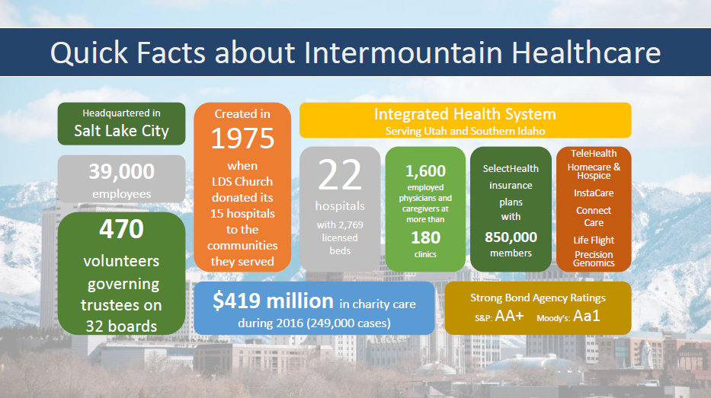

Slide 4

Background
Bachelor’s of Engineering in Medical Electronics – Bioinstrumentation; Signal and Image Processing from B.M.S College of Engineering, Visveswaraya Technological University, Bangalore, India
Masters of Engineering in Biomedical Devices from San Jose State University, California
Currently working on a Doctorate in Health Administration
Certified Healthcare Technology Manager by AAMI Credentials Institute
Certified Change Management Specialist and Six Sigma Lean Professional from Management and Strategy Institute
Research and Technical Adviser for BME departments at San Jose State University and B.M.S College of Engineering
Joined Intermountain Healthcare in July 2016. Prior experience in Stanford Health Care, Stanford Children’s Health, Santa Clara Valley Medical Center, Stanford University Medical Center, and Stanford University
Worked in GE Healthcare and Philips Healthcare on hybrid imaging modalities R&D prior to HTM industry
Have worked in the medical device industry for over 10 years and HTM industry for over 7 years
2017 Winner of the AAMI Young Professional Award and 2015 BI&T Best Article Award
Board Member at ACCE and Active member of the Healthcare Technology Certification Commission
Active Member at AAMI’s Awards Committee, Nominating Committee, EQ Committee, BI&T Editorial Board, and Technology Management Council
Active Member of HIMSS, NH-ISAC, MDSISC, and NH-ISAC cybersecurity education committee

Slide 5
Session Overview
This presentation will outline aspects of regulatory compliance as it pertains to HTM and other stakeholders in the EOC
How to start a HTM compliance program and role of a dedicated compliance professional in HTM
The speaker will discuss and present the challenges faced complying with different regulatory standards and how to overcome them with operational enhancements
This session will also introduce HTM and EOC professionals the means to evaluate their program(s) effectively and help them be ready for federal, state and other regulatory inspections

Slide 6
Current State
Healthcare faces more regulations each year and a more aggressive enforcement environment.
HTM services have their own requirements and for the vendors/ suppliers they partner with.
Issues can flare up in minutes, magnifying the impact of problems, that in the past did not seem such a big deal.

Slide 7
What If..?
You had a well‐documented, current and accurate program that could be referred to at any time when federal, state, or other accreditation inspection knocks on your door.
You had an employee base that knew what they were supposed to do, or not do, to keep the services in compliance and avoid trouble.
You had a process that allowed the services to operate smoothly and reasonably respond to changes in your industry and regulatory environment.

Slide 8
HTM COMPLIANCE PROGRAM
Designed to
  Prevent and detect wrongdoing
  Manage the risk of non‐compliance and appropriately react to problems when they occur
  Assure external stakeholders (aka Regulators)
  Assure internal stakeholders (aka Executive Management/ Board of Directors) that the organization is doing what it can to manage the risk
  Allow employees to know what they need to do in their jobs to avoid compliance problems
  Allow everyone to sleep better at night
Notes:
When a company starts a compliance program, it is often tempted to delay starting the process of building a compliance program until they have: • Analyzed all the issues they have now or will have in the future • Identified all the risks that apply to their businesses that they know about and then start hunting for risks that they do not know about • Benchmark against the structure and resources that other companies have • Identify all the legacy policies and procedure documents and carefully filing them away in a central repository. • Before the company starts: • Putting any resources into compliance • Identifying owners of any compliance risks • Creating any policies and procedures designed to manage compliance risk.
The problem is that while all of this investigation is going on, compliance risks still apply to the company and the delay in the company’s response creates even more risk.

Slide 9
HTM Compliance Program – More Than Just Regulatory Requirements
Fosters a culture of ethics and compliance
Understands the nature of risks in medical device management
Identifies and manages medical device risks that impact the organization
Enhances visibility into the organization’s medical device risks
Ensure governance of the organization’s risk management framework for medical devices
Provides greater accountability

Slide 10
What Does That Mean For The HTM Department
Standardization across the system (for an IDN or large health system)
  Standard Catalog
Cybersecurity management
Service contract review and systemization
Internal audit
PPG management
Speak the same language as organizational compliance, legal, and privacy
Education and awareness

Slide 11
Governance - How Information is Reported, Questions Answered, & Decisions are Made
Decisions will need to be made as a compliance program is started and as it operates.
  Who will be accountable for the compliance program?
  If compliance is not followed, what happens?
  What resources will be devoted to compliance?
  How the company will choose between compliance alternatives?
  How will information about compliance be escalated?
  How will the organization/ team know what regulations they need to comply with and what to do if regulation changes?
  How will the organization/ team decide how to change the program if the services change?

Slide 12
7 Core Elements for an Effective Compliance Program
Compliance Officer/ Director
Well-written Policies, Procedures & Processes
Training, Education & Communication
Periodic Assessments
Auditing & Monitoring Plan
Disciplinary/ Corrective Actions for Non-Compliance
Respond Appropriately to Compliance Issues

Slide 13
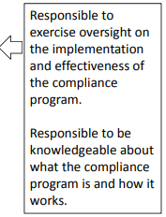
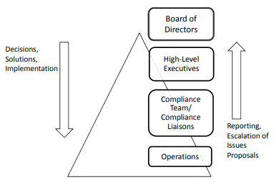
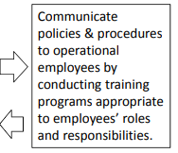
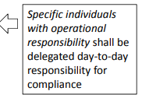
How Will The Organization Make Decisions About a Compliance Program?

Slide 14
Compliance Professional in HTM
Direct reporting to HTM Department and dotted line to Organization’s Compliance
Overall responsibility of day to day operations of the Compliance Program
Must have prompt access to Compliance Reporting
Must report routinely to the Compliance Board and Executive Leadership
Must have access to effective executive management and leadership oversight
Be a subject matter expert in HTM, Go-Getter, Motivated Individual
Exercise effective and ongoing oversight
Must promote the Program

Slide 15
CONTINUOUS IMPROVEMENT CYCLE “PLAN-DO-CHECK-ACT”
A recurrence theme in building a compliance program

Slide 16
Compliance Risk Assessment
Identify Risks
Evaluate/ Prioritize
Manage/ Mitigate
Report to Executive Management/ Board of Directors

Slide 17
Periodic Risk Assessments
Efficiency: risk assessments allow you to maximize the utility of scarce resources by directing them to the most significant compliance issues faced by your organization
“Buy-in” and Ownership: when individuals who have day to day administrative responsibilities participate in identifying compliance risks and developing mitigation plans they are more likely to actively participate in the compliance process
Coordination: most compliance risks have potential significance across multiple functions, so risk management encourages coordination and consensus building, particularly in organizations with distributed/ decentralized management

Slide 18
Periodic Risk Assessments (continued..)
Keep the risk management process simple
    Build into existing business processes
    Complex processes feel like red tape
Start small and build over time
    Don’t overload senior management with too many projects
    Additional projects and processes can be added over time
“Don’t let the perfect be the enemy of the good”

Slide 19
Design a Risk Assessment Project for Engagement
Eliminate Mystery – Map out the risk assessment project plan and educate stakeholders on the plan and expected resource needs and time frames. Be clear on the role of the stakeholder at each stage in the process. Keep stakeholders up to date on what you are doing and what you plan to do.
Time is Money – Have clear goals for every meeting with stakeholders, do not invite stakeholders to meetings where they do not have a role. Avoid using meetings to investigate facts with stakeholders, use the time to get decisions and input from stakeholders. Make sure materials for stakeholders are easy to understand at a glance.
Make People Look Good – Keep stakeholders up to date on information and reports about issues related to their team before it is reported to upper management. Engage stakeholders personally in discussions with upper management whenever possible so they get credit for being sophisticated about compliance and solving problems.
Develop Ownership – Look for stakeholder decision‐making on eliminating obstacles or solving problems involves their teams during the project. The more decisions stakeholders make, the more they have ownership in the process.

Slide 20
Conducting the Compliance Risk Analysis
What is your HTM department’s objectives, structure, and operations?
Risk identification: what are the possible medical device related risks your organization faces?
Risk assessment:
      What is the likelihood of the risk event happening?
      What is the potential impact of the risk event?
Risk evaluation: having assessed the risks:
      What is your organization’s “appetite” for risk?
      What are the most important risks to address?

Slide 21
Compliance Risk Analysis (continued..)
Risk Treatment: what steps must be taken to accept/ transfer/ mitigate/ manage the risks?
Monitoring, review, and corrective action:
      Are internal controls working effectively to mitigate risk?
      Is there any corrective action needed?
Communication: throughout the organization

Slide 22
Risk Identification
Process flow analysis
    Regulatory analysis
    Responsible parties
Event inventories
    Department history
    Executive leadership expectations
    Best practices in the industry
Interviews, questionnaires, and surveys
Facilitated workshops
Leading events and escalation triggers

Slide 23
Creating a Compliance Risk Registry from Scratch
Selection of Laws/ Regulations Based on Current Operations
+
Selection of Laws/ Regulations Based on Strategic Plan
+
Selection of Laws/ Regulations Based on Benchmarking
+
Selection of Laws/ Regulations Based on Enforcement Trends
+
Any Other Sources That Your Services Find Important
=
Compliance Risk Registry

Slide 24
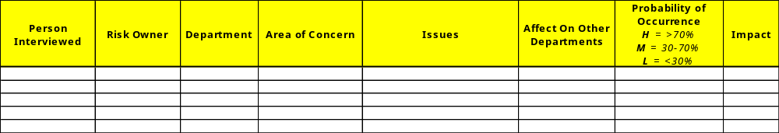
Risk Identification (continued..)
Risk assessment survey
What are the issues/ areas of concern that keep you up at night?
What is the probability of occurrence?
Risk owner impression of impact level
Create a risk registry

Slide 25
Risk Evaluation
Having assessed the risks:
    What is your organization’s “appetite” for risk?
    What are the most important risks to address?

Slide 26
Risk Evaluation (continued..)
For the high probability and high impact risk, do a detailed analysis on the impact or consequences of the risks
    Patient safety
    Legal/ compliance
    Reputation
    Environmental health and safety
    Operational
    Social/ behavioral
    Physical environment
    Financial
Rate the impact of each risk using a defined scale

Slide 27
Likelihood Matrix
 | 4 | 3 | 2 | 1
How frequently does the set of facts that create the potential risks of non-compliance exist in the organization’s operations? | This risk applies to operations continually | This risk applies to operations regularly | This risk applies to operations infrequently | This risk applies to operations but the circumstance where is applies is rare

Slide 28
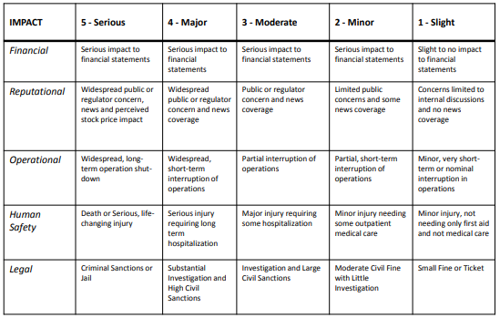
Impact Matrix

Slide 29
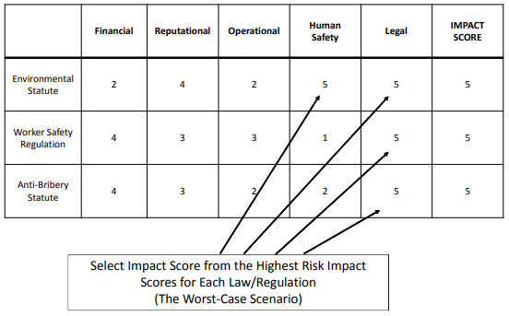
Potential Impact Worksheet Example

Slide 30
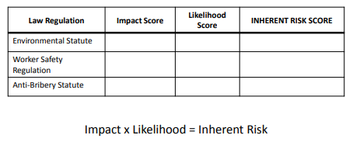
Inherent Risk Worksheet

Slide 31
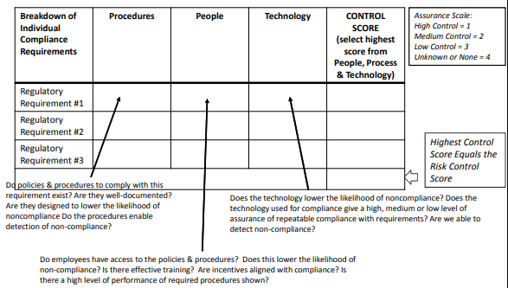
Evaluate Existing Risk Controls for Each Law/ Regulation (Mitigation/ Management)

Slide 32
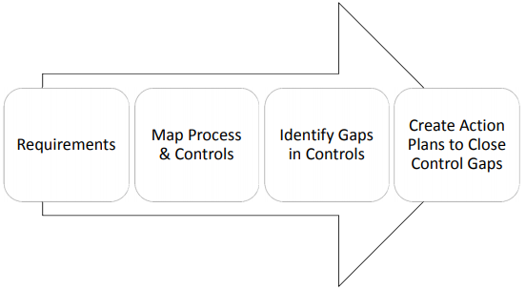
Creating Action Plans to Mitigate/ Manage Risks

Slide 33
Design Reporting for Engagement
Frequency: Quarterly keeping in mind your organization’s budget cycle. This frequency also means that you will always have a relatively up‐to‐date report to present at any time.
At – A – Glance: Design reports communicating the main points with diagrams and tables (whenever possible). Also give underlying detail in a concise easy to read manner.
Specificity: Use every communication as an opportunity to educate specifics on the risks and impact to the company. Include specific controls (not just “financial controls” for instance) and other mitigating efforts.
Consistency: Use the same format of the report for every quarter to avoid training executives multiple times on multiple formats. Ensure that risks that appear in working documents appear in the final report.

Slide 34
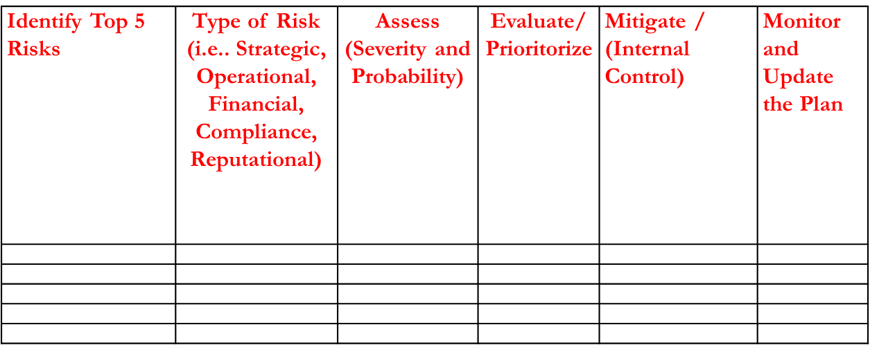
Distill Registry to Top 5 Risks

Slide 35
Risk Response
Avoidance
Reduction/ mitigation (internal controls)
Sharing (e.g., insurance)
Acceptance
    Crisis management plans
    Business continuity plans
    Other operational plans
    Development of new policies/ procedures

Slide 36
Internal Controls
Organizational/ process controls (i.e., separation of duties)
Documentation – written policies, procedures, and processes
Training
Audit reports
Security and integrity

Slide 37
Tactical Process Overview
Risk assessment
Risk identification
Risk analysis
Risk evaluation
Risk treatment
Risk communication, monitoring, and review

Slide 38
Compliance Communications
More Elements:
Written policies, procedures, and processes
Training and education
Lines of communication
    Hotline and Whistleblowers
Standards enforced through well-publicized guidelines
    Leadership statement
    Reporting obligations
    Whistleblower, non-retaliation

Slide 39
Monitoring & Review
Reasonable steps include monitoring and auditing, to:
    Ensure that the organization’s compliance program is followed
    Periodically evaluate the effectiveness of the compliance program
Routine monitoring of actual performance vs. expected performance
Review and periodic investigation of the current state
Internal monitoring and assurance processes should be ongoing

Slide 40
Monitoring & Review (continued..)
What should be monitored?
    The risks and context – are things changing?
    Effectiveness/ appropriateness of the strategies and management systems
    Risk management plan and system as a whole
Types of Monitoring
    Line management reviews of risks and their treatments
    Internal auditing
    External auditing

Slide 41
Response to Monitoring
After monitoring and auditing of the program, the organization shall take reasonable steps to:
    Respond appropriately to any violations of the law or policies to prevent future misconduct
    Modify and improve the organization’s program
    Make restitution when appropriate if criminal conduct is found

Slide 42
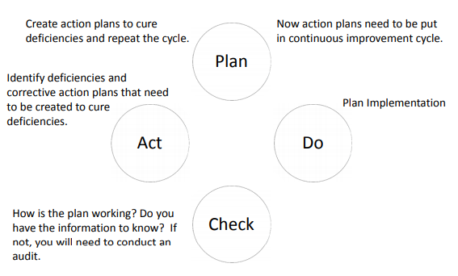
Continuous Improvement Cycle

Slide 43
Before Building an Effective Compliance Program
You must have buy in from the top
Establish Compliance as a component of the department’s strategic plan
Identify common behaviors that cut across multiple compliance areas and make those central
Establish risk ownership and management of risk
Develop a model that focuses on:
    Regulatory standards
    Guidelines and best practices
    Emerging regulations and guidelines

Slide 44
Develop a Department Compliance Calendar
Create universal template
    Must include the governing authority/ risk owner
    Description of action steps, responsibility, and completion date
Divisions of regulatory compliance
Organization wide inventory of dates for compliance
    Must include the standard, requirement, risk owner, deadline, and status update

Slide 45
Summary
“Do what you can, with what you have, where you are.”‐ Theodore Roosevelt
Start with Governance
Risk Assessment
Manage & Mitigate Risks with Action
Reporting
Continuous Improvement
Design for Engagement

Slide 46

Thank You

