Slide 1
One Call for All
Dispatching and Tracking of Service Events Through a Service Coordination Center
Mike Busdicker, MBA, CHTM - Clinical Engineering System Director
Dustin Smith, MBA - Clinical Engineering Central Support Manager

Slide 2
DISCLAIMER
“The slides in this presentation were prepared as talking points by the presenters. It is compiled from data, experiences, and processes at Intermountain Healthcare and are for information sharing purposes only.”

Slide 3
Agenda
Objectives
Introduction to Intermountain Healthcare
Initial Evaluation and Findings of the Imaging Service Program
Implementation of the Service Coordination Center
Service Coordination Center
  Structure and Operation
  Benefits
  Challenges
Tools
Analytics to Action
Q & A

Slide 4
Objectives:
1. Provide data and information on the steps utilized by Intermountain Healthcare to evaluate the service of medical equipment and the establishment of a business plan to move the organization into a blended service model for Imaging Equipment Service as a first step.
2. Outline the business plan to handle service calls for imaging equipment, that includes the dispatching process, communication, and service tracking.
3. Provide information on lessons learned, key tips, strategies, and utilization of metrics/benchmarking for successful communication.

Slide 5
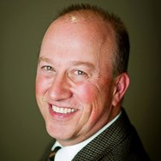
MIKE BUSDICKER
Mike Busdicker is the System Director of Clinical Engineering Support Services at Intermountain Healthcare. Mike started his healthcare career with the United States Air Force as a 1983 graduate of the DoD Biomedical Equipment Repair School. His total military service included seven years of active duty and 20 years with the Wisconsin Air National Guard. During his military time he served as a Biomedical Technician, First Sergeant, and Human Resource Advisor, completed an operational deployment to Iraq, and achieved the highest enlisted rank of Chief Master Sergeant.
Mike received his Bachelor's and Master’s Degree in Business from Baker College in Flint, Michigan. Prior to his employment with Intermountain he has held leadership positions with ServiceMaster Management Services, Aramark Clinical Technology Services, TriMedx Healthcare Services, and Alexian Brothers Healthcare System. Mike is an active member of AAMI, ACHE, UHE, HIMSS, NH-ISAC, MDSISC, and is a member of the AAMI Technology Management Council.

Slide 6
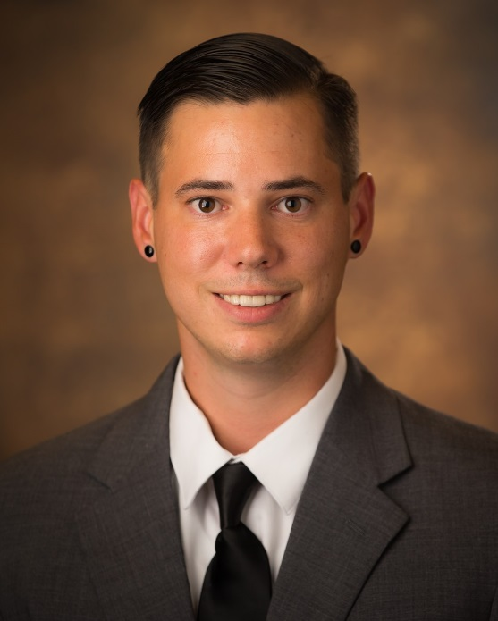
Dustin Smith
Dustin Smith is the Central Support Manager of Clinical Engineering Support Services at Intermountain Healthcare. Dustin Smith started his career at Intermountain Healthcare while still attending high school in Food and Nutrition. His passion for the work he was doing in Food and Nutrition quickly led him to be the lead on transitioning the patient service structure from a Tray-line Model to a Room Service Model. This project gave Dustin the knowledge that led him to assisting manage the patient side of Food and Nutrition. He continued to work in Food and Nutrition for over seven years before transitioning into Analytics. In Analytics he worked first as a Financial Analyst and the sole employee responsible for the Product Rebates Program in Intermountain and then later as a Products Analyst still holding the Rebates Program. He worked in Analytics for three years before moving into Clinical Engineering to get back into an operations role.
Dustin Smith received his Bachelors Degree in Finance from Weber State University and his MBA from the University of Utah.

Slide 7
About Intermountain Healthcare

Slide 8








An Integrated Delivery Network with a Tradition of Innovation
About Intermountain Healthcare
Helping people live the healthiest lives possible TM
39,000 Employees
$2 B Non-labor spend
Based in Salt Lake City, Utah
Continuum of Care
Intalere
Hospitals
Health Plans
Medical Group
1983 Started
SelectHealth
900,000 members
25% of Utah market
1994 Started
1,400 employed physicians
4,000 affiliated physicians
185+ clinics
TeleHealth
Homecare
Life Flight
Central lab
Central pharmacy
Clinical Engineering
1986 Started
2015 Ownership
Commercial platform
$8B Spend GPO
1975 Beginning
22 Hospitals
2,800 Licensed Beds

Slide 9
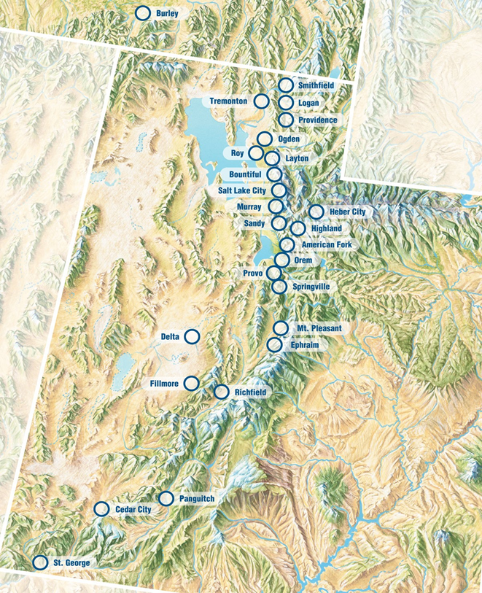
CLINICAL ENGINEERING SUPPORT SERVICES STRUCTURE
Central Support Services and Management
  System Director
  CE Medical Equipment Security Manager
  Central CE Support Director
  Service Coordination Center
  Office Coordinator
  Inventory Coordinator
  Data Analysts
CE Regional and Hospital Operations
  Three Regional CE Directors
  Local CE Departments and Technicians
  Local Parts and Supply Stock
Imaging Equipment Services Program
  Program Director
  Regional Service Engineers
  Centralized Parts Stock
Central Depot Repair Services
  Program Supervisor
  Depot Clinical Engineers
  Centralized Parts Stock
Notes:
CESS structure and roles/ responsibilities

Slide 10
Intermountain Healthcare
CE and Imaging Equipment Service
Initial Evaluation and Findings

Slide 11
Clinical Engineering
Operational Variation
    Reporting structures – separate teams with local accountability
    Department managers/clinical staff managing service contracts and service expense
    Levels of expertise and training
    Parts inventory
    Parts procurement
    Service levels
    Service models
    Risk management
    Equipment standards
    Scope of work
    Service call requests
    Data management
    Specialization by facility – no cross-pollination or resource sharing
    Inefficient management of capital equipment
Notes:
CESS structure and roles/ responsibilities

Slide 12
Imaging Service Delivery Process
Opportunities for Improvement
Inconsistent Supplier/Tech Communication
Inaccurate or Lack of Supplier Service Reports
No Data Capture In the CMMS
Vendor Data Streaming Nonexistent or not Fully Utilized
Inconsistent PM Communication
Techs Managing Service Events
Multiple service call placement routes

Slide 13
Operational Feedback
Based on 100 Imaging Operational Survey Results
No comprehensive inventory
Don’t know when PM is scheduled
PMs performed during norm business hours
Don’t track equipment downtime
Don’t understand hrs of equipment coverage
No escalation procedure for extended downtime
Not aware of which equip is under service contract

Slide 14
Imaging Service Call Process
Previous
Vendor equipment ID (with phone number for service) affixed to each piece of imaging equipment
Imaging Technologist places service call directly with provider
Technologist receives return call from the service provider with an ETA
Service provider arrives & services equipment
If OT is required, it must be discussed with lead technologist, who can escalate to dept manager
Service provider completes repair & communicates update to technologist
Service provider leaves completed Service Report
Service provider leaves premises
Purchase Order issued for Overtime services
Inconsistent Quarterly Vendor Discussions: Service Events, Equipment Uptime, Overtime Billing Questions & PM History

Slide 15
Equipment Service
Analysis & Planning
To Reliably
Influence
These
Operational
Costs
Clinical
Excellence
Capital
Expenditures
Accurate
Data
PM Timing
These Must
be Managed
ENTER
HERE
Uptime
Availability
Accountable
Staff/Vendors
Applicable
Technology

Slide 16
Clinical Engineering Program
Ongoing Scope & Objectives
Intermountain Mission:
Helping People Live the Healthiest Lives Possible
Imaging Equipment Services Team – Strategy and Scope:
Optimize medical equipment maintenance & management strategies to assure clinical quality, patient safety & best cost/value proposition
High Level Objectives:
Create Best Practice In-House Service Program
Quality Service Metrics
Consistent Equipment Availability
Total Asset Management Processes
Lowered Financial Risk
Positive Impact on Capital Spend
Direct management of Authorized Service Provider’s performance

Slide 17
Operational Effectiveness
We seek better care and better health at the lowest sustainable cost.
Excellent healthcare is of little use if patients can’t afford it. At Intermountain, we work to keep our rates as low as possible while still allowing us to continue to serve.
We continually improve quality. In healthcare, higher quality tends to cost less, because patients usually experience fewer complications, readmissions, and other issues requiring additional care. By focusing on providing the right care in the right setting at the right time, we tend to see lower costs.
We encourage wellness. We reach out to people before they become patients to help them stay as healthy as possible. When they do need healthcare, we help them comply with the treatment plans prescribed by their physicians.
We operate as efficiently as possible. We use a wide range of techniques to avoid waste and use resources wisely. For example, since 2012 the HTM Department has supported over $7M in savings and value throughout Intermountain, largely through the evaluation of work flows, processes, contract management, and collaboration with suppliers.

Slide 18
Intermountain Healthcare
Implementation of the Service Coordination Center

Slide 19

Intermountain Healthcare
Service Coordination Center
In the Past
Variation of Service Call Process from Department to Department
No standardization of work flows, service tracking or data capture
Significant opportunity for process improvements exist for requesting service and data integrity
Department managers/clinical staff managing service events instead of clinical care of patients
The Present Operation
Integrated service request and dispatching for the entire System
Standardized processes and staffed for:
        All Service Request for Imaging Equipment
        Complete Oversight of Authorized Service Providers
        Oversight of Service Request for In-house Staff
        Data Management for Imaging Equipment Service
        Field Service Report Matching and Uploading
        Authorized Service Provider PM Tracking

Slide 20
Imaging Equipment
Current Service Call Process
Asset ID (with phone number for service) affixed to each piece of imaging equipment
Technologist places service call to Service Coordination Center
Service Coordination Center records call in CMMS and dispatches service call
Service Engineer or Authorized Service Provider acknowledges call and provides estimate of onsite time
Service Coordination Center, or in-house engineer, contacts customer to provide onsite arrival time
Repair is completed and work order is updated or field service report is sent to the Service Coordination Center
Field Service Report is uploaded into the CMMS System by the Service Coordination Center
Documentation includes dispatch time, response time, on-site time, downtime, and completion of event
Service Engineer or Authorized Service Provider arrives and services equipment
Quarterly Reviews are held with Stakeholders and ASP: Information presented includes Service Events, Equipment Uptime, and PM History

Slide 21
Service Coordination Center - Structure
Service Coordination Center handling more than 20,000 calls annually, 2017 was 20,303
3 Service Coordinators
2400 imaging assets (recorded), 40 medical lasers, ~500 assets in dialysis centers
Hours of operation 7 AM to 5 PM
After Hours – On Call Engineers

Slide 22
What does 20,303 Calls Annually Mean
4,675 Events
Over 6,091 Corrective Maintenance Work Orders
Dispatched to over 40 different engineers
  20+ Authorized Service Providers
  20+ In-House Engineers between imaging, dialysis, and laser

Slide 23
Since 2015 Calls have grown by 7.8% - from 18,826 to 20,303

Slide 24
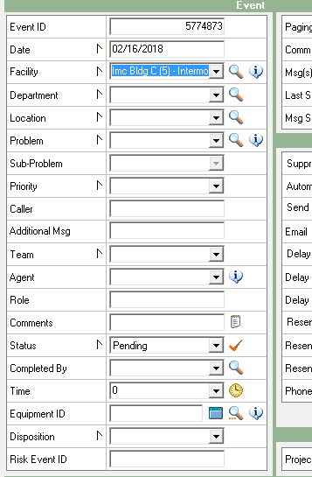
Service Coordination Center – Operations
Information Gathered During Calls – Initial Dispatch
  Tag
  Clinician
  Problem
  Patient Impact

Slide 25
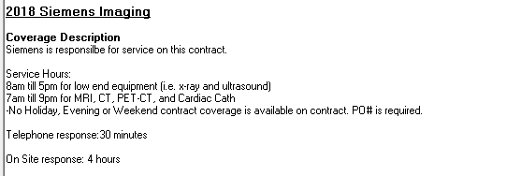
Service Coordination Center – Operations
Information Derived - Assignment
  Contract Level
  Assigned Engineer

Slide 26
Service Coordination Center – Operations
Escalation Process
  Initial dispatch
  Potential Resolution
  Reassignment
IHE
ASP

Slide 27
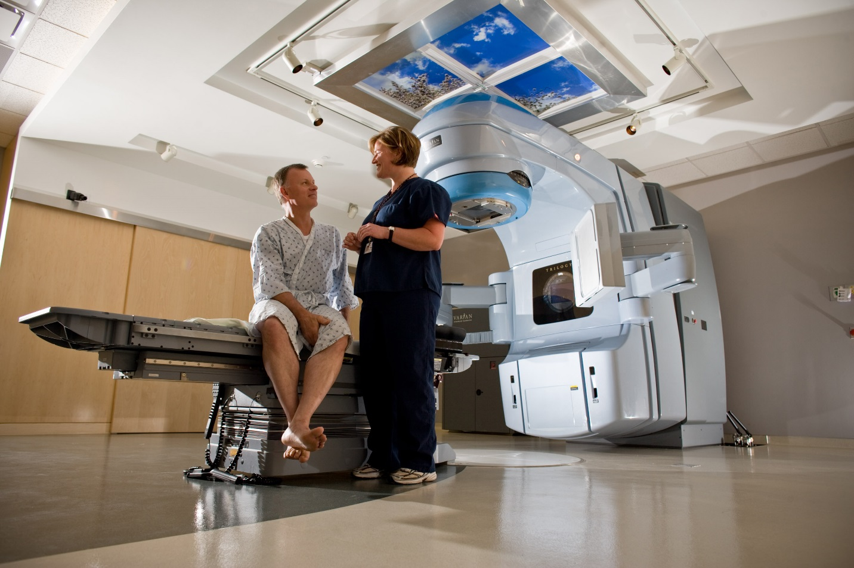
Service Coordination Center – Operations
Tracking of Downtime
  Priority
  Contacted
  On-Site
  Repaired

Slide 28
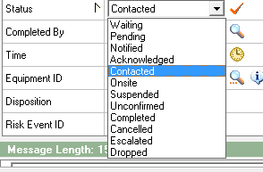
Service Coordination Center – Operations
Engineer Accountability
  Over 10 Days – Corrective Maintenance
  PM Completion
  Status Flips – Downtime Tracking
  Build Out Work Orders
  After Hours Dispatching – Voicemails

Slide 29
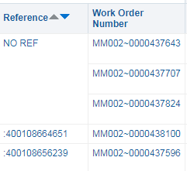
Service Coordination Center – Operations
Data Integrity
  PM Dates
  FSR Uploads
  Asset Adds
  Erroneous Work Orders
  Escalation Tracking
  Disparate Data Integrations

Slide 30
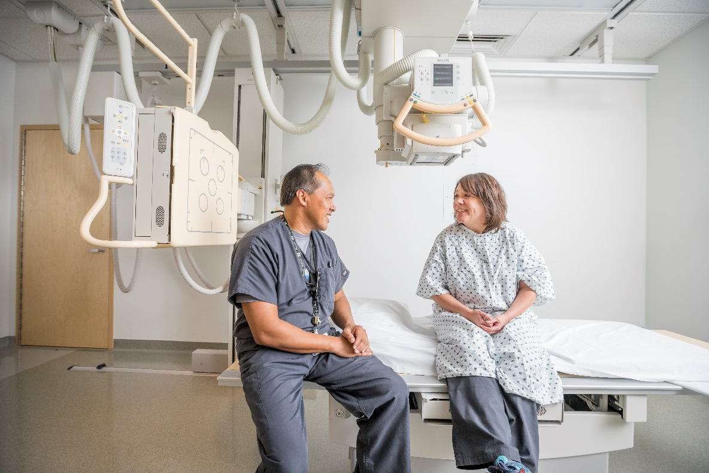
Service Coordination Center – Benefits
Time Back to Clinicians
  Enabling additional time for clinicians to work with patients.
  Alleviating unnecessary stress.
  Enabling expertise and tacit knowledge.

Slide 31
Service Coordination Center – Benefits
Quality Dispatching
  Service coordinators are trained dispatchers and know the appropriate questions to ask.
  Service coordinators are consistently aware of modalities and engineer schedules.
  Accountability is key in ensuring compliance, happy customers, and reducing downtime.

Slide 32
Service Coordination Center – Benefits
Accountability
  SLA’s
  PM Completion
  Appropriate Asset Record
  Physicist Reports
  Accreditation
    Joint Commission
    American College of Radiology
  30/60/90 Day WO Completions

Slide 33
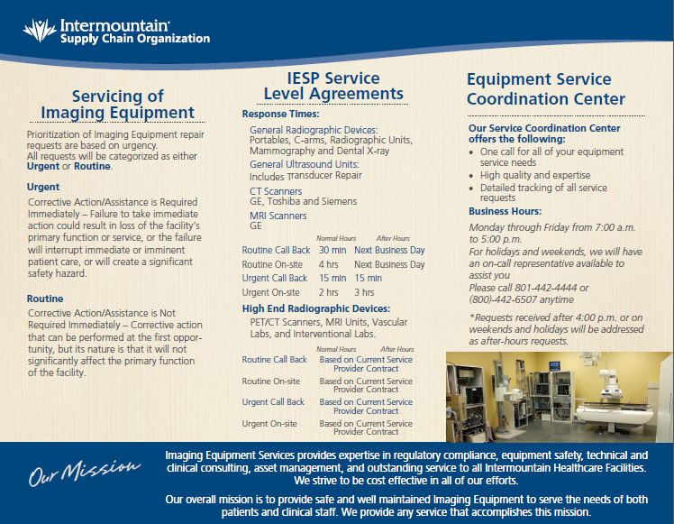

Slide 34
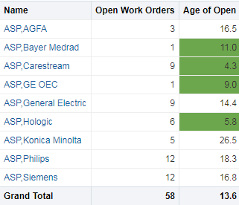
Service Coordination Center – Benefits
Average Documentation Time for ASP’s and Access to Data
Complete CMMS
  TCO
Enabling Analytics

Slide 35
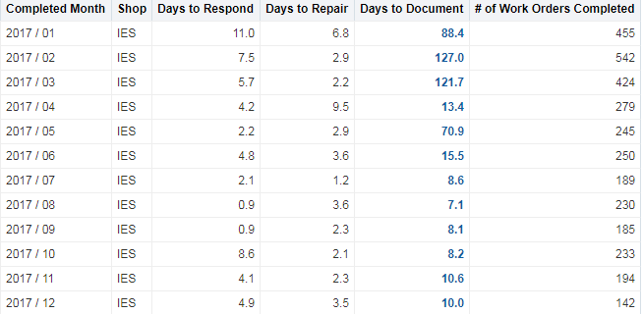
Authorized Service Provider Accountability and Understanding

Slide 36
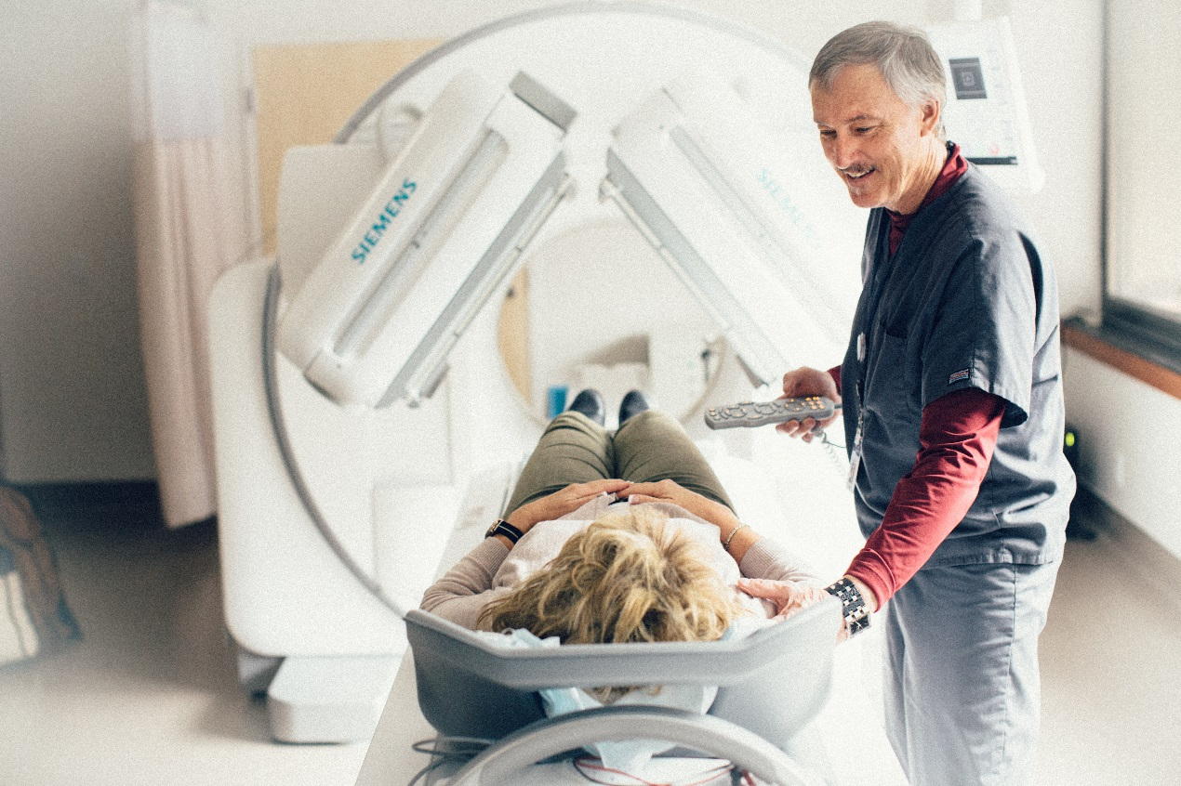
Service Coordination Center – Benefits
Robust Downtime Tracking
  Enablement
  Reduces Data Burden on Engineers
  Increased Visibility

Slide 37
Service Coordination Center – Challenges
Internal Buy In
Growth in Volumes
Appropriate Infrastructure
  CMMS
  Dispatching Tool
  Phone System
Turnover Risks

Slide 38
Service Coordination Center Tools
In-House Dispatching Tool – EMMA Communication Corridor
Contract Tracker – EMMA Budgeting
Avaya Phone System
  CMS Supervisor
CMMS – Peoplesoft Maintenance Management Module – Current
  EMMA - Legacy

Slide 39
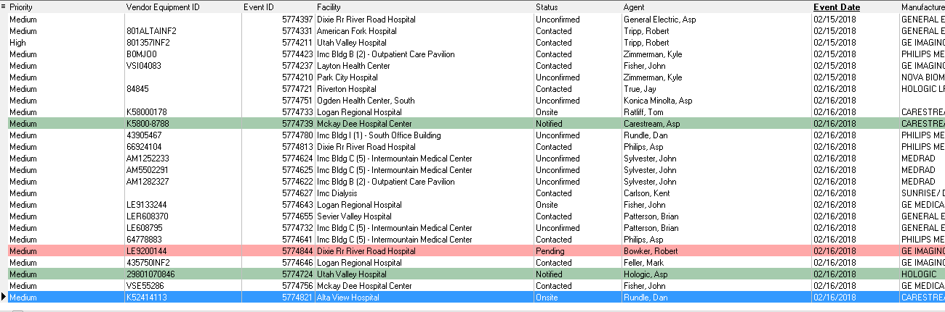
The Grid

Slide 40
Service Coordination Center Tools
Tableau – Business Intelligence Tool
OBIEE – Business Intelligence Tool
Service Coordinators – Knowledge Base Tacit – Not Software

Slide 41
Analytics to Action
Downtime Reporting (Tableau)
Engineer Accountability (OBIEE – Annoyance Report)
  CM
  PM
Work Order Integrity Audits (Annoyance Report Continued)

Slide 42

Q & A/ COMMENTS

