Slide 1

The role of the HTM professional in equipment planning of new clinical areas
Presented by
Inhel Rekik, MS
Director of Health Technology Security, MedStar Health

Slide 2
Plan of the presentation
Important aspects of equipment planning
How to work with equipment planning consulting firms
How to work with IT
How to work with facilities
Case study: Hybrid OR
Lessons learned

Slide 3
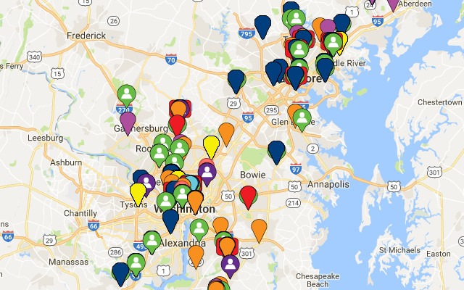
To be the trusted leader in caring for people and advancing health
1999 MedStar Health is established as the new name for the largest not-for-profit health care system in the mid-Atlantic region
30,000 associates and 6,000 affiliated physicians
10 hospitals
MedStar Health care for more than half-million patients each year across Maryland and the Washington, D.C., region in our hospitals, urgent care and ambulatory care facilities, and physician offices
MedStar Family Choice – health plan

Slide 4
Important aspects of equipment planning
What are the most important aspects of equipment planning?
Identify the procedures that will be accomplished in the clinical areas
Identify a planning team (surgeons, anesthesiologists, nurses, engineers (CE/Biomed), architects, facilities and IT)
Establish responsibilities
Perform as many site visits as possible
Plan for (the ability of) future expansion

Slide 5
How to work with equipment planning companies
Identify responsibilities
Set expectations
Be present in all meetings and discussions
Verify equipment list
Identify existing equipment in your inventory
Recommend technology
Make sure they plan for future expansion

Slide 6
How to work with IT
Have them engaged from the beginning of the project
Work with them to identify IT needs for the project
Plan for BMDI

Slide 7
How to work with facilities
Understand the involvement of facilities in the project
Provide them with power and data requirements
Cabling diagram

Slide 8
Case study
Hybrid OR

Slide 9
Hybrid OR
Why build a hybrid OR suite?
Perform open heart surgery, complex vascular surgery and minimally invasive cardiac surgery in one location
Endovascular procedures are becoming more complex and require the back up of an OR
Accommodate emergency cardiac procedures

Slide 10
Equipment planning for a Hybrid OR
Identify the procedures that will be performed in the OR
Create a mock up room to determine what works and what doesn’t work
Imagine workflow and determine where the equipment will be positioned in the room (invasive to non invasive)
Determine where the equipment will be parked in the room (storage room)
Obtain a drawing that shows the positioning of all equipment in the room
Determine which equipment can be shared

Slide 11
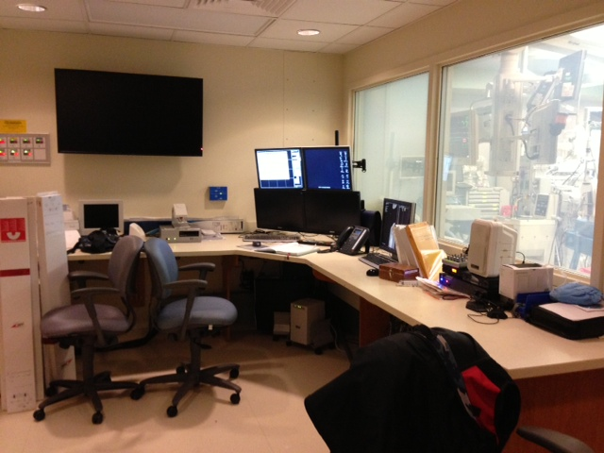
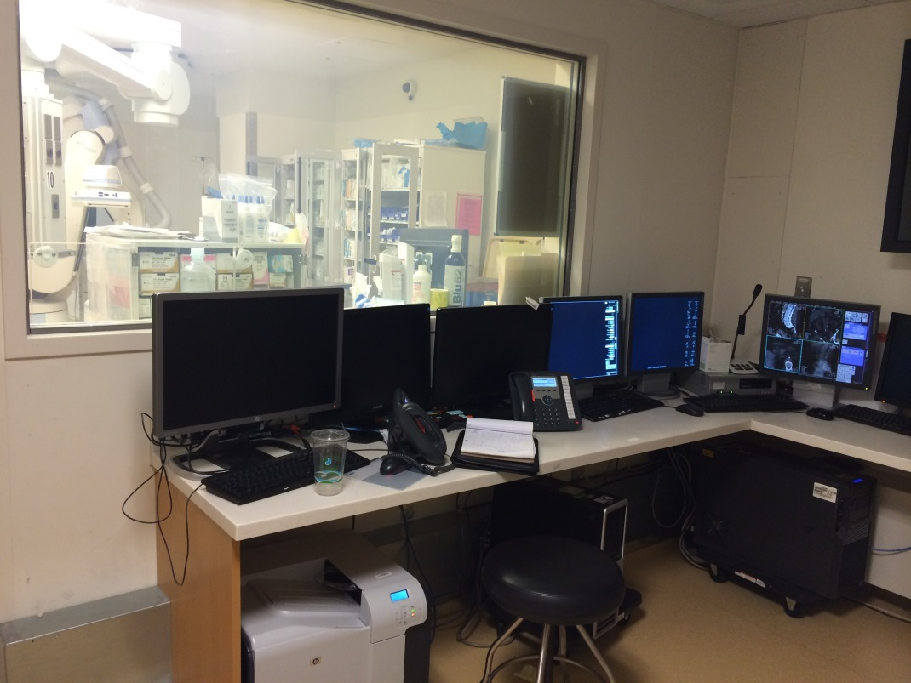
Control Room
Space and layout are important :Which one is a better design and why?

Slide 12
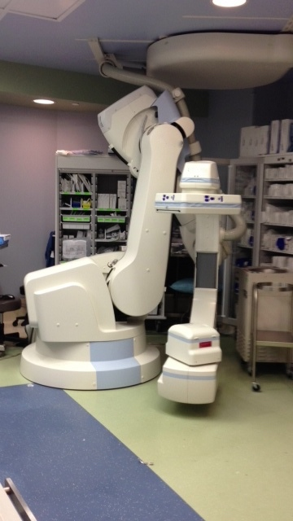
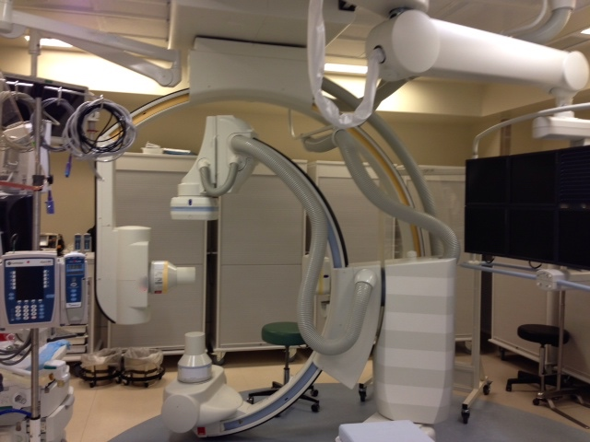
Equipment Selection
Establish criteria for selection of equipment and evaluation forms with the staff
Options needed
Angiography unit: (need to be selected early in the process)
  Ceiling mounted system or floor mounted
  Monoplane versus Biplane
  Low dose while providing a clear image (tissue dose reporting and fluoro times)
  Size of the detector
  For Adult hybrid OR, a robotic system is usually selected because it’s fully robotic and can be parked away.

Slide 13
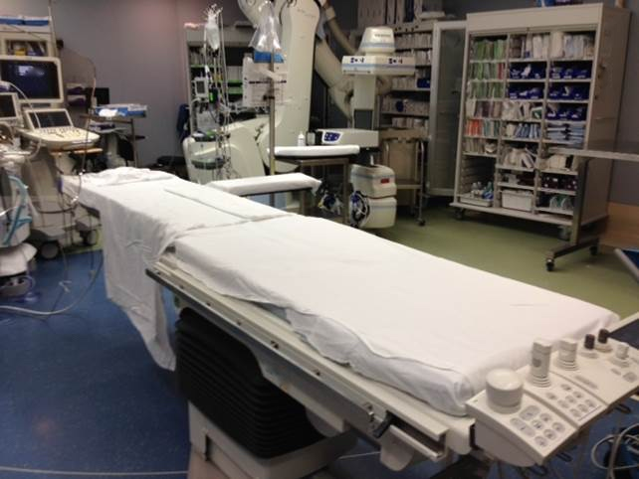
Equipment Selection
Operating table
  Interoperability with radiology system
  Angiography table or a robotic surgery table
  Peds hybrid utilize a regular OR table

Slide 14
Equipment Selection
Hemodynamic system (What’s the most important selection criteria?)
    Standardize

Slide 15
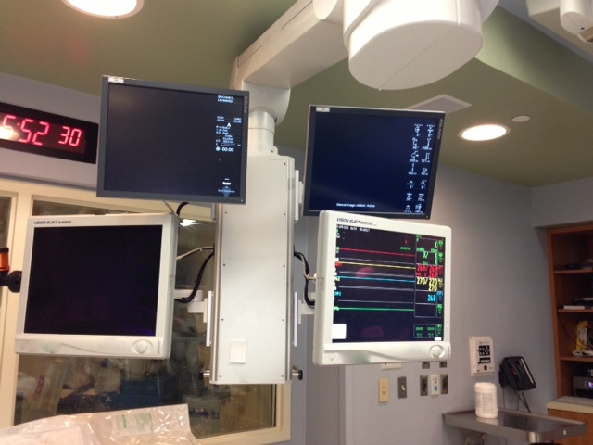
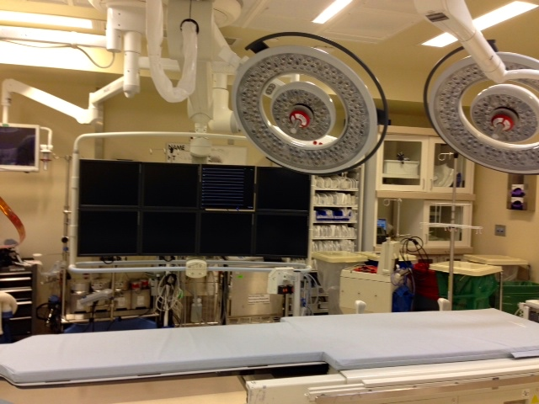
Equipment Selection
Monitors
  Large screen monitor (up to 24 inputs)
  No monitors on the wall but we ran conduit to the wall where viewing monitors or cameras could be mounted for future needs
  A 46 inch monitor in the control room for the residents and other staff to view the procedure from the control room

Slide 16
Equipment Selection
Booms:
  Perfusion boom and nursing booms similar
  Verify the range of the boom, movement and reach
  3 D simulation and Mock up room
  Location gas outlets (suction on top of flowmeters won’t work)
  Cabling
Surgical Robot:
  An integration kit for the room was purchased allowing the Surgical Robot cart to be connected to the equipment boom.
  You will need to determine where surgeons consoles will be located and to which boom the Surgical Robot will connect to for proper room integration/placement

Slide 17
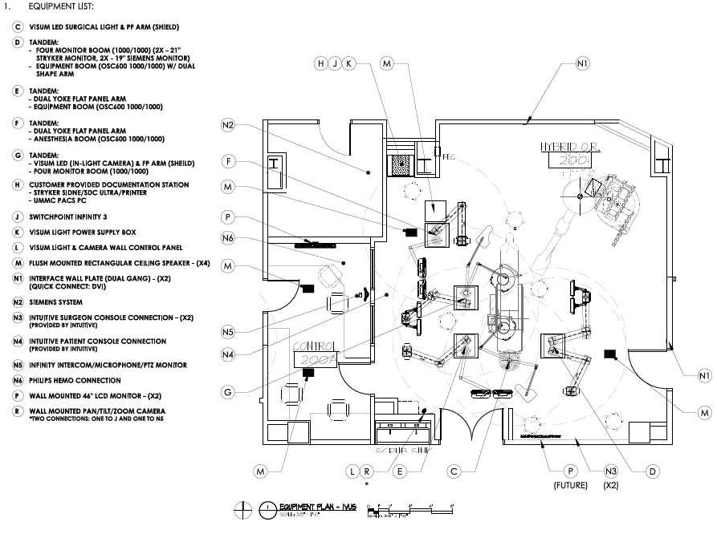
Booms

Slide 18
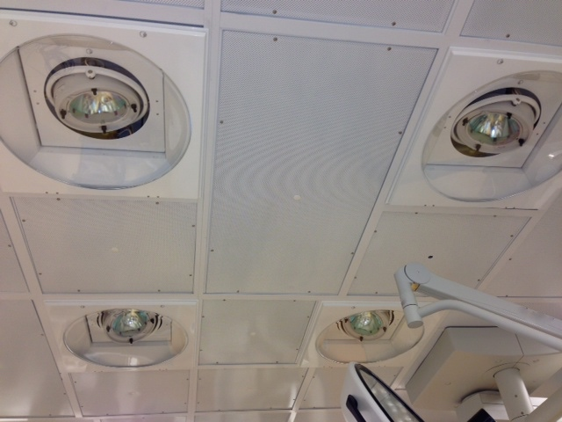
Equipment Selection
Surgical lights
  As few ceiling mounted OR lights as possible to prevent collisions with the booms and other equipment; need to be positioned to cover the entire table
  2 OR lights to host an in light camera and 4 ceiling mounted lights
  Headlight: Battery operated headlights to gain space in the operating field

Slide 19
Equipment Selection
Integration system
  Size of your router in the room (number of inputs and outputs)
  Get a list of all the medical devices that you will be displaying in the room. Sending images to the surgical Robot
  PTZ camera has two video feeds: one to the integration system and one to a dedicated monitor for Cathlab (not enough outputs in the router)
  Location of the video plates based on the location of the equipment
  Determine the options needed: use a questionnaire
    Control medical equipment ESU, OR lights , Endoscopic tower
    Recording and archiving
    Videoconferencing

Slide 20
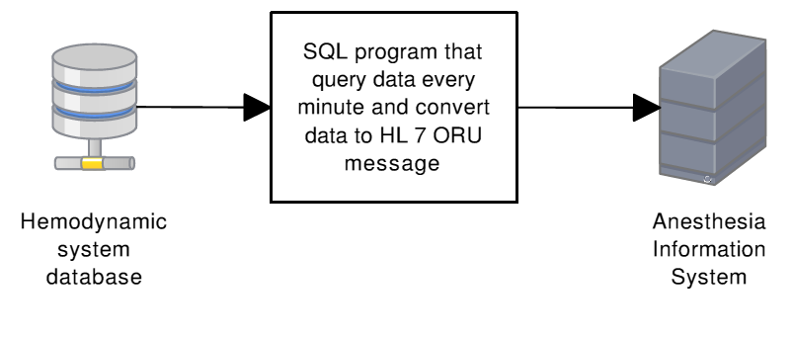
Equipment Selection
Important to make sure all the systems purchased integrate with each other
Hemodynamic system in peds hybrid didn’t integrate with our anesthesia (MDDS)

Slide 21
Equipment Selection
If you purchase a new device or interface an existing device with information system, testing need to be done in advance.

Slide 22
Equipment Selection
Lasers
Shields:
  In addition to the shields placed on the boom on each side of the table, ensure that sufficient shielding is available for entire staff (procedures and more stringent regulations regarding protecting staff due to radiation safety)
  Intercom
Contrast injector

Slide 23
Equipment Selection
Ultrasound
  Dedicated 3D echocardiography
  ICE (shared between OR and Cathlab)
  IVUS shared between Hybrid ORs
  Supplies:
  Location to hang the lead Apron worn by the staff

Slide 24
Design Elements That Facilitate Shifting From Non Invasive to Invasive
No shelves: to avoid collisions with other equipment in the room and make the room more flexible
Equipment on wheels
Storage on wheels, no built in cabinets
Dedicated room for storage of equipment not used all the time
Determine where the equipment will be parked in the room when not in use: Surgical Robot tower, Endoscopic Tower, Contrast Injector, etc….
Space for perfusion to enter the room

Slide 25
Lessons Learned
Determine the staff that will use the room
  Cathlab tech to operate the hemodynamic system
  Trained X ray tech to operate angiography system during the entire case
Create a strong procedural program
  Dedicated staff and super users
  The multidisciplinary team needs to learn to work together and learn each others work flow
Collaboration between Cathlab and OR is key

Slide 26
Lessons Learned
Ensure rooms will be utilized to their full potential : (ROI)
  Identify case load needs prior to project start
  Ensure all requested options are needed and will be utilized
  If only a C arm is needed then it is not cost effective to install an advanced radiography system
Make the positioning of the room work for different disciplines (trauma vascular, Emergency cases)

Slide 27
Other lessons Learned
It’s important that all parties with interest be involved and participate in all meetings and walkthroughs
Identify where the equipment will be positioned in the room to plan for appropriate data and power
Plan enough room for the equipment room:
Determine ahead of time the IT needs of the project and have IT involved from the beginning of the project
If you hire a consultant to do the planning, be very involved in all aspects of the project
Plan for future expansion and compatibility

Slide 28

Questions

