Slide 1

Ultrasound Applications Essentials and Image Artifacts
Matt Tomory
Head of Strategic Advancement

Slide 2
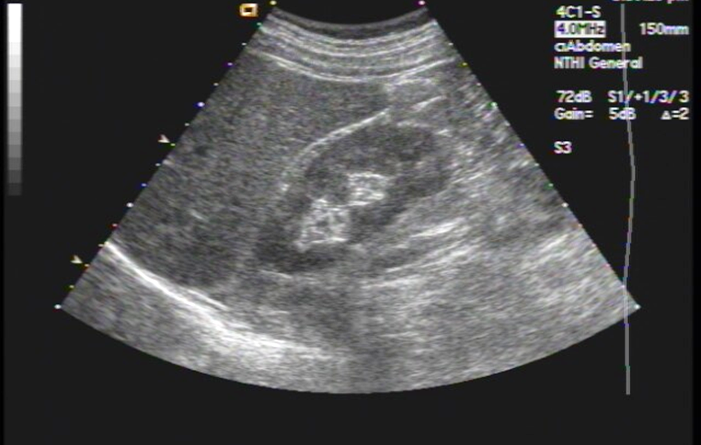
Importance of Knowledge
Instill customer confidence
Ability to differentiate between applications issue and malfunction
  Time and credibility saver
Ability to test system clinically
Understand the language of the sonographer/technologist
Differentiator between a good service engineer and great service engineer

Slide 3
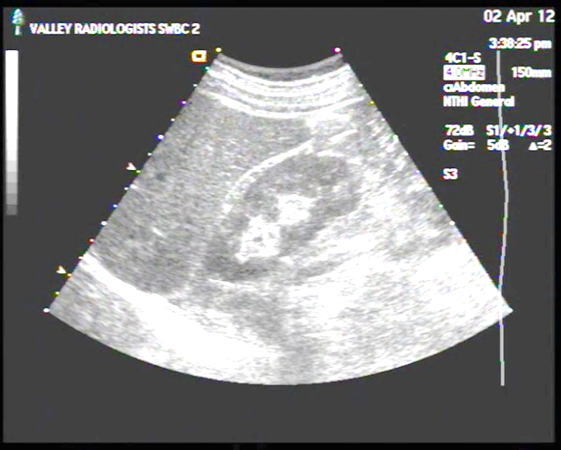
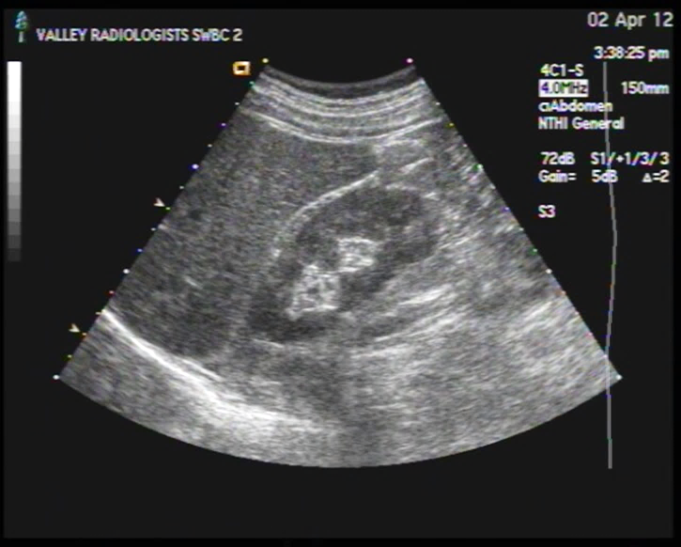
System Display Settings
System display settings must be correct before making any image evaluations or adjustments
  Adjust room lighting to typical scanning room intensity
  Use system grayscale bar to adjust brightness – bottom should be barely visible
    Bars are graduated or step
  Contrast is adjusted for “white whites” but not blooming
  Requirement for ACR accreditation
Ensure customer approves of and understands any changes made!

Slide 4
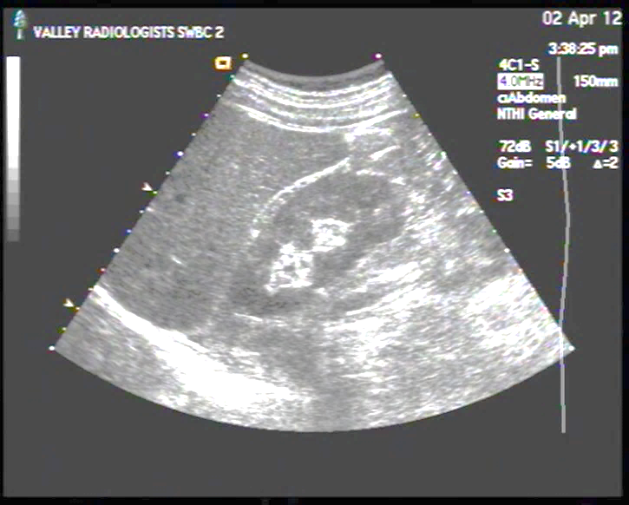
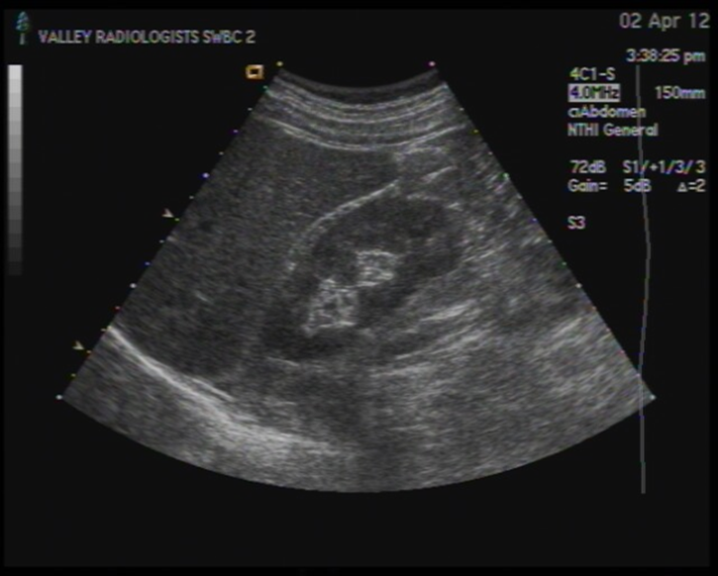
Pop Quiz
Will adjusting the system’s main display settings have any effect on the image presentation on a Picture Archiving and Communication System (PACS) display?

Slide 5
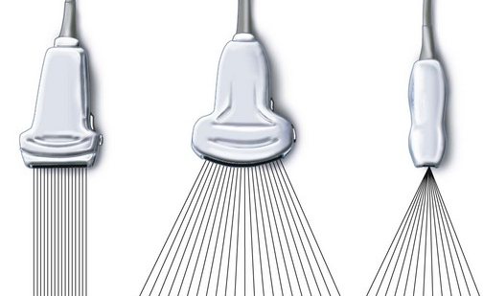
Transducer / Probe / Scanhead Types
Transducers have different formats for different clinical applications
Linear / Trapezoidal
  Rectangular or trapezoidal format
  Vascular, intraoperative, small parts
Curved linear / Convex
  Wide near field, wide far field
  Abdominal, obstetrical, endocavity
Sector / Vector
  Narrow near field, wide far field
  Cardiac abdominal

Slide 6
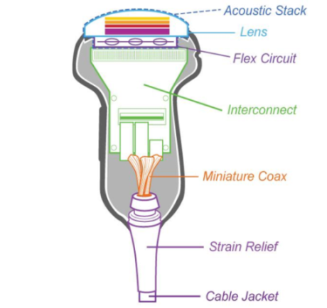
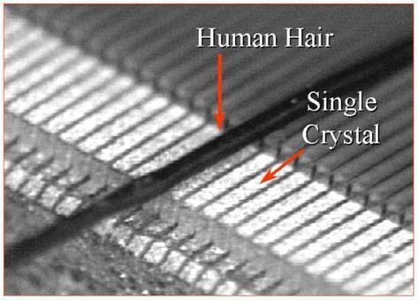
Transducer Construction
Lens
  Mechanical focus of ultrasound beams
  Single or multilayer materials
  Must be ISO 10993 compliant
Matching layer(s)
  Maximizes transmission of energy from crystal array to tissue by reducing reflection (acoustic impedance matching)
  Increases spectrum of frequencies (bandwidth) emitted by transducer
  Generally ¼ wavelength of center frequency of array in thickness
Array
  Piezoelectric material
  Converts electrical energy to mechanical energy (pressure wave) and vice versa
  From 1 to thousands of individual elements / crystals
Shielding
  Typically around array and backing material
  Reduces electromagnetic interference
Backing Material
  Dampens crystal vibrations to reduce pulse duration which increases axial resolution

Slide 7

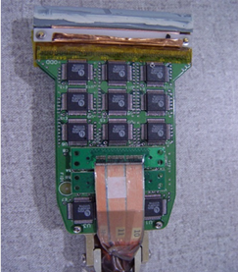
Transducer Construction (cont.)
Flex circuit
  Flexible circuit board which connects the interconnect board to the individual elements
Interconnect
  Bridge between individual coaxial cables and flex circuit
  May have multiplexing circuitry
  May have beam forming circuitry
Miniature coax
  Used to transmit pulses and receive echoes
  Specific impedance and capacitance
Strain relief
  Reduces stress on main and coaxial cables
Cable jacket
  Protects main transducer cable
Main Cable
  Contains 64-128 coaxial cables
    Specific impendence and capacitance
  Shielding

Slide 8
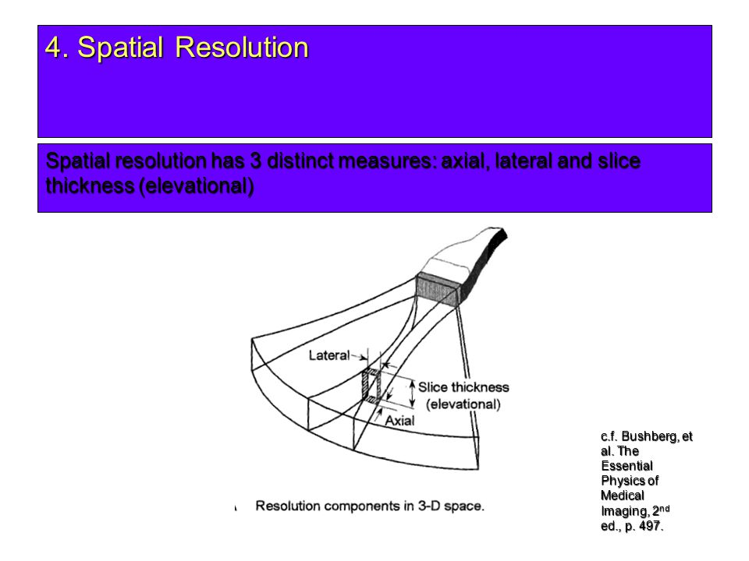
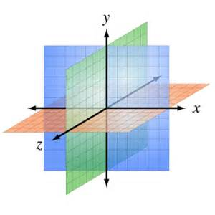
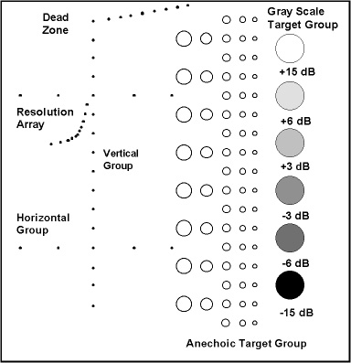
Image Resolution
Spatial Resolution
  Lateral (X)
    Ability to distinguish between two objects perpendicular to ultrasound beam
    Varies with depth
  Axial (Y)
    Ability to distinguish between two objects parallel to ultrasound beam
    Does not vary with depth
  Elevational (Z)
    Ability to distinguish between two objects perpendicular to scan plane (slice thickness)
    Varies with depth
Contrast Resolution
  Ability to distinguish between two regions of similar echogenicity/amplitude
Temporal
  Ability to distinguish change over time

Slide 9
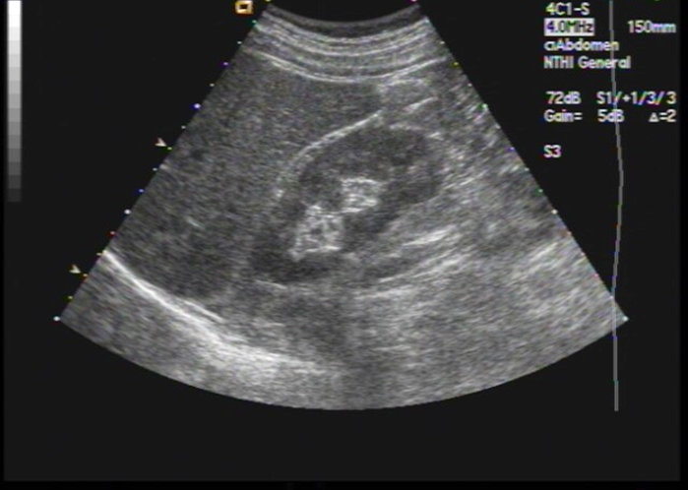
Transducer Designations
Designations generally indicate format type and center frequency or spectrum of frequencies
GE E8C
  Endocavity / Convex 3.5MHz – 11.5 MHz
Philips C5-2
  Convex, 5 MHz – 2 MHz
Siemens 4C1
  Convex, 4.5 MHz – 1 MHz
GE ML 6-15-D
  Matrix array, linear, 4 MHz – 15 MHz, D type connector

Slide 10
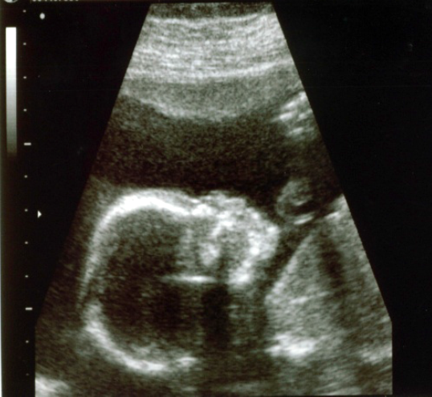
B-Mode Imaging
B – mode (Brightness Mode) is a basic 2 dimensional image of a cross section of tissue
Sound waves are emitted along axis of propagation
Echoes received and converted to voltages
Voltages are amplified and assigned various shades of grey
  Stronger intensities = brighter pixels assigned
    Bone, dense tissue, vessel walls
  Weaker intensities = darker pixels
    Soft tissue, interior of vessels, heart chambers, fluid filled structures

Slide 11
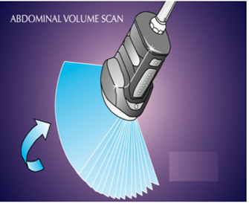
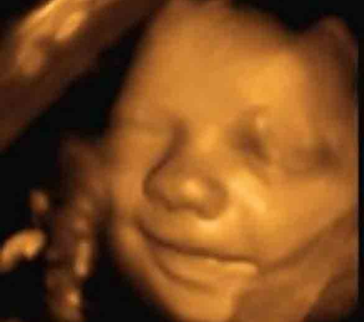
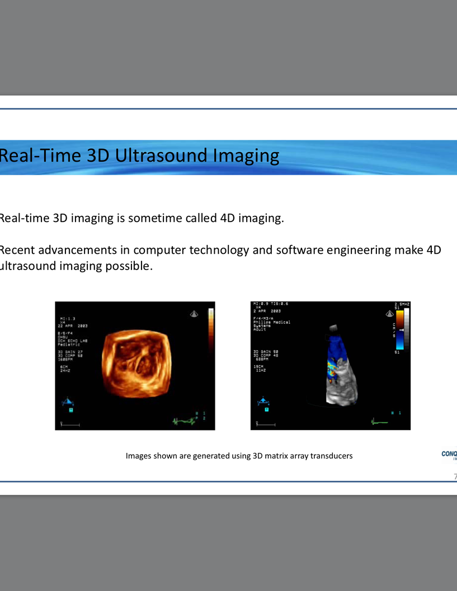
3D / 4D / Volume Imaging
Three dimensional imaging with the added dimension of time (live) is 4D imaging or volume imaging
Multiple scan planes are reconstructed live to create image
Probes may be mechanical or solid state

Slide 12
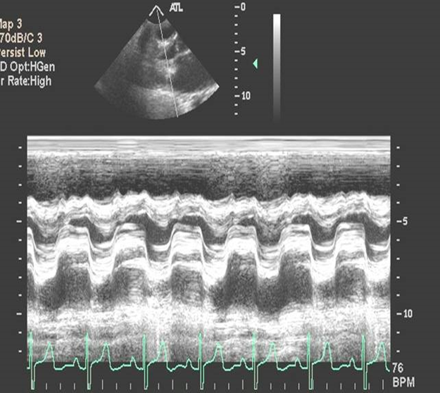
M-Mode Imaging
M-mode (Motion Mode) is used to detect temporal motion of cardiac structure
Moving boundaries of anatomy create reflections which are used to determine and display their specific velocities
  Valves, wall motion

Slide 13
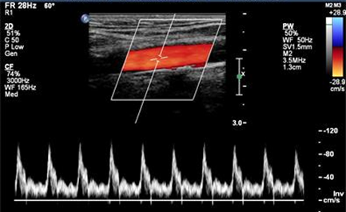
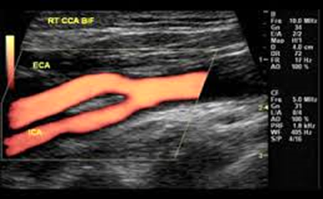
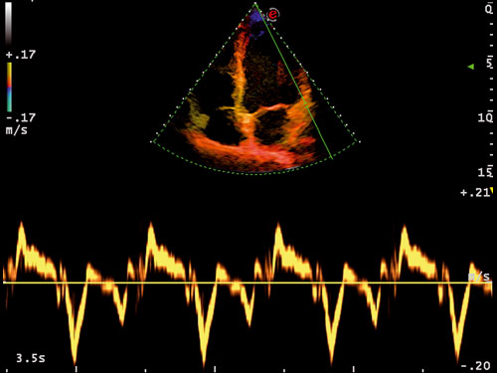
Doppler Mode
Doppler uses a signal bounced off red blood cells of anatomy to measure flow or movement
Pulsed Wave Doppler
  Directional, location and velocity information displayed over time
Continuous Wave Doppler
  Directional and velocity information displayed over time
  Good for high velocities
Color Doppler
  Directional and velocity information converted to colors
  BART: Blue away (from transducer), Red towards (transducer) generally
Power / Energy Doppler
  Independent of velocity, direction and angle
  Extremely sensitive
Doppler Tissue Imaging / Velocity
  Displays velocities of tissue movement

Slide 14
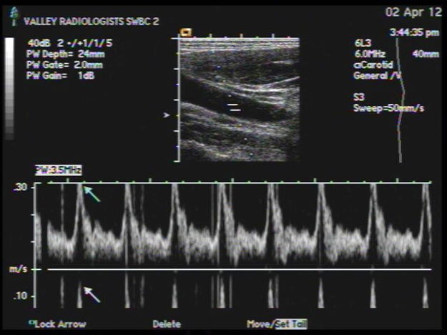
Doppler Aliasing
Flow is occurring faster than system sample rate
System displays as reverse flow
Scale / PRF or baseline adjustment
Note signal wraparound

Slide 15
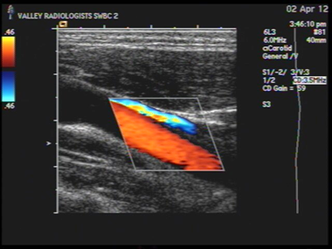
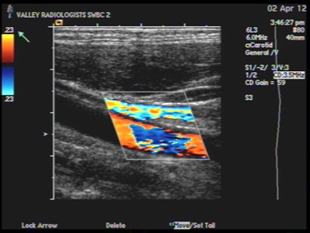
Color Doppler Aliasing
Top image of Common Carotid Artery has proper scale / Pulse Repetition Frequency (PRF) setting
Bottom image of Common Carotid Artery scale too low for velocities sampled
System trying to image faster than sample rate
Note color wraparound
  May appear as reverse flow

Slide 16
Applications / Presets
Ultrasound systems have many presets
Each one is designed for a specific body part, body type and transducer
  Small Parts, Adult Echo, Pediatric Echo, Abdomen, Abdomen ++ etc.
Presets are created for individual preferences
Factory settings are rarely, if ever, used
Each individual presets has 20-30 unique system parameter settings
Applications Specialists spend hours creating presets for sonographers
Backup often, backup your backup!

Slide 17
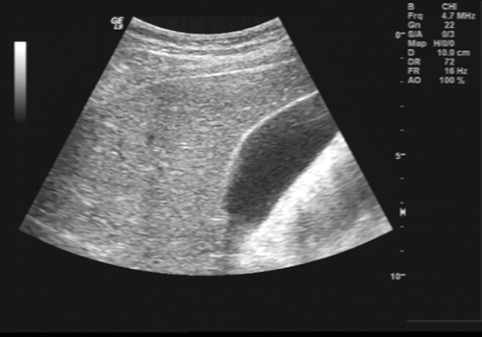
Power / Acoustic Output
Displayed as Transmit Power or Acoustic Output
Amount of acoustic / mechanical energy transmitted into the body
  System monitors and displays as MI (Mechanical Index)
  System is calibrated to OEM specifications transducer for accuracy
ALARA. As Low As Reasonably Achievable
Measured in dB or percentage of maximum output
  Every 3dB change = 50% power change
    0 dB = 100%, -3 dB = 50%, -6 dB = 25%, etc.
Receiver amplifiers will compensate for changes in transmitted power to a certain degree

Slide 18
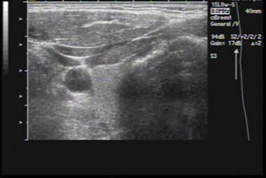
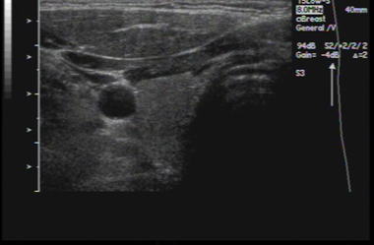
Gain
This is the level of amplification of the received echoes from the body
These images of a thyroid are identical in every way except:
  Top image has 17 dB gain
  Bottom image has -4 dB gain

Slide 19
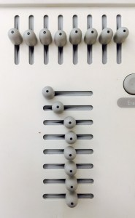
DGC / TGC / LGC
Depth Gain Control / Time Gain Control
  Vertical
Later Gain Control
  Horizontal
Adjusts image brightness to compensate for hyper-reflective (bright) and hypo-reflective (shadowed) areas
Can minimize near field “main bang”
Optimizes image uniformity

Slide 20
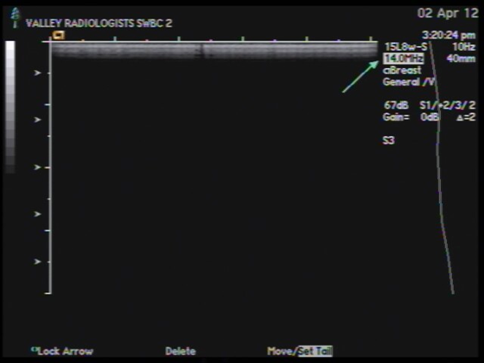
Transducer Frequency
Transmitted frequencies vary depending on probe and application
Low frequencies = higher penetration / lower resolution
High frequencies = lower penetration / higher resolution
  Thyroid: 12 MHz – 18 MHz
  Deep abdomen: 1 MHz – 2 MHz
Modern probes have a wide spectrum of frequencies
Selectable by frequency or Res / Norm / Pen (Philips / GE) controls on system user interface or touch panel

Slide 21
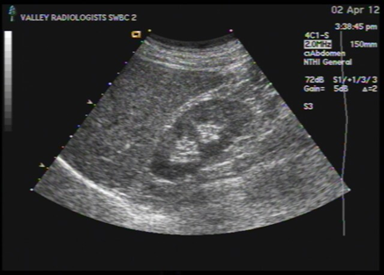
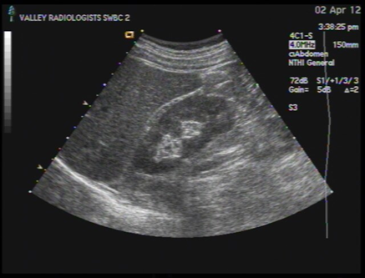
Transducer Frequency
Identical patient, identical probe, identical present except transmitted frequency
Top image of liver / kidney scanned with 2 MHz
Bottom image of liver / kidney scanned with 4 MHz
  Note increased spatial resolution in bottom image
Rule of thumb: Use highest frequency possible for region of interest

Slide 22
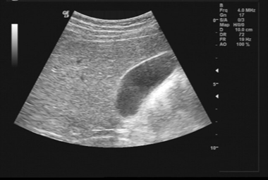
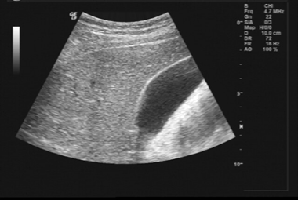
Harmonics
Harmonics allow a system to transmit pulses at lower frequencies and receive pulses at higher frequencies
  Fundamental frequency (f) transmitted but filtered out on receive cycle
  Harmonic frequency (2f) received and processed
Reduces noise, improves images on difficult-to-image patients
Identical patient, identical probe, identical present except harmonics is used in lower image
  Note noise reduction in gall bladder

Slide 23
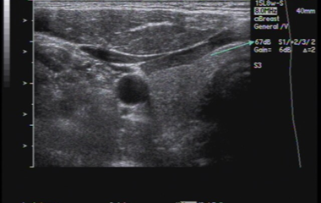
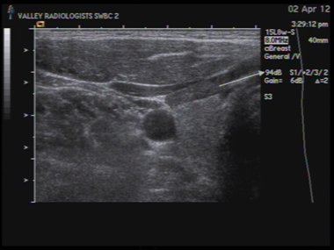
Dynamic Range
Range of echoes processed from strongest to weakest
Lower setting = less range of grays
Higher setting = more range of grays
  Thyroid image top = 67dB
  Thyroid image bottom = 94 dB

Slide 24
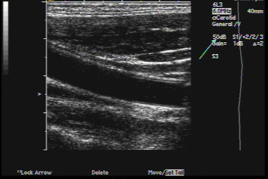
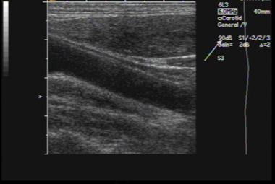
Dynamic Range
Common carotid artery images
  Top image = 50 dB
  Bottom image = 90 dB
Which dynamic range is best suited for this type of exam?

Slide 25
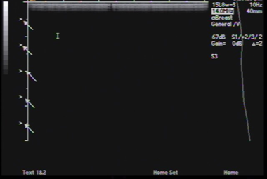
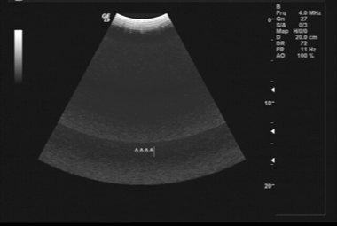
Focal / Transmit Zones
The region(s) the system is electronically focusing is determined by focal zone(s) position
  (Probe lens and array design determines mechanical focus)
User selectable
System can have from 1 to 8 or more
Frame rate or Temporal Resolution will decrease as number of focal zones increase
Image or Spatial Resolution will increase as number of focal zones increase
Systems performs individual pulse – echo sequences
Note “stitching” artifact in lower image

Slide 26
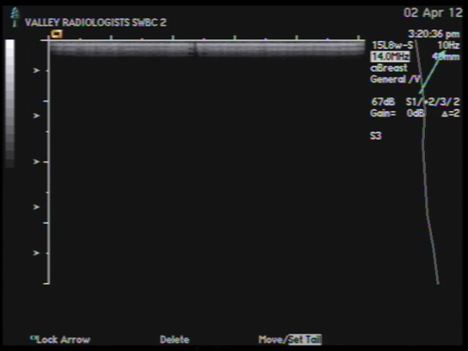
Frame Rate
Ultrasound systems scan at different frame rates depending on:
  Image width
  Frequency
  Depth
  Scan line density
Low frame rates typically demonstrate better spatial resolution (ability to distinguish between 2 points in space)
  Soft tissue, musculoskeletal, small parts
High frame rates demonstrate better temporal resolution (ability to detect an object’s motion over time)
  Vascular, cardiac
Note low frame rate of 10 Hz (frames per second) in image due to multiple transmit zones

Slide 27
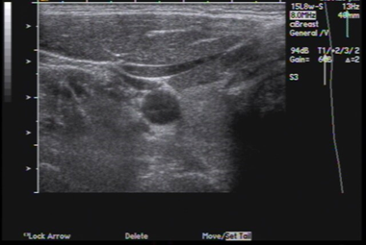
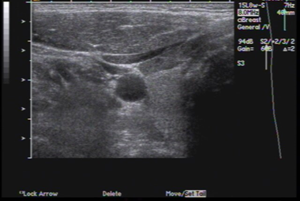
Space Time / Resolution
User can define system resource allocation preferences to enhance Spatial or Temporal resolution
Spatial = axial and lateral resolution centric
Temporal = frame rate centric
Top image of thyroid is T(emporal) 1
Bottom image of thyroid is S(patial) 2

Slide 28
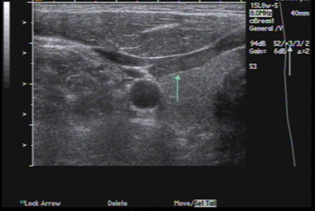
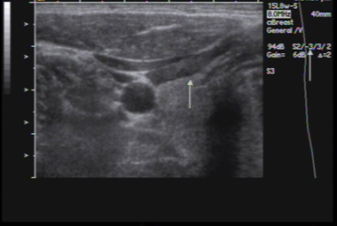
Edge / Pre-Processing
Sharpens edges or borders of structures
Increases image contrast around sharp edges
  Similar to “Sharpness” setting on televisions and monitors
Top image of thyroid is maximum edge (+3).
  Note crisp borders but also image noise
Bottom image of thyroid is minimum edge (-3).
  Note smooth tissue texture but blurry borders

Slide 29
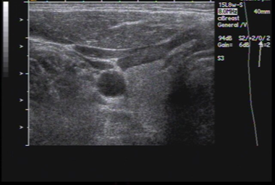
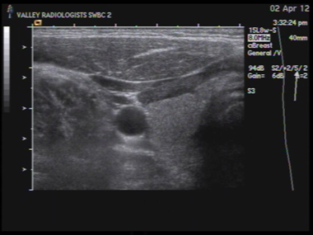
Persistence / Frame Averaging
Ultrasound images are typically several frames averaged together
Top image of thyroid has minimum averaging.
  Note image noise and contrast
Bottom image of thyroid has maximum averaging.
  Note image smoothness

Slide 30
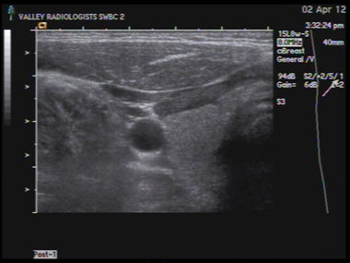
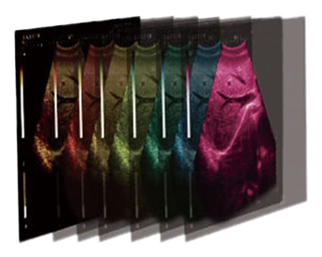
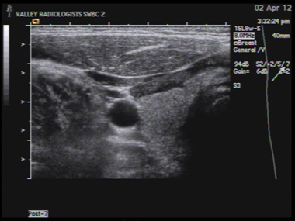
Post Processing / Gray Map
This is a gray scale map assignment to different echo intensities
These images are identical in every way except the Post Processing / Gray Map setting
Colors are also used in post processing for images and Doppler waveforms
  Human eye is more sensitive to subtle color changes than grayscale

Slide 31
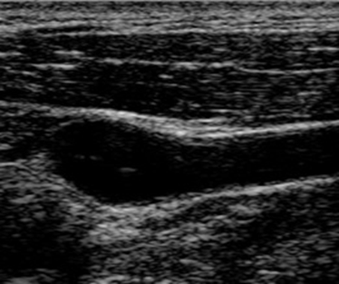

Speckle Reduction Imaging
Speckle in ultrasound images reduces image quality and contrast
Called SRI, XRES, uScan etc.
Top image: SRI off
Bottom image: SRI on

Slide 32



Compound Imaging
Transmits and receives / analyzes ultrasound lines from a variety of angles at target anatomy
Called CrossBeam, SonoCT
Top image: compound imaging off
Bottom image: compound imaging on

Slide 33

Troubleshooting Artifacts
Potential root causes for the artifact:
  Probe array
    A single missing or weak element may show small artifact
  Probe cable
    Typically 128 coaxial cables in main cable assembly
  Probe pins/connector
    Inspect regularly
    Clean pin-less connector interfaces
  Connector board
    Inspect regularly
  System Front End Board
Note image artifact in near field of image
  Artifacts are typically hypoechoic vs hyperechoic

Slide 34


Troubleshooting Image Noise
Image noise sources vary
Check probe cable – especially at scan head strain relief
  Enable PW Doppler or Continuous Wave Doppler
Can you isolate system by unplugging all connected potential noise sources
Can you try different power source
Can you move system to a different environment within the facility
Are system grounds intact internally and externally
  GE L9 card cage
  Power cord
Is facility ground compromised

Slide 35

Thank You!
Questions?
matt.tomory@innovatusimaging.com
C: 480.518.7444

