Slide 1





Women in Healthcare Technology Management
Presented by:
Izabella Gieras, MS, MBA, CCE
Priyanka Upendra, MS, CHTM
Jennifer DeFrancesco
April 5, 2018

Slide 2
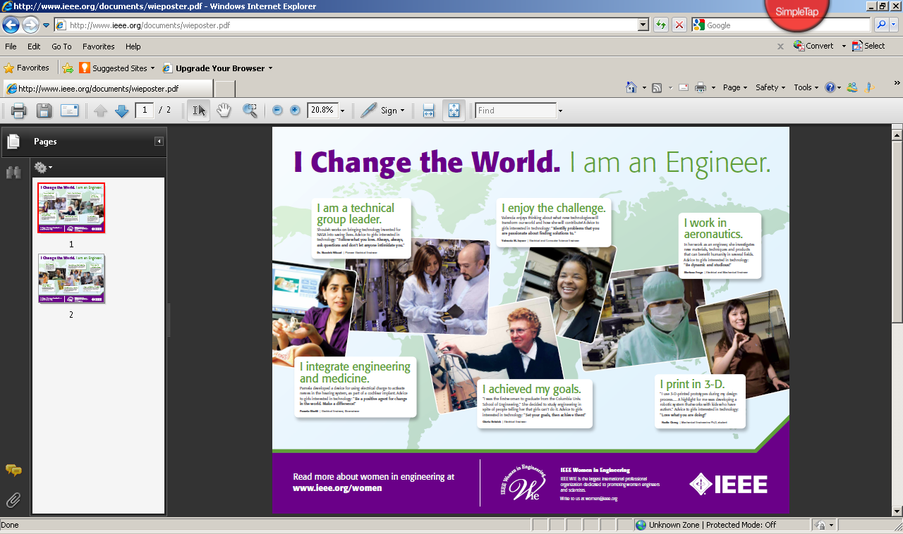
www.ieee.org

Slide 3
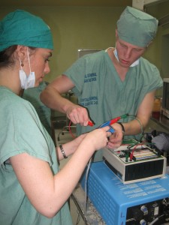
Session Overview
The field of engineering has traditionally been dominated by men. Over the past 20 years, we started to see more women enter the field especially in clinical engineering. The presenters will provide a historical overview of women in engineering, share their own experiences in the field as well as highlight other successful women in the field and their contributions.

Slide 4
Background Overview

Slide 5
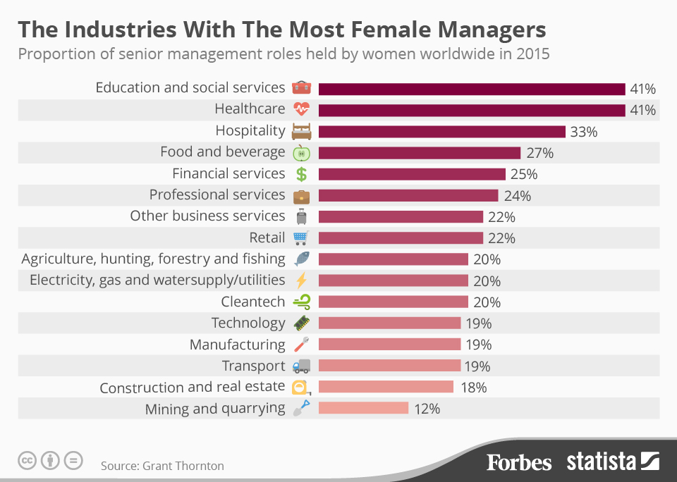
https://www.forbes.com/sites/niallmccarthy/2016/03/08/which-industries-have-the-most-women-in-senior-management-infographic/#62aeb5945cc4

Slide 6
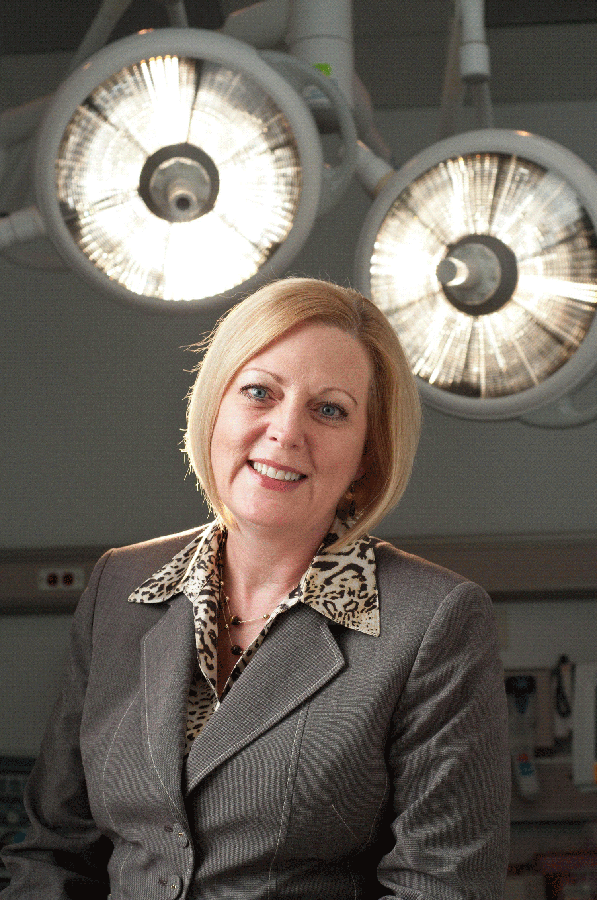
Fact Sheet: The Women’s Leadership Gap
Women are 50.8% of the U.S population
60% of UG degrees and 60% of all master’s degrees
47% of all law degrees and 48% of all medical degrees
44% of all business degrees including 37% MBAs
47% of the U.S labor force and 59% of the college-educated entry-level workforce
AND YET..
Only 14.6% are executive officers, 8.1% top earners, and 4.6% Fortune 500 CEOs
34.3% of all physicians and surgeons but only 15.9% medical school deans
Only 25% in legal are non-equity partners and 15% are equal partners
In IT, only 9% management and 14% senior management in Silicon Valley startups
15% of Armed Forces
  19% in USAF, 9% in Marines, 18% in Navy, and 14% in the Army
Sally Goebel presentation, www.accenet.org
https://www.americanprogress.org/issues/women/reports/2014/03/07/85457/fact-sheet-the-womens-leadership-gap/
http://www.pewresearch.org/fact-tank/2017/04/13/6-facts-about-the-u-s-military-and-its-changing-demographics/

Slide 7
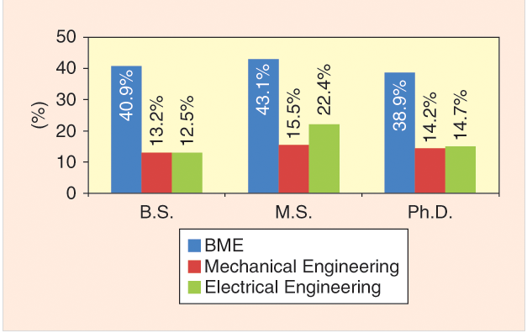
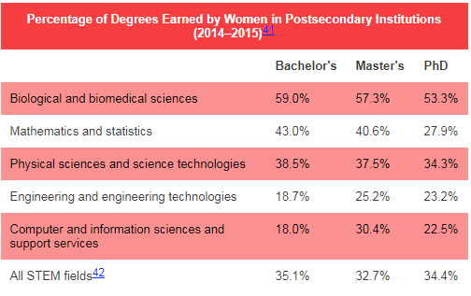
Interesting Statistics cont.
https://pulse.embs.org/may-2017/women-break-an-engineering-barrier/
http://www.catalyst.org/knowledge/women-science-technology-engineering-and-mathematics-stem
Notes:
From previous slide deck:
The percentage of female graduate students in engineering in 2001 was 20%. In 2014, the data showed that 39% of graduates in biomedical engineering were women.
Doctoral degrees awarded to women in engineering increased from 11.6% to 17.6% of total degrees awarded between 1995 and 2004.
The workforce remains as the area of highest under representation for women; only 11% of the engineering workforce in 2003 were women.

Slide 8
Interesting Statistics cont.
Biomedical Engineering is extremely attractive to women as a degree program and career. Women earn a greater percentage of college degrees in Biomedical Engineering than any other engineering discipline, according to the American Society for Engineering education.
As an example, at UCONN
  BS Degrees in Biomedical Engineering: 39% were awarded to women in 2010-2011
  MS Degrees in Biomedical Engineering: 39.2% of biomedical degrees awarded went to women
  Doctorial Degrees in Biomedical Engineering: 36.7% of biomedical engineering degrees awarded went to women.
www.uconn.edu
https://www.bme.uconn.edu/about-biomedical-engineering/women-in-bme

Slide 9
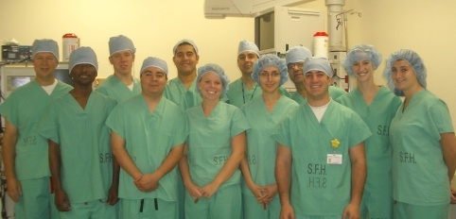
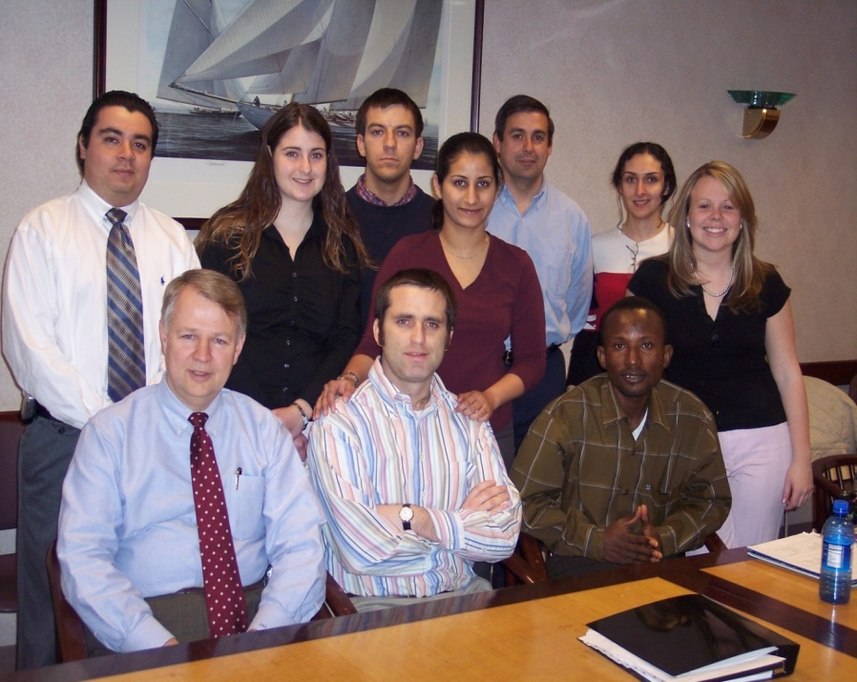
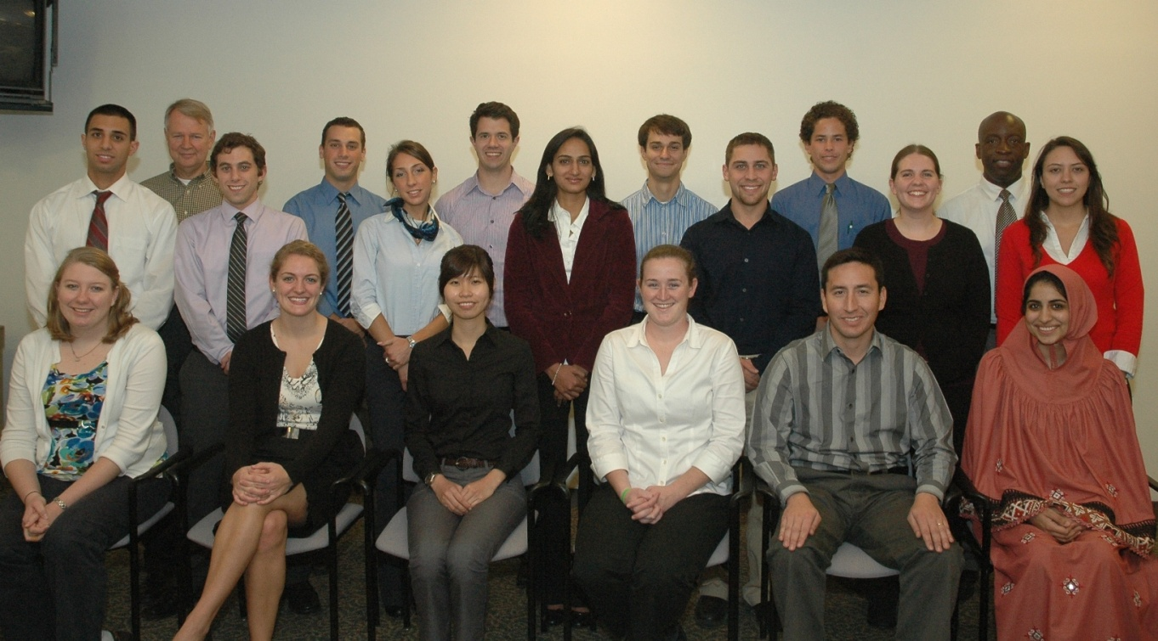
Educational Programs - UCONN
Courtesy of Uconn Program
Notes:
Under Frank’s leadership per 2010, 17 women graduates

Slide 10
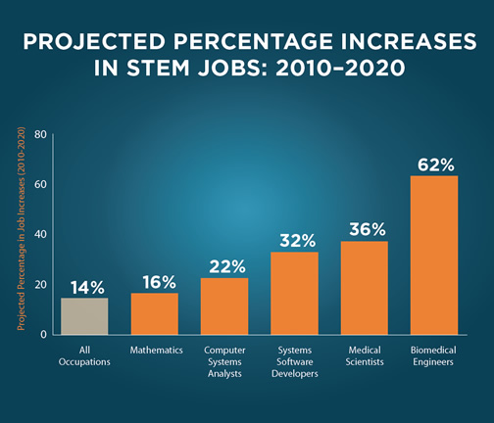
US Department of Education
Notes:
Science, Technology, Engineering and Math: Education for Global Leadership
http://www.esa.doc.gov/sites/default/files/stemfinalyjuly14_1.pdf
https://www.myfuture.com/careers/overview/biomedical-engineers_17-2031.00

Slide 11
Women in Engineering

Slide 12

What attracts women to enter the field?
Good at math and science¹
Opportunity to be socially responsible and make a positive impact on society¹
Ability to be creative²
Aging population = more medical equipment = job security²
Advanced system design with diagnostic remote and central tools²
Educational resources are more easily available (online)²
More modalities which means more opportunities (PACS, Medical Device Integration)²
Gratifying and fulfilling career²
¹Harvard Business Review (https://hbr.org/2016/08/why-do-so-many-women-who-study-engineering-leave-the-field)
²Sally Goebel presentation, www.accenet.org

Slide 13
Good things come in diverse packages
Fortune 500 companies with at least three female directors have seen their return on invested capital increase by at least 66%, return on sales increase by 42%, and return on equity increase by at least 53%. ¹
In a study by Dezsö and Ross of 1,500 U.S. ﬁrms in the S&P, female representation in top management improved ﬁnancial performance for organizations where innovation is a key piece of the business strategy. ¹
In 2012, a NCWIT analysis of women’s participation in IT patents found that U.S. patents produced by mixed-gender teams were cited 30% to 40% more than other similar patents. ¹
Gallup has found that companies with more diverse teams (including more women) have a 22% lower turnover rate. Organizations with more inclusive cultures also have an easier time with recruiting. ¹
Companies in the top quartile for gender diversity are 15 percent more likely to have financial returns above their respective national industry medians. ²
Companies in the bottom quartile both for gender and for ethnicity and race are statistically less likely to achieve above-average financial returns than the average companies in the data set (that is, bottom-quartile companies are lagging rather than merely not leading). ²
¹ https://www.fastcompany.com/3028227/here-are-all-the-quantifiable-reasons-you-should-hire-more-women
² http://www.mckinsey.com/business-functions/organization/our-insights/why-diversity-matters

Slide 17
What scares women away from engineering?
Women make up 18-20% of engineering graduates, but it’s been estimated that nearly 40% of women who earn engineering degrees either quit or never enter the profession.
  Blatant sexual harassment
  Gender stereotypes emerge during team projects; women assigned (and accepted) more menial tasks than male counterparts
  Different treatment from professors, supervisors
    Female employee requested more challenging project, was asked how she would have time to take care of her family with the extra work demands
  Little or no access to supportive network of peers
¹Harvard Business Review (https://hbr.org/2016/08/why-do-so-many-women-who-study-engineering-leave-the-field)

Slide 18
Behaviors that need to change
Expect success and own personal accomplishments
  Women traditionally underestimate success more often than male counterparts
  When receiving praise, women tend to focus thanks to the team, the support network, etc…
Balance the need to be liked versus the need to get the job done
  Adjectives used to describe male and female leaders during a project
    Bossy, selfish, aggressive
    Confident, self-assured, focused
  Fear of not being liked cited for holding female leaders back
Take a seat at the table

Slide 19
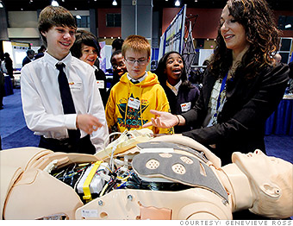
Professional Organizations (incomplete list)
IEEE Women in Engineering (IEEE WIE) (http://www.ieee.org/membership_services/membership/women/index.html)
Society of Women Engineers (http://societyofwomenengineers.swe.org/)
American Institute of Medical and Biological Engineering
(www.aimbe.org )
National institute of Health, Women in Biomedical Engineering (http://womeninscience.nih.gov/)
  The Working Group has sponsored national workshops focusing on mentoring women in biomedical careers and best practices for sustaining career success

Slide 20

Example: IEEE – Women in Engineering
(IEEE WIE)
Mission
The mission of IEEE WIE is to inspire, engage, encourage, and empower IEEE women worldwide
www.ieee.org

Slide 21
IEEE WIE
www.ieee.org
Vision: IEEE WIE envisions a vibrant community of IEEE women and men innovating the world of tomorrow.
IEEE WIE strives to:
  recognize women's outstanding achievements in electrical and electronics engineering through IEEE Awards nominations;
  organize receptions at major technical conferences to enhance networking and to promote membership in WIE;
  advocate women in leadership roles in IEEE governance and career advancement for women in the profession;
  provide assistance with the formation of new WIE Affinity Groups and support ongoing activities;
  promote IEEE member grade advancement for women to the membership grades of Senior Member and Fellow;
  facilitate the development of programs and activities that promote the entry into and retention of women in engineering programs;
  administer the IEEE Student-Teacher and Research Engineer/Scientist (STAR) Program to mentor young women in junior and high schools.

Slide 22

Example: AIMBE
The American Institute for Medical and Biological Engineering (AIMBE) announced the formation of the Women in Medical and Biological Engineering Committee (WIMBE) in March, 2005.
The committee will celebrate women’s contributions to both the field and to the health and well-being of our society. The committee members’ knowledge is extensive spanning corporate, academic, and government institutions.
www.aimbe.org

Slide 23
Successful Women in the Field
Carol Davis Smith
Erin Sparnon
Nancy Pressly
Sam Jacques

Slide 24
Own Experiences

Slide 25

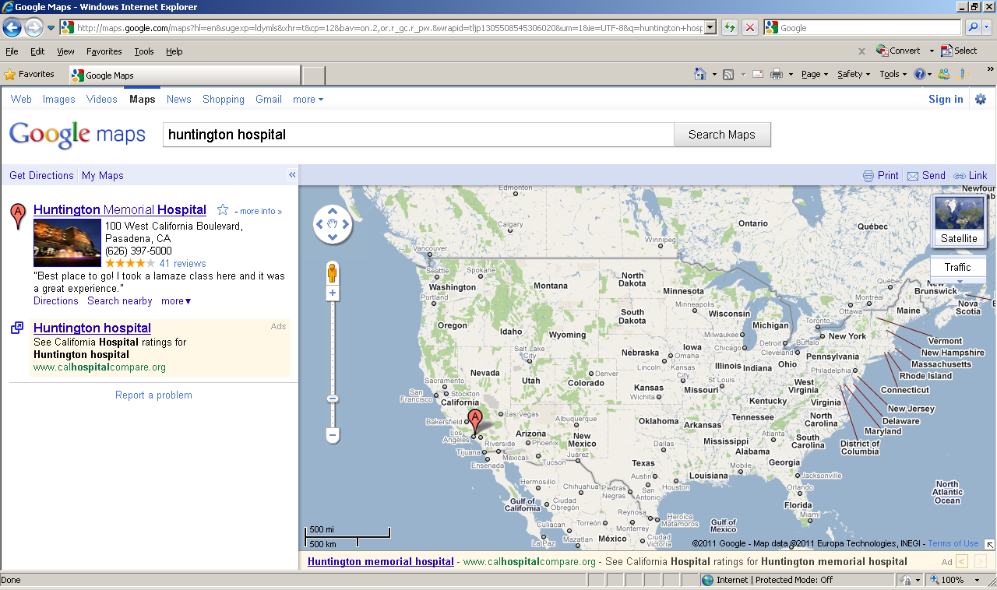
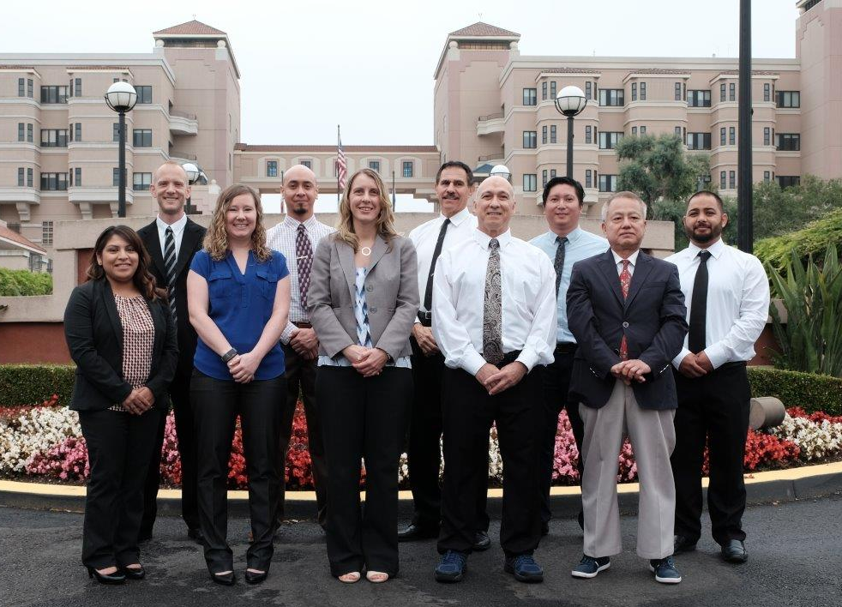
Magnet Recognition
Best Hospitals US News

Slide 26
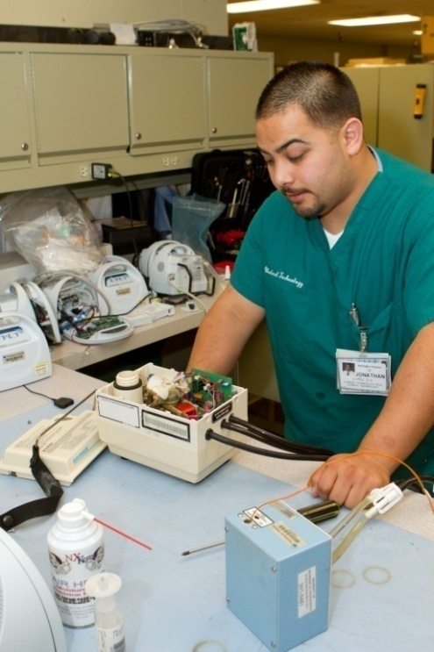
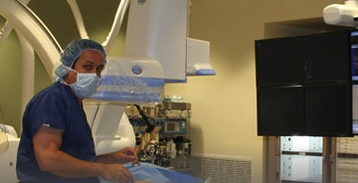
Huntington Hospital
Huntington Hospital
619 licensed beds
Bariatric & Stroke Center
Magnet Recognition
3 da Vinci Robotic Systems
18 Operating Rooms (4 MIS suites)
Skills Labs
5 Cath Labs & IR Suites
9500 medical devices
280 applications
450 servers with 200+ TB storage
1000+ wireless access points
4500+ end user computing devices
300+ hospital owned smart phones
60 Clinical & Information Technology employees
Courtesy of Huntington Hospital

Slide 27
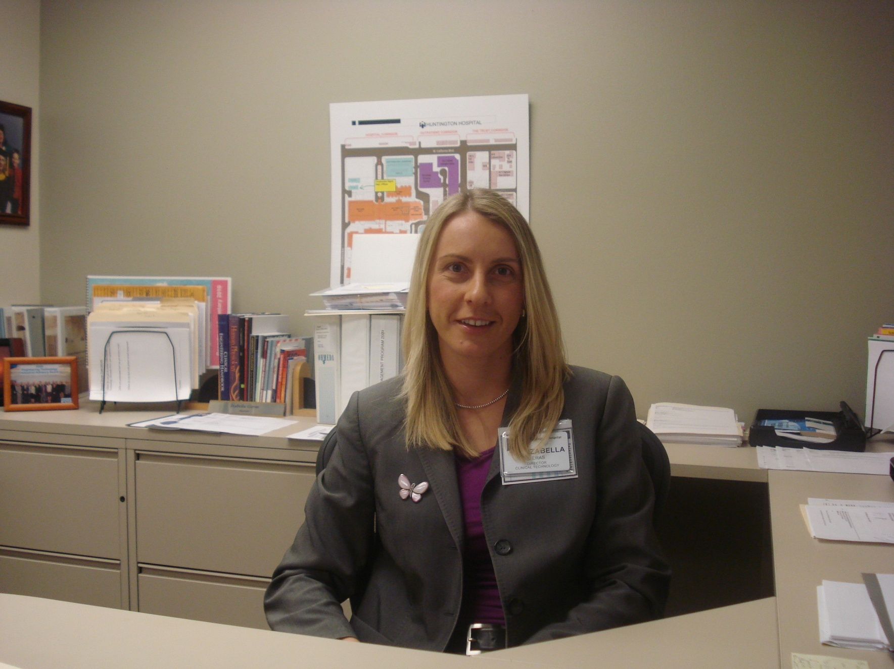
Background
Currently the Director of Clinical Technology at Huntington Memorial Hospital in Pasadena, CA
Most recently worked at ARAMARK Healthcare as the Director of Clinical Engineering at The Mount Sinai Medical Center, New York, NY
Previously served as the Director of Technology Management at William Beaumont Hospital in Royal Oak, MI
Past President of ACCE (American College of Clinical Engineering)
Fellow of ACCE
Board Member, AAMI-ACCE-HIMSS Strategic CE & IT Community
Certified Clinical Engineer (CCE)
Holds a B.S. in Electrical Engineering from the University of Cape Town in South Africa, M.S. in Biomedical Engineering from the University of Connecticut and an MBA from Walsh College in MI

Slide 28
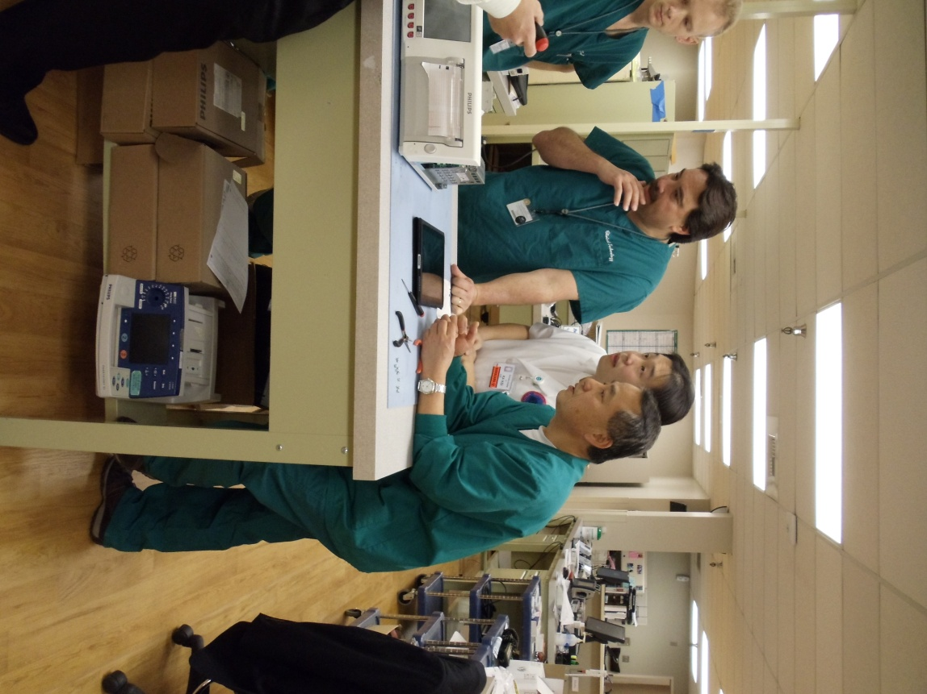
Activities at Huntington Hospital
Medical equipment replacement
Capital equipment management
  Infusion Pumps
  Wireless telemetry upgrade
  Sequential Compression Devices
  CSP Masterplan
  Facilities Masterplan
Service contract management
Medical Device Integration
Stronger partnerships with IT and Info Sec
Alarm Management

Slide 29
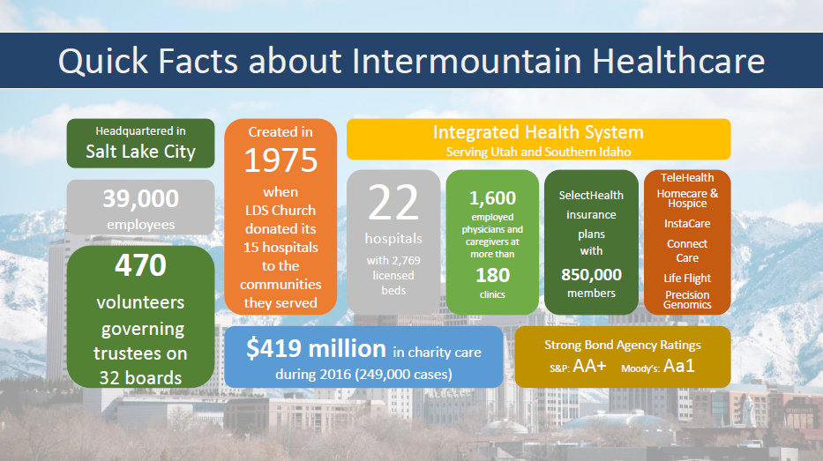

Slide 30

Clinical Engineering Organizational Structure
Central Support Services and Management
  System Director <--- CE Compliance Manager (Shared Clinical Services Compliance)
  Central Support CE Director
  Equipment Service Dispatch Center
  Inventory Coordinator
  Business Analysts
  Service Contract Specialist
  Homecare CE
  Surgical Services CE
CE Hospital Operations
  Three CE Directors
  Local CE Departments and Technicians
  Local Parts and Supply Stock
Imaging Equipment Services Program
  Program Manager
  Regional Service Engineers
  Centralized Budget and Parts Stock
Central Depot Repair Services
  Depot Clinical Engineers– Mobile Medical Equipment
  Field Service Operations
  Centralized Parts Stock

Slide 31
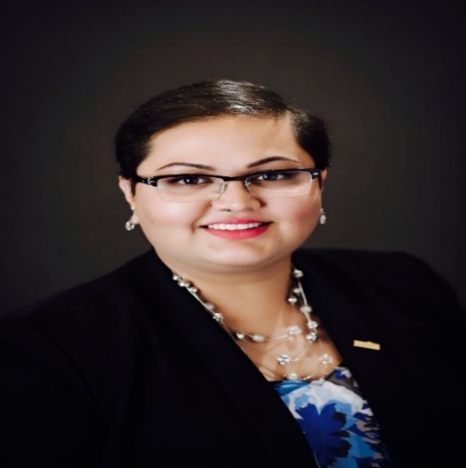
Background
Bachelor’s of Engineering in Medical Electronics – Bioinstrumentation; Signal and Image Processing from B.M.S College of Engineering, Visveswaraya Technological University, Bangalore, India
Masters of Engineering in Biomedical Devices from San Jose State University, California
Currently working on a Doctorate in Healthcare Administration
Certified Healthcare Technology Manager by AAMI Credentials Institute
Certified Change Management Specialist and Six Sigma Lean Professional from Management and Strategy Institute
Research and Technical Adviser for BME departments at San Jose State University and B.M.S College of Engineering
Joined Intermountain Healthcare in July 2016. Prior experience in Stanford Health Care, Stanford Children’s Health, Santa Clara Valley Medical Center, Stanford University Medical Center, and Stanford University
Worked in GE Healthcare and Philips Healthcare on hybrid imaging modalities R&D prior to HTM industry
Have worked in the medical device industry for over 10 years and HTM industry for over 7 years
2017 Winner of the AAMI Young Professional Award and 2015 BI&T Best Article Award
Board Member at ACCE and Active member of the Healthcare Technology Certification Commission
Active Member at AAMI’s Awards Committee, Nominating Committee, EQ Committee, BI&T Editorial Board, and Technology Management Council
Active Member of HIMSS, NH-ISAC, MDSISC, and NH-ISAC cybersecurity education committee

Slide 32


Activities at Intermountain Healthcare
Oversee HTM Compliance, Quality & Risk Program
  Internal Audits & Mock Surveys
  Continuous Improvement Initiatives
Technology Evaluations
  General Biomedical Equipment
  Nurse Call Systems
  Imaging Systems
  Cybersecurity Solutions
  Clinical System Architectures
Vendor Remote Access Management
Medical Device Integration
Cybersecurity Life Cycle Management
  Service Contracts’ Data Security T&C
Vendor and Supplier Sanctions
Technical Conferences and Cyber Education & Awareness
Scholarly Publications
IG: Priyanka.Upendra @Arches National Park

Slide 33


Women in Biomedical Engineering: A Positive Outlook for Technology
Published on February 16, 2015
Although women remain a minority in most HTM departments, the field offers them growing opportunities for fulfilling careers
By: Phyllis Hanlon
Wonder Women – A New Type of Healthcare Technology Professional
Published in Jan/ Feb 2018 issue
Underrepresented in many engineering, IT, and technical professions, women find HTM a welcoming field with incredible opportunities
By: Martha Vockley

Slide 34
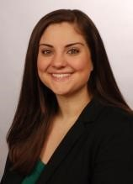
Background
Dr. Jennifer DeFrancesco currently serves as the Acting Associate Director for the Dayton VA Medical Center. Prior to her current appointment, she served as the Chief Biomedical Engineer for the Veterans Integrated Service Network (VISN) 10 serving Indiana, Michigan and Ohio.
Her VA career has included assignments as the Chief of Biomedical Engineering at the Indianapolis VAMC, VISN 11 Lead Biomedical Engineer, Chief of Biomedical Engineering at the Richmond VAMC and a prior detail to the Office of Healthcare Technology Management (10NA9).
BS & MS in Biomedical Engineering from the University of Miami (FL), Doctorate in Health Administration
Certified Clinical Engineer (CCE), Certified Healthcare Technology Manager (CHTM)
US Representative to the WHO/PAHO 2016 Edmundo Granda Ugalde Leaders in International Health Program
Graduate of VHA’s Technical Career Field (TCF) Program for Biomedical Engineers, Healthcare Leadership Development Program (HCLDP) and Executive Career Development Program (ECDP)
Co-Chair of VHA’s Biomedical Engineering Recruitment and Retention (BERR) group 2012-2018
Awards and Honors
  2016- VHA’s Certified Mentor of the Year, AAMI Young Professional Award, VHA’s Chief Biomedical Engineer of the Year, TechNation’s Professional of the Year
  2017- Received AAMI’s Bright Idea Award, Named to the University of Miami’s Inaugural 30 under 30 class
  2018- Named to Dayton Business Journal’s 40 under 40 class
Involvement
  AAMI- Member of the Technology Management Council (TMC), Chair of the HTM Career Planning & Guidance Task Force, Former Mentor in the Mentorship Program, Annual Conference Committee
  ACCE- Former Co-Chair of the Education Committee
  Member of the American College of Healthcare Executives and Indiana Biomedical Society

Slide 35
Workforce Snapshot
Female to Male ratio of Biomedical Professionals^{*2016 Numbers}
  37% Female
  63% Male
Educational Backgrounds
  Diverse
    Graduate Degrees
    BS
    AS
    Military Training
    Cross-Functional
      Different Engineering tracks, technology, Engineering, information technology etc.

Slide 36


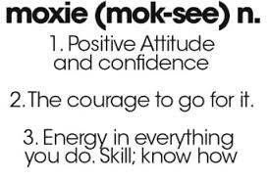
Keys to Success
Acquired Diversity
Mentorship
Sweat Equity
Role Models
Understanding Healthcare Trends
Proactively Adapting to Customer Needs
There’s No Going Back
Photo: Jennifer DeFrancesco, AED on the West Rim of the Grand Canyon, AZ
Photo: Jennifer DeFrancesco, Ladder down a cliff of Huayna Picchu in Peru

Slide 37
Thank you!
Join the Club!

