Slide 1

Soft Skills
David Scott, CBET

Slide 2
A little about me
Started as a student in Biomed in 1989
Started Colorado Association of Biomedical Equipment Technicians (CABMET) CBET Study Group in 2004
2009 AAMI/GE Biomed of the Year
Member of 2012 MD Publishing Department of the Year
Featured as “Tech of the Month” in Medical Dealer Magazine
Served as CABMET President, Vice President, Board Member
Provided CBET Review at MD Expo
AAMI CBET Review Presenter
A.S. Degree in Sports Medicine Technology
Military trained BMET (US Army)
Employed as a Senior Biomedical Technician at UCHealth

Slide 3
Topics Covered
Customer Service
HEAT
AIDET
Work Order Management
Professional Emails
Professionalism

Slide 4
Customer Service
Customer service skills are often described as things like “being a people person”
Being a people person isn’t a skill — it’s a trait — it’s not something you can develop.
Here’s a list of skills — not traits — that are both developable and observable.

Slide 5
Patience
Customers who reach out to Biomed are often confused and frustrated.
Being listened to and handled with patience goes a long way in helping customers feel like you’re going to alleviate their current frustrations.
Patience among customer service teams is also important because great service beats fast service every single time.
If you deal with customers on a daily basis, be sure to stay patient when they come to you stumped and frustrated, but also be sure to take the time to truly figure out what they truly need.

Slide 6
Communicate Clearly
Be mindful of how some of your communication habits translate to customers, it’s best to err on the side of caution whenever you find yourself questioning a situation.
You need to be cautious about how communication habits translate to customers.
When it comes to important points that you need to relay clearly to customers, keep it simple and leave nothing to doubt.
For example, once I went to get work done on my car, I was told by an employee that if I wanted an oil change, it would be “included” in my final bill.
I thought that meant I’d be getting it for free, yet as it turns out, that wasn’t the case.

Slide 7
Using positive language
Customer service means having the ability to make minor changes in your conversational patterns. This can truly go a long way in creating happy customers.
For example, let’s say a customer contacts you with a service call- that’s not an emergency.
Responding with positive language can affect how the customer hears your response:
Without positive language: ”I’m really busy right now and I’m not sure when I can get to your call”
With positive language: “ Your call is important to me. I’m working on a couple things right now and I will be there as soon as I can”

Slide 8
Acting skills
Sometimes you’re going to come across people who you’ll never be able to make happy.
Situations outside of your control (they had a terrible day, or they are just a natural-born complainer) will sometimes creep into your usual support routine.
You’ll be greeted with those “barnacle” customers that seem to want nothing else but to pull you down.
A great customer service professional needs basic acting skills to maintain their usual cheery persona in spite of dealing with people who are just plain grumpy.

Slide 9
Unflappability
This person is sometimes described as: “keeps their cool,” “staying cool under pressure,” and so on, but it all represents the same thing:
The ability to stay calm and even influence others when things get “crazy”!
Sometimes we are put in stressful situations and other people (doctors, nurses, other techs) are aggravated because their equipment is not working as it should.
BMETs need to be the calming factor. That way the customers know we have it under control.
The best BMETs know that they can’t let a situation force them to lose their cool.
In fact, it is our job to try to be the “rock” for customers who think the world is falling apart as a result of their current problems.

Slide 10
Ability to handle surprises
You want to create a system for when you come across a customer who has a product or service problem you’ve never seen before. You need to know:
Who? Decide who should be your go-to person when you don’t know what to do. Define a logical escalation path so you won’t be left wondering who you should reach out to. Maybe when to call tech support or a co-worker?
What? When the problem is out of your league, what are you going do? Get help from a co-worker, call in manufacturer/factory support? Tech support?
How? When it comes time to get someone else involved, how are you going to contact them? At what point do you draw the line and realize you need help?

Slide 11
Tenacity
A willingness to do what needs to be done (and not take shortcuts) is a key skill when providing the kind of service that people talk about.
Remembering your customers are people too — and knowing that putting in the extra effort will come back to you ten-fold — should be your driving motivation to never cheat your customers with bad service.

Slide 12
H.E.A.T.
Hear them out
Empathize
Apologize
Take Action

Slide 13
Hear them out
This isn’t always easy to do, but in the end the customer is going to feel better.
If they can just get it off their chest, it’s likely they’ll be much more open to your solutions.
We’ve all been there; sometimes a person just needs to vent.
Let them talk, and simply listen.

Slide 14
Empathize
Feel what your customer is feeling by putting yourself in their shoes.
Name their emotions: “I understand that you are frustrated. I would be too.”
By showing your customer you understand, you can begin to defuse the situation.

Slide 15
Apologize
This one is important, especially if you did not personally make the error or create the situation that’s making the customer angry.
Maybe you didn’t do it, but “Biomed” did – and you’re a team.
A simple “I’m sorry” can go a long way. Stand united, take the HEAT for your team.
We all make mistakes.

Slide 16
Take Action
Make sure you have an action plan ready to follow your apology.
How are you going to fix the problem?
What can the customer expect next?
It will probably sound something like, “I’m so sorry that this has happened. Here’s what I can do….”

Slide 17
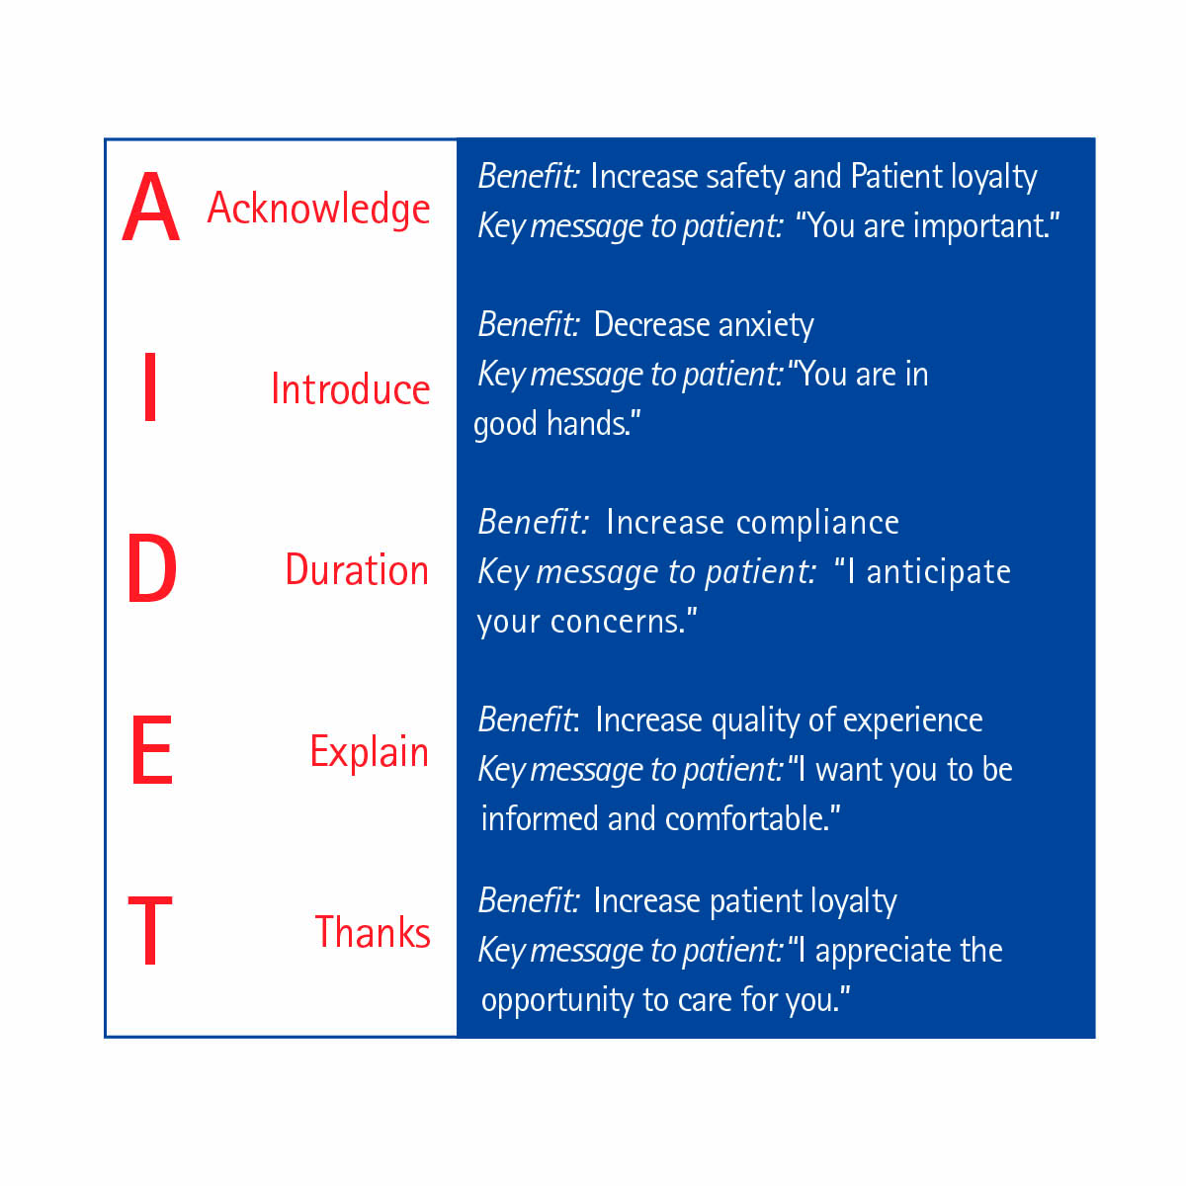

Slide 18
Acknowledge
Greet people with a smile and use their names if you know them. Attitude is everything. Create a lasting impression.

Slide 19
Introduce
Introduce yourself to others politely. Tell them who you are and how you are going to help them.

Slide 20
Duration
Give the best estimate of how long you think what you are doing will take to complete

Slide 21
Explanation
Advise others what you are doing, how procedures work.

Slide 22
Thank You
Thank somebody. Thank people for their help or assistance.

Slide 23
AIDET
Example w/ Staff:
Hi, I’m Dave with the Clinical Engineering Department. I will be working in your department today to complete maintenance on medical equipment. I will be here most of the morning. Thanks at the end of your work.

Slide 24
AIDET
Example with Patient or Patient Family:
Hi, I’m Dave from the Clinical Engineering Department. I’m here to look at the monitor in your room. This should only take a few minutes. (After work is done) Thank you for your time.

Slide 25
Work Order Measurement Metrics
What will management be looking at from you?

Slide 26
Fantasy Football Reference
What is looked at in Fantasy Football?
Statistics
Average points per game
Projected points- guess by experts what they think
Who can get your team the most points?
Getting the best players
That’s how the starting line up is made
These factors make up the strength of your team

Slide 27
HTM Measurement Metrics
PM Completion Percentage
Time Management
Average Repair Time
Total Time to Repair
Cost of repairs- labor and parts
Work Order Analysis

Slide 28
PM Completion Percentage
How many of your PMs you get done in the period they are assigned
  Factors-
  Cannot locate
  In use
  Salvaged
  Storage

Slide 29
Time Management
This tells management what you are doing throughout your day
  Time to complete PMs
  Time to complete repairs
  Time for meetings
  Time for professional development
  Time for whatever else you do during the day
  Usually, management will be looking at how many hours out of a day you have “booked” or accounted for.
  You might have a department goal?
  Usually, management will want you to account for most of your 8-hour day on workorders

Slide 30
Time Management
PMs
Divide up time for PMs completed
Some PMs take longer to do than others
Does your workplace have standard times for PMs? If so use them
Time for ordering PM parts
Time for looking for PMs that are due even though they weren’t completed.
If PM is done by vendor count the time to set up the call with vendor, PO, Schedule with the user and FSE.
Time to meet the vendor and show them to the equipment.
Time to get the PM report from vendor and post it and complete PM

Slide 31
Time Management
This is an area where a lot of techs get in trouble!!!
If everyone is doing this correctly it can make management’s job easier
This can help factor into adding staffing
Look at solutions to time consuming tasks and look for solutions

Slide 32
Average Repair Time or Average Work Order Time
Gives management an idea of how much time is being spent on repairs on average.
Depending on the area techs work average repair times can vary
Sometimes used to compare repair times among techs
Used to determine techs needed to complete the workloads and department staffing

Slide 33
Total Time to Repair
This is usually measured in days time to complete
Gives management an idea of how long it takes to turn over repairs
Can factor into department staffing levels
Can also point out areas that need more investigation
  Such as parts availability or backorders for parts
  Time it’s taking a vendor to complete work sent to them
Measurement of department efficiency

Slide 34
Cost of Repairs
Cost of Service Ratio (COSR)
  Purchase cost of equipment inventory
  Factors:
  Shop hourly labor rate
  Cost of parts
  Cost of vendor repairs
  Cost of service expenses- such as mileage reimbursement or transportation cost
  Cost of service contracts
  Operational Costs- example: office supplies, printer paper, etc.
All of these factor into a ratio (COSR)
  Measured in a percentage

Slide 35
Cost of Repairs
Cost of repairs can help identify equipment with high repair costs
Can look at history of the equipment and how much has been spent to repair it over its lifetime.
Once the equipment reaches a threshold it can be added to a list of equipment needing to be replaced with new equipment.
Can help identify “lemons”
Helps equipment planning

Slide 36
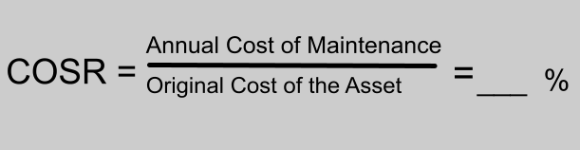
Cost of Repairs
COSR – Cost of Service Ratio is a measurement of department efficiency
COSR can help in looking at areas to cut costs and service contracts
Your medical equipment requires PM labor, PM parts, repairs, some user errors, service calls, maybe a service contract.

Slide 37
Analysis
PM work orders are analyzed to determine whether an AEM can be done
AEM is Alternate Equipment Maintenance
This maintenance differs from the manufacture recommended interval or PM steps.
If PMs are routinely completed on a certain piece of equipment with no adjustments necessary, then maybe an AEM can be considered.
Equipment with no previous service history are not eligible for AEMs

Slide 38
Analysis
It is important to code PM work orders correctly.
If a PM passes with no adjustments the work order should be closed noting no adjustments needed.
If minor adjustments are needed, then close it that way.
If repairs are needed at PM close with completed- repairs needed and open a corrective maintenance work order.
All these closing codes play into the AEM determination.

Slide 39
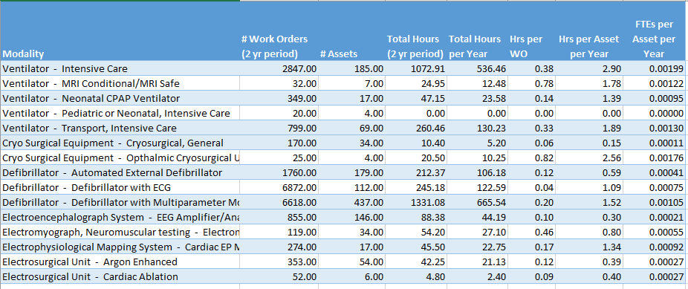
Staffing Analysis

Slide 40
Professional Emails
Subject Line
Always fill in the subject line with a topic that means something to your reader.
Make it pertinent to what the email is about
Such as “Treadmill Repair in PT Gym”
Or just “Treadmill Repair”

Slide 41
Professional Email
Put your main point in the opening sentence. Most readers won't stick around for a surprise ending.
Make your email as short as possible. Be considerate of others time.
Be brief and polite. If your message runs longer than two or three sentences, consider (a) reducing the message or (b) providing an attachment.
Take all emotion out of the email.
Just state facts.
Don't use ALL CAPITALS (no shouting!), or all lowercase letters either.

Slide 42
Professional Email
As a general rule, PLZ avoid textspeak (abbreviations and acronyms): You may be ROFLOL (rolling on the floor laughing out loud), but your reader may be left wondering WUWT (what's up with that)!
No slang
It is a professional email sent in a business setting.
This is not a text

Slide 43
Professional Email
Appropriate Closing
The end before putting your name.
Don’t get too creative.
Some endings are considered distracting sign-offs such as “cheers” and “VR” (very respectfully), so choose one that won’t feel out of place. Some of the most reliable options are:
Sincerely,
Yours truly,
Thanks again,
Appreciatively,
Best regards,
Respectfully,

Slide 44
Professional Email
Add a signature block with appropriate contact information.
It should include: your name, business address, and phone number.
A legal disclaimer (if required by your company).
Do not clutter the signature block with a clever quotation and artwork.
Your workplace might have a format for accepted signature blocks

Slide 45
Professional Email
Edit and proofread before hitting "send."
You are not too busy to sweat the small stuff. Take the time to complete this step.
If this is not done your reader may think you’re careless or do not pay attention to details.

Slide 46
Professional Email
Reply promptly to serious messages.
If you need more than 24 hours to collect information or make a decision, send a brief response explaining the delay.

Slide 47
Professional Email
Out of office reply
When you know you’re going to be off work set up an auto reply.
Include on the auto reply what phone number to call instead of yours- maybe a shop or department number.
Or if it can wait until you get back
This way the customer will not be expecting a quick response.

Slide 48

Professionalism

Slide 49
Dress for Success
You are a professional
You will be talking with other professionals
You could be talking with doctors, nurses, directors, VPs.
Dress appropriately
You only get one chance to make a first impression

Slide 50
What does this mean?
No jeans
No sneakers- unless maybe you wear scrubs as a uniform
No hats
Pants - Dockers style- comfortable
Shirt- polo is a minimum, button shirt is better
Shoes- casual business shoes- something comfortable

Slide 51
Other items
Clean shaven or very well-kept beard/facial hair- less than 1 inch preferable
Cologne/Perfume- don’t wear it
Most hospitals don’t allow this because patients and staff could have allergies or be sensitive to the strong scents of cologne/perfume
Deodorant- wear it! It should not be heavily scented.
No excessive jewelry including piercings
If you have tattoos on your arms you may have to wear long sleeves

Slide 52
Other Items
Good hygiene - clean nails, teeth, hair, shoes, body, and clothes.
Hair- should be clean and groomed. Hair color or style should not be extreme.
Smoking- cigarettes or vaping- no hospitals allow this
  If you smoke, work on stopping
  No chewing (tobacco)

Slide 53
Other Items
Marijuana- you can’t do this even in states where it is legal
  This could be a workman’s comp issue. If you are injured on the job you may be asked to take a UA
CBD- It is recommended not to do it. This can show up on a UA as THC since there is a small amount in CBD.

Slide 54
Other Items
Driving record
  No DUIs
  No DWIs
  If you drive a company vehicle you could be asked to submit your driving records.

Slide 55
Other Items
Background Check
Possibly Credit Check as part of background check

Slide 56
Questions
Discussion
Thank you for joining me for this presentation

