Slide 1
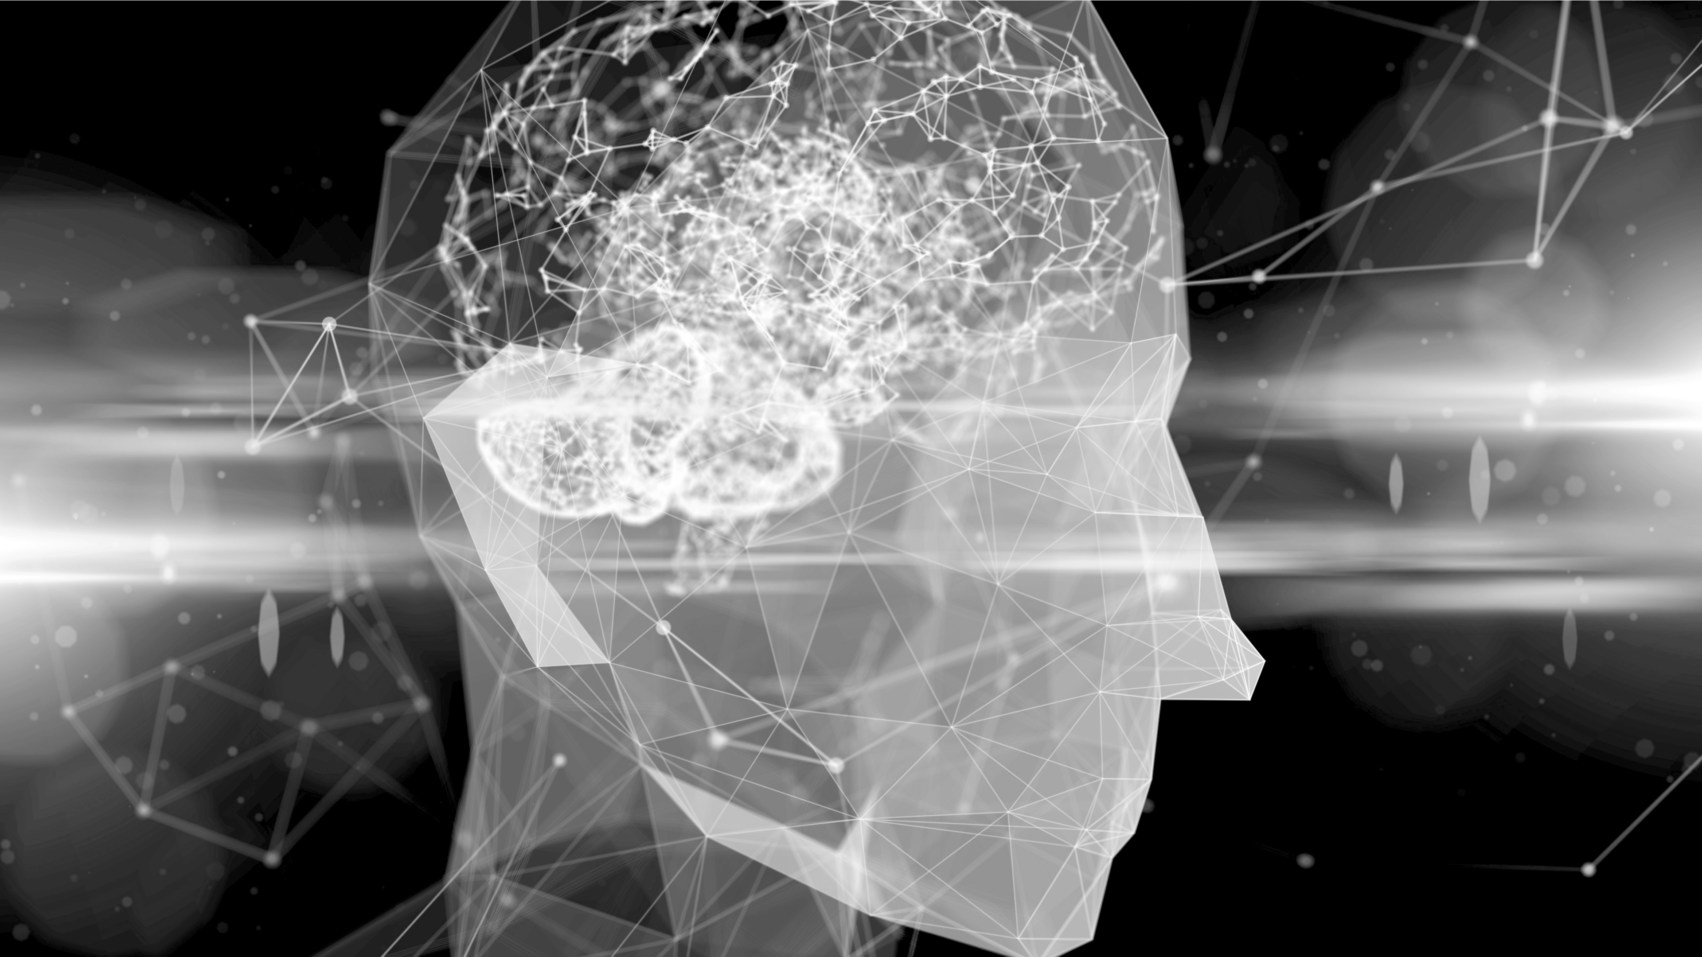

Understanding
The Brain at Work
A New Leadership Model & Framework
Understand Brain Science & Affect Change
Change Your Brain, Change Your Life
Notes:
Need to understand how we respond to stimulus & how to motivate others.
Beginning of a new leadership model & framework to effect change that draws from neuroscience.
What makes others tic?
We can see the brain at work. Bettter understand thinking and behaviors.
Need to understand how we respond to stimulus & how to motivate others.

Slide 2
Prefrontal Cortex
Organizing Principle of Brain
SCARF Model of Motivation
Strengthening Our Ability to Respond
Discussion
Notes:
As we advance to the next slide…Why has our brain evolved as it has?

Slide 3
The Brain’s Fundamental Functions
Regulating
Learning
Selecting
Notes:
The brain involved to regulate the functions of our increasingly complex body. Energy efficiency was key to survival.
Uses 20% of our metabolic fuels. 12 watts. It would need to use more if it hasn’t evolved a lot of unconscious tricks.
So, your brain selects knowledge from the past to predict your immediate future. Which becomes the present. It's planning your actions. This is a skill we can all learn.
It predicts so that limited energy resources can be used appropriately.
We often think about the easiest things, rather than the right things! Why? To conserve energy. Problems & Solutions.

Slide 4
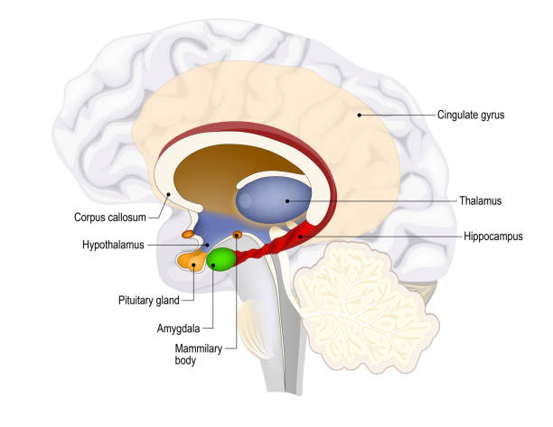
Why We Are The Way We Are
The Limbic System
Notes:
Is grand central station of emotion. Intense emotional reactions & also passionate motivation. Most Amygdala neurons are used to look for bad news & anything negative.
Largely unconscious responses as it Limbic System detects pleasant & unpleasant. Scans for threats, intentions, Ops, H20, Food sex, rage.
It energizes & orients us IF the PFC is strong!
Pituitary gland acts like a fire alarm!
Low neuroplasticity

Slide 5
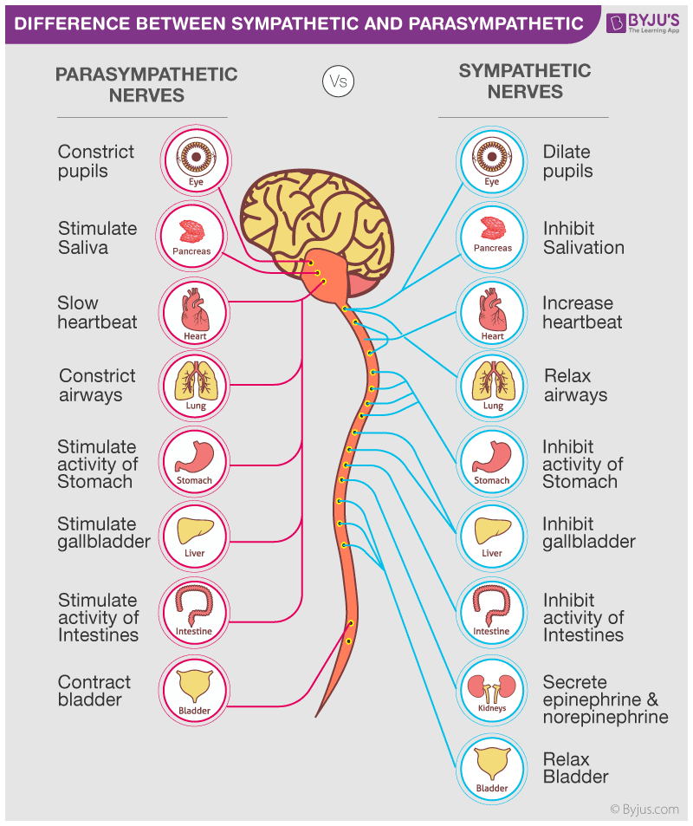
Parasympathetic vs Sympathetic
Controlled by Pre-Frontal Cortex
Notes:
Calm down…take a deep breath
Consistency is key!
Next slide: What’s it look like when the Sympathetic Nervous system is controlling us?

Slide 6

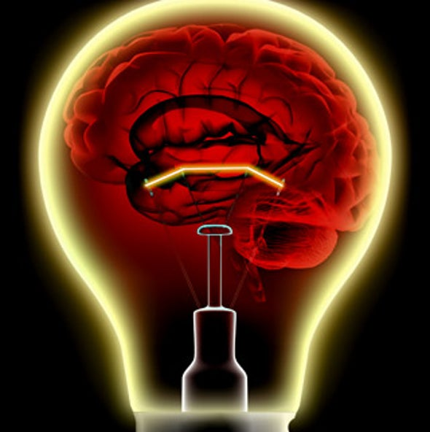
Touch is Comforting
Notes:
PFC performs mental gymnastics. Executive functions. Performs the 5 functions that make up our conscience thought: Understanding ,Deciding, Recalling & Inhibiting
Personality, intelligence, concentration, planning, judgement, self awareness.
Very limited stage. Energy consuming!

Slide 7
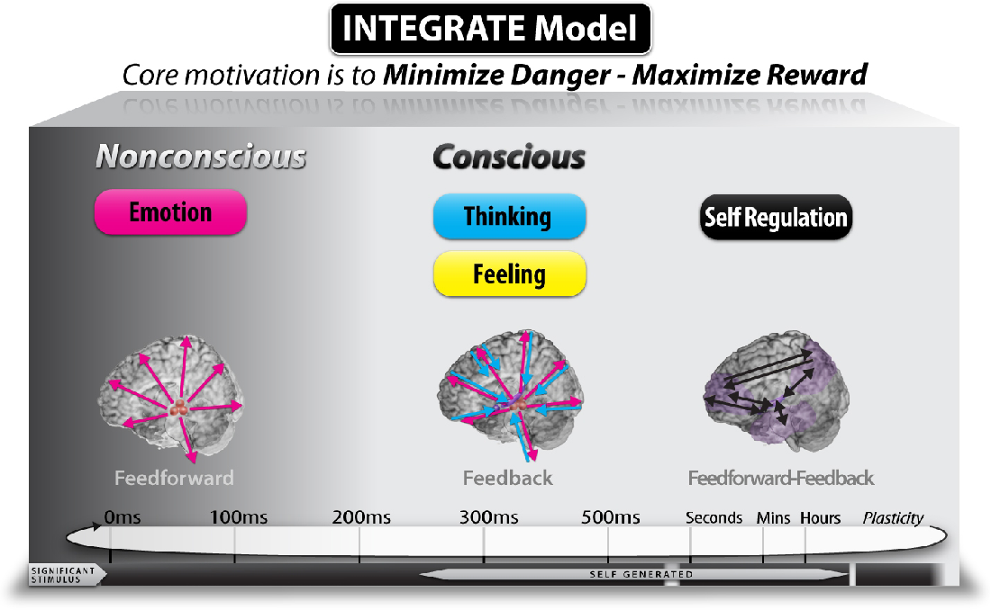
Organizing Principle of the Brain
INTEGRATE
Model
Notes:
The Limbic System is much faster than our self regulation.
2nd Darts

Slide 8
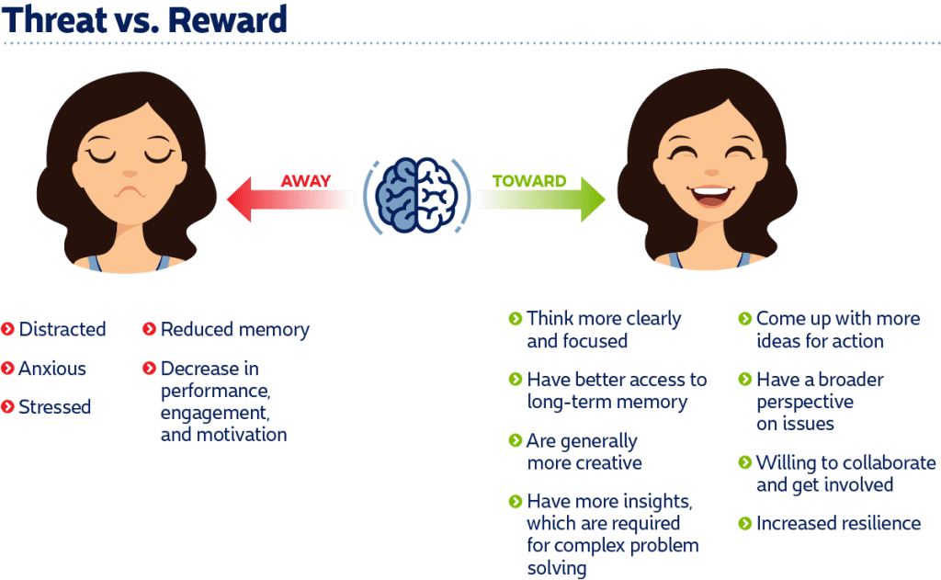
Threat vs. Reward

Slide 9
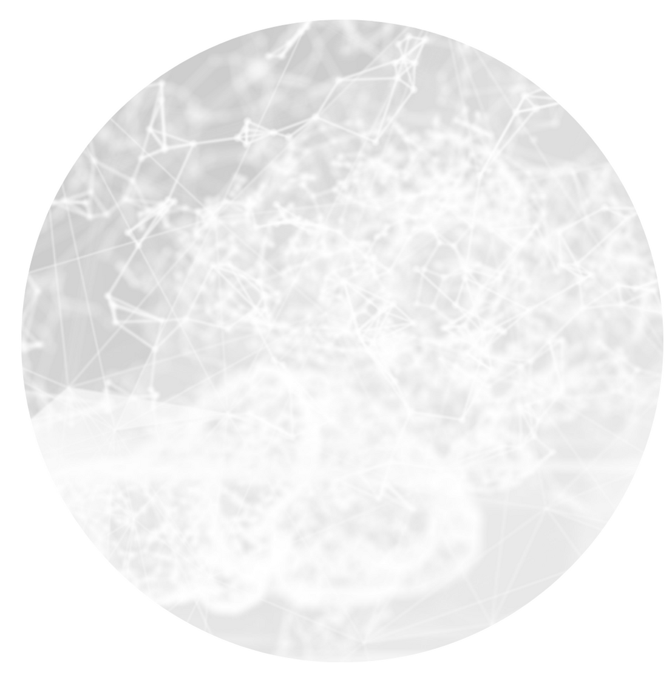
The SCARF Model
Know Your Triggers
Status
Certainty
Autonomy
Relatedness
Fairness
AWAY
Threat Response
TOWARDS
Rewards Response
Notes:
Each are major drivers of our behavior. We don’t function well when any are threatened.
Some people are more sensitive to one than another.
The state of mind we are in determines our level of motivation
Towards = more engaged, open minded, deeper insights, do better & more accurate work. Dopamine, Seratonine
Conversely, Away = just the opposite. Cortisol & adrenaline.
We have a powerful negative bias.

Slide 10
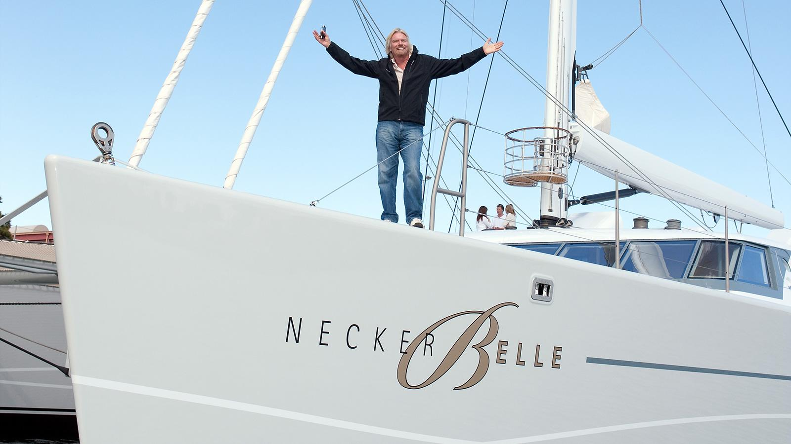
Status
Notes:
As service providers, when someone questions the quality of our service. It’s a threat.
Status has always been a driver of social behavior. Roaming the Serengeti, that’s how our genes got passed on.
Obtaining & improving our status are primal needs. Hard wired to protect our status.
Ego and many other negative social behaviors are efforts to enhance our status.
As service professionals, we deal w/ problems and complaints. We need to understand the brain interprets these as threats.
Has anyone ever been left out of a decision making process? How did that feel?
What do you do to increase someone's status at your work?

Slide 11
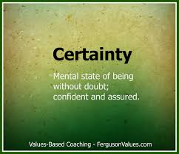
Notes:
If we’re uncertain, we fill in the gaps w/ info we believe are relevant. We make stuff up.
Brains are predicting & pattern recognizing machines. If we can’t predict, we experience anxiety. Basil Gaglia stores patterns.
Establishing expectations creates certainty.
Music is comforting.
Meeting expectations increases dopamine levels.
Any Mergers? What are some good examples?

Slide 12
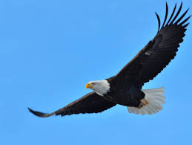
Autonomy
Notes:
Who enjoys being micro-managed? Leaders who provide too much direction.
Studies show that entrepreneurs have lower stress levels than hourly workers. Why?
We feel stress when we don’t feel as though we have choices.
Is anyone here experiencing either lack of autonomy or the joy of having it?

Slide 13
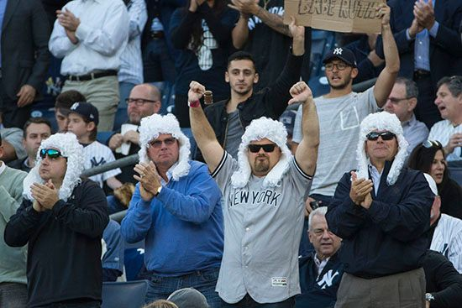
Relatedness
Notes:
We like people who we relate too. We view strangers as potential threats.
We instinctively form Tribes.
The neural pathways we use when we perceive some to be “like us”, are similar to those we use when we think about ourselves. Foes are processed using much different pathways.
We have little empathy for competitors.
What should we do when a new co-worker joins us?

Slide 14
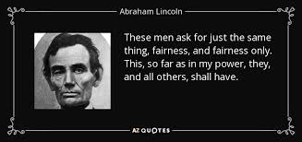
Notes:
Unfair exchanges cause a strong threat response.
Pay discrepancies. Accusations. Politics. Double standards. Workloads. Favoritism
Double standards.
If someone is perceived to be doing something considered unfair, we care less for their welfare.
How to ensure fairness…communication to establish clear expectations & ground rules. How do you ensure fairness?

Slide 15
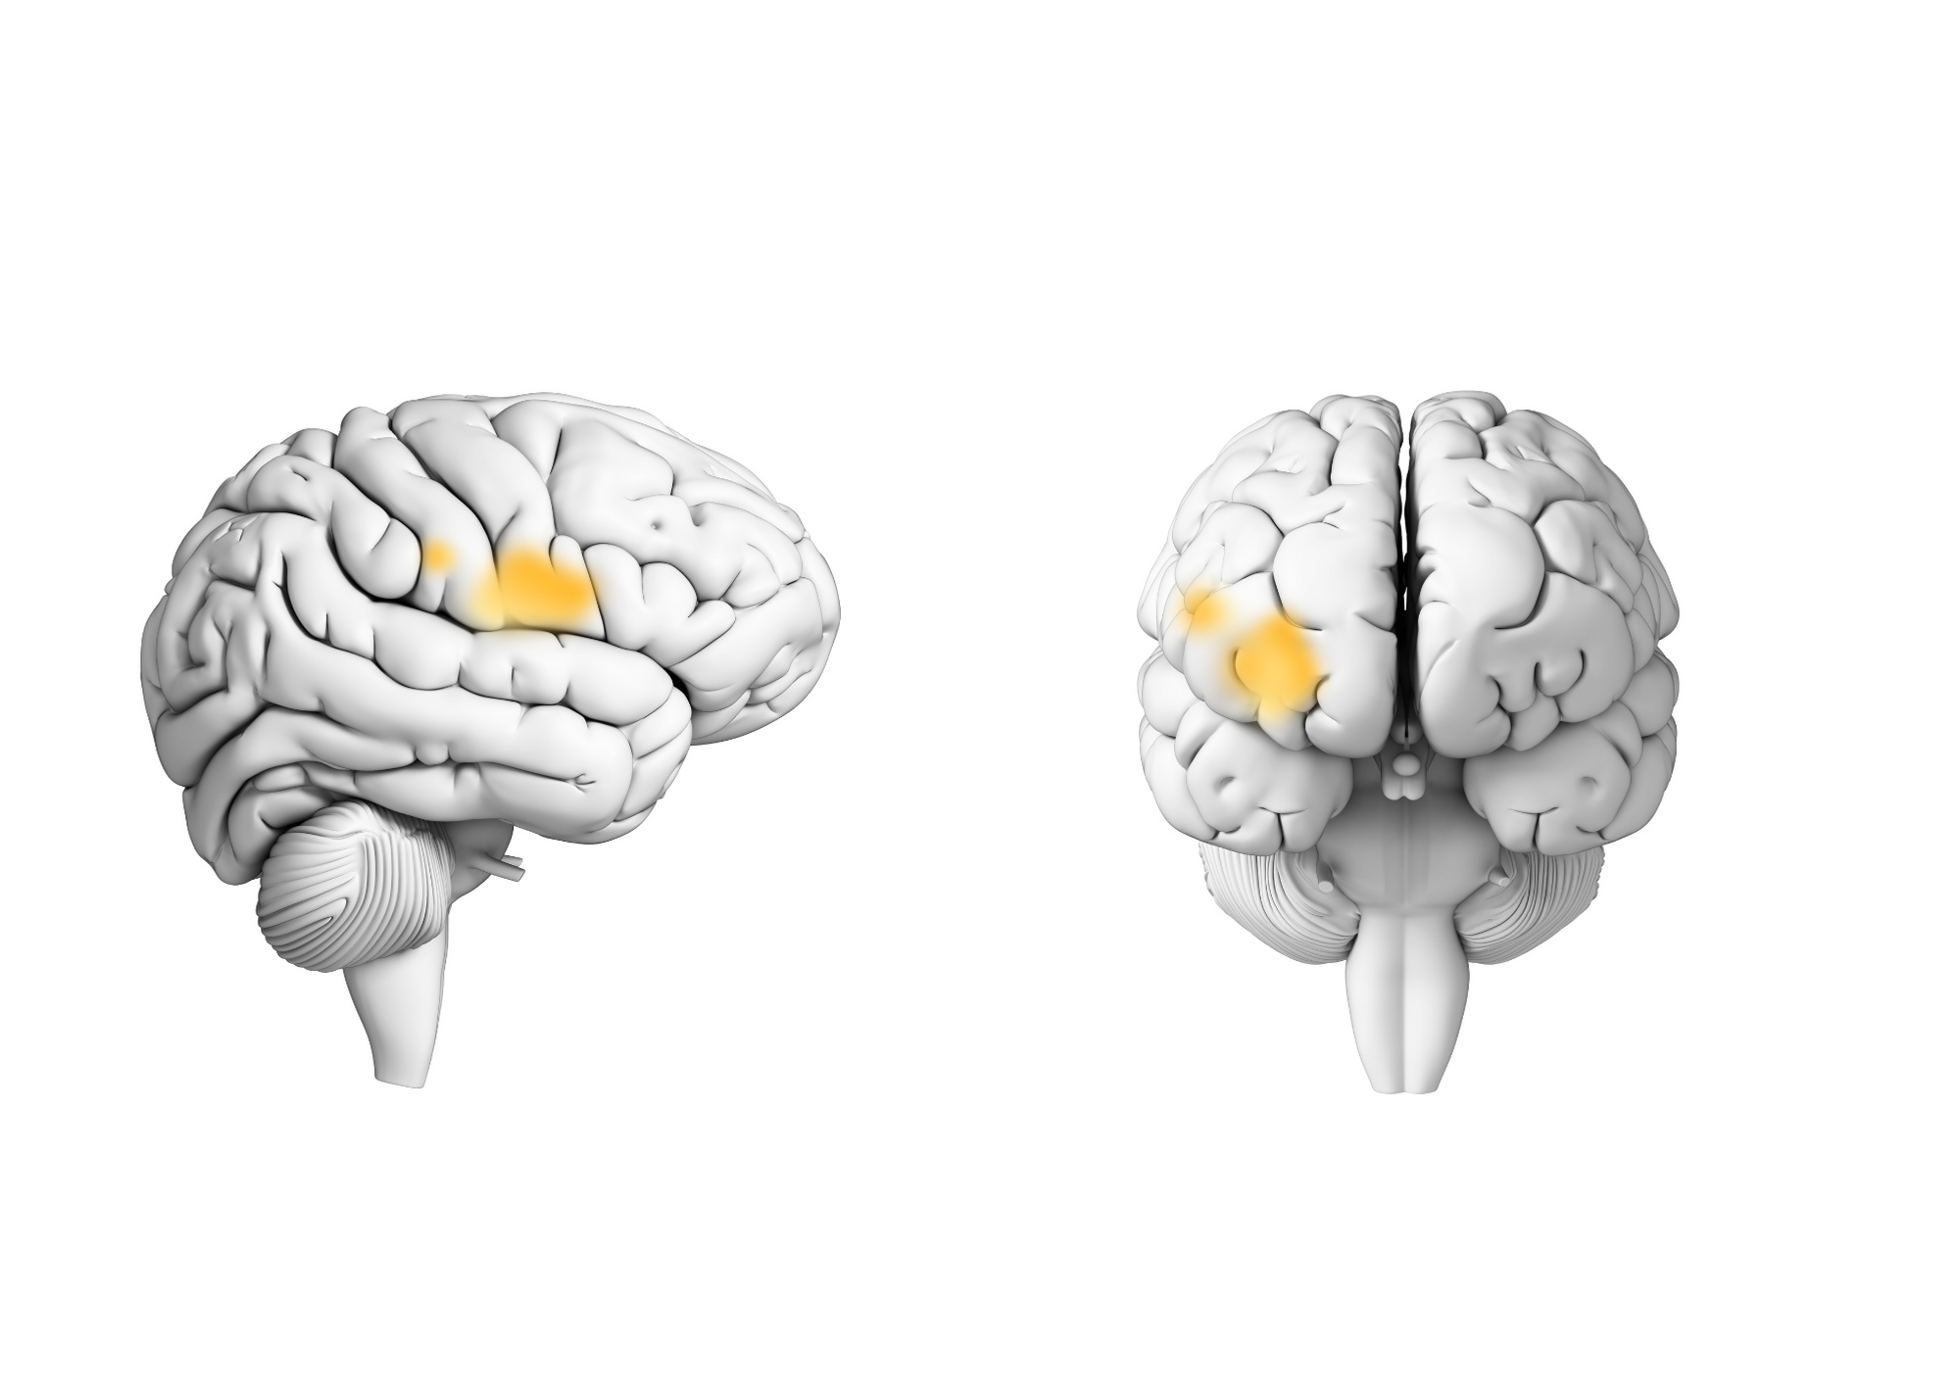
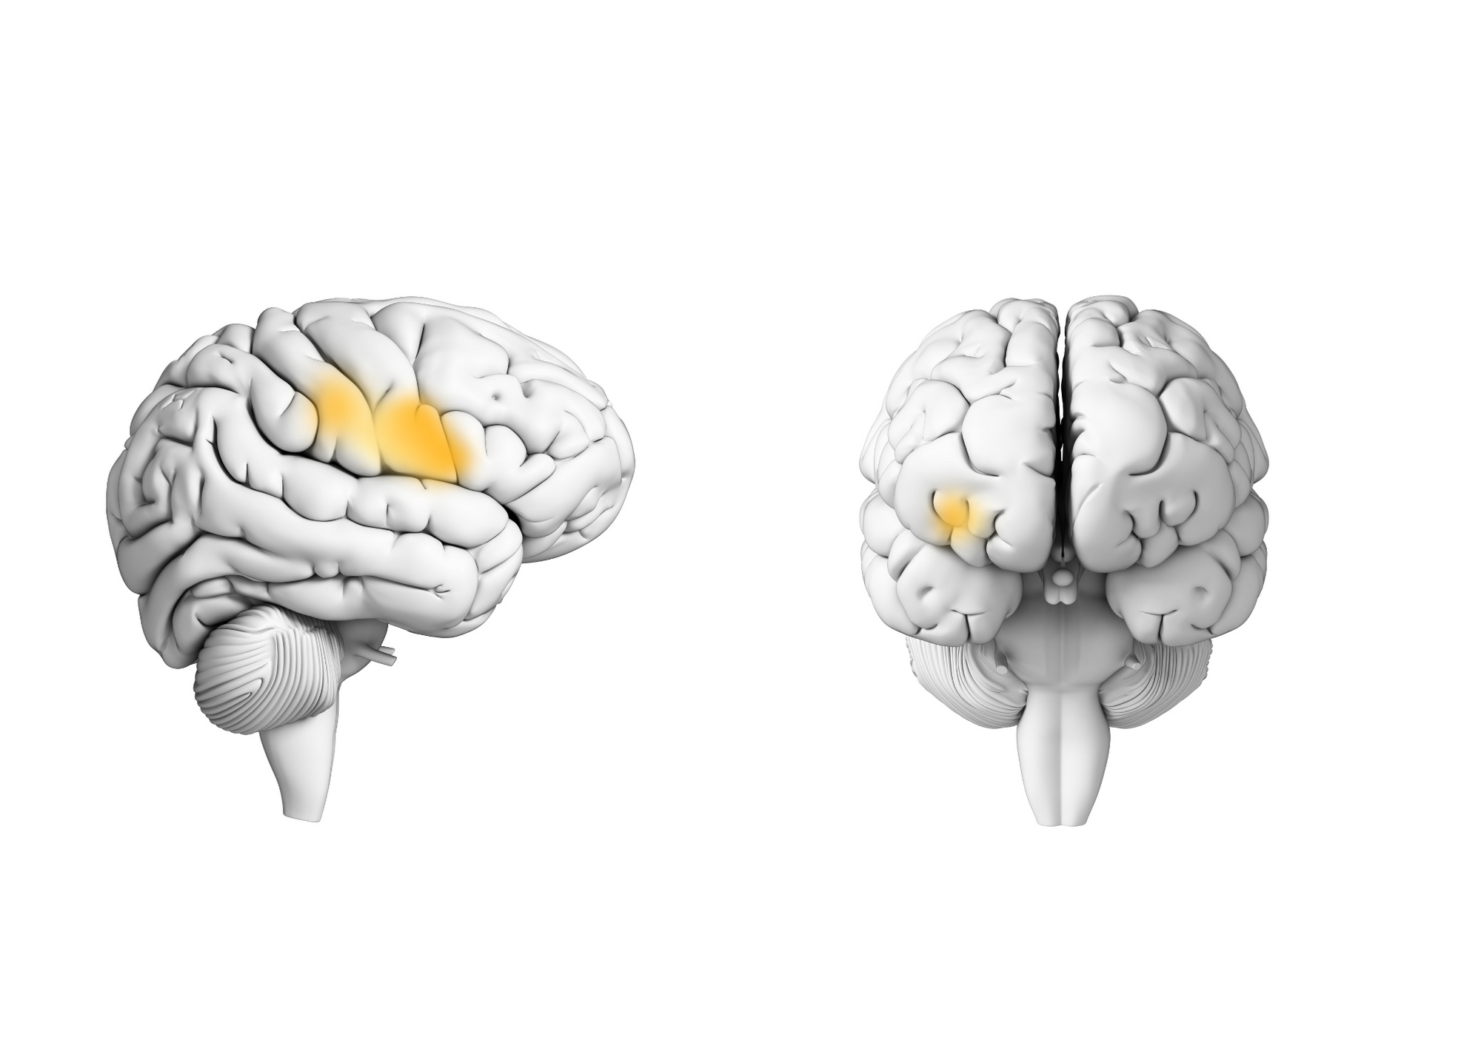
Status Threats are Memorable
Social Pain
Physical Pain
Notes:
Suppose we inadvertently threaten the Status of a colleague or customer
What can we do to

Slide 16
The SCARF Model
Know Your Triggers
Status
Certainty
Autonomy
Relatedness
Fairness
AWAY
Threat Response
TOWARDS
Rewards Response
Notes:
Each are major drivers of our behavior. We don’t function well when any are threatened.
Some people are more sensitive to one than another.
The state of mind we are in determines our level of motivation
Towards = more engaged, open minded, deeper insights, do better & more accurate work. Dopamine, Seratonine
Conversely, Away = just the opposite. Cortisol & adrenaline.
We have a powerful negative bias.

Slide 17
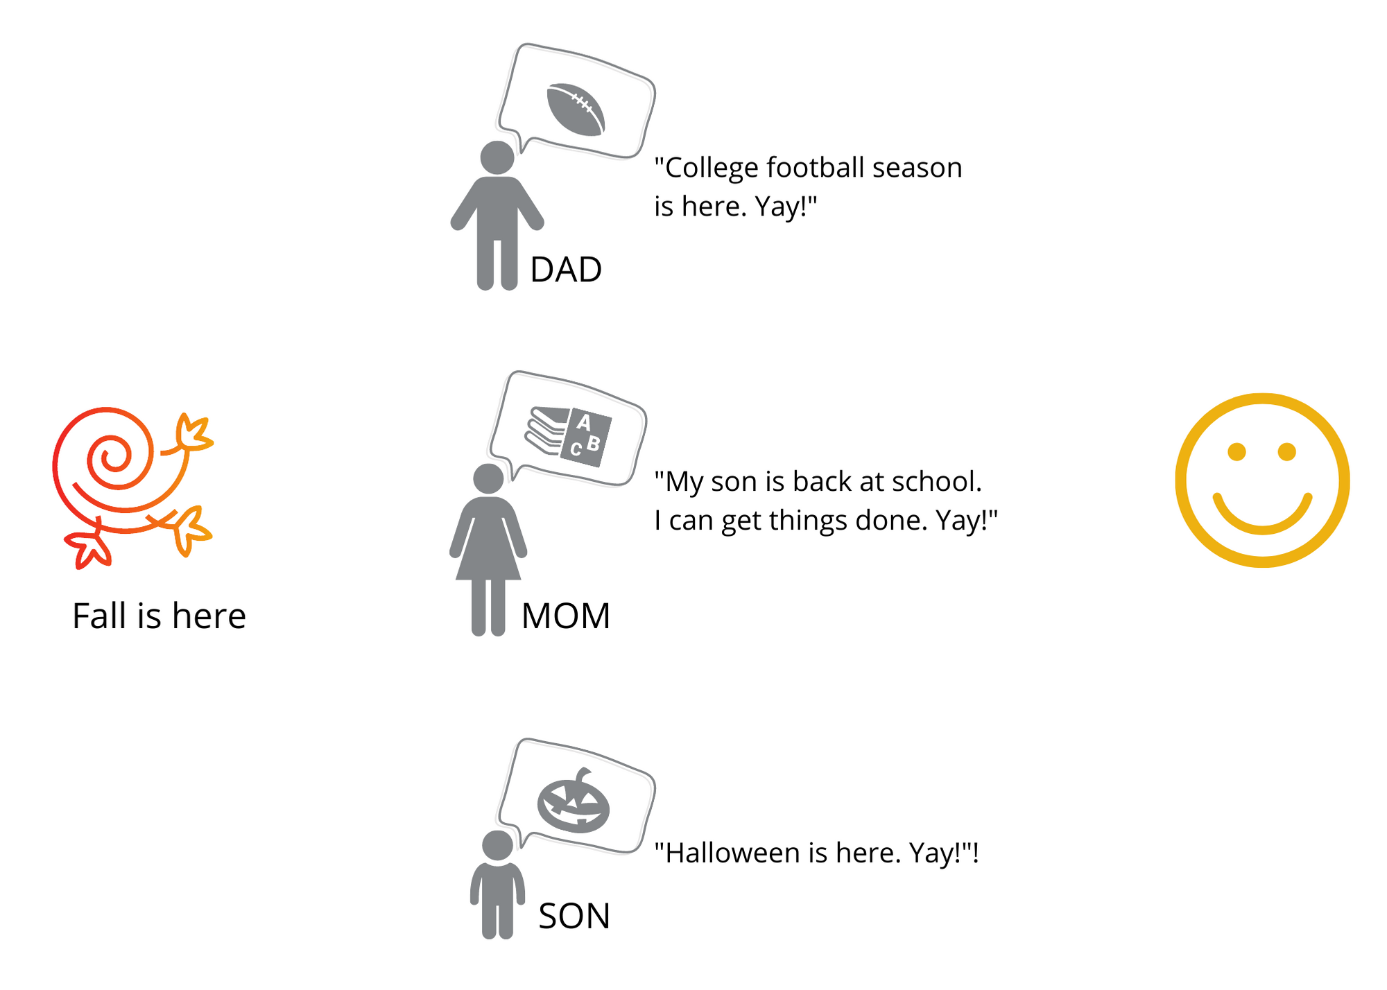
Label & Reappraise: Strengthening Our Ability to Respond
REALITY
OPINION
EMOTION
Fall is here
I feel happy
Notes:
AKA Cognitive change strategies (e.g. lemonade out of lemons)
Don’t suppress emotions!
Looking at things from another’s perspective. Control our interpretation of the meaning of a situation.
It’s a habit that becomes stronger with practice. Remember: Limbic System responds faster that PFC!
Covey’s Subway Story.
Know your triggers…and label them. “That’s just my trigger”.

Slide 18
Labeling & Reappraisal
Notes:
We like people who we relate too. We view strangers as potential threats.
We instinctively form Tribes.
The neural pathways we use when we perceive some to be “like us”, are similar to those we use when we think about ourselves. Foes are processed using much different pathways.
We have little empathy for competitors.
What should we do when a new co-worker joins us?

Slide 19
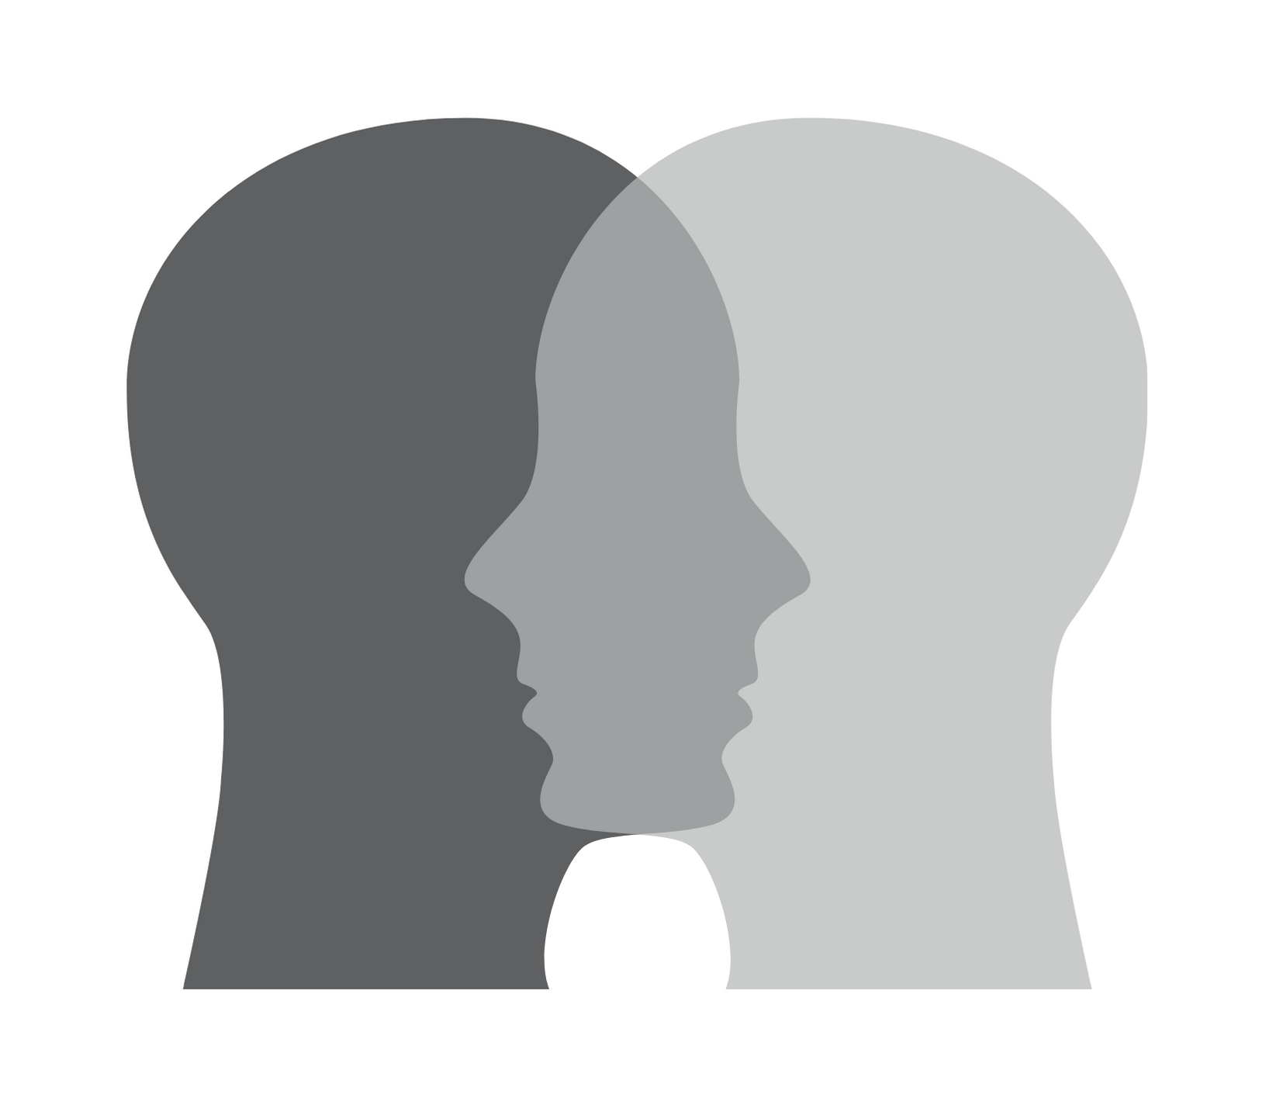
YOU
ME
INTRIGUING
STORIES
served fresh daily
story
WE

Slide 20
Aloha
John Walls
john@calyxmet.com

