Slide 1

Navigating a full CMS Survey
John Garrett
Program Director Capital planning
Tech management Entech
Banner Health

Slide 2
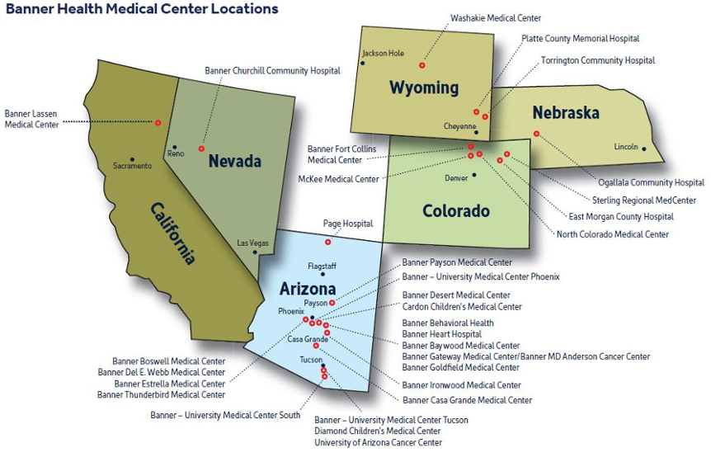
Mission: “Making health care easier, so life can be better.”
Banner Health is a non-profit health system in the United States, based in Phoenix, Arizona
It operates 32 hospitals and several specialized facilities across 6 states
The health system is the largest employer in Arizona and one of the largest in the United States with over 50,000 employees
> 1600
Operating locations and buildings

Slide 3

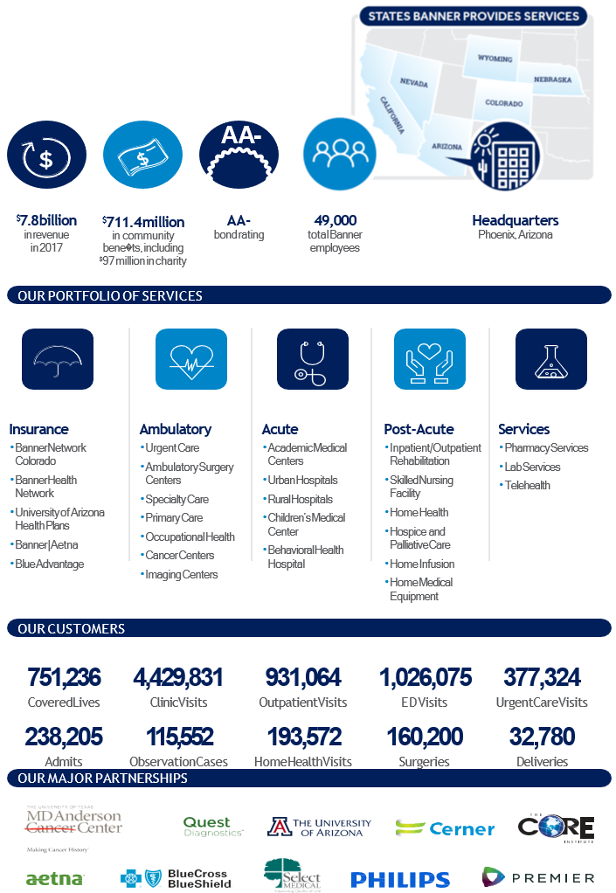
At a Glance
AA-
Making healthcare easier,
so life can be better
Operating locations and buildings
Clinical Engineering | Diagnostic Imaging Services | Medical Physics | Clinical Technology Assessment & Planning | FF&E Planning | ENTECH

Slide 4
John Garrett
Served in the US Navy
Worked in the Clinical Engineering/HTM space for 25+ years
Navigated a full CMS inspection as CE Manager in 2019
Published in Imaging Community Exchange (ICE) magazine
BA in Health and Human Services Management
MS in Psychology

Slide 5
CMS Survey
Deemed Status
  Allows for reimbursement from Center for Medicare and Medicaid Services (CMS)
  Ensures quality care for all patients
CMS, Joint Commission, HFAP, DNV
  Surveys/Inspects to ensure that entity meets or exceeds CMS requirements
  Approves or removes Deemed Status as an accredited agency
CMS Surveys
  Can be done performed at any time
  Typically limited to a complaint or specific area of the medical facility
  Can be due to the removal of deemed status in order to regain deemed status
  We will cover the CMS survey to regain deemed status.

Slide 6
What to Expect
From the surveyors
  Thorough review of documentation
    This will include personnel files, policies and procedures, inventories, billing, and maintenance
  Walk through inspections of facilities
  Observation of multiple procedures in the hospital
  They are here to help
From the hospital
  Avoiding an Immediate Jeopardy (IJ)
  8am – 5pm survey – 5pm to 8am correcting findings
  Need for overtime and extra effort
From your team
  Everyone rounding and reporting issues
    Both in areas of responsibility and other areas
    Head on a swivel, looking at all possible problems
  Document review

Slide 7
Hospital Procedure
Best practices
Have escort with radio for each surveyor
  Radio in request for documents
  Navigate inspectors to desired locations
  Relay intended destinations
Have a central command for all documents
  When documents are requested, they are brought in for review
  Documents are presented to the surveyor in the area they work from
Have an Executive assigned as an expediter
  Has the authority to make decisions hospital wide
    Includes overtime, contractor work approval, purchases, etc.
    Adjusts staffing as needed for clearing findings
  Is responsible for helping to clear any findings
    Works with department heads to get them what they need
    Defers only when a decision would violate hospital policy or procedure such as capital purchasing
> 1600
Operating locations and buildings

Slide 8

HTM/CE/Biomed
During Survey:
Take Ownership
  Make sure to verify PM completion and documentation
    Check documentation
    Round
  Round more frequently
    People may be less available due to extra duties
    There may be more needs than normal on the floors
  Create a supportive environment
Be the Eyes and Ears
  Look at everything from ceiling tiles to floor conditions
  Ensure that any issues are reported to the command center
Support ALL Departments

Slide 9

Survey Preparation
The best survey preparation is having a solid HTM/CE program.
Documentation
  Accurate inventory & service history
  COMPLETE documentation
    Calibrated tools listed on service reports
    Accurate detailed descriptions of service
  Random Audits
PM Completion
Qualified Personnel
  Documentation of background checks
  Up to date shot records
  Training records
Documentation
  It is important enough it needs mentioned again.

Slide 10

Things to Consider
Alternate shift
  It may help to have a second or third shift to help with corrections
  A second or third shift may be able to complete work interrupted by the survey
Limits of CMMS
  Is gathering large amounts of data difficult?
  Make sure someone is available to navigate and provide information from CMMS
Communication
  Be available to leadership
  Be available to surveyors
Flexibility
  Be prepared to change and adjust as needed
  Be fluid, flexible is too rigid

Slide 11

Things that Help
Take care of the team
  Make sure that everyone has the support they need
  Check in on your team members
  Make sure they get enough rest and that they eat
Take care of each other
  Be kind to those from other departments they are stressed
  Take opportunities to support them whenever possible
Take care of yourself
  Make sure you get enough rest
  Make sure you eat
  Remember there is life outside of the hospital. This is temporary.

Slide 12

  John.Garrett@BannerHealth.com
  We are Hiring
  Google “Banner Health Careers”
  Select ‘Biomed’ Category
  Open FTEs

