Slide 1
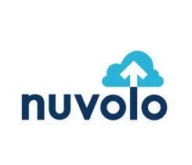
What Is A Connected Hospital? Parkland Health & Hospital System Explains How They Now Can Coordinate Activities Involving Multiple Departments

Slide 2

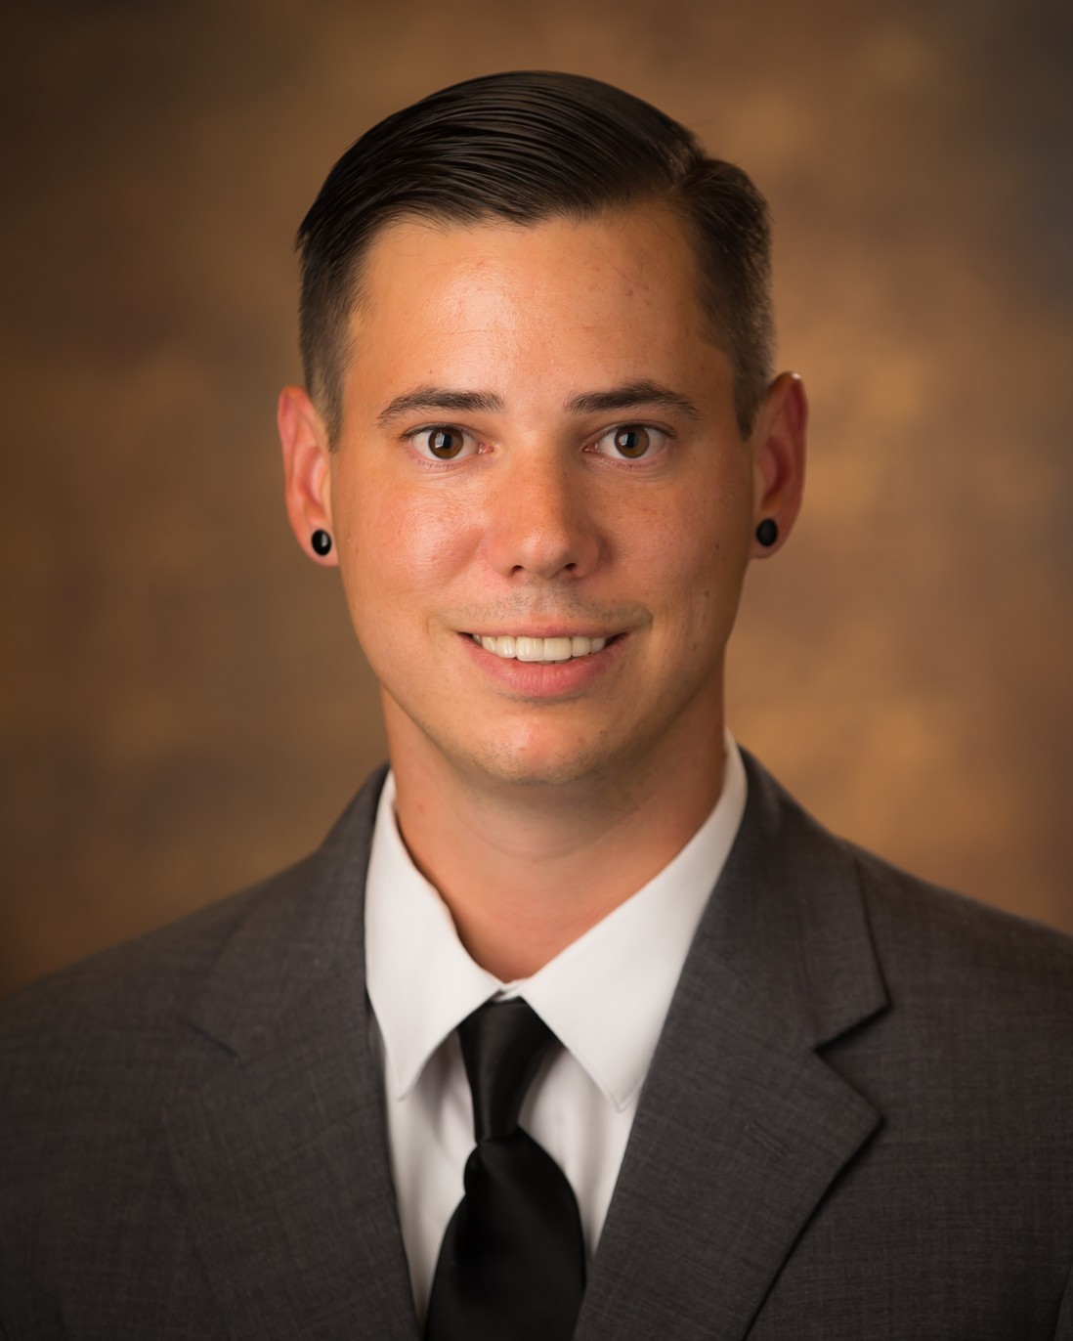

Speaker Introductions
Dustin Smith, CHTM
Advisory Solution Consultant
Nuvolo
Notes:
Each person introduces themselves. Name, tiltle, background, and current role and job responsibilities

Slide 3


Introduction to Parkland Health & Hospital System
Challenges from Legacy CMMS
Criteria for Choosing a New CMMS Solution
Benefits from HTM Modernization
Solution Demonstration
Enabling the Connected Workplace in Healthcare
Questions and Answers
Agenda
Notes:
Heidi

Slide 4
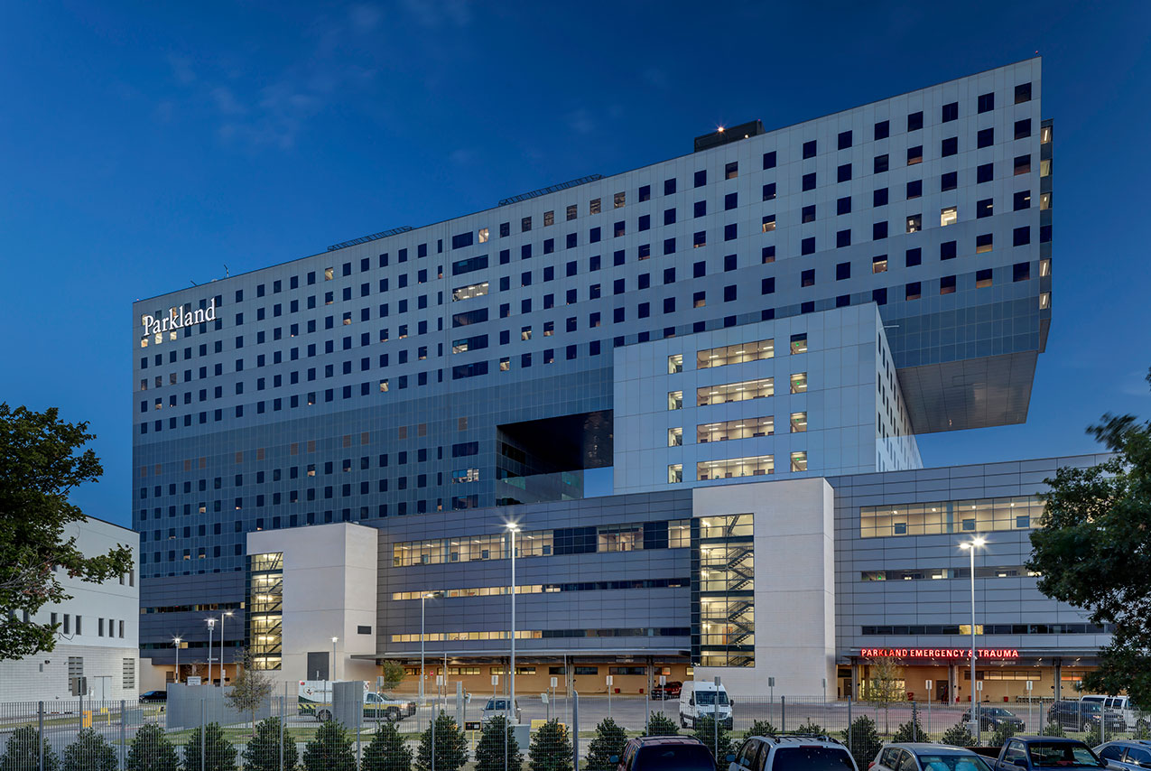

Parkland Health & Hospital System
Dedicated to the health and well-being of individuals and communities
Hospital System serving Dallas area since 1894
One of the Largest Public Hospital Systems in the US; 900 bed hospital
Includes 20 community-based clinics and 12 school-based clinics
33,000+ clinical devices requiring support and maintenance
Recognized as one of the most technologically advanced hospitals in the nation
Notes:
Justin

Slide 5


Challenges from Legacy CMMS
Top 3 Issues
The “Call-Tree” Problem – different support numbers and service request systems
Difficult integration for passing work orders between support groups
Lacking mobile application for field service technicians to access work orders, checklists, and maintenance guides
Slow interface to view data online and filter information
Complicated report creation
No way to combine data from different support groups
Took multiple clicks to achieve even simple tasks
Slow response time moving between screens and list views
Mobile application was lacking necessary features
Reporting Issues
Usability Issues
Notes:
Mark

Slide 6
Advice on Choosing a new CMMS Solution
Picking the best HTM platform for the future
Single platform for sharing work order management (IT, HTM, Asset Management, Facilities, Nutrition Services, etc.)
Scalable and Easily Customizable Platform
Includes Vendor Support Contract Management and ROI Tracking
Powerful Reporting and Graphical Dashboards
Provides Performance Analytics for Support Staff
Includes Forecasting for Clinical Device Replacements
Notes:
Mark

Slide 7

Benefits from HTM Modernization – Single Platform
New Asset Onboarding
Support Contract Management
Asset Life-Cycle Management
Track performance history for all devices by Mfg, Model, etc.
Enables accurate replacement forecasting for clinical devices based on dates / performance
Accurate inventory and maintenance history for TJC compliance audits
Streamlined onboarding process
Workflow processing to quickly setup new devices
Maintains accurate inventory of clinical assets
Also supports asset retirement and removal
Monitor contract ROI based on accurate maintenance work order history
Detailed information available for contract renegotiations
Service techs have online access to contract coverage within Work Orders
Notes:
Justin

Slide 8



Benefits from HTM Modernization, continued
Work Order Management
Monitor Team Performance
Plans for OT Cyber Security
Integrate with network monitoring system - Medigate
Enable fast remediation for connected devices
Coordinate upgrades and patches for devices based on published lists for clinical cyber security risks
Workflow processing to assign work orders to the correct HTM support group
Tracking and reporting for maintenance performance to meet SLA’s
Central support team can assign new service requests to any of 13 different support ‘SHOPS’
Activity metrics showcase staffing justifications
Managers can level-out workload across HTM team
Spotlight awards for top performers on the team
Notes:
Justin

Slide 9



Solution Demonstration
Service Requests
Mobile
Dashboarding
Contracts
Notes:
Mark and Justin – demo – 20 minutes

Slide 10

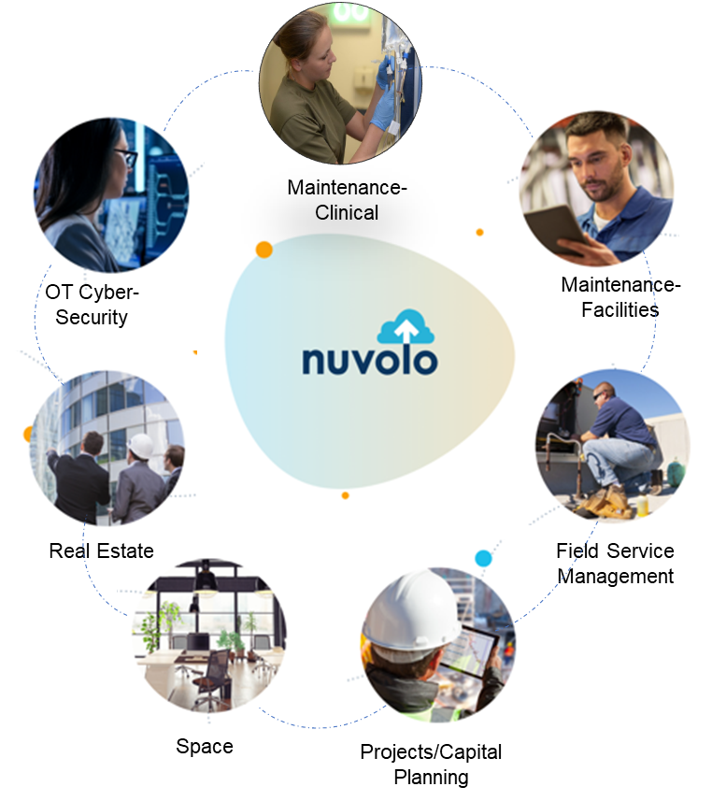
Enabling the Connected Workplace in Healthcare
Connects different support teams, locations, assets and business services on the same platform
Collaborate
Across the organization
Coordinate
Activities to streamline operations
Track and Report
On all projects
Improve
The overall employee experience
Notes:
Heidi

Slide 11
Questions & Answers
Dustin Smith – dustin.smith@nuvolo.com
sales@nuvolo.com
(844) 468-8656

