Slide 1
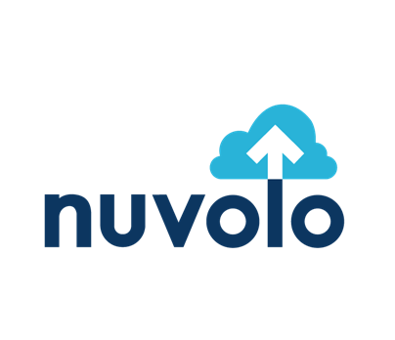

Safeguarding Medical Devices from Cyber Security Threats

Slide 2



Speaker Introductions
Heidi Horn, MA, AAMIF
VP Product Marketing - Healthcare
Nuvolo
Dustin Smith
Advisory Solution Consultant
Nuvolo
Notes:
Everyone introduces themselves

Slide 3


About Nuvolo
Investor and employee-owned company started in 2013
Built on ServiceNow™ platform
Nuvolo’s Connected Workplace for Healthcare solution provides an integrated cloud-based application for full life-cycle management of clinical and facilities assets.
400+ employees and growing rapidly
Worldwide offices: US, UK, India, Bulgaria, Canada and Netherlands
Strong commitment to supporting the healthcare community:
  Dedicated healthcare teams - we hire and partner with industry subject matter experts
  Over 100 Healthcare provider clients (and growing)
  Active involvement in healthcare technology management (HTM) associations to keep pulse on client needs and changing regulations, identify best practices, and provide thought leadership
  First company to provide funding ($10k) to help hospitals participate in AAMI’s BMET Apprenticeship Program.
Notes:
Our vision statement focuses on helping our customers like you tear down the walls between siloed departments and deliver on the promise of a fully Connected Workplace, empowering everyone to do their very best work. The Connected Workplace connects all people, locations, assets and business services natively on the NOW platform.”

Slide 4

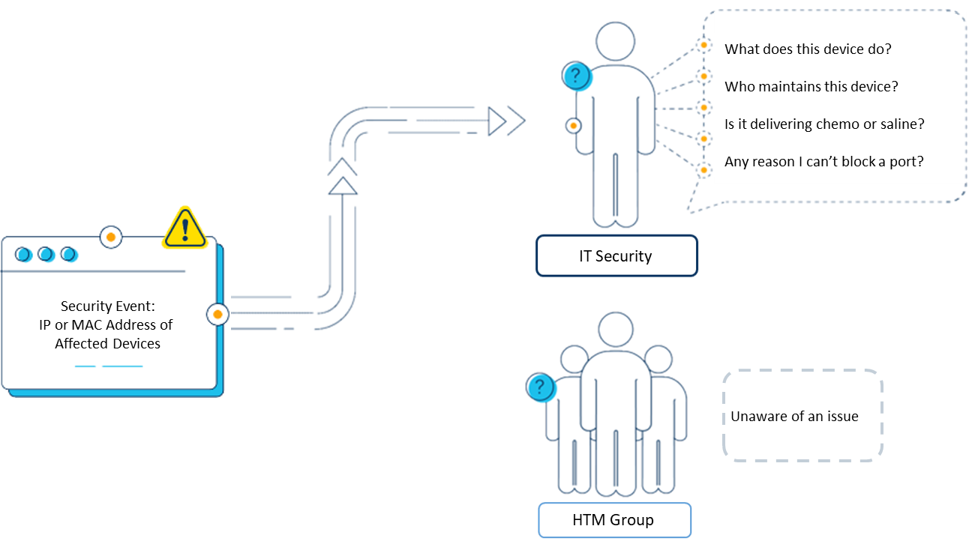
What Happens When a Cyber Threat is Identified?
Notes:
Heidi

Slide 5
Nuvolo OT Security Solution Demo
Notes:
Dustin

Slide 6
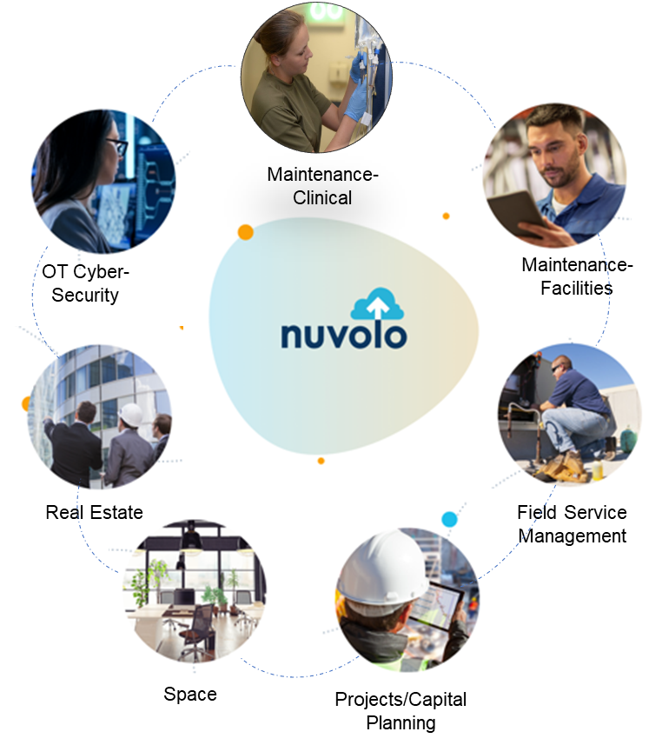
Solving Healthcare’s Top Challenges
Powered by Nuvolo’s Connected Workplace
Clinical and Facilities Maintenance
Key Features:
Consolidated asset inventory
Work order mgmt. across multiple departments
Mobile workflows
Clinician self service
Superior dashboards and reporting
Easily configured and integrated
Value:
Eliminates the need for multiple, disparate applications
Controls costs
Coordinates work between departments
Greatly improves efficiency & productivity
Helps ensure regulatory compliance
OT Security
Key Features:
Single device inventory integrates with discovery and security monitoring tools to orchestrate remediation of cyber security events
Automatically coordinate remediation across support teams to resolve issues quickly
Value:
Enables fast identification & response to OT security events
Allows Healthcare Technology Management (HTM) and IT to coordinate to mitigate security risks and respond to threats.
Space & Move
Key Features:
Native AutoCAD plugin to bring floor plans into Nuvolo directly
Space Editing
Space Planning
Wayfinding
Space Reservations
Value:
Enables organizations to safely return employees to the workplace with a proper space management strategy
Space optimization and utilization
Real Estate
Key Features:
Entire life-cycle lease tracking
Automation for on-boarding, amending, renewing and retiring leases
Advanced payment tracking
Value:
Empowers Corporate Real Estate professionals with a tool to manage leases on the same platform as people, locations & assets
Projects
Key Features:
Construction and renovations project management
Capital planning
Vendor portal for bidding support
Superior reporting & GANTT charts for full project visibility
Value:
Enables multi-departmental coordination on projects and capital planning with full visibility into costs, assets & space
Nuvolo’s Connected Workplace for Healthcare
Notes:
Heidi

Slide 7


