Slide 1


Taking The Pressure Off Ventilator Testing
Presented by Jerry Zion
©2020 Fluke Corporation
Notes:
Jerry
And with that, we are back to ventilator testing!

Slide 2
What We Will Cover Today
1
2
3
Purpose of mechanical ventilation
Ventilator test how and why
Ventilator test best practices
©2020 Fluke Corporation
Notes:
Jerry
Today we’ll cover a lot of ground. We’ll start with the overall clinical application of mechanical ventilators; we will talk about the role that they play in the hospital environment.
We will then transition into how ventilators work and why we should be testing them.
Finally, we’ll provide you with the best practices when it comes to ventilator testing………

Slide 3
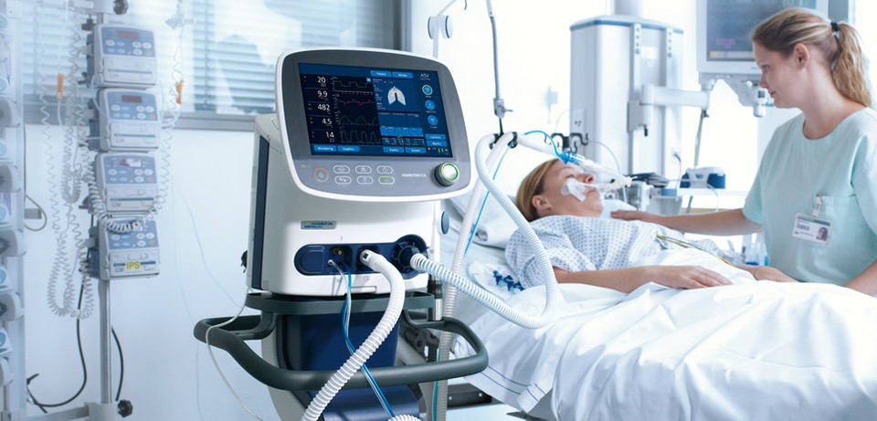
Starting With The Basics
Mechanical Ventilator
Medical device that helps people breathe when they are not able to breathe enough
on their own*
Considered life-sustaining treatment that can prolong patient’s life
Used in both ICU and regular units in hospitals, rehabilitation facilities or at home
*https://www.thoracic.org
©2020 Fluke Corporation
Notes:
Jerry
As usual, we will start with the basics.
Mechanical ventilation is a life support treatment. A mechanical ventilator is a machine that helps people breathe when they are not able to breathe enough on their own. The mechanical ventilator is also called a ventilator, respirator, or breathing machine. Most patients who need support from a ventilator because of a severe illness are cared for in a hospital’s intensive care unit (ICU). People who need a ventilator for a longer time may be in a regular unit of a hospital, a rehabilitation facility, or cared for at home.
Why are ventilators used?
■ To get oxygen into the lungs and body
■ To help the body get rid of carbon dioxide through the lungs
■ To ease the work of breathing—Some people can breathe on
their own, but it is very hard. They feel short of breath and uncomfortable.
■ To breathe for a person who is not breathing because of injury to the nervous system, like the brain or spinal cord, or who has very weak muscles.
https://www.thoracic.org/patients/patient-resources/resources/mechanical-ventilation.pdf

Slide 4
Starting With The Basics (cont’d)
Mechanical Ventilator
Medical device that helps people breathe when they are not able to breathe enough
on their own*
Can be invasive (intubation) or non-invasive (mask)
Can do all of the breathing or only assist the person’s breathing
Frequently used to simply keep patient’s throat/lungs open
*https://www.thoracic.org
©2020 Fluke Corporation
Notes:
Jerry
The ventilator is connected to the person through a tube (endotracheal or ET tube) that is placed into the mouth or nose and down into the windpipe. When the health care provider places the ET tube into the person’s windpipe, it is called an intubation. Some people go through surgery to have a hole place in their neck and a tube (tracheostomy or “trach” tube) is connected through that hole. The trach tube is able to stay in as long as needed. At times a person can talk with a trach tube in place by using a special adapter called a speaking valve. (For more information on having a tracheostomy see ATS patient information series at www.thoracic.org/patients).
The ventilator blows gas (air plus oxygen as needed) into a person’s lungs. It can help a person by doing all of the breathing or just assisting the person’s breathing. The ventilator can deliver higher levels of oxygen than delivered by a mask or other devices. The ventilator can also provide what is called positive end expiratory pressure (PEEP). This helps to hold the lungs open so that the air sacs do not collapse. The tube in the windpipe also makes it easier to remove mucus if someone has a weak cough.
https://www.thoracic.org/patients/patient-resources/resources/mechanical-ventilation.pdf

Slide 5
Poll Question
What is the clinical goal of ventilation?
Get oxygen into the lungs
Get carbon dioxide out of the lungs
Provide treatment to produce proper gas exchange
Notes:
Jerry

Slide 6
Poll Question
What is the clinical goal of ventilation?
Get oxygen into the lungs
Get carbon dioxide out of the lungs
Provide treatment to produce proper gas exchange (oxygen in, carbon dioxide out)
Notes:
Jerry

Slide 7
Risk What Can Go Wrong? Operators
Asphyxiation/hypoxemia
Barotrauma
ARDS
Collapsed lung
Scarring of the lung
Pulmonary edema / embolism
©2020 Fluke Corporation
Notes:
Mike
Ventilators are critical life support equipment so they must be treated with respect.
Improper maintenance can lead to patient harm and even death.
Many of these issues are caused by the ventilator itself and are easily preventable.
Some issues are tied to too little being delivered to the patient, such as Asphyxiation – too little oxygen
Others are tied to too much being delivered to the patient like barotrauma – too much pressure.
Ultimately the damage done to the patient take the form of a collapsed lung, damaged lung, pulmonary edema or embolism.
Patients can rely partially or wholly on a ventilator for their breathing, so it is critical that they are working properly.
Patient life is at stake.

Slide 8
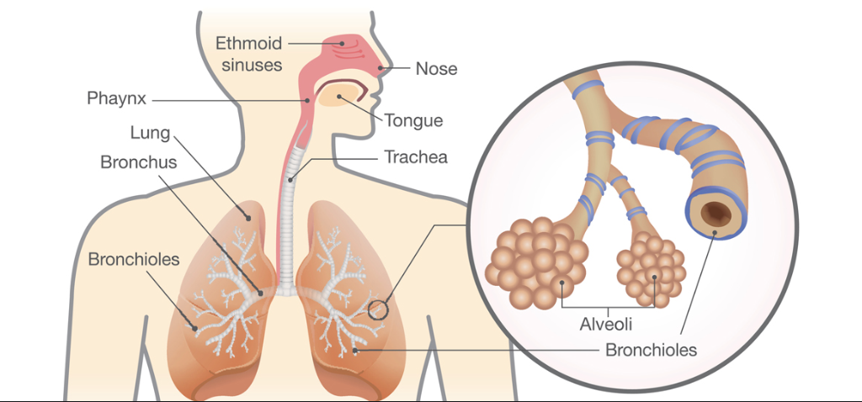
Risk What Can Go Wrong? Operators
Asphyxiation/hypoxemia
Barotrauma
ARDS
Collapsed lung
Scarring of the lung
Pulmonary edema / embolism
Ventilator failure can have significant implications for patient safety including patient death.
©2020 Fluke Corporation
Notes:
Mike
The lung is a sensitive organ and I’d like to dig a little bit into that organ here.
The goal here is for good gas exchange from the respiratory system to the cardiovascular system.
This is done through transferring oxygen through the lungs to the blood.
The part of the lung that is most critical to this is the alveoli.
These thin-walled cells act like tiny air bubbles aid in proper gas exchange.
We have many of these cells and gas exchange is done over the surface area of the alveoli.
Too much pressure in these cells can cause them to rupture – causing the body to lose some surface area and have less efficient gas exchange.
Emphysema can also cause alveoli to fuse together which is another form of losing surface area.
Ultimately, these are the parts of the lungs that rupture or scar, causing lasting damage to the patient.

Slide 9




Mechanical Ventilation Setup
Patient
Monitor
Air and O₂ supply
Mechanical
Ventilator
AC power supply
Infusion
Pump
©2020 Fluke Corporation
Notes:
Mike
Let’s take a look at the ICU – intensive care unit or CCU – critical care unit.
Anyone on a ventilator in an ICU setting will be hooked up to a monitor that measures ECG, heart rate, respiratory rate, blood pressure, and oxygen saturation. Other tests that may be done include chest-x-rays and blood drawn to measure oxygen and carbon dioxide. Members of the health care team (including doctors, nurses, respiratory therapists) will use this information to assess the patient’s status and make adjustments to the ventilator if necessary.
Another treatment may be applied based off of the patient’s vital signs. An infusion pump may be used to deliver a specific dose of medicine to the patient to aid them in fighting their condition.
As you can see, there are quite a few medical devices that could be at play to ensure a patient in the ICU is getting the correct diagnosis and treatment.

Slide 10
10 Best Practices
  for ventilator testing
©2020 Fluke Corporation
Notes:
Mike
Now that we know the medical device, the environment in which it works and where things can go wrong – we can move onto testing.
We’re going to transition to the top 10 tips for ventilator preventive maintenance, as identified by our industry experts.

Slide 11
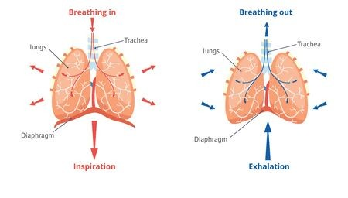


1
Understand the physiology of breathing
And the laws of gas physics
www.tasmeemme.com
©2020 Fluke Corporation
Notes:
Mike
The first thing that should be understood before performing ventilator testing is the science behind it.
It is important to know and understand the ideal gas law and how humans breathe in order to understand how the ventilator under test should perform and the effect that changes to it can have on the human body.
We should understand the relationships between pressures, flows and volumes to act as a sanity check to what we are doing.
Are the readings moving in a way that is logical?
Not knowing the theory behind what you are doing can be detrimental to our end goal here, patient safety.
Shown here is the ideal gas law, but Boyle’s law (P1V1=P2V2) is another great law to understand.

Slide 12
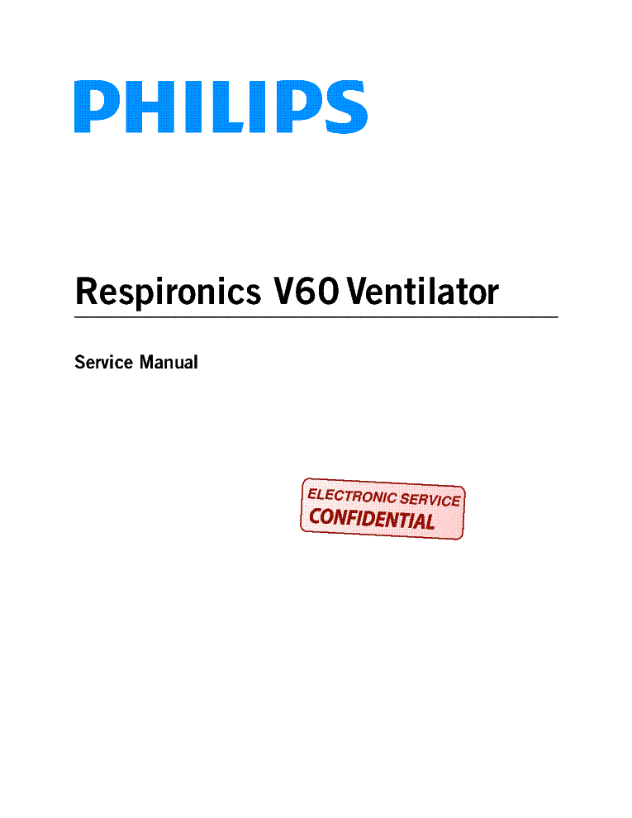
2
Obtain and understand test requirements
Use
International Standards
or
manufacturer’s service manual
(brand and model specific)
©2020 Fluke Corporation
Notes:
Mike
I know this can be a tough one, but it’s really important here.
Read and understand the service manual.
Know the minimum performance and safety requirements for every brand and model of ventilator you are testing.
This will identify key parameters that need to flow into your best practices.
What is the gas correction mode?
What tests do I need to carry out?
What do these things mean?
Following and understanding the manufacturer requirements is key to making sure your testing is compliant.

Slide 13
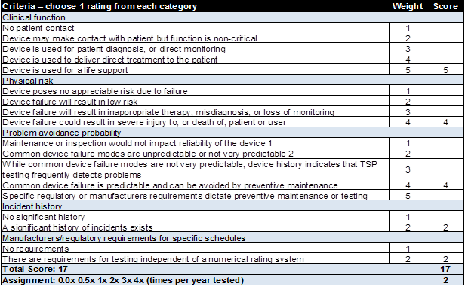
3
Adopt a consistent inspection frequency
If service manual is not available, inspection frequency must still be determined
Sample risk assessment
Use risk-based approach
Use your hospital’s experience as well as the industry’s experience with the medical device
Twice a year is recommended for lung ventilators for human use
Score | Test Frequency
13+ | Semiannual
9-12 | Annual
<8 | Less than annual
©2020 Fluke Corporation
Notes:
Mike
Something else that may come out of the service manual is the frequency of testing.
A consistent inspection frequency should be adopted and followed.
Circumstances may present themselves where testing must be done, but no information from the manufacturer is available.
In such cases a “ventilator category-specific” test procedure may be adopted and documented as a deviation from policy for the medical facility owning and using the ventilators.
An example of this is provided in the Medical Equipment Quality Assurance Program Development and Procedures book by J. Tobey Clark, et. al.
This is published by the University of Vermont and available from Fluke Biomedical.
This book includes a process by which the proper frequency of inspection can be determined.
This process compares the criticality of a device’s clinical function, physical risk to the patient in failure, ability to prevent such a failure, the hospital or industry’s history with the ventilator brand and model and the manufacturer’s requirements for testing.
In this case, a ventilator is a life support device that could cause death, failures are predicable and preventable, such incidents have occurred in the past and the manufacturer does require testing.
This yields a total score of 17 – requiring semi-annual testing.
This process can be followed for any medical device and perhaps taking a more quantitative approach might lead you to change your current test procedures.
The University of Vermont’s biomedical engineering department repeats their own assessment using this process every 2 years.
It is important to note that test frequency may not always be about the calendar date.
One may want to consider a test frequency based upon medical device usage.
Also, a facility can always go above and beyond the requirements to ensure patient safety.

Slide 14

4
Standardize your test – and lock it
Use an automation program
Get a quantitative assessment compared to:
  Manufacturer’s specifications
  IEC, AAMI-ANSI or other global standards
Do not change procedure without rationale statement
  Change description and validation data
Results in tracking and predictive maintenance
©2020 Fluke Corporation
Notes:
Mike
Once you have read and understood the service manual and determined test frequency – set your procedure and lock it.
This procedure should not change over time and if it does, document why the change is happening.
Ideally, this would be entered into an automated test program to control the procedure and ensure that the steps are exactly followed and not skipped.
It is also important to look at your results quantitatively.
If the same procedure is followed consistently, then you can track your results and see how they are trending.
This is the first step towards predicting device failure and getting ahead of costly repairs and downtime.

Slide 15
Poll Question
How many modes of ventilation should be tested?
All modes selectable on the ventilator
Assisted modes only (including CPAP and BIPAP)
Control modes only (including Volume and Pressure control modes)
Notes:
Mike

Slide 16
Poll Question
How many modes of ventilation should be tested?
All modes selectable on the ventilator
Assisted modes only (including CPAP and BIPAP)
Control modes only (including Volume and Pressure control modes)
Notes:
Mike

Slide 17
Standardize your test:
Ventilation Modes
4
Critical to understand the basic modes of ventilation available
v
v
v
Volume Control
Mode
Pressure Control
Mode
CPAP / PEEP
Mode
  Delivery of controlled breaths limited by the volume of gas per breath prescribed by the physician, and adjusted to obtain the best possible gas exchange
  Delivery of controlled breaths limited by the pressure of gas per breath prescribed by the physician, and adjusted to obtain the best possible gas exchange
  Delivery of patient-initiated breaths limited by the patient’s own inspiratory effort per breath.
  Gas exchange is not guaranteed in this mode.
…and many more!
©2020 Fluke Corporation
Notes:
Mike
In relation to standardizing your test, you should ensure that your procedure includes the testing of all ventilation modes.
There are several modes of operation of lung ventilators for human use.
New modes continue to evolve which are variations and combinations of the three main modes of operation shown on this slide.
Some example ventilator operation modes names combining functions of the 3 above are:
Volume Support mode
Pressure Support mode
Pressure Support, volume guarantee mode
Assist-Control mode
----there many having similar function but proprietary names.
Be sure to understand what they are and how they work before you begin to do testing for minimum performance and safety.
All modes must be tested.
Modes can be switched during surgery!!
That’s why important to test them all since a vent can work well in one mode and not the other.

Slide 18
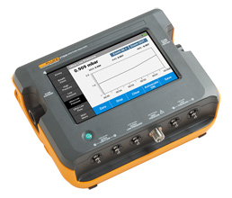
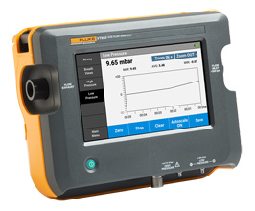
5
Choose the right test tool
The key is to ask the right questions
Can it test all required parameters?
Is it easy to use and learn?
Can it store data for easy retrieval/reporting?
Can it be automated?
Can it be transported?
Does it have a battery?
What is the return on investment?
Can it be easily used for all medical gas flow/pressure devices?
©2020 Fluke Corporation
Notes:
Jerry
choose the right test equipment. Use the following criteria when choosing a gas flow analyzer:
Can it test all parameters required by the manufacturer?
Is it easy to use (and learn)?
Does it have the ability to store data for easy retrieval/reporting?
Can it be automated?
Can it be transported?
What is the return-on-investment?
Also, think about what other medical gas flow testing needs your equipment could fulfill.

Slide 19

6
Standardize on additional equipment
For one comprehensive test
Patient
Monitor
Air and O₂ supply
Mechanical
Ventilator
AC power supply
Infusion
Pump
We recommend that you come prepared with a complete test tool kit
©2020 Fluke Corporation
Notes:
Jerry
The ventilator and air supply are covered by the ventilator tester/gas flow analyzer, but there is more to the story! There is also power supply which will require an electrical safety test, most likely a patient monitor, an infusion pump and of course the patient that will be absent during the test so you will need a test lung.
The majority of ventilators are powered electrically. While there are some pneumatic powered ventilators, the majority are powered by mains or battery and require electrical safety testing.

Slide 20
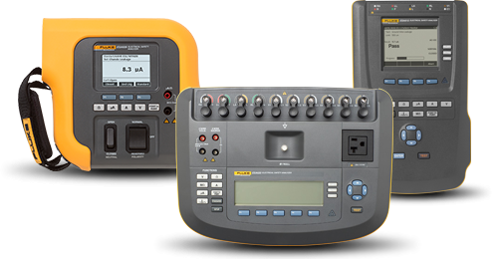
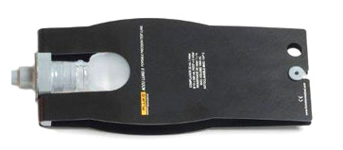
6
Standardize on additional equipment
For one comprehensive test
Pair additional test equipment with your ventilator tester for comprehensive testing and standardize on that additional equipment
Most PM procedures require electrical safety tests – have one handy
You will need a certified test lung for ventilator testing to serve as your transfer standard patient load equivalent
©2020 Fluke Corporation
Notes:
Jerry
You need to document and standardize on test equipment. As stated, you’ll need a gas flow analyzer, test lung, patient simulator and infusion pump analyzer to perform complete testing of ICU equipment.
We have a webinar on the importance and use of each of these pieces of equipment, so look at our webinar library to learn more.

Slide 21
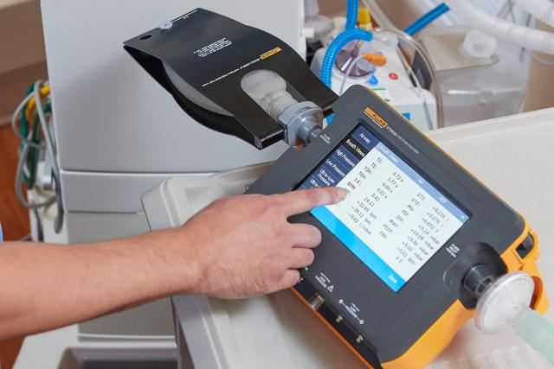
7
Understand the connections
Before you start the test
Understand the connections on both your ventilator and your test tool
Shorten tubing lengths
  Better and faster results
  Less turbulence
©2020 Fluke Corporation
Notes:
Jerry
When testing ventilators, there are quite a few connections that need to be made and changed throughout the procedure.
These can include which adapter to use (15/22 mm),
where to place a filter (to extend the life of your analyzer),
Where to connect the tubing (to which side of the analyzer),
Where and when to use a test lung,
When to connect to particular ports on the gas flow analyzer (High flow, Low flow, Ultra low flow, Pressure / DISS),
It is important to know when, where and how to make these connections.
Your procedure should tell you these aspects of the test, but it is much easier if there are photos to help guide you.
Workflow automation software can help you ensure that the proper connections are made at the proper time to ensure the best results.

Slide 22
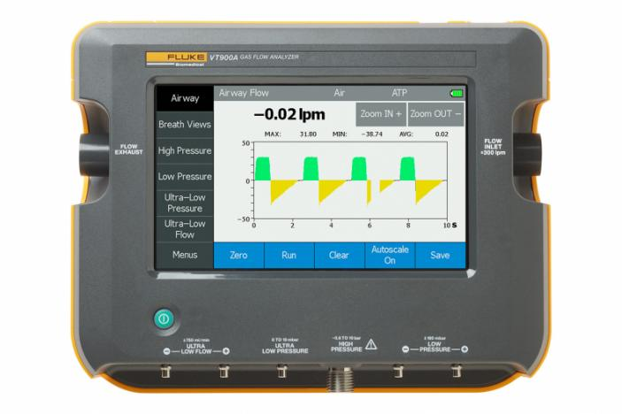
8
Ensure higher accuracy
And better results
Zero frequently or be confident in your last zero
Compensate for temperature, humidity, pressure
Go for 17025 accredited calibration
Allow sensors to fully warm for full accuracy
©2020 Fluke Corporation
Notes:
Jerry
Some testers will do compensation calculations for you (VT), some won’t so you will have to do math yourself
17025 we will give you the data on how it was calibrated, not just a calibrated unit (for added traceability and confidence that you are within spec).
For best results and more confidence and traceability in your results look for 17025
If you warm your sensor, you’ll get the best results (test tool).
VT doesn’t need a warm-up, VT+ needs it

Slide 23

9
Document electronically
Use workflow automation
Avoid common issues associated with documenting on paper
Archive results in CMMS
  Traceability in case of audits
  Trend analysis for accurate predictive maintenance
    Valuable cost and time savings
    Increases uptime for device
  Misplaced records
  Legibility
  Skipped steps
  Accidental errors
  Filing
  Time consuming
©2020 Fluke Corporation
Notes:
Jerry
Document your results electronically and use workflow automation if you want to avoid common errors and reduce risk in your shop. What can this avoid?
Misplaced records, Legibility problems, Skipped tests, Accidental errors, Filing efforts, all adding to lots of lost time and productivity
There are different ways of going about this – onboard automation and software automation. Use a gas flow analyzer with built-in data storage to record your results as you test. Better yet, choose a gas flow analyzer that interacts with an electronic testing work flow to configure the test instrument to be used and automatically collect the measurements. These measurements can be automatically compared with pre-determined test limits for quick pass/fail results
Please make sure that you’re are archiving your data. The best place to store this data is in a CMMS system. There are many available and they allow for traceability back to your test results, equipment, any number of things. This is invaluable in the event of an audit and an added way to add confidence to your compliance efforts. Nothing to lose, misplace or have to spend hours searching for.
Also, having your data digitally stored is another way that you can track data to see how it is trending over time – increasing uptime and saving you time and money.
(if you don’t use SW) Use a gas flow analyzer with built-in data storage or, better yet, interacts with an electronic work flow to configure the test instrument to be used and automatically collect the measurements made. Be sure that these measurements can be automatically compared with pre-determined testing limits for objective pass/fail results

Slide 24

10
Use safety measures during test
To keep the spread of contamination
Use anti-bacterial/anti-microbial filters
Protect yourself – use rubber gloves
Carry less, decontaminate less
Use paperless documentation
For more helpful how-to videos and tips
during the COVID-19 crisis go to
flukebiomedical.com/application/covid-19
©2020 Fluke Corporation
Notes:
Mike
COVID is still prevalent in 2021, so it is important to protect your patients through protecting your test equipment and yourself.
Here are a few hints that we can provide to help you do just that:
Use anti-bacterial/anti-microbial filters – prevent PB&J from entering your analyzer, extend life of sensor, use on both sides of the analyzer for uni-directional flow
Protect yourself – use rubber gloves, VT screen able to be used with a rubber glove; This is just our recommendation due to COVID.
Carry less equipment into the patient room – less to disinfect, less to de-contaminate – use multi-parameter test equipment
Paperless documentation – paper is absorbent, a computer/PC/tablet is easier to clean and doesn’t absorb & pass on viruses/bacteria
Please visit the link on this page to watch videos and learn more about what you can do.

Slide 25


Thank You!
Fluke Biomedical Advantage Training Center
https://www.flukebiomedical.com/knowledge-center/training
  Self-paced free training
  Quizzes
  White papers
  Application notes
  Videos
  ROI calculator
Advantage Training: a courtesy service from Fluke Biomedical
©2020 Fluke Corporation
Notes:
Lindsay

