Slide 1


Strategic Approach to Developing a Mature Capital Replacement Program
Alan Gresch
VP of Healthcare Strategy
Accruent

Slide 2
Why?
  Common Workflows & Pain Points
  Benefits - Now
  Benefits - Future
  Deeper Relationships with Executive Leadership
How?
  Data Integrity
  Data Standardization
  Assessment Methodology
  Additional Analyst Staff
What?
  Results

Slide 3
Why?
  Common Workflows & Pain Points
  Benefits - Now
  Benefits - Future
  Deeper Relationships with Executive Leadership
How?
  Data Integrity
  Data Standardization
  Assessment Methodology
  Additional Analyst Staff
What?
  Results

Slide 4
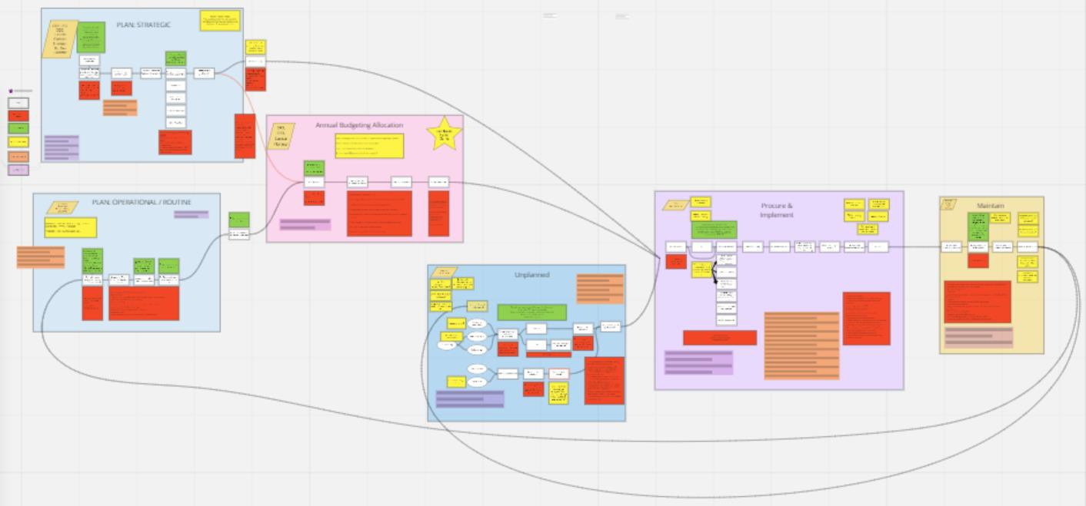
COMMON CAPITAL ALLOCATION WORKFLOWS AND PAIN POINTS
DIFFICULTY PRIORITIZING AND UNDERSTANDING TRADE-OFFS
A. Strategic Planning
CONTINGENCY FUNDS THAT LINGER WITH NO PLAN
CHALLENGES CALCULATING ROI AND GETTING TRUE COST OF OWNERSHIP
C. Alignment & Prioritization
SELECTING EQUIPMENT TAKES TIME AND EFFORT
B. Operational Planning
E. Procure & Implement
F. Maintain
UNCLEAN DATA OR DATA IS NOT ACCESSIBLE
D. Unplanned Capital
BIOMED SYSTEM IS NOT ACCESSIBLE TO EVERYONE

Slide 5
Benefits - Now
Capital planning based on technological guidance & support
An unbiased analysis based on requirements, not wishes
Administrative awareness to operational & strategic impacts
Advocacy for delivery of care via appropriate technologies
Vital analysis for equipment planning & construction

Slide 6
Benefits - Future
Long-range Capital replacement plan
System-wide 5-year Capital Plans
Drive Standardization
Ability to plan / participate in Group Buy opportunities
Emergent technology forecasting
Engage / Drive vendor’s product development
Incorporation in major capital/ IT / construction projects
Notes:
Standardization – Reduces downstream costs to support (TCO)
Deeper Relationship with Executive Leadership!!!

Slide 7
Why?
  Common Workflows & Pain Points
  Benefits - Now
  Benefits - Future
  Deeper Relationships with Executive Leadership
How?
  Data Integrity
  Data Standardization
  Assessment Methodology
  Additional Analyst Staff
What?
  Results

Slide 8
Assessment Methodologies - ProHealth
Use this list to enter the estimated replacement equipment and ancillary expenses. |  |  | Use this section to enter the Lifecycle in years based upon utilization
Main List data will update Using this information |  |  | Replacement Cycle
Modality | Equip Cost ($K) | Ancillary Cost ($K) | HIGH | AVERAGE | LOW
CT | $ 920 | $ - | 10 | 11 | 12
MR | $ 1,730 | $ - | 10 | 11 | 12
IR | $ 1,500 | $ - | 9 | 10 | 11
Cath | $ 1,310 | $ - | 9 | 10 | 11
BMD | $ 64 | $ - | 10 | 11 | 12
NM | $ 460 | $ - | 9 | 10 | 11
PET | $ 2,100 | $ - | 10 | 11 | 12
C-Arm | $ 199 | $ - | 8 | 9 | 10
C-Arm - Mini | $ 85 | $ - | 8 | 9 | 10
Mammo | $ 430 | $ - | 9 | 10 | 11
Mammo-Bio | $ 62 | $ - | 9 | 10 | 11
O-Arm | $ 450 | $ - | 9 | 10 | 11
R&F | $ 565 | $ - | 10 | 11 | 12
U/S | $ 130 | $ - | 8 | 9 | 10
U/S - CV | $ 175 | $ - | 8 | 9 | 10
XR | $ 425 | $ - | 12 | 13 | 14
XR-Mobile | $ 138 | $ - | 12 | 13 | 14
XR-Dental | $ 225 | $ - | 12 | 13 | 14
XR-Spec | $ 100 | $ - | 12 | 13 | 14
U/S - Int | $ 280 | $ - | 8 | 9 | 10
Robotics | $ - | $ - | 7 | 8 | 9
Lin Acc | $ 3,000 | $ - | 10 | 11 | 12
Data Validation Table for the Life Cycle Stage Column on the Main List Tab
Suggestions for Changes at end of table. This appears to be a Techology Lifecylce rather than an equipment lifecycle
Life Cycle Stage | Definition
1 New Technology
2 Useful Life
3 End of Useful Life
4 Extended Life

Slide 9
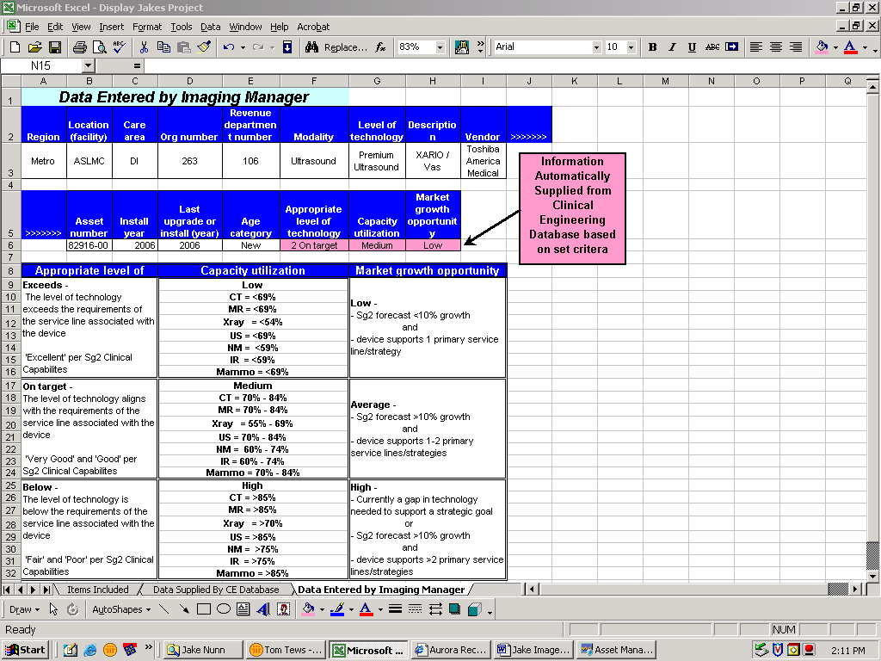
Assessment Methodologies - Aurora

Slide 10
Assessment Methodologies – Alexian Brothers
Assessment Factor | Max Value | Evaluates |  | Value
Serviceability | 13 | Age Factor
Includes the evaluation of four aspects of service |  |  | 0 to 65% of Life | 0
 |  |  | 65% to 150% of Life | 1
 |  |  | 150% or higher of Life | 2
 |  | Service Cost vs. Purchase Cost*
 |  |  | 0 to 25% of Cost | 1
 |  |  | 26% to 50% of Cost | 2
 |  |  | 51% to 75% of Cost | 3
 |  |  | 76% or higher of Cost | 4
 |  | Service Event
 |  |  | Normal Service | 0
 |  |  | Increasing Service | 2
 |  |  | Extensive Service | 3
 |  | Support Capability
 |  |  | Service Support Available | 0
 |  |  | Aftermarket | 2
 |  |  | No Longer Available | 4
Equipment Functional Risk* | 10 | General Care or Ancillary Device* |  | 1-2
Identifies equipment failure risk in relation to clinical function and care. As defined by the American Society for Healthcare Engineering of the American Hospital Association. |  | Analytical or Patient Support * |  | 3-5
 |  | Therapeutic or Diagnostic * |  | 6-9
 |  | Life Support * |  | 10
Clinical Assessment Factors
Probable Clinical Impact | 17 | No Impact | 0
Considers the probable clinical limitations of the device |  | Standardization | 2
 |  | Service Mission | 8
 |  | Limits patient care | 17
Probable Financial Impact | 16 | No Impact | 0
Considers potential financial impact on revenue, throughput, and/or increase in operational cost. |  | Limit Revenue Potential | 9
 |  | Increased Operating Cost | 12
 |  | Potential Lost Revenue | 16
Technology Level | 14 | Leading Technology | 3
Considers the existing technology in relation to clinical efficacy and market expectations |  | Current Technology | 7
 |  | Aging Technology | 11
 |  | Obsolete Technology | 14
Safety/Regulatory Risk | 20 | Not Applicable | 0
Considers regulatory or standards compliance or safety concerns |  | Applicable | 20
Technology Initiative | 10 | Compatible / Not Applicable | 0
Considers compatibility with current technology initiatives, e.g. HL7, PACS, etc. |  | Not Compatible | 10

Slide 11
Equipment Data
Equipment demographics
    Control number, type, manufacturer, model, serial number, location, purchase information, etc.
AHA Useful Life
Service histories
OEM support information
Equipment functional risk

Slide 12
Equipment Scoring
“Each” medical device is profiled & assigned a Replacement Index based upon the sum of seven assessment factors with a maximum value of 100. A higher replacement index generally indicates a more urgent need.
Serviceability – Max Value 13
Equipment Functional Risk – Max Value 10
Probable Clinical Impact – Max Value 17
Probable Financial Impact – Max Value 16
Technology Level – Max Value 14
Safety/Regulatory Risk – Max Value 20
Technology Initiative – Max Value 10

Slide 13
Assessment Factors
Serviceability – Max Value 13 – Includes the evaluation of four aspects of service comprised of:
  Age Factor – Max Value 2
  Service Cost vs. Purchase Cost – Max Value 4
  Service Events – Max Value 3
  Support Capability – Max Value 4

Slide 14
Assessment Factors
Age Factor – Max Value 2
Age (today less purchase date) divided into the American Hospital Association (AHA) estimated useful life for that equipment type.
These Infant Warmers are much greater than AHA estimated useful life.

Slide 15
Assessment Factors
Service Cost vs. Purchase Cost – Max Value 4
Life Cycle Service Cost divided into Purchase Cost
Some Anesthesia Units have Service Costs of 26%-50% of their purchase cost.

Slide 16
Assessment Factors
Service Events – Max Value 3
# of Service Events (not including incoming inspection, safety test and preventive maintenance) divided by age; standard scoring is a 2 for > 1 and a 3 (Extensive) for > 2 service events per year but scoring is device specific (see below).
MRI Scoring is a 2 for > 5 and a 3 (Extensive) for > 10 service events per year.

Slide 17
Assessment Factors
Support Capability – Max Value 4
Support Capability based on availability of replacement parts, etc. as evidenced by Clinical Engineering.
Service Support is no longer available for all GE models older than 129.

Slide 18
Assessment Factors
Equipment Functional Risk – Max Value 10 – Identifies equipment failure risk in relation to clinical function & care; as defined by the American Society for Healthcare Engineering (ASHE) of the American Hospital Association (AHA).
The majority of devices have a scoring of 2 for General Care while Anesthesia Units, Defibrillators and Ventilators have a score of 10 for Life Support.

Slide 19
Assessment Factors
Notes:
Additional Analyst Staff

Slide 20
Why?
  Common Workflows & Pain Points
  Benefits - Now
  Benefits - Future
  Deeper Relationships with Executive Leadership
How?
  Data Integrity
  Data Standardization
  Assessment Methodology
  Additional Analyst Staff
What?
  Results

Slide 21
ProHealth

Slide 22
ProHealth

Slide 23
ProHealth
Marker | PHC Asset # | Modality | Company/ OEM | Location | Model | Install Date/ Upgrade Date | Facility | Department | Director | Manager | Life Cycle Stage | OEM Grouped | Age (Years) | Utilization # | Utilization | Estimated Lifecycle (Yrs) | Estimated Rep Date | Not Used | Scheduled Hrs/week
PHC002 | 00039471 | MR | GE | DN Greenwald | Signa HD 16.x 1.5T | 1/10/2005 | D.N. Greenwald Center | WMH MRI - MUK | Bye, Marie | Kuechler, Heidi | 4 Extended Life | GE | 16.8 | 1 | LOW | 12 | 1/2017 |  | 48.00
PHC004 | 00064150 | MR | Siemens | Pewaukee | Magnetom Aera 1.5T | 6/1/2015 | Pewaukee Clinic | WMH MRI - PKE | Bye, Marie | Kuechler, Heidi | 1 New Technology | Siemens | 6.4 | 3 | AVERAGE | 11 | 5/2026 |  | 48.00
PHC005 | 00993246 | MR | Siemens | MR1 | Magnetom Aera 1.5T | 12/1/2015 | Oconomowoc Memorial Hospital (OMH) | OMH MRI | Bye, Marie | Kuechler, Heidi | 1 New Technology | Siemens | 5.9 | 3 | AVERAGE | 11 | 11/2026 |  | 50.00
PHC007 | 00607217 | MR | Siemens | Pewaukee | Magnatom Skyra 3.0T | 7/1/2016 | Pewaukee Clinic | WMH MRI - PKE | Bye, Marie | Kuechler, Heidi | 1 New Technology | Siemens | 5.3 | 3 | AVERAGE | 11 | 6/2027 |  | 48.00
PHC104 | 00039666 | BMD | Hologic | Radiology | Discovery Ci | 12/15/2004 | D.N. Greenwald Center | WMH BIS - MUK | Bye, Marie | Kuechler, Heidi | 4 Extended Life | Hologic | 16.9 | 3 | AVERAGE | 11 | 12/2015 |  | 44.00
PHC221 | 00990410 | BMD | Hologic | CBC New Berlin Clnic | DISCOVERY QDR4500 | 10/1/2005 | New Berlin Clinic | WMH BIS - New Berlin | Bye, Marie | Kuechler, Heidi | 4 Extended Life | Hologic | 16.1 | 3 | AVERAGE | 11 | 9/2016 |  | 44.00
PHC012 | 00045625 | CT | GE | VCT1 | VCT 64 | 8/10/2010 | Oconomowoc Memorial Hospital (OMH) | OMH CT | Bye, Marie | Kuechler, Heidi | 2 Useful Life | GE | 11.2 | 3 | AVERAGE | 11 | 8/2021 |  | 75.00
PHC013 | 00064151 | CT | GE | Room 1 | Revolution HD w/GSI | 5/20/2015 | Pewaukee Clinic | WMH CT - PKE | Bye, Marie | Kuechler, Heidi | 1 New Technology | GE | 6.4 | 3 | AVERAGE | 11 | 5/2026 |  | 45.00

Slide 24
ProHealth
FY 2019 | FY 2020 | FY 2021 | FY 2022 | FY 2023 | FY 2024 | FY 2025 | FY 2026 | Plan Status | Current Status | Replacement / Upgrade Year | Strata Jazz | Budgetary Cost | FY 2021 ($K) | FY 2022 ($K) | FY 2023 ($K) | FY 2024 ($K)2
r | m | m | m | m | m | m | m | In Proccess | Active | 2019 | 39471 | $1,730 | $ - | $ - | $ - | $ -
u | u | m | m | u | m | m | r | No Change | Active | 2026 |  | $1,730 | $ - | $ - | $ - | $ -
u | u | m | m | u | m | m | r | No Change | Active | 2026 |  | $1,730 | $ - | $ - | $ - | $ -
m | m | u | m | u | m | m | m | No Change | Active | - |  | $1,730 | $ - | $ - | $ - | $ -
m | m | m | r | m | m | m | m | Submitted | Active | 2022 |  | $64 | $ - | $ 64 | $ - | $ -
m | m | m | r | m | m | m | m | Submitted | Active | 2022 |  | $64 | $ - | $ 64 | $ - | $ -
m | m | m | m | m | r | m | m | Forecasted | Active | 2024 |  | $920 | $ - | $ - | $ - | $ 920
m | m | m | m | m | m | m | r | No Change | Active | 2026 |  | $920 | $ - | $ - | $ - | $ -
Action Road Map

Slide 25
ProHealth
General Notes | Utlization Notes
7/3: Unit being replaced in FY19; new unit to be upgraded in FY23
7/3: Heidi would like upgraded in FY20 & again in FY23 12/18: We will need to have meeting with Siemens to see if we can extend our 7 yr upgrade timeline to FY23 as the FY20 upgrade was delayed at their recommendation | Used PACs to count how many all year. Used PACMR1
7/3: Heidi would like upgraded in FY20 & again in FY23 12/18: We will need to have meeting with Siemens to see if we can extend our 7 yr upgrade timeline to FY23 as the FY20 upgrade was delayed at their recommendation | Got number by using PACS web to count how many in the past year
7/3: Heidi would like upgraded in FY21 & FY23 | Used PACs to count how many all year. Used PACMR2
Not Approved 2020, Moved to 2021 - DKB 12/18: Will resubmit for FY21 5/14/2020: Per discussion with Marie/Heidi/Rob regarding FY21 capital this can be deferred to FY22; however, this unit is end of life so if it goes down we will need to request contingency capital 2/9/21: 00039666 & 00990410 deemed priority 3&4 for FY22 per Heidi. Will want to replace both in same FY as staff float between the two sites. | Got number by using PACS web to count how many in the past year. PACS Modality OT.
Not Approved 2020, Moved to 2021 - DKB 12/18: Will resubmit for FY21 5/14/2020: Per discussion with Marie/Heidi/Rob regarding FY21 capital this can be deferred to FY22; however, this unit is end of life so if it goes down we will need to request contingency capital 2/9/21: 00039666 & 00990410 deemed priority 3&4 for FY22 per Heidi. Will want to replace both in same FY as staff float between the two sites. | Got number by using PACS web to count how many in the past year. Used nbholdxa
12/18: Bump from FY24 to FY23 per Heidi 2/9/21: Per Heidi we can move this back to FY24 for replacement. 2/18/21: Per 2/9/21 conversation moving to FY24, pending leadership approval | Got number by using PACS web to count how many in the past year
 | Got number by using PACS web to count how many in the past year.

Slide 26
ProHealth

Slide 27
ProHealth

Slide 28
Aurora

Slide 29
Aurora

Slide 30
Aurora

Slide 31
Aurora

Slide 32
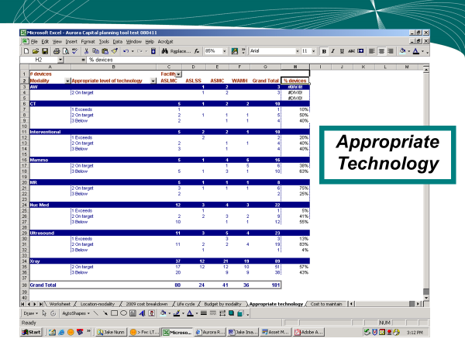
Aurora
Notes:
Added one for Cost to Maintain

Slide 33
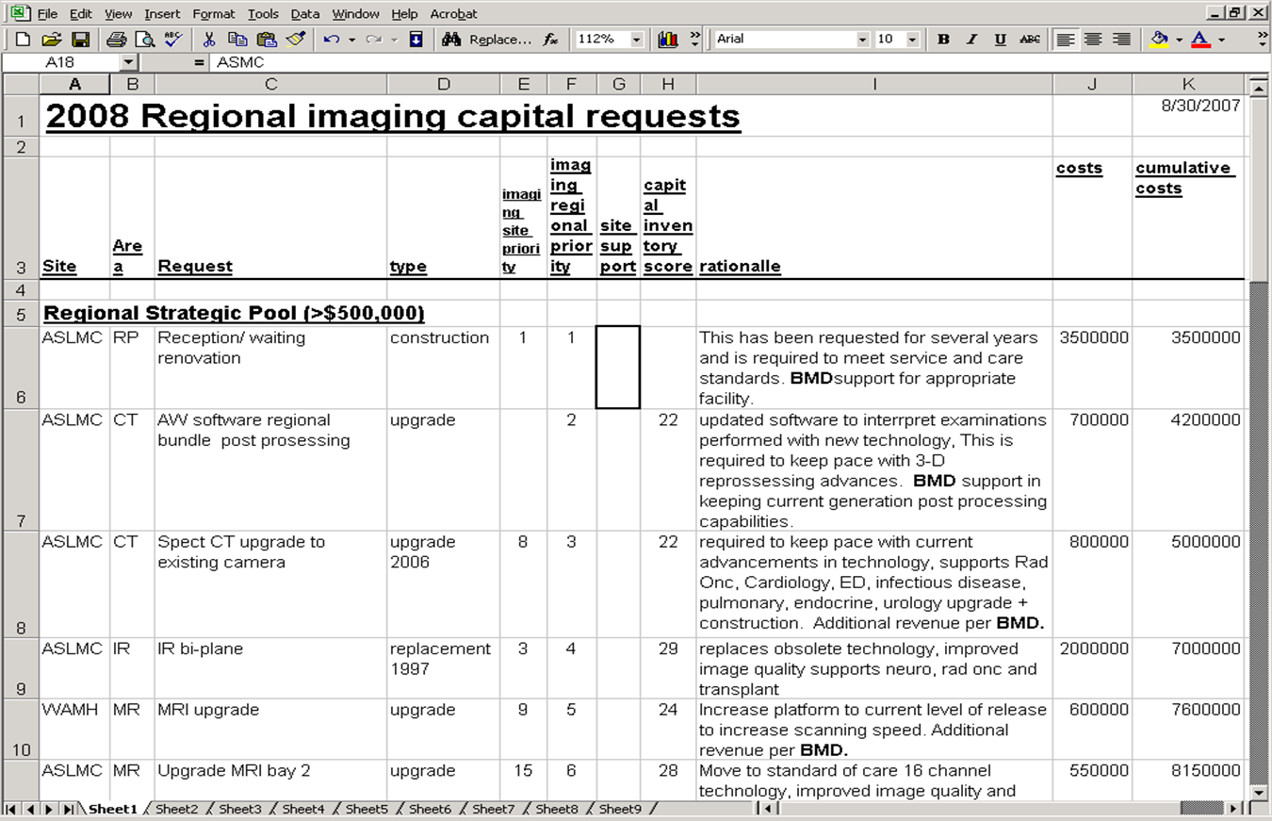
Aurora

Slide 34
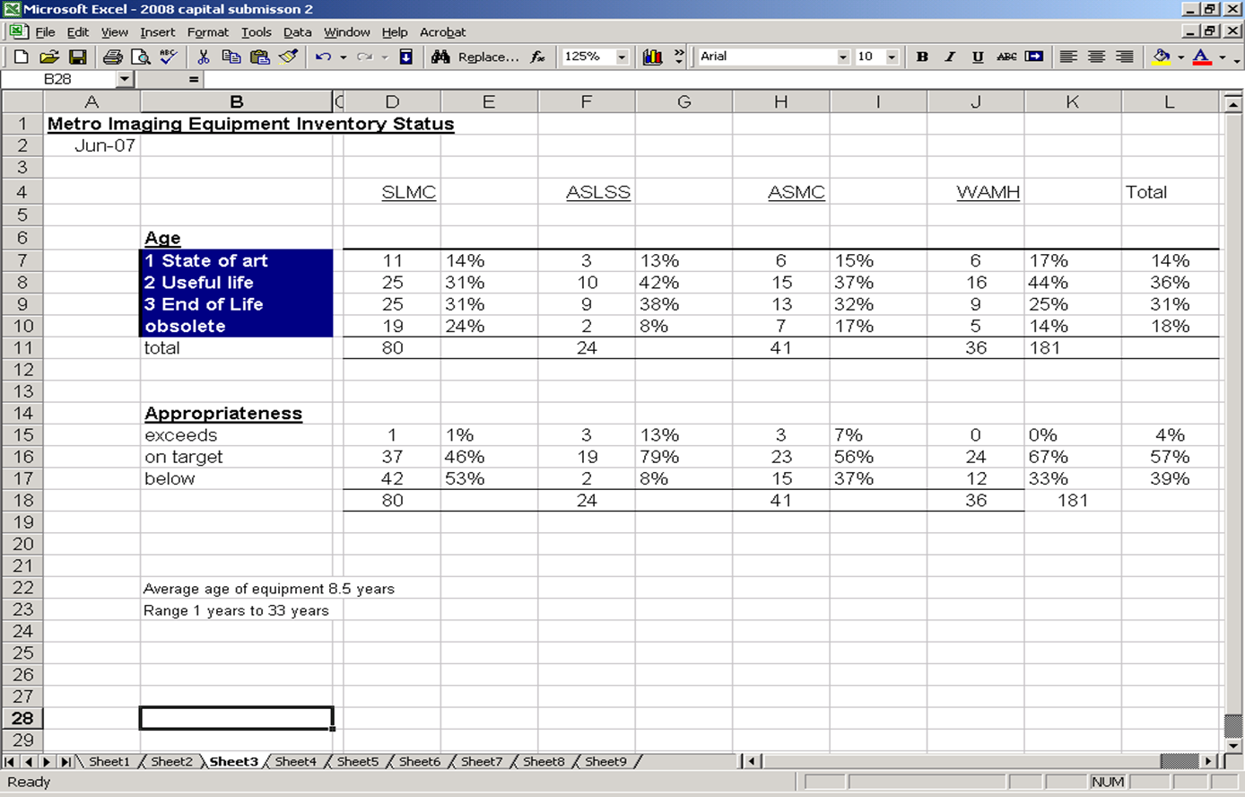
Aurora

Slide 35
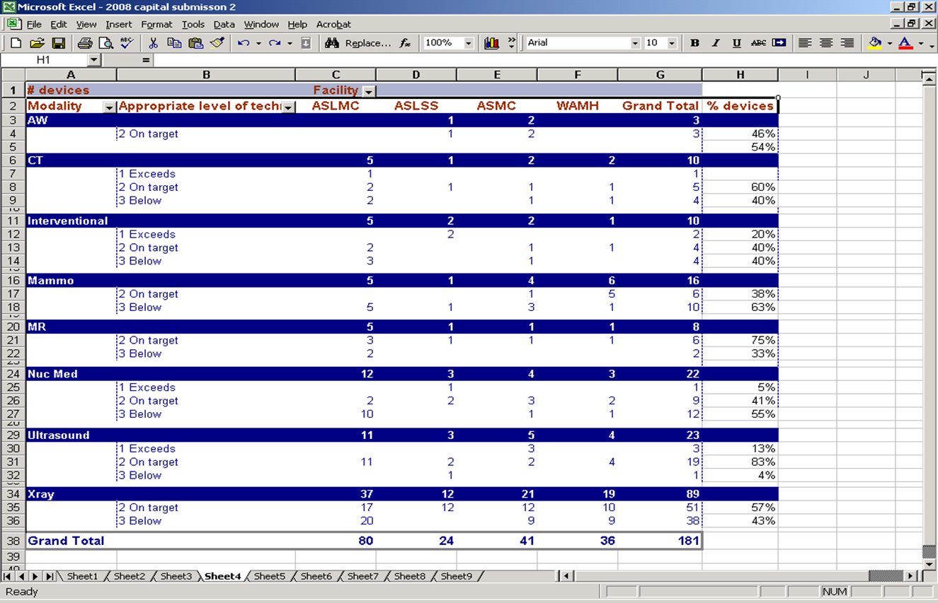
Aurora

Slide 36
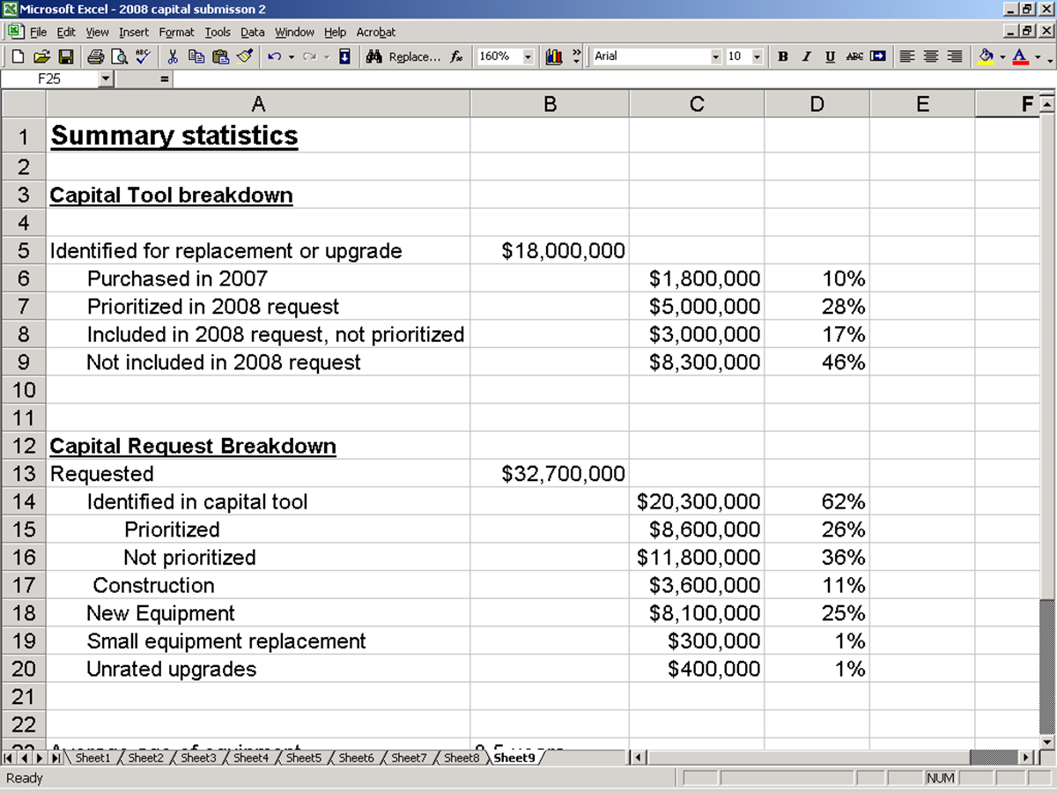
Aurora

Slide 37
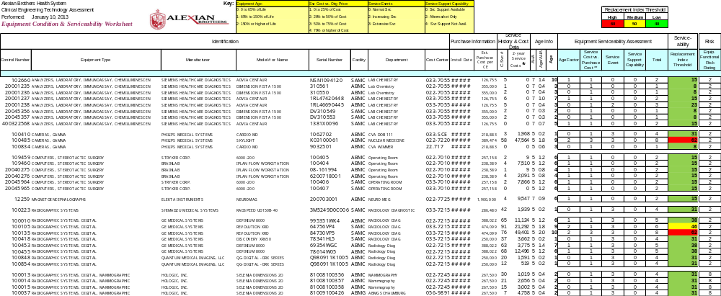
Alexian Brothers

Slide 38
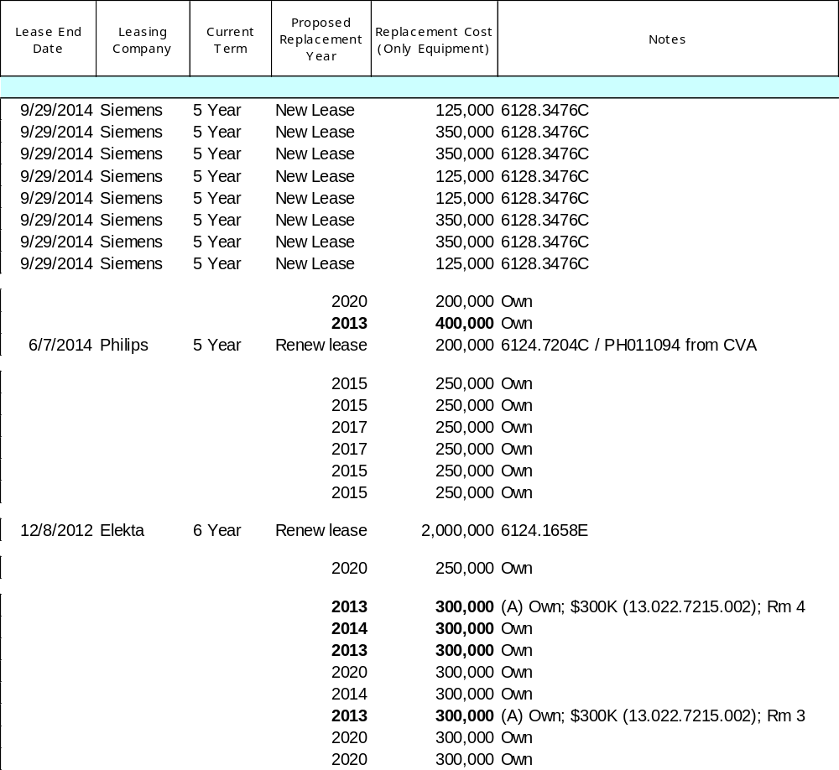
Alexian Brothers
Lease Info

Slide 39
DATA INTEGRITY!

Slide 40


Slide 41
Data Insights – Automated Prioritization Scoring
We created a new “Replacement Score” which includes the
following factors:
Age of Device vs. Expected Life
Age of Device vs. Max Life
Age of Model
Failure Rate Over Life
Recent Failure Trends
Patient Risk
End of Support Date from Manufacturer

Slide 42
Data Insights

Slide 45
agresch@accruent.com

