Slide 1




Clinical Device Efficiency
Dynamic Management of Connected Devices

Slide 2

Using data to solve some of the largest challenges in healthcare

Slide 3
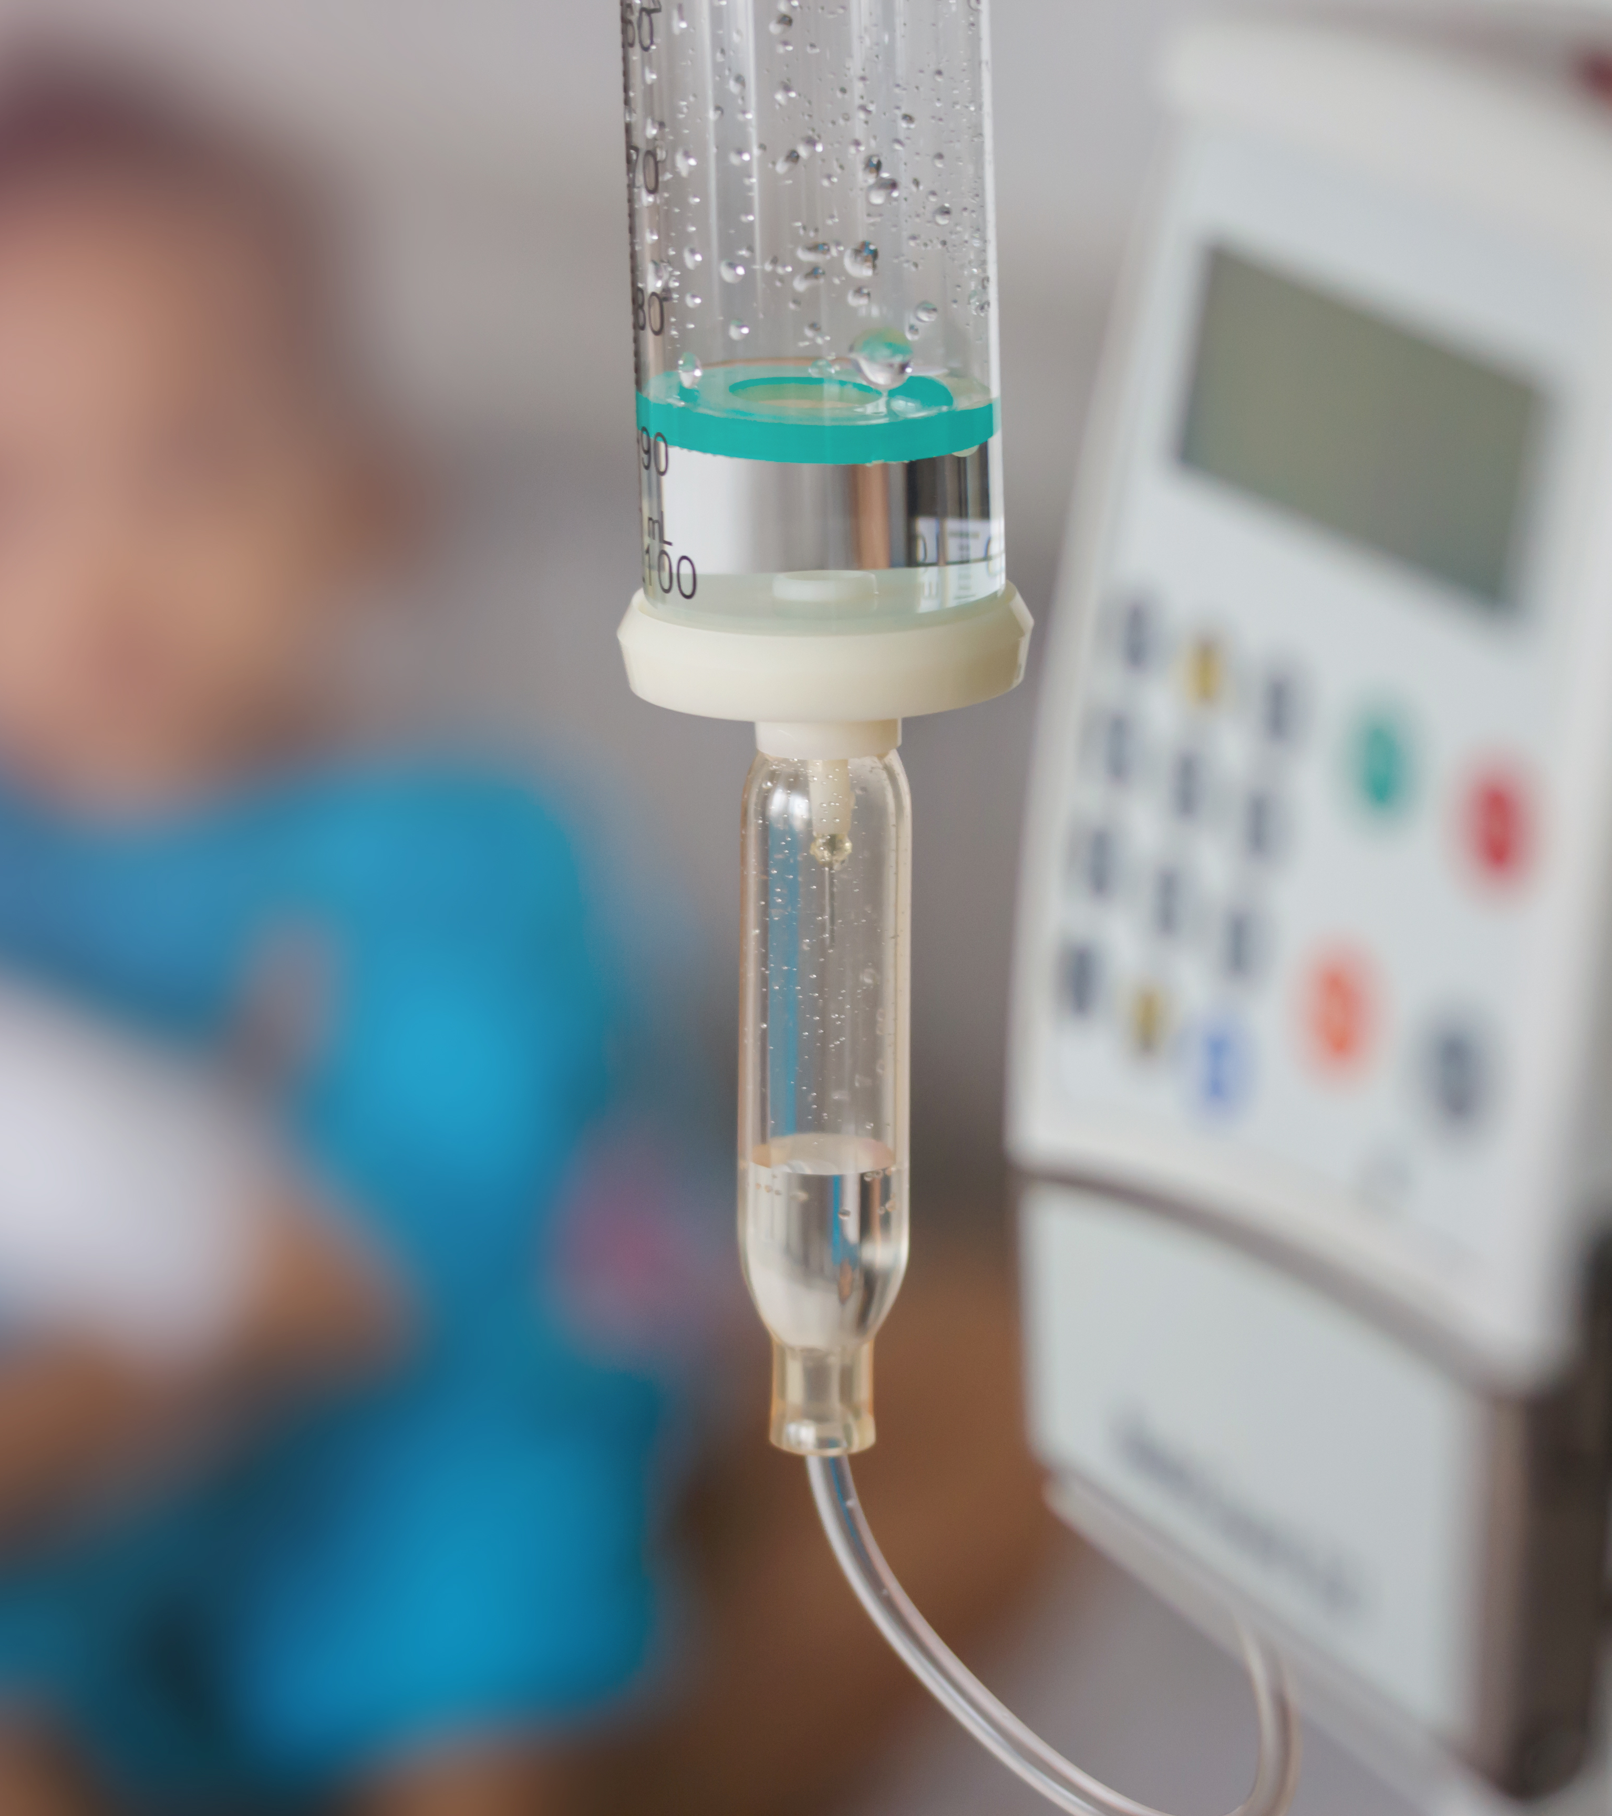
Challenge:
Every day, in every hospital, a nurse is looking for an infusion pump.

Slide 4
Medigate Clinical Device Efficiency
MDSP
Benchmarks
Network Management
RTLS
Location
RIS/EMR
CMMS
Actionable Recommendations
Device Logs
Utilization
CDE
Engine
PACS
CMMS
Inventory
Network Traffic
Financial Costs
Notes:
The Clinical Device Efficiency Engine takes information from multiple sources that are already active as integrations into the MDSP and presents them in a clean User Interface for the HDO to take advantage of. Building on the foundational device visibility and classification, CDE adds three additional sources of data; Location, Utilization, and Inventory:
Location: CDE pulls location information from the Network Management Integrations (Aruba AirWave, Cisco Prime), RTLS vendors (to be completed in a future release), and the network traffic itself to provide a near real-time location for each connected medical device.
Utilization: How much each device is used in a given time period is measured by the Radiological Information System (RIS), the Electronic Medical Record (EMR), the Device Logs, the Picture Archiving and Communication System (PACS), and the network traffic. Because we know each connected device, we know when they are communicating with their assigned control units in the execution of a patient care function.
Inventory: How many devices an organization has is commonly understood from the CMMS, but many times devices can go missing and be removed from the inventory. This is why we also look at actual network traffic to validate the total number of connected medical devices.
Benchmarking: taking data from outside the HDO, industry benchmarks are brought into the CDE Engine to better understand a recommended number of devices per bed, or other useful metric. Additionally, this data can be internally benchmarked, with multiple sites comparing their information to one another and feeding the CDE Engine with additional data points
Once the data from the MDSP is collected, the CDE Engine presents a clean User Interface that shares all the relevant information and can be customized however a customer wants or needs to solve their distinct use case. The UI provides Actionable Insights for the HDO, based on all collected data.

Slide 5
Healthcare is our Core Competency
30+
Awards
In the last year, our platform has received awards in Healthcare Security, IoT Security and Cybersecurity
100%
Healthcare
We spend all of
our time solving
problems for
healthcare
1M +
Unique medical devices identified and available in our database
10M+
Devices
We have discovered millions of medical, clinical and general IOT devices
1000+
Hospitals
We have deployed our solutions in hundreds of hospitals across the world
165+ proprietary protocols parsed
Our focus on healthcare allows us to invest in doing the hard work of decoding protocols

Slide 6
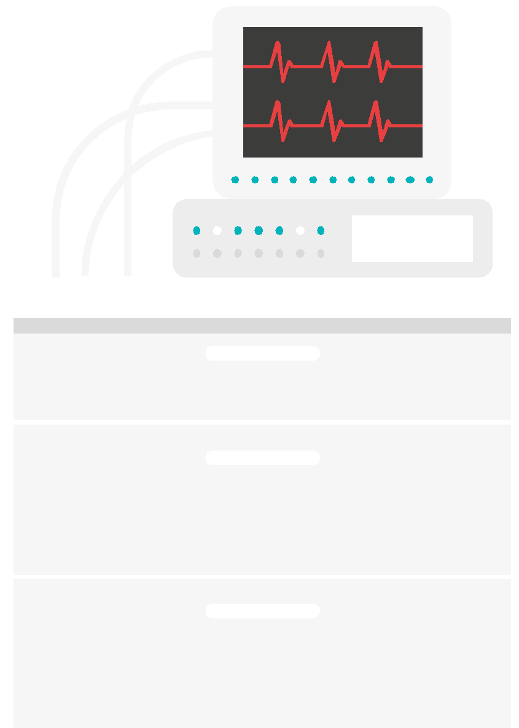

Powered by Medigate Services
White + Security Operations
Green _ Network Protection
Orange = Operational Efficiency
1. Discover
2. Assess
3. Protect
4. Monitor
5. Optimize
REINFORCE THE FOUNDATION
VULNERABILITY & RISK IDENTIFICATION
MITIGATE & REMEDIATE
CONTEXTUAL ALERTING
OPERATIONAL EFFICIENCY
Network Security, Clinical Engineering
Information Security
Network Security, Information Security
Security Operations
Clinical Engineering, Supply Chain
Risk
Build Device Profiles
Remediation Actions
Design & Enforce Policies
Supply Chain Visibility
Supply Planning & Scheduling
Risk Ranking and Prioritization
Quarterly Business Reviews
Integrated Business Planning
Incident Response Management
Clinical
SOC
Supply Chain Collaboration
Asset Discovery and Profiling
(SOC, NPM, OE)
Risk Assignment & Acceptance
Tuning and Integrations
Vulnerabilities and Risk Identification
Threat Intel & Forensics
Playbook
Automation & Orchestration
Governance Alignment
Define Segmentation Strategy
Solution Deployment
Data
Validations
Responsibilities Alignment
Risk Management Framework
Maturity
CUSTOMER JOURNEY
Deploy, discover, and profile all connected devices
Identify model and governance
Formalize and
deploy program
Automate and orchestrate program
Operationalize and optimize program

Slide 7
Device Inventory
Use Cases

Slide 8






Up-to-Date Inventory
CDE transforms a disconnected, static physical inventory in the CMMS and transforms it into a fully connected and dynamic digital system. CAE fixes inherent CMMS inventory data deficits and problems related to asset coverage and data management are fixed.

Slide 9
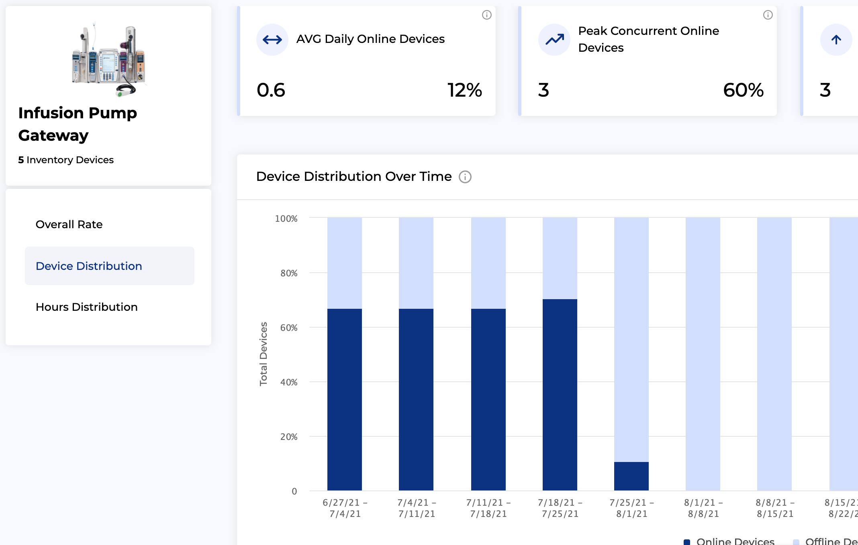
Demand-Driven Reallocation
Consistently tracking where devices are needed will help ensure they are distributed appropriately and can be dynamically adjusted based on need or volume. This creates a more balanced device fleet and reduces the amount of time a nurse spends looking for a needed device.

Slide 10
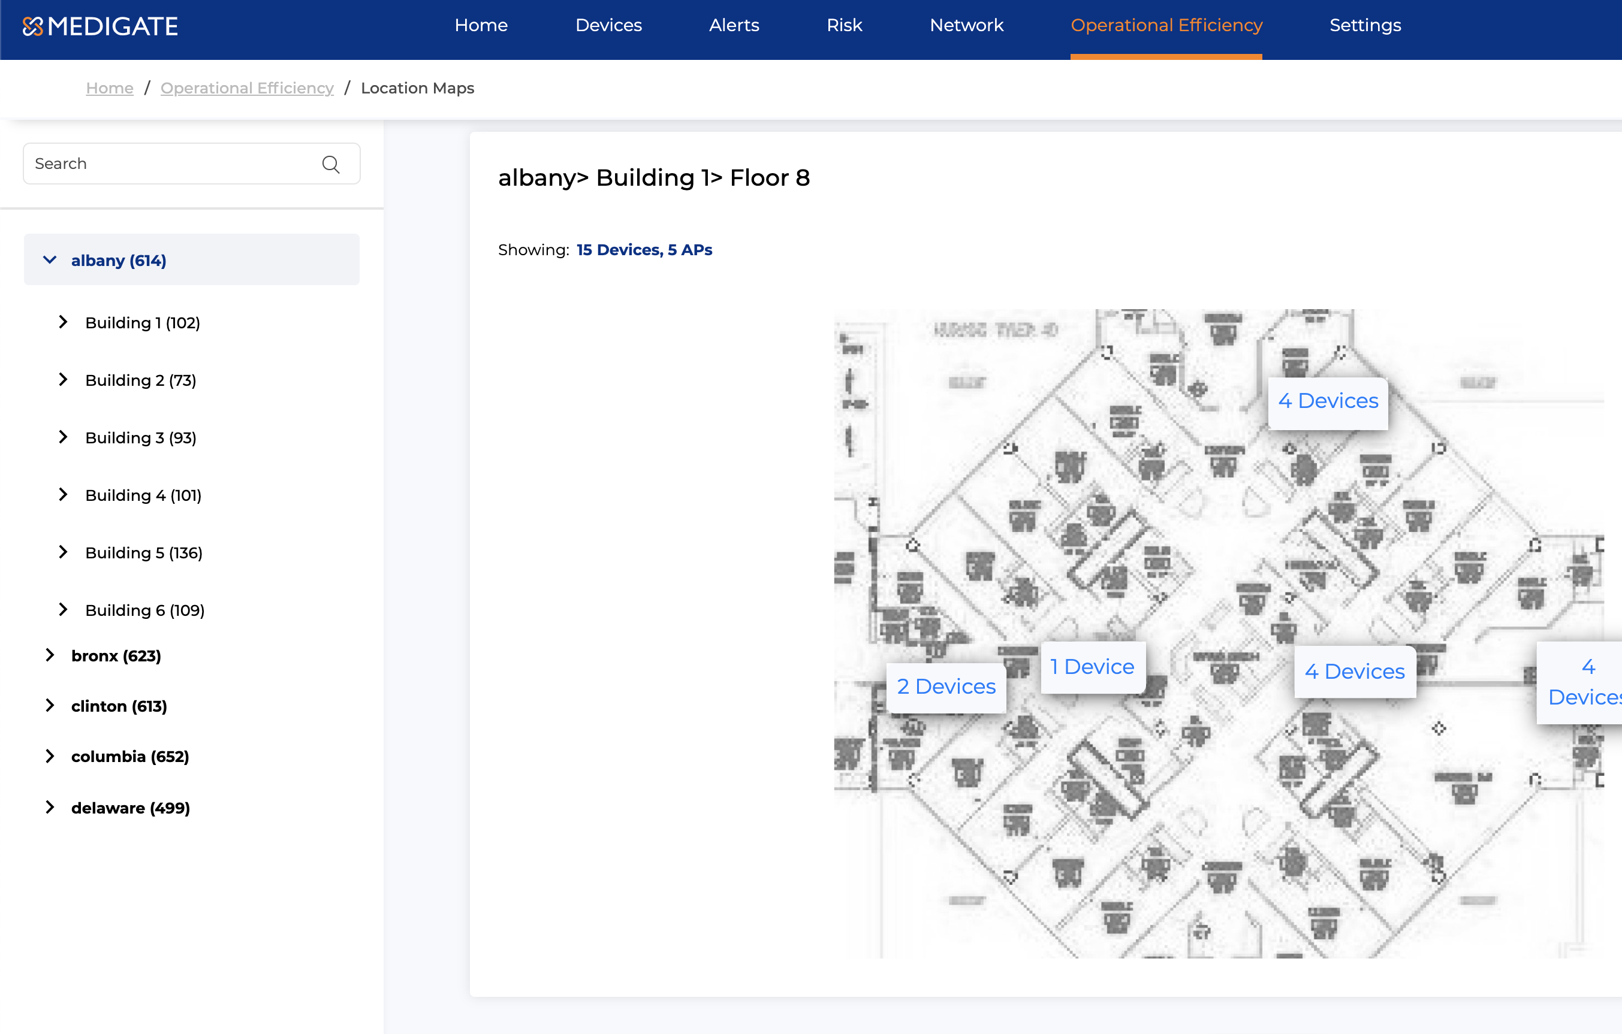
Locate Lost & Missing Devices
The number of devices in the fleet can grow incrementally as more are acquired to replace those marked as lost or missing in the CMMS. By locating these ‘extra’ devices, they can be returned to use instead of replaced.

Slide 11
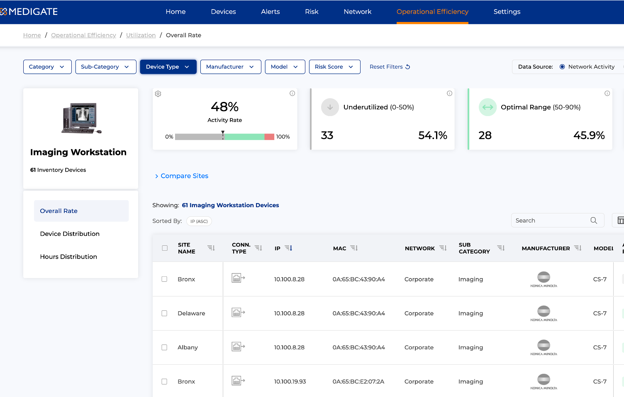
Increased Utilization
With an average of 42% utilization rate, connected medical devices sit idle most of the time. By increasing the usage rate per device, more can be accomplished with a potentially smaller number of overall devices

Slide 12
Industry Benchmarks
Comparing how many devices are deployed per bed and recommending changes based on industry best practices. This allows the HDO to compare its own anonymized data against similar peers to achieve optimal performance from their clinical devices

Slide 13
Device Maintenance Optimization

Slide 14
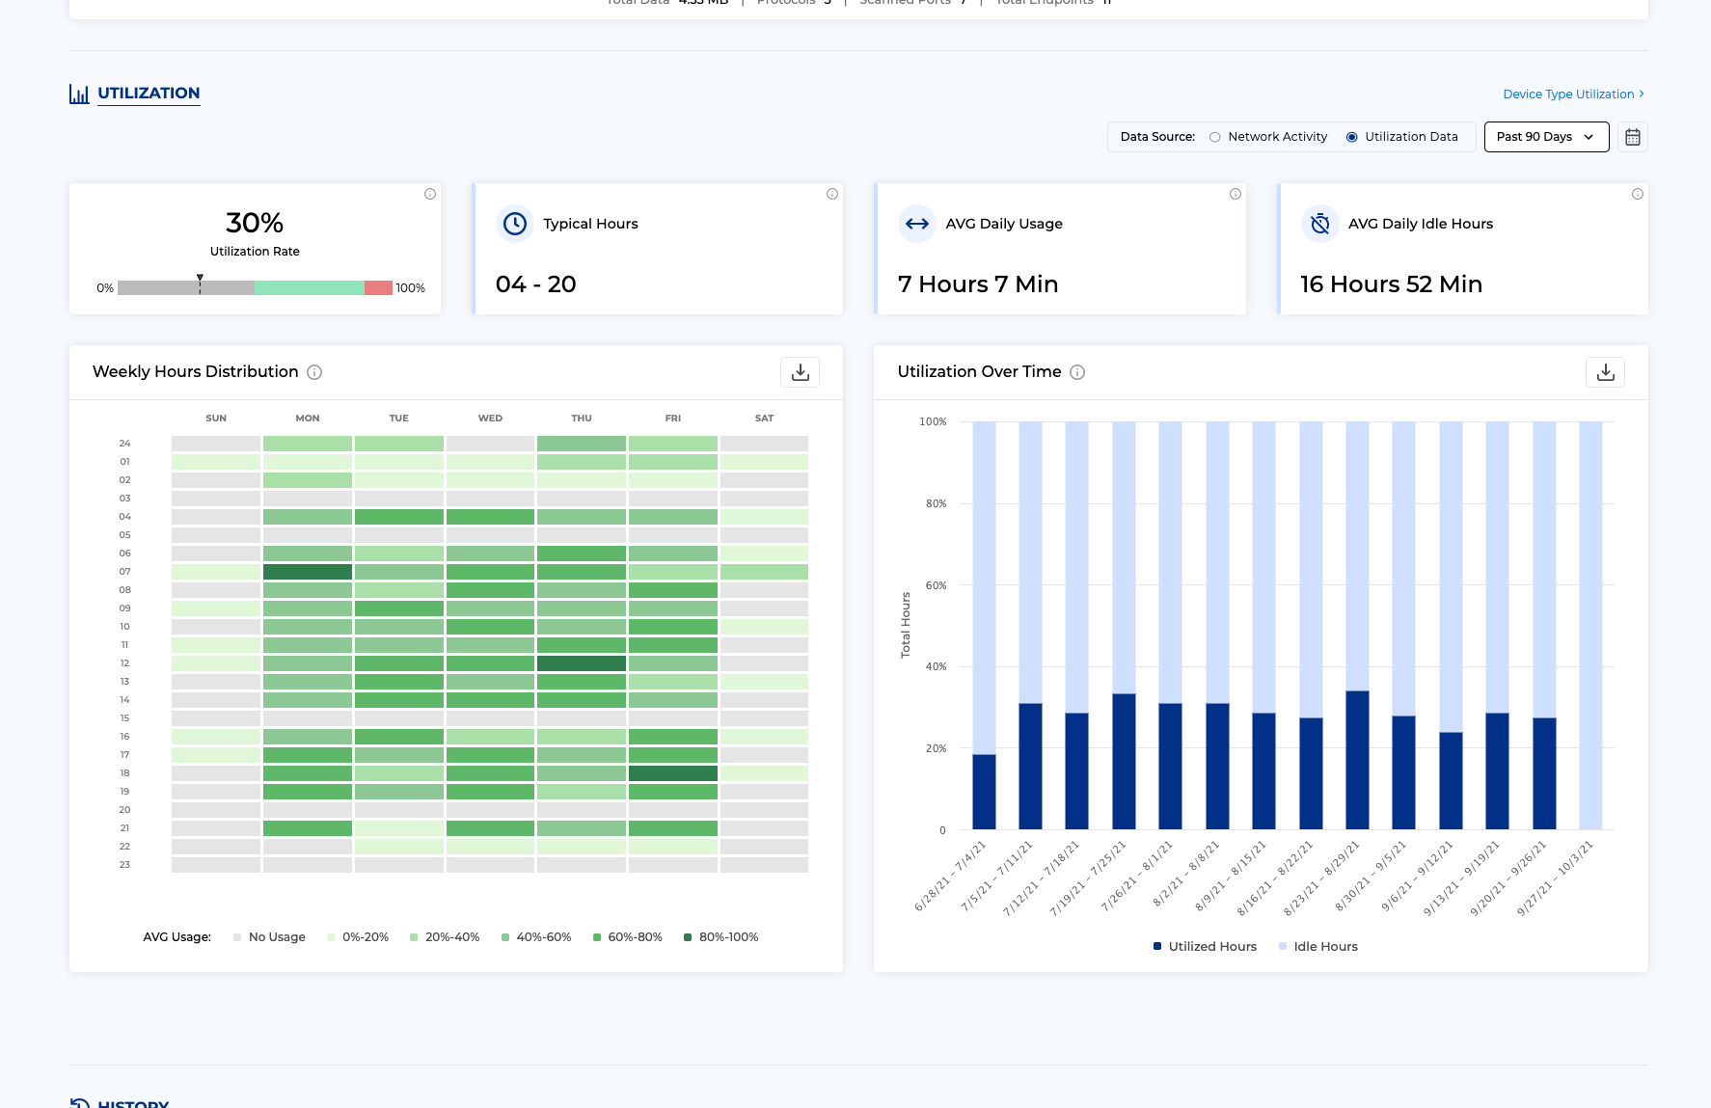
Alternative Maintenance Schedules
It is costly and time consuming to perform PM on a device that has only been used sparingly throughout the year. By leveraging an AEM, the device can undergo the required PM when it needs, based on usage, saving CE time and effort.

Slide 15
Low Impact Preventative Maintenance
When it is time for PM, finding the device quickly helps speed the process. Additionally, knowing the operating schedule of a device allows the PM to be completed during its ‘off’ hours and reduces the impact to patient care.

Slide 16
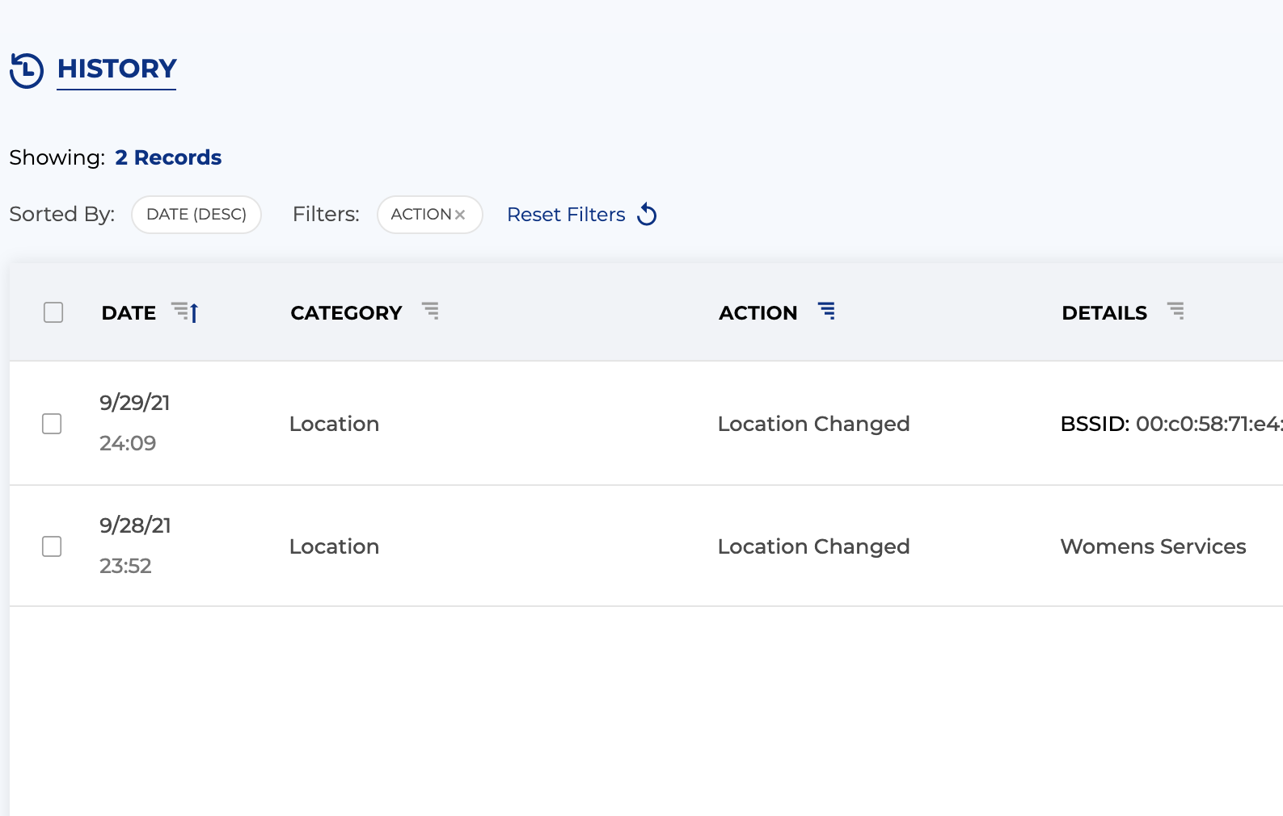
Infection Control
Many times, a device will be used in an environment that requires it to undergo sanitation before being reintroduced to the available pool of devices. Knowing location and utilization allows this to be enforced and lessens the infection risk to staff and patients from improperly sanitized devices.

Slide 17
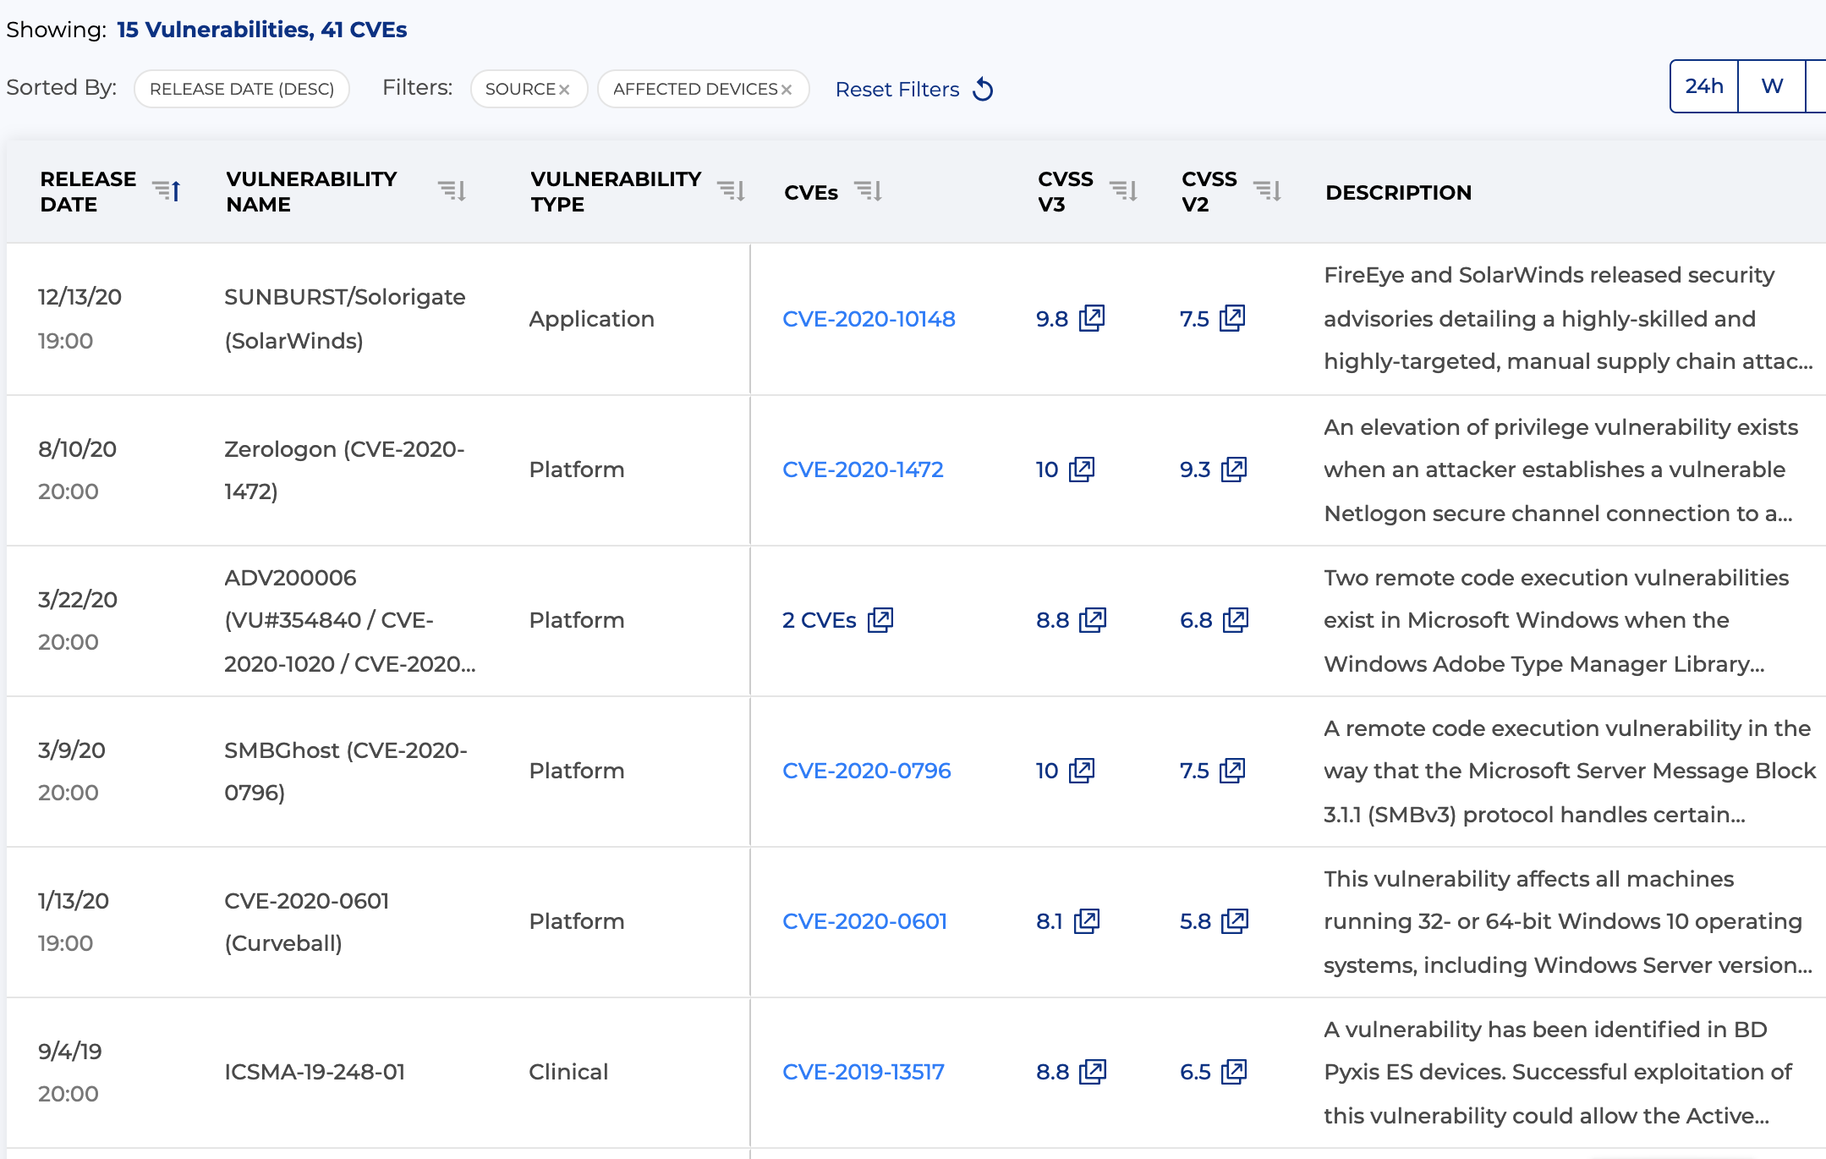
Vulnerability Reporting
Medigate tracks device vulnerabilities, providing visibility to the location of affected devices. With an integration into their ticketing system, the correct action can be taken quickly.

Slide 18

Achieve Measurable ROI: OpEx and CapEx Cost Savings
1
2
3
4
MAINTENANCE
INCIDENT RESPONSE
ASSET UTILIZATION
PURCHASING/SUPPLY CHAIN
Full DLM Visibility
Elimination of outdated manual routines
AEM Programs
Dynamic, risk scored inventory
Automatic vulnerability correlations
Auto-generated remediation instructions
Cross-functional data synchronization
Real-time views of available capacity
Real-time view of current demand
Demand driven reallocations
Reduced time reconciling fixed assets
ROI Calculations based
on utilization
Request a financial savings assessment

Slide 19
Realized Customer Value
$700k
$2M
$3M
Device replacement
purchase cancelled
Avoided buying a new C-Arm device
Improved device utilization revenue

Slide 20

Thank You

