Slide 1

Embrace Your Geek
Monday, November 1, 3:30-4:30 p.m.
Have you ever felt like you are twice removed from the patient’s quality of care or the decisions on when and what to buy in the department? This is the lecture for you! I will illustrate how healthcare technology management directly relates to patient care, patient outcomes and departmental decision.

Slide 2
Embrace Your Geek
Goals
Integrate the analytics of BioMed with the needs of the imaging department
Use that integration to help facility future planning
Why do I call it Embrace your Geek?
Dr. Nicole T. Walton-Trujillo
nwalttruj@yahoo.com, 505-975-0091 cell
R.T. (R) (CT), ASRT, ARRT, BSRS, NMSRT, MBAH, MOL

Slide 3






What do I mean?

Slide 4

WHY DO I CARE!!!???
How to use the concepts of an alignment board to create connection and communication as well as provide a review of departmental volume, internal quality projects, patient satisfaction, overall departmental scorecard that includes the prior data as well as financials, and the integration of biomed information to affect change.
The dreaded sentences:
Show me why you need another FTE
Show me why you need another scanner
How can you justify the capital expenses you are asking for in Budget Season (Budget Defense)

Slide 5
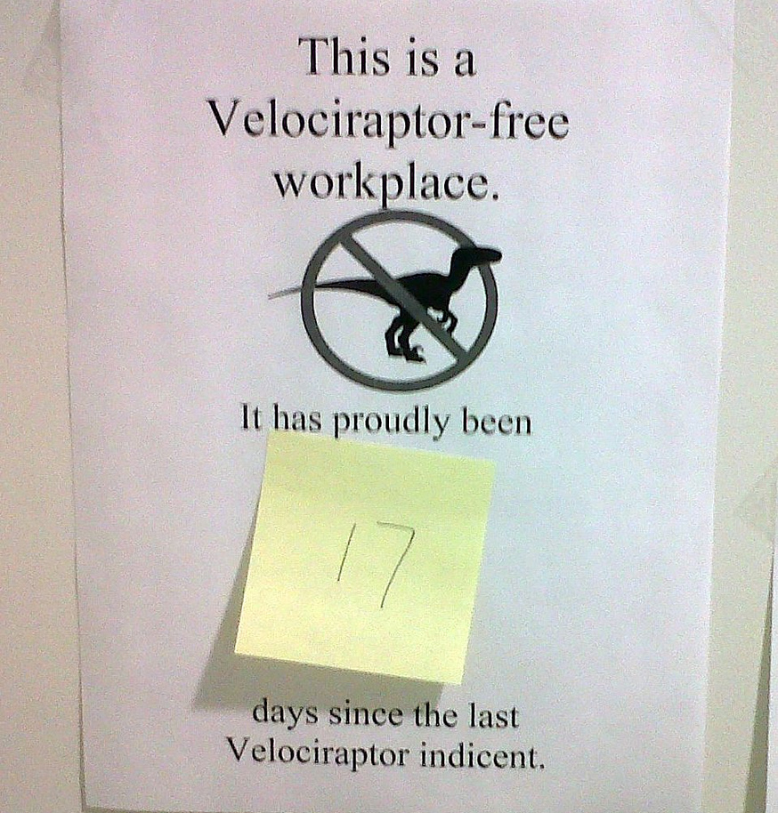
Communication
Understanding the WHY makes the HOW easier to implement
Helps to reduce the distance of the point of view from each end of the spectrum

Slide 6

CSUITE – CEO, COO, CFO, Executive Team (Decision Makers)
Boots on the Ground – The front line patient facing team members

Slide 7
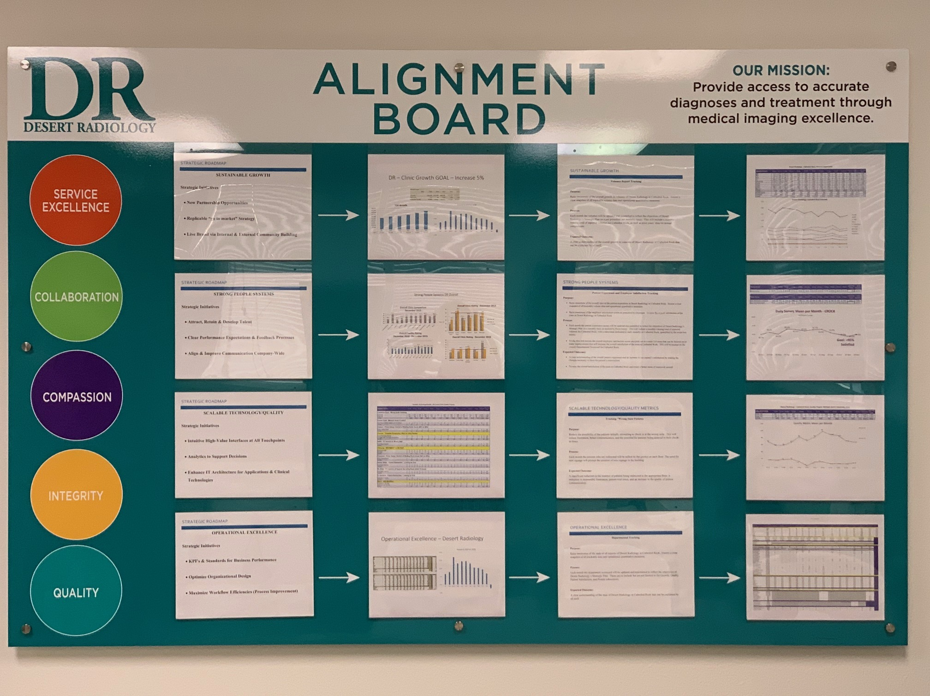
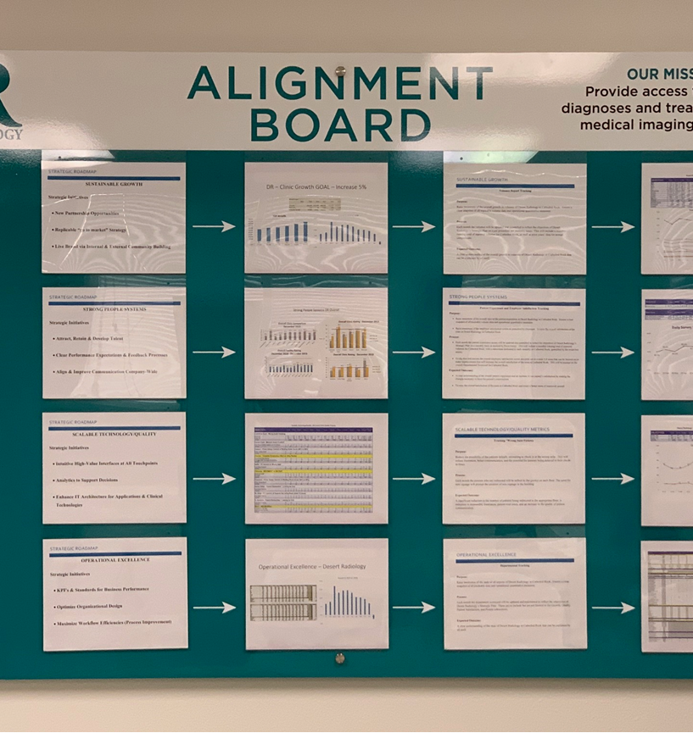

Slide 8
Alignment Board – World View
Column 1 – Strategic 3-5 Year Plan
Column 2 – CSuite Deliverables
Column 3 – Facility Aligned Goals
Column 4 – Facility Aligned Goal Deliverables

Slide 9
Alignment Board – World View
Row 1 – Sustainable Growth (Volume)
Row 2 – Strong People Systems (Patient Satisfaction)
Row 3 – Scalable Technology/Quality (Quality Metrics)
Row 4 – Operational Excellence (Scorecard)

Slide 10
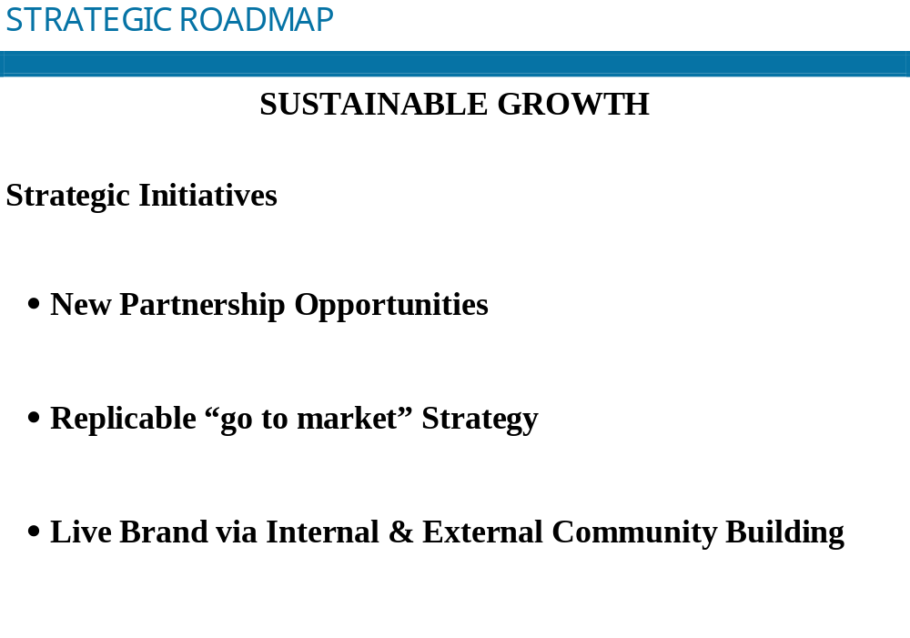

Slide 11
Column 2: – Clinic Growth GOAL – Increase 5%
Growth Trend
2014 | 2015 | 2016 | 2017 | 2018 | 2019
274,283 | 305,186 | 316,008 | 349,518 | 396,906 | 441,057
%Growth | 11% | 4% | 11% | 14% | 11%
# Studies Growth | 30,903 | 10,822 | 33,510 | 47,388 | 44,151

Slide 12
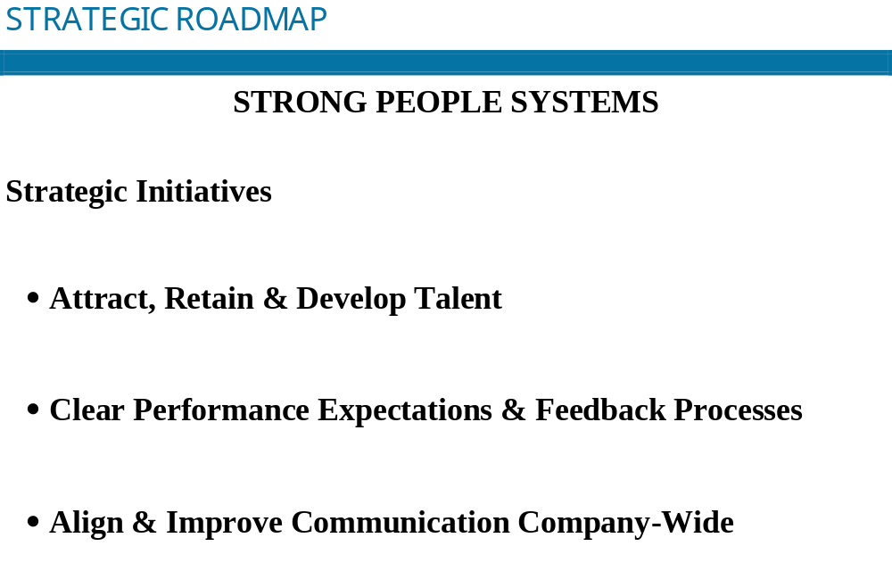

Slide 13
Column 2: Strong People Systems Overall

Slide 14
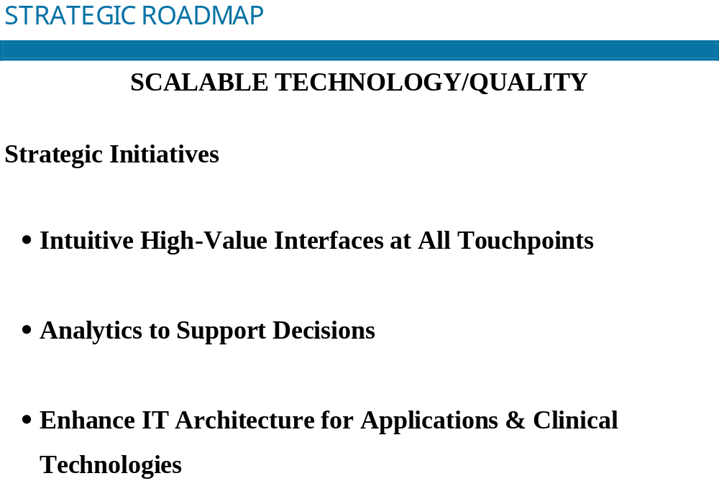

Slide 15
Column 2 – Scalable Technology/Quality
Scalable Technology/Quality - DR Overall Clinic Quality Projects
OBJECTIVES | 19-Jan | 19-Feb | 19-Mar | 19-Apr | 19-May | 19-Jun | 19-Jul | 19-Aug | 19-Sep | 19-Oct | 19-Nov | 19-Dec | 2019 ytd | 2018 YTD Totals
Cathedral Rock - Wrong Suite Tracking
Suite 230 | 681 | 577 | 586 | 667 | 831 | 715 | 827 | 985 | 899 | 871 | 720 | 687 | 9,046 | 7,865
Suite 150 | 164 | 156 | 172 | 184 | 121 | * | 111 | 115 | 63 | 66 | 61 | 88 | 1,301 | 2,097
TOTAL | 845 | 733 | 758 | 851 | 952 | 715 | 938 | 1100 | 962 | 937 | 781 | 775 | 10347 | 9962
Centra Point - Mammo Gown Comfort
How Many Patients Stated Lack of Comfort | 2 | 1 | 1 | 2 | 1 | 1 | 0 | 1 | 1 | 0 | 0 | 0 | 10 | n/a
TOTAL | 2 | 1 | 1 | 2 | 1 | 1 | 0 | 1 | 1 | 0 | 0 | 0 | 10 | n/a
Eastern - Press Ganey Comfort of Waiting Room Score (84% to 90%)
Press Ganey Score |  |  |  |  |  |  |  |  |  |  |  |  | 0 | n/a
TOTAL | 0 | 0 | 0 | 0 | 0 | 0 | 0 | 0 | 0 | 0 | 0 | 0 | 0 | n/a
Horizon - Templete Scheduling Effect on 2Day Review
Amount of 2Day Review |  |  |  |  |  |  |  |  |  |  |  |  | 0 | n/a
Changes With Templete Schedulding |  |  |  |  |  |  |  |  |  |  |  |  | 0 | n/a
TOTAL | 0 | 0 | 0 | 0 | 0 | 0 | 0 | 0 | 0 | 0 | 0 | 0 | 0 | n/a
Nellis - PT Arrived on Wrong Date
How Many Patients |  |  |  |  |  |  |  |  |  |  |  |  | 0 | n/a
TOTAL | 0 | 0 | 0 | 0 | 0 | 0 | 0 | 0 | 0 | 0 | 0 | 0 | 0 | n/a
Pahrump - MEDSMART vs DR Staff
Medsmart Staff | 6 | 6 | 6 | 6 | 6 | 6 | 6 | 6 | 6 | 6 | 6 | 6 | 72 | n/a
DR Staff | 5 | 5 | 5 | 5 | 5 | 5 | 5 | 5 | 5 | 5 | 5 | 5 | 60 | n/a
TOTAL | 11 | 11 | 11 | 11 | 11 | 11 | 11 | 11 | 11 | 11 | 11 | 11 | 132 | n/a
Palomino - Press Ganey Comfort of Waiting Room Score (84% to 90%)
Press Ganey Score |  |  |  |  |  |  |  |  |  |  |  |  | 0 | n/a
TOTAL | 0 | 0 | 0 | 0 | 0 | 0 | 0 | 0 | 0 | 0 | 0 | 0 | 0 | n/a
Sandy Ridge - Patient Redirection - Looking for Exit
How Many Patients | 2 | 3 | 1 | 2 | 2 | 1 | 1 | 3 | 1 | 2 | 1 | 2 | 21 | n/a
TOTAL | 2 | 3 | 1 | 2 | 2 | 1 | 1 | 3 | 1 | 2 | 1 | 2 | 21 | n/a
St. Rose - PT Concern of Reports Not being Read within 72 Hours
How Many Patients | 2 | 3 | 0 | 1 | 1 | 3 | 6 | 4 | 1 | 2 | 2 | 1 | 26 | n/a
TOTAL | 2 | 3 | 0 | 1 | 1 | 3 | 6 | 4 | 1 | 2 | 2 | 1 | 26 | n/a
S. Rainbow - Patient Redirection - Looking for Exit
How Many Patients |  |  |  |  |  |  |  |  |  |  |  |  | 0 | n/a
TOTAL | 0 | 0 | 0 | 0 | 0 | 0 | 0 | 0 | 0 | 0 | 0 | 0 | 0 | n/a
Wynn - MRI Workflow
Procedures Per Day | 15 | 15 | 8 | 12 | 12 |  |  |  |  |  |  |  | 62 | n/a
Cancelations Per Day | 2 | 2 | 2 | 2 | 2 |  |  |  |  |  |  |  | 10 | n/a
TOTAL | 17 | 17 | 10 | 14 | 14 | 0 | 0 | 0 | 0 | 0 | 0 | 0 | 72 | n/a

Slide 16
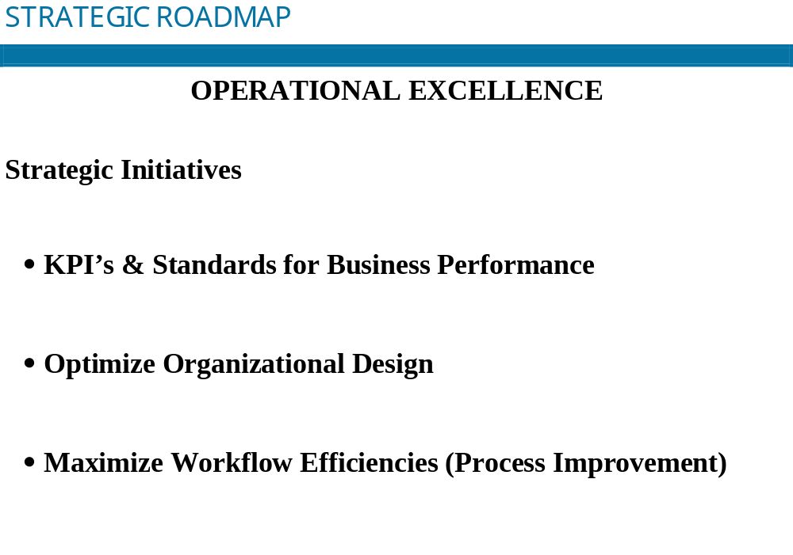

Slide 17
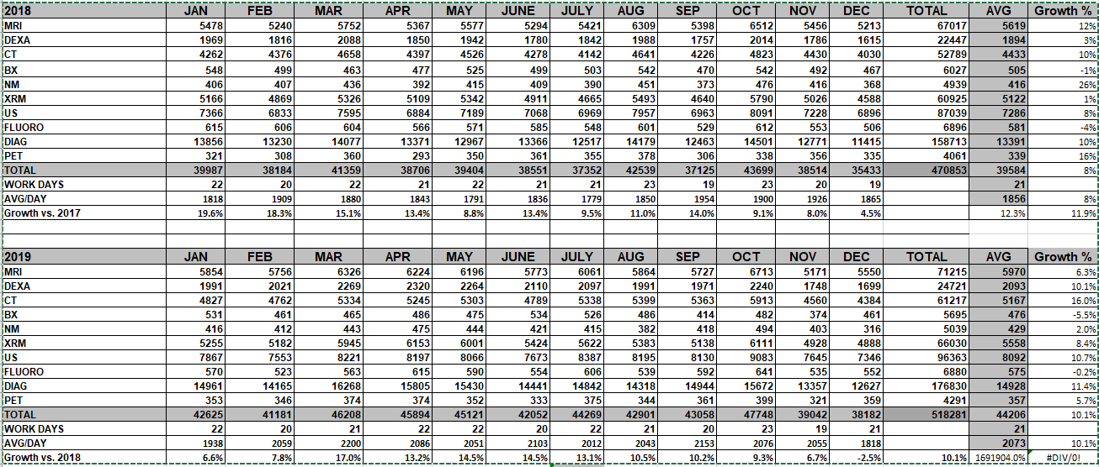
Colum 2:Operational Excellence

Slide 18
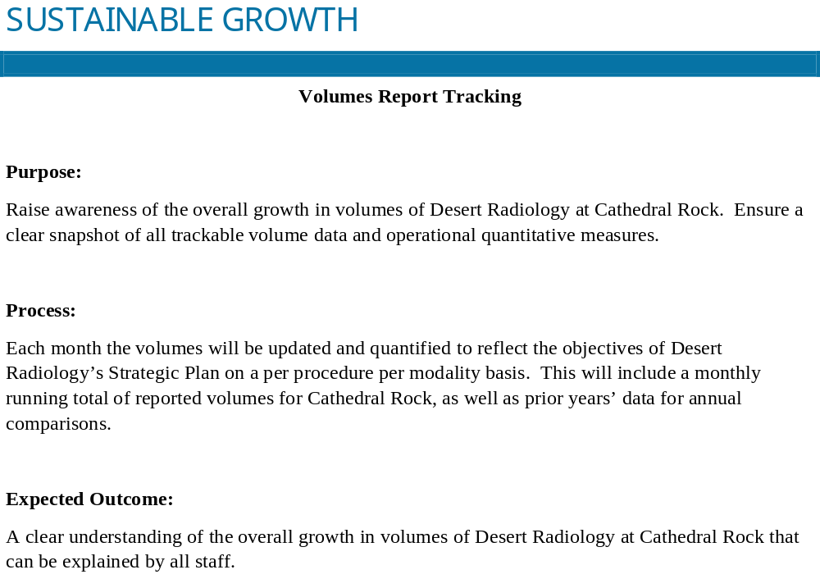
Column 3 – Facility- Sustainable Growth

Slide 19
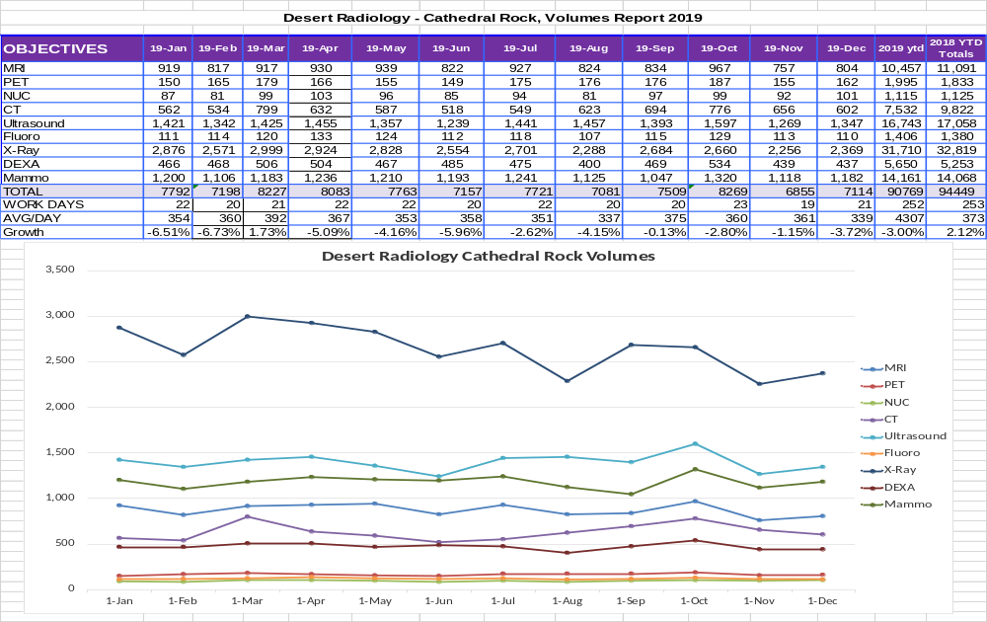
Clinic Specific Deliverable

Slide 20
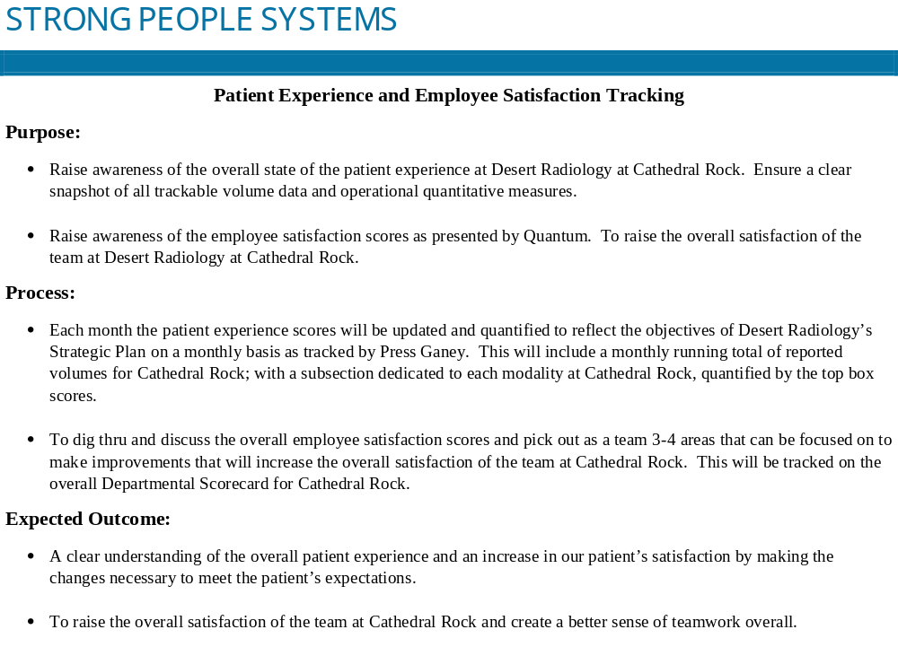
Column 3 – Facility- Strong People Systems

Slide 21
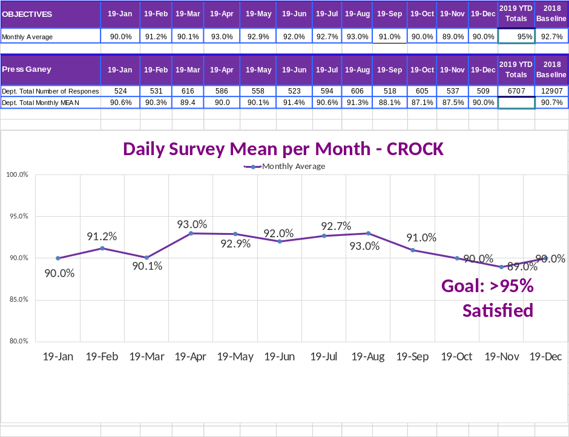
Clinic Specific Deliverable

Slide 22
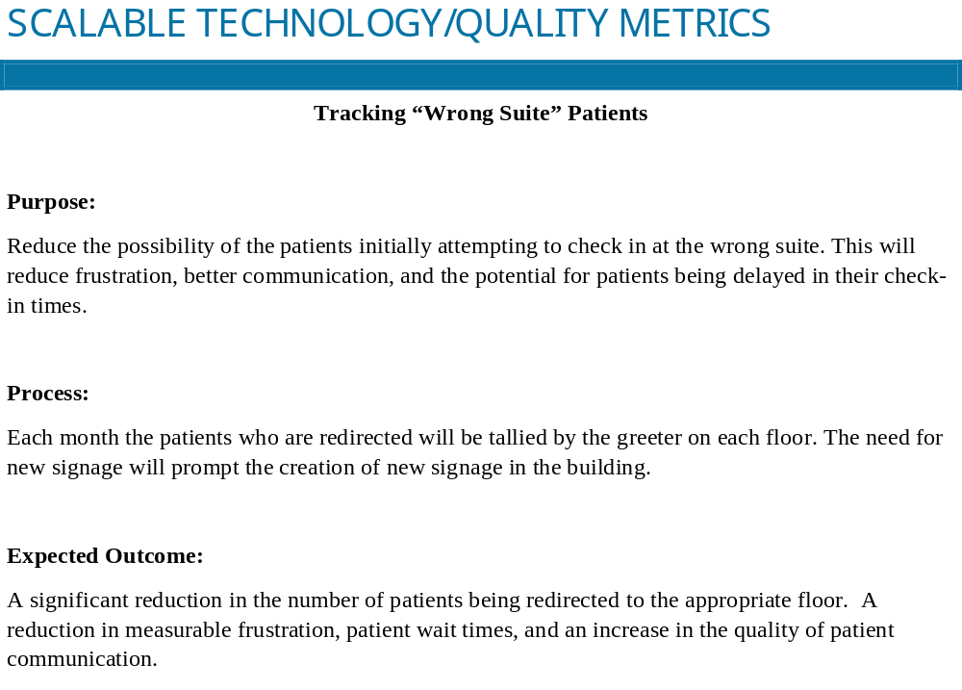
Column 3 – Facility- Scalable Tech/Quality

Slide 23
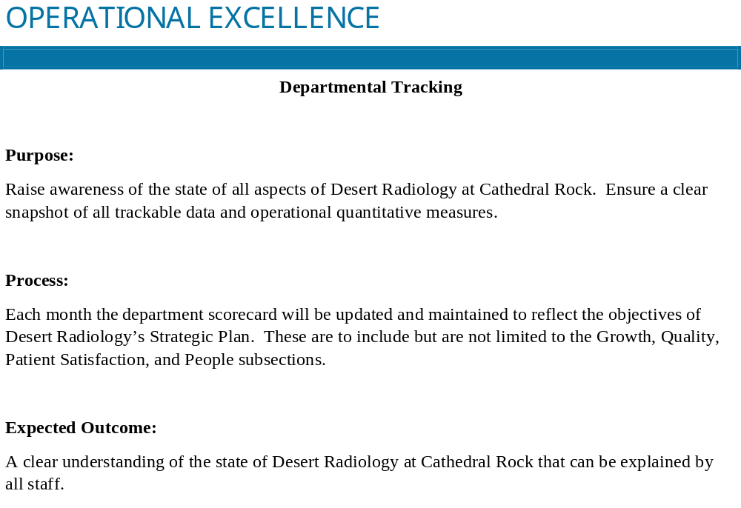
Column 3 – Facility- Operational Excellence

Slide 24
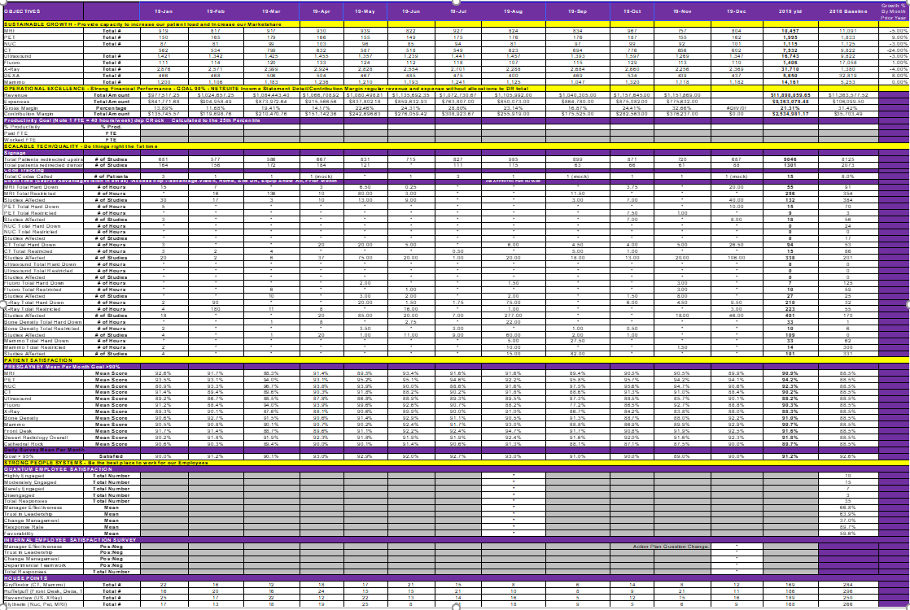
Operational Excellence – Scorecard/Clinic Specific Deliverable

Slide 25
Questions
How often do you communicate with your department managers?
…Modality managers?
What do you share with them?
…How do you share it?
What are you bringing to the table to help with decision making?

Slide 26


Service Provider Integration
Preventive Maintenance:
Give back hours in relation to PM’s and why not reflected on Scorecard:
  103 Total PMS completed during fourth quarter (98% Completion)
  All of which were completed after hours or after last patient of the day, providing Desert Radiology with 222.25 hours of scan time back to the schedule.
  Total GBH Y4Q2 = 222.25
  Total GBH Y1 = 525.5, Y2 = 474.25, Y3 = 551, Y4 = 804
How am I integrating the Biomed management aspect of our field to Decision making in the department? Agenix DR dashboard

Slide 27
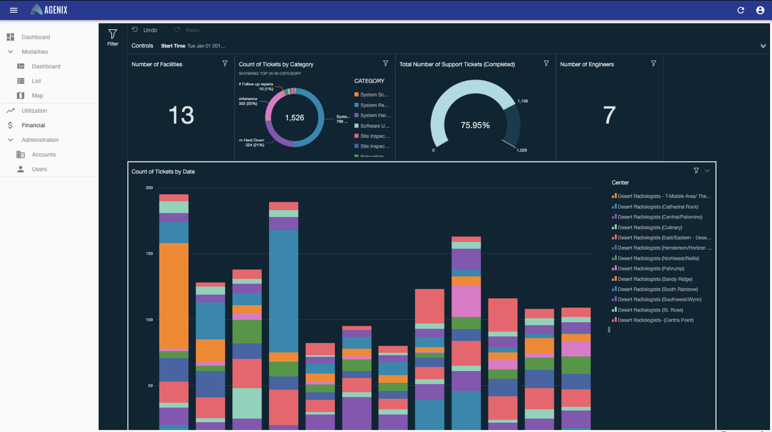
Agenix – How does this help me as a leader?

Slide 28
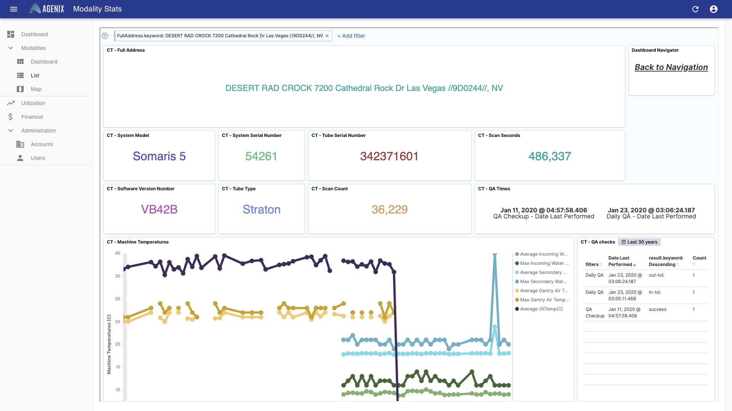
Agenix – How does this help me as a leader?

Slide 29
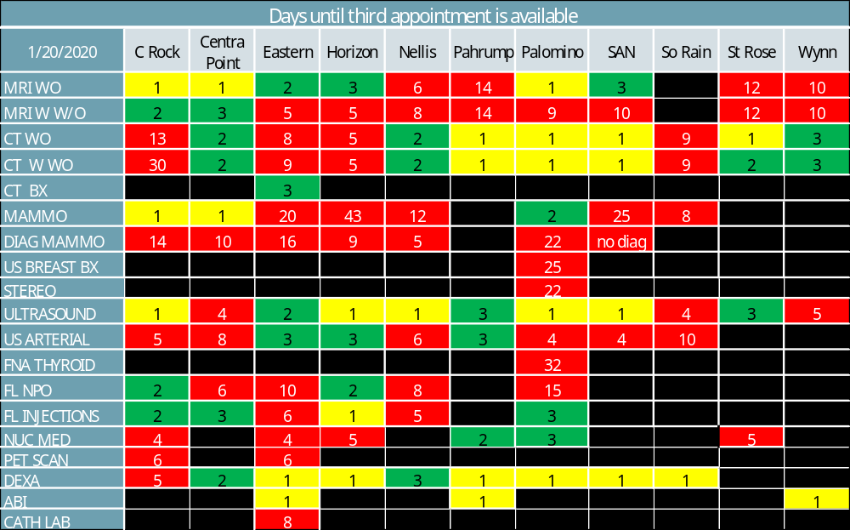

Slide 30
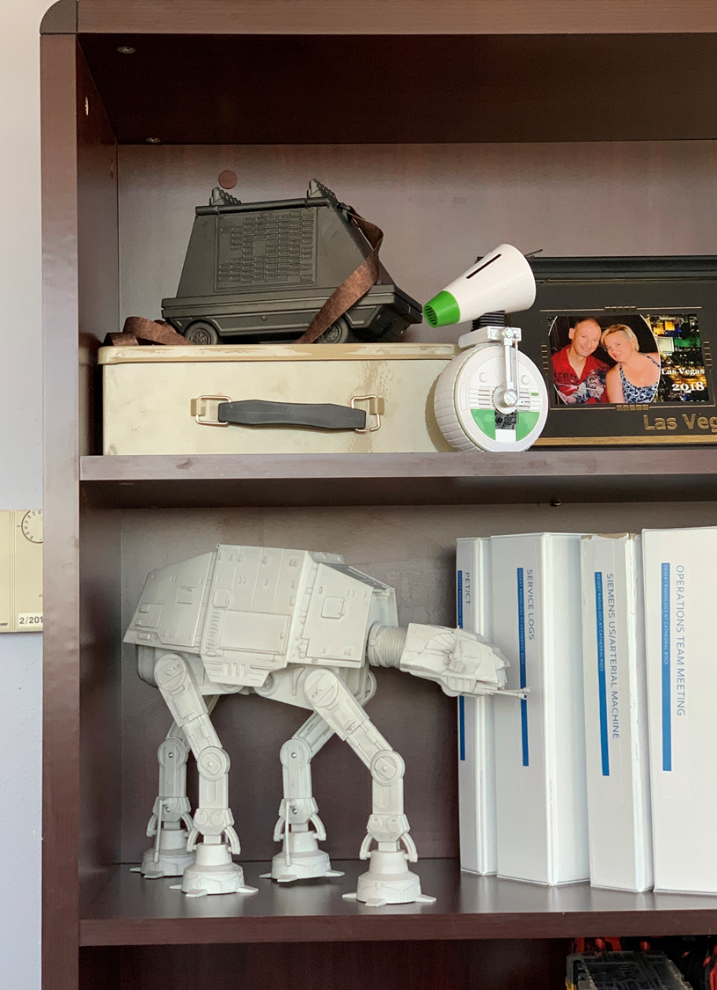
Strong People Systems/Team Building – House Points
I am a GEEK!!
  I don’t hide it ,my love for Star Wars, Disney, Star Trek, and Harry Potter
I use my powers for evil for sure
I found a way to apply this to building teams within the department
  Reduces the invisible walls between modalities

Slide 31

POP QUIZ!!!
Who knows what this is???

Slide 32
References
Thank You
AGENIX, Medical Imaging Solutions, David Anthony, COO Jan2020
Alignment Board, Nicole T Walton-Trujillo, Doctoral Studies from Colorado Technical Institute
Desert Radiology, Nicole T Walton-Trujillo, Former Director, Jan2020
MIS, Medical Imaging Solutions, David Anthony, COO Jan2020
Pollack, J., & Pollack, R. (2015). Using Kotter’s eight stage process to manage an organizational change program: Presentation and practice. Systemic practice & action research, 28(1), 51-66. doi:10.1007/s11213-014-9317-0

