Slide 1

Cost Effective Strategies in Healthcare Technology Management
Izabella Gieras
Roberto Torres, Jr
Cedars-Sinai Healthcare System

Slide 2
Agenda
Session Summary
Healthcare Environment
Healthcare Technology Management (HTM) Position
Perspectives
  Cedars-Sinai Healthcare System
    Huntington Hospital
    Cedars-Sinai Medical Center
Best Practices

Slide 3
Session Summary
Healthcare Technology Management departments (HTM) are asked to continue to cut cost and work with less to support the daily operations. With such increased budget constraints, HTM departments need to employ creative strategies, develop key indicators, with no impact to patient care and safety.
Often, this requires a collaborative approach amongst diverse healthcare stakeholders. The presenters will address current initiatives at Huntington Hospital and Cedars-Sinai Medical Center, part of the Cedars-Sinai Healthcare System and engage audience in interactive dialogue to share ideas.

Slide 4

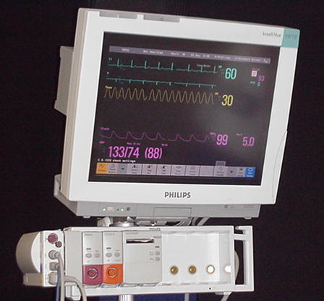
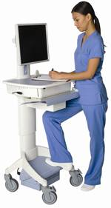
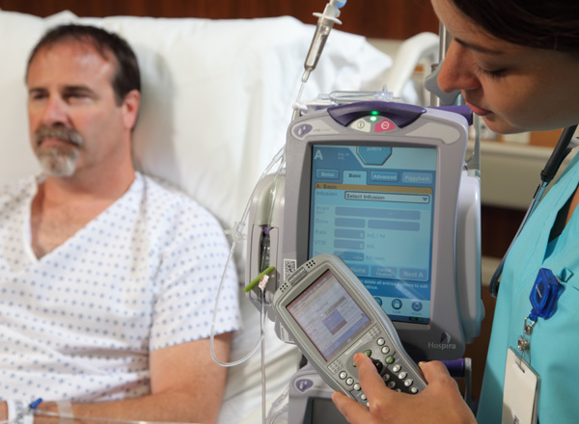
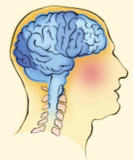
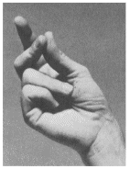

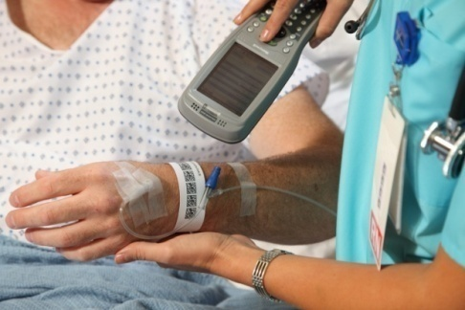

Healthcare Environment
Regulatory Requirements
Regulatory Requirements
Patient Environment
Patient Environment

Slide 5
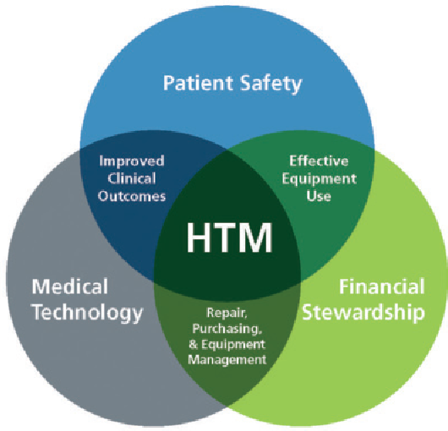
HTM Position
HTM in Healthcare
  C-Suite
  Information Technology
  Information Security
  Compliance
  Facilities
  Purchasing
Semantic scholar

Slide 6

HTM Perspectives
Key HTM Department Cost Effective
Strategies
  Purchasing decisions
    Service Management
      Contracts
      Parts
    Medical Equipment
  In house Leverage
    Training
    Springtime cleaning
    Internships/volunteer program
    Employee management

Slide 7


Huntington Hospital Clinical Technology
Level II Trauma Center with 619 licensed beds
Bariatric & Stroke Center
Over 10,000 assets
18 Operating Rooms
3 DaVinci Robotic Systems
6 Cath Labs & IR Suites
6500+ personnel
300+ applications
4500+ end user computing devices
Over 120 Clinical Technology & I.T. Staff
  11 Clinical Technology staff
  Clinical Technology reports to IT

Slide 8


Cedars-Sinai Clinical Engineering
Located in West Hollywood/Beverly Hills part of Los Angeles
889 bed hospital
34 member strong
Reports to Enterprise Information Systems
Manage 30,000 assets
From the HIMSS Analytics Press Release:
"Cedars-Sinai is one of the most fully deployed and automated facilities we have encountered in the HIMSS Analytics Stage 7 program. With all of their progress on device integration, including fully integrated smart pumps, Cedars-Sinai has approached a new level of patient safety, even among stage 7 facilities.”
-John Hoyt, executive vice president of HIMSS Analytics

Slide 9
Huntington Hospital Perspectives

Slide 10

Purchasing Decisions
Service Management
  Contracts
    Are you involved in service contract management?
      Checklist for assessing service contracts
      RFP process (ECRI, GPO)
      Partnership with Purchasing and end users
      Consolidate service contracts – master contract approach
      In-house and partnership contracts
      Certified third party
      Insurance – risk-based approach

Slide 11
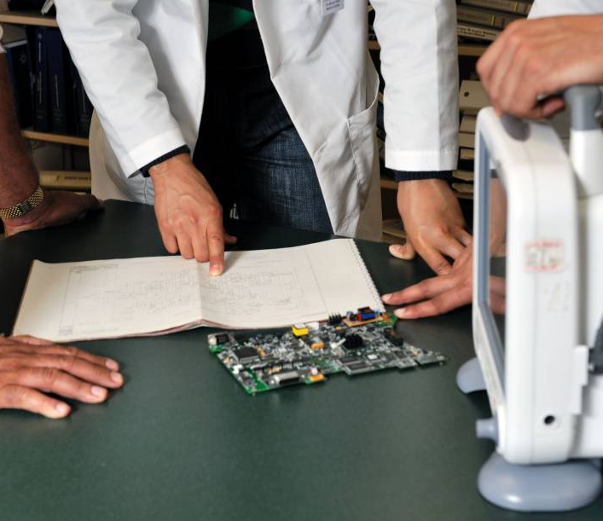
Purchasing Decisions
  Parts
    Strategic contracts in place
      Discounts on OEM parts
      Bulk discounting for frequently used parts
    Shop around
      Validate
    Par levels
    JIT inventory
      Do not overstock – more is not always better!
      Assess shelf life

Slide 12

Purchasing Decisions
Medical Equipment
  Are you involved in new medical equipment purchases?
    Checklist for new medical equipment evaluations
    RFP (ECRI)
    ROI
    Partnership with various healthcare stakeholders
    Training/testing equipment with equipment purchases
    Extended warranties and PMs during warranty
    Replacement roadmap
      Partnership with Construction for fixed equipment

Slide 13
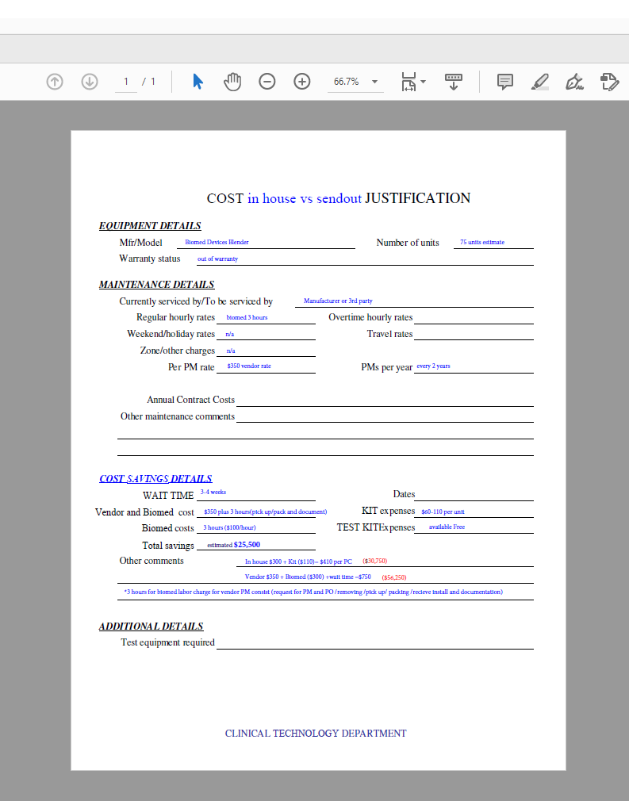
In House Leverage
Training
    ROI Models - sample
    Long term training matrix
    Bundle with capital purchases
    Reassess throughout the year
    Include as part of your service contract renewals

Slide 14
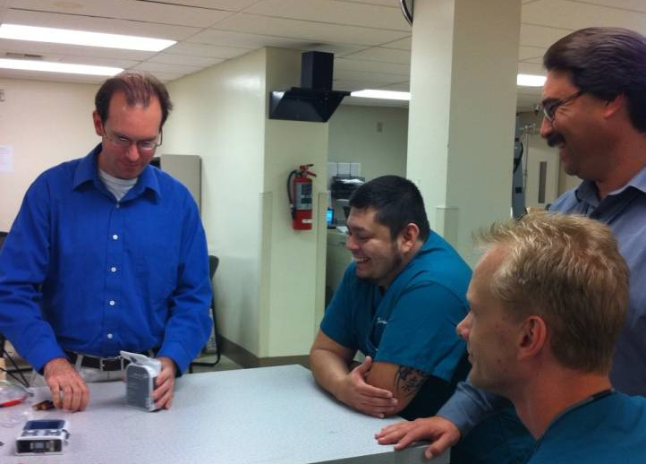
In House Leverage
Springtime cleaning
    Schedule semi-annual cleanups
    Partner with a vendor
Internship/volunteer program

Slide 15
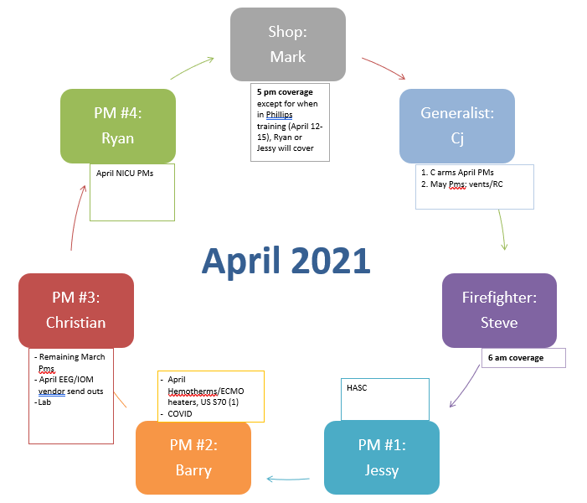
In House Leverage
Employee Management
  Position Cycle
    Focus on the strengths
    Regular employee surveys
  Documentation/Reporting
    Weekly Employee accountability reports
      90% productivity
  Daily CM and PM reports

Slide 16
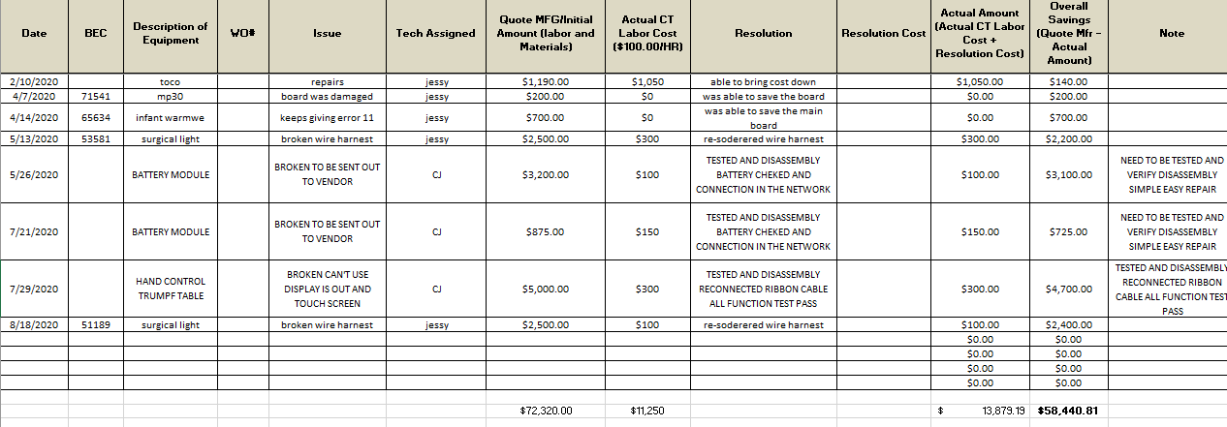
In House Leverage
Employee Management
  Departmental cost savings captures - sample

Slide 17
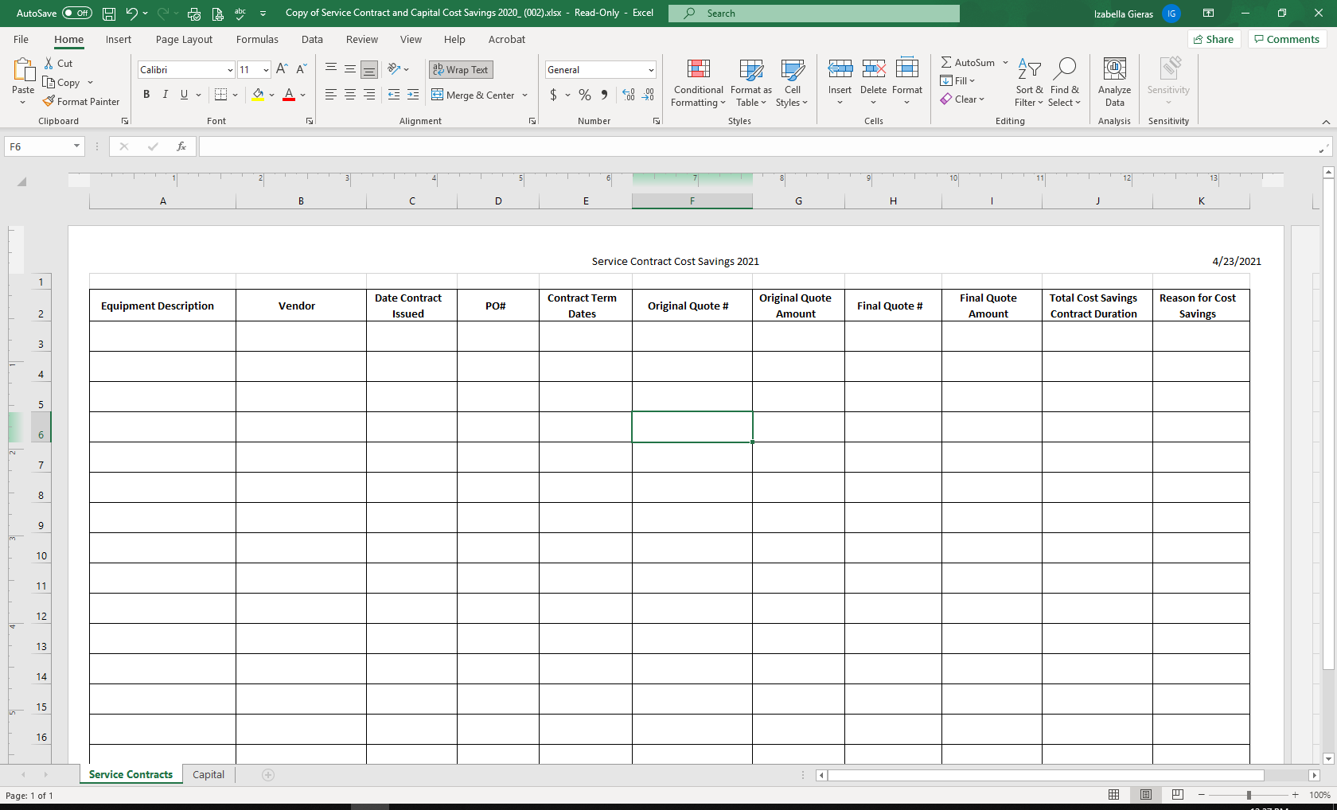
In House Leverage
Employee Management
  Reports on cost savings from service contracts and capital projects
    Work in progress in partnership with Purchasing

Slide 18

In House Leverage
Employee Management
  Unable to Locate equipment – reduce nonproductive time and partner with end users
    Gift cards
    Lunch
    Competition between teams/staff
  Work allocations
    Tech I vs Senior Tech work balance
  Shift adjustments

Slide 19
Cedars-Sinai Medical Center Perspectives

Slide 20

Purchasing Decisions
    Always consider Total Cost of Ownership which includes costs beyond the initial acquisition costs (consumables, maintenance/support, S/W upgrades, fork-lift upgrades, etc.). We use a 10-year model to estimate costs.
    Consider existing hospital technology to promote standardization.
    Be aware of your team’s service capabilities. You may be able to save training and integration costs for new technologies.
    Being part of a GPO (group purchasing organization) can offer substantial discounts.

Slide 21

Purchasing Decisions
    Service Management
      Contracts
        Consider POS service contracts if you already know this isn’t a technology you can or won’t support.
        Ask if the new technology can be supported in-house. Is there training for the in-house team and are parts available?
        When renewing service agreements ask if there are multi-year discounts.
        Always read the small print. (Service hours, after hours/OT rates, response times, etc.)
        Always have QBR’s to track repair trends and opportunities.

Slide 22

Purchasing Decisions
    Parts
      Negotiate ‘preferred vendor’ pricing.
      Stay current on industry pricing for services.
      Always have QBR’s to track spending trends with parts suppliers.

Slide 23
In House Leverage
Training and Cross Training
CLINICAL ENGINEERING TRAINING MATRIX
 | GENERAL BIOMED |  |  |  |  |  |  |  |  |  |  |  |  |  | ADVANCED BIOMED |  |  |  |  |  |  |  |  |  |  | SPECIALTY |  |  |  |  |  |  |  | IMAGING |  |  |  |  |  |  |  | LAB |  |  |  |  |  | ADVANCED LAB |  |  |  |  | LICENSES, CERTIFICATION
TECHNICIAN | ALARIS PUMPS | DEFIBRILATORS | PHYSIOLOGICAL MONITORS | SCD | FEEDING PUMP | URIMETER | THEMOMETERS | PATIENT WARMERS | SUCTION DEVICES | FLOW DOPPLER | PACEMAKER | BLADDER SCANNER | PATIENT SCALES | NIBP MONITORS | TELEMETRY | NURSE STATION | NETWORKING | NEURON | MVP | FETAL MONITORS | ESU | EPIDURAL PUMP | MATERNAL INFANT CARE DEVICES | SYRINGE PUMPS | GAS MONITORS (CO2) | VENTILATORS, BIPAPS | ANESTHESIA | ADVANCED NETWORKING | VIDEO SYSTEMS | DEVICE INTEGRATION, CS-LINK | ADVANCED ESU | VAD | CATH LAB | CONTRAST INJECTOR | ULTRASOUND | X-RAY | CT | CR/DR READERS | LINEAR ACCELERATORS | NUC MED | MRI | CENTRIFUGES | INCUBATORS | HEATING BLOCKS, ROCKERS, SHAKERS | WATER BATHS | RESEARCH | PATHOLGY/HISTOLOGY | CHEMISTRY | IMMUNOCHEMISTRY | HEMATOLOGY | LABORATORY AUTOMATION | RESEARCH ADVANCED | CCE | CBET | CRES | CLES | OTHER
 |  |  | X | X | X | X | X | X | X | X |  |  | X | X
 |  | X | X | X | X | X | X | X | X | X | X |  | X | X | X | X | X | X | X | X | X | X | X | X | X | X | X |  | X | X |  |  |  |  |  |  |  |  |  |  |  | X | X | X | X | X | X |  |  |  |  |  |  | X
 | X | X | X | X | X | X | X | X | X | X | X |  | X | X | X | X | X | X | X | X | X | X | X | X | X |  |  | X |  | X |  |  |  |  |  |  |  |  |  |  |  | X | X | X | X | X
 | X | X | X | X | X | X | X | X | X | X | X | X | X | X | X | X | X | X | X | X | X |  | X |  | X |  |  |  |  | X |  |  | X | X | X |  |  |  |  |  |  | X | X | X | X | X |  |  |  |  |  |  |  | X
 |  | X | X | X | X | X | X | X | X | X | X |  | X | X | X | X | X | X | X | X | X | X |  | X | X |  | X |  | X | X |  |  |  |  |  |  |  |  |  |  |  | X | X | X | X | X
 | X | X | X | X | X | X | X | X | X | X | X | X | X | X | X | X | X | X | X | X | X |  | X | X | X |  |  | X |  | X |  |  |  |  | X | X |  |  |  |  |  | X | X | X | X | X | X
 |  | X |  | X | X |  | X | X | X | X |  | X | X | X |  |  |  |  |  |  |  |  |  |  |  |  |  |  |  |  |  |  |  |  |  |  |  |  |  |  |  | X | X | X | X | X
 | X | X | X | X | X |  | X | X | X | X | X |  | X | X | X | X | X | X | X |  |  |  |  |  |  |  |  |  |  | X |  |  |  | X | X | X | X | X |  | X | X
 | X | X | X | X | X | X | X | X | X | X | X | X | X | X | X | X | X | X | X | X | X | X |  | X | X | X | X |  | X | X |  | X |  |  | X |  |  |  |  |  |  | X | X | X | X | X
 | X | X | X | X | X | X | X | X | X | X | X | X | X | X | X | X | X | X | X | X | X | X | X | X | X |  | X | X | X | X |  |  |  |  |  |  |  |  |  |  |  | X | X | X | X | X |  |  |  |  |  |  |  | X
 | X | X | X | X | X | X | X | X | X | X | X | X | X | X | X | X | X | X | X |  | X |  | X | X |  |  |  | X |  | X | X |  |  |  |  |  |  |  |  |  |  | X | X | X | X | X
 |  | X | X | X | X | X | X | X | X | X | X |  | X | X | X | X | X | X | X | X | X | X | X | X | X | X | X |  | X | X |  |  |  |  |  |  |  |  |  |  |  | X | X | X | X | X | X
 | X | X | X | X | X | X | X | X | X | X | X |  | X | X | X | X | X | X | X |  |  | X | X | X | X |  |  |  |  | X |  |  |  |  |  |  |  |  |  |  |  | X | X | X | X | X
 |  |  |  |  |  |  |  |  |  |  |  |  |  |  |  |  |  |  |  |  |  |  |  |  |  |  |  |  |  |  |  |  |  |  |  | X

Slide 24
In House Leverage
    Have a career path to motivate your staff to grow.
    Holding on to well trained staff is more cost effective than training new staff.
Career Path and Opportunities | Biomedical Equipment Technician |  |  |  |  | Clincal Systems Engineer
 | BMET I | BMET II | BMET III | Lead BMET |  | CSE | Sr. CSE | Lead CSE
Years of Service/Seniority
Range | 1 Year | 2 Years | 5 years | 5 years |  | 7 Years | 7 Years | 10+ Years
Education/Certification | A.S. Electronics/ Biomedical + experience | A.S. Electronics/ Biomedical + experience | A.S. Electronics/ Biomedical + experience | A.S. Electronics/ Biomedical + experience |  | BS/MS CompSci or BioMd Engr; or BioMdEngr + experience | BS/MS CompSci or BioMd Engr; or BioMdEngr + experience | BS/MS CompSci or BioMd Engr; or BioMdEngr + experience
Accomplishments, Awards
Individual Awards (e.g. spot awards, CEDI awards, internal/external awards)
Team or Individual Accomplishments
Education, Training, Certification
Electronics Degree
Certification (e.g. CBET)
Manufacturer's technical training:
St Croix
Philips Medical Systems
OR video systems
Labor & Delivery
Electrosurgical units
Anesthesia
Respiratory
Infusion Pumps
etc.

Slide 25

When help is needed …….
  Third Party Labor Services
    When to use:
      To supplement for seasonal work. (high PM month)
      For implementation projects. Incoming inspections and deployments.
      To supplement for sick time or vacation time.
      For house-wide projects so as not to pull your in-house staff from their primary duties.
      Well defined scope of work.
      Negotiate labor costs up front.
        T&M vs Annually contracted.
        Who’s test equipment will be used.
        OT/after-hours rate.

Slide 26

In House Leverage - Creative Solutions
  Incentive for creative solutions for savings opportunities and cost avoidance.
    Your staff know how to take care of your facility. Let them share their ideas to save money on repairs.
    Some of your more creative team members may go above and beyond.
      Ex., create a 3D printed replacement parts for obsolete equipment.
      Repurposing old hardware for new technology. E.g., recycling GCX mounts.
    Reward excellent ideas and accomplishments (food is a great and relatively inexpensive motivator.)

Slide 27

Best Practices
Accountability
  Our primary responsibility is to do our due diligence on every decision we make for our organization.
  Our goal is to be as efficient and effective as possible.
  Good practices are repeatable in multiple departments.
  Keep track of and celebrate your successes.

Slide 28
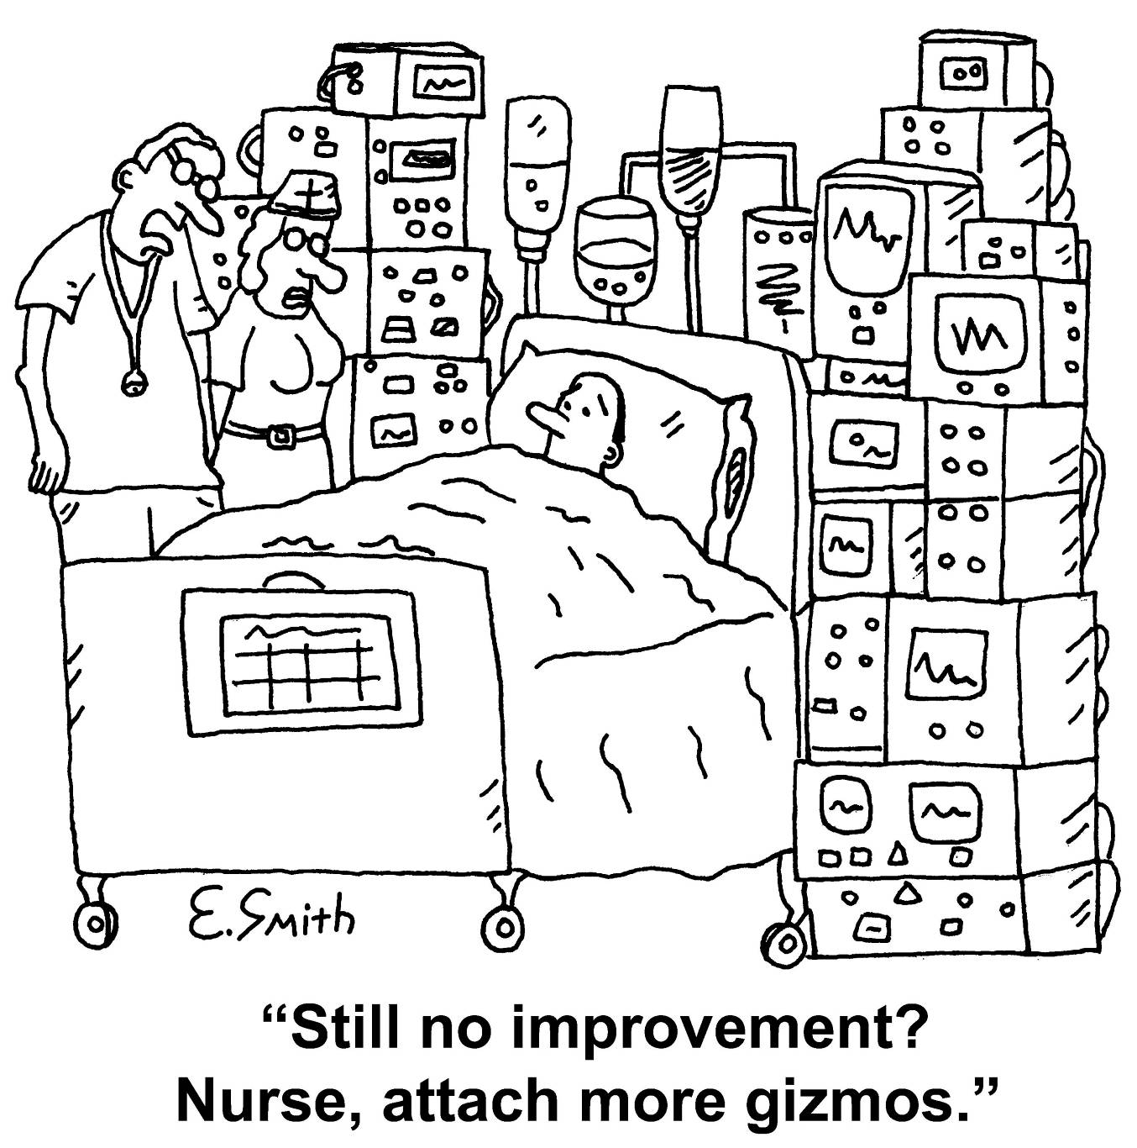
THANK YOU!

