Slide 1
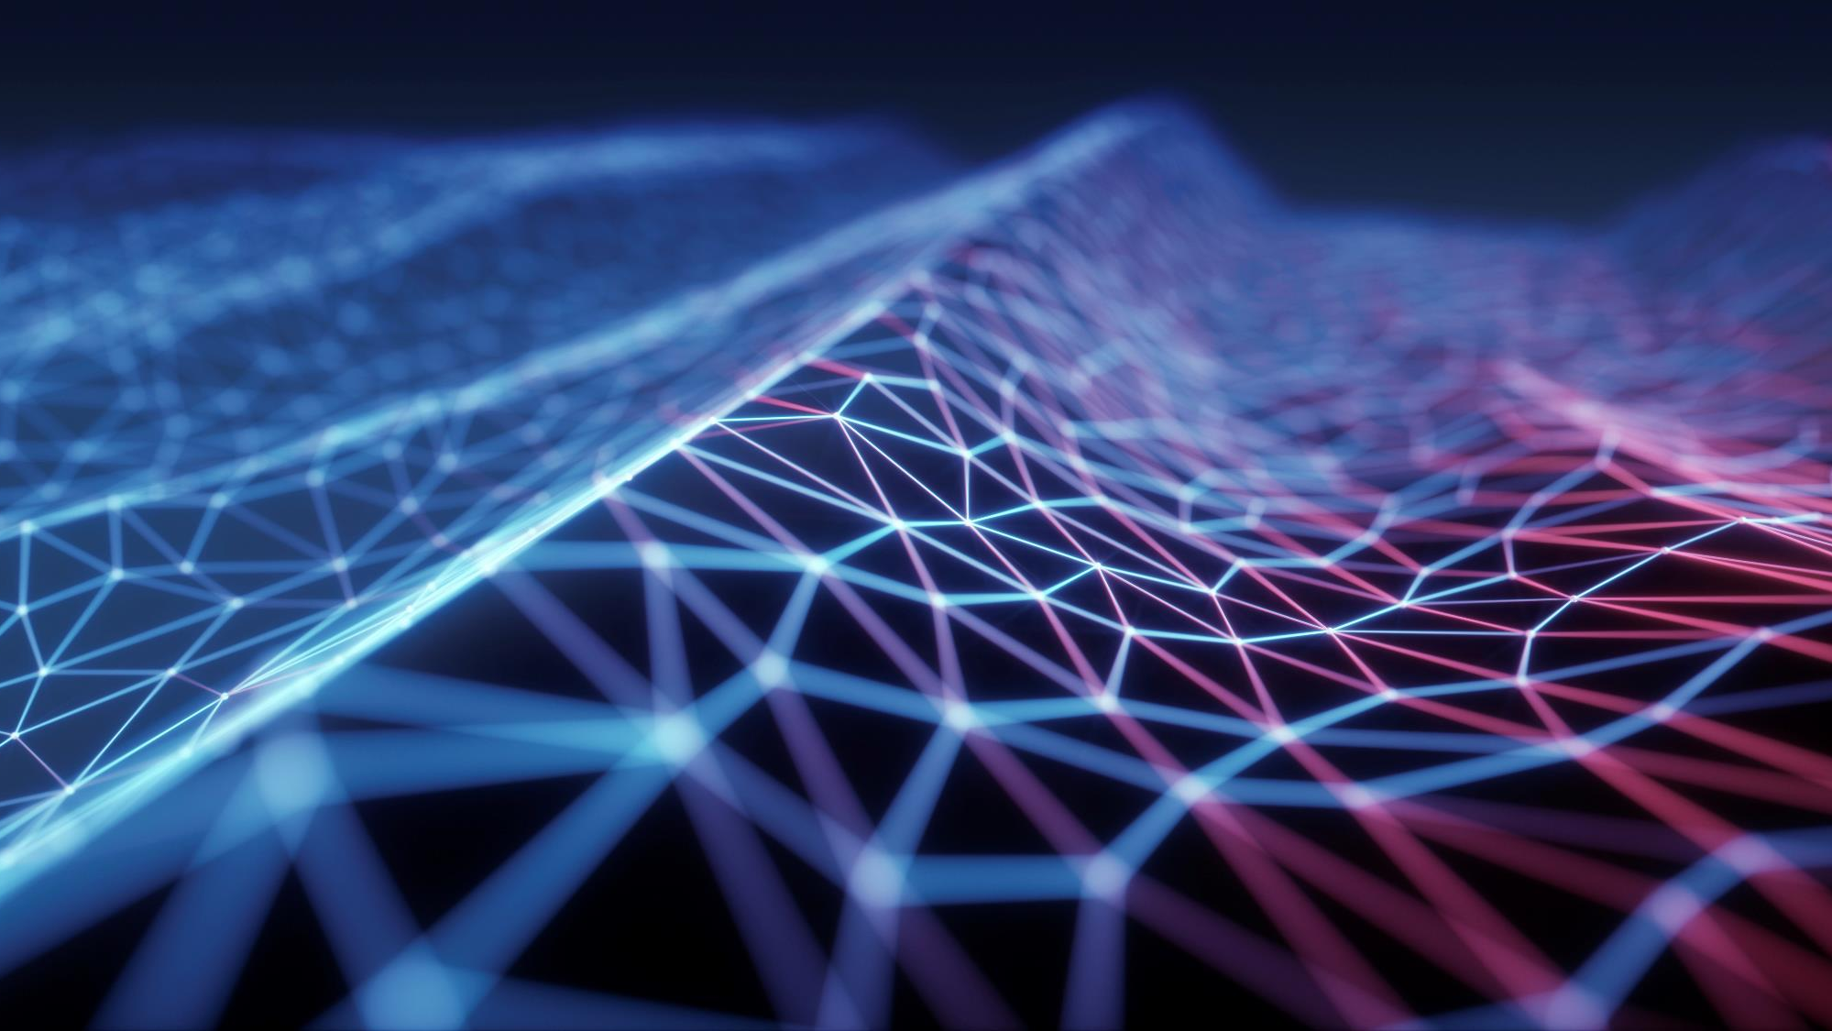
Professional Self-Management in a Chaotic Environment
Presented by Shawn molloy
Notes:
Introduction
Shawn Molloy System Director with Trimedx in the University of Chicago Health System
During this presentation we will test our awareness and perception of time and explore ways of organizing and managing out time in the chaotic setting we work in.

Slide 2
Professional Self-Management in a Chaotic Environment
Itinerary
Time Defined
The Stone in a Jar
Perception of Time
- Perception Experience 1
- Perception Experience 2
- Why it matters?
Too much to do
-Prioritize
-Manage your Calendar
Master your Tools and Technology
-Master your Email
-Phone Calls
-Chrome
-Excel
Notes:
We will quickly define time, and then spend a little bit of time becoming familiar with the Perception of time and how that affect out perception of productivity.
Then we will look at different elements of time and our management of these task to get the most out of every hour, minute, and second of the day.

Slide 3
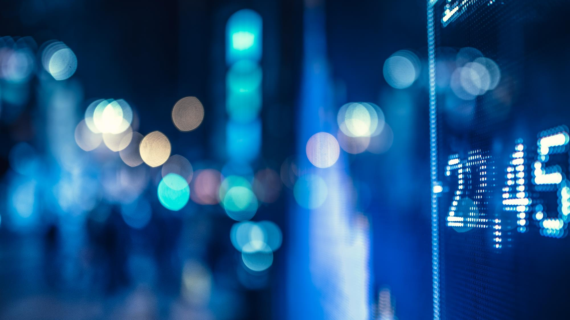
Time Defined
The measured or measurable period during which an action, process, or condition exists or continues : DURATION
A nonspatial continuum that is measured in terms of events which succeed one another from past through present to future.
Notes:
Time has a multitude of definitions and uses. What time is its? Time to take time to talk about time. Some of you are timing me right now. It about time. There was a time, I have no time, I have too much time, its timeless, time flies, no time like right now, killing time…. It’s a verb and a noun. Its considered a dimension that travels in a perpetual line for us 3 dimensional beings, always moving forward, and never backwards, we can only see on direction in time, the past and the present. The future reveals itself to us, over time.
We understand that time is a continuum and we wish to master the actions and processes that occur within its spectrum.
However is the perception of time the same for each of us. Is one sec a sec to all.
Well yes and no.

Slide 4
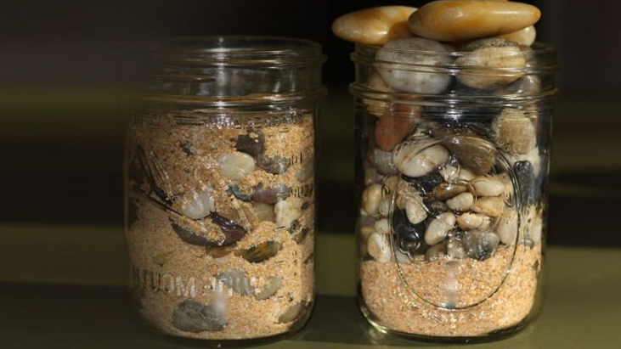
Stones, Rocks, Sand in a jar
The jar represents our day.
Stones are important but rare events that take 3 hours or more.
Rocks are specific items that occur often and take around an hour to 30 minutes.
Sand are small task that occur frequently and take less this 30 mins.

Slide 5
Stones, Rocks, Sand in a jar
Mixing in the stones, rocks, and sand allows for everything to fit.
Be specific with the placement of your stones.
Surround your rocks with sand.
Sand clusters together

Slide 6

Stone Event
- Large unmovable Objects in Time
- The choice here is yes or no
- Look for a less time-consuming option

Slide 7
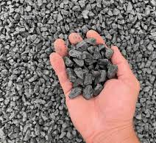
Not your Rocks
-do you bring value
-delegate
-yes or no
-respect the owner (you are a participant)
-Know context and be prepared
-stay on topic
-don’t interrupt

Slide 8
Own Your Rocks
-Set Proper Time
-Create and send itinerary
-now what results you need and record future actions requested
-Don’t start until all are present
-set proper time, 15 mins?
-only choose necessary attendants
-maintain command and control
-Use a parking lot

Slide 9
Own Your Rocks
- Cancel meeting if priorities change
- Verify Technology and room before
-stay on track (Have a plan)
-Keep Roundtable to the meeting on hand, sidetracks go to parking lot.
-recap your results and actions requested with deadlines.
-the meeting is over when it over…. Try to end on time or early… Never late.

Slide 10

Sand
-group these into blocks of time that occur periodically
-allow them to be tentative so they can surround your meetings as secondary task
-utilize Hacks, short cuts, Continues improvement, and technology

Slide 11

Water- Time Perception

Slide 12
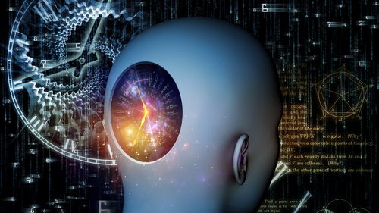
Perception of Time
Characteristics of the Time Experiencer
Age- Memory of time
Health
Time-related Behaviors and Judgment
Emotion
Awareness
Attention
Contents of a Time Period
Volume
Fulfilment
Density
Activities During a Time Period
Complexity
Enjoyment
Novalty
Notes:
Volumetrically time is time and relative to the earths rotation and orbit of the sun. 60 seconds to a minute and 60 minutes to an hour and so on and so on.
But the funny thing about relativity is that things are only relative to your focal point and that focal point has conditions of relativity.
Time can be perceived very differently from person to person and moment to moment.
Several factors can manipulate the perception of time for a person.
These are some of those factors.

Slide 13
Perception of Time
Characteristics of the Time Experiencer
Age- Memory of time
Health
Notes:
Volumetrically time is time and relative to the earths rotation and orbit of the sun. 60 seconds to a minute and 60 minutes to an hour and so on and so on.
But the funny thing about relativity is that things are only relative to your focal point and that focal point has conditions of relativity.
Time can be perceived very differently from person to person and moment to moment.
Several factors can manipulate the perception of time for a person.
These are some of those factors.

Slide 14
Perception of Time
Time-related Behaviors and Judgment
Emotion
Awareness
Attention
Notes:
Volumetrically time is time and relative to the earths rotation and orbit of the sun. 60 seconds to a minute and 60 minutes to an hour and so on and so on.
But the funny thing about relativity is that things are only relative to your focal point and that focal point has conditions of relativity.
Time can be perceived very differently from person to person and moment to moment.
Several factors can manipulate the perception of time for a person.
These are some of those factors.

Slide 15
Perception of Time
Contents of a Time Period
Volume
Fulfilment
Density
Notes:
Volumetrically time is time and relative to the earths rotation and orbit of the sun. 60 seconds to a minute and 60 minutes to an hour and so on and so on.
But the funny thing about relativity is that things are only relative to your focal point and that focal point has conditions of relativity.
Time can be perceived very differently from person to person and moment to moment.
Several factors can manipulate the perception of time for a person.
These are some of those factors.

Slide 16
Perception of Time
Activities During a Time Period
Complexity
Enjoyment
Novelty
Notes:
Volumetrically time is time and relative to the earths rotation and orbit of the sun. 60 seconds to a minute and 60 minutes to an hour and so on and so on.
But the funny thing about relativity is that things are only relative to your focal point and that focal point has conditions of relativity.
Time can be perceived very differently from person to person and moment to moment.
Several factors can manipulate the perception of time for a person.
These are some of those factors.

Slide 17
Why it Matters
Slowing down the perception of time does not allow you to accomplish more.
Being aware of your perception of time will allow you to bring more value to your day and understand your feeling of accomplishment.
Being aware of perception CAN help you enrich your time at work.
Being aware of perception CAN help you enrich your free time.
Notes:
The truth is all images occurred at the same amount of time.
This is referred to as the odd ball effect. Where our brains take longer to process unusual or abnormal data and extends the perception of time.

Slide 18
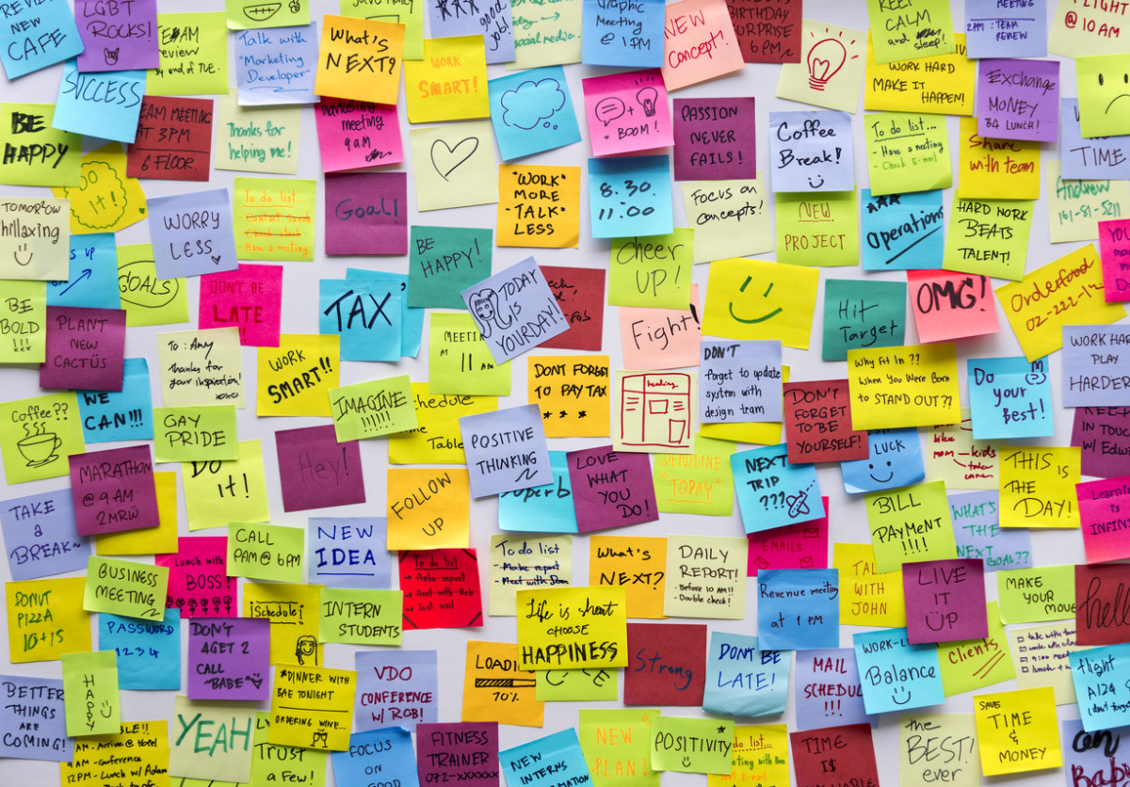
TO much to do

Slide 19
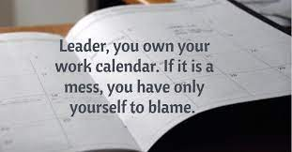
Calendar Tips

Slide 20
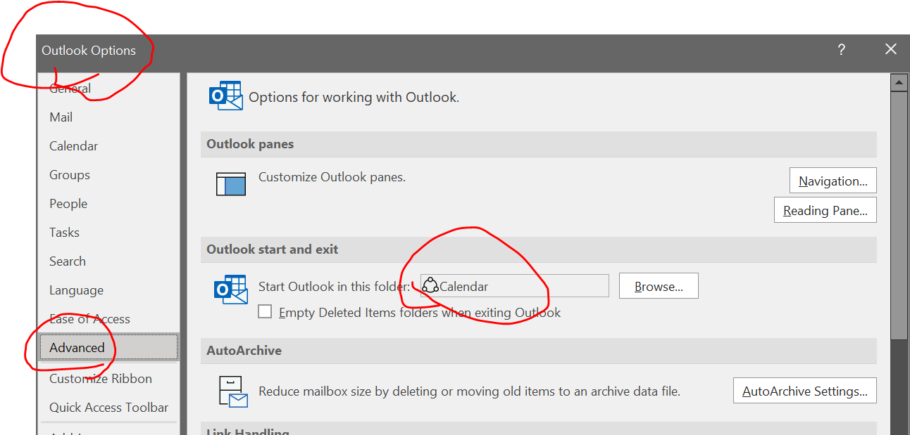
SET YOUR Outlook to default to Calendar when it opens

Slide 21
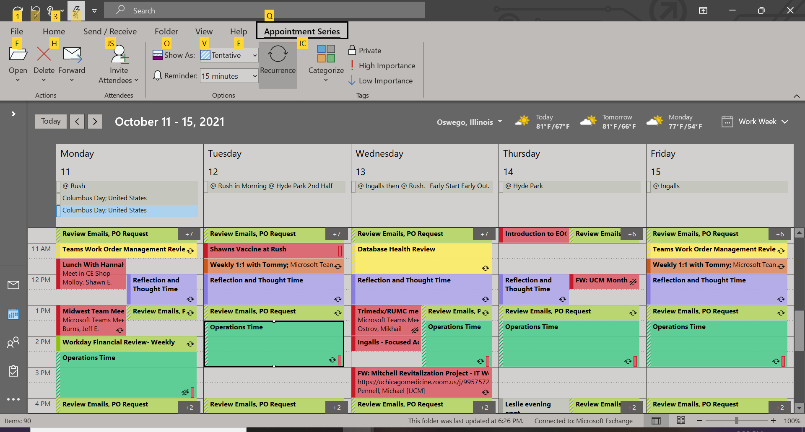

Slide 22
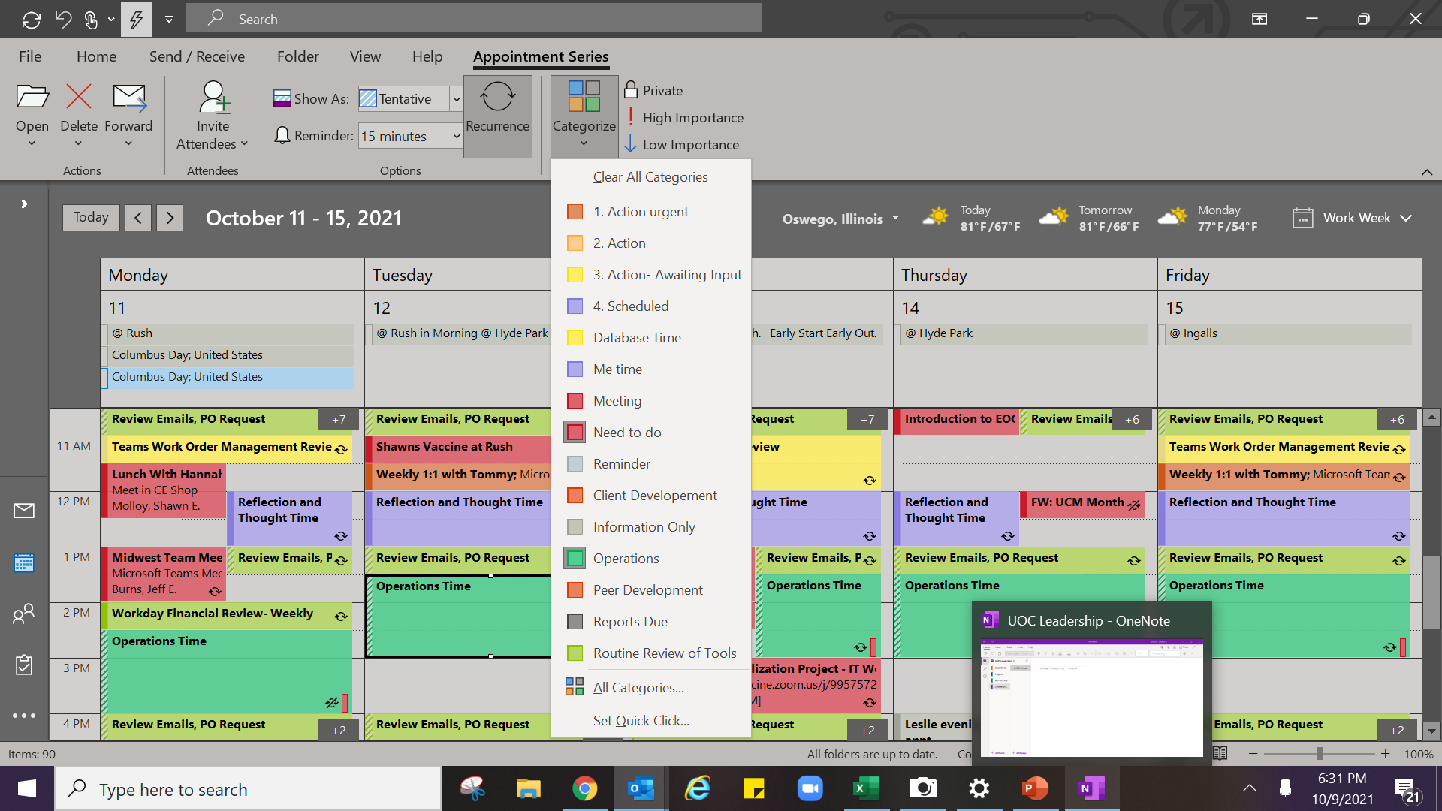
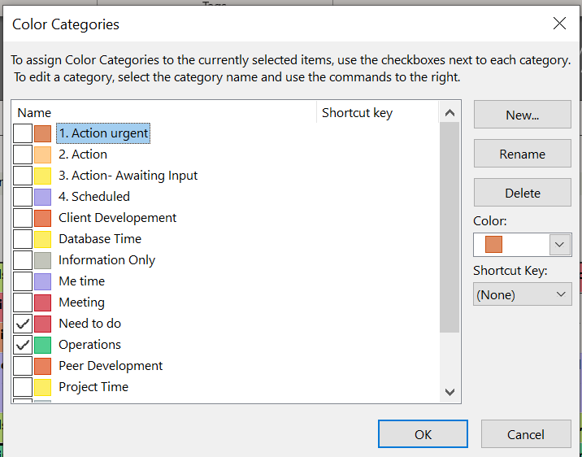

Slide 23
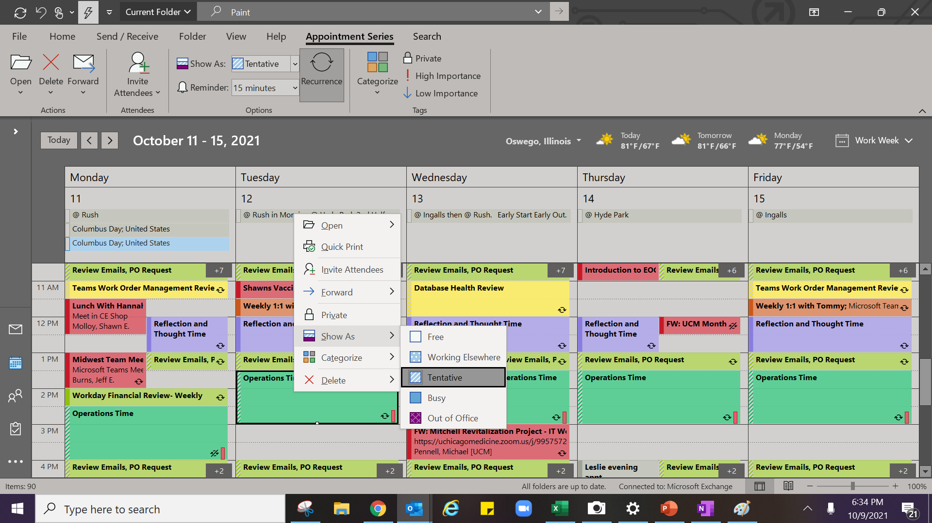

Slide 24
Quick Tips
-Copy and paste alike emails
-If its not scheduled its not a priority
-Set a week in advance, review two weeks in advance.

Slide 25
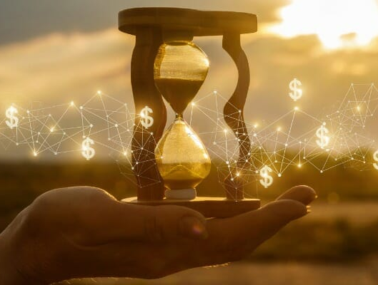
Make Investments IN Time, do not make deductions

Slide 26
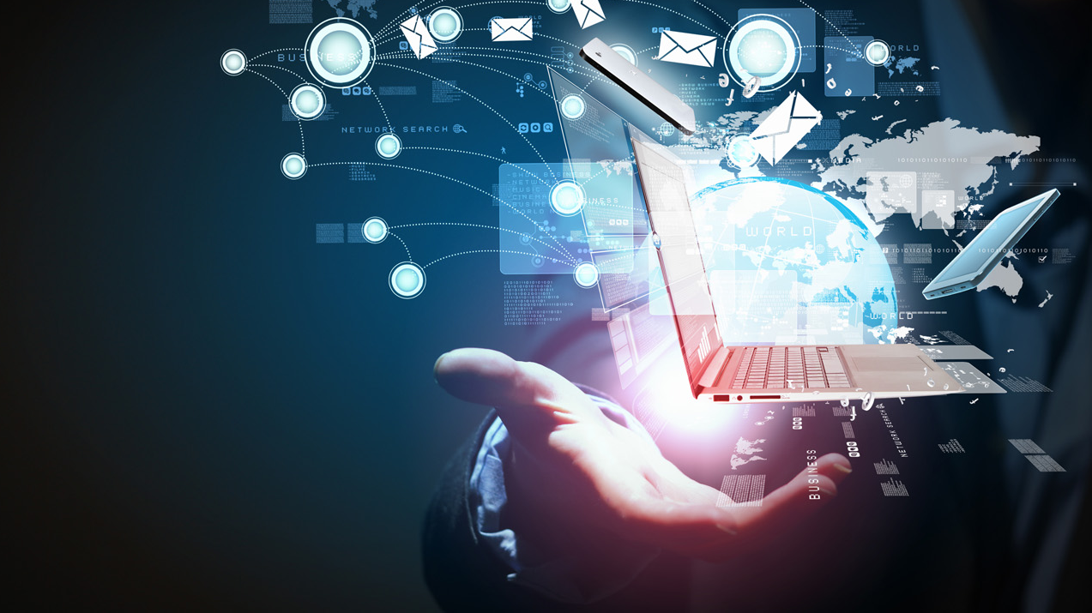
Master your tools and technology

Slide 27

Email

Slide 28
Email Tips
- Emails do not require an immediate response
-check during set periods of time
-Utilize Technology

Slide 29
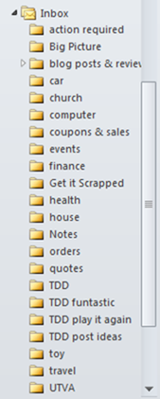
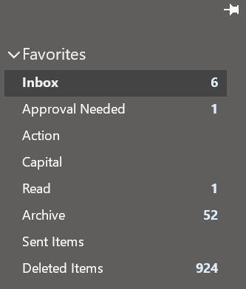
Minimalize your folders

Slide 30
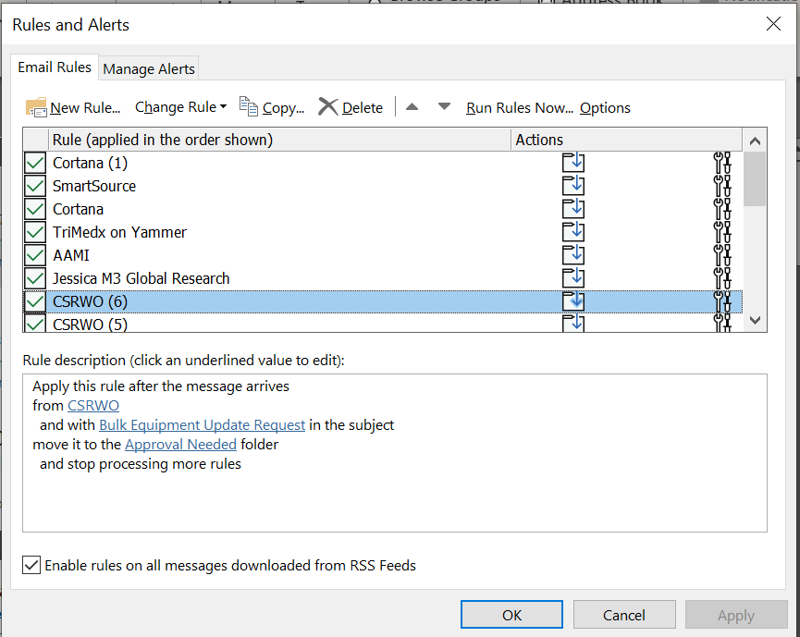
Use rules for more then filtering out junk.
-Move to action folder ,mark as Unread ,and send notifications

Slide 31
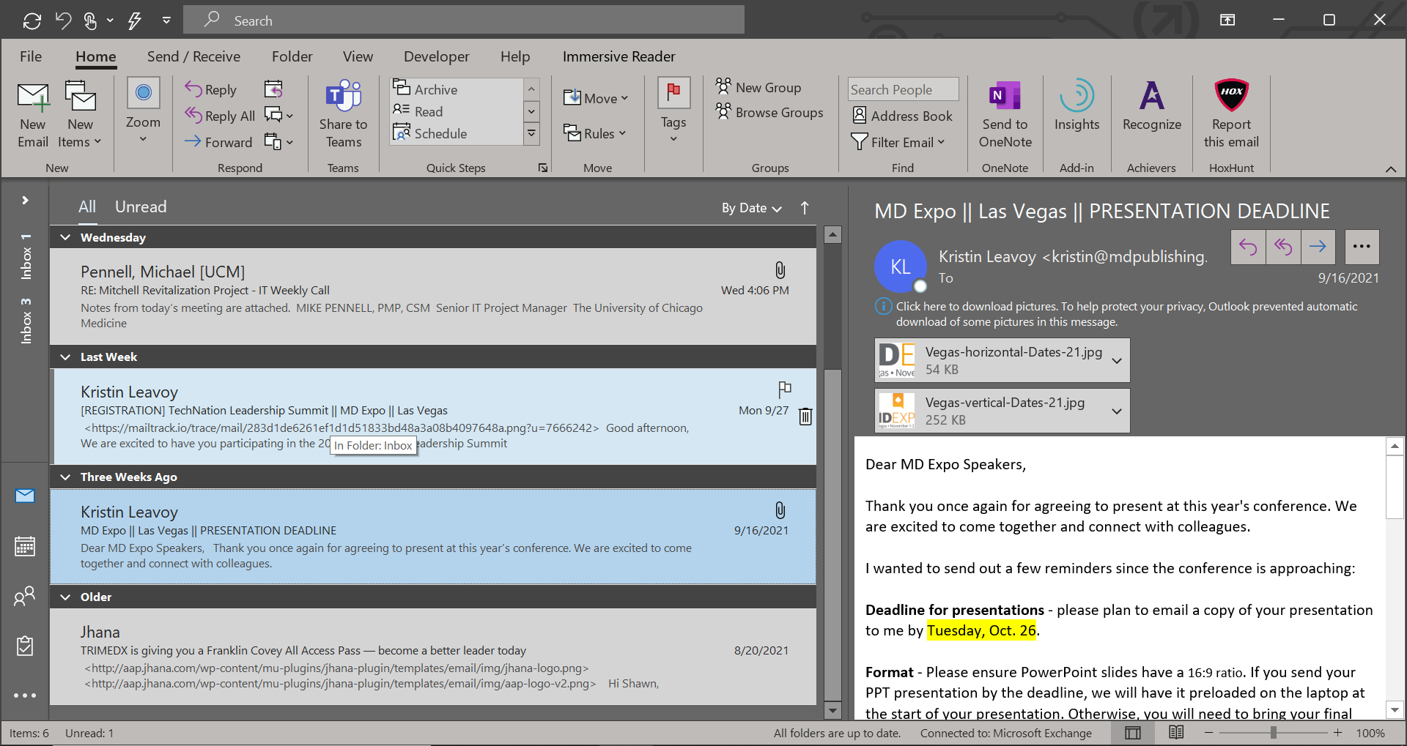
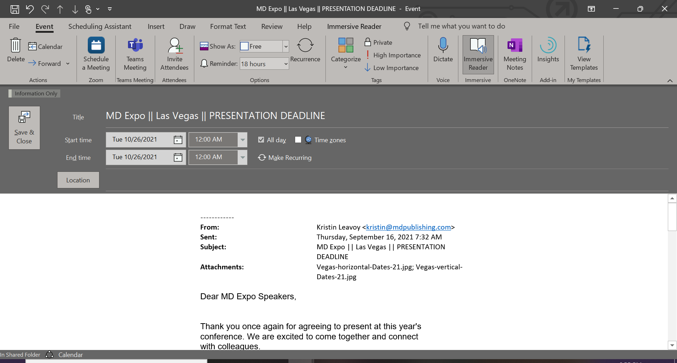
Dragging emails to the icons for Schedules, To do list, and contacts.

Slide 32
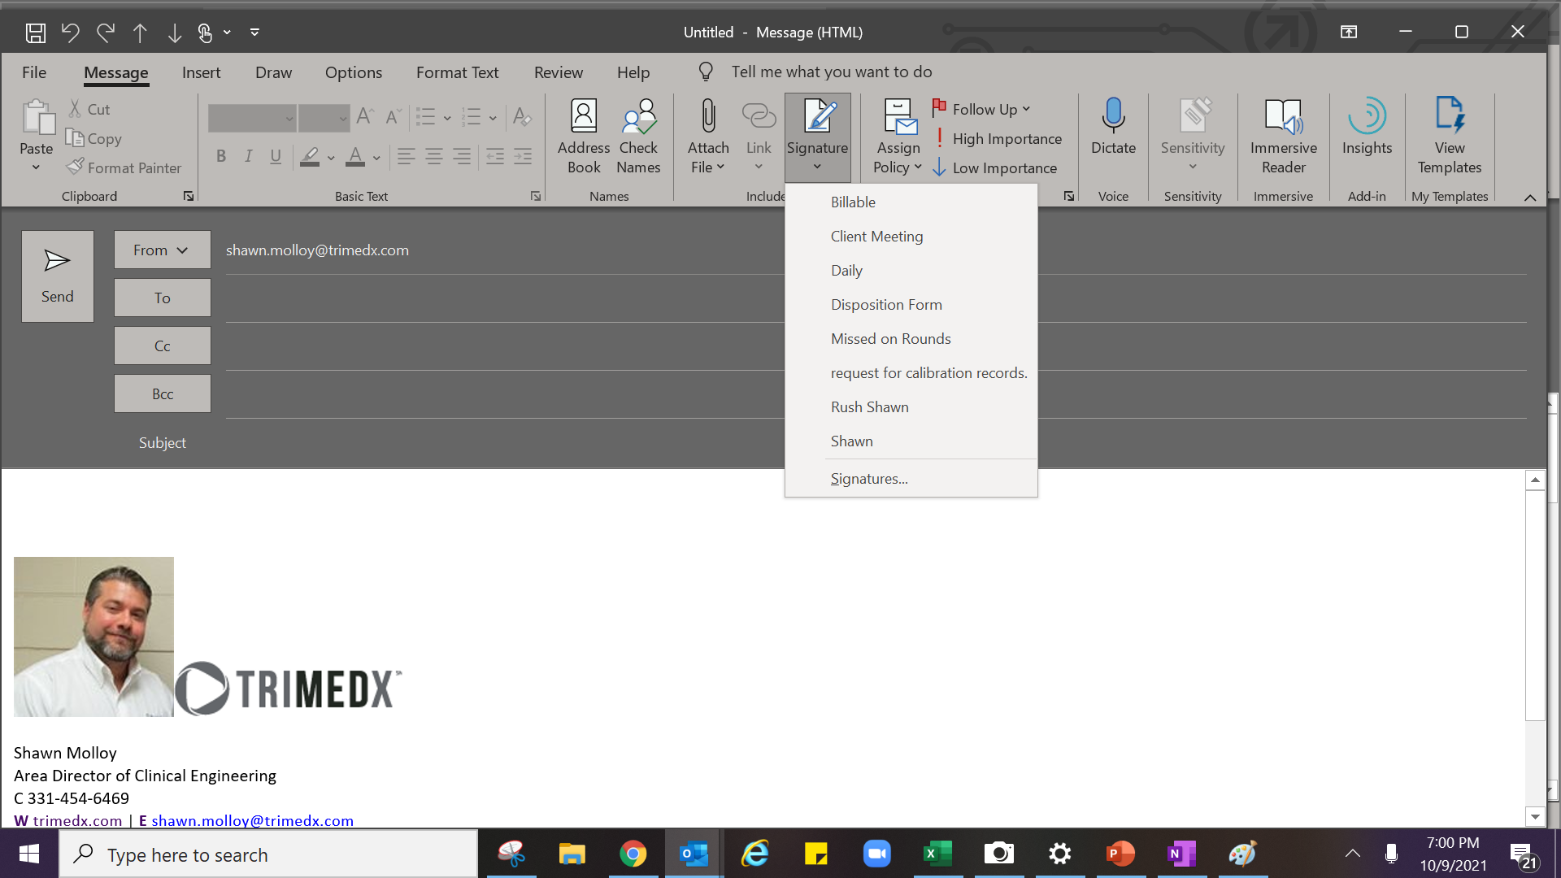
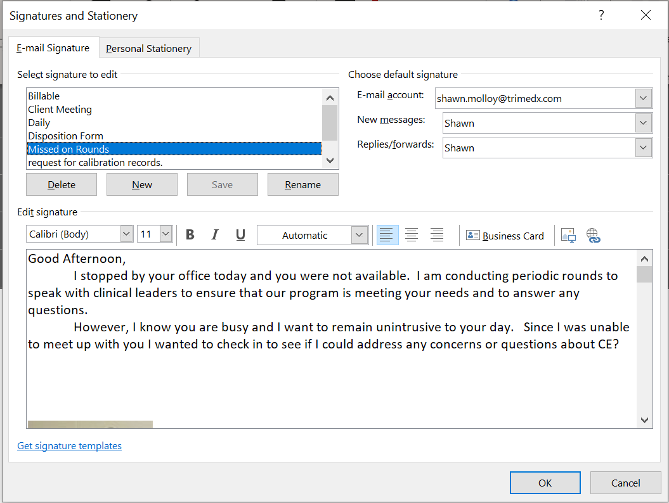
Use Signatures as templates for repeat emails.

Slide 33
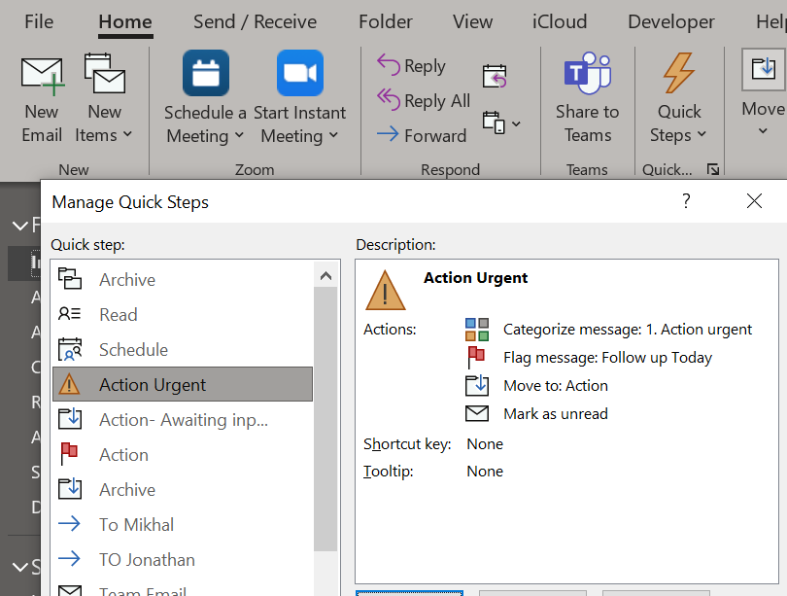
Utilize quick task to quickly execute multiple steps.

Slide 34
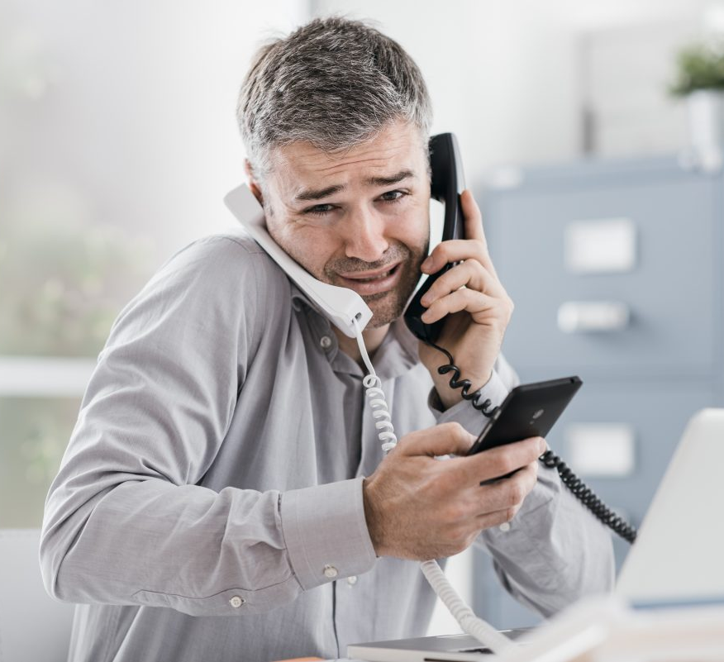
Plan your phone call time
-important calls
-Have a plan
-Consider signal strength
-Stick to the point
- Don’t multitask
-Non-Important
- Limit frequency and duration

Slide 35

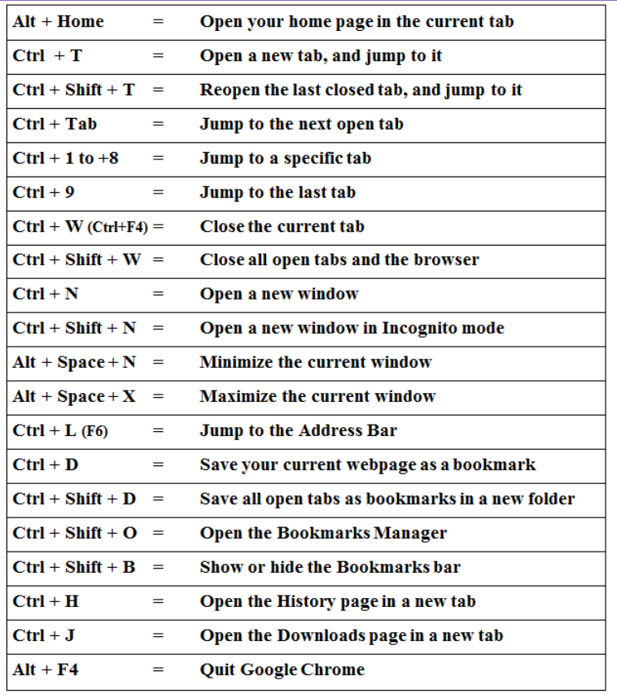
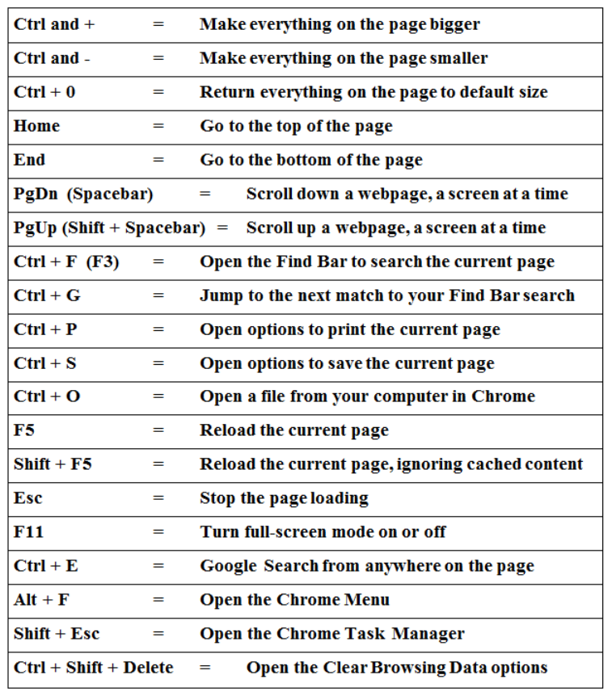

Slide 36

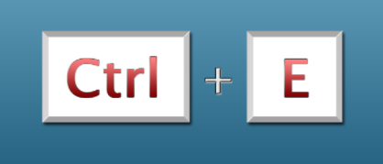
Excel Tips
FIRST | LAST | LAST 4 | PHONE | FIRST AND LAST | FIRST INITIAL LAST | FIX PHONE | LAST INITIAL LAST 4
john | smith | 1111 | 1111111111 | JOHN SMITH | JSMITH | 111-111-1111 | j1111
tom | johns | 2222 | 2222222222
jan | thomas | 3333 | 3333333333
tim | marks | 4444 | 4444444444
Tina | Roberts | 5555 | 5555555555
Dan | Marks | 6666 | 6666666666
Phil | Charm | 7777 | 7777777777
FIRST | LAST | LAST 4 | PHONE | FIRST AND LAST | FIRST INITIAL LAST | FIX PHONE | LAST INITIAL LAST 4
john | smith | 1111 | 1111111111 | JOHN SMITH | JSMITH | 111-111-1111 | j1111
tom | johns | 2222 | 2222222222 | TOM JOHNS | TJOHNS | 222-222-2222 | t2222
jan | thomas | 3333 | 3333333333 | JAN THOMAS | JTHOMAS | 333-333-3333 | j3333
tim | marks | 4444 | 4444444444 | TIM MARKS | TMARKS | 444-444-4444 | t4444
Tina | Roberts | 5555 | 5555555555 | TINA ROBERTS | TROBERTS | 555-555-5555 | T5555
Dan | Marks | 6666 | 6666666666 | DAN MARKS | DMARKS | 666-666-6666 | D6666
Phil | Charm | 7777 | 7777777777 | PHIL CHARM | PCHARM | 777-777-7777 | P7777

Slide 37
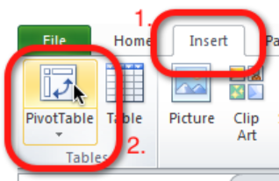
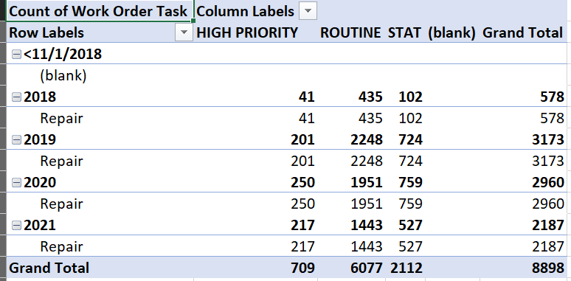
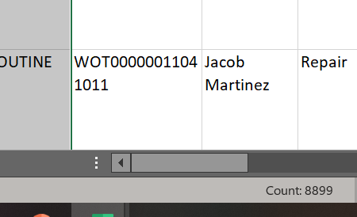
Excel Tips

Slide 38

Be aware of and manage your time waste
-Eliminate waste
-When it can’t be avoided multitask
Notes:
When old hold Multitask.
Listen to podcast on long drives

Slide 39
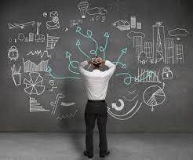
Final Thought

Slide 40
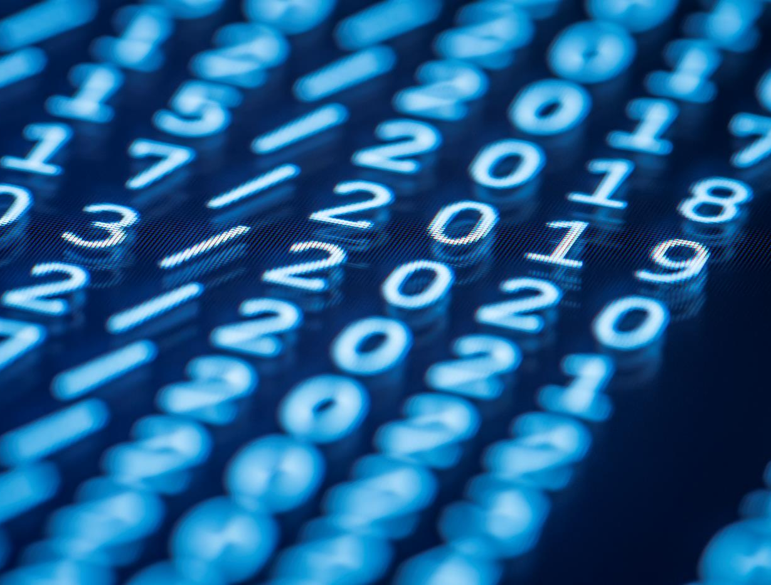
Thank You for your time

