Slide 1

Customer Service Performance Improvement and the Cost Saving Results
James Anderson, Director, Healthcare Technology Management, Spring Valley Hospital, Desert View Hospital, & Valley Health Specialty Hospital
Christopher Nowak, CBET, CHP, CSCS, Senior Director, Healthcare Technology Management, Universal Health Services

Slide 2

Topics – Agenda - Points
Exceptional Customer Service
  Creating the Mindset
Savings
  Money
  Less Work
Take Action
  Enjoy Life doing it

Slide 3

Customer Service Defined
​The help and advice that a company gives people who buy or use its products or services. Oxford University Press (2021)
Customer service is the provision of service to customers before, during, and after a purchase. The perception of success of such interactions is dependent on employees "who can adjust themselves to the personality of the guest". Buchanan, Leigh (1 March 2011). “A Customer Service Makeover”. Inc. magazine

Slide 4
My Favorites from Customer Service Manager
“Customer service is the ability to provide a service or product in the way that it has been promised”
“Customer service is an organization’s ability to supply their customers’ wants and needs”
“Customer Service is a phrase that is used to describe the process of taking care of our customers in a positive manner”
“Customer service is a process for providing competitive advantage and adding benefits in order to maximize the total value to the customer”
“Customer Service is the commitment to providing value added services to external and internal customers, including attitude knowledge, technical support and quality of service in a timely manner”
“Customer service is a proactive attitude that can be summed up as: I care and I can do.”
2021 Definition of Customer Service, CSM, The Magazine for Customer Service Managers & Professionals

Slide 5
What is Exceptional Customer Service?
Your customers define exceptional customer service.
Exceptional customer service is the unconditional commitment to giving the highest level of product or service to every person, regardless of the circumstances.
It doesn’t matter if the customer is at fault for the issue. It doesn’t matter if it’s a once-in-a-lifetime situation. When you’re thinking about how to deliver exceptional customer service, remember this simple motto: Do anything and everything within your power. Elizabeth Wellington, 8 Companies with Exceptional Customer Service + Helpful Tips, 2021 HelpScout

Slide 6
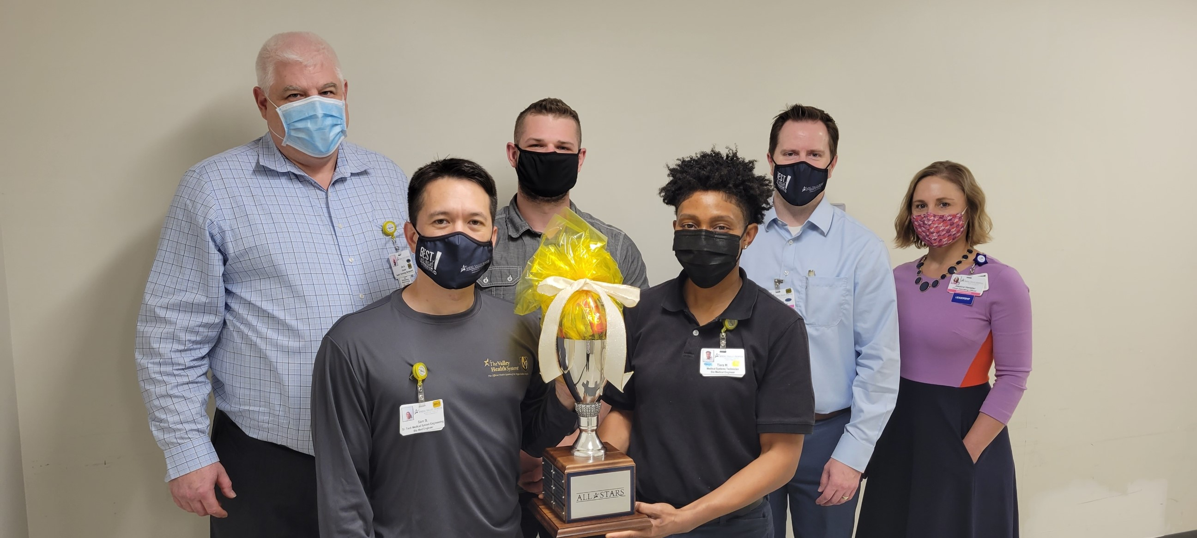
Exceptional Customer Service has Rewards!

Slide 7


Competition
Versus
Build a team as if it was your own business.
Build your business believing you customers have a choice.
What would you do differently if there was another HTM department in facility to call? At the end of 2nd year, the hospital keep the best team.
  Expanded hours – Earlier and later
  No interruption PMs – done after-hours
  Quicker response
  Better trained team
  Project Management
  Would you answer the phone differently?

Slide 8

Own Every Problem
Own every problem that comes to HTM
Not my job, not in our scope, someone needs to, or anything that doesn’t help our customer is forbidden.
  Train your team
  Be an example
Every interaction is a chance to help, it is also a chance to learn.
  Our customer contacts us, because they trust us.
Extreme Ownership: How U.S. Navy SEALs Lead and Win, Jocko Willink & Leif Babin, St. Martin’s
Notes:
Asked to help find scissors for cutting Ortho Glass casts

Slide 9

Communication
Communication – Communication – Communication
From the time the problem/issue/request is made.
  It is our problem now; the clinical department can focus on something else.
  Train your team
  Be an example
Follow up
  Share steps in the process
  Share ETA
  “I DON’T KNOW” is an appropriate answer sometimes, but please expand on the reason.
Human nature will fill in blanks that we leave out.
Notes:
Relieve the departments you support of the burden ‘how is this going to get fixed’
Sharing is important, - (even when we talk in HTM jargon sometimes)

Slide 10
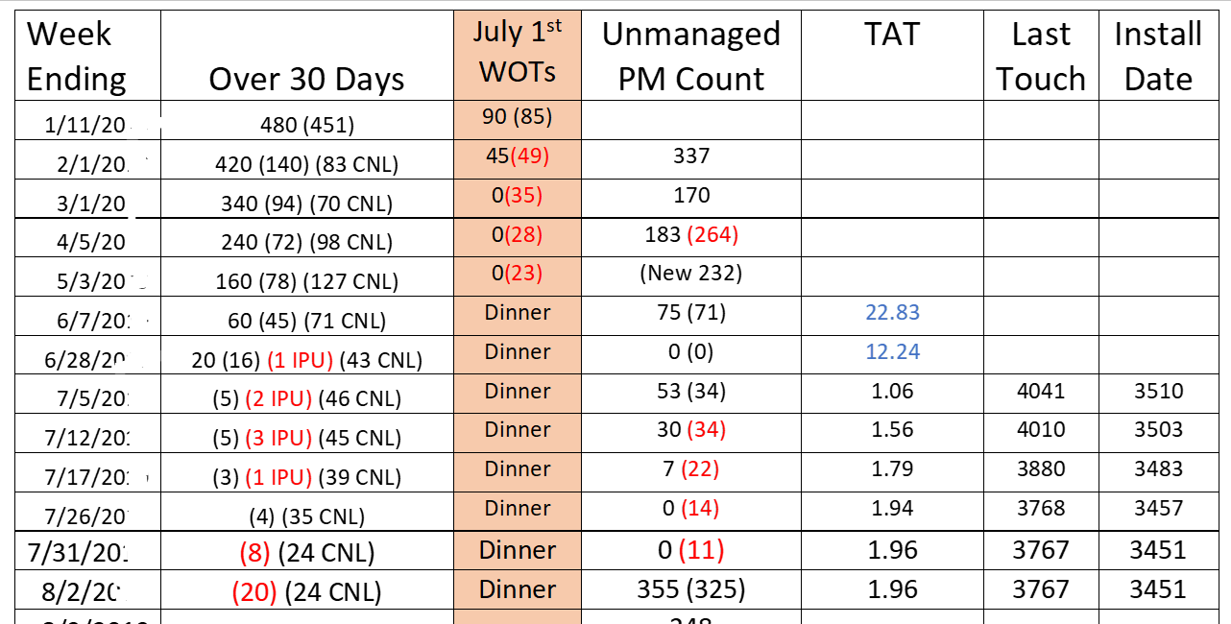

Find a Way to communicate
Share the KPIs/Metrics/Scores with your teams that do the work, let them know what goals to set so they can succeed.

Slide 11
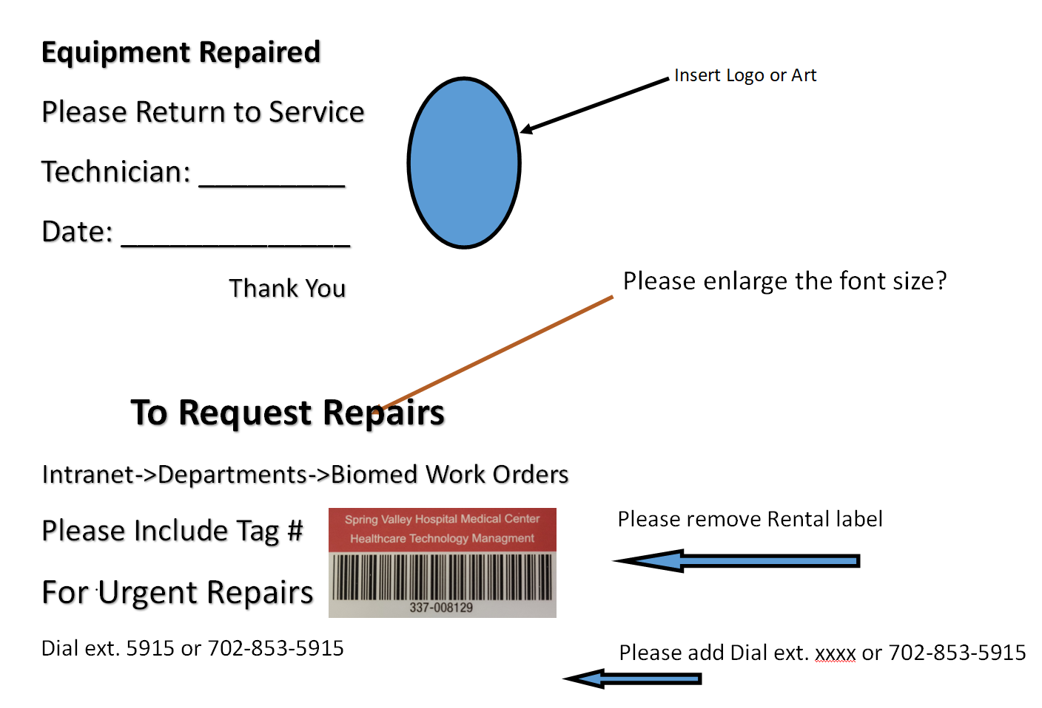
Find More Ways to Communication
Let people know you fixed the device and share a little information on how to place service requests in the future.

Slide 12

More Communication
Be the trusted expert.
Interact with your leaders in the manner they want.
  Face to Face – not as much anymore
  Phone – when written explanation doesn’t do justice
  Email – when the recipient may need some time to review, good for pictures, and non-urgent request.
  Text – Great for quick updates and questions.
  Interoffice mail – just kidding, do people still use that?
Ask for Feedback
Notes:
Trust is the key
In the manner they want is key, not how you want to communicate

Slide 13
Turnaround Time
Improved Turnaround Time:
  Builds trust
  Simplifies HTM (leadership) work
    Reduced inquiries from clinical colleagues regarding status concerns.
    Reduced capital equipment needs is reduced maintenance.
    Exceptions that fall outside the norm are easier to identify.
    HTM Department is cleaner
  HTM Leaders discuss how team members’ actions or inaction effect HTM team goals and so they understand how they directly affect that time.
  Repairs that take longer than two weeks, look in to why?
Notes:
Only share team results, allow exceptions for Recalls/Notices, OEM backorders, and investigations. Balancing with shipping costs, 2nd Day a great option. A real dislike for me is Overnighted Parts sitting and waiting for installation.

Slide 14
Teams and Committees
Step out beyond EOC Committee, join something out of your comfort zone.
HTM can help improve your hospital, our skills sets and troubleshooting processes are great resources to many non-HTM areas.
  Share your talent.
  Encourage your team to share (and learn)
  Lead by example
  Visit Department Meeting, answer questions
Start a Team or Committee.
  Noise Reduction
  Multi-Year Equipment Planning
Notes:
I am asked to find Ortho-Glass Cast Cutting Scissors
I started a team to find ways to reduce noise in the working environment

Slide 15

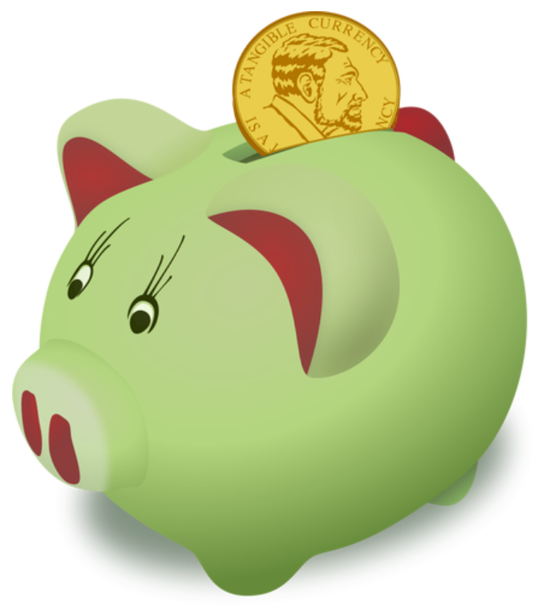

Cost Savings, The Golden Ticket
Cost savings is the benefit realized from actions that reduce an organization's overall spending on assets that directly impact its bottom line. Actions that can result in cost savings range from improving efficiency to negotiating lower prices for supply purchases. 2021, Gartner Glossary, Gartner
Employee expense and total department expense are often inverse. Additional HTM staff will save the hospital money with good leadership.
Notes:
Refurbished Fan Assembly $600 - $1,100, cost of exact replacement fans $16, Rivet $8, time $125 (including benefits)
Not always successful, but time is a very important factor to saving money.
App universe has taught us and vendors that lots of small transactions can produce huge profits.

Slide 16
How does customer service save money?
Capital Expense:
  Hospitals that trust HTM for timely repairs buy less spare capital equipment.
  HTM is involved in the planning stages.
    What power protection steps are we taking?
    How do we plan to service the equipment for next seven (7) years?
    Why are we being charged for new network switches again?
Overnight Shipping:
  Leaders that trust HTM are less demanding for quick repairs, there is trust the repair will be timely and not forgotten/misplaced/ignored.
  HTM teams plan ahead with some spare parts, either because it is a routine replacement part or urgency of repair (aka downtime). **
Routine Damage:
  Communication with leaders about training and other ways to limit damage.
  Breakaway cords, cost is more, but then savings is even more.
**Must balance Risks and Rewards
Notes:
We keep a hydraulic manifold on hand for our ICU beds, we average once a month: we order each to be delivered ground.
We are able to repair that ICU bed the same day, if time allows.
I realize this is a balancing act, you might not always win.

Slide 17

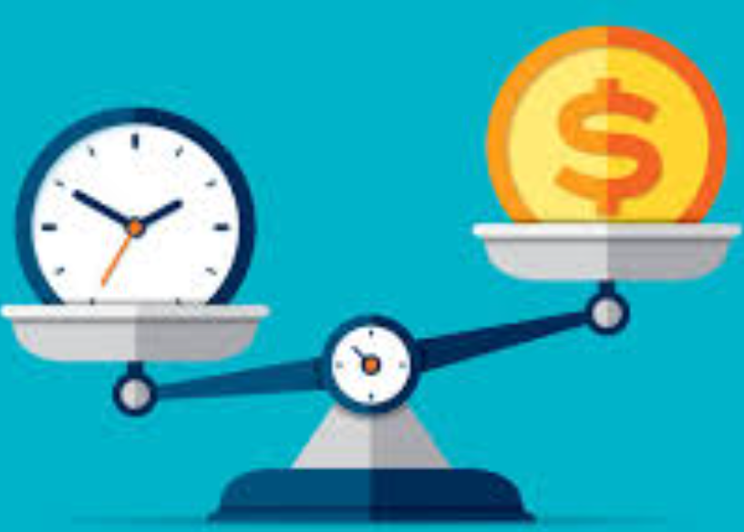
Turnaround Time
  Uptime allows the hospital to make a bunch of income.
  Downtime puts unnecessary stress on clinical caregivers.
Communication
  Time is money, your team’s time is money, invest and collaborate with other departments. The payback is worth it.
  Asking why has saved more time and money than anything I know.
Help solve problems outside your department.
  You really can help make a difference. Save time and money, plus you might learn something.
  My interest in Audio/Video has saved hospitals money (outside of HTM).
Notes:
What is it now $50k to replace a nurse?
We have always done it that way.

Slide 18
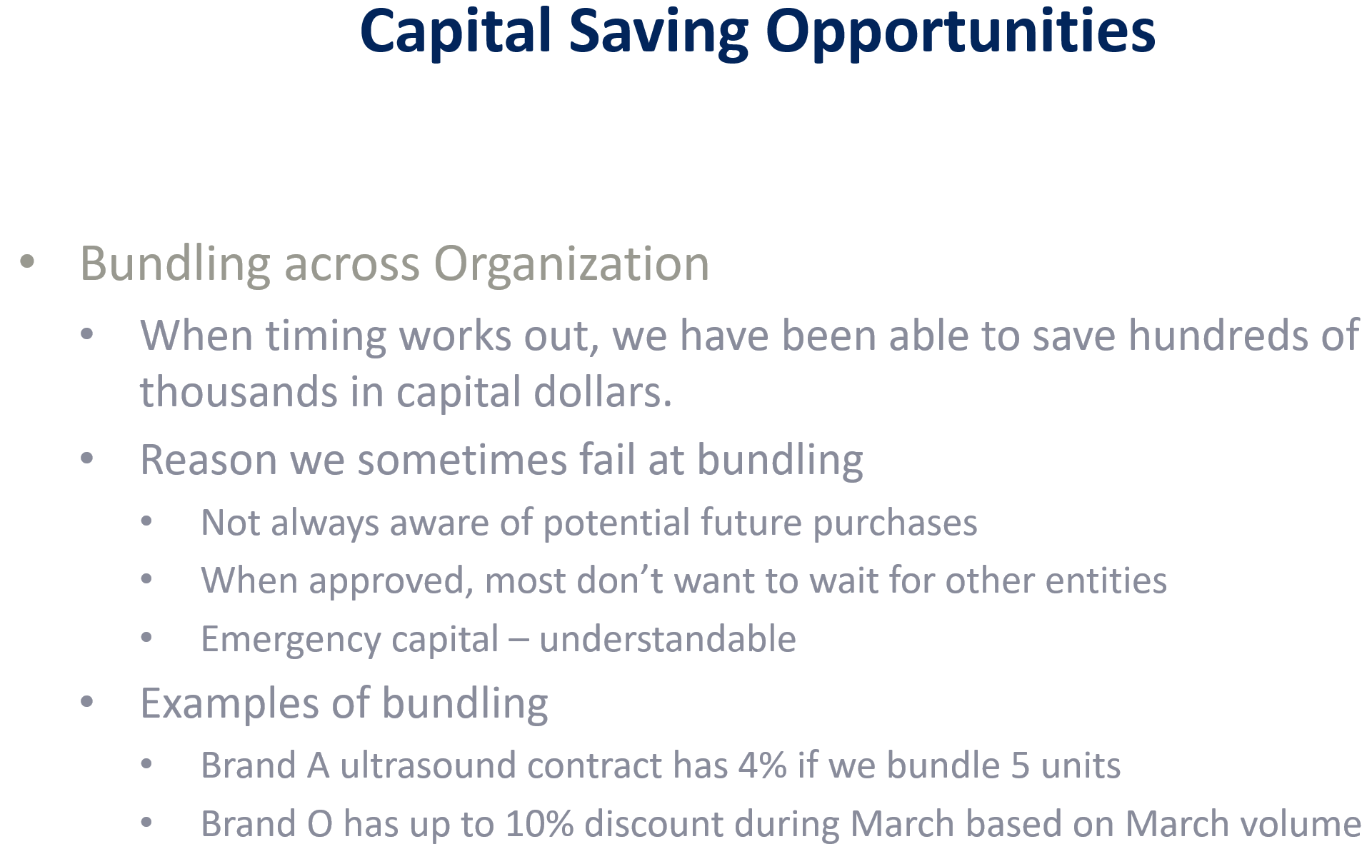
Capital Savings
Trust and Communication are the biggest roadblocks to savings!

Slide 19
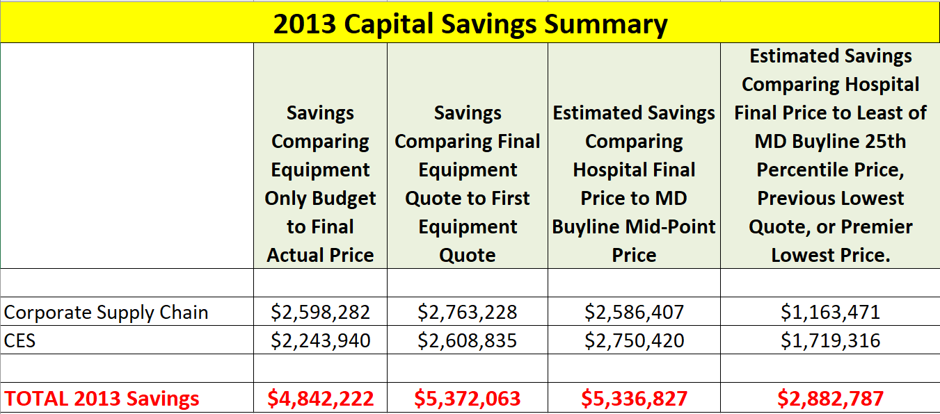
Real Savings Really Happen
Based on $16M of Capital when HTM was ask to participate in the process.
The participation rate increased but saving in last column remained flat.
Notes:
Savings is continually harder to achieve for the same items already on contract. What this slide doesn’t show is the FREE HTM Training, Free Clinical Training we got as part of value adds in our agreements.

Slide 20
More Saving and Less Work!
Less Service Calls
  Clinical caregivers that trust HTM are much more likely to take better care of their equipment and report small problems early on.
  P.S. Clean equipment before you return it, always! Fix/replace damaged covers and cases. Clean equipment is treated better.
  When equipment lasts longer, capital savings is also realized.
  Less downtime means less capital and less equipment to service.
Less Troubleshooting
  Clinical caregivers that trust HTM are much more likely to share more about the problem than “It’s Broken”.
  More communication leads to more collaboration.
Notes:
Shiny cars are treated better dumpy cars, if you don’t care why should they.
Thank You so much for your help, it saved me so much time.

Slide 21

Take Action
My favorite quote is “I work hard to be lazy”.
Change is the hardest part of the whole process.
  HTM Team
  Hospital Leadership
  Clinical Caregivers
  Yourself (Okay, this might be the hardest of the hardest)
It will take time; you may even have to start over.
People are encouraged by positive changes so keep going and keep a positive attitude.
There are so many benefits beyond cost savings – mostly peace of mind with established practices.
Notes:
We have all damaged new boards or parts while repairing equipment. If you learn something it is positive.
Don Franks, there are only two types of people that don’t break stuff during repairs, the ones that lie and ones that don’t do repairs.

Slide 22
Take Care – Be Mindful – Be Aware
Take Care of your team
  Challenges and changes affects people differently treat each one of them as individuals.
  Celebrate successes and often; positive reinforcement is the best tool you have for creating and keeping an awesome team.
  H.A.L.P. Hungry – Angry – Lonely – Pain reduce people’s chances to be successful, your eyes and ears can help catch this early.
Take Care of yourself
  Be honest and truthful to yourself and about yourself.
  Ask for help early on.
  H.A.L.P. can affect you too, know when to take a breath/break/vacation.
Notes:
You will not know what someone is going through unless they trust you enough to share.
Good Leaders often get asked to lead more, why – because we don’t go to our favorite restaurant for bad food.

Slide 23


