Slide 1


Securing Connected Devices: Our Journey
David Yaeger – Biomed Security DBA, ProHealth
Ben Stock – Director Healthcare Product Management, Ordr

Slide 2

About ProHealth Care
Community based non-profit health care system serving Waukesha County, WI and surrounding areas.
3 Hospitals – 360 beds
13 clinics
Freestanding emergency department
Cancer center
Partnerships with surgery and endoscopy centers

Slide 3

The Team
Biomedical Engineering | Healthcare Technology Management
1 Supervisor | 1 Director
1 Admin/dispatcher | 1 Cyber security analyst
7 Senior biomed techs | 1 Database analyst (CMMS)
2 Imaging techs | 1 Medical device integration engineer
5 Senior imaging techs | 1 Biomedical equipment lifecycle planner
1 Imaging associate | 1 Parts procurement specialist
 | 1 Project manager senior – biomed

Slide 4




Getting Started: Know what you have
(An accurate medical device inventory is key to success)
What devices need to be inventoried?
What data needs to be collected?
What tools do
we already have?
Do we need to
invest in new tools?

Slide 5
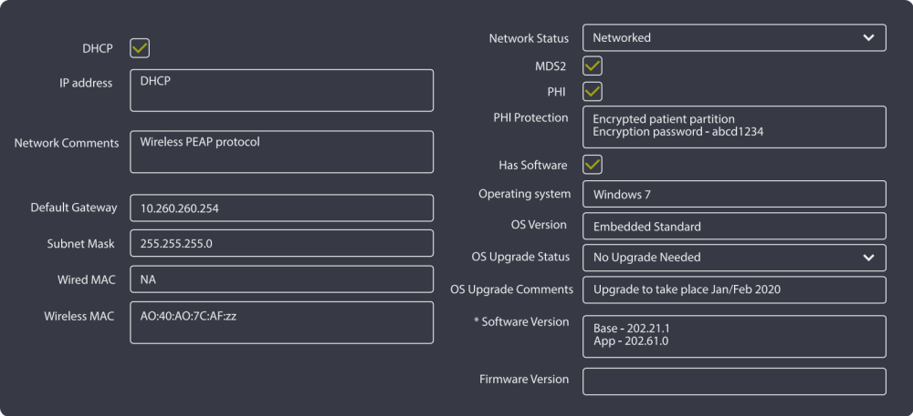
Is your CMMS up to the task?

Slide 6

Is an IoMT discovery tool needed?
How do you determine if an IoMT discovery/security tool is right for your organization?
What is the process to identify the tool that meets your needs?
What key problems should every IoMT tool solve?
What does a typical IoMT tool implementation look like?
Notes:
Discussions with IT and Biomed to determine what is in place now and what gaps there may be. Can a discovery tool close those gaps??
Research, research, research and create a list of questions and gaps that you need to address. After you have done your research ask for remote demonstrations from several vendors in this space. From the demonstrations you should have a good idea on who you may want to do a proof of concept with, I suggest a minimum of 2 or 3 companies. This is in distinct relationship with your IT department as they will need to provide access to the network.
Identifying devices on your network, where they are and who they talk with, internally and externally. Devices that are vulnerable based on their makeup, OS for example.
So, you have decided on an application tool, what’s next. Again, with IT’s help, decide what facilities you are interested in gathering information at, is it all or specific places. How are you going to attach to the network, based on your IT infrastructure.

Slide 7




Is an IoMT discovery tool needed?
Now what?
Regulate all new devices coming in
Recommend replacement
on highest risk devices
Protect what you
can’t upgrade
Upgrade what you can

Slide 8

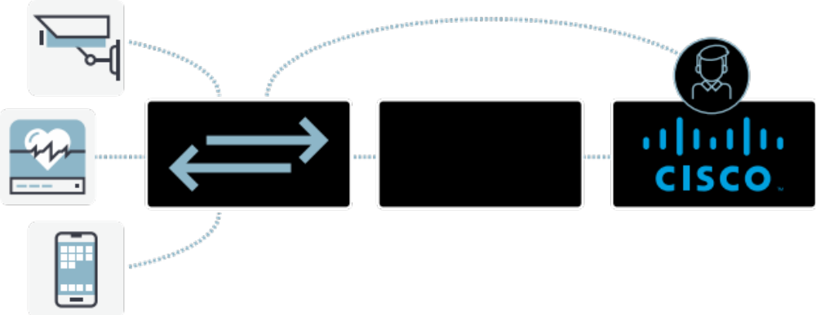
IoT – Segmentation & Security
IoT profiler
enables IoT orchestration via Cisco ISE
asset discovery & tracking
identify, classify and inventory IoT assets
enrich asset records with contextual data
relay IoT context to ISE
Scattered IoT assets
Organized micro-segmentsa
micro-segmentation
define ‘security groups’ in ISE using IoT context
network admission policies based on IoT ‘security groups’
organize assets dynamically in context-aware micro-segments
policy definition
learn normal device behaviors
apply principles of least privilege to IoT assets
generate ACLs to only allow trusted behaviors
IoT Profiler
Cisco ISE Administrator
security enforcement
detect deviations from expected baseline
surgically block malicious connections
isolate and quarantine the device
Zero-touch, non-disruptive deployment

Slide 9

Breaking down barriers starts with leaders
IT, Security, and HTM leaders need to have open lines of communication
Ideally all should report up to a common leader
Identify an individual or group directly responsible for medical device security
Work as a team to create policies and procedures with roles and responsibilities clearly defined

Slide 10

Know what you already have
Identify any applications, employee resources, or contracted services that may already exist
  Security team members with medical device experience
  HTM team members with security experience
  Systems that can identify devices on the network
  Contracted services that can help identify equipment

Slide 11

What more do you need?
Do you need more FTEs (Can you justify why)?
Do you need a better, more accurate inventory?
Do you need permanent or temporary resources?

Slide 12














NIST CSF framework
National Institute of Standards and Technology
Identify
Analyze
Protect
Recover
Detect
Respond

Slide 13
One time event or service
Identify
Automated discovery solution
Use internal resources
+ Pros
  Relatively quick
  One time expense
  Inexpensive
- Cons
  Inaccurate the next day
  Can be intrusive
+ Pros
  Relatively quick
  Real time updates
  Can help in protect and detect phase
  Identifies new devices
- Cons
  Can be expensive
  Ongoing expense
  Requires some maintenance
+ Pros
  Little to no expense
  Can be completed during PM cycle
- Cons
  Inaccurate the next day
  Can be intrusive
  Takes away from daily tasks
  Significant time to complete

Slide 14
Protect
Have a Policy
  Outline responses to multiple situations
  Include upgrade and patching procedures
  Encryption strategy
  New equipment evaluations
  Backup and restore procedures
Segmentation (Micro/Macro)
  Network Access Control (NAC)
  Firewalls
  VLANs
Physical Security is Cybersecurity
  Block USB ports
  Isolate vulnerable devices
  Physically restrain portable devices

Slide 15
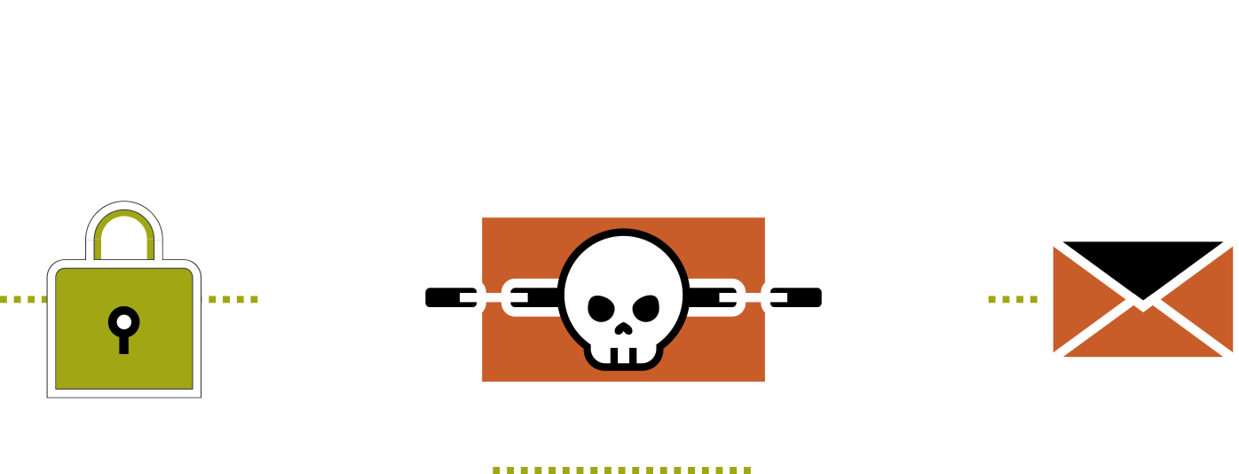
Detect
Respond
Understand typical device behavior to identify anomalies
Work with IT Security and Networking to understand available tools
Outline a clear communications process if a threat is detected
Be part of the solution
Build a relationship with your IT department
Time is your biggest enemy

Slide 16
This is all great, but my organization will not pay for this

Slide 17
Health Information Technology for Economic and Clinical Health (HITECH) Act
Signed February 18, 2009
Addressed privacy and security concerns with EPHI
Outlined categories of violations and levels of culpability
Determined penalty system for violations

Slide 18
PUBLIC LAW 116–321: Jan. 5, 2021
Amendment to the Health Information Technology for Economic and Clinical Health Act
SEC. 13412. RECOGNITION OF SECURITY PRACTICES.
“the Secretary shall consider whether the covered entity or business associate has adequately demonstrated that it had, for not less than the previous 12 months, recognized security practices in place that may”
Mitigate Fines
Early Favorable Termination of Audits
‘‘(1) RECOGNIZED SECURITY PRACTICES.—The term ‘recognized security practices’ means the standards, guidelines, best practices, methodologies, procedures, and processes developed under section 2(c)(15) of the National Institute of Standards and Technology Act, the approaches promulgated under section 405(d) of the Cybersecurity Act of 2015, and other programs and processes that address cybersecurity and that are developed, recognized, or promulgated through regulations under other statutory authorities. Such practices shall be determined by the covered entity or business associate, consistent with the HIPAA Security rule (part 160 of title 45 Code of Federal Regulations and subparts A and C of part 164 of such title).

Slide 19






Takeaways
Building a Successful Medical Device Security Program
Break down communication barriers
Identify key roles and responsibilities
Analyze current resources
Determine if new resources are needed
Leverage economies of scale
Develop a plan to meet the needs of the organization

Slide 20


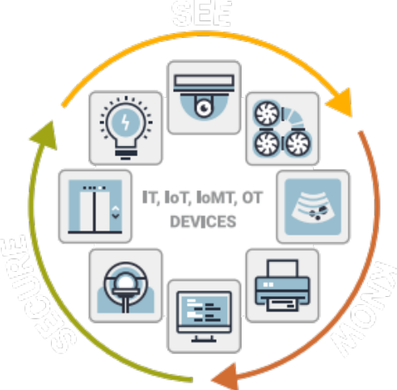
Introducing Ordr
AI-powered SaaS platform for visibility and security of all connected devices
See every asset and connection
Know all risks and behaviors
Secure
every thing
Comprehensive visibility
Profile every asset in the network
Map every connection for every asset
Physical context: make, model, serial #
Network context: MAC,IP, VLAN, subnet
Actionable risk insights
Known threats via threat detection engine
Unknown threats via baselining behavior
Vulnerabilities, weak passwords, recalls
Anomalous behavior – C2, app anomalies
Cyber resilient response
Proactive Zero Trust policies
on NAC, FW, switches
Reactive policies for incident response
Retrospective analysis for new IoCs
Unify network and security infrastructure via enrichment and automated policies

Slide 21












The market leader in healthcare security
KLAS Healthcare IoT Security Leader for 2 years in a row
Cleveland Clinic
Mayo Clinic
Honor Health
Fairview Health
Nat’l Institute of Health
Unity Point Health
Representative vendor in Gartner Med Device Security Market Guide
Dartmouth Hitchcock
ProHealth
Children’s Colorado
Christus Health
Hartford Healthcare
Memorial Hermann
Deployed in over 500 hospitals protecting more than 60,000 beds
Tower Health
Halifax Health
Univ Mississippi Med
Mercy Healthcare
Univ. MD Medical
Aspirus
Largest device database: 12 million+ profiles, 1 billion flows
Harris Health
Beebe Health
Avera
Driscoil Children’s
Dayton Children’s
Cook Children’s
Investments by Mayo Clinic Ventures, KP Ventures
Southampton NHS Trust
Plymouth NHS Trust
El Camino Hospital
St. Luke’s Duluth
Children’s Omaha
Cooper Healthcare

Slide 22
Questions?
David Yaeger
Biomed Security DBA; ProHealth
Ben Stock
Director Healthcare Product Management, Ordr bstock@ordr.net

Slide 23










Ordr Connected Device Cybersecurity Framework
See
Know
Secure
Every thing
Every connected asset
Every network connection
Every vulnerability
Every risk and exploit
Every anomalous behavior
With proactive, reactive, retrospective response
Unify existing security and networking infrastructure

