Slide 1
HTM Department Data Analytics, Huddle Boards and Standardization
MD Expo
November 2nd , 2021
Mike Busdicker CHTM, FACHE, System Director, Clinical Engineering, Intermountain Healthcare
Samar Al Ibrahim M.S., Medical Device Security Specialist, Intermountain Healthcare
BJ Rousey Medical Device Security Manager BSIT ITIL v3, Intermountain Healthcare

Slide 2
Agenda
Introduction to Intermountain Healthcare
Defining HTM mission, vision, values, and high-level objectives.
  Understanding the organization’s vision and values.
  Meeting the standards and regulations as the baseline.
  What have we accomplished?
What’s next?
  Finding gaps and opportunities to grow your HTM department.
  Step back review.

Slide 3


Introduction to Intermountain Healthcare
Salt Lake City, Utah
25
300+
1.0M+
41,700
2400
Hospitals including virtual hospitals and telehealth
Clinics serving six state area
Select Health insurance plans cover people in three states
Caregivers
Intermountain
Medical Group employed physicians and 3,800 affiliated physicians

Slide 4
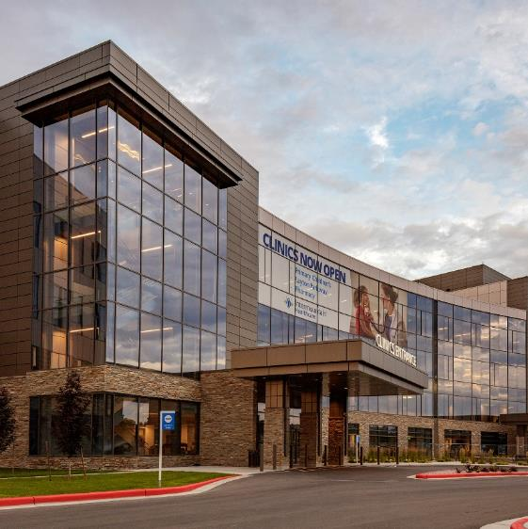
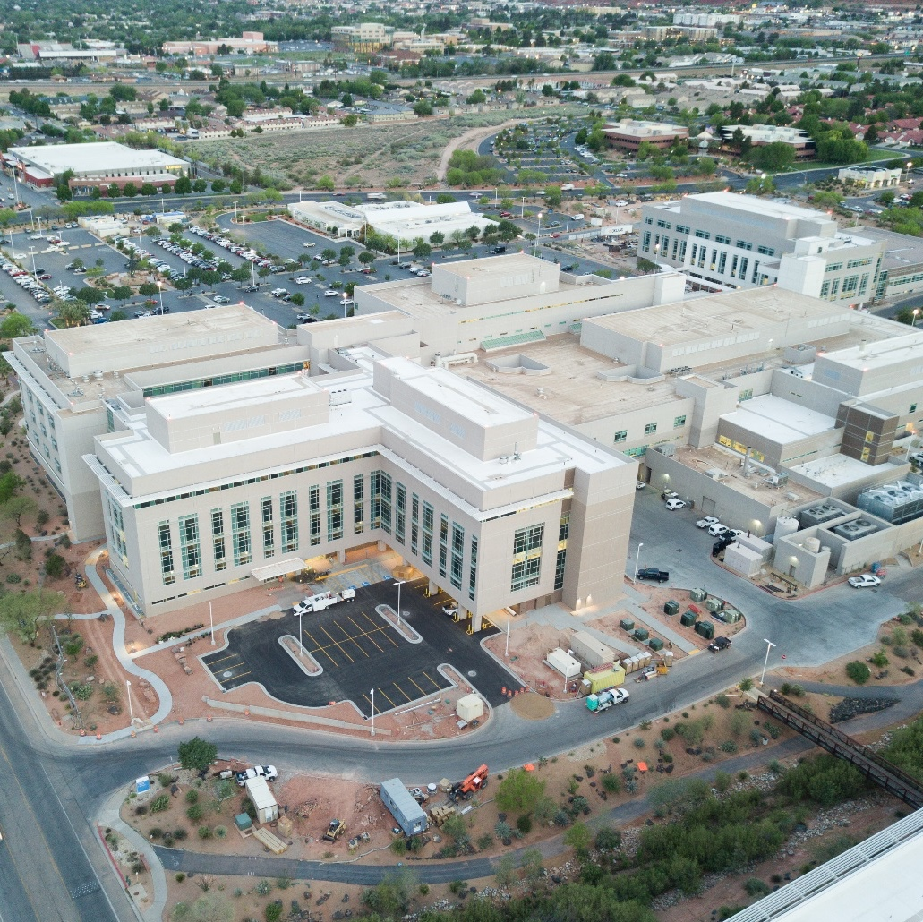
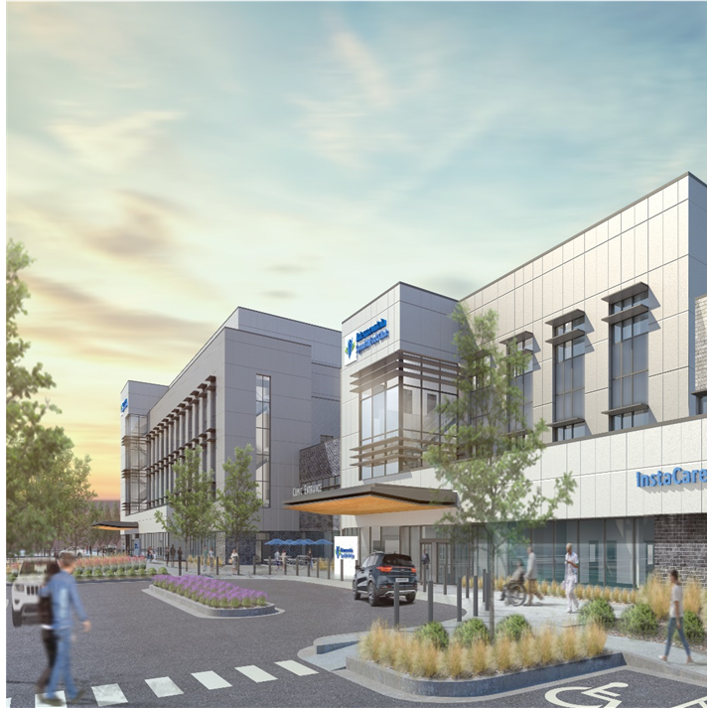
Better Access For Growing Communities
Layton Hospital
St George Regional Medical Center Expansion
Spanish Fork Hospital
Opened October 2018
Opened in Phases in 2018
Opened April 2021
Primary Children’s Hospital - Lehi
Saltzer Health - Idaho
Nevada Healthcare Partners
Construction started 2021
Acquired in 2020
Acquired in 2020
Notes:
Steve to find capital investment $

Slide 5
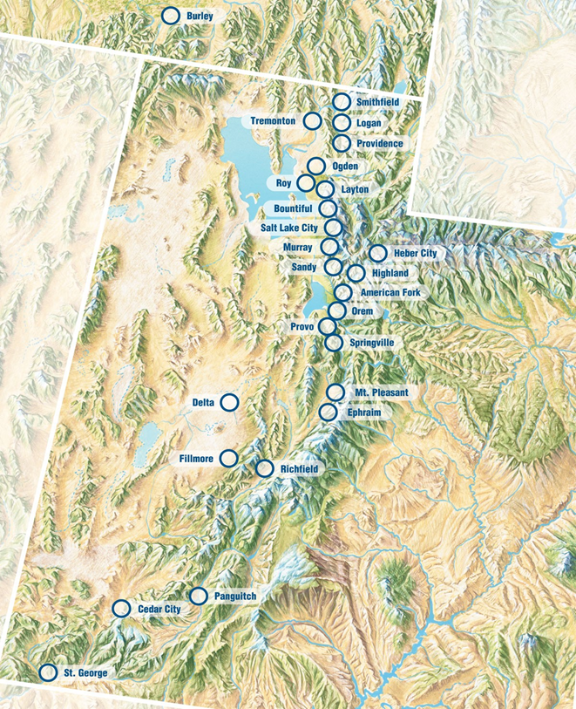
Clinical Engineering Shared Services
Central Support Services and Management
  System Director
  CE Medical Equipment Security
  Central Support Manager
  Service Contract Specialist
  Service Coordination Center
  Office Coordinator
  Inventory and Parts Coordinator
  Data Analysts
CE Area and Hospital Operations
  Four Area CE Directors
  Local CE Managers and Technicians
  Local Parts and Supply Stock
Central Depot, Homecare, and Field Services
  Program Manager
  Depot CE Technicians
  Hospital Bed Field Service
  Dialysis Equipment Field Service
  Sterilizer Field Service
  DME and Power Chair Services

Slide 6
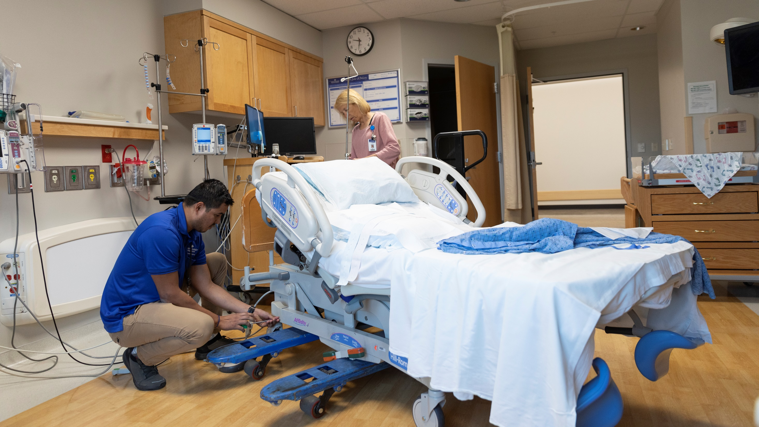

Mission, Vision, Values, and High-Level Objectives.

Slide 7

Helping people live the healthiest lives possible®
The Mission

Slide 8
Intermountain Healthcare’s Mission, Vision, and Values
Our Mission
Helping people live the healthiest lives possible®
Our Vision
Be a model health system by providing extraordinary care and superior service at an affordable cost.
Our Fundamentals of Extraordinary Care
Safety: Ensure patients and caregivers are safe.
Quality: Deliver evidence-based care that meets each individual’s health goals and leads to top performance.
Equity: Eliminate disparities and create opportunities for caregivers, patients, members, and communities to thrive.
Experience: Ensure each Intermountain experience is personalized and caring.
Access: Provide care and information where, when, and how our consumers prefer, with seamless coordination across the system.
Stewardship: Be an indispensable community partner, achieving the healthiest communities with the lowest cost per person in the nation. Be a financially sound, forever organization.
Engaged Caregivers: Create an unparalleled caregiver experience that supports us in delivering on the fundamentals of extraordinary care and service.

Slide 9
Intermountain Healthcare Clinical Engineering
Connecting the Mission, Vision, and Values
Our Mission
Helping people live the healthiest lives possible®
  No need for a separate mission statement
  Leaders must connect the dots for all caregivers
Our Vision
Be a model health system by providing extraordinary care and superior service at an affordable cost.
Be a model department by providing extraordinary service and superior quality at the lowest possible cost.
  Slight variation – still supporting the organization
Our Fundamentals of Extraordinary Service and Quality
Safety: Ensure patients and caregivers are safe.
Safety: Ensure patients and caregivers are safe by providing an outstanding medical equipment management program.
Quality: Deliver evidence-based care that meets each individual’s health goals and leads to top performance.
Quality: Deliver evidence-based medical equipment service and management that leads to top performance.

Slide 10
Intermountain Healthcare Clinical Engineering
Connecting the Mission, Vision, and Values
Our Fundamentals of Extraordinary Service and Quality (Cont.)
Equity: Eliminate disparities and create opportunities for caregivers, patients, members, and communities to thrive.
Equity: Eliminate department disparities and create opportunities for caregivers, patients, members, and communities to thrive.
Experience: Ensure each Intermountain experience is personalized and caring.
Experience: Ensure each CE service event and equipment management experience is personalized and caring.
Access: Provide care and information where, when, and how our consumers prefer, with seamless coordination across the system.
Access: Provide care and information where, when, and how our stakeholders prefer, with seamless coordination across the system.
Stewardship: Be an indispensable community partner, achieving the healthiest communities with the lowest cost per person in the nation. Be a financially sound, forever organization
Stewardship: Be an indispensable department, achieving the highest quality service with the lowest possible cost.
Engaged Caregivers: Create an unparalleled caregiver experience that supports us in delivering on the fundamentals of extraordinary care and service.
Engaged Caregivers: Create a caregiver experience that supports delivering on the fundamentals of extraordinary quality and service.

Slide 11
Current State of HTM Operations

Slide 12
Meeting the Standards, and Regulations as Baseline.
Providing compliance with the applicable standards and regulations is the most fundamental requirement of any HTM department.
HTM
Medical device Management and Improvement.
Inventory Best Practices
Record keeping
User Training
Recalls and Alerts
Incidents Response
Policies and Procedures
Service Contract Management
Equipment Retirement

Slide 13
What We Have Accomplished
Joint Commission, FDA standards, CMS Health and Safety standards, State standards
Intermountain Healthcare Mission
Helping people live the healthiest lives possible®
Equipment
Management
Recalls and Alerts
I
Inventory Best Practices
Policies and Procedures
Contract
Management
Record Keeping
Safety
Quality
Equity
Experience
Access
Stewardship
Engaged Caregivers
Healthcare Technology Management
Optimize Medical Equipment Maintenance and management strategies to assure clinical quality, patients' safety and best cost/ value proposition
Outstanding Technology
Equipment Availability
Reducing Cost
Efficiency Driven
Leverage Talent
Respond to physicians Need
Clinical Engineering Program Quality
  Complete parts inventory and centralized procurement process
  Centralized recall and equipment hazard alerts process
  Centralized mobile medical device service, savings of $250K/ yr.
Clinical Engineering Support Services
  Standardization CE policies, procedures and regulatory items
  System level CE meetings
  CE corporate representation on system level committees
Medical Equipment Savings and Cost Avoidance
  Centralized budget tracking and parts procurement
  Central service call dispatching
  Centralized Master Service Agreements
  Central service strategies and training
  Annual cost savings provided by Clinical Engineering - $600k+

Slide 14
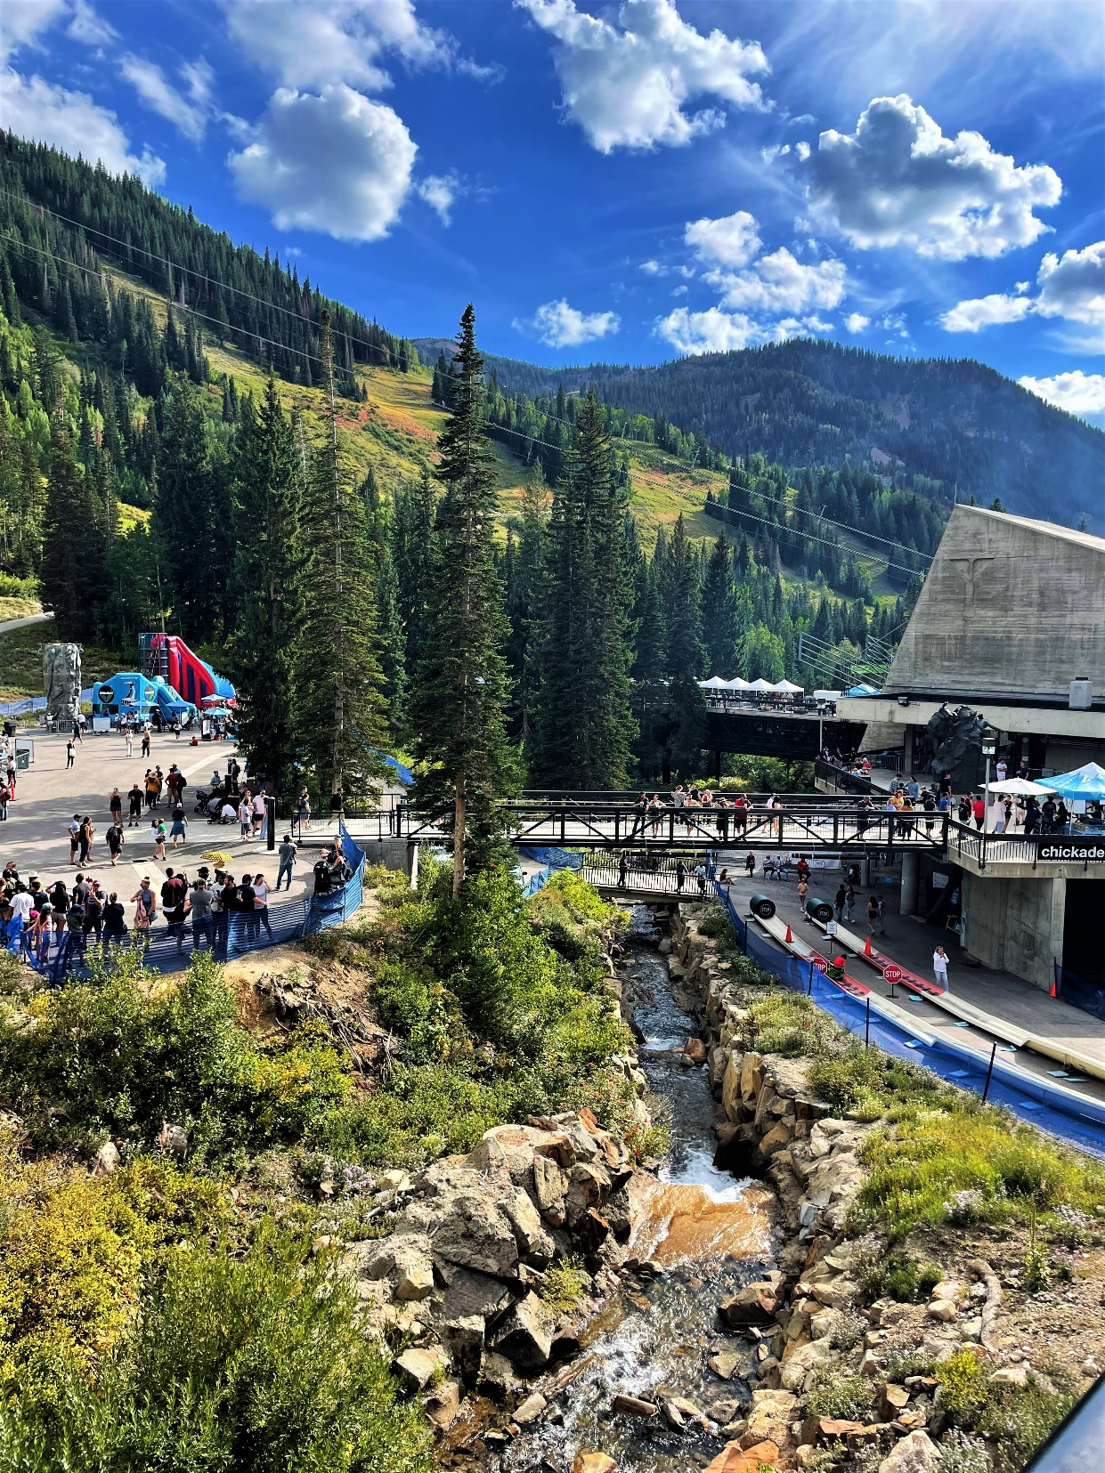
Elevate from CE Repair Shop to an HTM Department
HTM Department
Data Analysis
Clinical Engineering Shared Services
Equipment Management and Service
Leadership
Medical Device Cybersecurity
Service Contracts

Slide 15
What’s Next?

Slide 16
Finding Gaps and Opportunities to Grow
Joint Commission, FDA standards, CMS Health and Safety standards, State standards
Intermountain Healthcare Mission
Helping people live the healthiest lives possible®
Equipment
Management
Recalls and Alerts
Best Practices
Policies and Procedures
Contract
Management
Record keeping
Safety
Quality
Equity
Experience
Access
Stewardship
Engaged Caregivers
HTM Mission, Vision, and Values
Optimize Medical Equipment Maintenance and management strategies to assure clinical quality, patients' safety and best cost/ value proposition
Outstanding Technology
Equipment Availability
Reducing Cost
Efficiency Driven
Leverage Talent
Respond to physicians Need
Annual Goals, KPIs, and Standardization Initiatives

Slide 17
Finding Gaps and Opportunities to Grow Your HTM Department
SMART Goals
Intermountain mission vision and values
+
Standards and Regulations
+
HTM high level objectives
Inventory Accuracy
Service Contracts
Documentation
Standardization Initiatives
Recall Management
Cybersecurity Program
Medical Device Visibility
Regulatory Compliance
Staff Management

Slide 18

Finding Gaps and Opportunities to Grow Your HTM Department
In the Past
Variation of equipment tracking, inventory, and service scheduling
No standardization of workflows, service tracking or data capture
Significant opportunity for process improvements in tracking service and data integrity
Department managers/clinical staff managing service information instead of taking care of patients
The Present Operation
Integrated service tracking, data entry, and reporting for the entire system
Standardized processes and staffed for:
        Complete Oversight of Authorized Service Providers
        Oversight of Service Request for In-house Staff
        Data Management for Medical Equipment Service
        Data Tracking, Metrics, and Reporting
        Field Service Report Matching and Uploading
        Authorized Service Provider PM Tracking

Slide 19
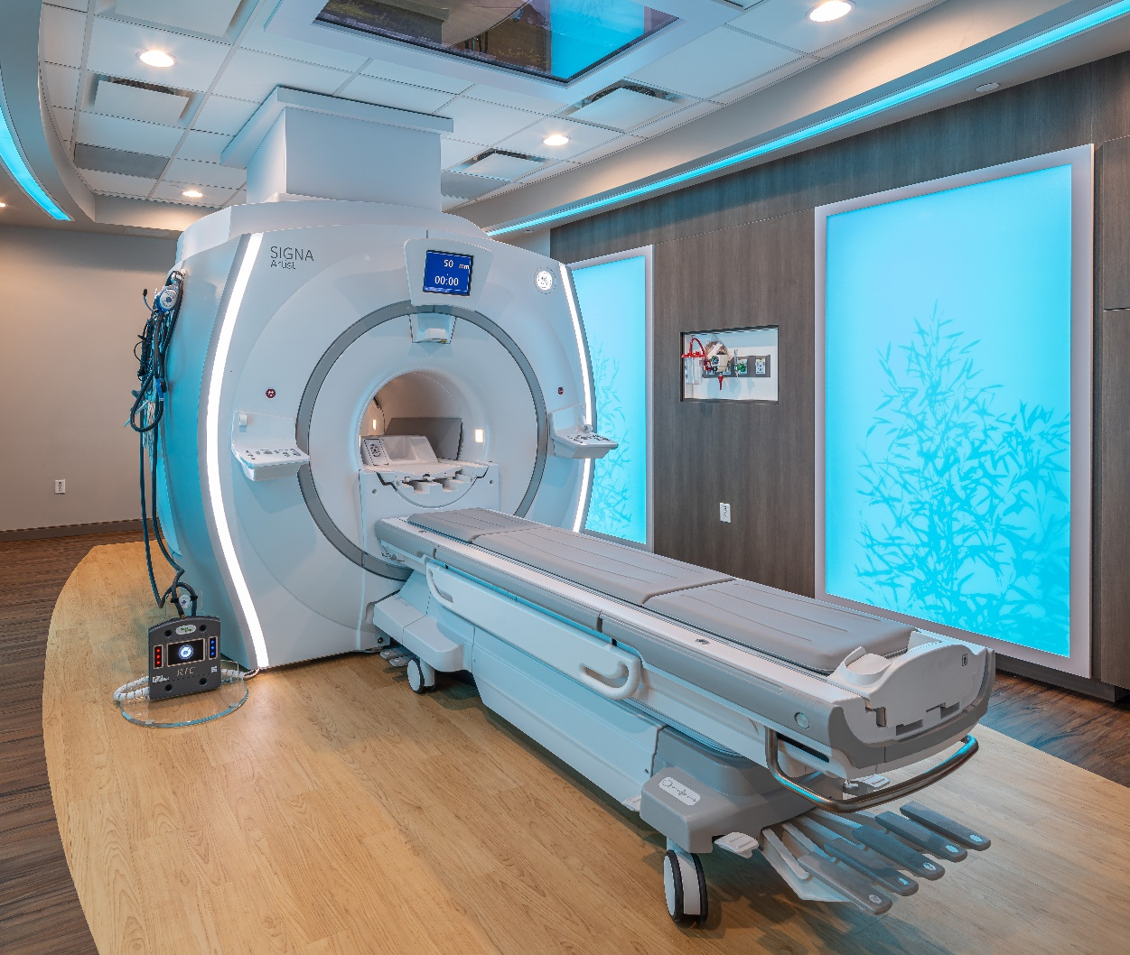
Areas of HTM Focus
Operational and Financial
Preventive Maintenance Compliance
Documentation and Recording
Inventory Accuracy
Medical Device
Service Contracts
Recalls and Alerts
Medical Device Visibility
Standardization Initiatives

Slide 20
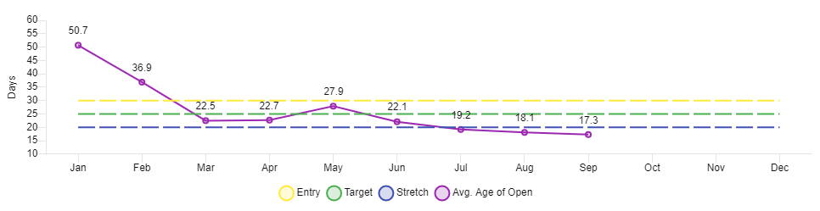
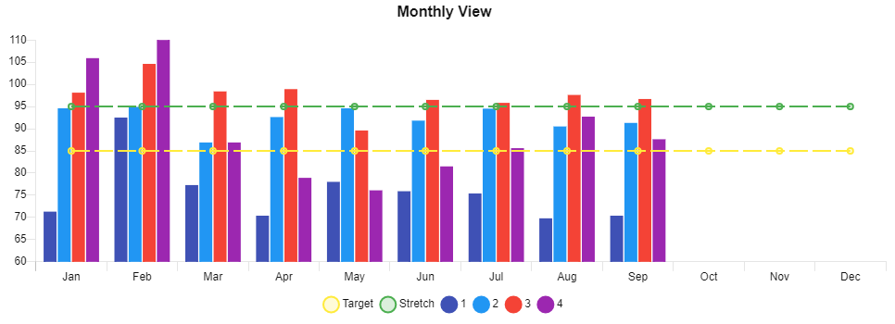
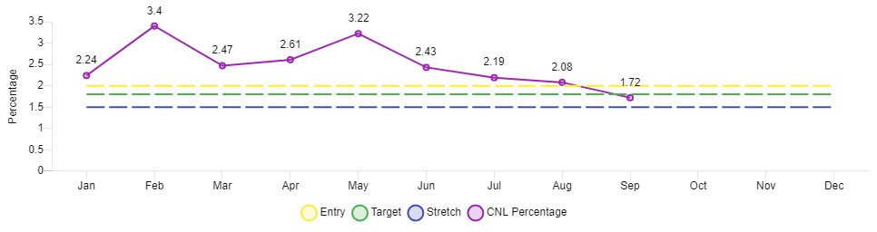
Data Analytics
Performance Dashboards and Continuous Improvement
Average Age of Open Work Orders
Entry 30 Days Target 25 Days Stretch 20 Days
Caregiver Documented Time
Entry 30 Days Target 25 Days Stretch 20 Days
Percent of Could Not Locate
Entry 2% Target 1.8% Stretch 1.5%

Slide 21
Continuous Improvement - Standardization
Initiative | Significance | Deliverables | Success Criteria
Initiative Name: CE Shared Services contribution “Likely to Recommend” System Leader: Fundamental(s) of Care: Patient Satisfaction | The organization is placing an emphasis on all departments providing a contribution in patient satisfaction through “Likely to Recommend”. This includes CE Shared Services across the system. | Create a script for CE caregivers to utilize when entering a patient room for the service of medical equipment Train all CE caregivers in the script and document this in their IDP and in WorkDay Retrain all CE caregivers in AIDET and the 10/5 rule for interaction with patients in our facilities. | Refine the CE caregivers’ script and document interactions with results Ensure AIDET and the 10/5 rule can be explained by all CE caregivers 100% of the training and success stories will be documented.
Initiative Name: Acquisition value range and establishing COSR by site System Leader: Fundamental(s) of Care: Stewardship, Quality | Acquisition value of medical equipment in the system varies based on site and other variables. This creates and issue with benchmarks and metrics for internal and external comparison | Implement a standard report to show acquisition values by medical equipment sub-type, manufacturer, and model Correct existing issues and validate data integrity in relation to capital acquisition value of equipment Create Cost of Service Ratio for each site and the imaging multi-vendor service program | Medical equipment acquisition values standardized within a range based on manufacturer, model, and sub-type Ability to quickly calculate cost of service ratio and do an internal and external metric comparison
Initiative Name: Implement HTM apprenticeship program across the system System Leader: Fundamental(s) of Care: Access, Stewardship | The healthcare technology management (HTM) industry has created labor practices and knowledge-based items for caregivers. This has been recognized by the National Department of Labor and Intermountain is an approved participant. | Implement the proper practices and documents for Intermountain Healthcare to ensure program compliance Enroll qualified candidates currently employed by Clinical Engineering Shared Services Develop an internal list of qualified candidates interested in the apprentice program for future hire into the department | Successful implementation of all program requirements All qualified and interested current CE caregivers enrolled in the program Create a list of at least 10 local candidates interested in enrolling in the HTM apprenticeship program

Slide 22
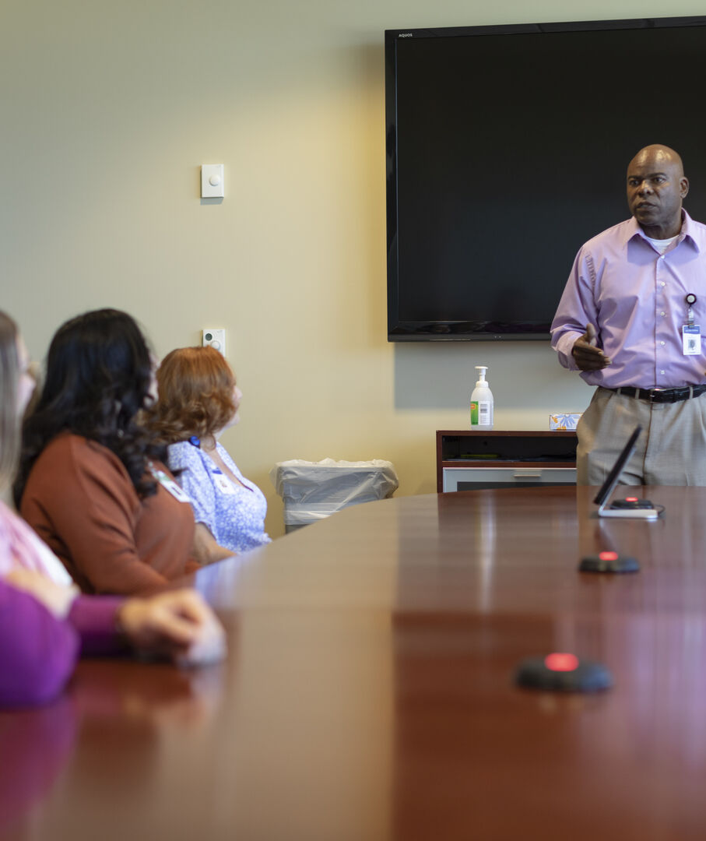
Caregiver Engagement
Connecting the Data
Communicate vision, mission, and values
Provide Organizational Chart
Invest in Education
Listen to Ideas
Provide opportunities
Take Tough Assignment
Succession Plan

Slide 23
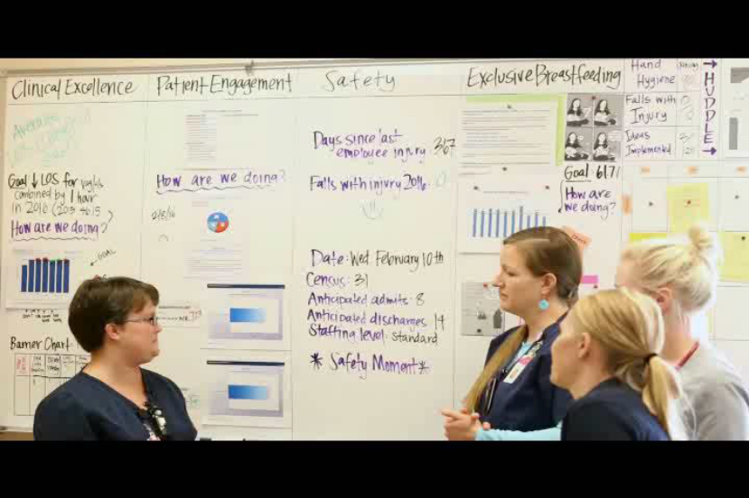
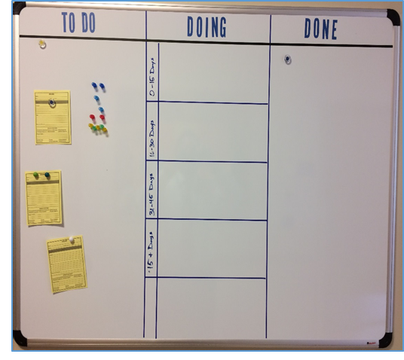
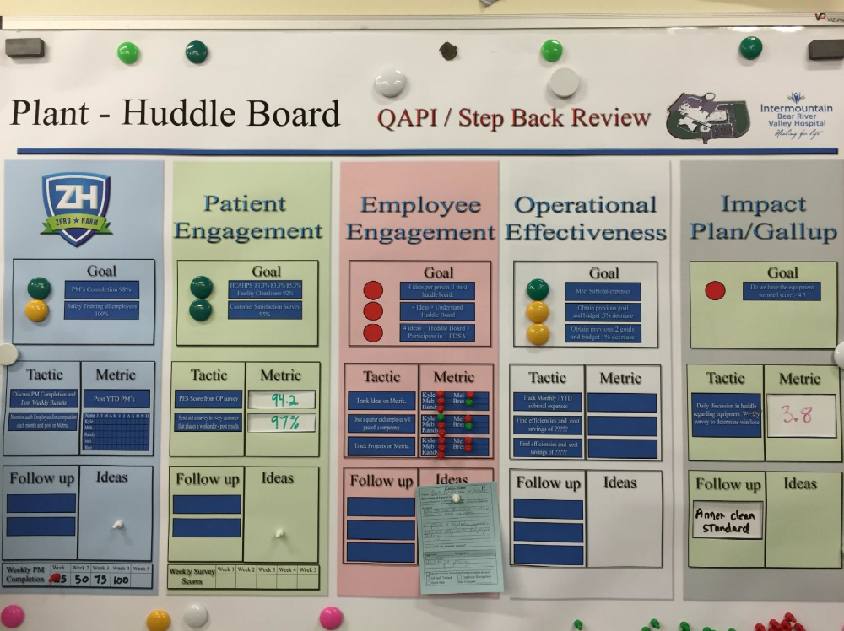
Caregiver Engagement - Daily Huddles
Same time(s), same place
Duration: 10-15 minutes
Leadership Responsibility
  Ensure huddles occur
  Attend huddles regularly
Choose a huddle facilitator
  Can change for huddles
Solicit team for ideas
  Keep track of submissions
  Establish goals and/or metrics
Categorize ideas
  To Do – In Progress – Complete
  Safety Related, Stewardship, Quality, Patient Experience
Review KPIs, metrics, goals
  Meaningful data and reports
Identify gaps (visual)
  Not for problem solving
  Develop return to green

Slide 24
HTM Caregiver Engagement – Huddle Board Data
Facility | PM Compliance | PM Due | PM Completed | PM Incomplete | Could | PM Late/Early | PMs On Time
 |  |  |  |  | Not Locate |  | Completion %
Hospital 1 | MET | 349 | 349 | 0 | 5 | 0 | 100.00
Hospital 2 | MET | 253 | 246 | 7 | 4 | 0 | 97.23
Hospital 3 | MET | 18 | 18 | 0 | 0 | 0 | 100.00
Hospital 4 | MET | 49 | 49 | 0 | 1 | 0 | 100.00
Hospital 5 | MET | 65 | 65 | 0 | 1 | 0 | 100.00
Hospital 6 | MET | 4 | 4 | 0 | 0 | 0 | 100.00
Hospital 7 | MET | 169 | 169 | 0 | 4 | 0 | 100.00
Hospital 8 | MET | 2 | 2 | 0 | 0 | 0 | 100.00
Hospital 9 | MET | 928 | 910 | 18 | 10 | 0 | 98.06
Hospital 10 | MET | 68 | 67 | 1 | 0 | 0 | 98.53
Hospital 11 | MET | 248 | 248 | 0 | 7 | 0 | 100.00
Hospital 12 | MET | 367 | 366 | 1 | 0 | 1 | 99.73
Hospital 13 | MET | 148 | 148 | 0 | 0 | 0 | 100.00
Hospital 14 | MET | 465 | 465 | 0 | 6 | 0 | 100.00
Hospital 15 | MET | 783 | 776 | 7 | 16 | 0 | 99.11
Hospital 16 | NOT MET | 161 | 130 | 31 | 9 | 0 | 80.75
Hospital 17 | MET | 196 | 196 | 0 | 5 | 0 | 100.00
Hospital 18 | MET | 32 | 32 | 0 | 0 | 0 | 100.00
Hospital 19 | MET | 249 | 249 | 0 | 9 | 0 | 100.00
Hospital 20 | NOT MET | 32 | 29 | 3 | 0 | 0 | 90.63
Hospital 21 | NOT MET | 259 | 170 | 89 | 9 | 0 | 65.64
Hospital 22 | MET | 1039 | 1039 | 0 | 6 | 0 | 100.00
Grand Total | MET | 5884 | 5727 | 157 | 92 | 1 | 97.33
Facility | WOs Completed | CNL YTD | CNL % YTD | CNL Prior Year | CNL % | CNL Projected Current Year
 |  |  |  |  | Prior Year
Hosp 1 | 2864 | 48 | 1.7% | 32 | 0.9% | 57
Hosp 2 | 2351 | 52 | 2.2% | 43 | 1.8% | 61
Hosp 3 | 451 | 8 | 1.8% | 7 | 1.5% | 9
Hosp 4 | 1016 | 14 | 1.4% | 16 | 1.4% | 17
Hosp 5 | 1002 | 40 | 4.0% | 1 | 0.2% | 47
Hosp 6 | 1163 | 39 | 3.4% | 9 | 1.0% | 46
Hosp 7 | 86 | 0 | 0.0% | 4 | 0.7% | 0
Hosp 8 | 11128 | 353 | 3.2% | 196 | 1.7% | 417
Hosp 9 | 837 | 17 | 2.0% | 18 | 1.8% | 20
Hosp 10 | 1992 | 58 | 2.9% | 38 | 1.7% | 69
Hosp 11 | 3752 | 76 | 2.0% | 128 | 3.0% | 90
Hosp 12 | 2896 | 31 | 1.1% | 35 | 1.0% | 37
Hosp 13 | 7030 | 103 | 1.5% | 82 | 1.1% | 122
Hosp 14 | 6605 | 60 | 0.9% | 63 | 0.8% | 71
Hosp 15 | 1900 | 31 | 1.6% | 101 | 4.8% | 37
Hosp 16 | 2605 | 49 | 1.9% | 45 | 1.6% | 58
Hosp 17 | 699 | 1 | 0.1% | 0 |  | 1
Hosp 18 | 6218 | 179 | 2.9% | 138 | 1.9% | 212
Hosp 19 | 255 | 0 | 0.0% | 0 | 0.0% | 0
Hosp 20 | 2397 | 89 | 3.7% | 115 | 4.0% | 105
Hosp 21 | 8516 | 153 | 1.8% | 124 | 1.3% | 181
Grand Total | 65792 | 1401 | 2.1% | 1195 | 1.7% | 1656
Hospital 21 | Name | PM Compliance | PM Due | PM Completed | PM Incomplete | PM Valid | PM Not Found | PM Late | PM Valid %
2021 / 10 | Caregiver A | NOT MET | 122 | 33 | 89 | 33 | 0 | 0 | 27.0
 | Caregiver B | NOT MET | 82 | 82 | 0 | 76 | 6 | 0 | 92.7
 | Caregiver C | NOT MET | 49 | 49 | 0 | 46 | 3 | 0 | 93.9
 | Caregiver D | MET | 1 | 1 | 0 | 1 | 0 | 0 | 100.0
 | Caregiver E | MET | 5 | 5 | 0 | 5 | 0 | 0 | 100.0
Name | # of WOs Completed | # of CNL | CNL %
Caregiver A | 949 | 26 | 2.7%
Caregiver B | 539 | 14 | 2.6%
Caregiver C | 270 | 12 | 4.5%
Caregiver D | 639 | 37 | 5.8%
Grand Total | 2397 | 89 | 3.7%

Slide 25
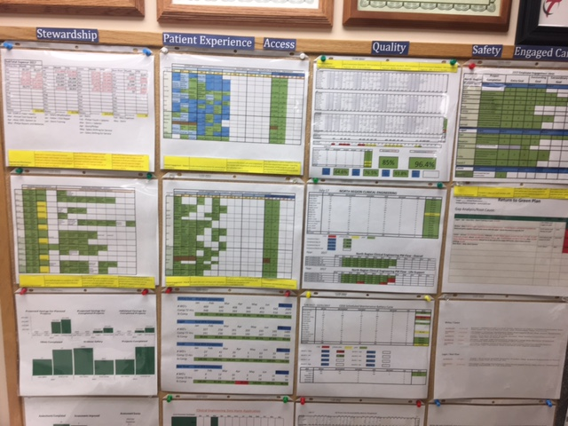
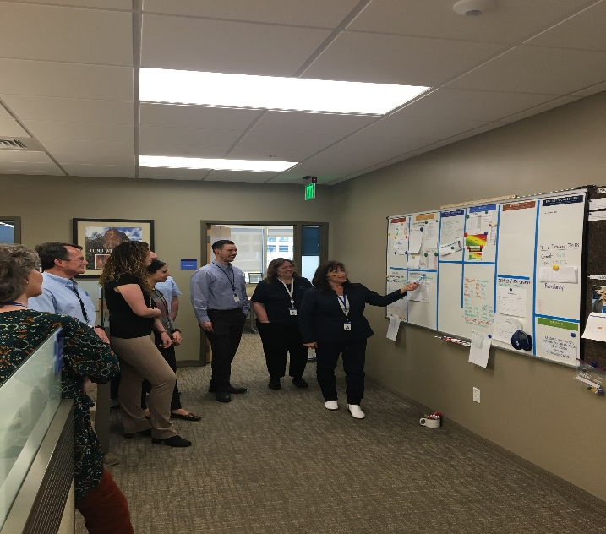
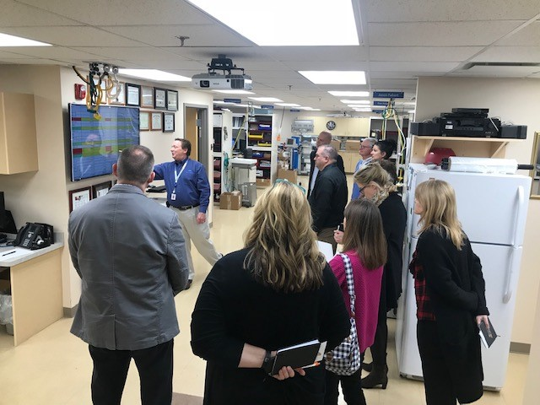
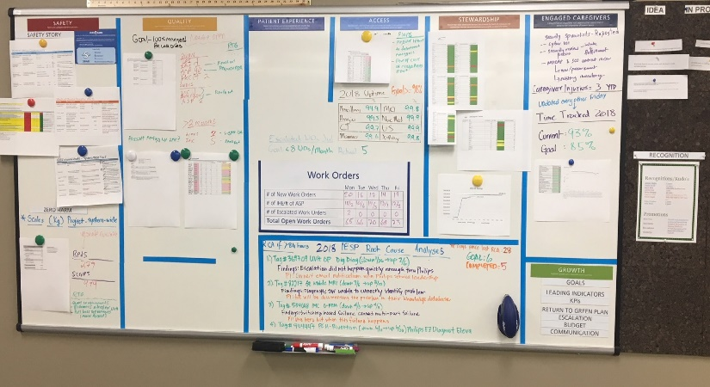
HTM Caregiver Engagement – Huddle Boards
Department and System Huddle Boards
Visual display board and electronic
Action Register – Issue, Action, Results, Follow-up
Involve HTM Caregivers at all levels
RCA Process – The 5 Whys, Reports of Success
KPIs, Metrics, and Dashboards
This is the scoreboard – quick visual understanding
Where do we stand – System, local, technician

Slide 26
Questions

