Slide 1
Who’s Protecting The Devices!?
Lessons from COVID-19
Reframing the Distribution of Responsibility for Medical Device Security

Slide 2

About Me
Chad Holmes
Focus Areas
  Making Things
  Breaking Things
  Teaching Others to do Both
My Goals Today
  Inform about IoT security challenges in Healthcare
  Discuss rapid risk reduction options
  Answer questions
  Provide additional resources
Notes:
Chad Holmes
Security Evangelist
20 Years in Tech Industry
Focus Areas
Making Things
Breaking Things
Teaching Others to do Both
My Goals Today
Inform about IoT security challenges in Healthcare
Discuss rapid risk reduction options
Answer questions
Provide additional resources

Slide 3

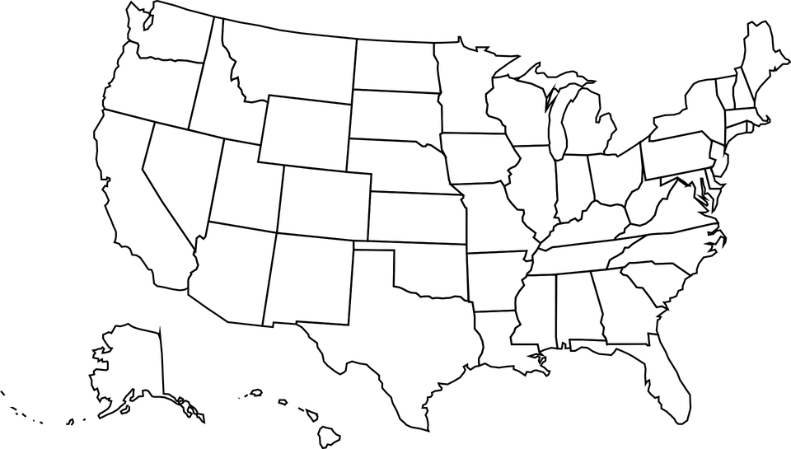

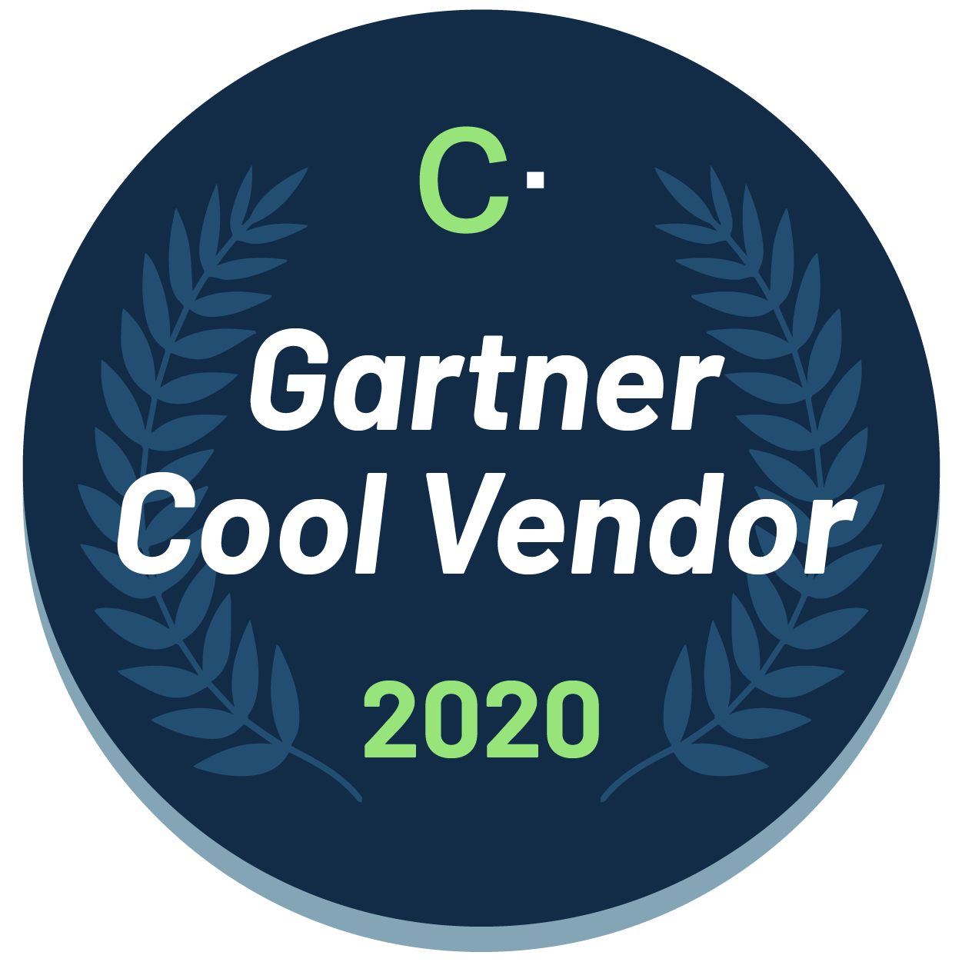
About Cynerio
Our Goal
Secure every IoT, OT and Medical Device in Healthcare Environments
Our Customers
Notes:
Speaker Notes
Founded: 2017
Goal: Enable hospitals to secure every connected asset
Focus Area: IoT, OT, Medical Devices
Offerings: Align with NIST Cybersecurity Framework - Identify, Protect, Detect, Respond, Recover
In the News
Gartner Cool Vendor
Forrester Wave Leader
$30M in Recent Funding

Slide 4
Quantifying the Headlines
580%
Notes:
580% - Increase in Ransomware attacks in 2nd half of 2020
*https://www.itij.com/latest/news/ransomware-attacks-healthcare-sector-surge
-We all know they shot up, but now we have some idea of how much
-Additionally, the cost per HC breach is up 29.5% YoY to over $9MM per incidnet

Slide 5
Today’s Agenda
Vocab: IoT in Healthcare
Rewards and Risks Introduced
Risk Landscape
Who’s In Charge?
Extending Traditional IT Practices
How Cynerio Helps
Take Action Today!
Q&A

Slide 6
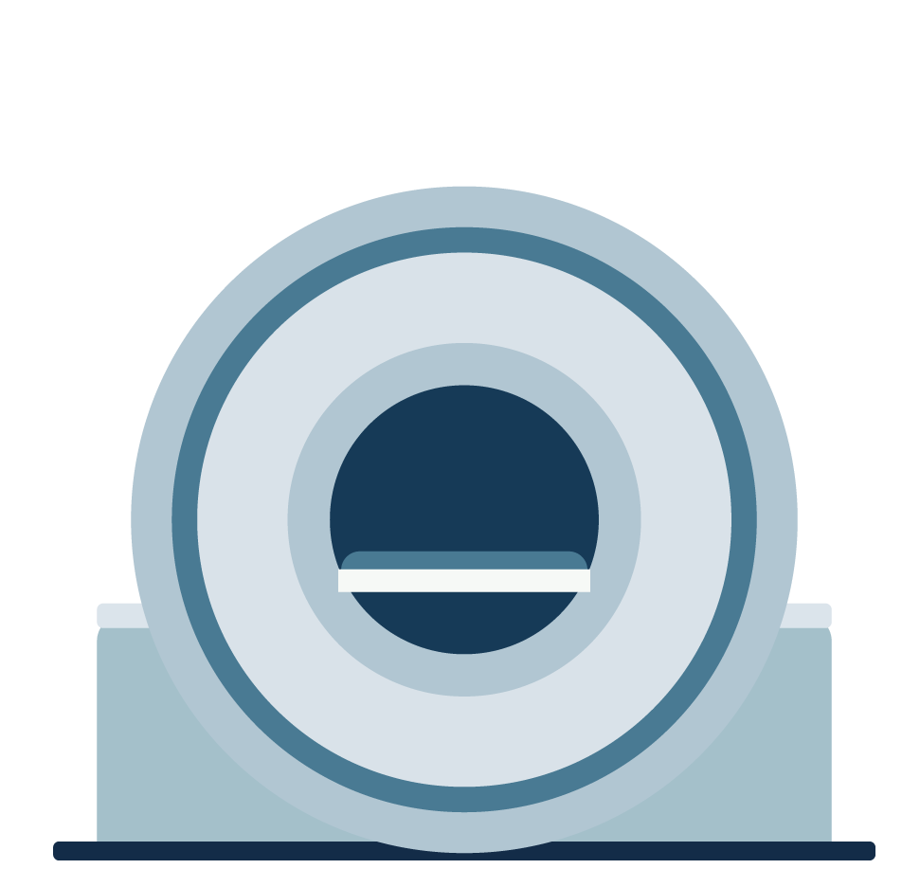
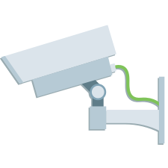
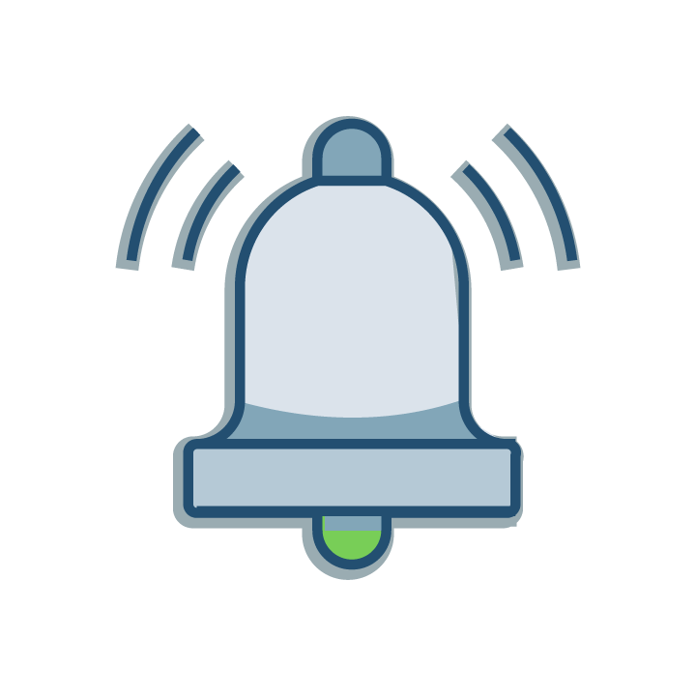
The World of IoT in Healthcare
IoMT
IoT
OT
Connected
Devices
Notes:
IoMT (aka, Medical IoT) - Internet of Medical Things
Medical devices with IoT connected components
Examples: MRI machines, IV pumps, heart monitors, glucometers
IoT - Internet of Things
Blanket Term for network-connected devices and other assets that are not traditional IT (computers, servers, etc).
Examples: Security cameras, VOIP phones, smart door locks
OT - Operations Technology
Hardware, software and communications systems that keep large-scale industrial equipment and assets running
Examples: HVAC, Elevators, Electrical grids
Connected Devices
Remotely connected and controlled; Often simpler than above devices
Examples: Light switch, coffee machine
*Today we’ll use “IoT” for simplicity in referring to this broader grouping

Slide 7
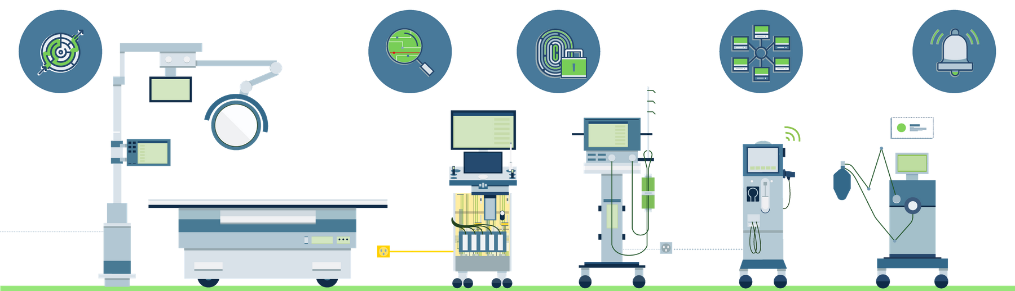
The Rewards and Risks of IoMT
Rewards
Risks
Improved care delivery
  Easier
  Faster
  More accessible
Connected to Patients
Updates
Vulnerable to Cyber Attacks
Ownership/Responsibility
Notes:
Connected to Patients
Updates - Manual, Time Consuming, Disruptive to Service
Vulnerable to Cyber Attacks
Outdated OS/Firmware
Increased Healthcare Targets
Difficult/Unable to Patch
Long Update Cycles
Ownership/Responsibility

Slide 8
Risk Landscape: A Vulnerable Footprint
5 Million
Operational healthcare devices with critical vulnerabilities
3X 20X
Value of PHI records over others
75%
Unmonitored network traffic in hospitals
Notes:
Perfect Target
Healthcare comes first
Service outages not acceptable
Compelled to report exposed records and face fines
Not typically cybersecurity adoption leaders
Mixed signals on ransom payment
Ransomware payment cheaper than alternative
Either through cybersecurity insurance or funds
What best allows them to provide care again?
Bottom Line: A Number’s Game (Best Case)
900,000+ Beds in United States
2 Beds / Room
~15 connected devices / room
70% of Medical IoT devices have 1 or more critical vulnerabilities
Attack Surface: At least 4.725 million devices operational with critical vulnerabilities
Why Focus on Healthcare Devices?
Personal health data is 3x more valuable than any other data
Hacking is a business
Remember!
Hospital staff members are doing good…
...the just need help

Slide 9
Risk Landscape: A Vulnerable Industry
Industry Goals
Regulatory Requirements
Care is the priority
Outages not acceptable
Spend favors patients
Compelled to report attacks
Focus on care
Greater industry insight for attackers
Technical Results
Conflicting Guidance
Slower security adoption
Greater attack surface
Reliance on cybersecurity insurance
FBI: Don’t pay ransom
Recovery costs 30x-50x higher
No silver bullet
Notes:
Perfect Target
Healthcare comes first
Service outages not acceptable
Compelled to report exposed records and face fines
Not typically cybersecurity adoption leaders
Mixed signals on ransom payment
Ransomware payment cheaper than alternative
Either through cybersecurity insurance or funds
What best allows them to provide care again?

Slide 10
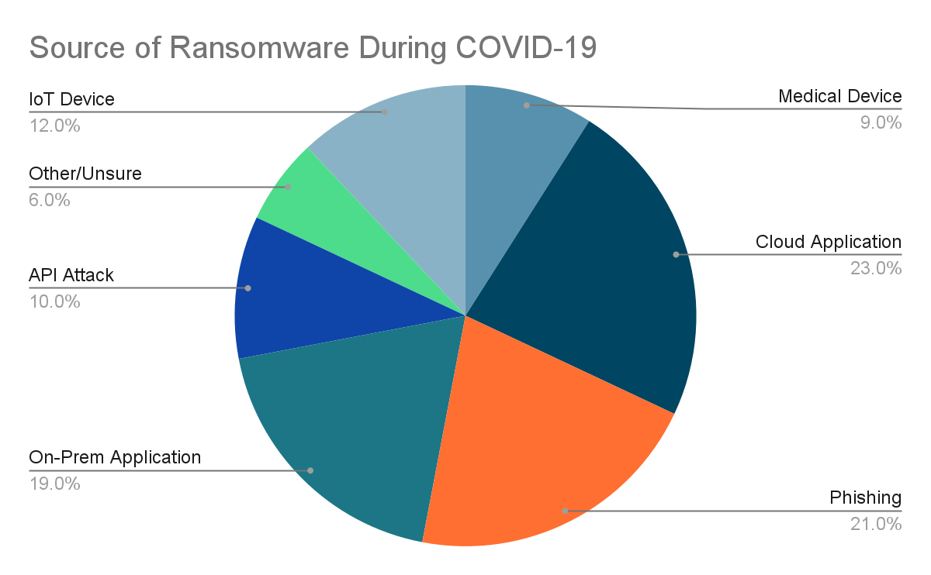
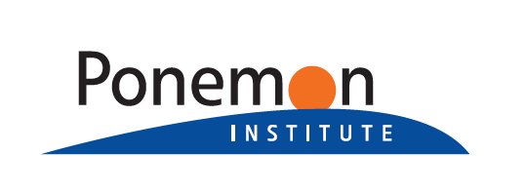

Risk Landscape: Shifting Patterns
Source: https://www.censinet.com/ponemon-report-covid-impact-ransomware/
Notes:
“You should invest at least as much in IoT/Medical device security as you do in any one of phishing, app or cloud security”
Mostly speculative/anecdotal...until late September 2021
Ponemon Study sponsored by Censinet
Focus: Impact of Ransomware on Healthcare during COVID-19 and Beyond
Entry points
Cloud Application: 23%
Phishing: 21%
On-Prem Application: 19%
IoT Device: 12%
API Attack: 10%
Medical Device: 9%
Other/Unsure: 6%

Slide 11
Who’s In Charge of IoT Security?
Security
BioMed
Manage real-time risks
Security solution use and implementation
Security vendor interaction
Manage device lifecycle
Maintain medical devices
Interact with Security, Network, IT teams around security posture
Network
IT
Keep network up and running
Identify and respond to network performance issues
Plan and support network upgrades
Implement and monitor IT assets and solutions
Compliance and audit support
Prioritize and support internal projects
Notes:
Everyone is a little bit in charge, but the core stakeholder will depend on how your organization is structured.
Ex: Security is often a subset of the IT team. Does a security team member lead the IoT security charge, or does IT? It all depends on your staff.
Don’t forget - all these team members will play a part!

Slide 12
But Really, Who’s In Charge?
Who can best direct efforts across multiple teams?
If priorities conflict, who has authority to make decisions?
Who has the best overall insight to inform the best choices?
Often: IT or Security
Access and Influence
Which teams have time to reasonably assume ownership of efforts?
Which team is least likely to see a disruption deprioritize efforts?
Often: Varies (Broader CIO/CTO team)
Availability
Who can implement required security updates?
Who can best resolve implementation challenges?
Often: BioMed or Network
Capability
Notes:
Remember, it varies for each org, but here are some factors to consider…
But really...who’s in charge!?
Identify a team lead - each org is different, but it’s typically someone in IT or Security. Usually these groups work closely together, and often are one in the same.
Network team to implement tools
BioMed to patch where available
IT, Security to help determine best next steps
See “Distributing Responsibility Across Teams” section in white paper

Slide 13
Extend IT Practices to IoT
Forensics
Asset Management
Vulnerability Management
Asset Management
Key Management
Data Loss Prevention (DLP)
IoT Solutions
IT Solutions
Risk Management
Policy Management
Cloud Access Security (CASB)
Risk & Compliance Management
Anomaly Detection
Deception and Incident Response
Log & Event Management

Slide 14
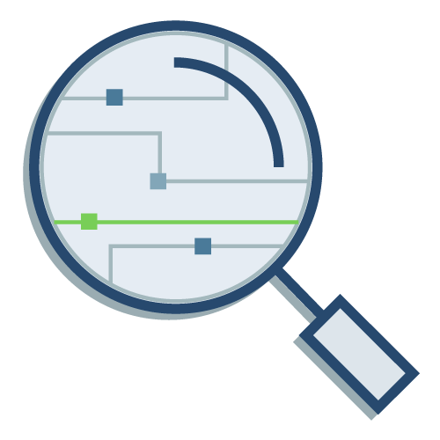

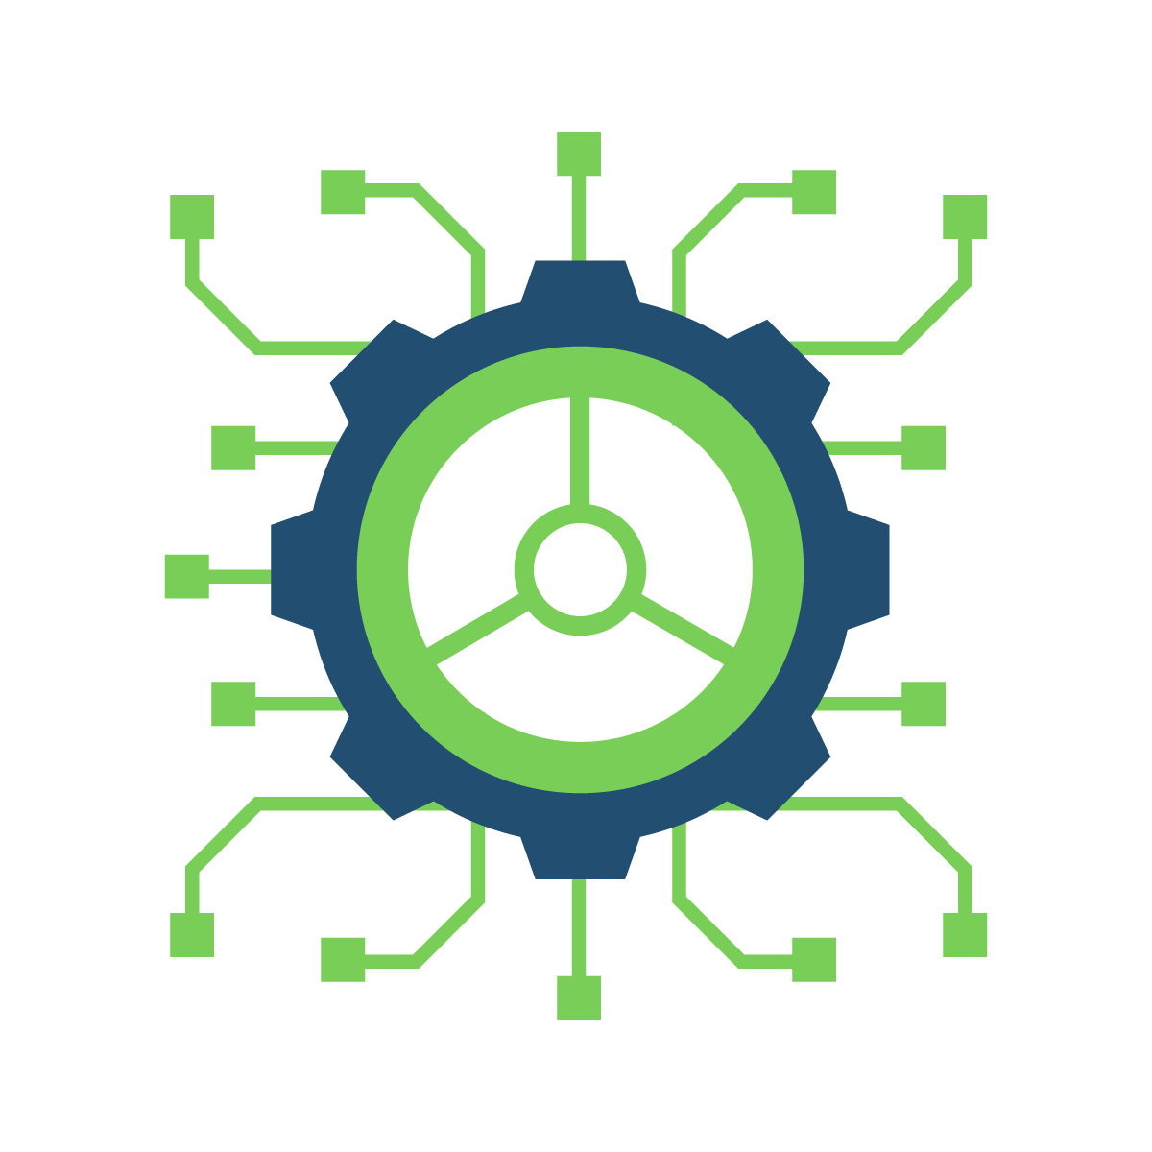
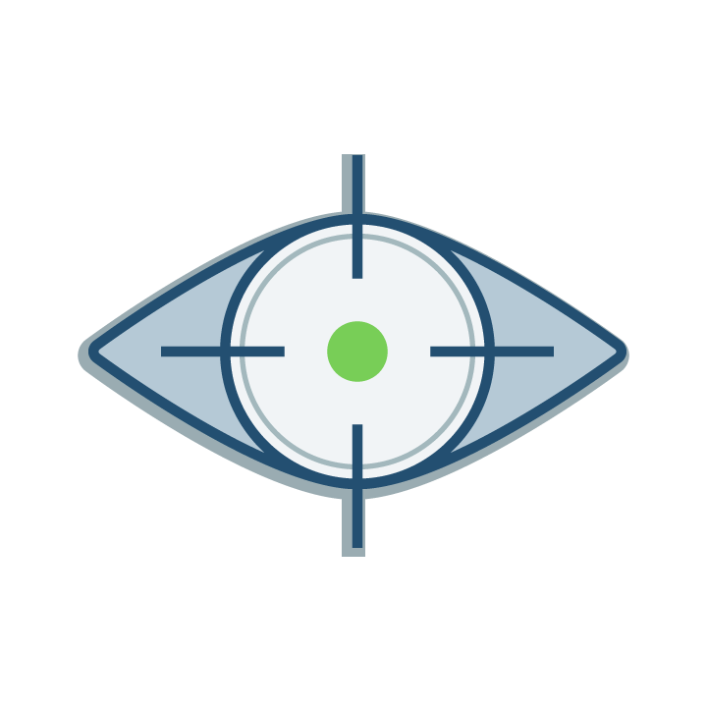

Proactively Addressing IoT Risk
Attack Detection & Response
Rapid Risk Reduction
N-S and E-W Segmentation
Segmentation
Analysis
Service
Hardening
Vendor Access
Control
Notes:
Expanding Proactive IoT Mitigation Approaches
Risk Identification - Monitor network traffic to identify potential risk associated with devices
N-S and E-W Segmentation/Microsegmentation - Policies that limit communication across networks to greatly reduce security risks
Virtual Segmentation - Implementing and testing segmentation rules prior to full deployment to ensure no negative impact
Service Hardening - Reducing an attack surface by limiting communication only to needed systems and devices
Vendor Access Control - Limiting the level and types of communication available to device vendors
Attack Detection & Response - Taking immediate action upon an event including alerts, containment, investigation, response and reporting

Slide 15
Rapid Risk Reduction in Action
01
Identify devices with default credentials in use
Trim down list to medical devices
Take action
Changing Default Credentials
(BioMed)
02
Identify risks most likely to impact service continuity
Discover impacted assets
Review rules, exceptions and push policies
Identify Rapid Network Mitigations
(Network)
03
Collect a list of active devices with recalls
Determine vendor and model
Identify options for action
Device Recall Research
(BioMed)
04
Identify past or current incidents
Determine current status
Investigate most impactful action
Investigate Incident
(Security)

Slide 16

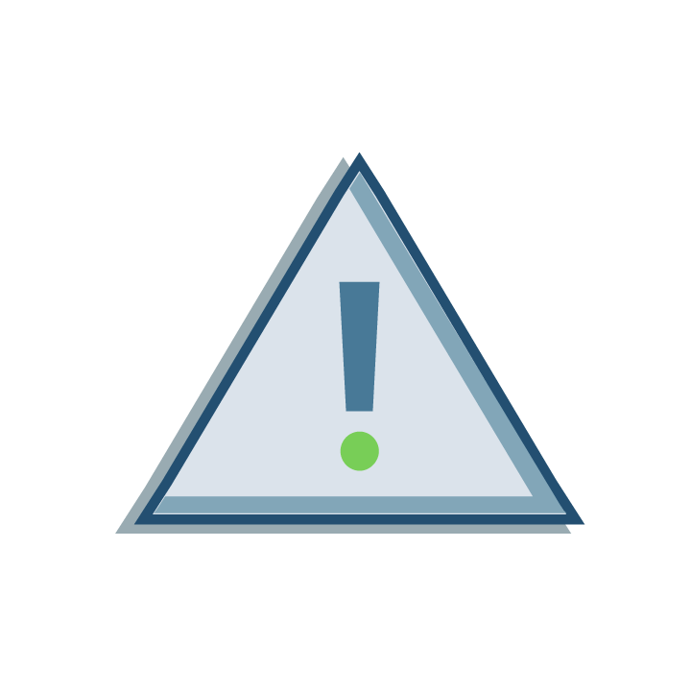
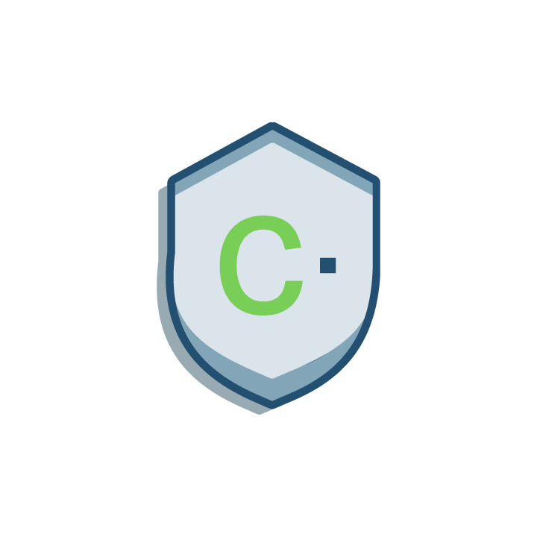
Take Action Today!
Have a Chat
How are IT, Network, Security, BioMed addressing IoT security?
Gaps between IT and IoT Practices?
What compliance requirements need action?
Understand Response Actions
In the event of a ransomware or other attack, who will you call?
What immediate actions will be taken?
What amount of downtime and recovery costs can you reasonably handle?
What does your cybersecurity insurance cover?
Contact Cynerio
https://www.cynerio.com/
chad.holmes@cynerio.com
Notes:
Compliance notes - DSPT for NHS
"Understand updated compliance requirements that need action. For example, DSPT version 4 now requires specific attention for medical devices. This includes basic action like device identification to more advanced efforts around weak password policies, addressing outdated operating systems, and implementing segmentation policies. This can be a bit daunting for some organizations, especially if you're subject to the upcoming Feb 28 interim assessments. Naturally our team is available to help if needed."
Version 4 now includes medical devices
(Identification, Weak password policies, outdated OS, segmentation, etc)
Interim assessments due 28 Feb 2022
Understand Your Threat Landscape
Ask internal teams about IoT Security - IT, Network, Security, BioMed
Determine where in-place IT systems leave IoT security gaps
Ensure past, current and future security planning includes IoT
Understand Response Actions
In the event of a ransomware or other attack, who will you call?
What immediate actions will be taken?
What amount of downtime and recovery costs can you reasonably handle?
What does your cybersecurity insurance cover?
Approach Trusted Security Provider
Determine specific actions and protections in place for IoT devices
Is there a gap between IT and IoT practices
Ask: How do we ensure ransomware does not enter through IoT devices?

Slide 17
Questions?
Healthcare IoT Cybersecurity
Secure. Faster.

