Slide 1
HTM Department
Business Continuity
Effective Operations in a Time of Crisis
Mike Busdicker, MBA, CHTM - CE System Director

Slide 2

MIKE BUSDICKER
Mike Busdicker is the System Director of Clinical Engineering Shared Services at Intermountain Healthcare. Mike started his healthcare career with the United States Air Force as a 1983 graduate of the DoD Biomedical Equipment Repair School. His total military service included seven years of active duty and 20 years with the Wisconsin Air National Guard. During his military time he served as a Biomedical Technician, First Sergeant, and Human Resource Advisor, completed an operational deployment to Iraq, and achieved the highest enlisted rank of Chief Master Sergeant.
Mike received his Bachelor's and Master’s Degree in Business from Baker College in Flint, Michigan. Prior to his employment with Intermountain he has held leadership positions with ServiceMaster Management Services, Aramark Clinical Technology Services, TriMedx Healthcare Services, and Alexian Brothers Healthcare System. Mike is an active member of AAMI, ACHE, UHE, HIMSS, NH-ISAC, MDSISC, and is a member of the AAMI Technology Management Council.

Slide 3
DISCLAIMER
“The slides in this presentation were prepared as talking points by the presenter. It is compiled from data, experiences, and processes at Intermountain Healthcare and are for information sharing purposes only.”

Slide 4
Agenda
Objectives
Introduction to Intermountain Healthcare
Quick Look at Early Emergency Preparedness
Emergency Preparedness Over the Years
2020 Introduces a New Challenge for HTM
Current State of HTM Emergency Preparedness
Emergency Preparedness Into the Future

Slide 5
Objectives:
1. Understand the early stages of emergency and disaster preparedness in Healthcare
2. Look at disasters and incidents that have shaped and molded HTM Emergency Preparedness
3. Review updates and data implemented by Intermountain Healthcare in 2020
4. How HTM should prepare and be involved with Emergency Preparedness into the future

Slide 6
About Intermountain Healthcare

Slide 7









About Intermountain Healthcare
An Integrated Delivery Network with a Tradition of Innovation
Helping people live the healthiest lives possible TM
40,000 Caregivers
Coverage in Eight States
Based in Salt Lake City, Utah
HTM Department
109 Caregivers
130,000 Medical Devices
Hospitals
Medical Group
Saltzer Health
Continuum of Care
Gifted to Community in 1974
24 Hospitals
2,900 Licensed Beds
Started in1994
1,400 employed physicians
4,000 affiliated physicians
185+ clinics
Acquired in 2020
80 Physicians
300 Caregivers
Over 100,000 Patients Served
TeleHealth
Homecare
Life Flight
Central lab
Central pharmacy
Health Plan
Castell Health
HCP Nevada
Classic Air Medical
Started in 1983
SelectHealth
1M plus members
25% of Utah market
Established in July 2019
Re-imagined Primary Care Model
Analytics and Technology Platform
Digital Tools for Virtual Care
Utilization of Clinical Best Practices
Acquired in 2019
340 Providers
1500 Caregivers
55 Clinics
Acquired in 2021
16 Rotary Wing Aircraft
12 Fixed Wing Aircraft
Serves Eight Western States
Notes:
A little about who we are and what we do and ongoing organizational initiatives keeping up with current trends in healthcare

Slide 8
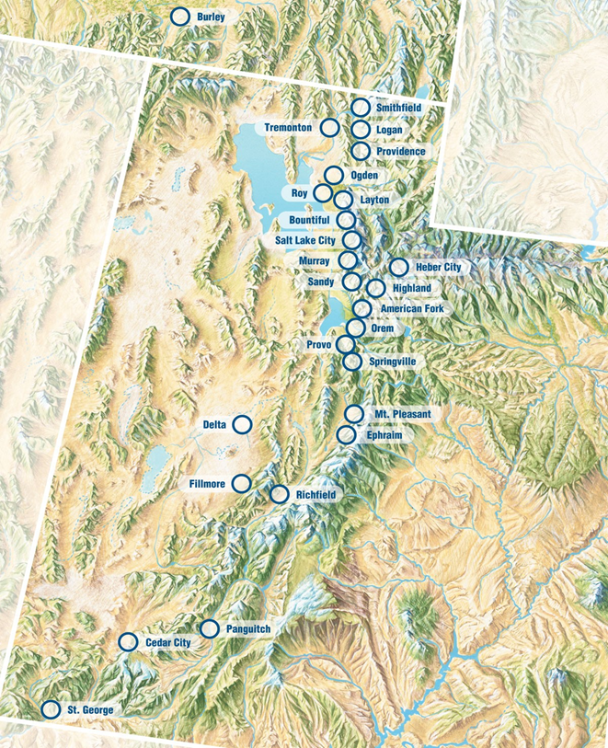
CLINICAL ENGINEERING SHARED SERVICES STRUCTURE
Central Support Services and Management
  System Director
  CE Medical Equipment Security
  Central Support Manager
  Service Contract Specialist
  Service Coordination Center
  Office Coordinator
  Inventory and Parts Coordinator
  Data Analysts
CE Area and Hospital Operations
  Four Area CE Directors
  Local CE Managers and Technicians
  Local Parts and Supply Stock
Central Depot, Homecare, and Field Services
  Program Manager
  Depot CE Technicians
  Hospital Bed Field Service
  Dialysis Equipment Field Service
  Sterilizer Field Service
  DME and Power Chair Services
Notes:
CESS structure and roles/ responsibilities

Slide 9
Healthcare Technology Management
Emergency Preparedness
The Past
The Present
The Future
Notes:
CESS structure and roles/ responsibilities

Slide 10
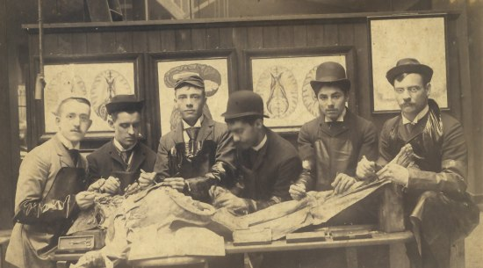
Consolidated History of Emergency Management
1803 – First Federal Government involvement – fire in Portsmouth, NH
1899 – First major response of the American Red Cross – flood in Johnstown, PA
1950 – Federal Disaster Relief Program – assist state and local governments
1961 – Federal Emergency Preparedness – MT 7.3 earthquake, hurricanes Donna and Carla
1968 – 911 Emergency System implemented in Alabama and Alaska
1974 – Disaster Relief Act passed allowing Presidential disaster declaration process
1979 – FEMA established to centralize disaster efforts
2001 – First activation of the Federal Response Plan
2002 – Homeland Security Act established
2003 – Presidential Directive establishing requirements for public health and medical preparedness
2016 – CMS published the Emergency Preparedness Final Rule – Covers participating providers
2017 – The Joint Commission publishes their final Emergency Management Standards
Early Contributors to HTM Emergency Management (L-R)
Malcolm Ridgway
Dave Francoeur
Stephen Grimes
Binseng Wang
Al Gresch
John Krieg
Notes:
CESS structure and roles/ responsibilities

Slide 11
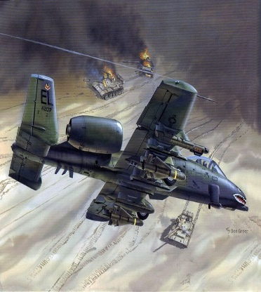
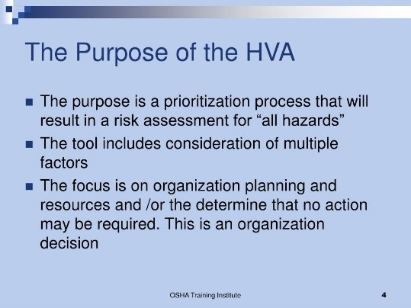
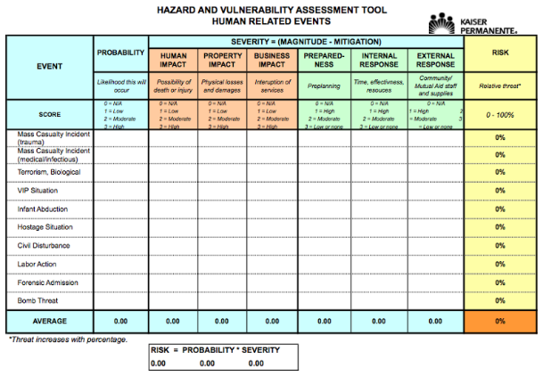
HTM Emergency Management Over the Years
What did HTM Emergency Management look like in the 1990s?
  Nationally we had major events including the Deseret Storm
  Standard HTM emergency prep for hospitals
  Hazard Vulnerability Assessment (HVA) – local area, state, and regional
Notes:
CESS structure and roles/ responsibilities

Slide 12


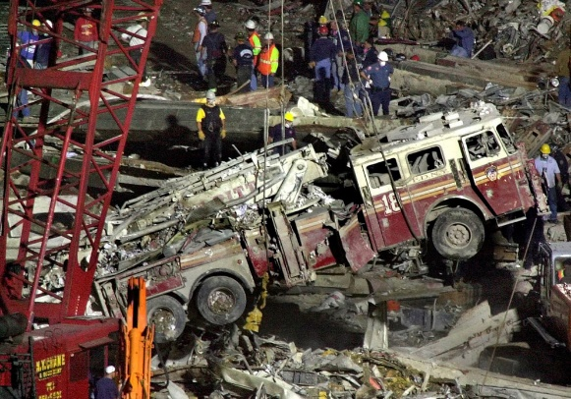
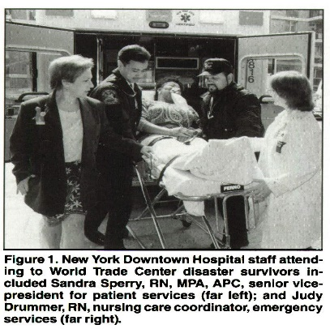
HTM Emergency Management Over the Years
What did HTM Emergency Management look like between 1999 – 2001?
  Y2K the world is coming to an end
  On January 1, 2000 - medical equipment will revolt
  World Trade Center Disaster in New York
Notes:
CESS structure and roles/ responsibilities

Slide 13
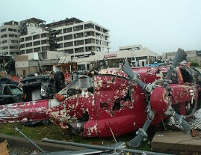
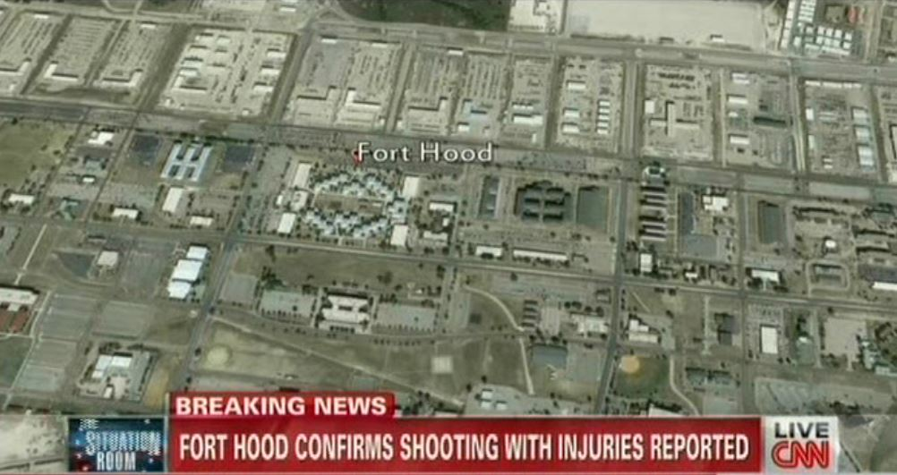
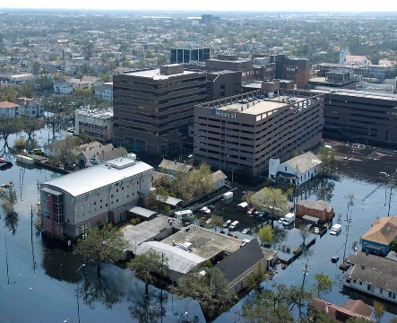
HTM Emergency Management Over the Years
Emergencies throughout 2005-2012 Impacting Healthcare Organizations
  Hurricane Katrina strikes New Orleans in 2006
  Fort Hood Active Shooter
  2011 Mercy Hospital in Joplin destroyed by an EF5 Tornado
Notes:
CESS structure and roles/ responsibilities

Slide 14
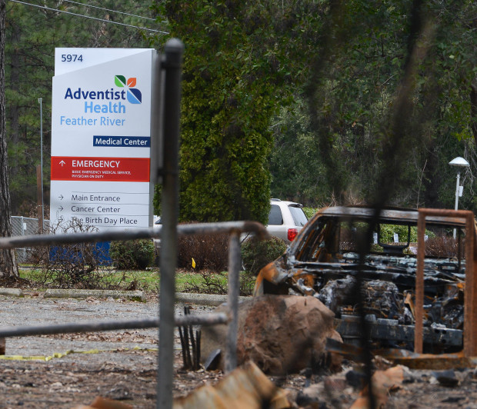
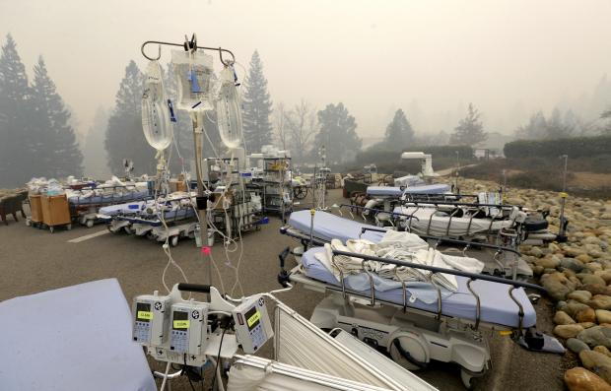
HTM Emergency Management Over the Years
2018 HTM Emergency Management in Paradise, California
https://youtu.be/xZECgAp0bDs
Notes:
CESS structure and roles/ responsibilities

Slide 15
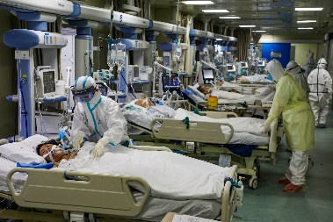

HTM Emergency Management – A New Challenge
In November 2019, the first case of COVID-19 Corona Virus in China
  January 2020 First COVID Case Reported in the United States
  Over 3M Cases Reported in July 2020 Including over 40K hospitalized
March 2020: Work conditions for healthcare staff takes a drastic change
  Remote work for non-essential caregivers
  Safety considerations for all caregivers and clinical staff
  Facility restrictions for visitors and suppliers
  Local, State, and Federal Command Centers
  Equipment and staff tracking, reporting, continued operations
Notes:
CESS structure and roles/ responsibilities

Slide 16
HTM Emergency Management – Current State
2020 COVID-19 Strategies and Outcomes
  Facility Level Incident Command System - Key Departments
  System Logistics Command Center – System Leadership
  State Command Center – Combined Data
Intermountain Healthcare HTM Reports
  Daily staffing reports
    Caregiver status
    Shift coverage
  Ventilator reports
    Usage stats locally, system, and state
    Types of units available for use
    Status of repairs
    Loaner ventilator availability
  Surge preparation
    Hospital and ICU occupancy
    Bed availability
    Overflow unit stand up status
    Repurpose equipment for surge
Notes:
CESS structure and roles/ responsibilities

Slide 17
HTM Emergency Management – Current State
Intermountain Healthcare HTM Caregivers
  Daily staff assessments
    Workloads
    Family status
    Personal health and well-being
  Data and information
    Evaluation of PM cycles and in-use equipment
    On-going review of CMS 1135 waiver use
    Local and state equipment shortages and request
    System level resource sharing to include staff
  Surge preparation
    3D printing of vent tubing parts
    Multi-patient use vent testing
    Repurpose patient care areas to COVID treatment
Notes:
CESS structure and roles/ responsibilities

Slide 18
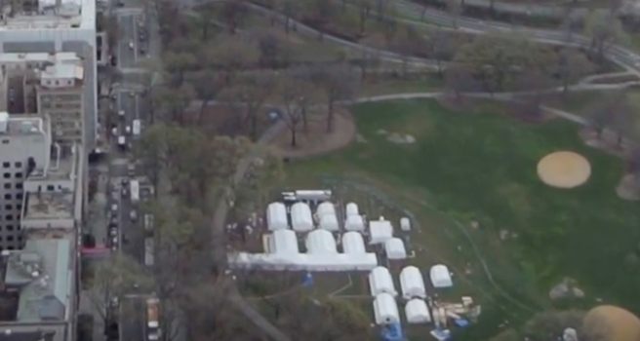
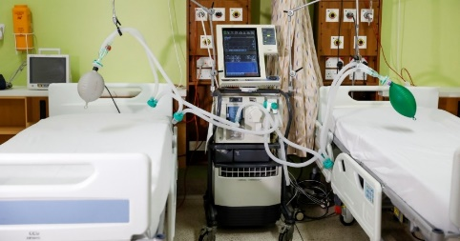
2020 HTM Emergency Management Updates
2020 a whole new Emergency Preparedness challenge for HTM
  COVID-19 unchartered territory for HTM
    Temperature checks for everyone
    Drive through testing sites
  Ventilator shortages and potential strategies
    Loaner vents from educational institutions
  PPE, disinfection, caregiver protection, supplier support
    PAPR unit repairs and maintenance
  Parts availability, 3D printing, FDA rapid approvals
    Net new devices into the organization
  Bed shortages, space limitations, and the list goes on!!
Notes:
CESS structure and roles/ responsibilities

Slide 19
2020 HTM Emergency Management Updates
Updates to the HTM Business Continuity Plan
  Purpose, Scope, and Objectives
  Risk Assessment
  Past, present, and potential future events
  Team Overview and Key Members
  Organizational structure and chain of command
  Greatest Threat Potential
  Communication, staff shortage, etc…
  Response
  Can operations continue as normal
  Responsibilities of staff across the system
  Recovery Phase and Record Keeping
    Software reloads, equipment resets
    Date, time, action, and potential expense
Notes:
CESS structure and roles/ responsibilities

Slide 20
2020 HTM Emergency Management Updates
Updates to the HTM Business Continuity Plan - Forms
  Critical Suppliers, Contact Info, and Names
  Mission critical devices
  Parts and Service Suppliers
  Business Continuity Plans – Local Support
  Home Locations of Critical Staff
  Ability to communicate and gauge response
  Potential need for personal caregiver assistance
  Damage Assessment and Documentation
  Location, condition, and recoverable
  Business Recovery Expense
  Facility, caregiver, cost, and payment method
  Post Emergency Tasks
  Asset inventory, staff debriefs, insurance, and movement
Notes:
CESS structure and roles/ responsibilities

Slide 21

2021 HTM Emergency Management into the Future
AAMI – TMC Subcommittee
EMERGENCY PREPAREDNESS
ASSESSMENT FOR HTM DEPARTMENTS
Notes:
CESS structure and roles/ responsibilities

Slide 22
AAMI – TMC Subcommittee
EMERGENCY PREPAREDNESS
ASSESSMENT FOR HTM DEPARTMENTS
Introduction
Understand federal, state, regional, local, and facility regulations and response plans
Follow the National Incident Management System (NIMS) model
Described in the Hospital Incident Command System (HICS)
Authority-based chain of command process, designed to be flexible and adaptable
Clearly defined roles and responsibilities for every participant
Annual risk assessment and be self-reliant for 96 hours
Should include HTM review of equipment availability and participation in drills
Notes:
CESS structure and roles/ responsibilities

Slide 23
AAMI – TMC Subcommittee
EMERGENCY PREPAREDNESS
ASSESSMENT FOR HTM DEPARTMENTS
Part 1 – Hospital Profile
Hospital name, licensed beds, clinical/non-clinical staffing levels
Off-site clinics along with locations and services
Suburban or rural, helipad available, accrediting organization
Identify departments, capacity, equipment inventory, surge capability
Department level staffing numbers and individual specialties
Emergency power and facility water supply
HTM respiratory device involvement and disaster training for staff
Notes:
CESS structure and roles/ responsibilities

Slide 24
AAMI – TMC Subcommittee
EMERGENCY PREPAREDNESS
ASSESSMENT FOR HTM DEPARTMENTS
Part 2 – Analysis of Critical Preparedness Factors
Section 1: Incident Command Center
HTM knowledge, participation, and communication
Mutual Aid Agreements
  Read and review memorandum of understandings (MOUs)
Emergency Management and Disaster Committees
  HTM active participation
  Participation in drills and exercises
Notes:
CESS structure and roles/ responsibilities

Slide 25
AAMI – TMC Subcommittee
EMERGENCY PREPAREDNESS
ASSESSMENT FOR HTM DEPARTMENTS
Part 2 – Analysis of Critical Preparedness Factors
Section 2: Emergency Management Planning
Emergency Management Plan (EMP)
  HTM familiar with facility Preparedness, Response, Mitigation, and Recovery
HTM Departmental EMP
  Addresses operations, staffing, business continuity, and compliance
Alternate Care Site
  HTM knowledge, needs assessment, and equipment plan
Notes:
CESS structure and roles/ responsibilities

Slide 26
AAMI – TMC Subcommittee
EMERGENCY PREPAREDNESS
ASSESSMENT FOR HTM DEPARTMENTS
Part 2 – Analysis of Critical Preparedness Factors
Section 3: Clinical Operations
Isolation Bed Capacity (Negative Air Flow)
  Number of beds, needs assessment, and equipment plan
Radiation Exposure
  Radiation safety officer, exposure survey and detection
Pharmacy, Laboratory, and Sterilization Services
  Potential need for relocation
  Knowledge of MOUs
  Possible workload transfer
Notes:
CESS structure and roles/ responsibilities

Slide 27
AAMI – TMC Subcommittee
EMERGENCY PREPAREDNESS
ASSESSMENT FOR HTM DEPARTMENTS
Part 2 – Analysis of Critical Preparedness Factors
Section 4: Logistics and Facilities
Supplies
  Durable medical equipment, alternate suppliers, and inventory
  Consumables and technician assignments
Personal Protective Equipment (PPE)
  Inclusion of HTM, restock plans, and staff training
Medical Gases and Ventilation
  Supply potential, calibration gases, fittings, and securing
  Impact on equipment and staff – HVAC and medical gas
Notes:
CESS structure and roles/ responsibilities

Slide 28
AAMI – TMC Subcommittee
EMERGENCY PREPAREDNESS
ASSESSMENT FOR HTM DEPARTMENTS
Part 2 – Analysis of Critical Preparedness Factors
Section 5: Communications, Warning, and Notification
Student/Volunteer Management
  Plan/Policy/Procedure for individuals
Staff Notification
  HTM point of contact (POC), facility notification process, on/off duty process
  Updated volunteer list, alternate POC, routine check-in process
Communications and Information Management
  Alternate communication process, data storage, and cybersecurity plan
Public Information and Media Relations
  Who is the public info officer and the organizations policy
Notes:
CESS structure and roles/ responsibilities

Slide 29
AAMI – TMC Subcommittee
EMERGENCY PREPAREDNESS
ASSESSMENT FOR HTM DEPARTMENTS
Part 2 – Analysis of Critical Preparedness Factors
Section 6: Training, Drills and Exercise
  Staff orientation and department participation in drills
Section 7: Performance Improvement and Quality
Emergency Management Standards
  After action reports, strengths and weaknesses
  Incorporate improvement initiatives
Appendix A: Emergency Travel Letter Template
Appendix B: HTM Department Business Continuity Plan
Appendix C: Scheduled Maintenance Guideline
Notes:
CESS structure and roles/ responsibilities

Slide 30

Questions?

