Slide 1
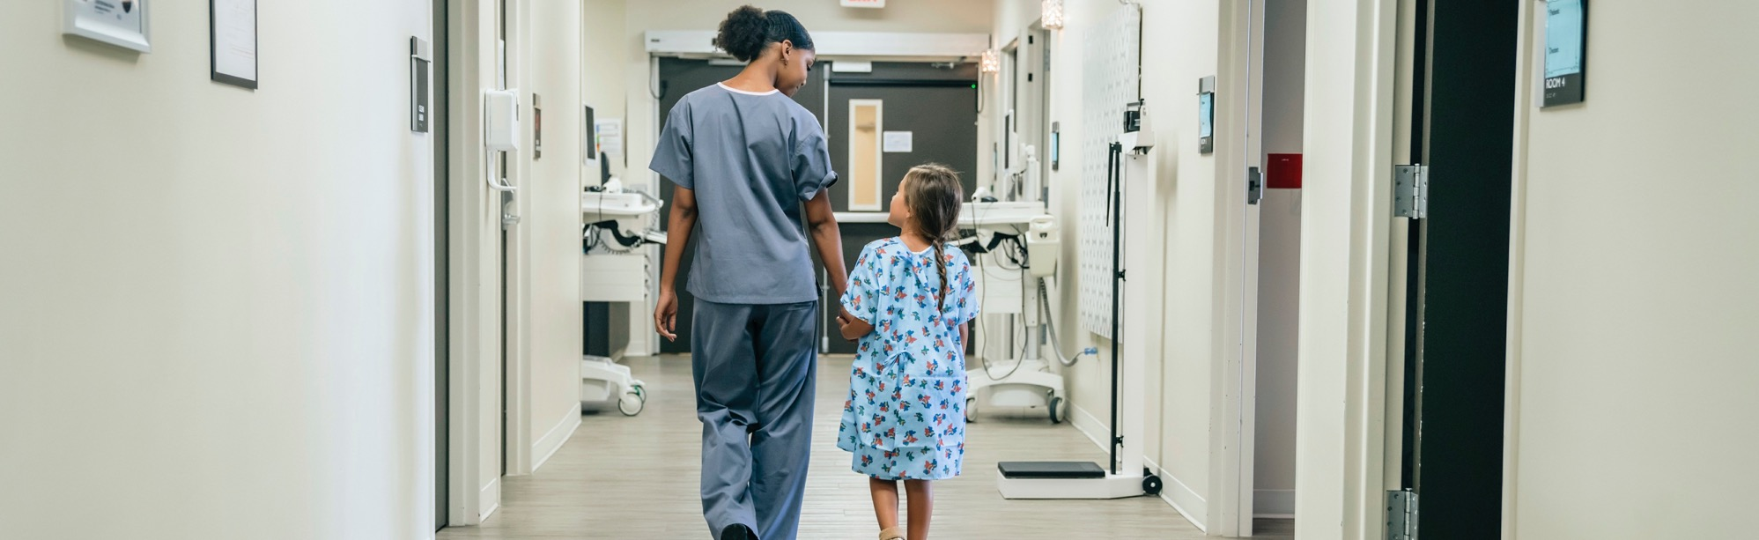
How Workflow Automation Supports Medical Device Quality Assurance Program Goals
Presented by Terry Harris and Elliot Weldon, Fluke Biomedical
2021 MD Expo Las Vegas
©2021 Fluke Corporation

Slide 2
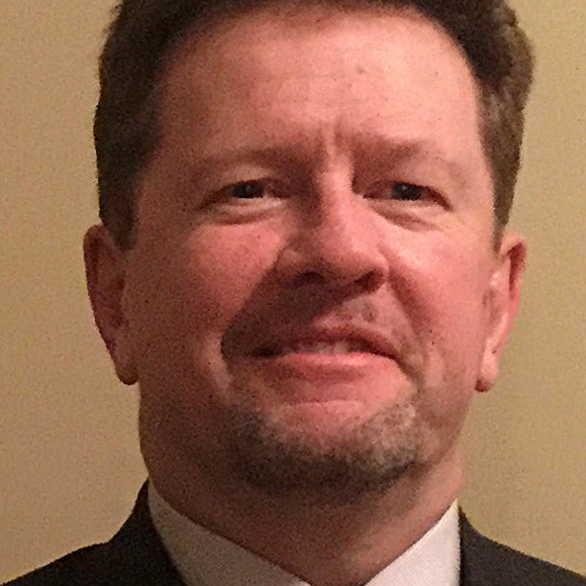

Today’s Speakers
      Terry Harris
      Software Sales Executive
      Fluke Biomedical
      Elliot Weldon
      Product Application Specialist
      Fluke Biomedical
©2020 Fluke Corporation

Slide 3
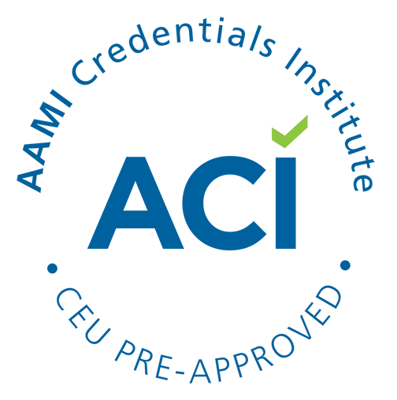


1 CEU credit from ACI
More credits available at Fluke Biomedical on-demand webinars
flukebiomedical.com Knowledge Center Webinars
©2020 Fluke Corporation
Notes:
Wait till the end to scan the QR code… also, we have webinars that you can watch on demand

Slide 4
What We Will Cover Today
1
2
3
Pains associated with paperwork
How to document effectively
Alleviating audit anxiety
©2020 Fluke Corporation

Slide 5
Do you like doing paperwork?
©2020 Fluke Corporation

Slide 6

Classic paperwork problems faced by biomedical engineers
Too many assets, too little time
Unsure how to set up test, make connections
Manager directed rework
Recording inputs manually
  Misplaced records
Attaching results to workorder
Unclear what steps are required for the test
©2020 Fluke Corporation
Notes:
Manually executing tests
Recording each individual measurement result
What do I connect to what?
Problems with using paper
Manually typing test results into CMMS / uploading scans of paper reports
Multiple sources of data, multiple reports

Slide 7

Managers have their own issues with the current state of things
Not enough time
Keeping up with regulations
Resistance to change
Throughput
targets
Deadlines
Pressure to reduce
cost
Audit
©2020 Fluke Corporation
Notes:
Let’s talk about the problems with the current state of things that a manager may be facing.

Slide 8

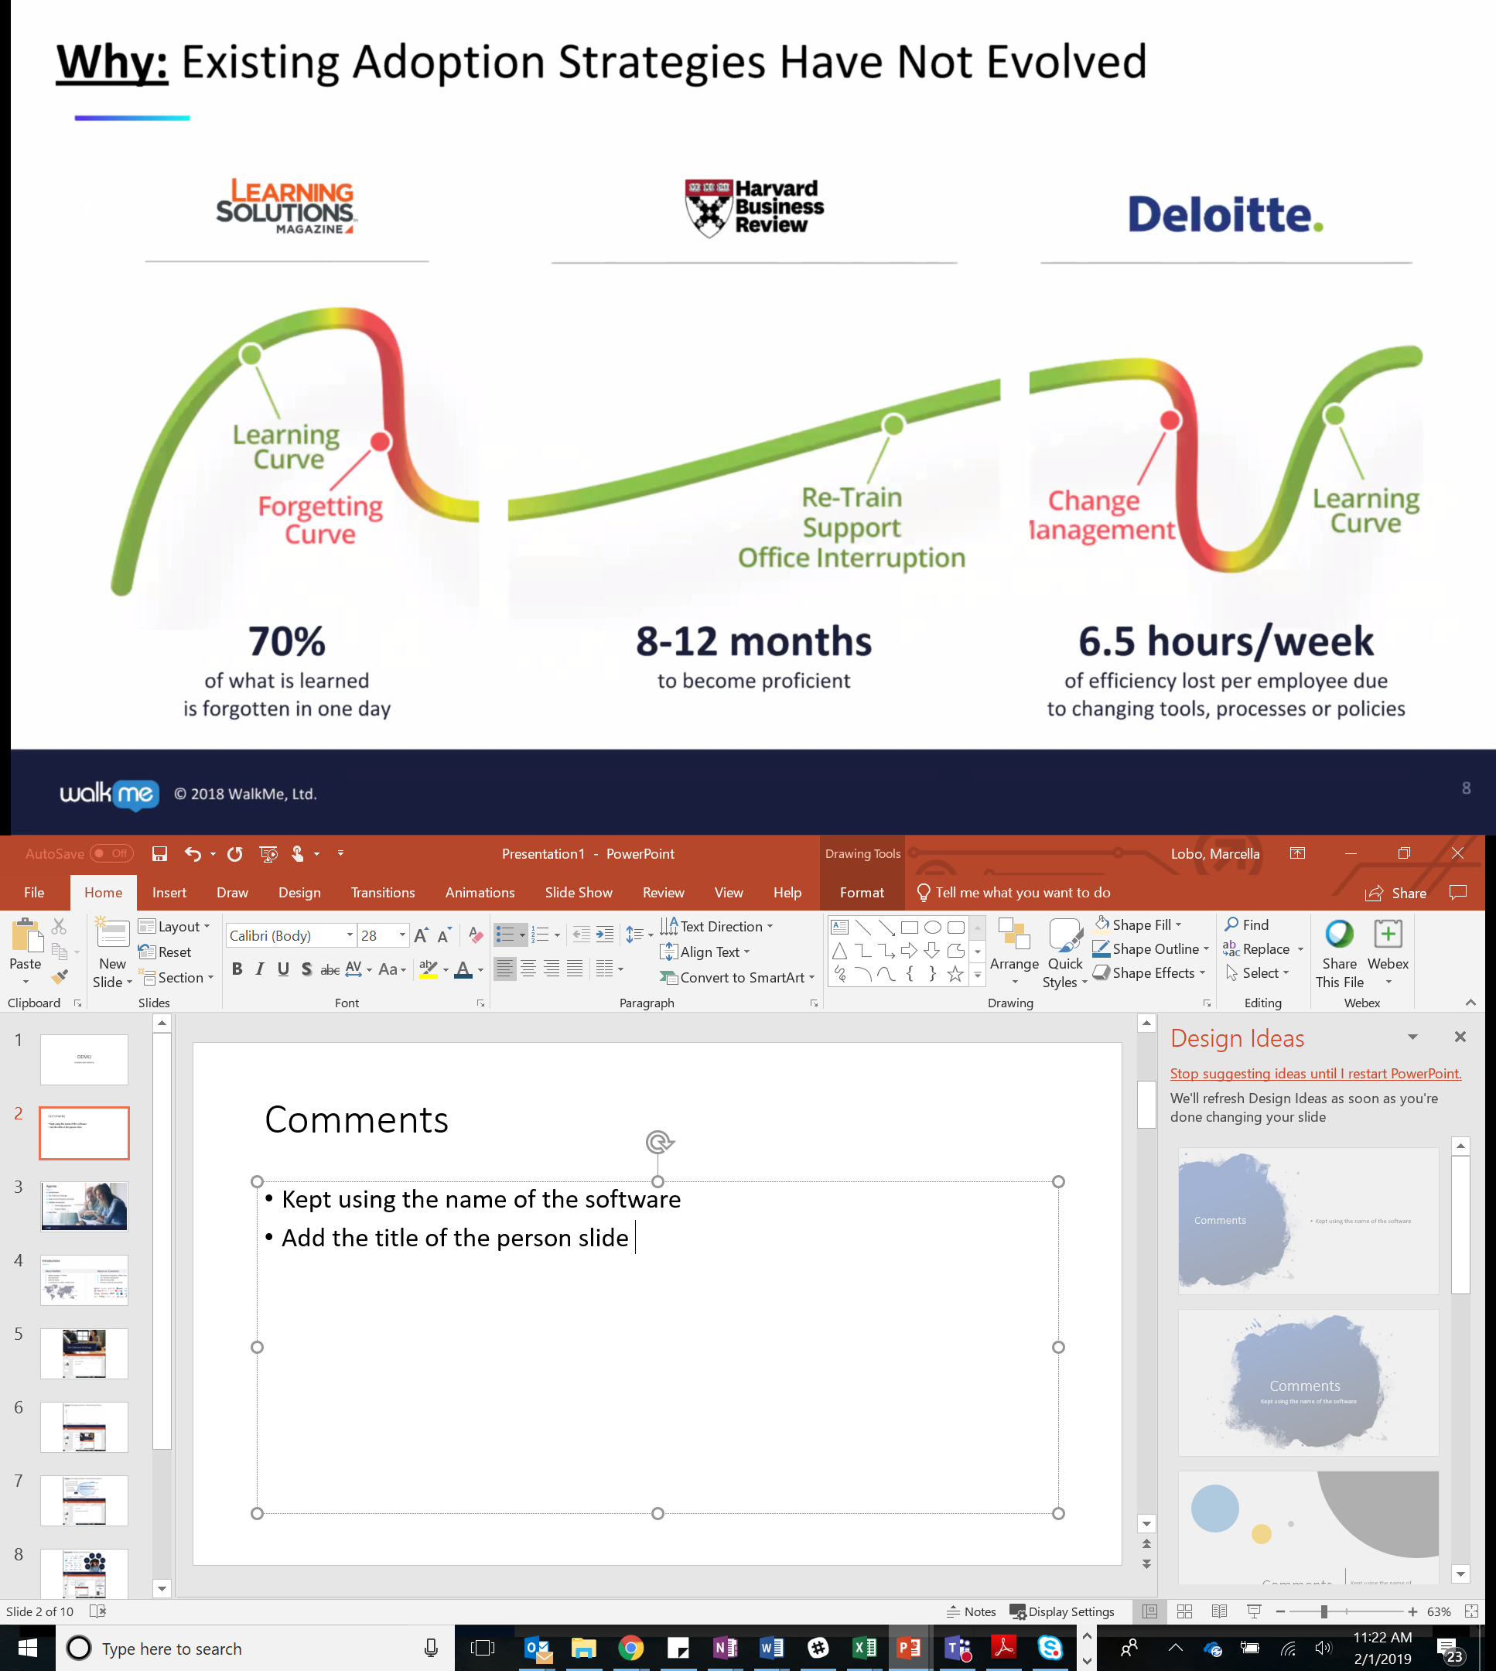
Studies show time lost with manual workflows
50%
6.5 hours per week
8-12 months
Average time Biomeds spend on paperwork
of efficiency lost per employee due to changing tools, processes or policies
To become proficient
Re-train
Support & Office interruption
15%
Notes:
We have done research on the subject. We have spoken to hundreds of biomeds across the globe and this is what we found: on average, Biomeds append about 50% of of their work time on paperwork. Isn’t it crazy? Documenting and properly storing test results is critical for traceability and compliance but there’s gotta be a better way to do it more efficiently, right??
Harvard Business Review and Deloitte also did research on work productivity and found the following. According to their data, 6.5 hours per week is lost by each employee solely due to lack of standardization on processes and tools. And Deloitte here reminds us that on average it takes each person quite a while to onboard and become proficient at what they do. 8 to 12 months to learn or to train a new employee.

Slide 9
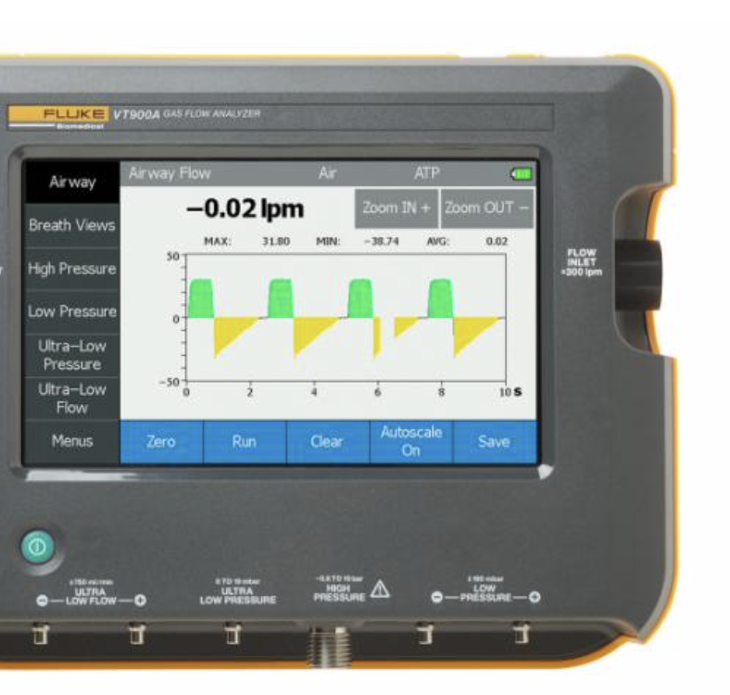

Test tools with on-board automation can increase workflow efficiency
  On-board automation and autosequences allow to
Run multiple test steps with the push of a button
Pull test results directly off the test equipment
x
Remaining pains
Multiple sources of test results
Test instrument setup / learning curve
©2020 Fluke Corporation

Slide 10

Remaining pains can lead to issues with the audit process
Areas of concern for incoming auditors
Unavailability of all required paperwork
    Illegible test results
  Incorrect dates
  Incomplete test results
  Multiple test reports for one asset
      No standard process
      Patient risk
Documentation process needs to be improved further
©2020 Fluke Corporation
Notes:
They are still some records that were taken or transferred manually and are missing
There are missing test report sheets
and some results, even though recorded correctly, were tied to the wrong assets
Some test results were illegible
Some dates were stated incorrectly
Some test results were incomplete
And some of the assets had multiple test reports per DUT
What were the takeaways from this for both Sally and Steve?
Even though test tools with on-board automation relieved multiple documentation pain points for Sally and her biomeds, there is still no standard process that is being followed
Thus increasing the level for patient risk
Sally needs to look for better ways to document.

Slide 11
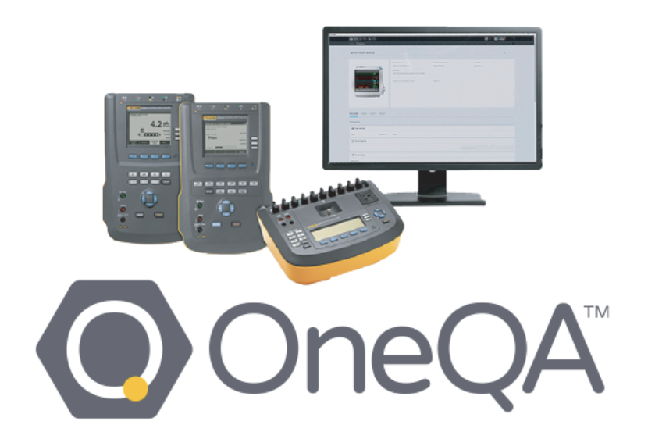
Achieve enhanced productivity and reporting with test automation software
    Fluke Biomedical OneQA allows you to do more with less
    Build a customized test procedure and lock it
    Insert visual guidance for test setup
    Create one test report per asset
    Automatically populate test results
    (ESA61x, ESA620, Impulse 6000D/7000DP, VT650/900A)
    Complete workorders and upload reports to CMMS
  Decrease risk. Drive standardization. Document electronically
©2020 Fluke Corporation
Notes:
OneQA allows you to
Build a customized, standard test procedure for each asset in the hospital that everyone on her team can easily follow
She can insert pictures of the test setup in that procedure to eliminate any confusion
She now creates one test report per asset
Test results are now automatically populated in the SW while the test procedure is being performed
Her work orders are now automatically completed and uploaded to the CMMS
You can decrease risk, you can drive standardization – you can document electronically.

Slide 12
Fluke Biomedical OneQA
Workflow Automation Software
Saving you time and money
Standardizing testing
Promoting Regulatory Compliance (instant retrieval for a JCAHO drop-in)
Increasing accuracy & efficiency; decreasing errors & missteps
Importing OEM service manual excerpts directly into procedure
Embedding device picture & notes with asset location
Adding a biomed onboarding tool for training new hires
Giving manager administrative control of procedure content
Creating a seamless CMMS integration with an open API for easy interface
OneQA software can be your complete procedure library for ALL biomedical devices.
It fully automates PMs performed with Fluke testing equipment.

Slide 13
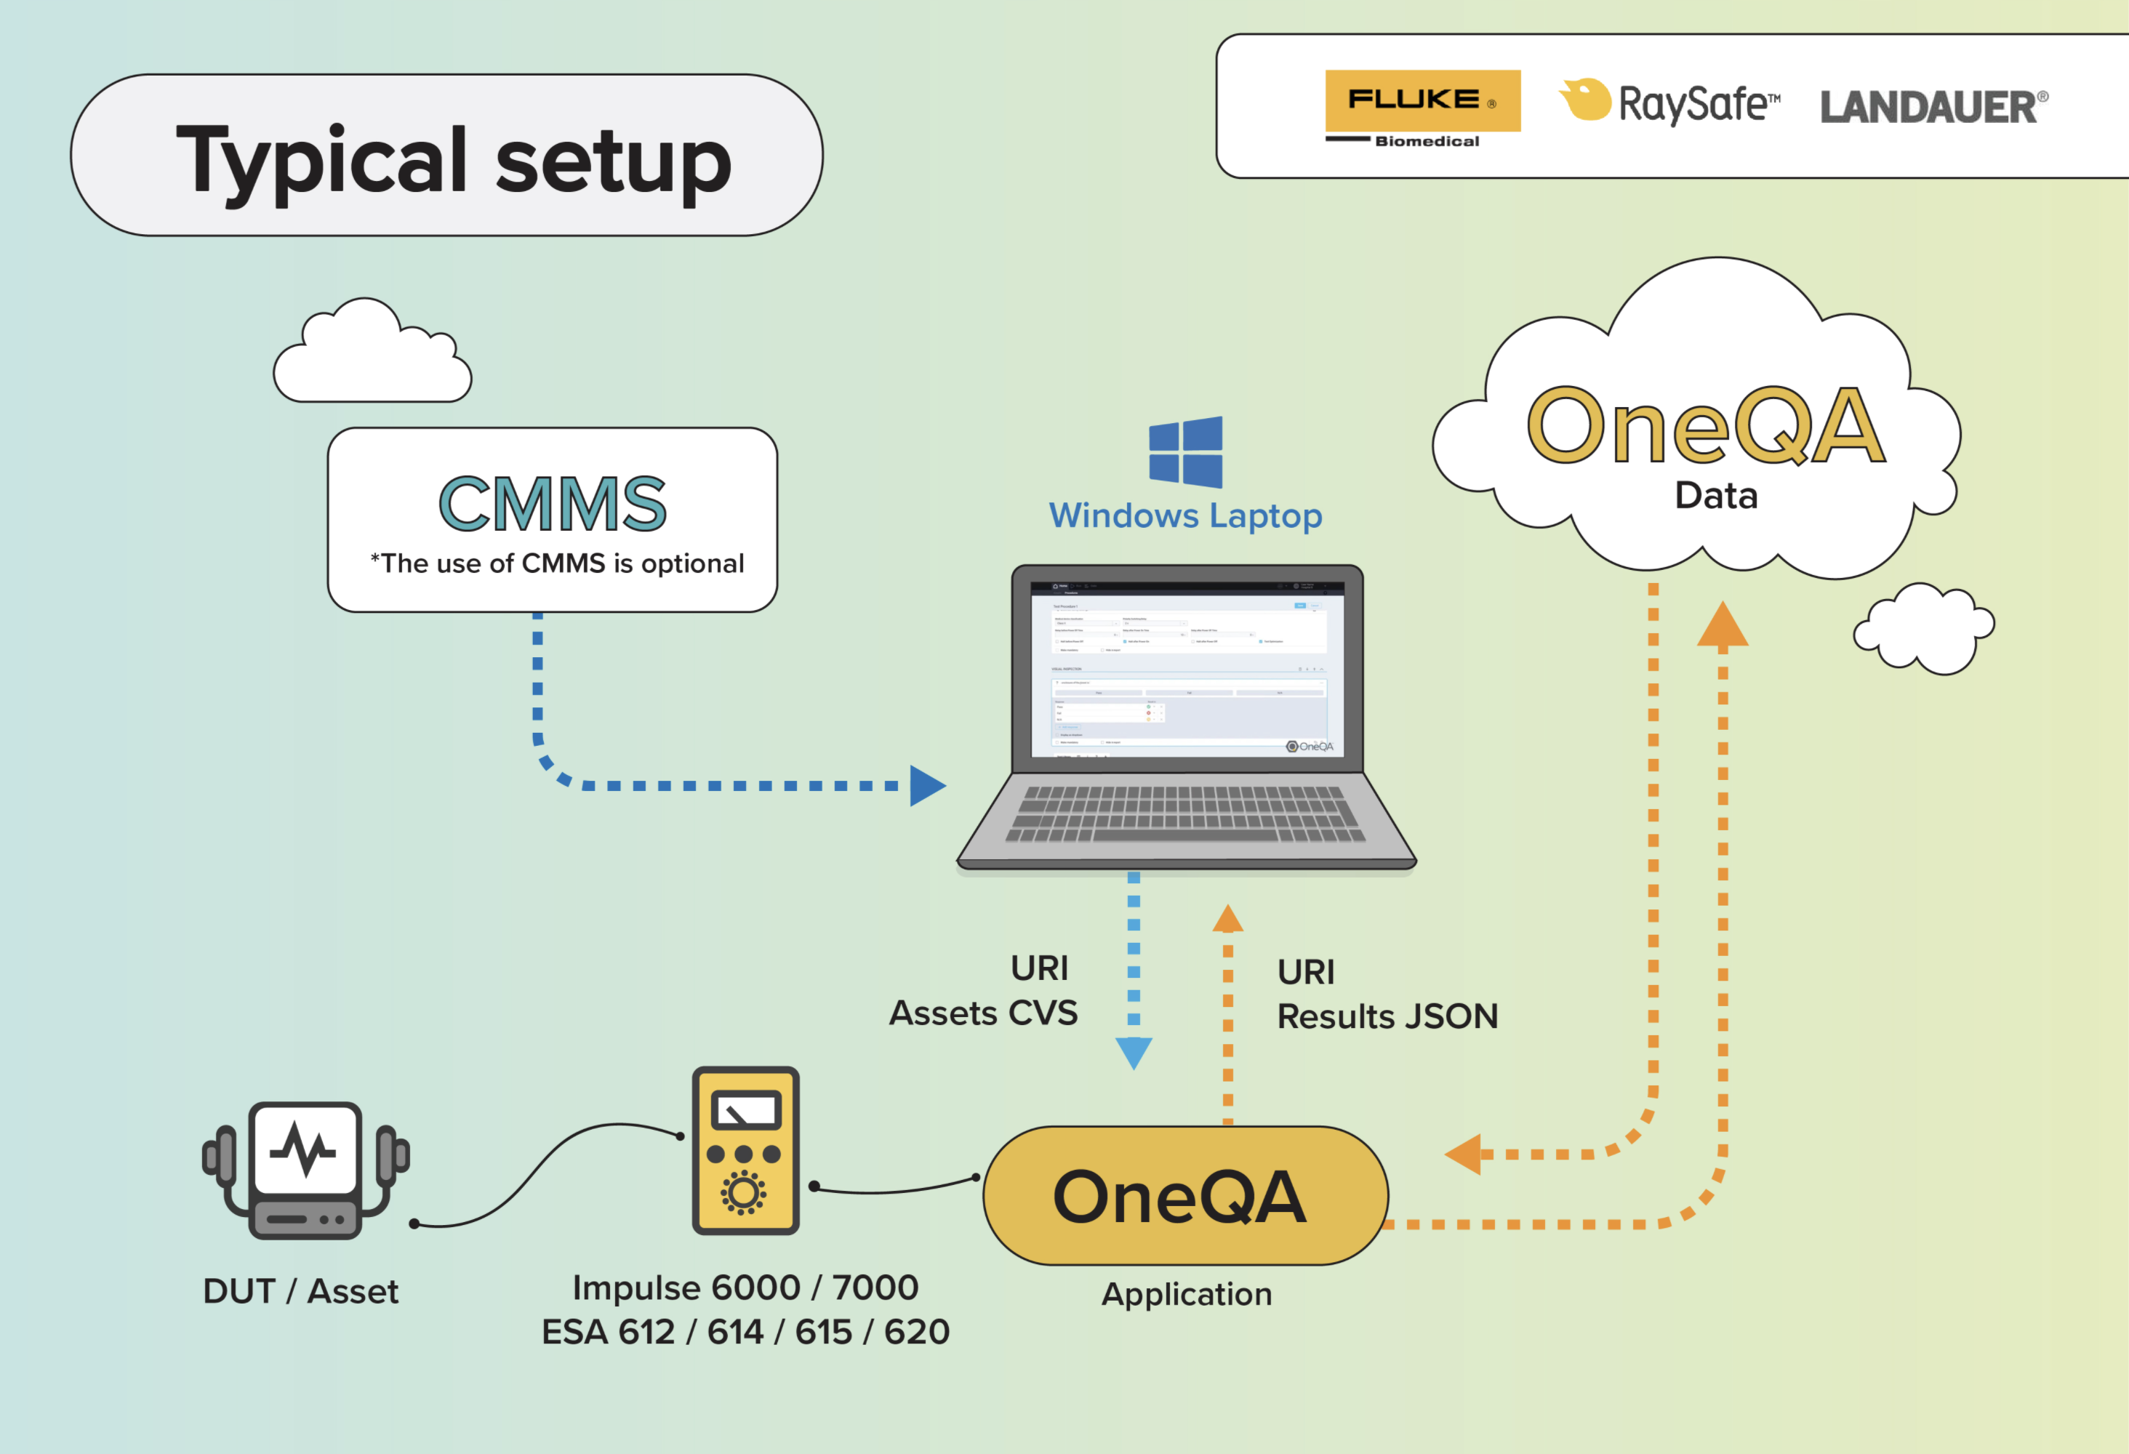

VT 650 / 900A

Slide 14
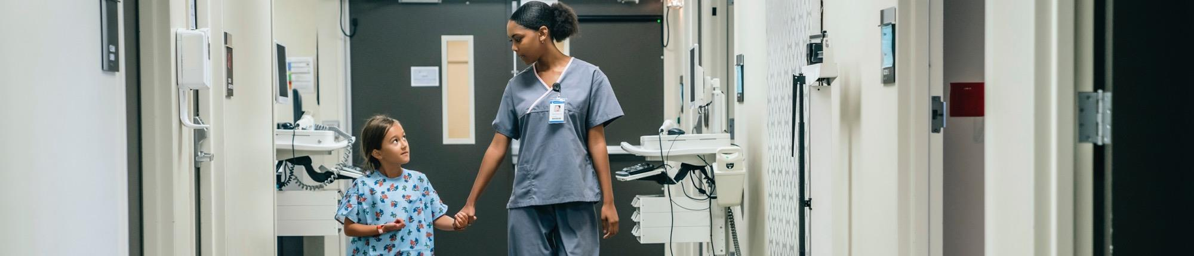

Q&A Time
Fluke Biomedical Advantage Training Center
https://www.flukebiomedical.com/knowledge-center/training
  Self-paced free training
  Quizzes
  White papers
  Application notes
  Videos
  ROI calculator
Advantage Training: a courtesy service from Fluke Biomedical
©2020 Fluke Corporation
Notes:
With that we move on to Q&A.

Slide 15
Thank You!
Please, visit us at
Flukebiomedical.com/OneQA
for more information
©2020 Fluke Corporation

