Slide 1
Alternative Equipment Management
Nader Hammoud
Disclaimer
Matt Baretich and Frank Painter educational workshop referenced.

Slide 2

Logistics and Disclaimer
My opinion Does Not represent my employer.
Don’t turn off your phone.
Interrupt me as much as needed.
You might be given an exam at the end of the session.
  If you fail, you are buying drinks for all in attendance.
If you get bored during the session, feel free to take a nap or play games on your phone (🔇)

Slide 3
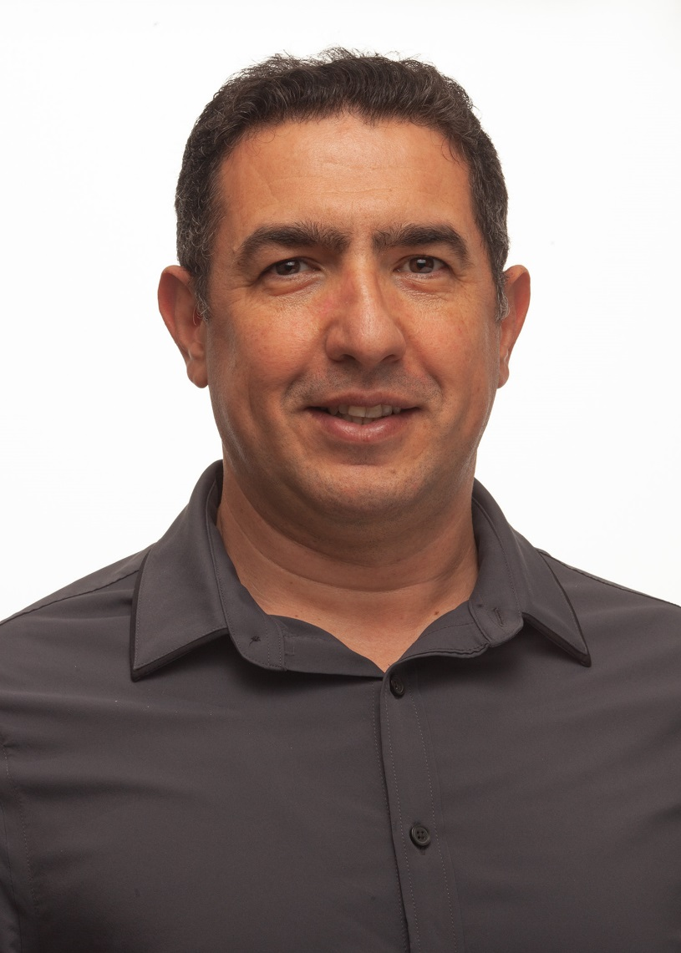

About the speaker
Nader Hammoud is currently the Biomedical Engineering Manager, at John Muir Health.
Biomedical Engineer with 3 degrees in Biomedical Engineering and an MBA
International Experience
Active member of the HTM community
Member of the Technology Management Council at AAMI
Member of Education Committee with ACCE
California HTM of the year for 2018
Recognized by ECRI and FDA for efforts in the domain.
Nader Hammoud, BE, MBA, CHTM

Slide 4
Takeaway
AEM definitions.
Where to start?
Process for doing AEM.
Practical Tips (best practice?)
Electrical Safety – Title 22 (CA Specific)

Slide 5
What is AEM?
CMS: Alternate Equipment Management
TJC: Alternative Equipment Maintenance

Slide 6
Why?
Reduce Cost!
  Equipment Safety.
  Compliance.

Slide 7
TJC EPs
 | OEM | AEM
High Risk | 100% | 100%
Non-High Risk | 100% | 100%
EC.02.04.01.04: Identify activity and frequency.
  Note 1: Must not reduce Safety. (ANSI/AAMI EQ56:2013)
  Note 2: if OEM -> 100%
  Note 3: Non-high Risk and High Risk AEM -> 100%
*100%:
  Only Medical Equipment
    Diagnose, Treat, Monitor
  Define CNL, UnAv, Document.

Slide 8
TJC EPS
EC.02.04.01.05: Don’t AEM these (Federal, State or Medicare):
  Medical Laser Devices
  Imaging and Radiologic Equipment
  New Medical Equipment (New tech. and < 25 years //or 50//)
History can be:
  ???

Slide 9
TJC EPs
EC.02.04.01.06: A Qualified individual(s).

Slide 10
TJC EPs
EC.02.04.01.07: Flag it.

Slide 11
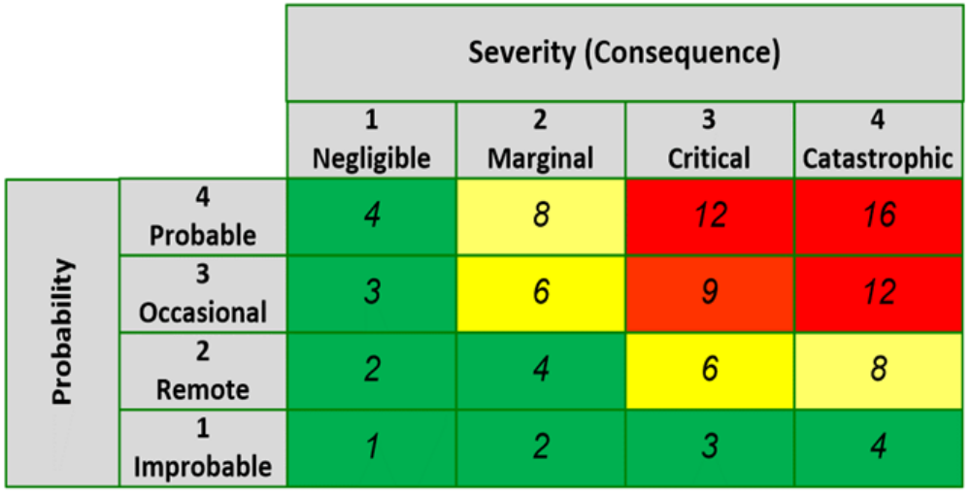
Risk Measurement
Severity:
  Equipment use and its risks.
  Backup?
  History.
  Maintenance requirements.

Slide 12
Process
Select equipment
  Time worthy?
  Forbidden?
  High Risk?
OEM PM review:
  Activities.
  Frequency.
  Alternative strategy?
Implement:
  New procedure and frequency.
  FYI/Approval of EOC
  Update CMMS

Slide 13
Practical Tips
Don’t be scared to use Category of equipment versus models.
Have a solid policy that spells out every aspect of the evaluation.
Involve customers when it is not Low Risk.
Report to EOC all AEMs:
  Low Risk: FYI
  Medium and High Risk: get approval.

Slide 14
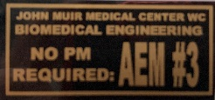
Practical Tips
ALWAYS use AEM reference numbers.
Tag the equipment with AEM tags showing AEM number.
Keep spreadsheet of all assets and their history for the time you did the analysis.
When adding equipment:
  Same model, no review or approval needed, no spreadsheet update needed.
  Different model, same category: review is a must, spreadsheet update is a must.

Slide 15
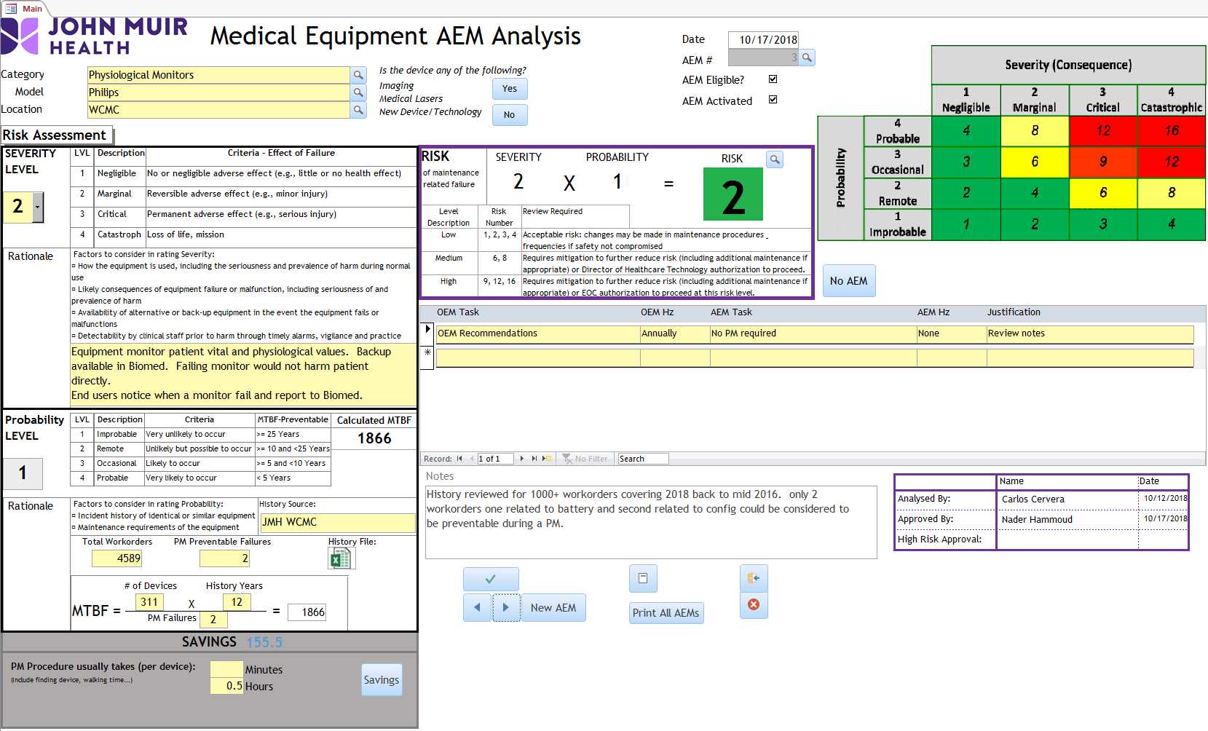

Slide 16
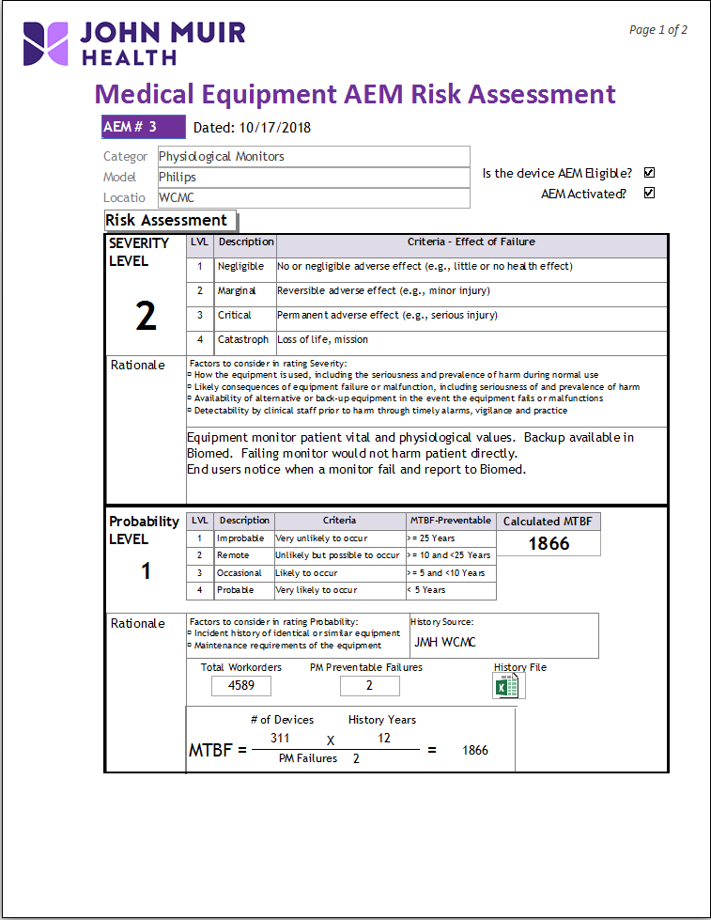
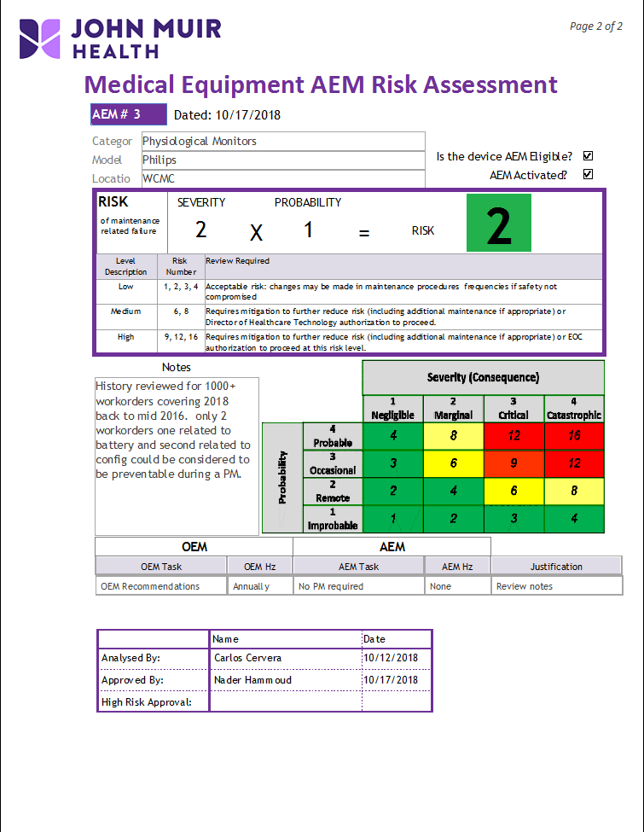

Slide 17
Electrical Safety – CALIFORNIA ☺
QUICK HISTORY:
“Title 22 California Code of Regulations Division 5
§70853. Electrically Sensitive Areas
(g) All portable (minor movable) electromedical equipment that is used in electrically sensitive patient areas shall be included in an appropriate preventive maintenance program. (1) Records of the maintenance shall include at least the following information. These measurements and inspections shall be made at least once every three months.“
On May 26, 1999, State of California – California Health and Human Services, Department of Health Services, Licensing and Certification unit, sent a letter to all general acute care hospitals, with Subject: “Update of Program Flexibility for Electro-Medical Equipment” Policy, By Marilyn I. Pearman, Chief Policy Section. It updated the requirement to be at least once every 12 months.
NFPA 99 (2005) mentioned:
“8.5.2.1.2.2. All Appliances used in patient care areas shall be tested in accordance with 8.4.1.3 or 8.4.2.2.1.1 before being put into service for the first time and after repair or modification. Patient-care-related electrical appliances shall be retested at intervals determined by their normal location or area of normal use, but not exceeding the intervals listed below:
- General care areas – 12 months.
- Critical care areas – 6 months.
- Wet locations – 6 months.”

Slide 18
Electrical Safety – CALIFORNIA ☺
Today:
Title 22 §70853. No Change “at least once every three months”
NFPA 99 (2012)
10.5.2.1.2 All patient care-related electrical equipment used in patient care rooms shall be tested in accordance with 10.3.5.4 or 10.3.6 before being put into service for the first time and after any repair or modification that might have compromised electrical safety.
Note: The requirements for testing intervals for all patient care-related equipment using tests and values as specified in Section 10.3 (and, where appropriate, 10.3.6) have been replaced. The revised approach is more consistent with current experiences regarding leakage current failures. The testing intervals stated in the previous editions were representative of nominal values that could be changed based on documented justification. The technical committee has decided that there is now sufficient experience to justify using the approach of performing the tests for touch and leakage current at the time of incoming inspections and following patient care-related equipment repairs or modifications. This is considered both a more effective method to ensure patient electrical safety and a more judicious and focused use of technical resources.

Slide 19
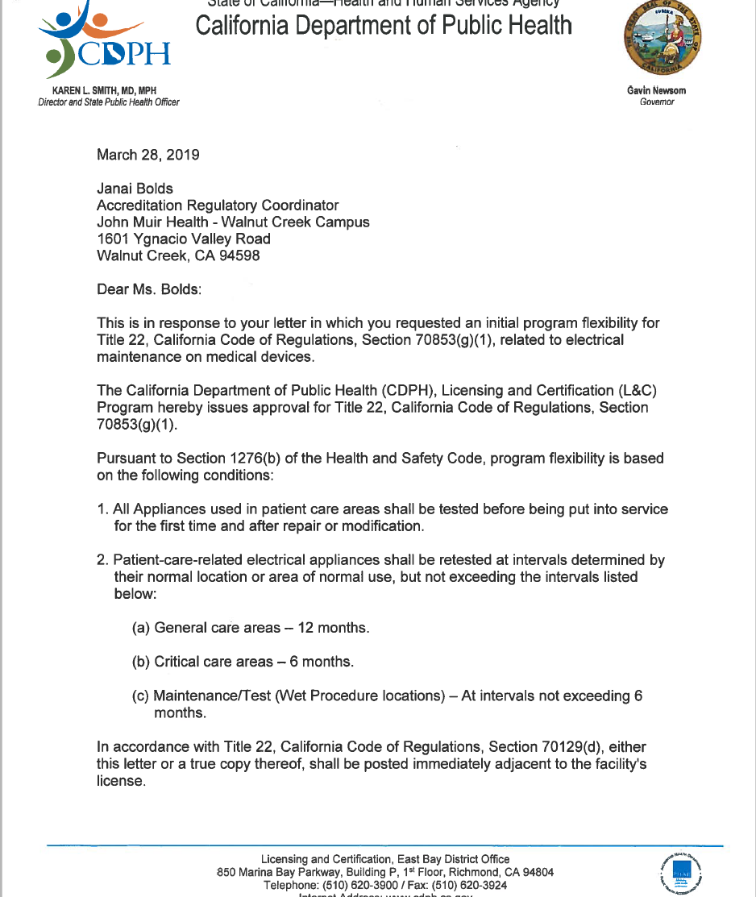
John Muir health
First request for Program Flex.

Slide 20
John Muir Health
April 2019:
We, at John Muir health, request the permission to adopt and follow the current NFPA 99 (2012) instead of Title 22 and the 1999 letter, for electrical maintenance of medical devices which means,
1) All Appliances used inpatient care areas shall be tested before being put into service for the first time and after repair or modification
2) Patient-care related electrical appliances shall be retested as the manufacturer recommendation or alternative Equipment management plan implemented in accordance with the Joint Commission.
3) Patient-care related electrical appliances in Wet Procedure Locations shall be retested at intervals not exceeding 6 months.

Slide 21
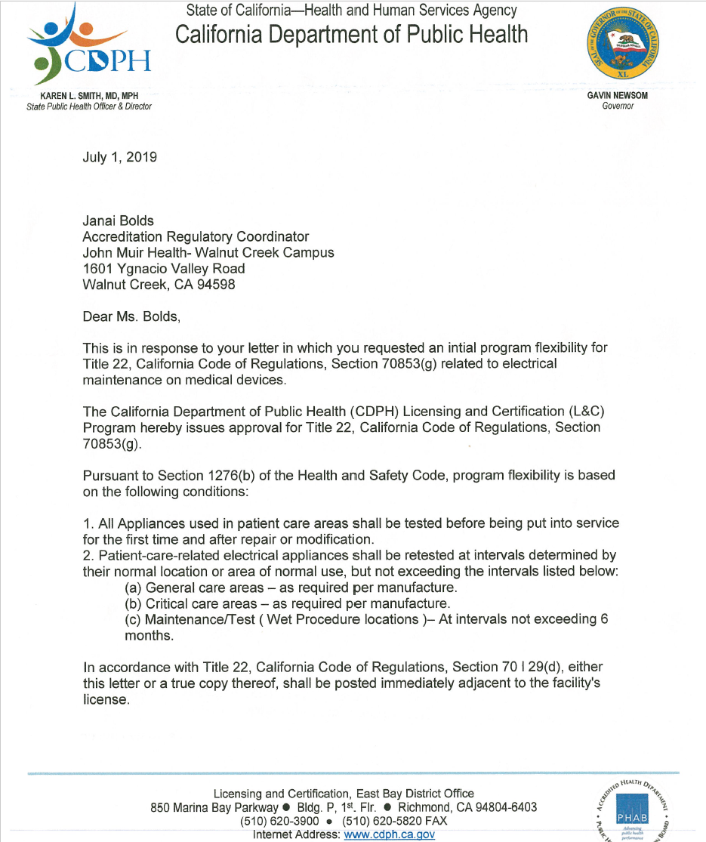


Slide 22
State Reasoning
NFPA 99, 2012
10.5.2.1.1 The facility shall establish policies and protocols for the type of test and intervals of testing for patient care–related electrical equipment.
10.5.3.1.2 Service manuals, instructions, and procedures provided by the manufacturer shall be considered in the development of a program for maintenance of equipment.
My response:
we do consider the manufacturer in developing the maintenance program. That is different than when the letter says “as required by manufacturer”, it is not saying to use manufacturer recommendation to develop a maintenance program, it is saying Stick to the manufacturer recommendations.

Slide 23
Last Step
September 25, 2019 Call:
UCSF (Jose Sabas, Ken Lindsay, Ramana Sastry)
Stanford (Eben Kermit, Don Armstrong)
Washington Hospital (Paul Kelly)
John Muir Health (Nader Hammoud)
Paul Kelly, Malcom Ridgway, Ted Cohen

Slide 24
References
California Department of Public Health (CDPH)
John Muir Health
NFPA 99 – 2012
CMS
Matt Baretich and Frank Painter PartsSource workshop

Slide 25

Hope you enjoyed the presentation.
QUESTIONS?

