Slide 1

Transitioning Culture,
Change to CE-IT
November 2, 2021
Speaker: IT Source:
Nader Hammoud, BE, MBA, CHTM Corey Chow, A+, MSCE, MCT
Stanford Healthcare

Slide 2
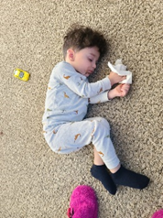
Logistics and Disclaimer
My opinion Does Not represent my employer.
Don’t turn off your phone.
Interrupt me as much as needed.
You might be given an exam at the end of the session.
  If you fail, you are buying drinks for all in attendance.
If you get bored during the session, feel free to take a nap or play games on your phone (🔇)

Slide 3
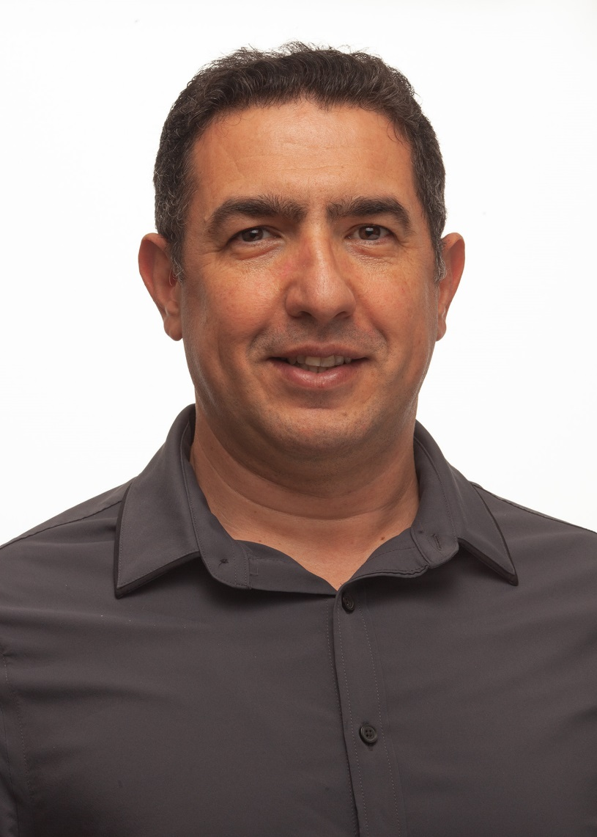

About the speaker
Nader Hammoud is currently the Biomedical Engineering Manager, at John Muir Health.
Biomedical Engineer with 3 degrees in Biomedical Engineering and an MBA
International Experience
Active member of the HTM community
Member of the Technology Management Council at AAMI
Member of Education Committee with ACCE
California HTM of the year for 2018
Recognized by ECRI and FDA for efforts in the domain.
Nader Hammoud, BE, MBA, CHTM

Slide 4
Session Description
Working together with IT to bridge the communication and process gaps.
Change management, disaster recovery and converged systems.

Slide 5
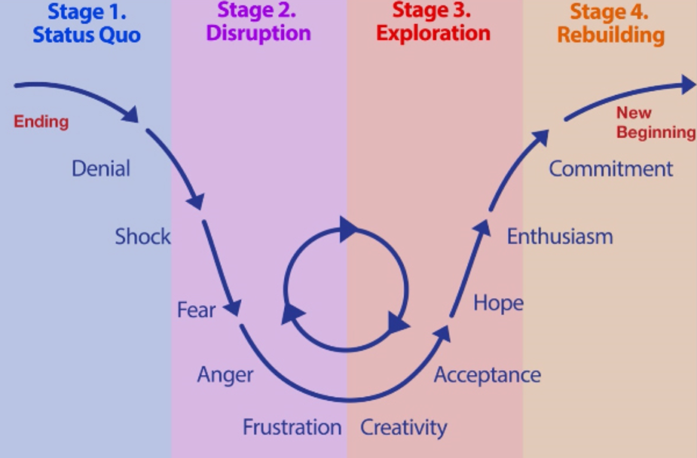
Stages of Change

Slide 6
Communication Process
Introduce the Change
Explain the rationale for the change
Describe what is negotiable and non-negotiable
Raise issues, problems or suggestions
Plan together to resolve issues and problems
Contract commitments
Offer support
Caution: Don’t let them shoot the messenger. Patiently stay focused on the issues and gently redirect any negative feelings that may feel like an attack. When emotionally engaged people say things they don’t mean, it is important you are ready to forgive and forget.

Slide 7
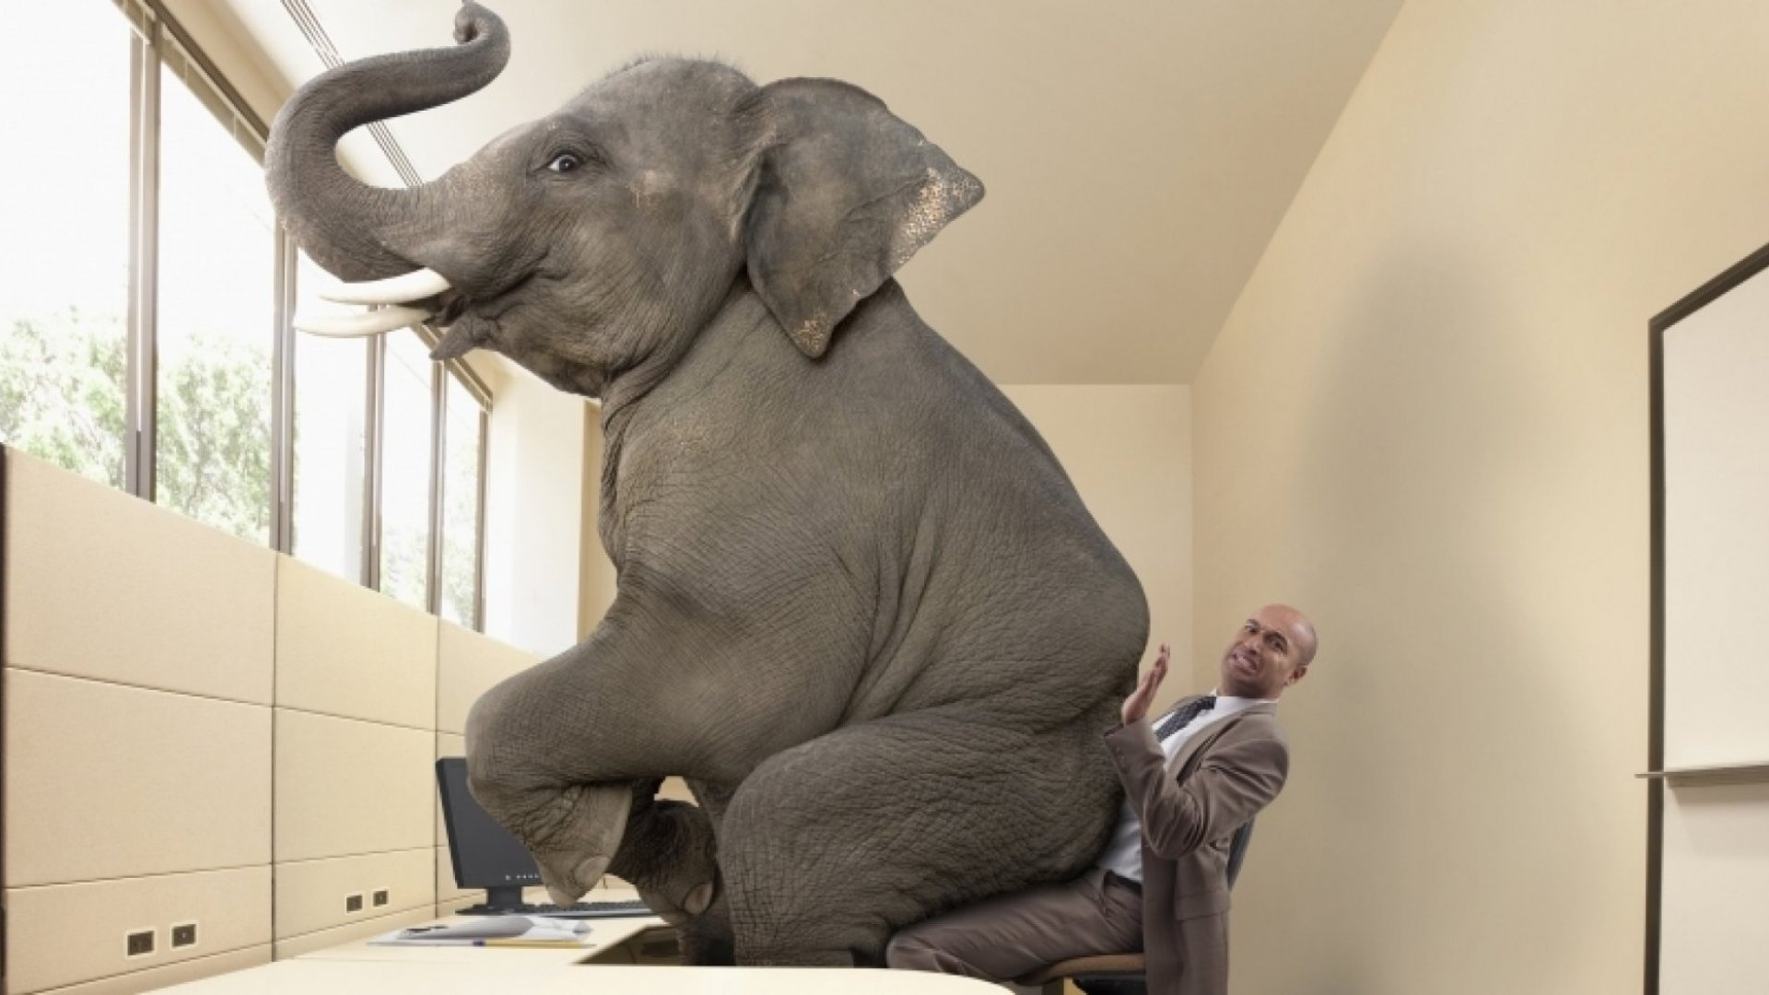
Biomed vs IT
Event Driven vs Process Driven
Do you like IT? Does IT like you?
Why?
Are they efficient? Is Biomed efficient?
Why?
Are you organized? Is IT organized?
Why?
Availability, Safety vs Security

Slide 8
Biomed perspective of IT
Submit a ticket first!
2 weeks turn-around time.
Metrics focused: Priority to closing tickets versus doing the actual work.
Lack of understanding of criticality of situations in Healthcare Org.
Treats everything like a PC.
Not willing to bend the rules to save a life.

Slide 9
IT perspective of Biomed
Unresponsive
Not knowledgeable
Do not understand IT integration to other systems
Does not communicate to IT – fire drill
Lack of planning
No IT settings documentation
Schedule downtimes

Slide 10
Where we should be?
The greatest enemy of communication is the illusion of it.
(William Whyte, 1950)

Slide 11
Where we should be?
COMMUNICATION
Biomed to Alert IT of changes/ upgrades
Biomed Alert IT of down equipment
Gray area is not gray:
  Biomed ownership of everything related to medical devices. (PC to operate a medical device is considered medical device)
  IT takes orders for medical devices from Biomed ONLY, regardless of request.
Joint Committees:
  Capital.
  Contracts Review
  Info Sec.
  Change Management
  Project Management

Slide 12

Hope you enjoyed the presentation.
QUESTIONS?

