Slide 1




NEW and IMPROVED!
Using Standardized CMMS Data to Make Smarter HTM Decisions
Work Order Types
Carol Davis-Smith MS CCE
Matt Baretich PE PhD
November 2, 2021
Las Vegas, NV
Notes:
Introductions … introduce Danielle McGeary as AAMI exec sponsor if she is in attendance

Slide 2

Today’s agenda & objectives
Standardizing CMMS Data
  Failure Codes (2020) … a review
  Work Order Types (2021) … an introduction
Leveraging Standardized CMMS Data
  Optimized AEM Programs
  Enhanced Strategic Technology Plans

Slide 3
Standardizing the CMMS Data
The value of HTM benchmarking has been recognized for decades and major efforts have been made to create effective benchmark databases. For a variety of reasons, those efforts have not been successful.
One barrier to effective benchmarking has been the amount of time required to produce actionable metrics. A closely related barrier is the lack of standardization in how HTM programs collect data.
Regulatory agencies define HTM metrics
No national database for AEM-related data
“Build it and they will come …”

Slide 4






The CMMS Collaborative
Identified leading CMMS vendors
Met unofficially at the 2019 AAMI Exchange
Initiated work in 2020 with AAMI support
Agreed to
  Standardize selected CMMS data elements
  Help CMMS clients with reconfiguration
2020 Recommendations – Failure Codes
2021 Recommendations – Work Order Types
Accruent (Connectiv, TMS, EAM)
EQ2 (HEMS II)
MediMizer (MediMizer)
Nuvolo (Nuvolo)
Phoenix Data Systems (AIMS)
TMA Systems (TMA)

Slide 5

CMMS Standardization Requirements
Clear, practical, single-purpose definition
Field choices must be exhaustive
Field choices must be mutually exclusive
Limited number of field choices
Actionable management information

Slide 6
Selection of the Failure Code Field
AEM program decision-making
PM program performance monitoring
Equipment replacement planning
Product design/manufacturing enhancements
Analysis of Failure Code field usage
  Superior Analytics
  2.5 million work orders
  Multiple CMMS types
Entries not representing failure data
  Cannot locate | Device in use
  Administration | Asset disposition | Training
  Initial inspection | Inspection request
  Hazard recall | Incident investigation
  Triage | Repeat problem

Slide 7
Recommended Failure Codes
PM-Related Failures
Not PM-Related Failures
Accessory or Disposable Failure
Calibration Failure
Component Failure (Battery)
Component Failure (Not Battery)
Failure Caused by Maintenance
Failure Caused by Abuse or Negligence
Network or Connectivity Failure
Software Failure
Use Error (Use Failure)
Failure Caused by Utility System
Failure Caused by Environmental Factor
Failure Could Not Be Identified
Failure Not Diagnoses – Device Not Repaired
No Failure Associated with the Work Order

Slide 8
Selection of Work Order Type
Distinguish between Maintenance and Non-Maintenance work
  Staffing models
  Budget forecasting & management
HTM Program Optimization
  AEM decision-making
  PM program performance monitoring
  Equipment replacement planning
Maintenance work order types are used for a single CMMS asset, not multiple assets. Costs associated with these activities are allocated to a particular asset. For purposes of the CMMS Collaborative work, the term “asset” refers to a single line item in the CMMS inventory

Slide 9
Selection of Work Order Type
Analysis of Work Order type usage
Superior Analytics - Nearly 16 million individual work orders
VA Health System - Biomedical Engineering Uniform Work Actions (n=45)
Multiple CMMS platforms
Similar Wording & Intent
Preventive Maintenance
Preventative Maintenance
Planned Maintenance
PM/SM
Examples of entries not representing work order types
Duplicate Calibration Sales
Performance Test Contract Payment Retired
Not Operating Properly

Slide 10
Recommended Work Order Types
Non-Maintenance Related
Maintenance Related
Planned Maintenance
Corrective Maintenance
Cybersecurity
Recall & Alert Management
Incident Investigation
Incoming Inspection
Training – HTM Staff
Support – Users
Project
Administrative
Cybersecurity
Recall & Alert Management
Incident Investigation

Slide 11
Next Steps
AAMI White Paper
CMMS Suppliers
New clients: industry leading implementation option
Current clients: tools to transition to standard codes
Adoption by HTM community
Publication of use cases & success stories by AAMI

Slide 12
Leveraging
Standardized CMMS Data
Optimized AEM Programs

Slide 13

Optimize Your AEM Program
Reduce PM cost
Equipment safety equivalent to manufacturer recommendations
Compliance with CMS requirements

Slide 14
Definitions
PM (Planned Maintenance) includes:
Device Restoration PM
  Intended to reduce the likelihood of failure
  Genuine preventive maintenance
Safety & Performance Verification PM
  Check for safe & effective function
  Identify latent failures not obvious to user
  Requires specialized knowledge or equipment
PM = Planned Maintenance
PM Activity = What we do
PM Procedure
PM^{OEM}
PM^{AEM}
PM Frequency = When we do it
Notes:
Matt

Slide 15

Failure Rate and
Mean time between failures (MTBF)
Failures that could have been prevented by better PM
Early failure of infusion pump battery
Work Order Type: Corrective Maintenance
Failure Code: Component Failure (Battery)
  Hidden failures that could have been discovered by better PM
Low defibrillator output
Work Order Type: Planned Maintenance
Failure Code: Calibration Failure
Notes:
AEM program is dependent upon clear understanding and documentation of failures.
Therefore, it is CRITICAL to define standardized work order types and failure codes; and then to use them consistently.

Slide 16
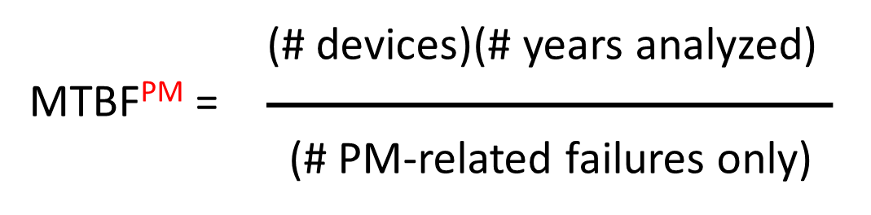
Take Aways
Monitor MTBF and MTBF^{PM} over time
For all equipment or for specific groups of equipment
For different failure codes
Flag PM-related failures
For proactive identification of emerging problems
Review significant trends and flags
For adjustments to PM procedures
For other management responses
MTBF^{PM}
Performance metric for Planned Maintenance
Depends on accurate
use of Work Order types
classification of Failure Codes
counting of failures

Slide 17
Leveraging
Standardized CMMS Data
Enhanced
Strategic Technology Plans

Slide 18
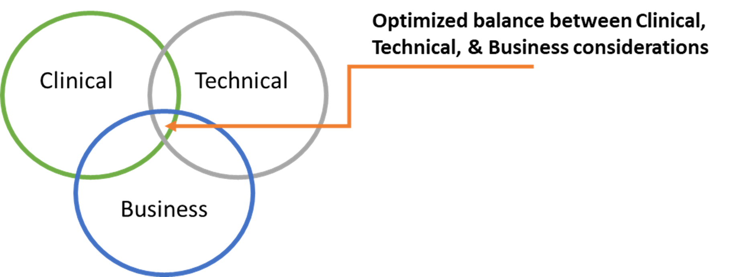
Enhance Your Strategic Technology Plan
Influence the prioritization of capital spending
Communicate with executives
Align HTM resources

Slide 19
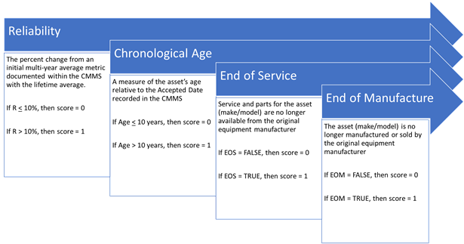
Technical Scoring
Industry Factor:
End of Life = End of Manufacturing + End of Service
Health System Factors:
Chronological Age = when purchased/installed
Reliability = operational &/or maintenance metrics
Notes:
Carol

Slide 20

Technical Scoring
Reliability
Examples of Reliability metrics:
# of Corrective Maintenance work orders
# of Corrective Maintenance labor hours
Mean Time Between Failures (MTBF)
Reliability (R) = the percent change from a baseline average relative to the lifetime average
RELIABILITY = (Metric^{LIFE} - Metric^{BASEAVG}) / Metric^{BASEAVG}
R < X% Acceptable Score = 0
R > X% Unacceptable Score = 1
Potentially focus on a specific type of failure
Notes:
Carol

Slide 21

Clinical Scoring
Industry Factor:
Clinical Protocols – AHA, ACC, AORN, etc.
Regulatory Impact – CMS, State DOH
Health System Factors:
Utilization & Workflow = reliability & useability
Technology Backups & Redundancy
Notes:
Carol

Slide 22

Reliability metrics:
# of User Support work orders
Mean Time Between User Support Events
Reliability (R) = the percent change from a baseline average relative to the lifetime average
RELIABILITY = (Metric^{LIFE} - Metric^{BASEAVG}) / Metric^{BASEAVG}
R < X% Acceptable Score = 0
R > X% Unacceptable Score = 1
Clinical Scoring
Reliability
(# devices)(# years analyzed)
MTBF^{UserSupport} =
(# User Support only)
Notes:
Carol

Slide 23
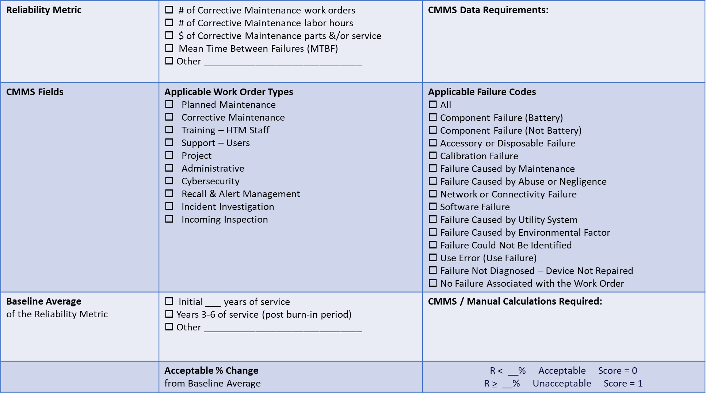
Take Away
Tool
Make A Plan
Notes:
Carol

Slide 24
Questions & Discussion
Phone: 970-493-8239
Email: mfb@baretich.com
Website: http://baretich.com
Phone: 602-821-4092
Email: Carol@CDSAssoc.com
Website: http://cdsassoc.com/

