Slide 1



Trish Payne
Block Imaging
The Benefits of Tracking Your Medical Imaging Equipment with the OEM
OEM & FDA Liaison

Slide 2
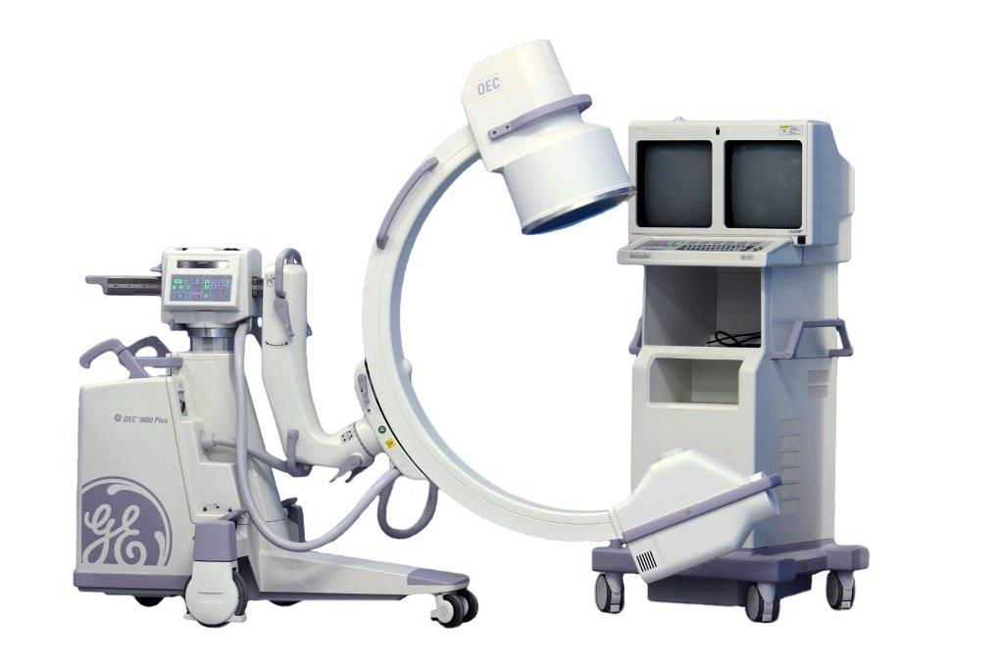
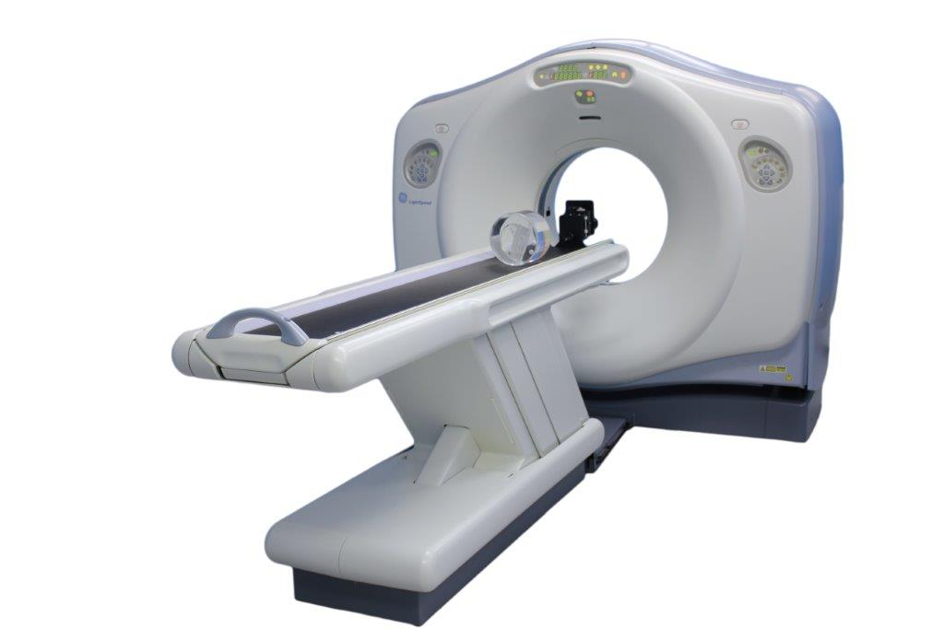
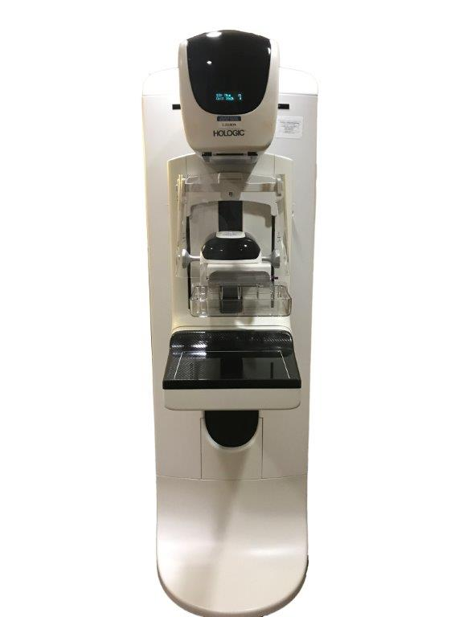
Recall- but you don’t know it
This system is EOS December 2021- but you don’t know it
Out standing field modification- but you don’t know it

Slide 3

Equipment isn’t functioning at 100%
Potentially dangerous
Missed diagnosis or incorrect diagnosis
FMI to fix software glitches
Plan for service and parts

Slide 4
FDA 21 CFR 821.1
(c) The primary burden for ensuring that the tracking system works rests upon the manufacturer.
OEM Tracking Obligations
Effective tracking of devices from the manufacturing facility, through the distributor network (including distributors, retailers, rental firms and other commercial enterprises, device user facilities, and licensed practitioners) and, ultimately, to the patient is necessary for the effectiveness of remedies prescribed by the act, such as patient notification (section 518(a) of the act) or device recall (section 518(e) of the act).

Slide 5

Tracking obligations of persons other than manufacturers…
Sec. 821.30A distributor, final distributor, or multiple distributor of any tracked device shall, upon purchasing or otherwise acquiring any interest in such a device, promptly provide the manufacturer tracking the device with the following information:

Slide 6
Name and address of destination
Identifier used by the manufacture to track the device
The date the device was received
The date the device was explanted (transferred), or the date the device was returned to the distributor or disposed of
Tracking obligations continued…
Notes:
Letters of destruction

Slide 7

Why a Tracking System?
To ensure that manufacturers or FDA can remove and correct potentially dangerous or defective devices quickly and effectively.

Slide 8

Question
Is any part of this regulation new to you and/or surprising?

Slide 9
Identifier?
OEM specific
Linked to serial number
Assigned to the site/ system by the OEM
Same SN for different modalities
Batch systems
Why needed?

Slide 10
Urgent & Important Notifications
Recalls
Field Corrections – could pertain to safety
End of Support or End of Life (Legacy Devices)

Slide 11
Device tracking is required for the useful life of the device.
The useful life of a device is the time a device is in use or in distribution for use. Doesn’t matter if it’s EOS or EOL.

Slide 12
System down – need a part asap

Slide 13
Biomed isn’t sure what is wrong with the system- need to call out the OEM

Slide 14
Speed of Play-Downtime vs Uptime
Ordering parts
OEM Service

Slide 15
Question
Who does the burden fall on in your facility to make sure this happens? Or does it happen?

Slide 16

Is all your equipment being tracked?

