Slide 1
MD Expo Atlanta 2022
April 12, 2022
Oscar Miranda
Field CTO for Healthcare

Slide 2
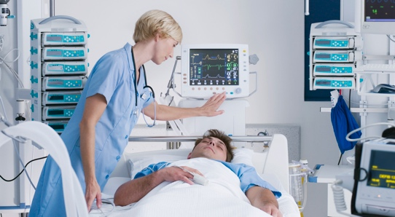
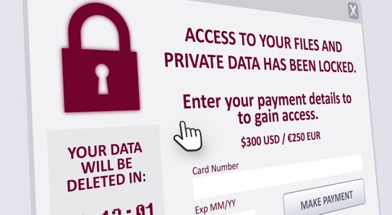

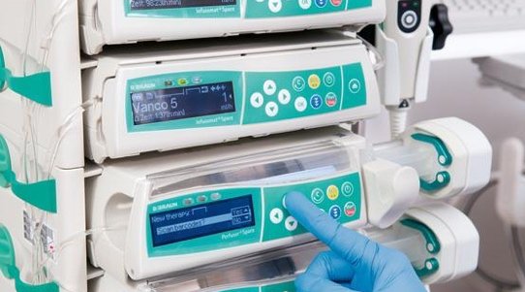
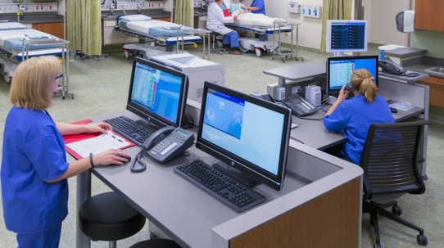
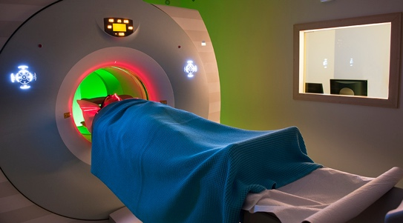

Healthcare Organization Concerns
Patient Safety
Medical Device Behavior
Disruption
Ransomware
Data Breach
Personal Health Info
Utilization
Maximizing Efficiency
Inventory
Locating Medical Devices
Exposure
“The other side of the house.”

Slide 3
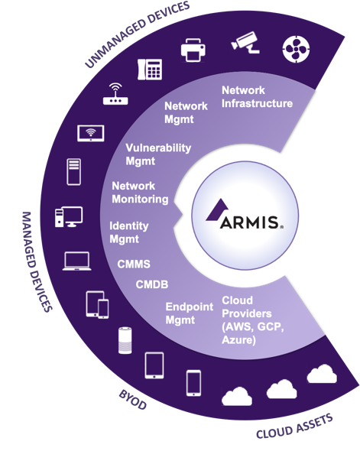



How Armis Works
1
Discover All Assets
Every device type
Make, model, OS, Network Info
Aggregate and enrich existing data
Across all sites
No Agents, No Scans
Risk and Behavior Analysis
Malware detection
Behavior monitoring
Device Utilization
FDA Recalls and MDS²
Vulnerability assessment
Adaptive risk score
Automate Enforcement
Alerting and remediation
Contextualized response actions
Enforce security policies
Supercharge existing investments
2
Device Knowledgebase
Threat
Detection Engine
3
Passive. Real-Time. Continuous.

