Slide 1

Fundamentals of Project Management for HTM
Gregory Goll CHTM CBET BS
Manager, Projects and Medical Imaging Services
WellStar Health System
Marietta, Georgia

Slide 2
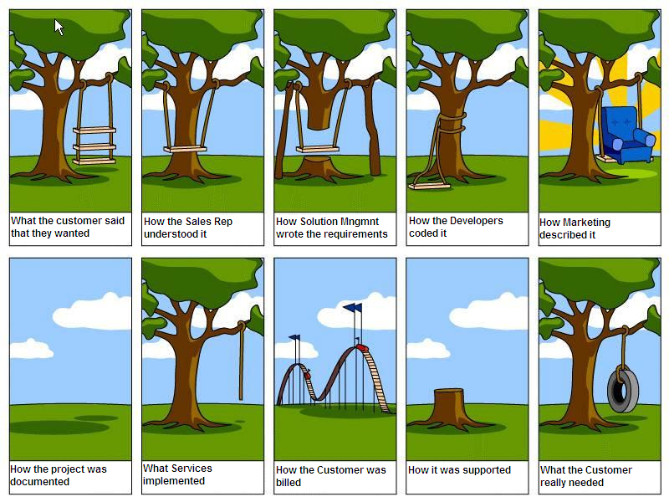
Every Project has clear communication

Slide 3
The cost of project failure
70% of all projects fail
The average cost overrun was 27%
1 in 6 Projects had a cost overrun of 200% and a schedule overrun of 70%
IT failure rates are between 5-15% representing $50 Billion to $150 Billion in loss per year.
Only 2.5% of companies successfully completed 100% of their projects.

Slide 4
Phases of Project Management
Initiating
Planning
Executing
Monitoring/Controlling
Closing
** These are universal definitions**

Slide 5
Project Life cycle
Project Life Cycle – The phases that a project passes through from initiation to the final closure.
** Every project that begins at some point has to end. **
Project Phases- These are the milestones/progress of a project.

Slide 6
Stakeholders
Any person/group that may be affected by the outcome of project or a decision or activity that is the result of a project.
Importance they are the end users of the completed project.

Slide 7
Sponsor
A person or possibly a group that provides the resources and support for a project.
Importance- They basically are the money controller, any budget changes directly affect them. In most cases they report to higher administration.

Slide 8
Project Manager (PM)/
Project team
The PM is a person designated by the organization to lead the team that is responsible for achieving the project objectives.
The group of individuals that support the project manager.
Importance- They are the leader over the project, they make assignments to other team members and track the overall progress of all aspects of the project.

Slide 9
Project Scope
The work done to deliver a product or service.
Importance- This is the baseline of what is being asked to be completed. This should have define parameters to insure project is completed and meets desired objectives.

Slide 10
Project resources
Money
Tools
People
Materials
Data
Relationships

Slide 11
Relationships
In this case relationship is defined as a set of expectations.
All vendor communications need to be consistent.
Set a standard for all external interactions.
A good example of this how incoming inspection and initial inventory process is handled.

Slide 12
Project Time lines
Timelines are used to set a base schedule for all team members to follow.
Importance- If timelines are not tracked it is difficult to determine the status/completion of work.

Slide 13
Project Management software
Microsoft Project
This has many tools for setting time lines, allocating of resources, and measuring project work.
This is a nice way of linking several different paths of project work together.
Also Microsoft Excel can be used as another option.

Slide 14
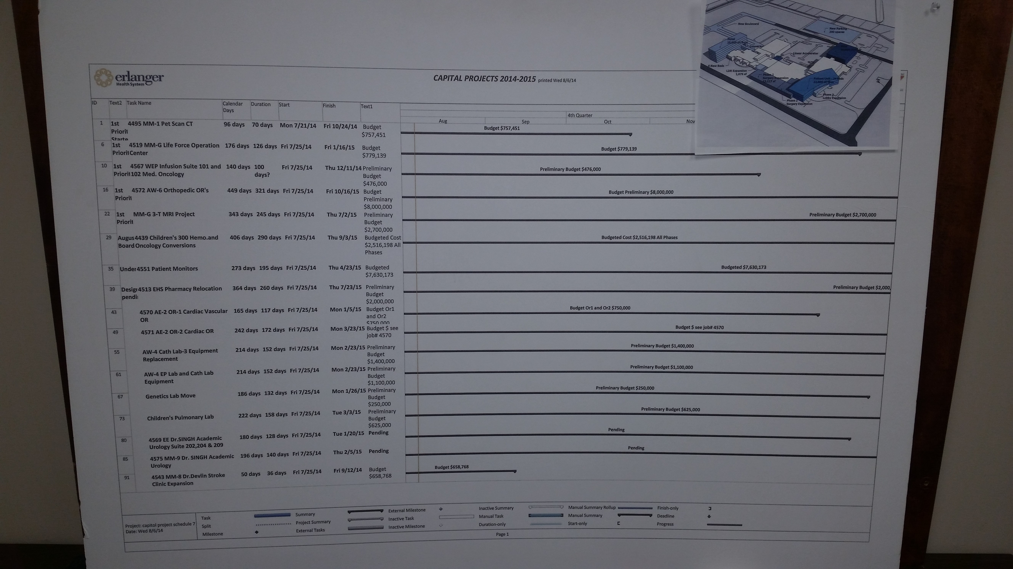
Example of Master time line

Slide 15
Risk Analysis
An event or condition that if it happens can have a positive or negative affect on one or more project objectives.
Define risks associated with a project. (Breakdown Structure)
How much risk can the sponsor take on. (Appetite)
How much risk can the organization stand.
All projects have some sort of risk.

Slide 16
Importance of meeting notes / general discussions
Documentation of progress.
Documentation of assignments.
Documentation of changes.
Clarification of understanding.
Defining aspects of a project.

Slide 17
Critical Path
A sequence of activities that define the longest path through a project.
Why it is important- Any process that interrupts the critical path will have a global impact on project timeline and success.

Slide 18
Scope Creep
The uncontrolled expansion of a project.
The main issue is as the project expands provisions were not made on how this change is to be funded.
This will also tie up resources such as team members.
This will affect final timelines in the majority of cases.

Slide 19
Scope Change
This happens when it is determined the path of a project must take a different direction than originally planned.
This usually will require a change in project cost and any timelines.
Between Scope Creep and Scope Change, change at least takes a direct. Scope Creep can potentially continue to grow in many directions.

Slide 20
Compression/Project Crashing/Fast Tracking
Compression – Maintain all aspects of the project, only decreasing the overall time to complete.
Project Crashing- A technique used to shorten the schedule duration for the least incremental cost by adding resources.
Fast Tracking - the process of performing tasks in parallel so as to be able to finish the project sooner.
Dysfunctional- A technique used to insure success is not an option.

Slide 21
Acceptance Criteria
A set of conditions that must be met for before a deliverable can be signed off.
Importance- This is the only way to be sure a goal has been met. A sign off must be from a person that has been designated to have the power to approve.

Slide 22
Planning for Installation
Clear understanding of the project scope.
Definition of timeline.
PM and Project team identified.
Clearly define who does what in the process.
Routine update times are scheduled.

Slide 23
Ways to build a project budget
Long Term- when a start date is somewhere in the future, potentially years. Use list price and adjust for future increase. This will be revised.
Short Term- Project has a defined start date and funds are available quickly. Use most accurate pricing available.
Build it to fit- The can be the hardest. You have a set amount of money that can not be increased.

Slide 24
Budget defining factors
Is there a predefined budget?
Has the scope been determined?
Did you add everything you need to the budget?
Is there selected vendors or a bid process?
Is the installation in a new area or an existing area?
Are you attempting to reuse anything without checking?

Slide 25
Payment terms / Issues
Are the funds available?
How much money is committed upon arrival?
How much money is due on final approval?
If possible know how long it takes for your employer to pay an invoice.

Slide 26
Organization of the project
Blueprint control.
Estimate/ revision control.
Project Notebook, file, or online tracking.
Create a shared access for all team members to communicate important items like budget planning.

Slide 27
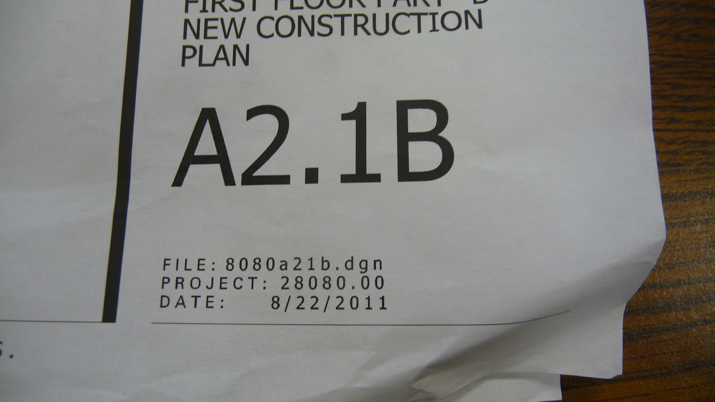
Make sure everyone has the same revision of documentation

Slide 28
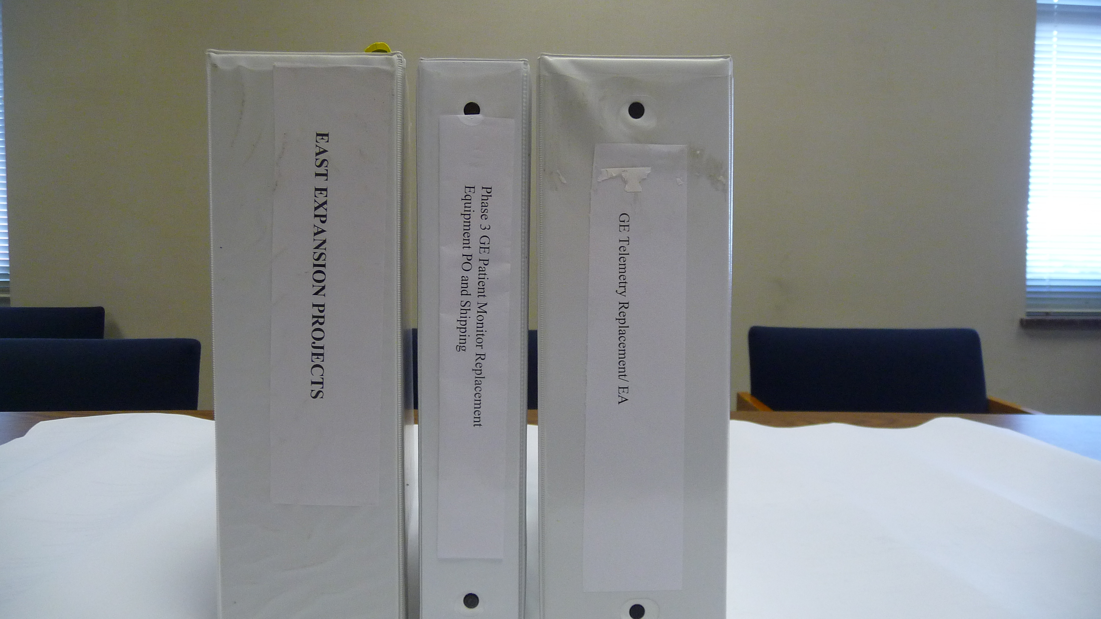
Project Notebook

Slide 29
Before you volunteer to take on a leadership role, something to think about
Bandwidth in life, sometimes leading a project requires altering work hours or overtime
Communication ability, it’s not only what you say. It’s how you say it that matters.

Slide 30
Internal Department Budgeting
Accurately project how much time a project will take from start to finish.
Make sure of who internally you want involved.
Who will pay the labor for involvement in a project?
How soon can back billing begin?

Slide 31
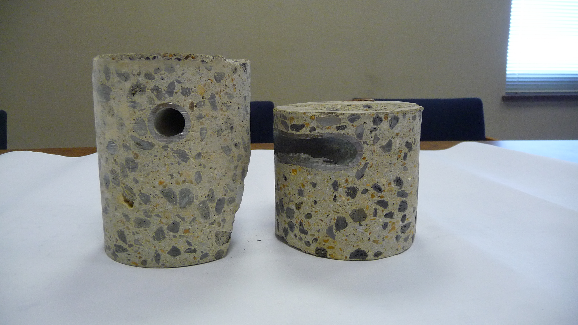
Lessons Learned

Slide 32
Lessons Learned
Take an inventory of both what went well and what did not.
Good experiences can be built upon.
Bad experiences help to avoid the same issue again.
Share both good and bad experiences, many times the best lessons learned are from listening to others.
Lessons are a dynamic, so as this process continues all of theses serve a building blocks for future projects.

Slide 33
Have a plan/ be careful
Before any work begins have a plan on exactly what is being done.
Know your expected role.
Know boundaries of your role.
Do not take on tasks you are not able to control.
Do not make time promises you can not keep.
Make a contingency plan.

Slide 34
Common Pitfalls
Purchasing equipment / software with user (clinical or other) input.
Joining late in a project and approaching involvement as a reactive verses proactive.
Not taking the time to properly verify information, details and contacts.
Not taking time for physical measurement verification.
Lack of engagement from senior management.
Making changes without proper approvals.

Slide 35
Common Pitfalls Continued
Deliberately working outside of area of responsibility.
Unfunded equipment replacements (consignment).
Quick purchases, only device not all supporting components (network).
Interfacing to non-compatible equipment.

Slide 36
Five ways to get it done wrong, or not at all!
Scope-less is hopeless. Don’t decide what you are doing—just throw money at a problem.
Focus on time and cost, not quality. Get it done yesterday. Never let anyone spend money. Don’t waste time checking anything—just get it done.
Know the right thing to do. Don’t analyze problems. Don’t listen to experts. And—absolutely, above all, whatever you do—be sure to ignore the customer. You wouldn’t launch a project if you didn’t know everything, and what does anyone else know?
Don’t thank the team, push them harder. Don’t waste time with planning, People ought to know what to do. Just tell the team to get it done now—or else.
Avoid big problems. All of our projects fail. And we’ve got no time for them, either—we’re too busy putting out fires.

Slide 37
Questions???

