Slide 1
BMET Staffing Shortages
It will take a village to raise awareness to a career in HTM!!

Slide 2
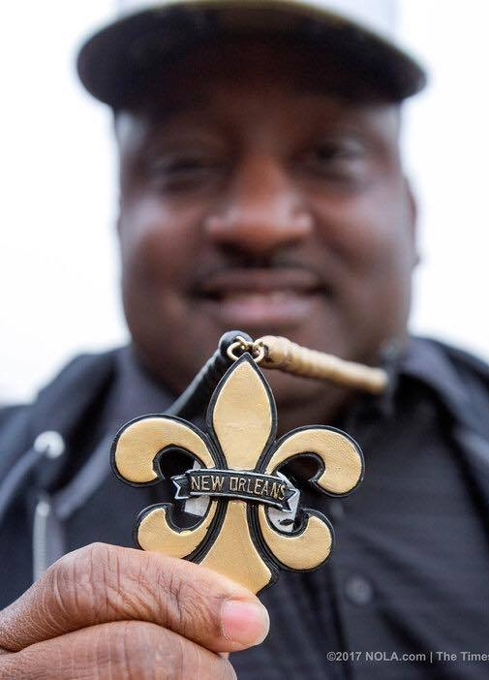

WHO DAT!!!

Slide 3


Slide 4


Slide 5
Ways to overcome BMET Staffing Shortage
Improve
Improve the recruiting Process
Upgrade
Upgrade the training process
Re-examine
Re-examine your management style
Encourage and offer
Encourage and offer opportunities for development and growth
Improve
Improve the work environment and offer superior benefits
Automate
Automate where you can

Slide 6


Slide 7


Slide 8

The Future –
Holding up the shield proudly!!

Slide 9
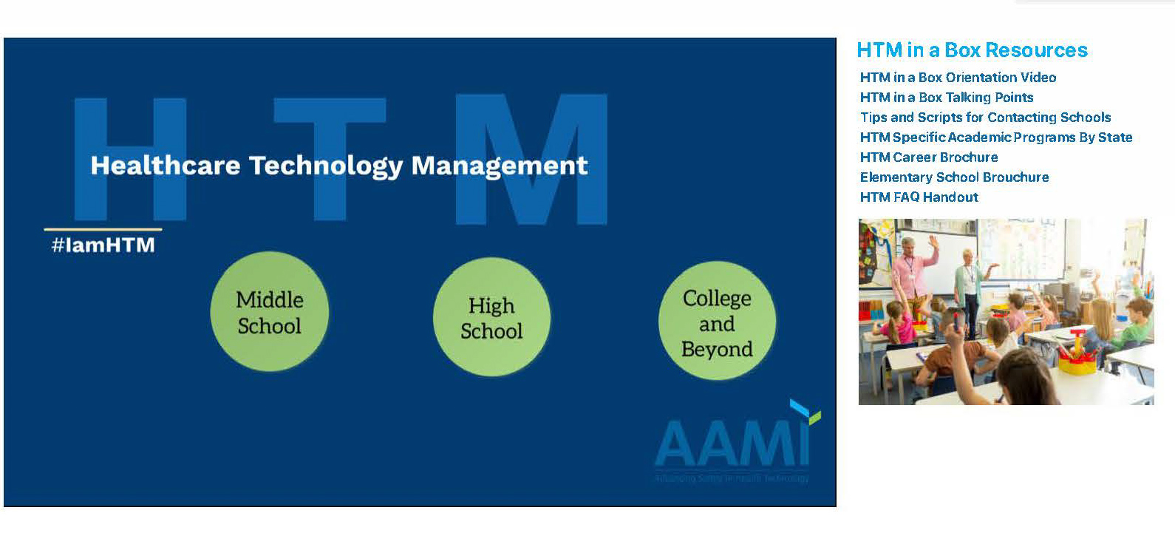
HTM In a Box!!
AAMI has created the tools to make promoting HTM easy! "HTM in a Box" is a free resource designed to eliminate the prep work required to present at local schools. With a standard and strong message, this virtual resource puts three exciting HTM career presentations at your fingertips. Each presentation is targeted for a specific age demographic. Click on the photo below to access the presentations.

Slide 10
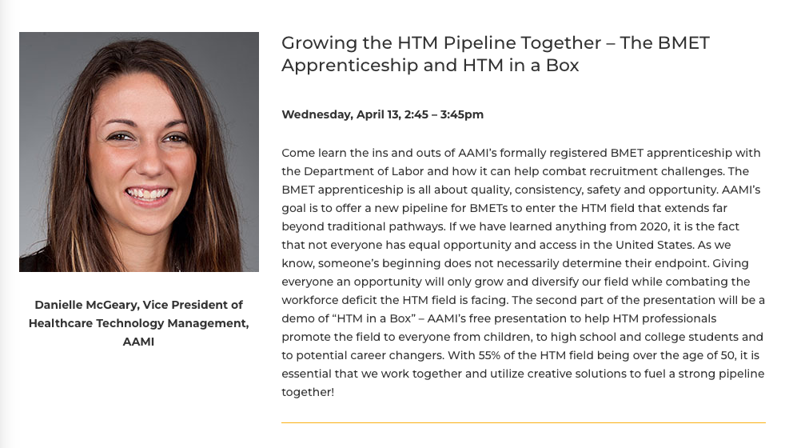

Slide 11
HTM Specific Academic Programs by States

Slide 12

Mdexpo Atlanta – Booth 311

Slide 13
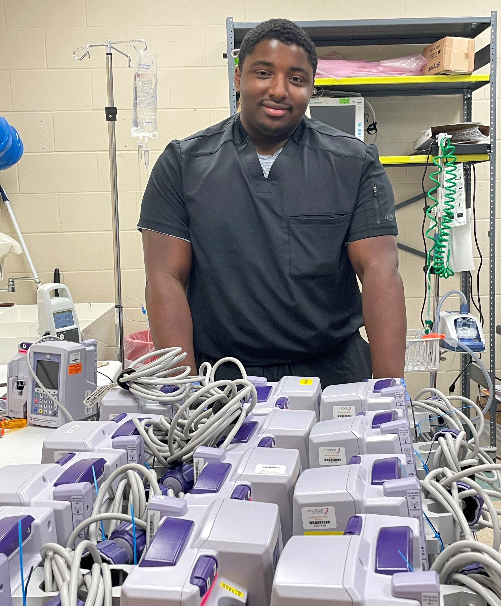
Career Path
Graduated High School – May 2020
Entered Biomed program at College of Biomed Equipment Technology – June 2020
Completed Program – October 2021
Started his BMET career November 2021

Slide 14
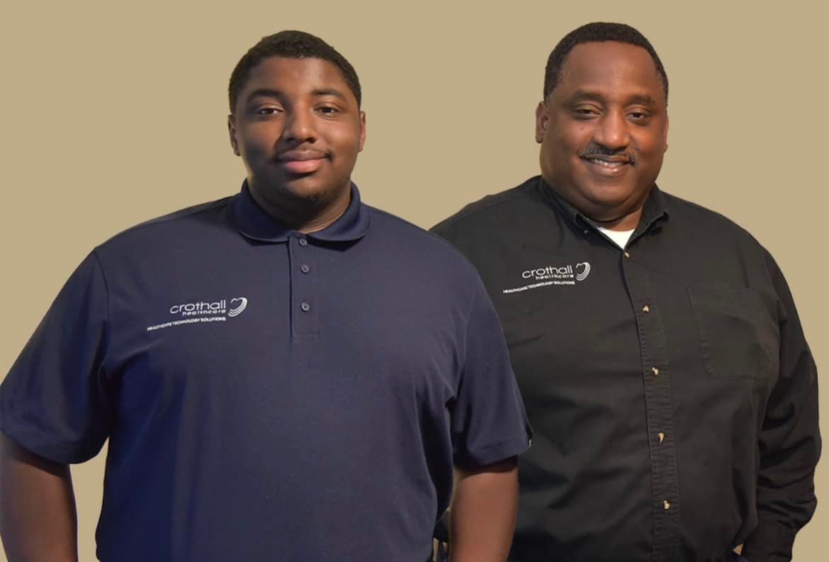

Slide 15
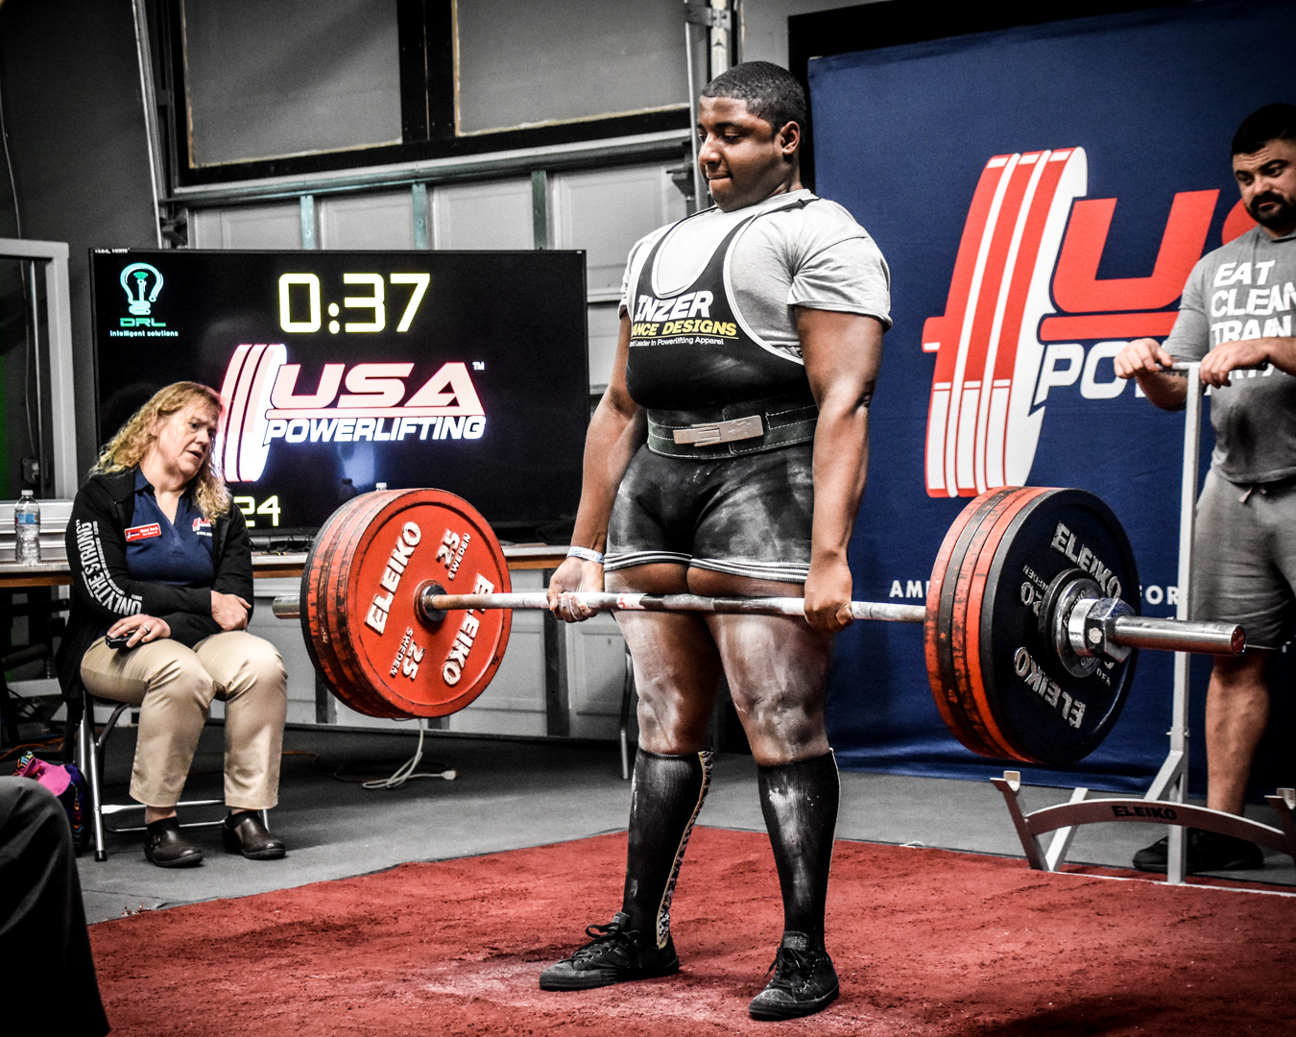

Slide 16
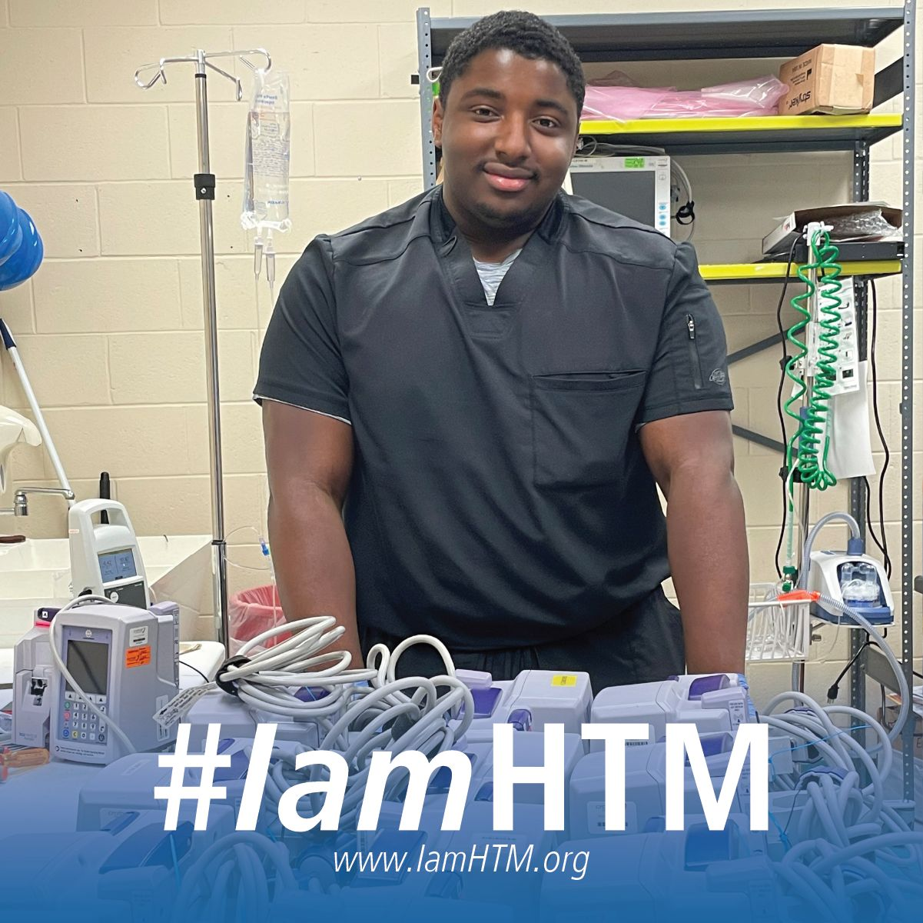

Slide 17
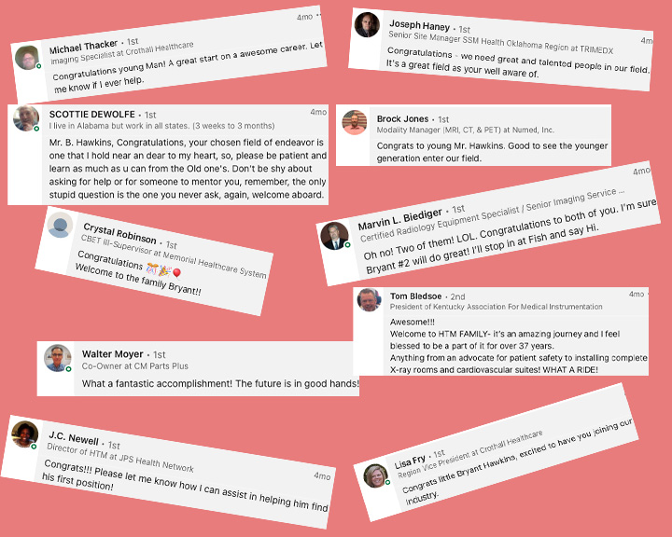

Slide 18



Slide 19
Any Questions?

