Slide 1



NAVIGATING THROUGH DIVERSITY AND INCLUSION CHALLENGES
Lucas Marsh, Department of Veteran Affairs
Priyanka Upendra, Asimily
Notes:
Priya

Slide 2
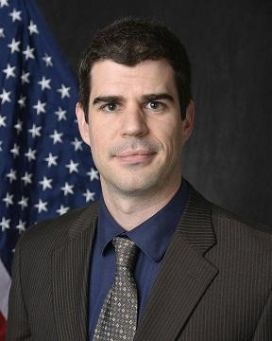
ABOUT LUCAS MARSH
Lucas Marsh is the Department of Veterans Affairs Southeast Network Healthcare Technology Manager. The VA Southeast Network provides care services to veterans in Alabama, Georgia and South Carolina and is currently the third largest VA Network serving an Enrolled Veteran population of well over 500,000.
In his role, Lucas serves as senior Healthcare Technology advocate, providing guidance and expertise to facility leaders. Lucas is responsible for the management and oversight of a portfolio of roughly 50,000 devices totaling over $550M in assets. He began his VA career in 2009 and prior to his current role, has been stationed at VA facilities in Arkansas, Texas, South Carolina and Georgia
Lucas holds a BS in Biomedical Engineering from Tulane University and a MS in Health Informatics from the Medical University of South Carolina. Lucas is a member of AAMI’s Technology Management Council and was awarded TechNation’s HTM Department of the Month in March 2020.
Lucas lives in Atlanta Ga and enjoys spending time outdoors with his wife and two children
Notes:
Priya

Slide 3
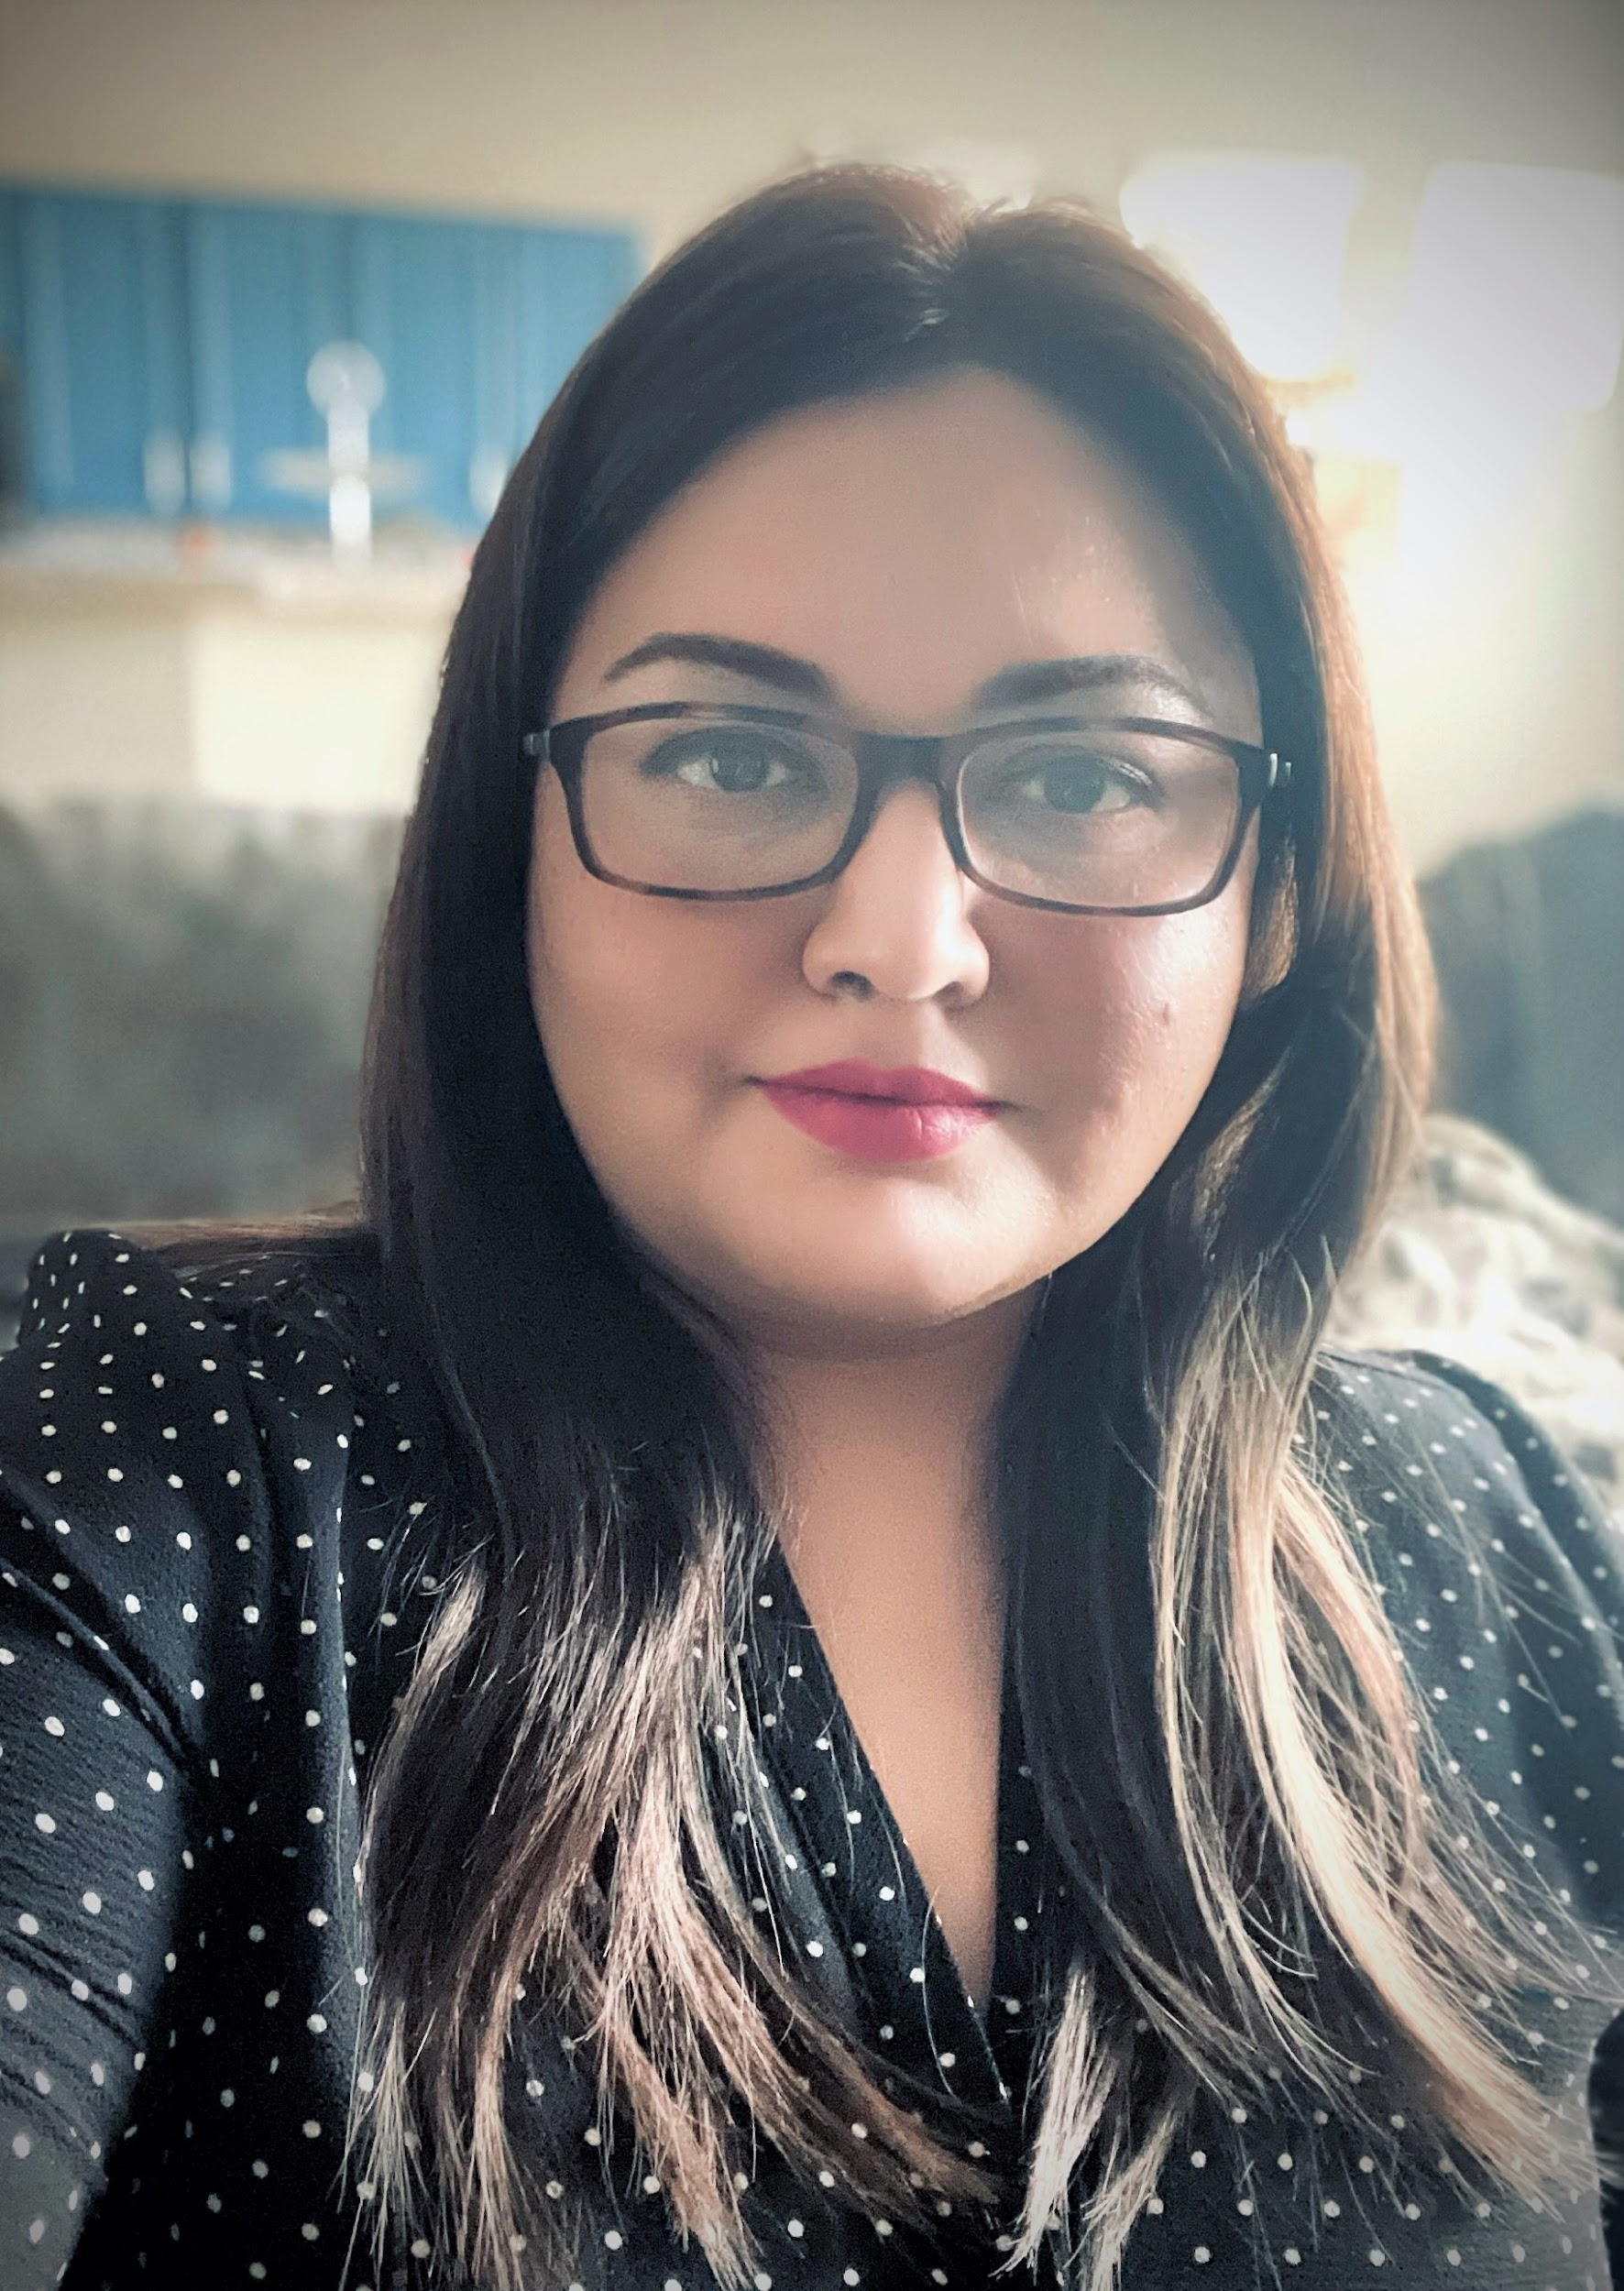
ABOUT PRIYANKA UPENDRA
Priyanka Upendra is the Senior Director of Customer Success at Asimily. Prior to Asimily, Priya served as a Compliance Program Director at Banner Health, Compliance Manager at Intermountain Healthcare, clinical technology & biomedical engineering analyst at Stanford Health Care, and clinical engineer at Stanford Children’s Health and Stanford University. She is a research advisor for BME undergrad and grad students at San Jose State University and B.M.S College of Engineering.
She is an active member of ACCE, AAMI, H-ISAC, and HIMSS; while serving on several committees. She was the recipient of BI&T Best Article Awards in 2015 and 2017, 2017 AAMI Young Professional Award, 2018 MedWrench Guru, 2020 ACCE Professional Achievement in Technology Award, and 2020 Doctoral Student Paper Award. She was awarded the Fellow status in AAMI in 2020 for her contributions to the HTM/CE community.
Priya holds a MS from San Jose State University and a BS from Visvesvaraya Technological University and is pursuing a Doctorate degree in Strategic Leadership and Healthcare Administration. She is a Certified Healthcare Technology Manager, Six Sigma Lean Professional, and Change Management Specialist. Priya currently serves as the ACCE President and member of AAMI’s Technology Management Executive Committee.
Notes:
Lucas - phonetically - Oop-en-drah

Slide 4
Disclaimer
Information presented in this session are opinions of the speakers, not of their employers.
Notes:
Priya

Slide 5
SESSION OVERVIEW
Diversity and inclusion (D&I) continue to be an important area in several industries. More and more organizations are ramping up efforts to be more inclusive of changing demographics, organizational goals and organizational changes that have an influence on D&I. Female leaders in particular face additional challenges, more so in health care leadership.
This session will overview important traits and skills that allow female leaders to establish firm foundations in their careers, including those that are often mislabeled. The presenter will discuss specific scenarios to engage the audience to gain a cross-functional understanding of how female leaders navigate through D&I-related issues.
Notes:
Priya - talk about AAMI webinar from 2021 conference

Slide 6
WHAT IS “DEI”?
Diversity – is the presence of differences
Equity – is promoting justice, impartiality, and fairness
Inclusion – is an outcome where diverse populations feel welcomed and participate to a full-extent
Like a string of beads, it is our unique differences and intricacies that make us so appealing and attractive. We would not be as beautiful if we were all the same. It’s the contrast and asymmetry that makes us worth while.
— Lindsey Lunsford
Notes:
Priya
igion, sexual orientation, ethnicity, nationality, socioeconomic status, language, (dis)ability, age, religious commitment, or political perspective
Equity – promoting impartiality with processes, procedures, and resources in organizations
Inclusion - inclusion outcomes are met when the individual and organization are inviting to all, even in the decision-making process and development opportunities

Slide 7
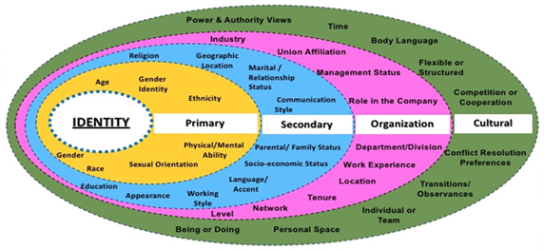
Diversity Spectrum
Notes:
Lucas
Diversity – differences in the form of race, gender, rel

Slide 8
WHY DEI MATTERS?
Larger talent pool
  Allows organizations to cast a wider net
  Reduces unconscious bias in the recruitment process
Better team performance
  Increased team engagement
  Increased productivity
More innovative solutions
  Brings new perspectives to service delivery
  Variety of experiences in decision-making and problem-solving
Improved financial performance
  Increased team engagement and productivity leads to better financial performance
Notes:
Lucas

Slide 9
DEI IN THE HTM COMMUNITY
Diversity
Increase awareness of the HTM field among diverse populations
Ensure diversity in hiring
Ensure diversity in your teams
Equity
Ensure every individual gets opportunities
Shift mindsets, behaviors, and practices to be more equitable
Share opportunities and learnings
Focus on retention
Inclusion
Ensure every individual gets to contribute
Ensure inclusive practices in organizational policies and procedures
Focus on retention
Notes:
Lucas

Slide 10
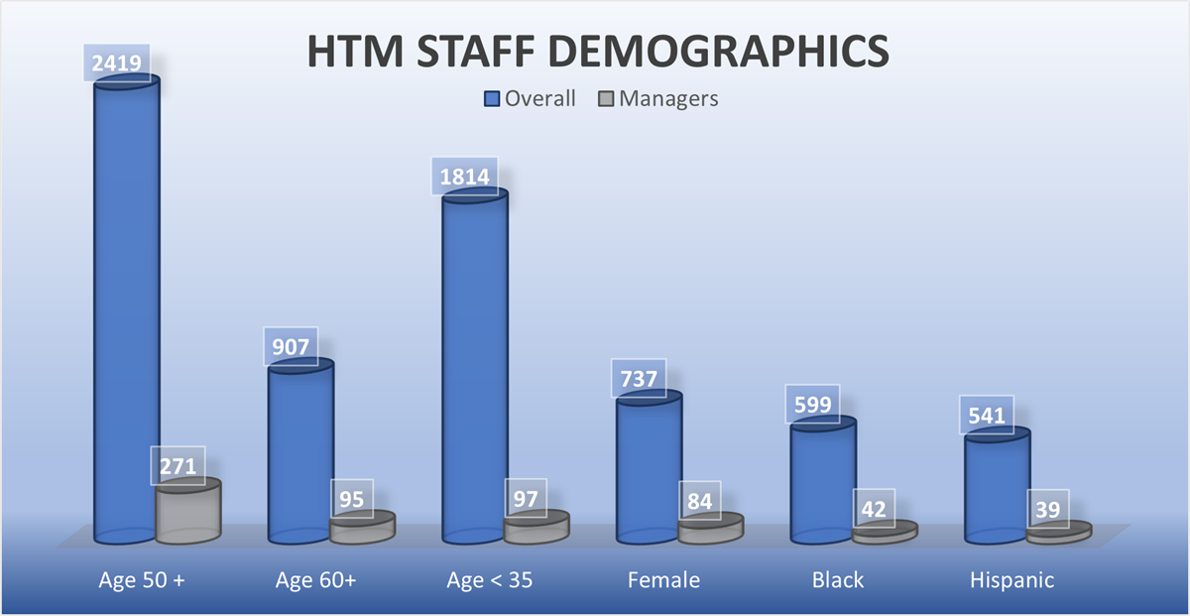
2021 HTM SALARY SURVEY
46% of 7000 HTM professionals are >50 years or older
<33% of respondents <40 years
Salaries saw growth in management and non-management roles
Salaries continue to remain competitive among imaging BMETs
71% recommend the profession
Notes:
Priya

Slide 11
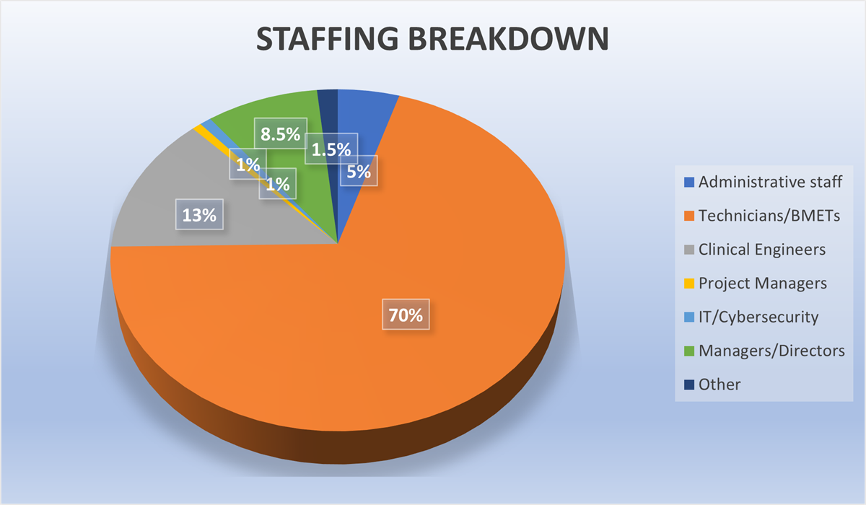
2021 HTM STAFFING BREAKDOWN
7000 HTM professionals
70% BMETs
13% CEs
5% cybersecurity
8.5% management
Notes:
Priya

Slide 12
DIVERSITY CONTINUES TO BE UNTAPPED
7000 HTM professionals
8.5% are black of African American
7.7% are Hispanic/Latinx
11% identified as female
47% are over 50 years old
60% of managers are over 50 years old
15.4% of managers are over 60 years old
14% of managers identified as female
8.5% open vacancies
33% organizations reported 2-4 months to fill a vacancy
30% reported taking >4 months to fill a vacancy
Notes:
Priya

Slide 13
A FEW FOCUS AREAS TO UNDERSTAND
Diversity among the HTM teams
Awareness of the HTM field in underrepresented populations
    Diversity in outreach
Retention of existing HTM staff
Shortening vacancy length
Diversity in recruitment
Notes:
Priya

Slide 14

DIVERSITY AMONG THE HTM TEAMS
Be an advocate and mentor
Encourage staff to take risks and stretch assignments
Offer opportunities…to everyone
Solicit input…from everyone
Notes:
Lucas - Lucas current department head staffing vs non supervisory staffing

Slide 15
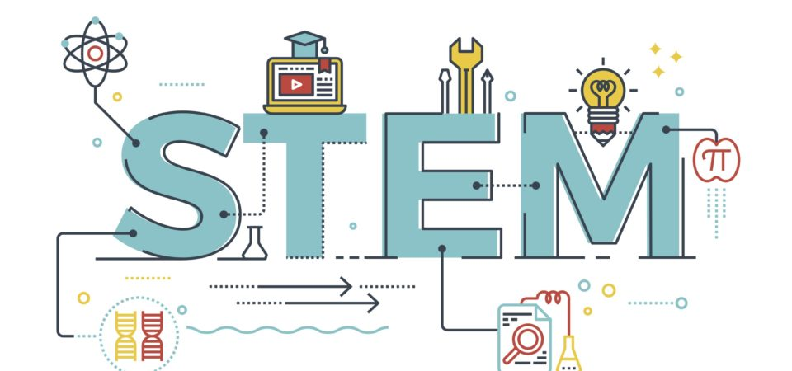
AWARENESS OF THE HTM FIELD IN UNDERREPRESENTED POPULATIONS
STEM/HTM outreach starting at the lowest level
    Introduce STEM/HTM early
    Elementary/Middle/High School?
Participate in STEM festivals and events
Ensure diversity of outreach team
Notes:
Lucas/Priya - interactive
Discuss prejudice – some employees are negative about hiring interns, students, and training them for future hiring
Students all levels unaware of career path, even teachers learn from outreach/education

Slide 16
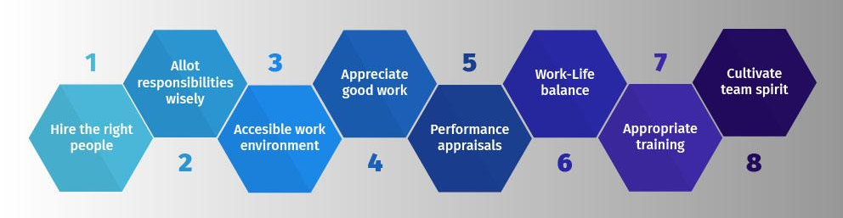
RETENTION OF EXISTING HTM STAFF
Development
Celebrate and recognize!
    Break bread
High energy tasks AKA pet projects
    Industry involvement
Notes:
Lucas/Priya - Interactive
Avoid contextual bias in staff retention and promotions – managers may have good review and intentions but may base a decision on external influences that may be irrelevant to current situation, thereby losing objectivity.
Avoid statistical bias – training staff or not training staff because data shows people leave after a major factory training due to better pay

Slide 17

DIVERSITY IN RECRUITMENT
Career Fairs
Schools (local & national)
Trade organizations
Local HTM chapters
Interview/resume panels
Social media (LinkedIn)
Notes:
Lucas/Priya - interactive
Discuss cognitive bias – recruiting decisions being made due to preexisting perceptions or forms of judgement that dictates present and future behaviors.
Recruitment results at career fairs

Slide 18
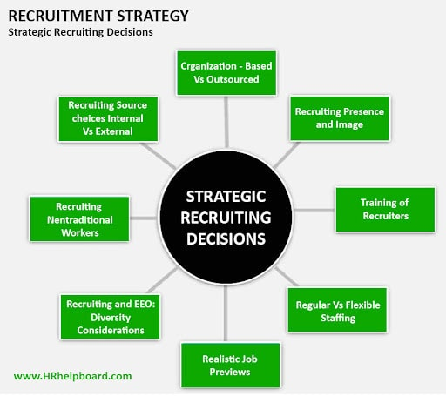
SHORTENING VACANCY LENGTH
Build relationships with education institutions and organizations
HTM is small, but a growing community, reputations matter
Succession planning
Pipeline of talent
    Try to capture as they leave school
Entry level positions
Leadership experience and exposure
    Supervisory
    C-Suite
Notes:
Lucas/Priya-interactive
Discuss unconscious bias – implicit stereotypes, unconsciously attributing certain qualities to certain groups.

Slide 19

Key Takeaways
Maintain a culture of diversity, equity, and inclusion
Seek DEI leaders in your HDOs and offer mandatory training to your teams
Use inclusive language – leader/team member communication
Develop diverse decision-making – collective opinions do bring great results!
Create a safe space for your teams – forms of bias
Use outside resources when needed – there are numerous DEI committees in various professional societies. They’re happy to come and educate your teams.
Notes:
Lucas/Priya

Slide 20
AAMI TMC’S DEI WORKGROUP
Formed in November 2021
Workgroup members: Danielle, Priya, Lucas, Maggie, Jennifer, Colleen
Purpose: Expand HTM field to diverse communities and create awareness on DEI for HTM professionals
Process:
  Review DEI survey results
  Connecting with diverse HTM professionals
  Connecting with other associations like HOSA, NSBE, NSBHP, SHPE, AISES, HACU, SWE, SACNAS, etc.
  Use HTM in a Box to introduce the field to underrepresented demographics
Expected outcomes:
  Increased visibility of the field in other associations and populations
  AAMI blog
  Cover story featuring diverse professionals and representatives from other associations
Notes:
Priya

Slide 21

THANK YOU

