Slide 1

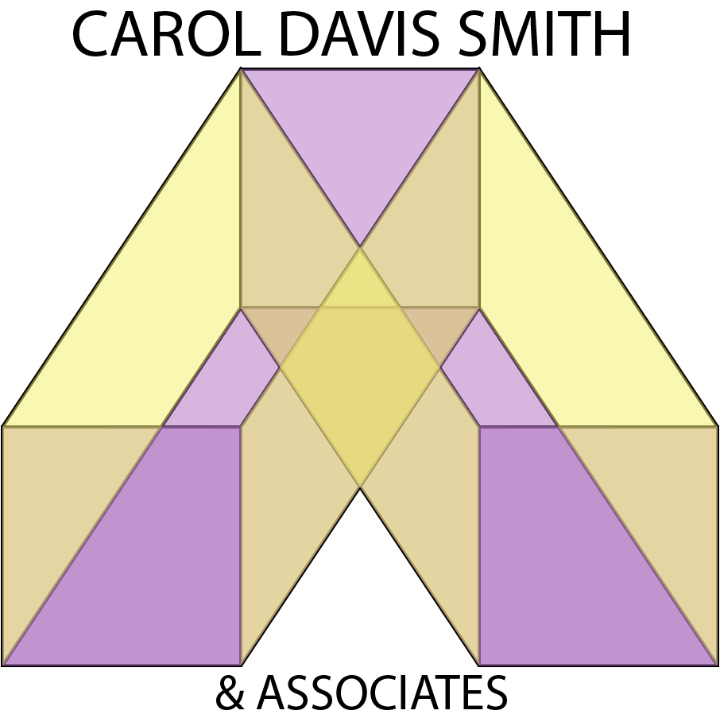


Clinical Protocols to Cybersecurity
How to build a clinical equipment acquisition strategy
Jim Daly
Chief Information Officer
Washington Regional Medical System
Carol Davis-Smith, MS CCE
President
Carol Davis-Smith & Associates, LLC

Slide 2


Agenda & Objectives
Welcome & Introductions
The Washington Regional Story
Questions & Discussions
Notes:
Carol
I will introduce the session with a focus on your interdisciplinary approach.

Slide 3
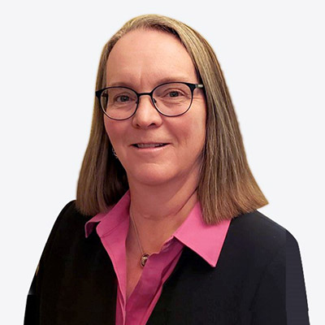

Carol Davis-Smith & Associates, LLC
Carol is a proven leader in the development and maintenance of safe, reliable, cost effective, and efficient patient care delivery systems through technology and process management. She has 30 years’ experience in academic and not-for-profit medical centers, group purchasing, consulting, and executive leadership. Through collaborative leadership and technical engagement, she continues to build successful teams across all aspects of the medical device lifecycle.
Carol Davis-Smith & Associates, LLC is a privately-owned consultancy established in 2017 and based in Phoenix, AZ. The firm is a woman-owned small business (WOSB) providing a consultative bridge between technical, clinical, and strategic perspectives in healthcare.
Carol also serves as the Director of the University of Connecticut Clinical Engineering Internship Program within the university’s Biomedical Engineering program.
She is the vice chair of clinical engineering for the Association for the Advancement of Medical Instrumentation (AAMI) Board of Directors and is a former (founding) member of the AAMI Technology Management Council. Additionally, she is a member of the American College of Clinical Engineering (ACCE) and former member of the United States Board of Examiners for Clinical Engineering Certification.
Carol holds a Master of Science degree from the University of Arizona and a Bachelor of Science degree from the University of Dayton. She is a certified clinical engineer and a Fellow in the American College of Clinical Engineering (FACCE) and the Association for the Advancement of Medical Instrumentation (AAMIF).
Carol Davis-Smith, MS CCE
Carol@CDSAssoc.com
President
Carol Davis-Smith & Associates, LLC
Notes:
Carol
I will introduce myself very briefly … they all know me ☺
I will introduce you at a high level, then turn it over to you for more details and the next several slides

Slide 4
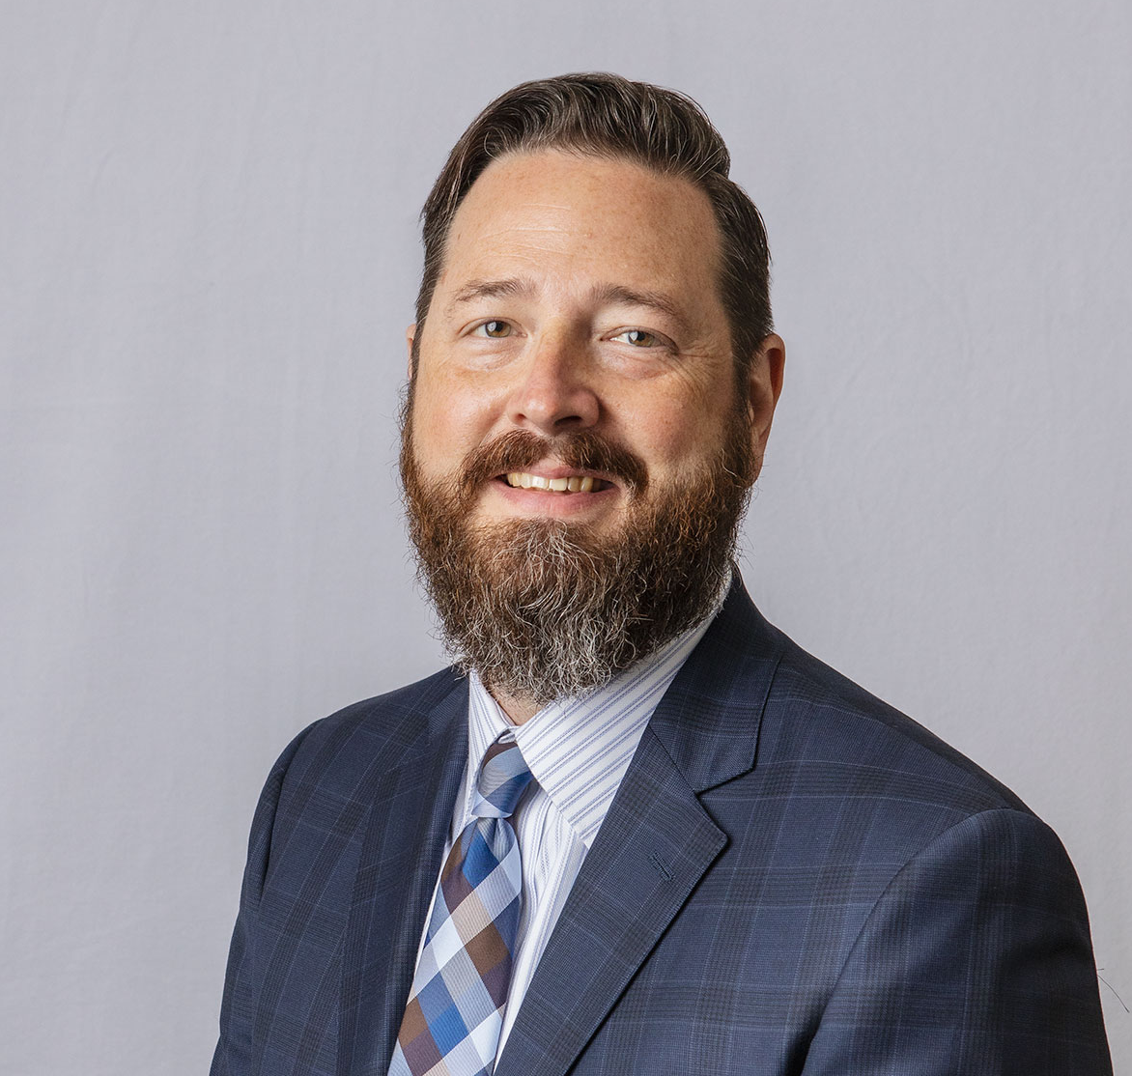

Washington Regional Medical Center
Jim Daly is Vice President and Chief Information Officer of Washington Regional Medical System in Fayetteville, Arkansas. He is responsible for aligning technology strategy to the mission and core values of the organization and oversees the infrastructure, applications, cyber-security, biomedical, portfolio management and service desk departments. Prior to joining Washington Regional he served as Sr. Director of Business Solutions for Health Care Service Corporation
He earned his undergraduate degree in Finance and Economics from the University of Arkansas, Little Rock and a Master of Business Administration and Healthcare Administration from the University of Arkansas Walton College of Business. He serves as President of the Healthcare Information and Management Systems Society, Arkansas Chapter and was recently recognized by Becker’s Hospital Review as one of the “102 Hospital and Health System CIOs to Know”.
Jim Daly
jdaly@wregional.com
Vice President & Chief Information Officer
Washington Regional Medical System
Notes:
Jim
The bio slides are “eye charts” but good for the attendees to have later. Give them a solid overview of your background … they will appreciate it.

Slide 5
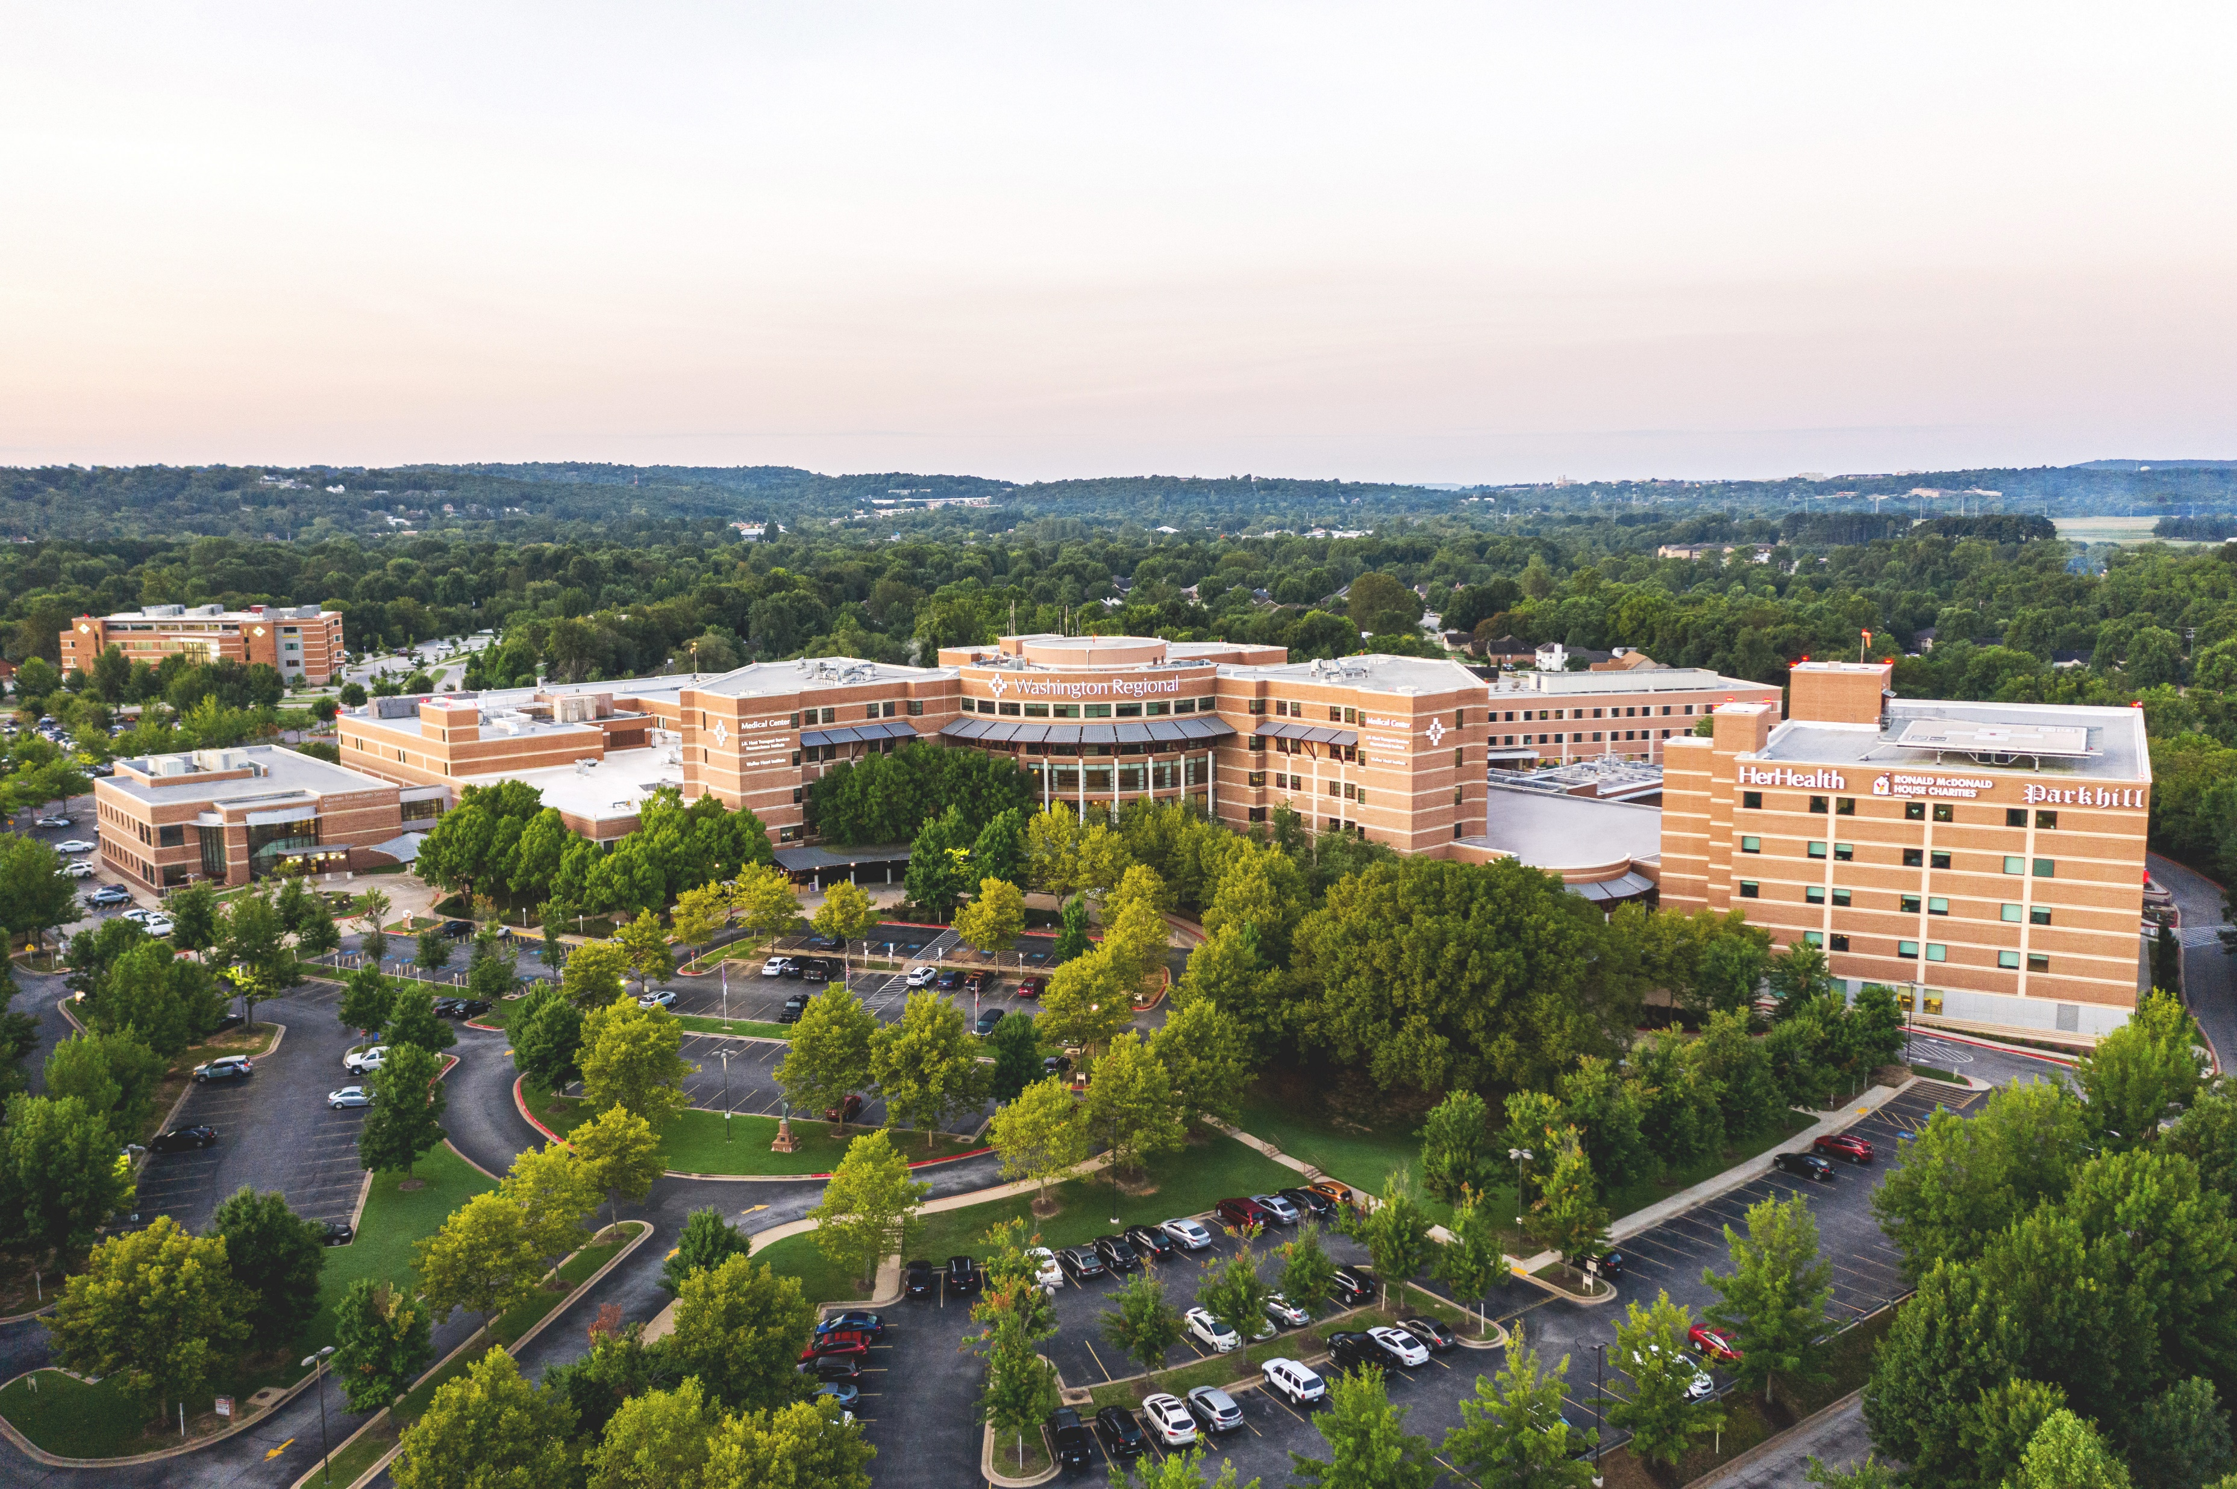



About Washington Regional
Northwest Arkansas’ only not-for-profit, community owned, locally governed health care system.
3,300+ team members
425-bed medical center
  Region’s only Level II trauma center
  Only Comprehensive Stroke Center in Northwest Arkansas
  1st in state to be named an Antimicrobial Stewardship Center of Excellence
  Named #1 Hospital in Arkansas by U.S. News and World Report (2021-2022)
Centers of Excellence
  J.B. Hunt Transport Services Neuroscience Institute
  Walker Heart Institute
  Women and Infants Center
  Total Joint Center
  Pat Walker Center for Seniors
50+ clinic locations
Washington Regional is committed to improving the health of people in the communities it serves through compassionate, high-quality care, prevention, and wellness education.
Notes:
Jim
U.S. News and World Report ranked Washington Regional as the #1 hospital in Arkansas and the #1 hospital in the Ozarks Region for 2021-22 and recognized Washington Regional as high performing in seven areas of care – stroke, abdominal aortic aneurysm repair, chronic obstructive pulmonary disease, heart attack, heart failure, hip replacement and knee replacement. Washington Regional is committed to improving the health of people in the communities it serves through compassionate, high-quality care, prevention, and wellness education.

Slide 6
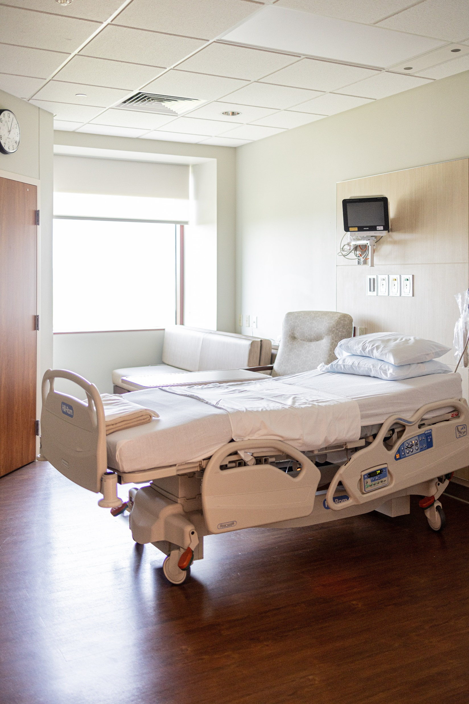
The Problem Statement
Emerging clinical needs
Upcoming end of life equipment
Fragmented data sources
Gaps in knowledge
We needed to quickly gain a deeper understanding of our inventory, clinical requirements, and end of life replacement needs to develop a strategy that aligned clinical, technology, and strategic sourcing objectives.
Notes:
Jim
Gaps in knowledge from transition to inhouse biomed, particularly in patient monitoring environment.

Slide 7





Internal Resources
External Resources
Chief Nursing Officer
Biomedical Engineering
Information Technology
  Infrastructure
  Applications
  Clinical Integration
  Cybersecurity
Supply Chain Management
  Strategic Sourcing
Notes:
Jim
You discuss the internal resources and then transition to Carol
Carol
I will speak to the type of data and support each of the external resources provided.
You should plan to “jump in” if I forget anything.

Slide 8

The Process to a Solution
Dedicate enough time to communicate needs and align to big picture
Facilitate internal resource engagement and provide access
Listen to the experts!
Industry Networking
  (Cybersecurity, AAMI material, etc)
Notes:
Jim

Slide 9
The Process to a Solution
Manage expectations of stakeholders
Keep the ‘why’ in the forefront when obstacles crop up
Ensure each stakeholder has a voice
Communicate, and then communicate more
Notes:
Jim
After you speak to this slide, please transition to me for a quick review of the data analysis.

Slide 10
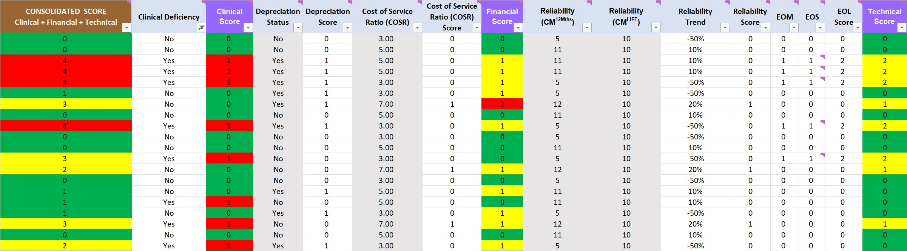
Equipment Replacement Forecast
Notes:
Carol
Let me know if there is anything in these tables that you prefer I not share.
Jim – please mock up the data vs using ours

Slide 11
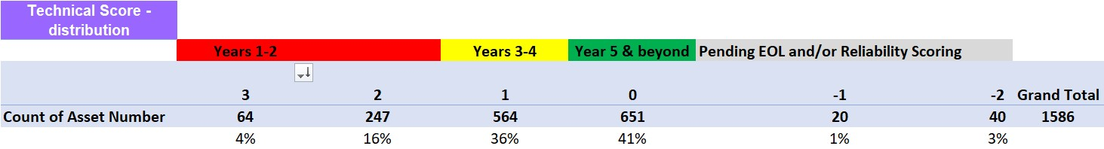
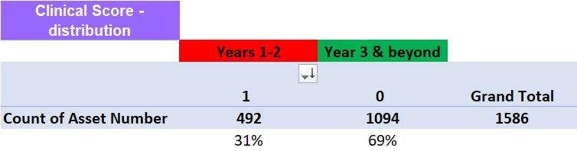
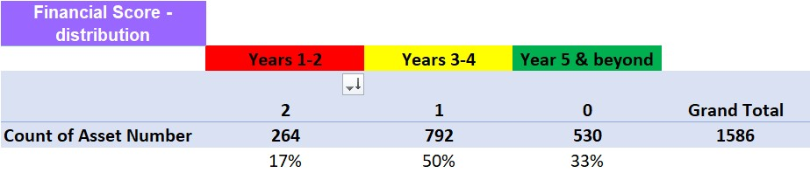
Equipment Replacement Forecast
End-of-Life is a matter of perspective.
Notes:
Carol
Let me know if there is anything in these tables that you prefer I not share.
Jim – please mock up the data vs using ours

Slide 12
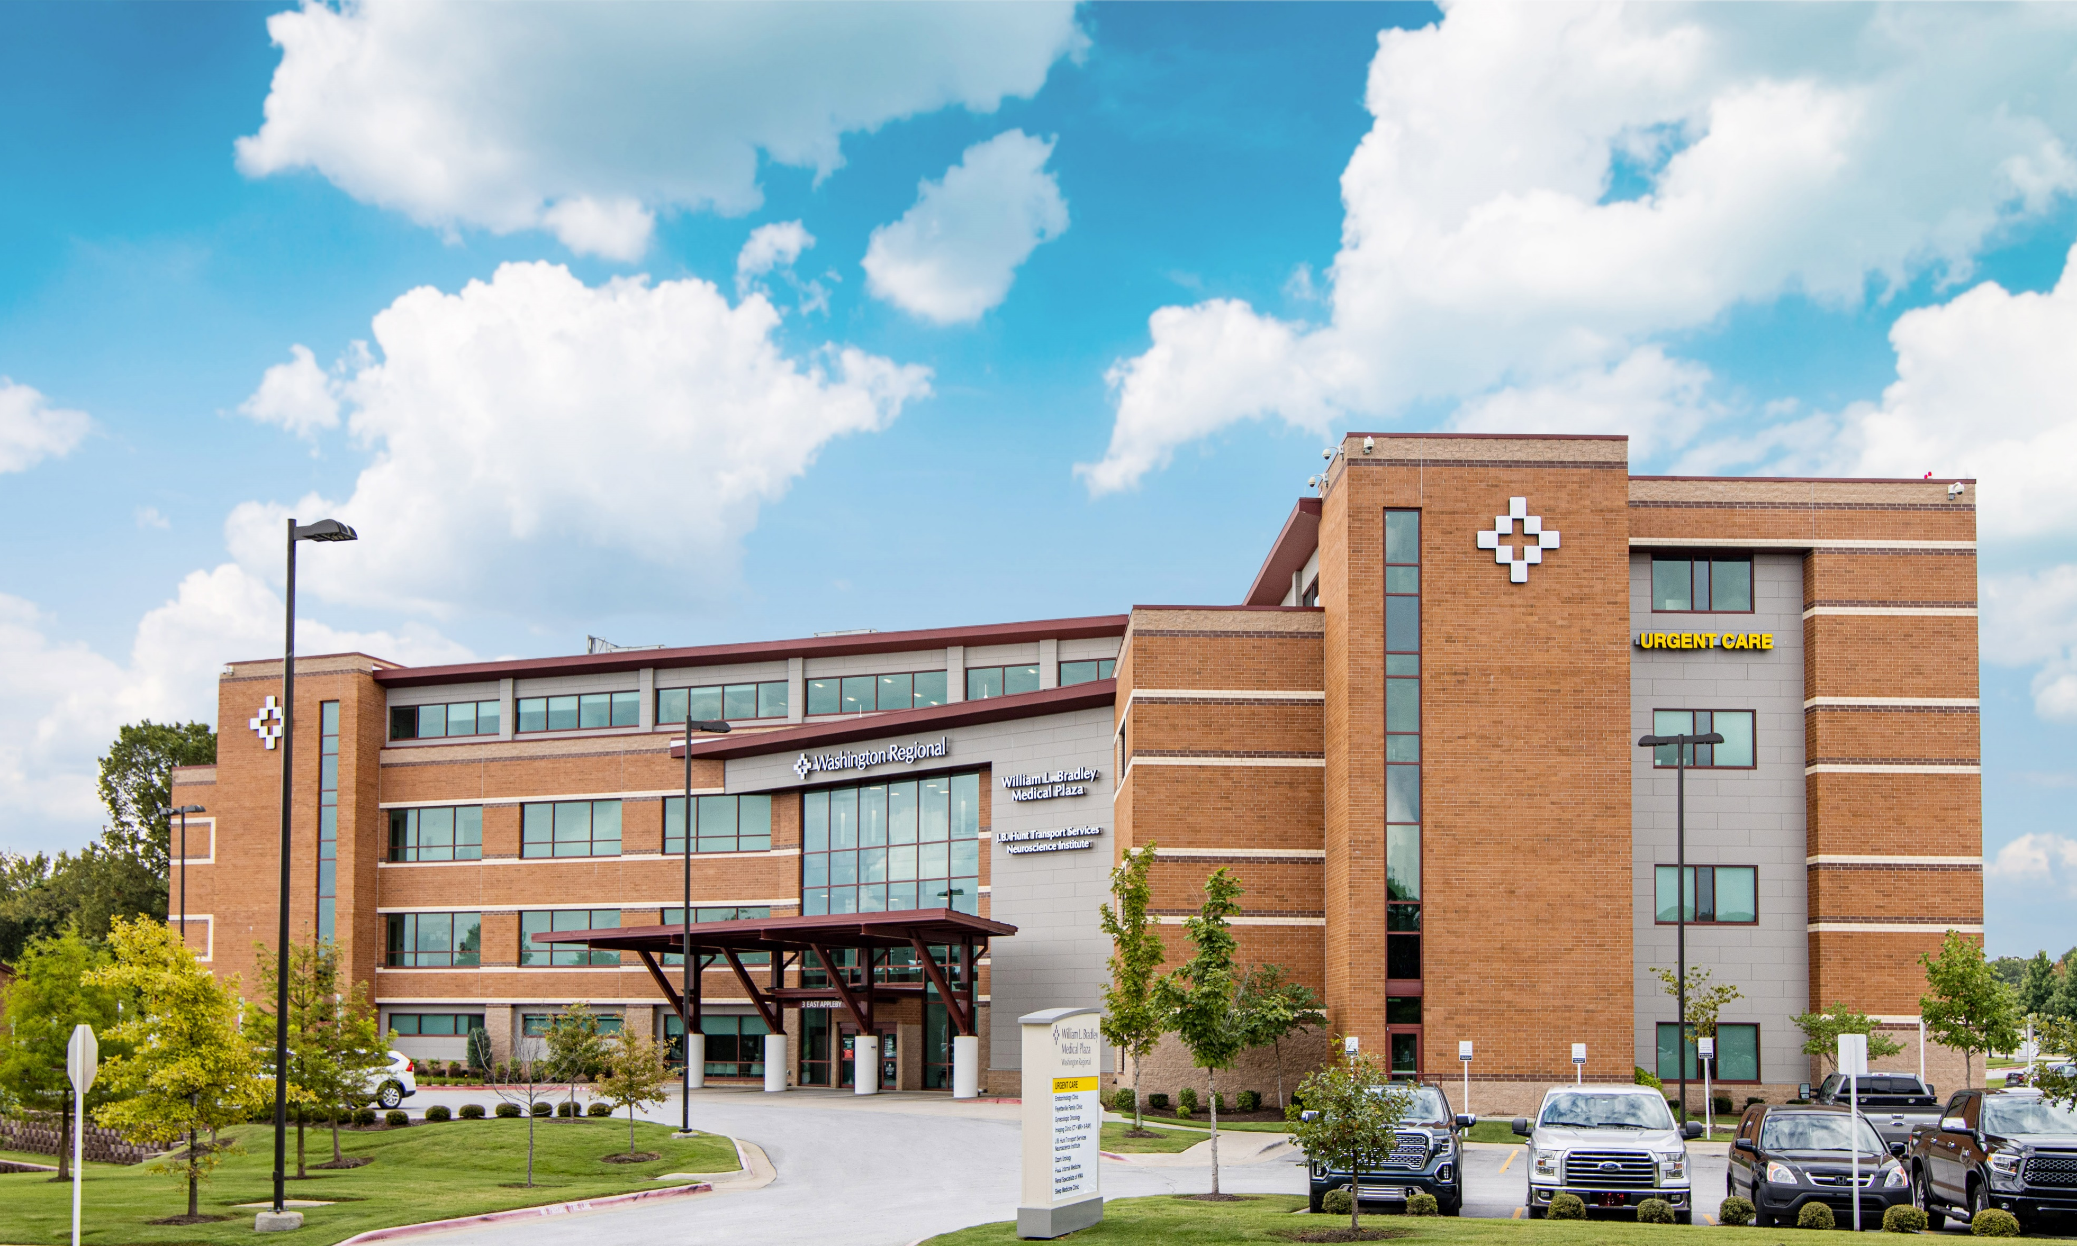
Where are we now?
Evaluating the market, coordinating demos
Building a sequencing plan
Developing business case and budget
Contacting like facilities that have undergone a monitoring transformation effort
Notes:
Jim
After you speak to this slide, please transition us to Q&A
I can transition to Q&A by asking the audience:
“One of my favorite aspects of these sessions is to learn from you; would anyone like to offer a comment on what they have learned in strategic clinical equipment acquisitions?”

Slide 13

Discussion & Questions

Slide 14

jdaly@wregional.com
Washington Regional Medical System
(wregional.com)
See you in Southern California!
Carol@CDSAssoc.com
Carol Davis-Smith & Associates (cdsassoc.com)

