Slide 1

Job Titles and Their Effects on Vacancies
Michael Heusser, MS, CCE, CHTM
Manager of Clinical Engineering
Middlesex Health

Slide 2
Summary
Poll
Consequences of a staffing shortage
Anticipated growth of the field
Why are staffing shortages more common now
Review data on job title inconsistencies found
Why this adds to the problem
What are some best practices
Job title specific findings
Suggestions for current and future postings

Slide 3
Poll Question 1
On average how long has it taken you to fill recent job vacancies?
1 - 3 months
3 - 6 months
6 - 9 months
Greater than 9 months

Slide 4
Poll Question 2
Have you had to change a job posting to find more candidates?
Yes
No

Slide 5
Poll Question 3
Have you needed to use a recruiting service to help fill vacancies?
Yes
No

Slide 6
Poll Question 4
Do you use level specific job titles for your technician job postings?
Yes
No

Slide 7
Consequences of a Staffing Shortage
Turnaround Time for Repairs
  Likely to increase
  Greater need for expanded prioritization
Compliance Challenges
  Greater difficulty completing planned maintenance activities on time
  Less time spent completing documentation
Staff Burnout
  Increased stress and demand based on competing priorities
  Need for persistent overtime [1]

Slide 8
Consequences of a Staffing Shortage
Direct Patient Care Impact
  Missed necessary planned maintenance leads to increased unexpected failures
  Longer turnaround time leads to lack of equipment available for patient care
  Rushed work could lead to mistakes during maintenance
Financial Impact
  Requests to purchase additional equipment to compensate for lack of available devices
  Increased reliance on costly support labor from external resources
  Increased overtime spending [1]

Slide 9
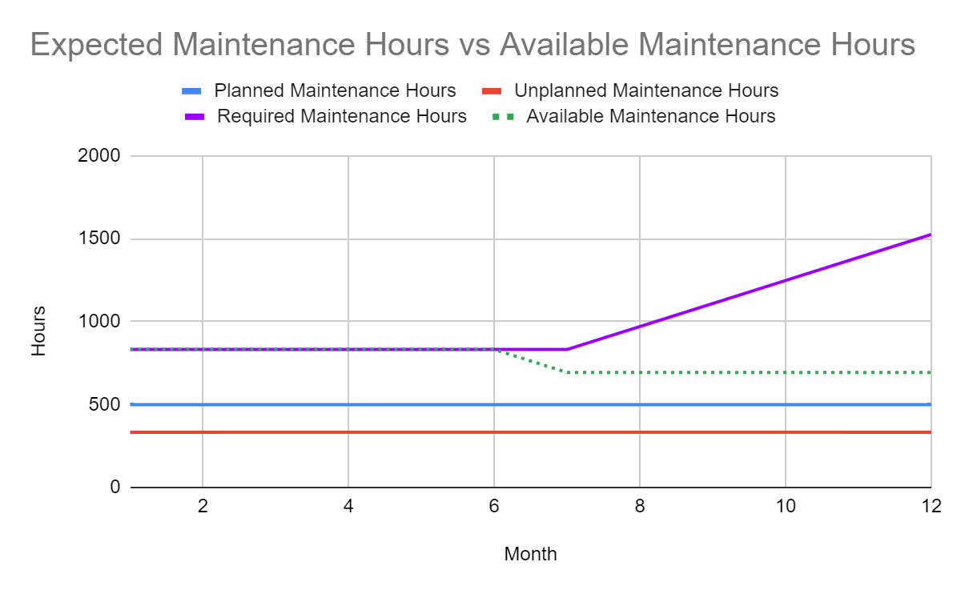
Consequences of a Staffing Shortage
Assumptions:
Available maintenance hours are 80% of staff’s time
6 Technicians drops to 5 on month 6
  Previously operated evenly not at a deficit
  Operating in a 140 hr/month deficit

Slide 10
Anticipated Growth of the Field
Federal government predicts a 7 percent growth of the field by 2030 [2]
  Average compared to all occupations
Estimated to be about 6,300 openings per year
  Primarily from retirements or transfers out of the field
Average age of technicians is estimated to be 47 [3]
  30% under 40
  Nearly 50% of the HTM workforce is over the age of 50
    Up to 35% of which is estimated to retire by 2028 [4]

Slide 11
Why Are Staffing Shortages More Common Now?
Growing need for medical equipment maintenance staff
  Retiring vs new coming in
  Many BMET education programs have closed due to reduced enrollment [5]
Lack of interest in the field
  Minimal awareness in the community of the field
Lack of qualified candidates
  Minimal students graduating with the necessary skills for many years
  Time to fill can be as high as 9 months
The Great Resignation
  Currently rates are highest in the technology and healthcare fields
  Rates are highest in fields that experienced increased workloads and burnout due to the pandemic [6]
Confusing job titles across industry
  398 total job postings were reviewed

Slide 12
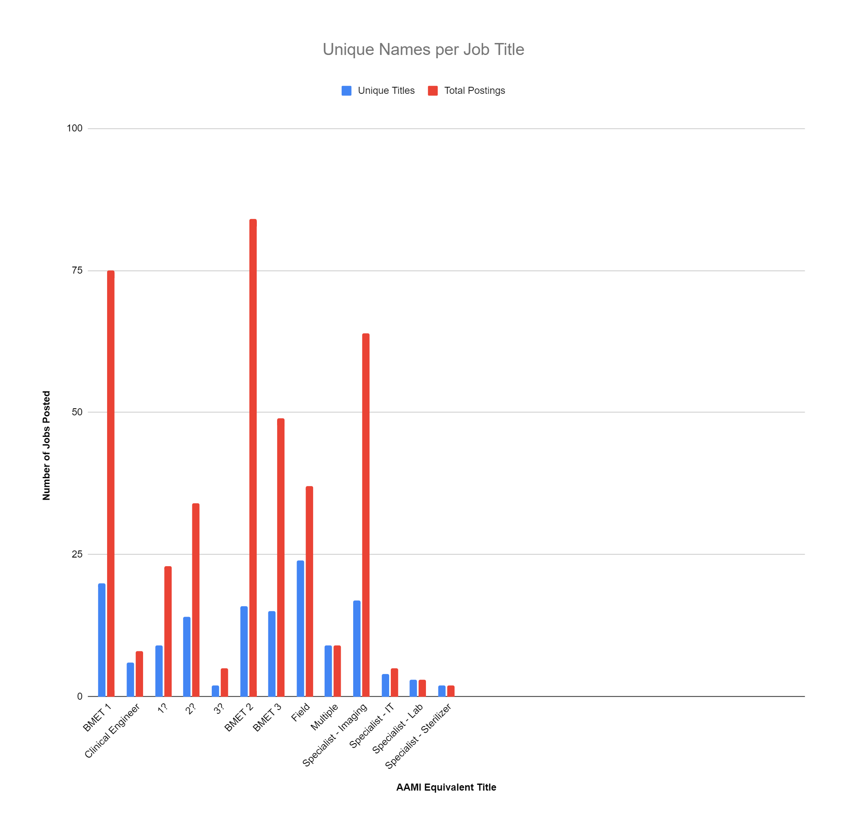

Slide 13
Why Do Institution Unique Job Titles Cause a Problem?
Improper candidates may apply
Applicable candidates may not find the posting based on the title
This could lead to an extended time to fill
  What has HTMJOBS seen in their experience?
Difficult to grade from a market perspective
  HR surveys will mismatch causing improper grading and salary inequities leading to higher turnover rates
Students interested in the field may seek the wrong education

Slide 14
What Job Titles Should Be Used?
Conform to regional or state titles used nearby?
Adopt the titles used by national organizations?
Adopt the titles used by department of labor?
Adopt the titles used in HR compensation surveys?
Adopt the titles created by AAMI?
  AAMI’s Career Planning Handbook [7]

Slide 15
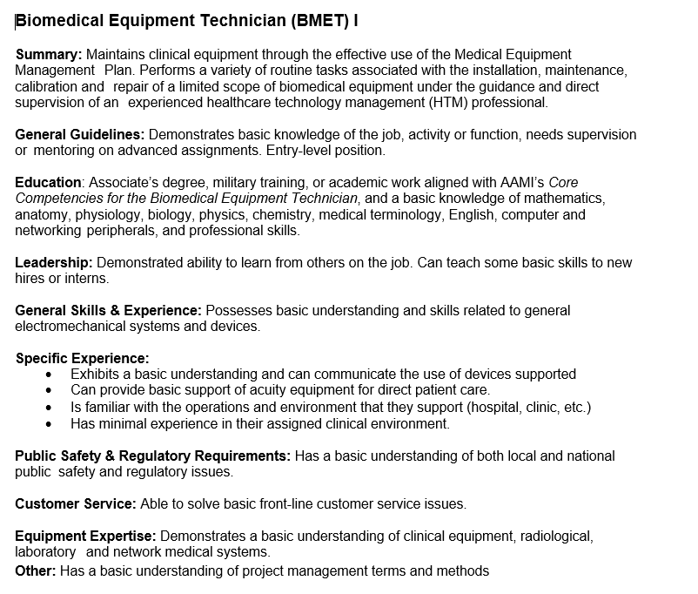
AAMI - Biomedical Equipment Technician (BMET) 1
Total Number of Job Postings Found: 75
  + 23?
Total Number of Unique Names: 20
  + 9?
Popular HR Compensation Survey Names:
  Biomedical Electronics Technician
  Biomedical Equipment Technician
AAMI Definition [7]

Slide 16
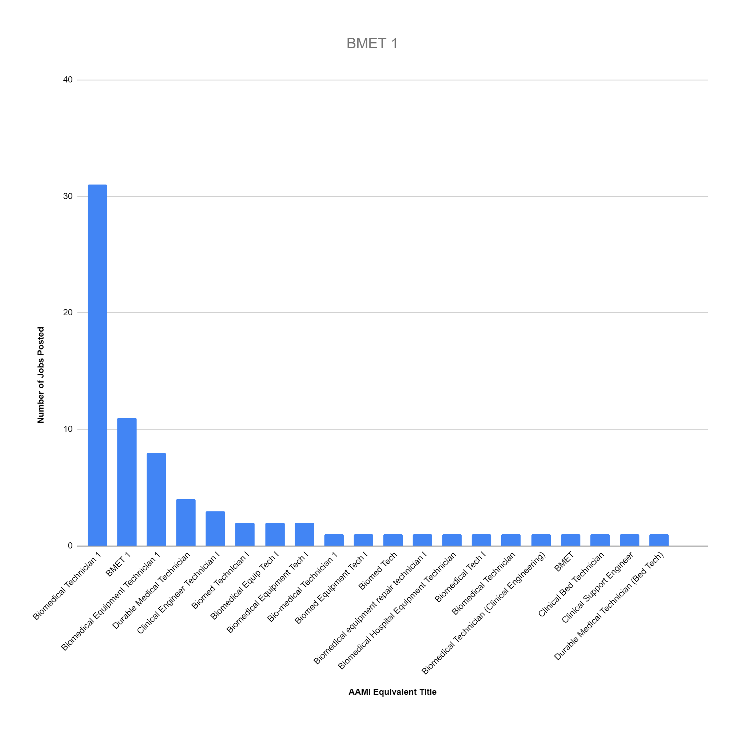

Slide 17
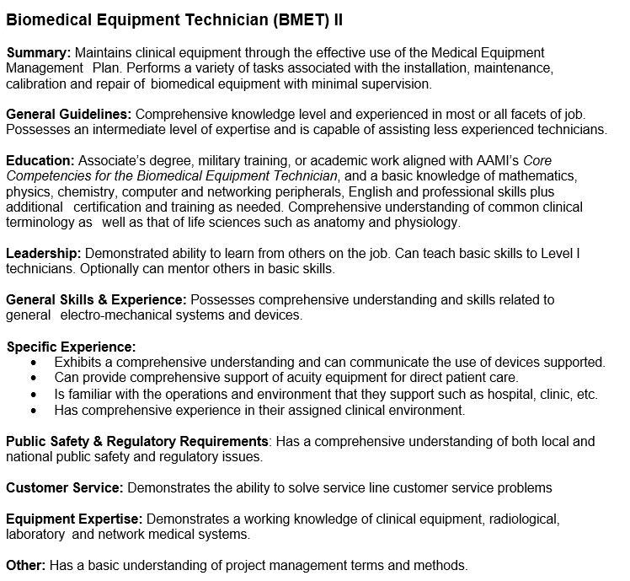
AAMI - Biomedical Equipment Technician (BMET) 2
Total Number of Job Postings Found: 84
  + 34?
Total Number of Unique Names: 16
  + 14?
Popular HR Compensation Survey Names:
  Biomedical Electronics Technician
  Biomedical Equipment Technician
AAMI Definition [7]

Slide 18
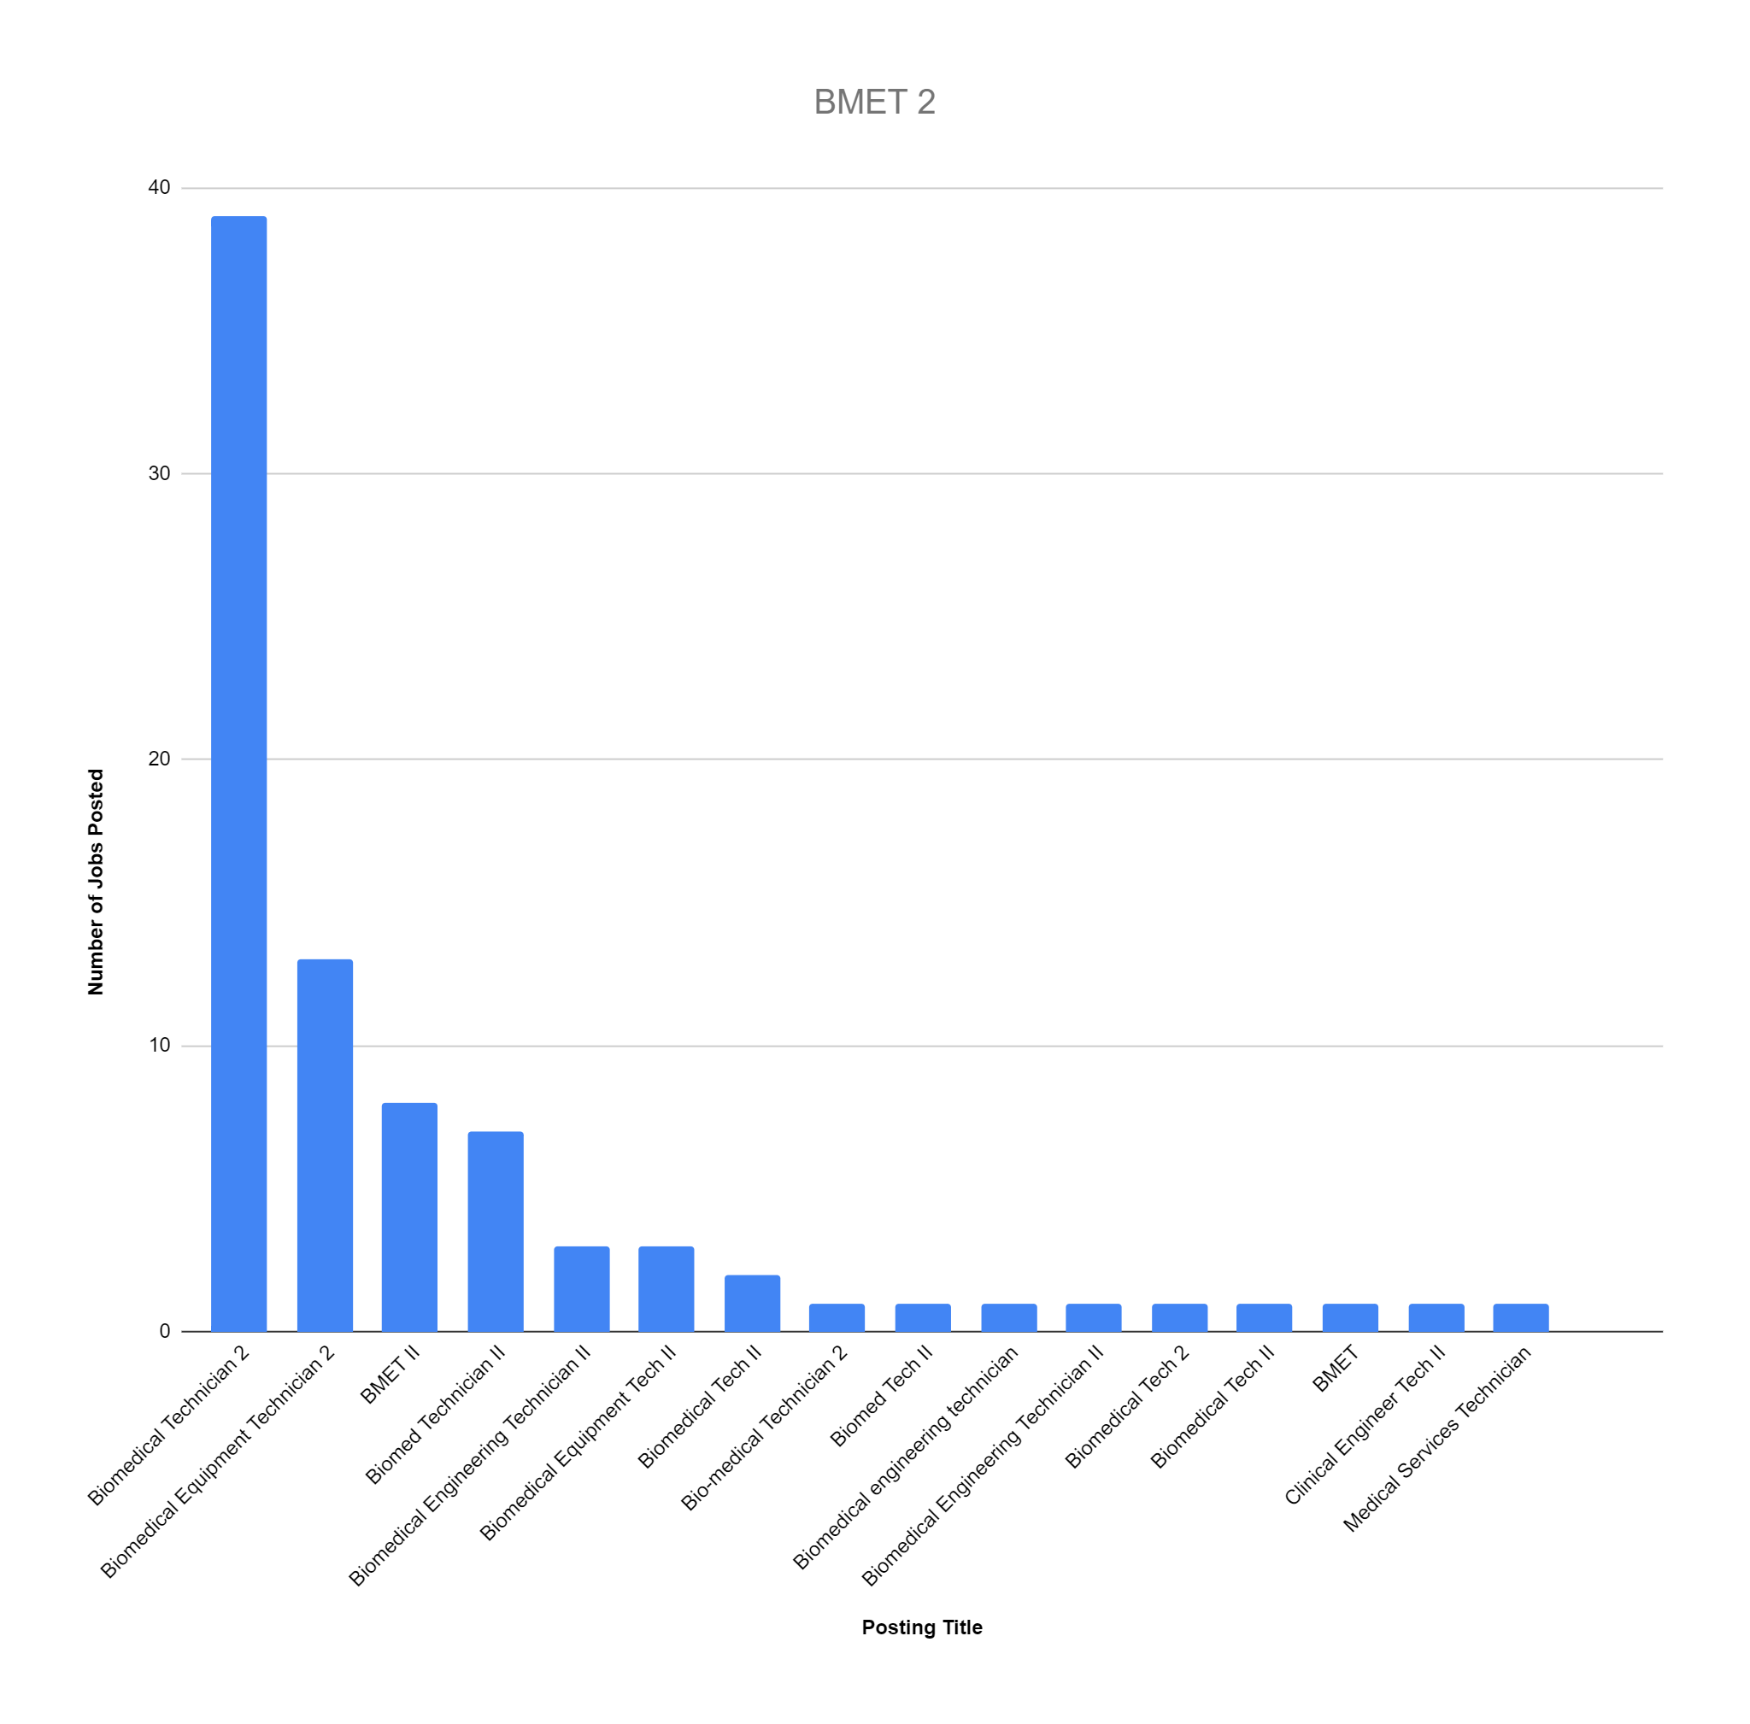

Slide 19
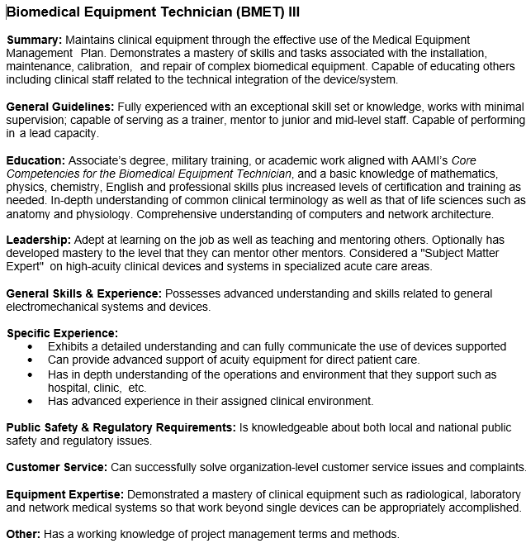
AAMI - Biomedical Equipment Technician (BMET) 3
Total Number of Job Postings Found: 49
  + 5?
Total Number of Unique Names: 15
  + 2?
Popular HR Compensation Survey Names:
  Biomedical Electronics Technician
  Biomedical Equipment Technician
AAMI Definition [7]

Slide 20
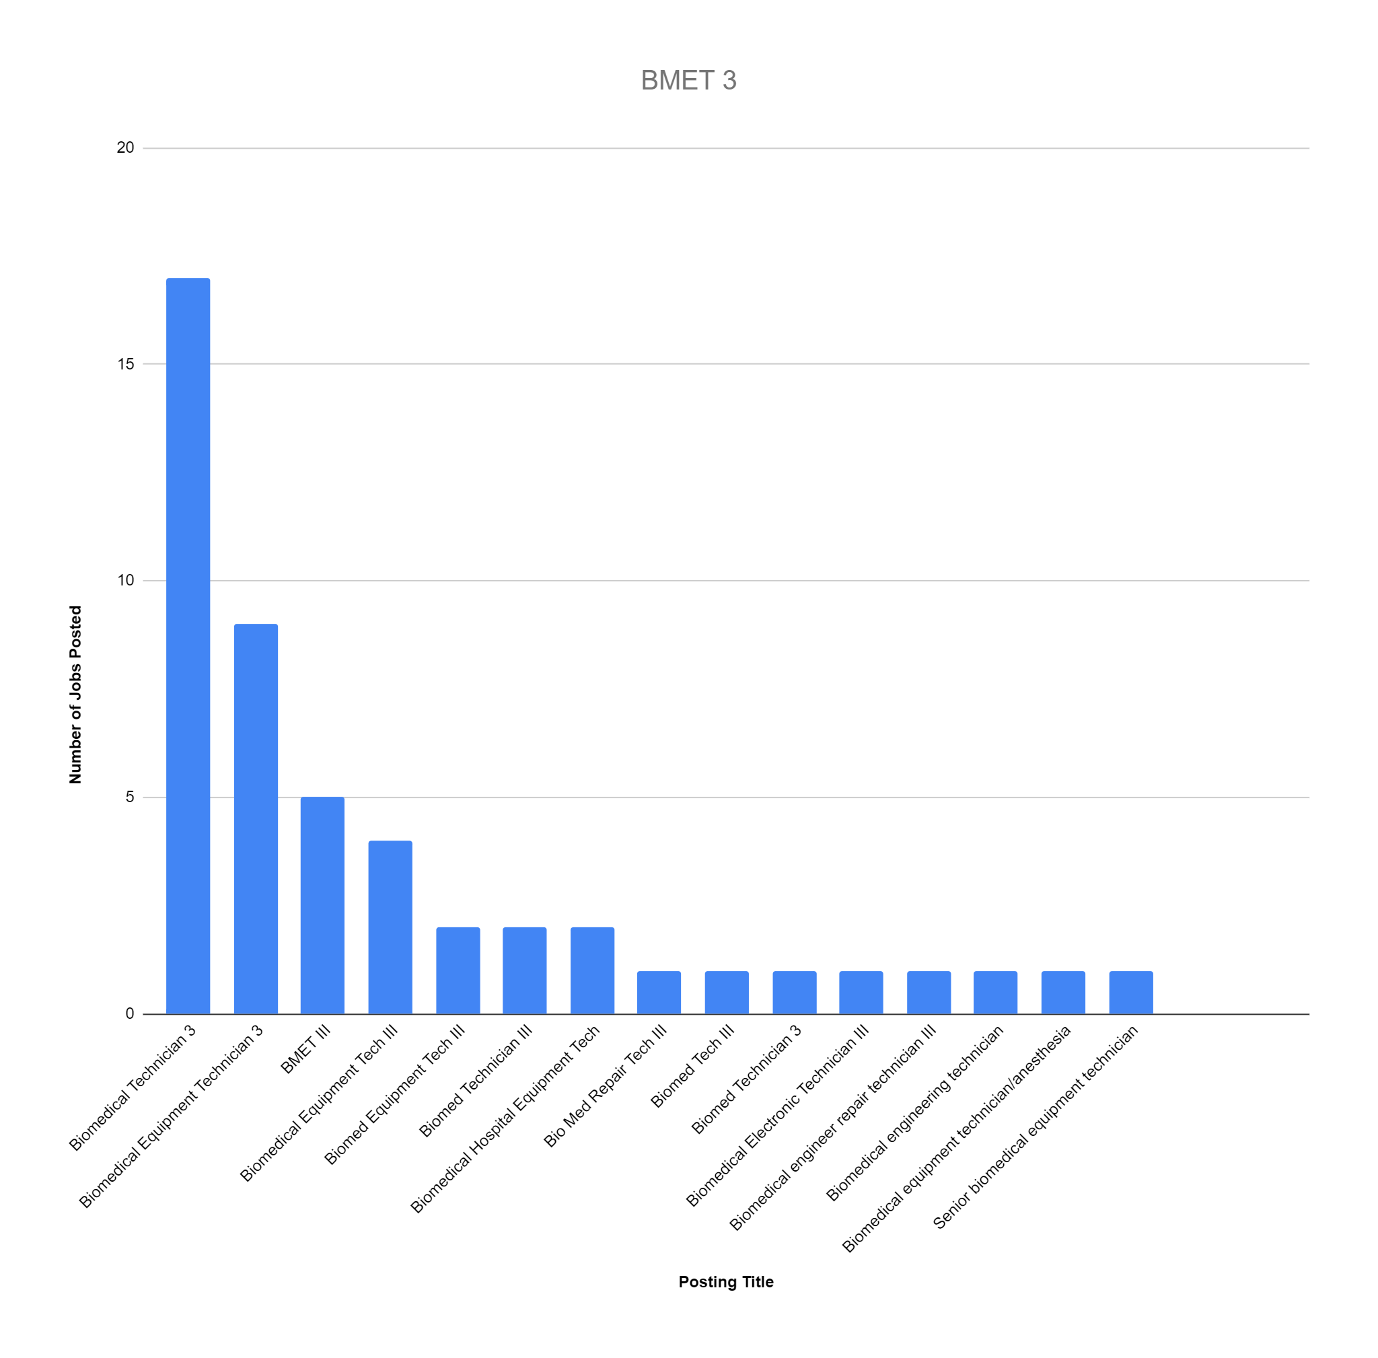

Slide 21
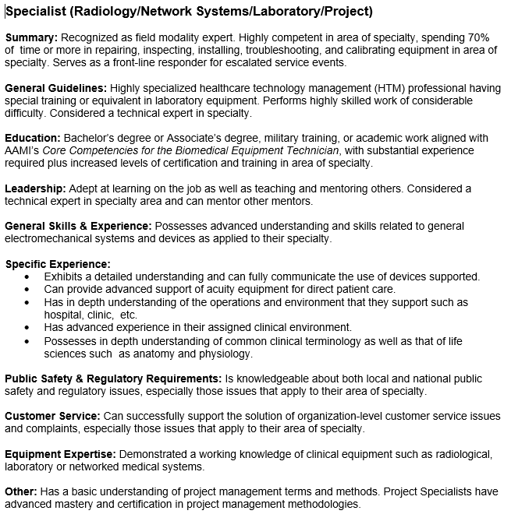
AAMI - Biomedical Equipment Technician (BMET) Specialist - Radiology
Total Number of Job Postings Found: 64
Total Number of Unique Names: 17
Popular HR Compensation Survey Names:
  Biomedical Electronics Technician
  Biomedical Equipment Technician
AAMI Definition [7]

Slide 22
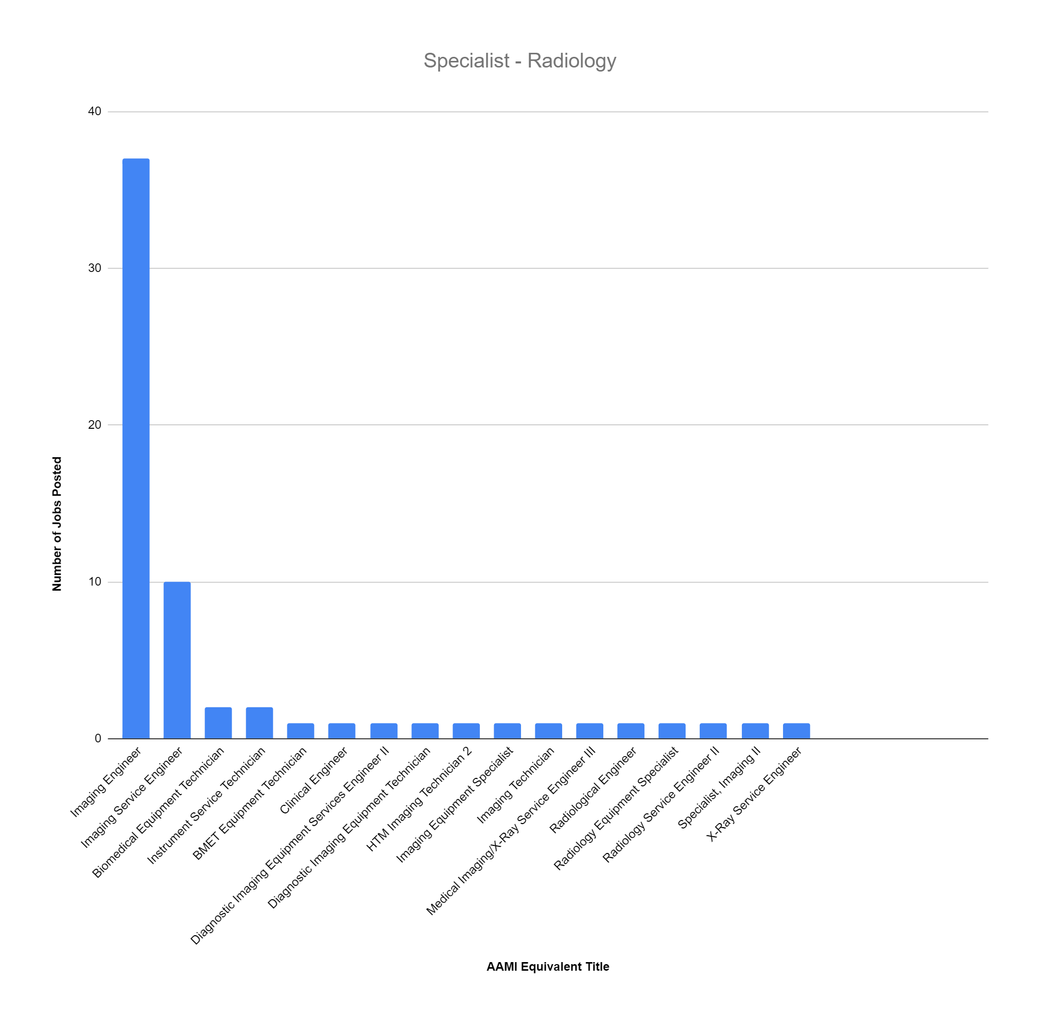

Slide 23
AAMI - Biomedical Equipment Technician (BMET) Specialist Continued
Network Specialist
Total Number of Job Postings Found: 5
Total Number of Unique Names: 4
Popular HR Compensation Survey Names:
  Biomedical Electronics Technician
  Biomedical Equipment Technician
Laboratory
Total Number of Job Postings Found: 3
Total Number of Unique Names: 3
Popular HR Compensation Survey Names:
  Biomedical Electronics Technician
  Biomedical Equipment Technician

Slide 24
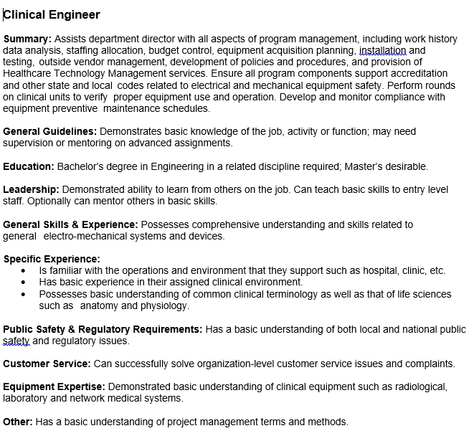
AAMI - Clinical Engineer
Total Number of Job Postings Found: 8
Total Number of Unique Names: 6
Popular HR Compensation Survey Names:
  Does not exist in the two sample surveys located
  Similar descriptions in other areas were:
    Operations Project Manager
    IT Project Manager
AAMI Definition [7]

Slide 25
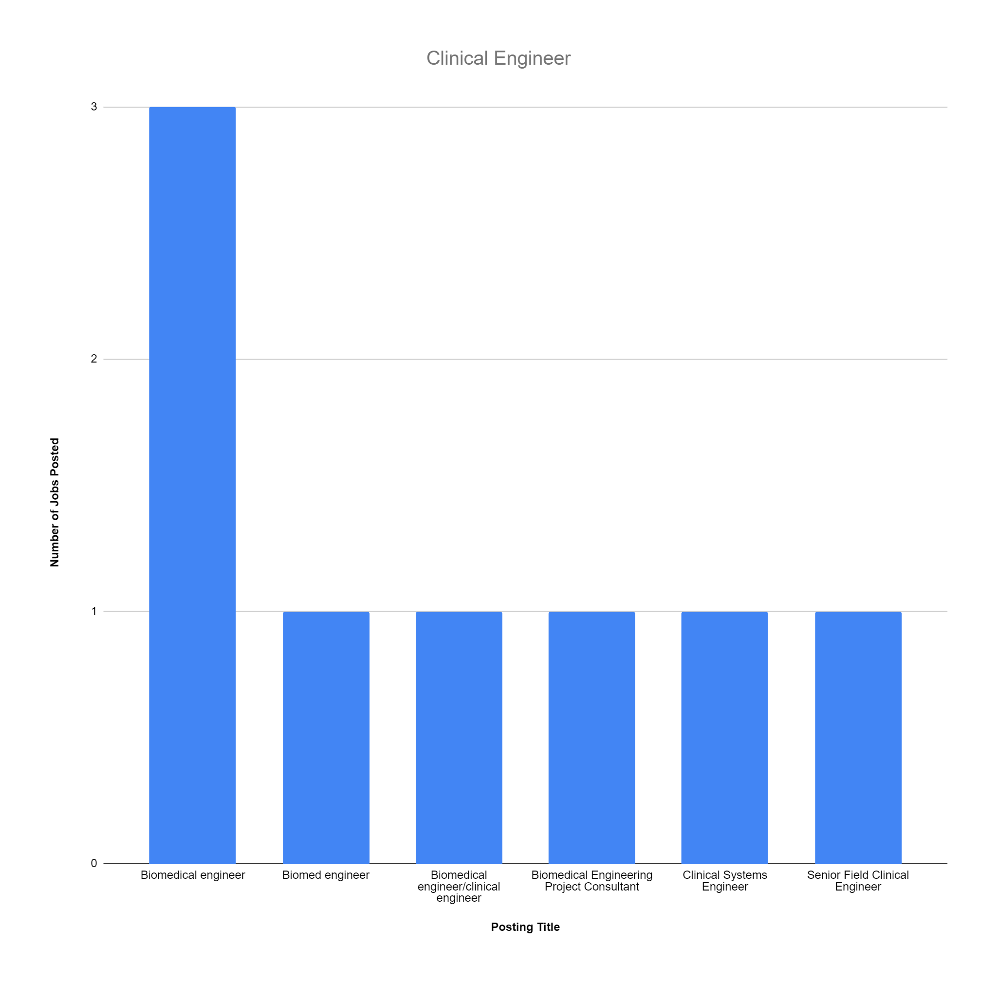

Slide 26
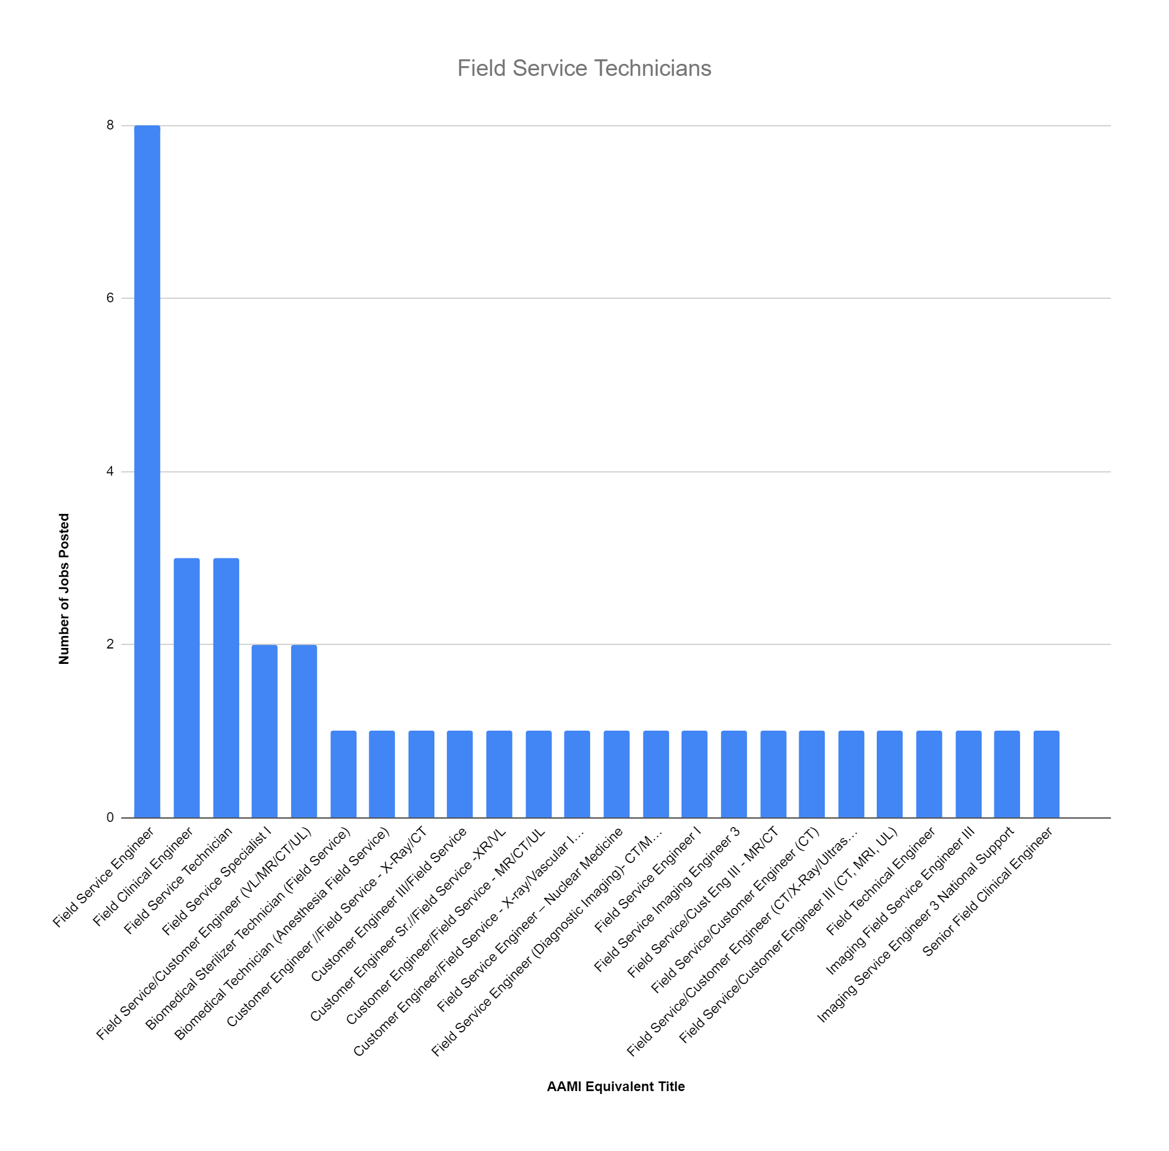
Notable Findings - Field Service Technicians
Total Number of Job Postings Found: 37
Total Number of Unique Names: 23

Slide 27
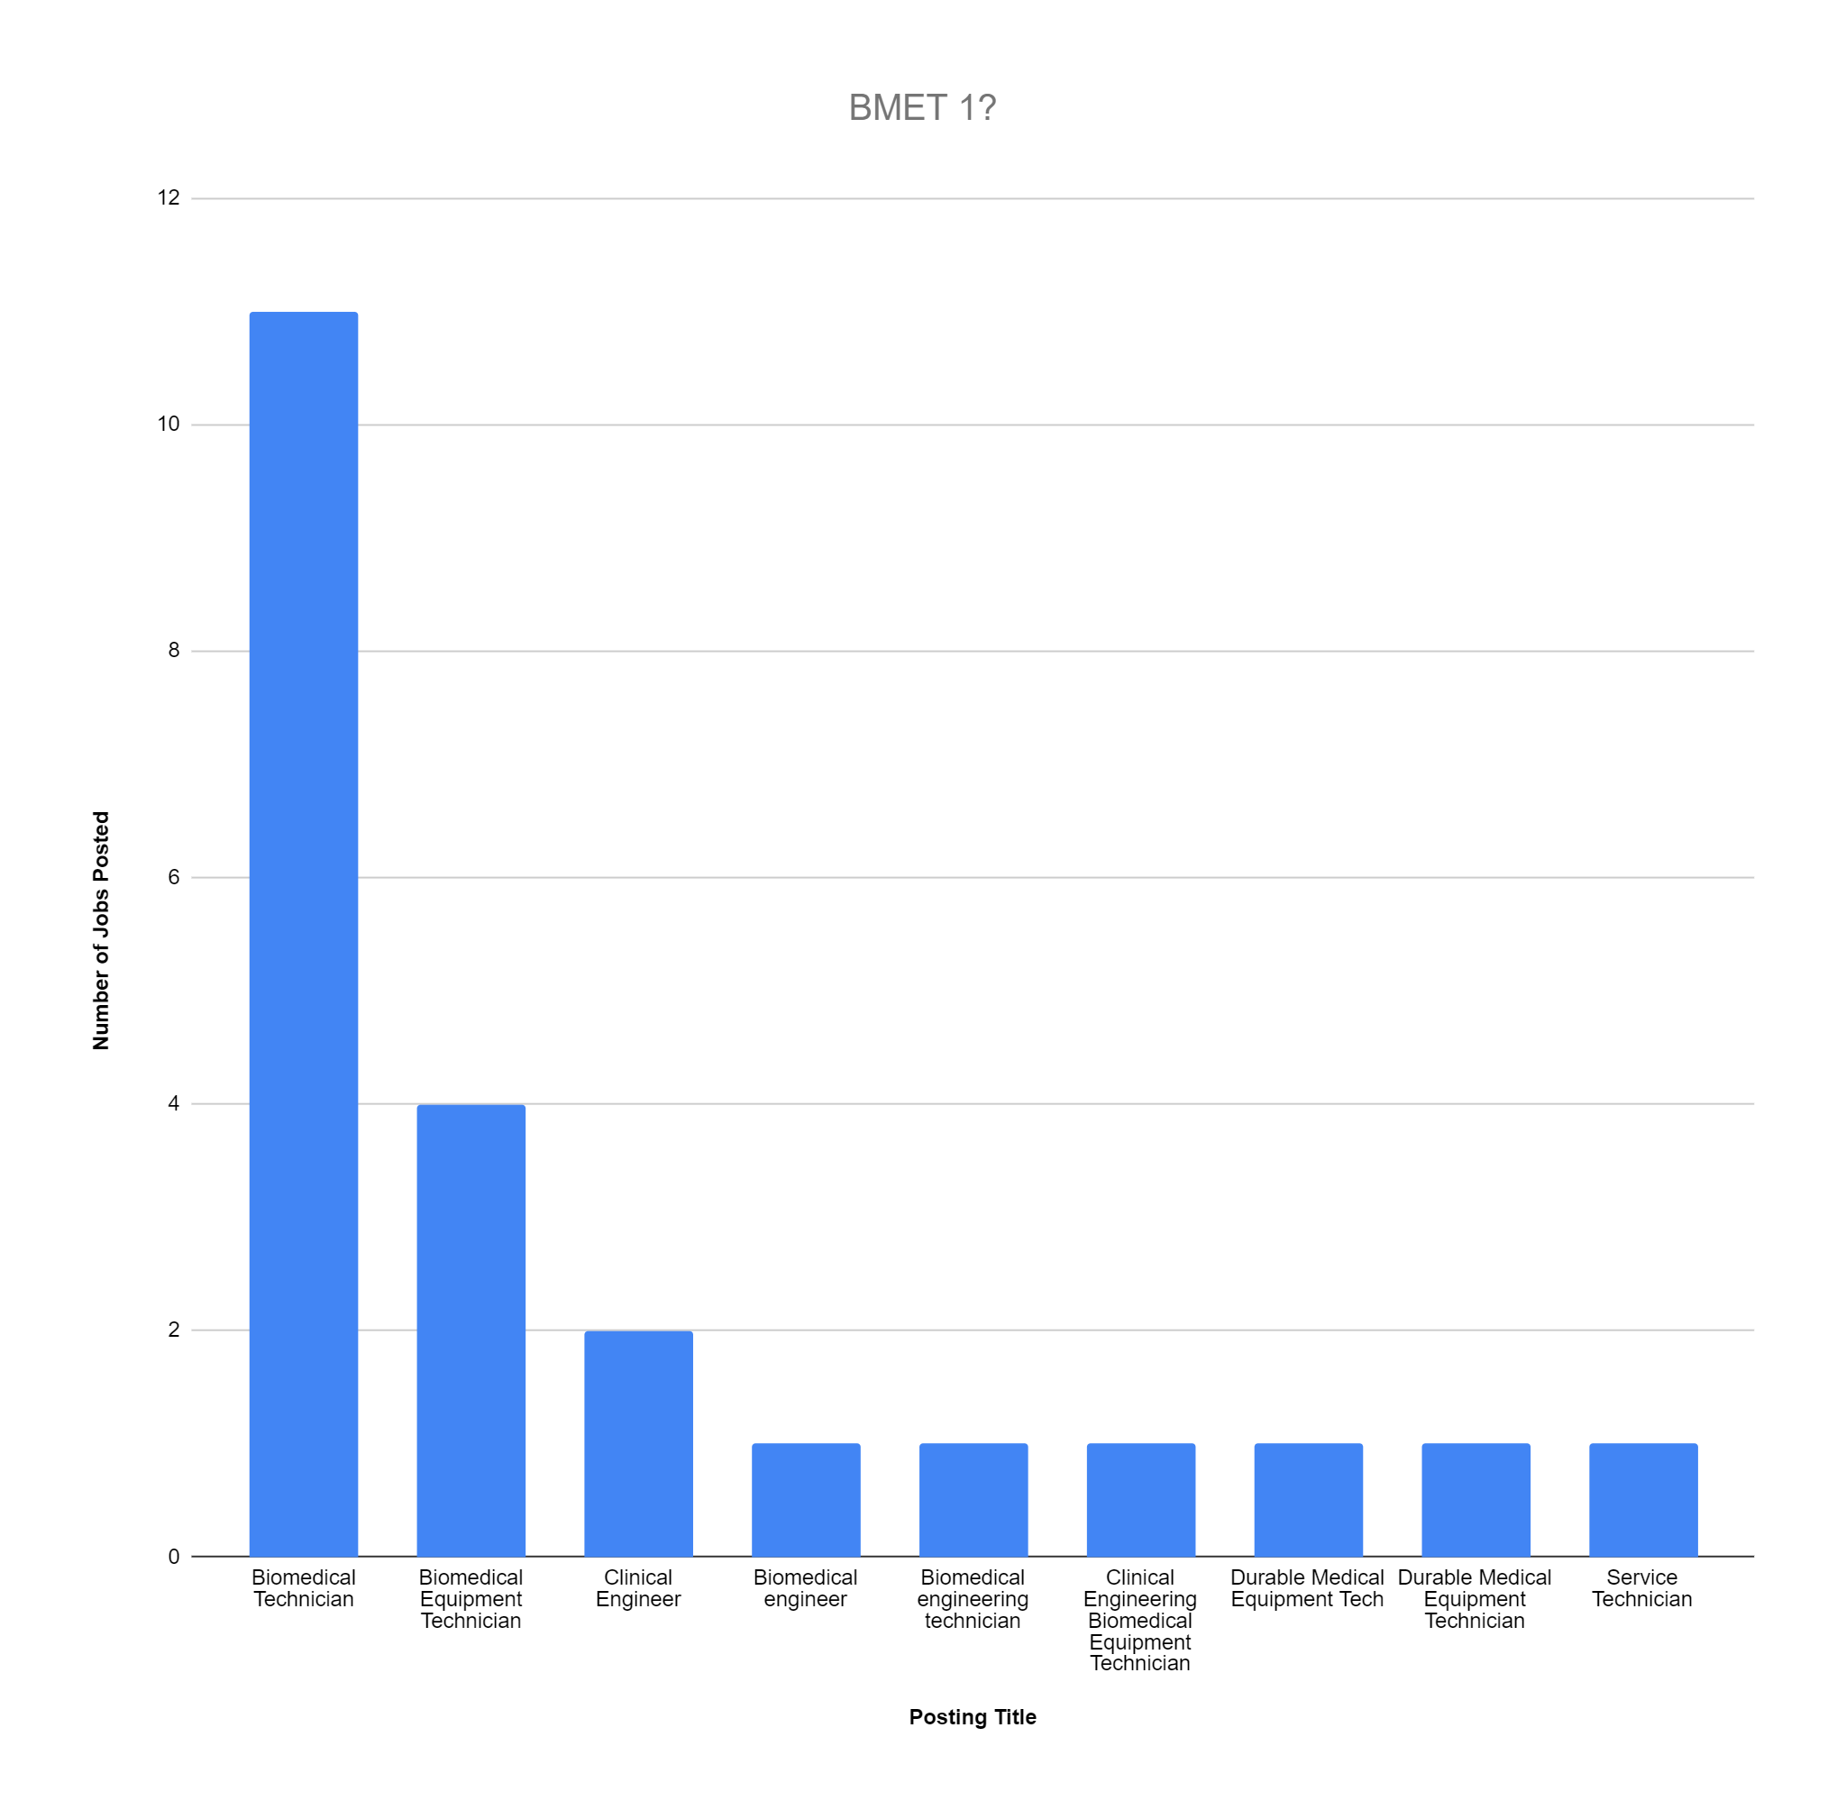
Notable Findings - BMET 1?

Slide 28
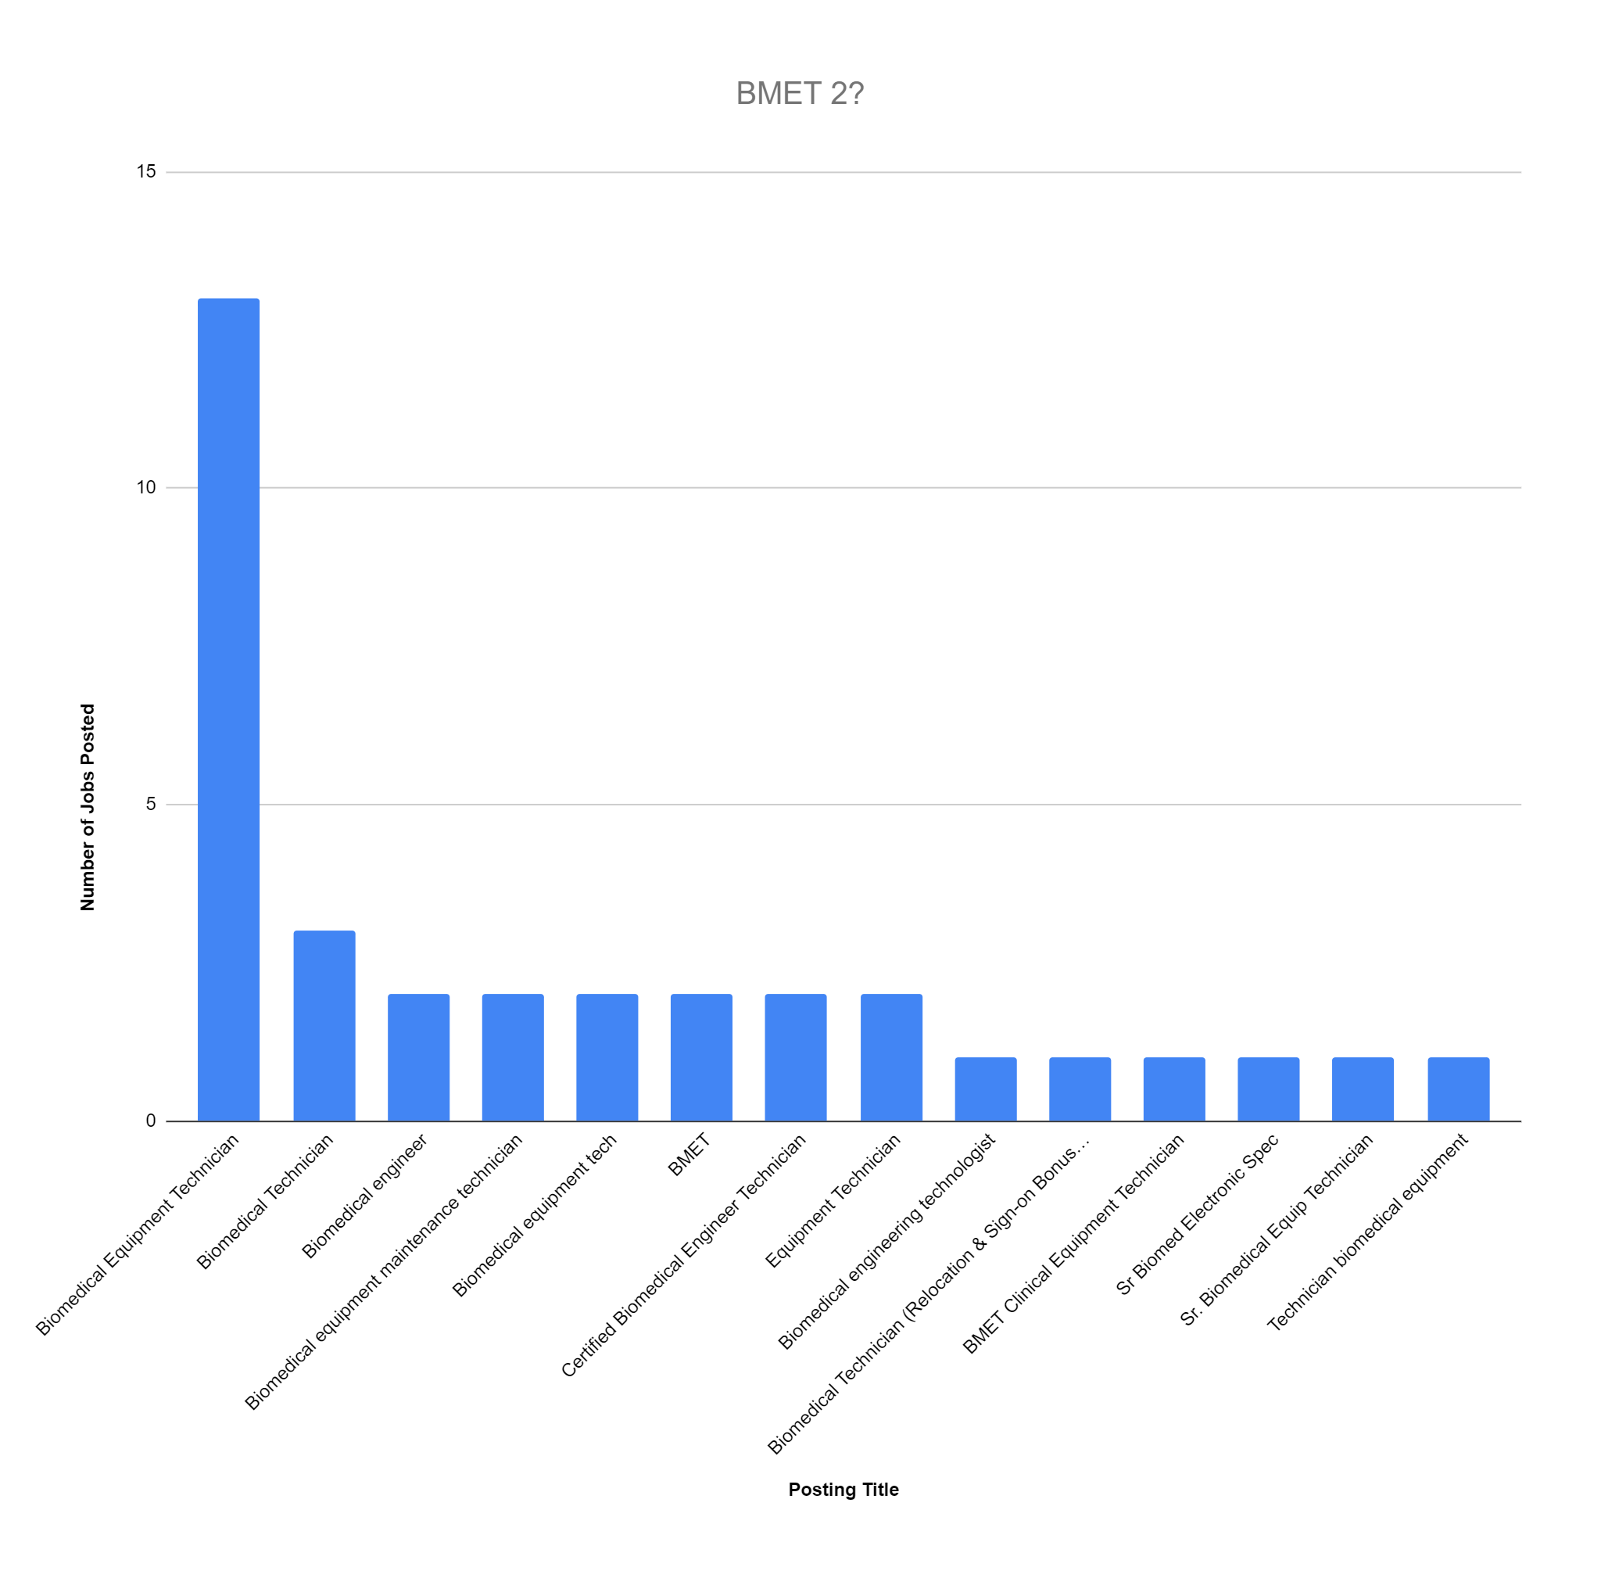
Notable Findings - BMET 2?

Slide 29
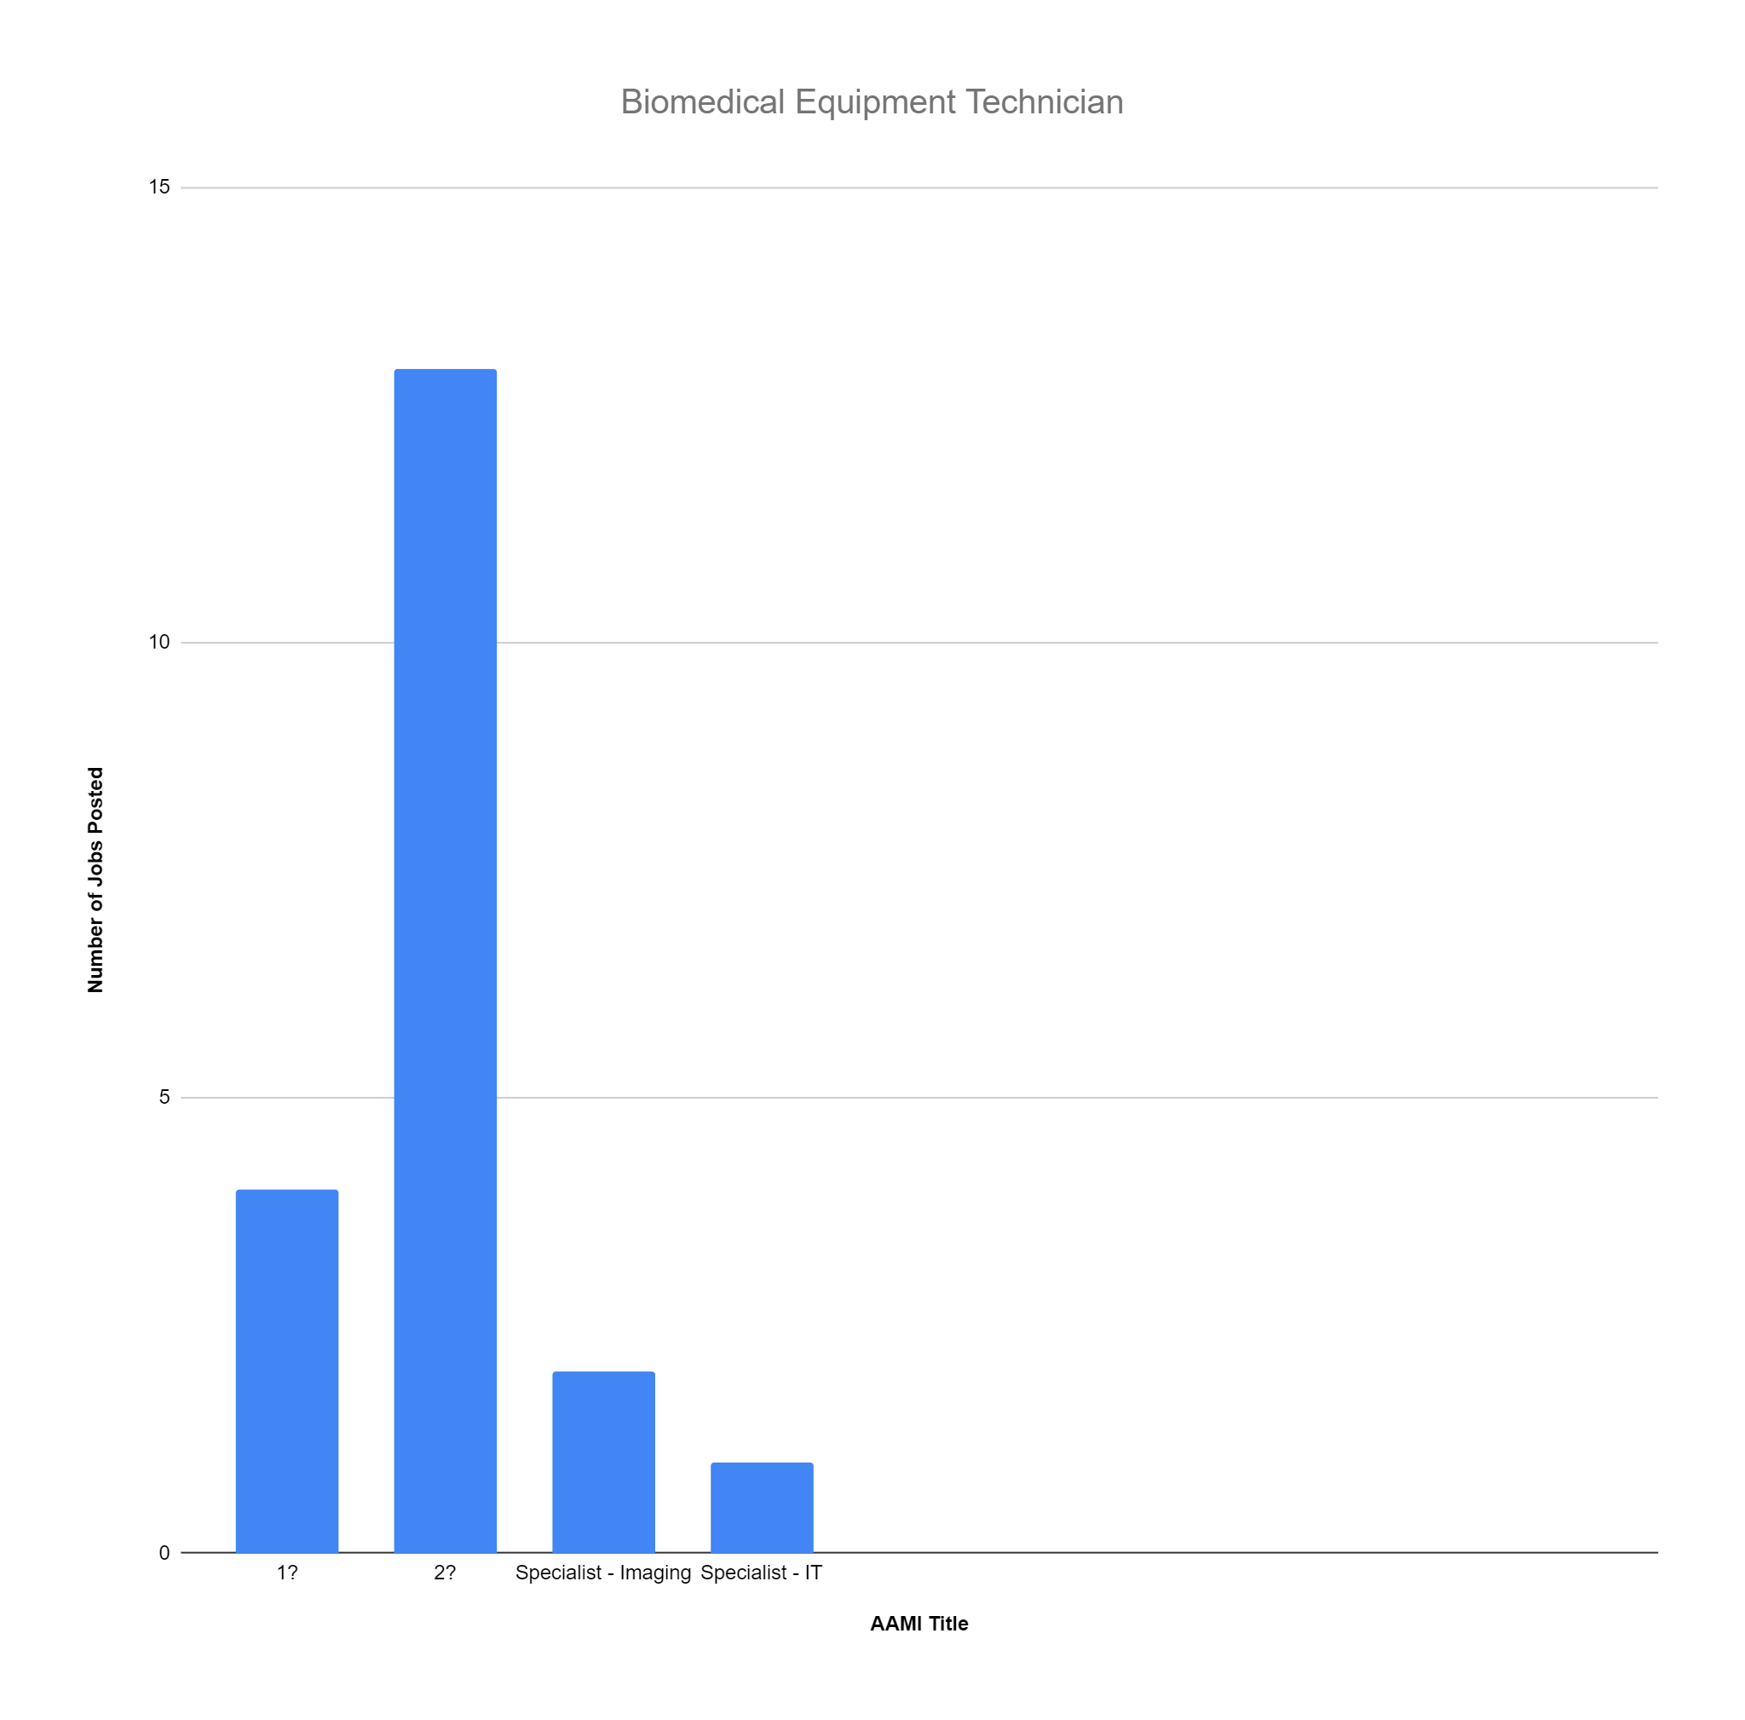
Notable Findings - Misleading Job Posts - Biomedical Equipment Technician

Slide 30
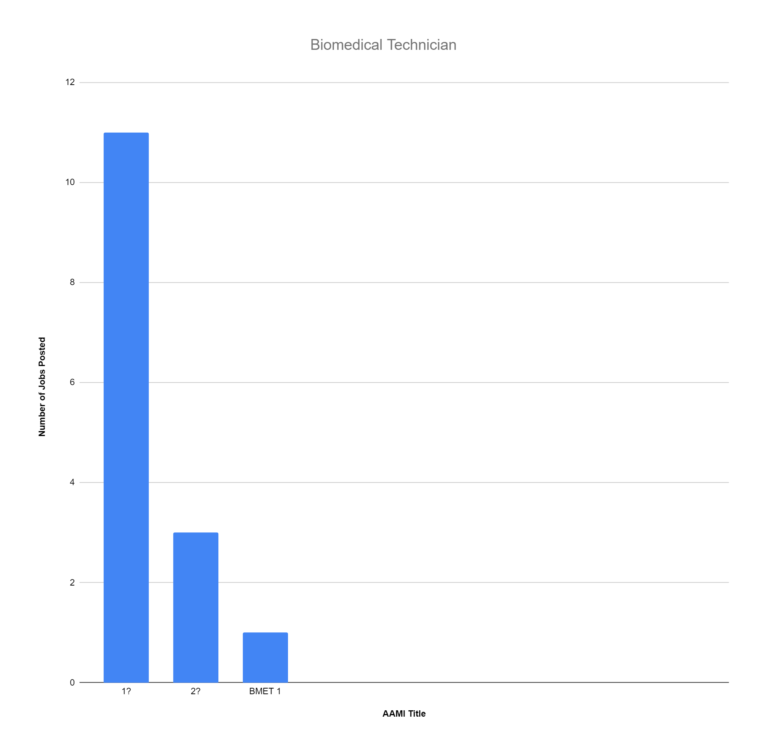
Notable Findings - Misleading Job Posts - Biomedical Technician

Slide 31
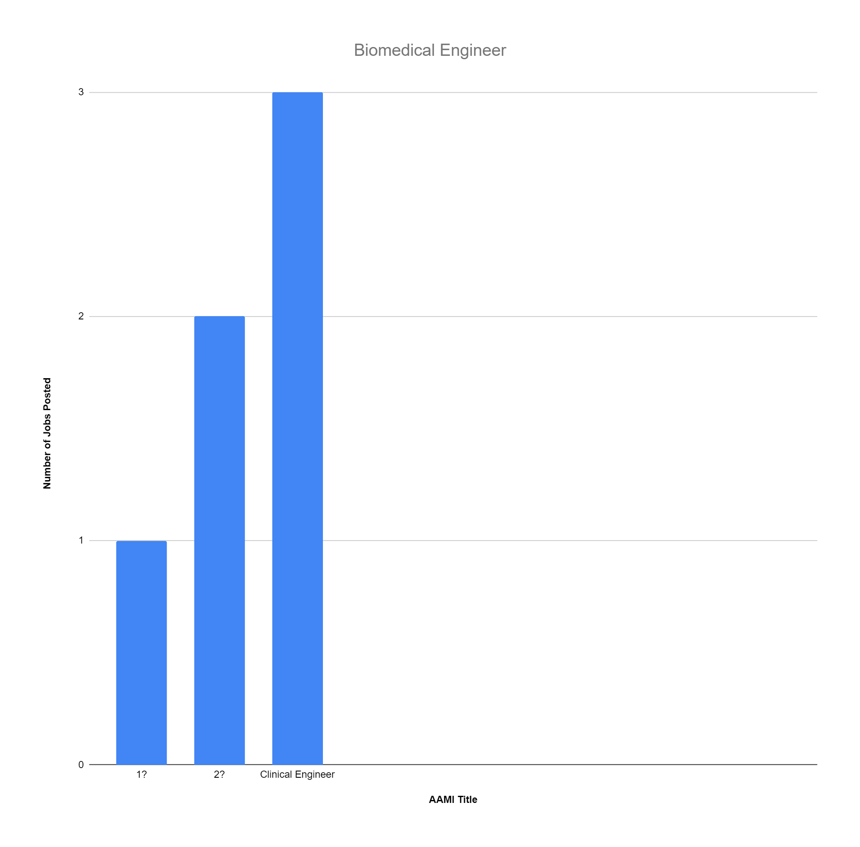
Notable Findings - Misleading Job Posts - Biomedical Engineer

Slide 32
How Can This Be Solved For My Current Posting?
Revise the current posting title to match the most commonly used in your area
  Research on commonly used job posting websites
Revise the description of the job to be descriptive to what you are looking for
Widen your range of your posting to include multiple levels if applicable
Hire a recruiting service
  Passive
  Assistive
  Active

Slide 33
How Can This Be Avoided For The Future?
Prevention
Preparedness
Response
Work with local organizations to create common titles in your area
- Proper candidates in your local area will apply
- Job openings will be easier to find
- Salaries will be easier to grade
- HR compensation surveys will match in your local area
Be prepared for some turnover time
- Create a succession plan internal to the department
- Education gap analysis
- Determine companies in the area for supplemental services
Work on retention strategies
Create a pipeline
- Internship
- AMMI Apprenticeship
- HTM in a box
Recruitment Service
-Do not wait too long

Slide 34
REFERENCES
[1] “The Impending Biomed Tech Shortage: How Will It Impact Hospitals?” Elite Biomedical Solutions, https://elitebiomedicalsolutions.com/resources/blog/biomed-tech-shortage-how-it-impacts-hospitals/.
[2] “Medical Equipment Repairers : Occupational Outlook Handbook: : U.S. Bureau of Labor Statistics.” U.S. Bureau of Labor Statistics, 13 Sept. 2021, https://www.bls.gov/ooh/installation-maintenance-and-repair/medical-equipment-repairers.htm.
[3] Forsythe-Stephens, Keri. “HTM Salary Survey 2021 | 24x7.” 24x7, 24×7 Magazine, 25 Jan. 2022, https://24x7mag.com/professional-development/department-management/salaries/htm-salary-survey-2021/.
[4] Douglas, K. Richard. “We Want You: HTM Profession Amid Retirement Exodus | TechNation.” TechNation, TechNation, 1 Sept. 2017, https://1technation.com/we-want-you-htm-profession-amid-retirement-exodus/.
[5] “‘No Student Debt,’ US Gov Approves Biomedical Equipment Technician Apprenticeship.” AAMI, AAMI, 15 Mar. 2021, https://pressroom.aami.org/posts/pressreleases/no-student-debt-us-gov-approves-biomedical-eq.
[6] https://hbr.org/2021/09/who-is-driving-the-great-resignation
[7] “HTM Resources | AAMI.” Default, https://www.aami.org/HTM/htm-resources. Accessed 3 Apr. 2022.
[8] “Job Search | Indeed.” Job Search | Indeed, https://indeed.com. Accessed 3 Feb. 2022.
[9] “Home - HTM Jobs.” HTM Jobs, https://htmjobs.com. Accessed 3 Feb. 2022.

Slide 35
Questions
?

